Slide 1
FairTorrent: BrinGing Fairness to Peer-to-Peer Systems
Alex Sherman, Jason Nieh, Cliff Stein
Columbia University

Slide 2
Problem
Delivering content using a P2P network is cheap, as P2P leverages user upload bandwidth…
… however today’s P2P networks lack strong incentives mechanisms for users to contribute bandwidth

Slide 3
Problem
Free-Riders and Low-Contributing peers
  Consume much bandwidth in P2P networks
  Cause much slower downloads for other users
High-Contributing peers often receives much less bandwidth than they contribute

Slide 4
Question
Can one design a P2P system that comes close to “ideal fairness”?
Ideal fairness: a peer downloads data at a rate at which it uploads

Slide 5
Related Work
Credit-Based Systems (e.g. Dandelion)
  No real-time fairness
Peer Reputation Systems (e.g. Eigentrust)
  Probabilistic, inexact
BitTorrent-like (most popular)
  Tit-for-Tat, Proportional Response, K-TFT

Slide 6

BitTorrent Overivew
File:
Seed
Seed
Leechers

Slide 7
BitTorrent’s Tit-for-Tat (TFT)
Estimates used as prediction
Willing to reciprocate at a higher rate
Commits BW for a duration of a round
Unstable peer relationships
2.5
1
0.5
1
Peer i
2.5
2
2
2.5
2.5

Slide 8
BitTorrent’s TFT
Leads to:
  Long peer discovery times [NSDI ’07]
  Much bandwidth waste, easily exploited by strategic clients (e.g., LargeView, BitTyrant)

Slide 9
Proportional Response [STOC ’07]
In each round peer reallocates upload rates in proportion to observed download rates
Assumes in each round peers can accurately estimate intended rate allocations of all neighbors
In practice, PropShare client [SIGCOMM ’08]
  Cannot accurately estimate inteded rate allocations
  Relies on optimistic unchoking to discover better peers
  Exhibits poor upload/download rate convergence

Slide 10
K-TFT [INFOCOM ’06]
Leecher Li stops uploading to leecher Lj when the trade “deficit” reaches some threshold of K bytes
Used by BitTyrant [NSDI ‘07] peers with one another
Problem: prevents high-uploaders from utilizing their bandwidth

Slide 11
Inherent Flaw: rate-allocation
Bit-Torrent-like approaches rely or rate allocation
  Inherently imprecise
  Perform poorly in realistic scenarios
If we do not use rate-allocation, what can be done…

Slide 12


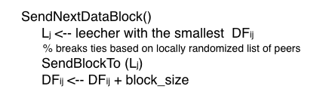
FairTorrent Algorithm: Leechers

Slide 13
FairTorrent Algorithm: Leechers
Effect: ensures fast rate convergence of a leecher’s download and upload rates
  total upload and download rates
  peerwise data-exchange rates

Slide 14

FairTorrent Algorithm: Seeds
Effects:
  Evenly splits seed bandwidth among leechers
  Helps new peers to bootstrap

Slide 15
Properties
Fast Rate Convergence of upload/download rates
Resilience to Strategic Peers
  E.g. free-riders

Slide 16
Strategic
Lj
DFij =1
Lk
DFik =1
Li
DFil =0
Ll
DFim =0
Lm
Rji = data rate from Lj to Li
If Rmi > Rji => Rim > Rij

Slide 17
Claim: reaches convergence quickly
= upload capacity of Li
Assume:
Lj
DFij =1
Lk
DFik =1
Li
DFil =1
Ll
DFim =1
DFin =0
Lm
Sends to new peers until:
Ln

Slide 18
Fairness Metric
DFij(t) = deficit at time t
Fairness metric = Maximum Deficit
… the maximum number of data blocks owed to Li at any time

Slide 19
Theorem
In a network with N leechers, with upload capacities selected uniformly from the range: [1,r] assuming leechers have data to exchange, for any leecher Li, with probability at least :

Slide 20
Corollary 1: fast rate convergence, because the amount of data downloaded by a leecher lags what it has uploaded by at most O(log(N))
Corollary 2: a strategic peer, such as a free-riders receives at most O(log(N)) free data blocks

Slide 21
Leechers Li, Lj, Lk with upload capacities 3,2, and 2
data blocks/sec
Idea data-exchange rates:
Li
1.5
1.5
1.5
1.5
0.5
Lj
Lk
0.5

Slide 22
Leechers Li, Lj, Lk with upload capacities 3,2, and 2
data blocks/sec
FairTorrent: converges in 2 sec.
BitTorrent: Li loses 1 block each sec
Li
Li
1.5
1.5
1.5
1.5
1.5
1.5
1
1
0.5
1
Lj
Lk
Lj
Lk
0.5
1
Li
K-TFT: capacity under-
utilized
1
1
1
1
1
Lj
Lk
1

Slide 23
PropShare:
Time 0 to 10
Time 10 to 20
Li
Li
1.5
1.5
1.5
1.5
1
1
1.2
1.2
1
0.8
Lj
Lk
Lj
Lk
1
0.8
Time 20 to 30
Time 30 to 40
Li
Li
1.5
1.5
1.5
1.5
1.28
1.28
1.31
1.31
0.74
0.69
Lj
Lk
Lj
Lk
0.74
0.69

Slide 24
Properties
Fast Rate Convergence
Resilience to Strategic Peers
Fully Distributed
Simple, requires no changes to protocol
Requires:
  No estimates of peers’ intended rate allocations
  No upload rate allocations
  No rounds or other parameter tuning

Slide 25
Evaluation
We implemented FairTorrent on top of the original python BitTorrent client
Evaluated on PlanetLab against:
  Original BitTorrent client
  Azureus (most popular)
  PropShare
  BitTyrant (uses K-TFT with other BitTyrant clients)

Slide 26
Scenarios
Base Case: uniform distribution
Live: rates picked from observed live networks
Skewed: many low-contributors
Running inside live BitTorrent swarms

Slide 27
Uniform Distribution
50 leechers with rates picked uniformly from a large range 1-50 KB/s
10 seeds upload at 25 KB/s
32 MB File
Repeated experiment five times with each network

Slide 28
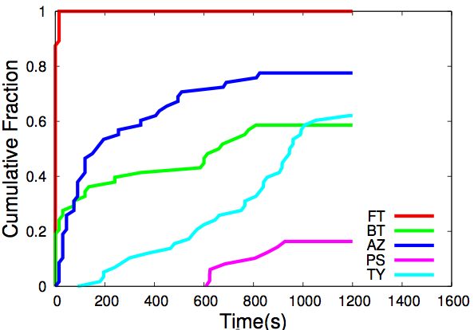
How fast do the leechers reach download rate from leechers>= 90% of upload?
Leechers that upload 40-50 KB/s

Slide 29
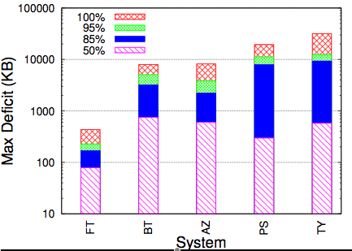
Maximum Deficit
FT(0.43MB), BT(8MB), AZ(8), PS(19), TY(31)

Slide 30
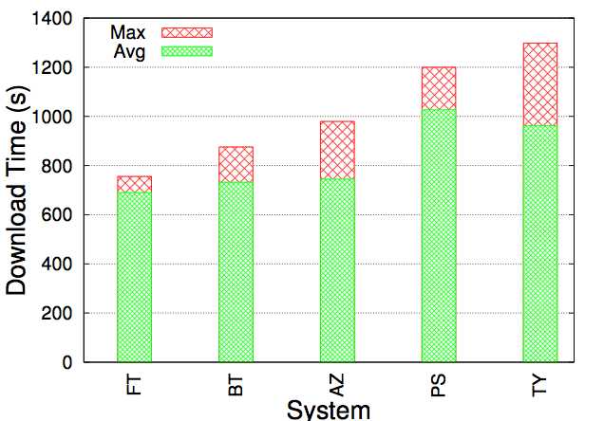
Download Times for Peers with 40-50 KB/s upload
FT (756 ), BT(876), AZ(980), PS(1200), TY(1298)

Slide 31
Live Upload Rates
Exponential-like distribution. Capacities from 4-197 KB/s. Mean 17KB/s. [Piateck07]
Top 10% of leecers account for 50% of total upload capacity
Dynamic arrivals/departures. New leecher enters every 5 seconds.
Doubled network size: 100 leechers, 20 seeds

Slide 32
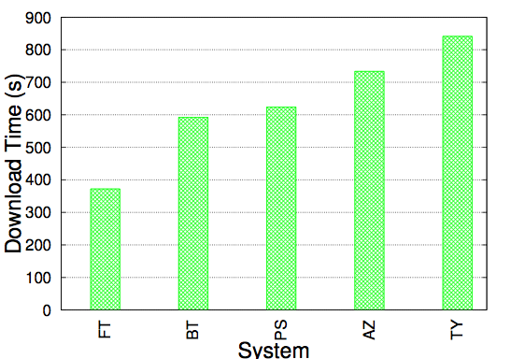
Avg Download Times of the top 10% of the Leechers
Download times: 372 (FT), 593(BT), 733(AZ) 624(PS), and 842 (TY) seconds. FT 37%-56% faster.

Slide 33
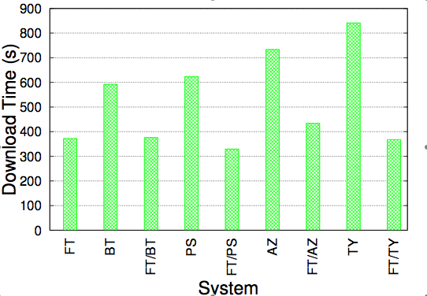
Live Upload Rates
FT high-uploaders reduce download times by 37% in BT, 41% in AZ, 47% in PS, 56% in TY

Slide 34
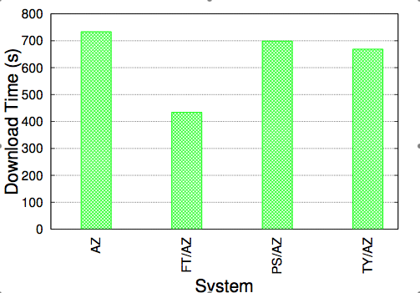
Live Upload Rates
Download times in AZ are reduced by 41% with AZ, 5% by PS and 9% by TY

Slide 35
Skewed Distribution
One high-uploader at 50 KB/s
49 low-contributors: upload at 1-5 KB/s

Slide 36
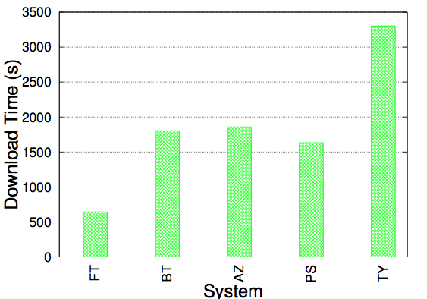
Skewed Distribution
Download Times: FT 644s, 3-5 times faster than BT (1804), AZ(1859), PS(1633) and TY(3305)

Slide 37
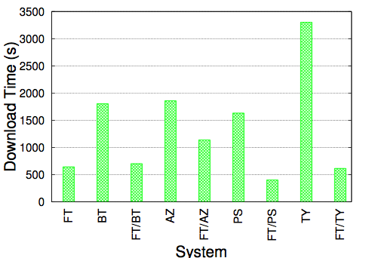
Skewed Distribution
FT high-uploader reduces download times by 61% in BT, 39% in AZ, 75% in PS, 81% in

Slide 38
Live Swarms
Large popular swarms with thousands of users
File sizes 1-10 GB
Joined 40 swarms for 1500 seconds. Measured download rate
Each client uploads at 300KB/s, Download capped at 600 KB/s
Max Connections: 50, 500
  500 (default for PropShare, BitTyrant)
  50 (default for Azureus)

Slide 39
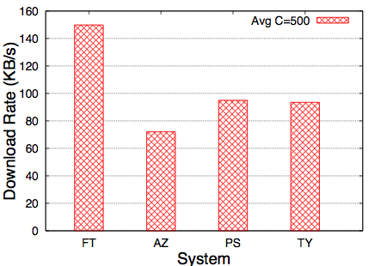
Live Swarms
FT outperforms AZ, PS, TY by 58-108% with 500 connections limit

Slide 40
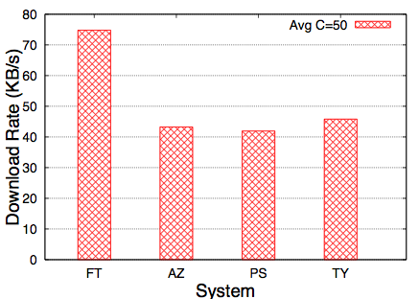
Live Swarms
FT outperforms AZ, PS, TY by 63-79% with 50 connection limit

Slide 41
Conclusions
We introduce, implement and evaluate a new simple deficit-based approach
FairTorrent achieves much more optimal fairness, rate-convergence and resilience to strategic peers than rate-allocation approaches
Guarantees better performance for high-contributing peers
Paves the way for implementation of more reliable content delivery services over P2P

Slide 42
Future Work
Incentives in P2P streaming
Exploiting network locality

Slide 43
Thank You
Project: http://www.cs.columbia.edu/~asherman/fairtorrent
Email: asherman@cs.columbia.edu

