Slide 1
Geometry of Similarity Search
Alex Andoni
(Columbia University)

Slide 2
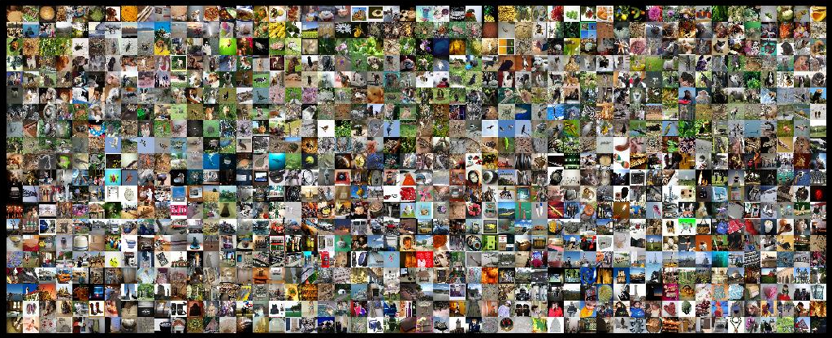
Find pairs of similar images
how should we measure similarity?
Naïvely: about $n^{2}$ comparisons
Can we do better?

Slide 3
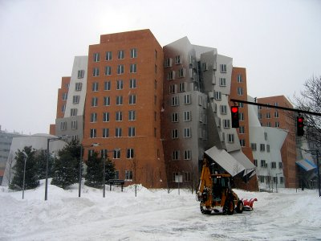
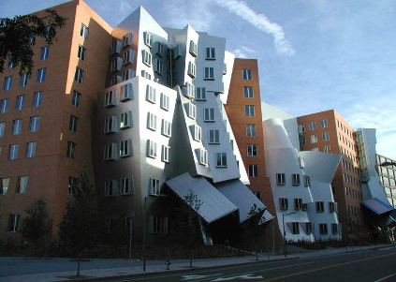
Measuring similarity
000000
011100
010100
000100
010100
011111
000000
001100
000100
000100
110100
111111
objects $⇒$ high-dimensional vectors
$${\left\{0,1\right\}}^{d}$$
Hamming dist.
$$R^{d}$$
Euclidean dist.
Sets of points
Earth-Mover
Distance
similarity $⇒$ distance b/w vectors
Image courtesy of Kristen Grauman

Slide 4
Problem: Nearest Neighbor Search (NNS)
Preprocess: a set $P$ of points
Query: given a query point $q$, report a point $p^{∗}∈P$ with the smallest distance to $q$
Primitive for: finding all similar pairs
But also clustering problems, and many other problems on large set of multi-feature objects
Applications:
speech/image/video/music recognition, signal processing, bioinformatics, etc…
$$p^{∗}$$
$$q$$
$n$: number of points
$d$: dimension

Slide 5
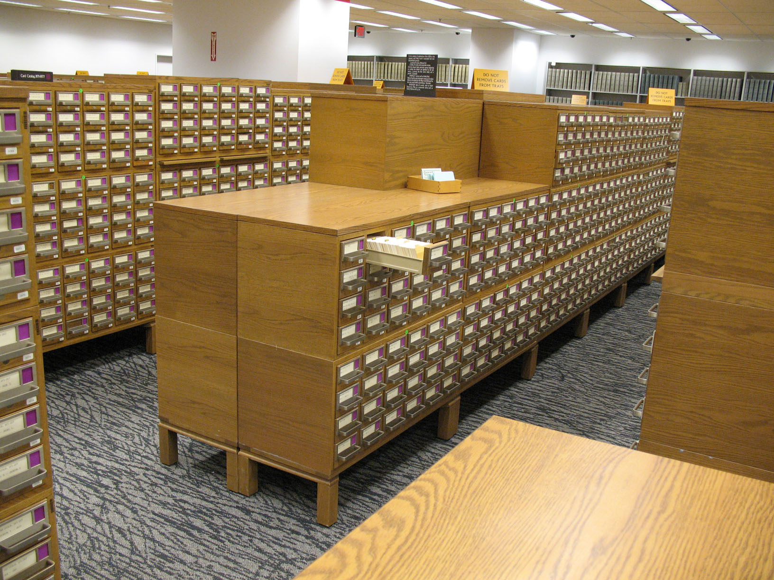
Preamble: How to check for an exact match ?
just pre-sort !
Preprocess:
Sort the points
Query:
Perform binary search
000000
000000
000000
000000
000000
000000
000000
001100
000100
000100
110100
111111
000000
011100
010100
000100
010100
011111
001100
011100
001100
001100
001100
001100
…
Query time | Space
$$O(\log{n})$$ | $$O(n)$$
Also works for NNS for 1-dimensional vectors…
1.1
2
3.5
5
6
7
7.3

Slide 6
High-dimensional case
$${\left\{0,1\right\}}^{d}$$
Hamming dist.
$$n=1,000,000,000$$
$d=400$
Underprepared: no preprocessing
Algorithm | Query time | Space
No indexing | $$O(n⋅d)$$ | $$O(n⋅d)$$
Overprepared: store an answer for every possible query
Full indexing | $$O(d)$$ | $$2^{d}$$
unaffordable if $d≫\log{n}$
Curse of dimensionality: would refute a (very) strong version of $P≠NP$ conjecture [Williams’04]
Best indexing ? | $$O(d)$$ | $$O(n⋅d)$$
A little better indexing ? | $$n^{0.99}$$ | $$O(n^{2})$$

Slide 7
Relaxed problem: Approximate Near Neighbor Search
$r$-near neighbor: given a query point $q$, report a point $p^{′}∈P$ s.t. $\left\|p′−q\right\|≤r$
as long as there is some point within distance $r$
Remarks:
In practice: used as a filter
Randomized algorithms: each point reported with 90% probability
Can use to solve nearest neighbor too
[HarPeled-Indyk-Motwani’12]
$c$-approximate
similar
$$cr$$
not similar
$$r$$
$$p^{∗}$$
$$cr$$
$$q$$
$$p^{′}$$
kind of…
either way

Slide 8
Approach: Locality Sensitive Hashing
[Indyk-Motwani’98]
Map: points $→$ codes: s.t.
“similar” $⇔$ “exact match”
$$q$$
$$p′$$
randomized
$$p$$
$$q$$
Map $g$ on $R^{d}$ s.t. for any points $p,q$
for similar pairs (when $\left\|q−p\right\|≤r$ )
$$g(q)=g(p)$$
for dissimilar pairs (when $\left\|q−p′\right\|>cr$ )
$$g\left(q\right)≠g\left(p^{′}\right)$$
$$P1=$$
$Pr⁡[g(q)=g(p)]$ is not-too-low
$$P2=$$
$Pr⁡[g(q)=g(p)]$ is low
several indexes
Use an index on $g(p)$ for $p∈P$
$$Pr⁡[g(q)=g(p)]$$
$$ρ=\frac{\log{1/P_{1}}}{\log{1/P_{2}}}$$
1
$nρ$, where
$$P1$$
How to construct good maps?
$$P2$$
$$\left\|q−p\right\|$$
$$r$$
$$cr$$

Slide 9
Map #1 : random grid
[Datar-Indyk-Immorlica-Mirrokni’04]
Map $g$:
partition in a regular grid
randomly shifted
randomly rotated
$$q$$
$$p$$
$$p′$$
Space | Time | Exponent | $$c=2$$
$$n^{1+ρ}$$ | $$n^{ρ}$$ | $$ρ=1/c$$ | $$ρ=1/2$$
Can we do better?

Slide 10
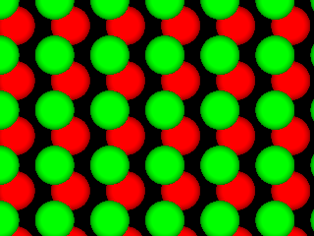
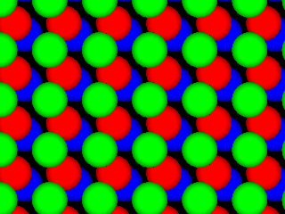
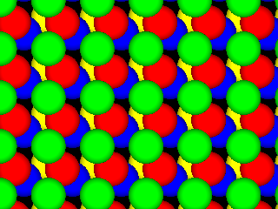
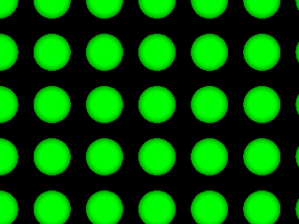
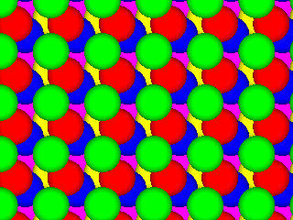
Map #2 : ball carving
[A-Indyk’06]
Regular grid → grid of balls
$p$ can hit empty space, so take more such grids until $p$ is in a ball
How many grids?
about $d^{d}$
start by projecting in dimension $t$
Choice of reduced dimension $t$?
$ρ$ closer to bound for higher $t$
Number of grids is $t^{O(t)}$
$$p$$
$$p$$
$$Rt$$
2D
Space | Time | Exponent | $$c=2$$
$$n^{1+ρ}$$ | $$n^{ρ}$$ | $$ρ→1/c^{2}$$ | $$ρ→1/4$$

Slide 11
Similar space partitions ubiquitous:
Approximation algorithms [Goemans, Williamson 1995], [Karger, Motwani, Sudan 1995], [Charikar, Chekuri, Goel, Guha, Plotkin 1998], [Chlamtac, Makarychev, Makarychev 2006], [Louis, Makarychev 2014]
Spectral graph partitioning [Lee, Oveis Gharan, Trevisan 2012], [Louis, Raghavendra, Tetali, Vempala 2012]
Spherical cubes [Kindler, O’Donnell, Rao, Wigderson 2008]
Metric embeddings [Fakcharoenphol, Rao, Talwar 2003], [Mendel, Naor 2005]
Communication complexity [Bogdanov, Mossel 2011], [Canonne, Guruswami, Meka, Sudan 2015]

Slide 12
LSH Algorithms for Euclidean space
Space | Time | Exponent | $$c=2$$ | Reference
$$n^{1+ρ}$$ | $$n^{ρ}$$ | $$ρ=1/c$$ | $$ρ=1/2$$ | [IM’98, DIIM’04]
 |  | $$ρ≈1/c^{2}$$ | $$ρ=1/4$$ | [AI’06]
Is there even better LSH map?
NO: any map must satisfy
$ρ≥1/c^{2}$
[Motwani-Naor-Panigrahy’06, O’Donell-Wu-Zhou’11]
Example of isoperimetry, example of which is question:
Among bodies in $R^{d}$ of volume 1, which has the lowest perimeter?
A ball!
Notes:
Other ways to use LSH

Slide 13
Some other LSH algorithms
To be or not to be
To search or not to search
sketch
search
not
not
not
not
Hamming distance
$g$: pick a random coordinate(s) [IM’98]
Manhattan distance:
$g$: cell in a randomly shifted grid
Jaccard distance between sets:
$J\left(A,B\right)=\frac{A∩B}{A∪B}$
$g$: pick a random permutation $π$ on the words
$g\left(A\right)=\min_{a∈A} π(a)$
min-wise hashing
[Broder’97, Christiani-Pagh’17]
be
or
to
be
or
to
1
…01111…
…11101…
1
…21102…
…01122…
{be,not,or,to}
{not,or,to,search}
be
to
for $π$=be,to,search,or,not

Slide 14
LSH is tight… what’s next?
Datasets with additional structure
[Clarkson’99,
Karger-Ruhl’02,
Krauthgamer-Lee’04,
Beygelzimer-Kakade-Langford’06,
Indyk-Naor’07,
Dasgupta-Sinha’13,
Abdullah-A.-Krauthgamer-Kannan’14,…]
Space-time trade-offs…
[Panigrahy’06, A.-Indyk’06, Kapralov’15,
A.-Laarhoven-Razenshteyn-Waingarten’17]
Are we really done with basic NNS algorithms?

Slide 15
Beyond Locality Sensitive Hashing?
Can get better maps, if allowed to depend on the dataset!
“ I’ll tell you where to find The Origin of Species once you recite all existing books
Non-example:
define $g\left(q\right)$ to be the identity of closest point to $q$
computing $g(q)$ is as hard as the problem-to-be-solved!
Can get better, efficient maps, if
depend on the dataset!
Space | Time | Exponent | $$c=2$$ | Reference
best LSH
algorithm
$$n^{1+ρ}$$ | $$n^{ρ}$$ | $$ρ≈1/c^{2}$$ | $$ρ=1/4$$ | [AI’06]
 |  | $$ρ≈\frac{1}{2c^{2}−1}$$ | $$ρ=1/7$$ | [A.-Indyk-Nguyen-Razenshteyn’14, A.-Razenshteyn’15]

Slide 16
New Approach: Data-dependent LSH
[A-Razenshteyn’15]
Two new ideas:
1) a nice point configuration
has LSH with better quality $ρ$
2) can always reduce to such configuration
data-dependent

Slide 17
1) a nice point configuration
As if vectors chosen randomly from Gaussian distribution
Points on a unit sphere, where
$cr≈\sqrt{2}$, i.e., dissimilar pair is (near) orthogonal
Similar pair: $r=\sqrt{2}/c$
Like ball carving
Curvature helps get better quality partition
$$cr$$
Map $g$:
Randomly slice out caps on sphere surface

Slide 18
1) a nice point configuration
2) can always reduce to such configuration
A worst-case to (pseudo-)random-case reduction
a form of “regularity lemma”
Lemma: any pointset $P∈R^{d}$ can be decomposed into clusters, where one cluster is pseudo-random and the rest have smaller diameter
$$cr$$

Slide 19
Beyond Euclidean space
Data-dependent hashing:
Better algorithms for Hamming space
Also algorithms for distances where vanilla LSH does not work!
E.g.: distance $||x−y||_{∞}=\max_{i=1..d}|x_{i}−y_{i}|$ [Indyk’98, …]
Even more beyond?
Approach 3: metric embeddings
Geometric reduction b/w
different spaces
Rich theory in Functional Analysis
Sets of points
Earth-Mover Distance
(Wasserstein space)
$${\left\{0,1\right\}}^{d}$$
Hamming dist.
[Charikar’02,
Indyk-Thaper’04,
Naor-Schechtman’06,
A-Indyk-Krauthgamer’08…]

Slide 20
Summary: Similarity Search
objects
high-dimensional vectors
similarity
distance b/w vectors
Geometry
Similarity
Search
Nearest Neighbor Search
Different applications lead to different geometries
Connects to rich mathematical areas:
Space partitions and isoperimetry: what’s the body with least perimeter?
Metric embeddings: can we map some geometries into others well?
Only recently we (think we) understood the Euclidean metric
Properties of many other geometries remain unsolved!
To search or not to search

