Slide 1
Nearest Neighbor Search (3)
Alex Andoni
(Columbia University)

Slide 2
Time-Space Trade-offs (Euclidean)
space
query
time
Space | Time | Comment | Reference
$$≈n$$ | $$n^{σ}$$ | $$σ=2.09/c$$ | [Ind’01, Pan’06]
low
high
 |  | $$σ=O(1/c^{2})$$ | [AI’06]
$$n^{1+ρ}$$ | $$n^{ρ}$$ | $$ρ=1/c$$ | [IM’98, DIIM’04]
medium
medium
 |  | $$ρ=1/c^{2}$$ | [AI’06]
 |  | $$ρ≥1/c^{2}$$ | [MNP’06, OWZ’11]
$$n^{1+o({1/c}^{2})}$$ | ω(1) memory lookups | [PTW’08, PTW’10]
1 mem lookup
$$n^{4/ε^{2} }$$ | $$O(d log n)$$ | $$c=1+ε$$ | [KOR’98, IM’98, Pan’06]
high
low
$$n^{o(1{/ε}^{2})}$$ | ω(1) memory lookups | [AIP’06]

Slide 3
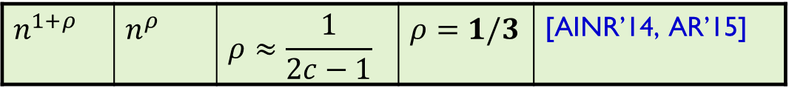
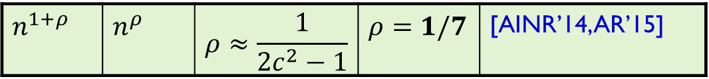
Beyond Locality Sensitive Hashing
Space | Time | Exponent | $$c=2$$ | Reference
Hamming
space
$$n^{1+ρ}$$ | $$n^{ρ}$$ | $$ρ=1/c$$ | $$ρ=1/2$$ | [IM’98]
LSH
 |  | $$ρ≥1/c$$ |  | [MNP’06, OWZ’11]
$$n^{1+ρ}$$ | $$n^{ρ}$$ | $$ρ≈\frac{1}{2c−1}$$ | $$ρ=1/3$$ | [AINR’14, AR’15]
Euclidean
space
$$n^{1+ρ}$$ | $$n^{ρ}$$ | $$ρ≈1/c^{2}$$ | $$ρ=1/4$$ | [AI’06]
LSH
 |  | $$ρ≥1/c^{2}$$ |  | [MNP’06, OWZ’11]
$$n^{1+ρ}$$ | $$n^{ρ}$$ | $$ρ≈\frac{1}{2c^{2}−1}$$ | $$ρ=1/7$$ | [AINR’14, AR’15]

Slide 4
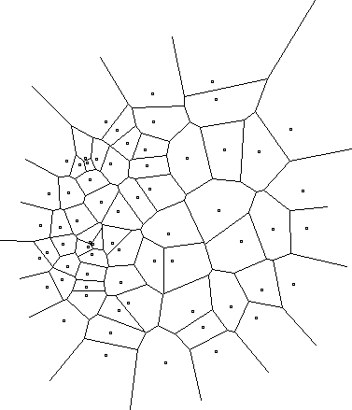
New approach?
A random hash function, chosen after seeing the given dataset
Efficiently computable
Data-dependent hashing
Notes:
Example: Voronoi diagram
but expensive to compute the hash function

Slide 5

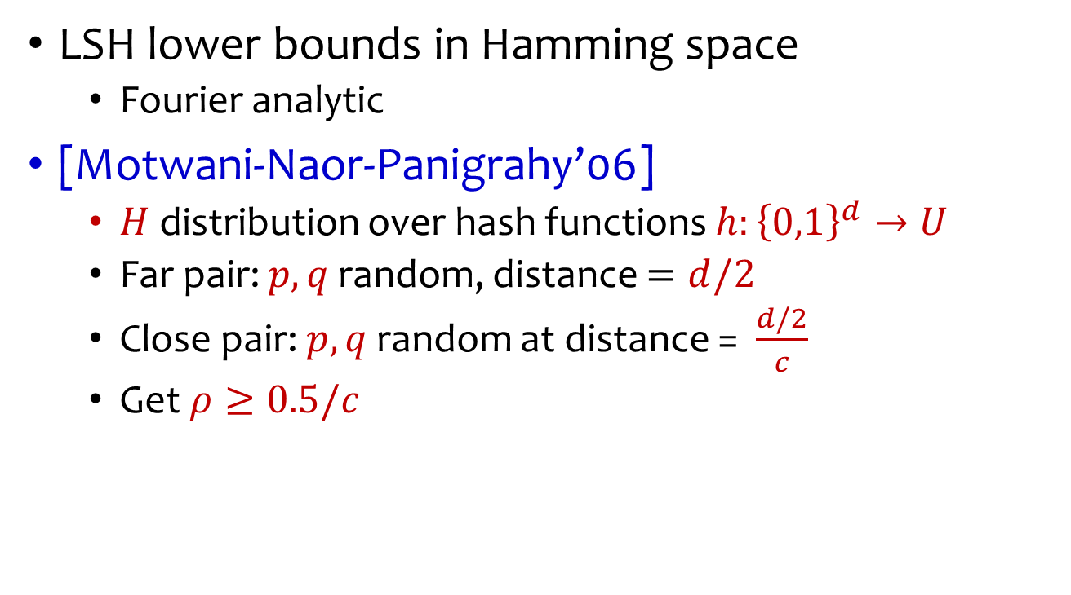


A look at LSH lower bounds
LSH lower bounds in Hamming space
  Fourier analytic
[Motwani-Naor-Panigrahy’06]
  $H$ distribution over hash functions $h:{\left\{0,1\right\}}^{d}→U$
  Far pair: $p,q$ random, distance $=d/2$
  Close pair: $p,q$ random at distance = $\frac{d/2}{c}$
  Get $ρ≥0.5/c$
[O’Donnell-Wu-Zhou’11]
$$εd$$
$$\frac{εd}{c}$$
$$ρ≥1/c$$

Slide 6

Why not NNS lower bound?
Suppose we try to apply [OWZ’11] to NNS
  Pick random $q$
  All the “far point” are concentrated in a small ball of radius $εd/2$
  Easy to see at preprocessing: actual near neighbor close to the center of the minimum enclosing ball

Slide 7
Construction of hash function
[A.-Indyk-Nguyen-Razenshteyn’14, A.-Razenshteyn’15]
Two components:
  Nice geometric structure
  Reduction to such structure
Like a “Regularity Lemma” for a set of points
has better LSH
data-dependent

Slide 8



Nice geometric structure
Like a random dataset on a sphere
  s.t. random points at distance $≈cr$
Lemma: $ρ=\frac{1}{2c^{2}−1}$
  via Cap Carving
  curvature
$$cr$$
$$cr/\sqrt{2}$$

Slide 9



Reduction to nice structure
Idea:
  iteratively decrease the radius of minimum enclosing ball
Algorithm:
  find dense clusters
    with smaller radius
    large fraction of points
  recurse on dense clusters
  apply cap carving on the rest
    recurse on each “cap”
    eg, dense clusters might reappear
Why ok?
Why ok?
no dense clusters
like “random dataset” with radius=$100cr$
even better!
radius = $100cr$
radius = $99cr$
*picture not to scale & dimension

Slide 10
Hash function
Described by a tree (like a hash table)
radius = $100cr$
*picture not to scale&dimension

Slide 11



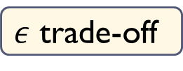
Dense clusters
$$\left(\sqrt{2}−ε\right)R$$
Current dataset: radius $R$
A dense cluster:
  Contains $n^{1−δ}$ points
  Smaller radius: $\left(1−Ω\left(ε^{2}\right)\right)R$
After we remove all clusters:
  For any point on the surface, there are at most $n^{1−δ}$ points within distance $\left(\sqrt{2}−ε\right)R$
  The other points are essentially orthogonal !
When applying Cap Carving with parameters $(P_{1},P_{2})$:
  Empirical number of far pts colliding with query: $nP_{2}+n^{1−δ}$
  As long as $nP_{2}≫n^{1−δ}$, the “impurity” doesn’t matter!
$ε$ trade-off
$δ$ trade-off
?

Slide 12
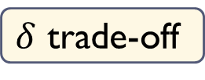
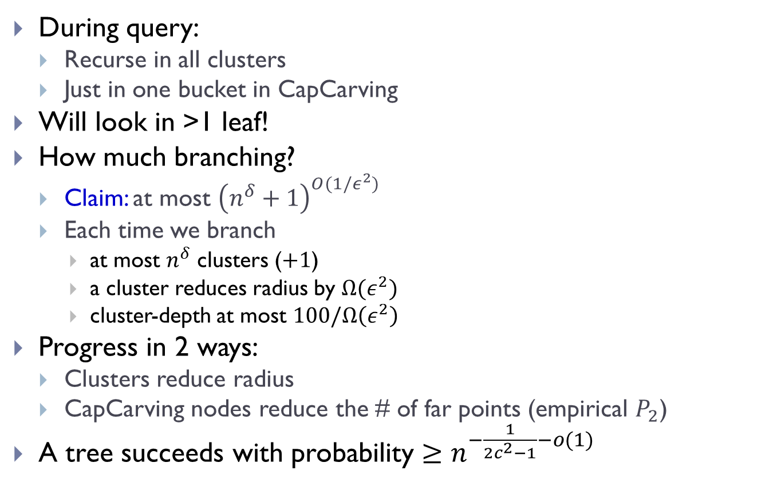
Tree recap
During query:
  Recurse in all clusters
  Just in one bucket in CapCarving
Will look in >1 leaf!
How much branching?
  Claim: at most ${\left(n^{δ}+1\right)}^{O(1/ε^{2})}$
  Each time we branch
    at most $n^{δ}$ clusters ($+1$)
    a cluster reduces radius by $Ω(ε^{2})$
    cluster-depth at most $100/Ω\left(ε^{2}\right)$
Progress in 2 ways:
  Clusters reduce radius
  CapCarving nodes reduce the # of far points (empirical $P_{2}$)
A tree succeeds with probability $≥n^{−\frac{1}{2c^{2}−1}−o(1)}$
$δ$ trade-off

Slide 13


Fast preprocessing
$$\left(\sqrt{2}−ε\right)R$$
How to find the dense clusters fast?
Step 1: reduce to $O(n^{2})$ time.
  Enough to consider centers that
  are data points
Step 2: reduce to near-linear time.
  Down-sample!
  Ok because we want clusters of size $n^{1−δ}$
  After downsampling by a factor of $\sqrt{n}$, a cluster is still somewhat heavy.

Slide 14
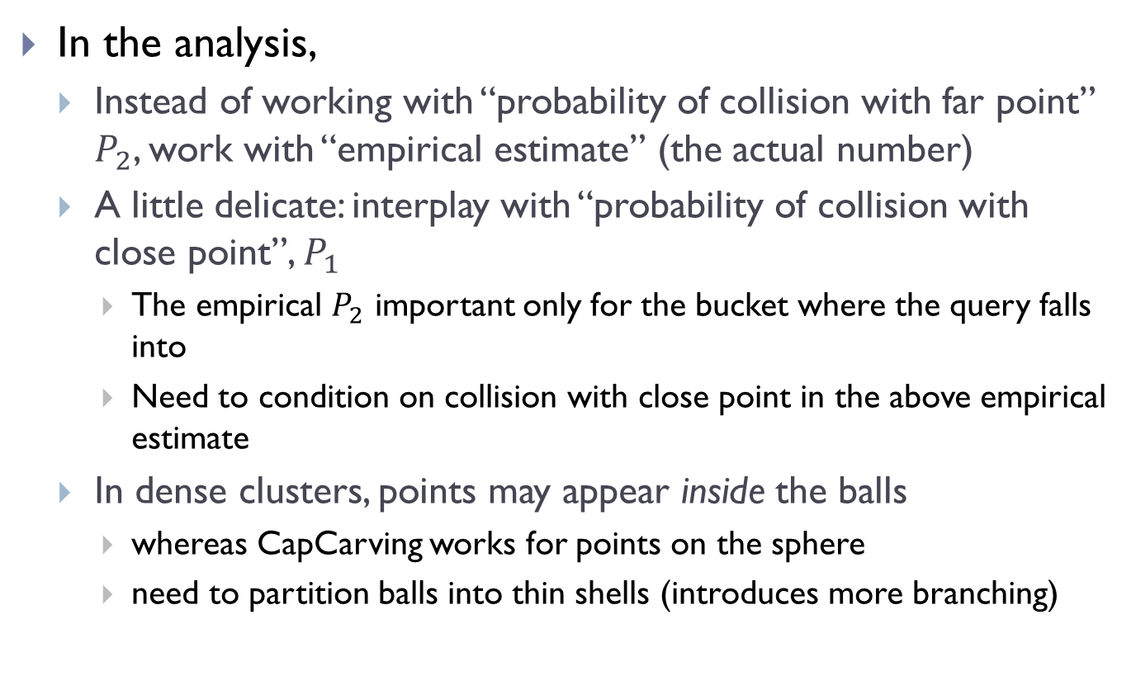
Other details
In the analysis,
  Instead of working with “probability of collision with far point” $P_{2}$, work with “empirical estimate” (the actual number)
  A little delicate: interplay with “probability of collision with close point”, $P_{1}$
    The empirical $P_{2}$ important only for the bucket where the query falls into
    Need to condition on collision with close point in the above empirical estimate
  In dense clusters, points may appear inside the balls
    whereas CapCarving works for points on the sphere
    need to partition balls into thin shells (introduces more branching)

Slide 15
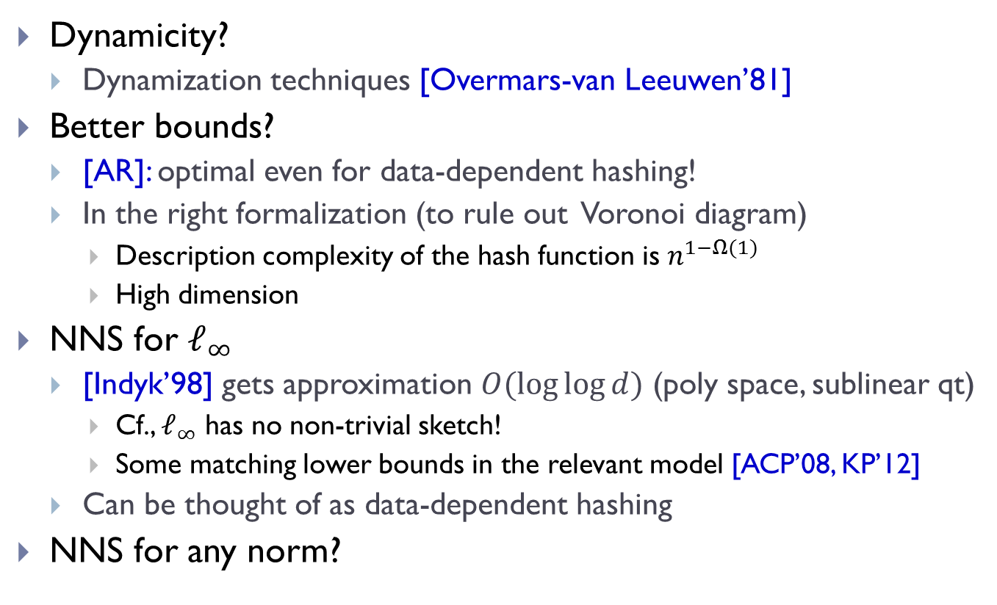
Data-dependent hashing wrap-up
Dynamicity?
  Dynamization techniques [Overmars-van Leeuwen’81]
Better bounds?
  [AR]: optimal even for data-dependent hashing!
  In the right formalization (to rule out Voronoi diagram)
    Description complexity of the hash function is $n^{1−Ω(1)}$
    High dimension
NNS for $ℓ_{∞}$
  [Indyk’98] gets approximation $O(\log{\log{d}})$ (poly space, sublinear qt)
    Cf., $ℓ_{∞}$ has no non-trivial sketch!
    Some matching lower bounds in the relevant model [ACP’08, KP’12]
  Can be thought of as data-dependent hashing
NNS for any norm?

Slide 16

Beyond $ℓ_{p}$’s ?

Slide 17





Sketching/NNS for other distances?
Earth Mover Distance:
  Given two sets A, B of points in a metric space
  EMD(A,B) = min cost bipartite matching between A and B
Applications in image vision
$$S$$
010110
$EMD(A,B)$ small or large?
$$S$$
010101

Slide 18
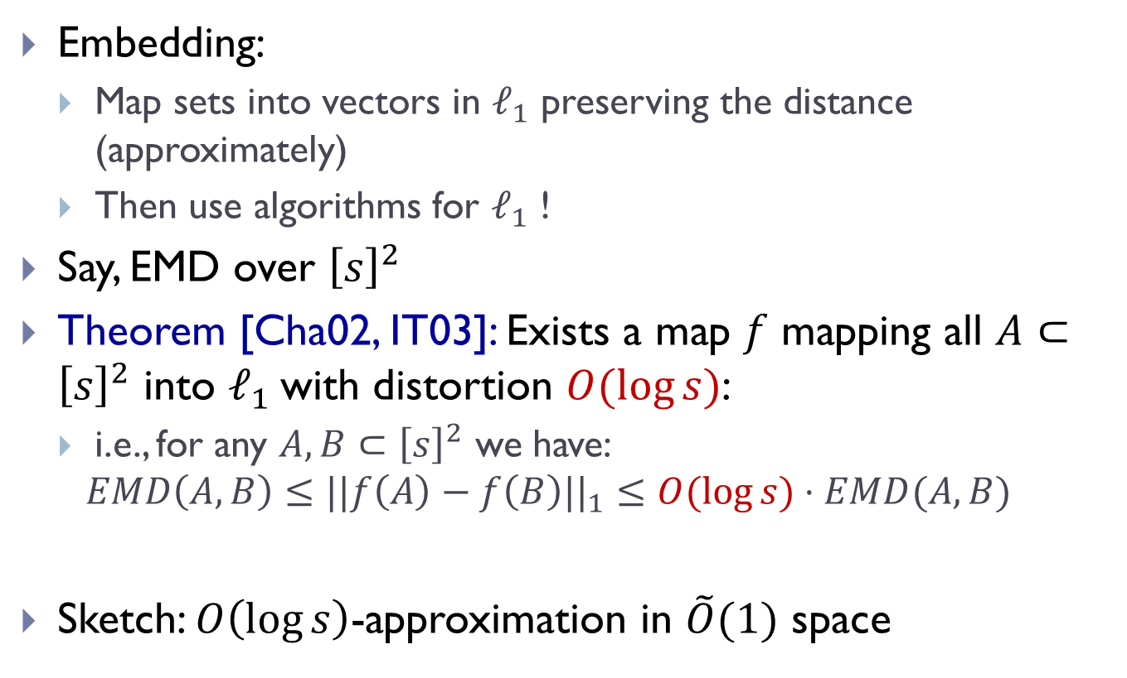
Algorithms via embedding
Embedding:
  Map sets into vectors in $ℓ_{1}$ preserving the distance (approximately)
  Then use algorithms for $ℓ_{1}$ !
Say, EMD over ${\left[s\right]}^{2}$
Theorem [Cha02, IT03]: Exists a map $f$ mapping all $A⊂{\left[s\right]}^{2}$ into $ℓ_{1}$ with distortion $O(log⁡s)$:
  i.e., for any $A,B⊂{\left[s\right]}^{2}$ we have:
  $$EMD\left(A,B\right)≤||f\left(A\right)−f\left(B\right)||_{1}≤O(\log{s})⋅EMD(A,B)$$
Sketch: $O\left(\log{s}\right)$-approximation in $\tilde{O}(1)$ space

Slide 19
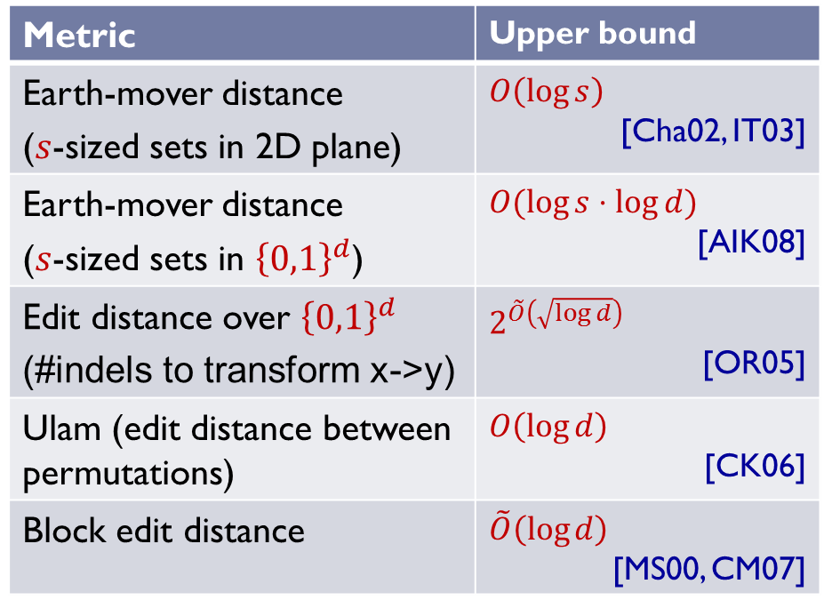

Embeddability into $ℓ_{1}$
edit( banana ,
ananas ) = 2
Metric | Upper bound
Earth-mover distance ($s$-sized sets in 2D plane) | $$O\left(\log{s}\right)$$ [Cha02, IT03]
Earth-mover distance ($s$-sized sets in ${\left\{0,1\right\}}^{d}$) | $$O(\log{s}⋅\log{d})$$ [AIK08]
Edit distance over ${\left\{0,1\right\}}^{d}$ (#indels to transform x->y) | $$2^{\tilde{O}\left(\sqrt{\log{d}}\right)}$$ [OR05]
Ulam (edit distance between permutations) | $$O\left(\log{d}\right)$$ [CK06]
Block edit distance | $$\tilde{O}\left(\log{d}\right)$$ [MS00, CM07]
edit(1234567,
7123456) = 2

Slide 20
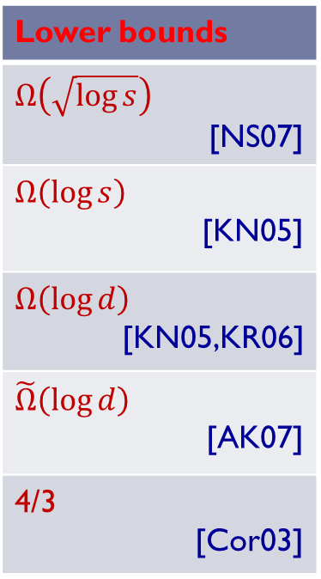
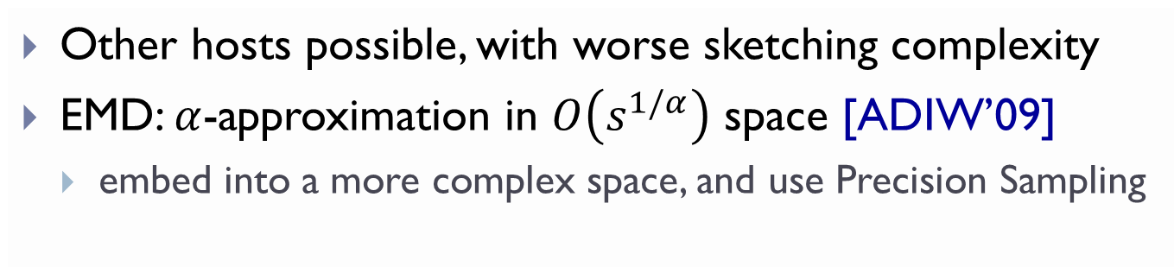

Non-embeddability into $ℓ_{1}$
Metric | Upper bound
Earth-mover distance ($s$-sized sets in 2D plane) | $$O\left(\log{s}\right)$$ [Cha02, IT03]
Earth-mover distance ($s$-sized sets in ${\left\{0,1\right\}}^{d}$) | $$O(\log{s}⋅\log{d})$$ [AIK08]
Edit distance over ${\left\{0,1\right\}}^{d}$ (#indels to transform x->y) | $$2^{\tilde{O}\left(\sqrt{\log{d}}\right)}$$ [OR05]
Ulam (edit distance between permutations) | $$O\left(\log{d}\right)$$ [CK06]
Block edit distance | $$\tilde{O}\left(\log{d}\right)$$ [MS00, CM07]
Lower bounds
$$Ω\left(\sqrt{\log{s}}\right)$$ [NS07]
$$Ω\left(\log{s}\right)$$ [KN05]
$$Ω\left(\log{d}\right)$$ [KN05,KR06]
$$\tilde{Ω}\left(\log{d}\right)$$ [AK07]
4/3 [Cor03]
Other hosts possible, with worse sketching complexity
EMD: $α$-approximation in $O\left(s^{1/α}\right)$ space [ADIW’09]
  embed into a more complex space, and use Precision Sampling

Slide 21
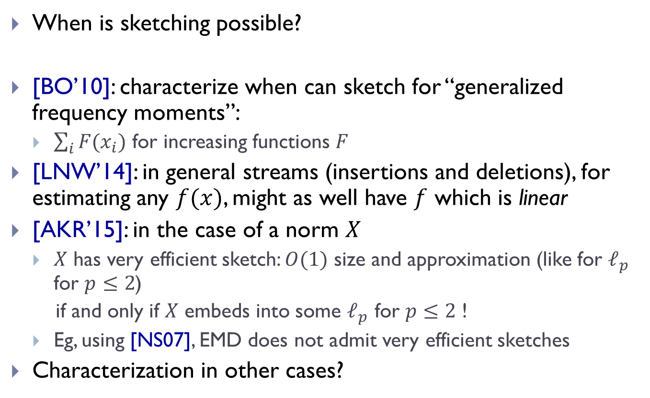
Theory of sketching
When is sketching possible?
[BO’10]: characterize when can sketch for “generalized frequency moments”:
  $\sum_{i}{F(x_{i})}$ for increasing functions $F$
[LNW’14]: in general streams (insertions and deletions), for estimating any $f(x)$, might as well have $f$ which is linear
[AKR’15]: in the case of a norm $X$
  $X$ has very efficient sketch: $O(1)$ size and approximation (like for $ℓ_{p}$ for $p≤2$)
  if and only if $X$ embeds into some $ℓ_{p}$ for $p≤2$ !
  Eg, using [NS07], EMD does not admit very efficient sketches
Characterization in other cases?

