Slide 1
Sketching (1)
Alex Andoni
(Columbia University)

Slide 2

131.107.65.14
Challenge: log statistics of the data, using small space
18.0.1.12
131.107.65.14
80.97.56.20
IP | Frequency
131.107.65.14 | 3
18.0.1.12 | 2
80.97.56.20 | 2
IP | Frequency
131.107.65.14 | 3
18.0.1.12 | 2
80.97.56.20 | 2
127.0.0.1 | 9
192.168.0.1 | 8
257.2.5.7 | 0
16.09.20.11 | 1
18.0.1.12
80.97.56.20
131.107.65.14

Slide 3
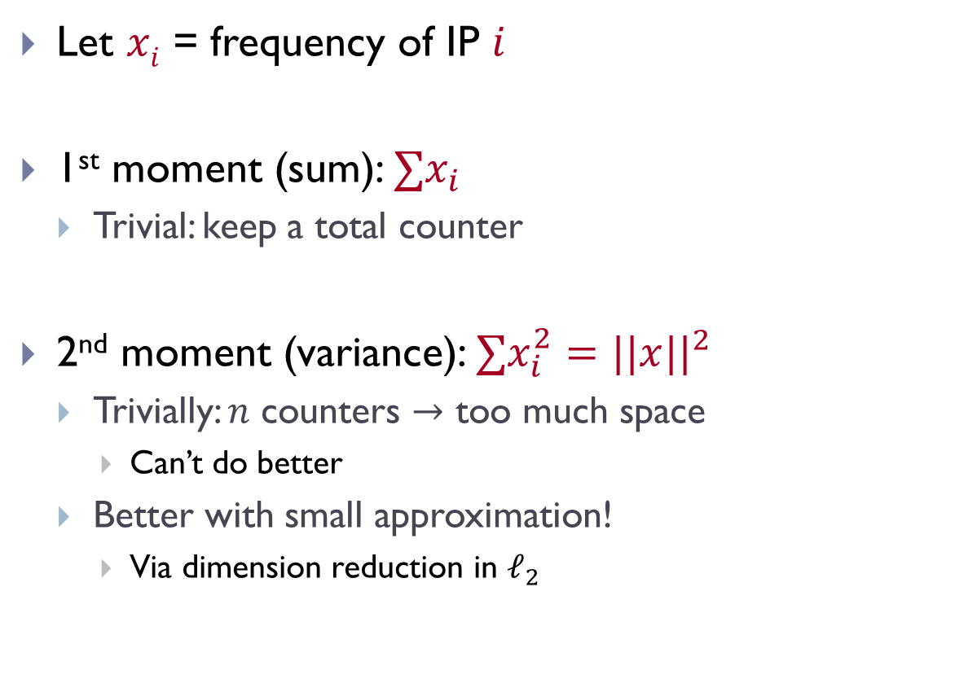


Streaming statistics
Let $xi$ = frequency of IP $i$
1st moment (sum): $∑x_{i}$
  Trivial: keep a total counter
2nd moment (variance): $∑x_{i}^{2}=||x||^{2}$
  Trivially: $n$ counters $→$ too much space
    Can’t do better
  Better with small approximation!
    Via dimension reduction in $ℓ_{2}$
IP | Frequency
131.107.65.14 | 3
18.0.1.12 | 2
80.97.56.20 | 2
$$∑x_{i}=7$$
$$∑x_{i}^{2}=17$$

Slide 4


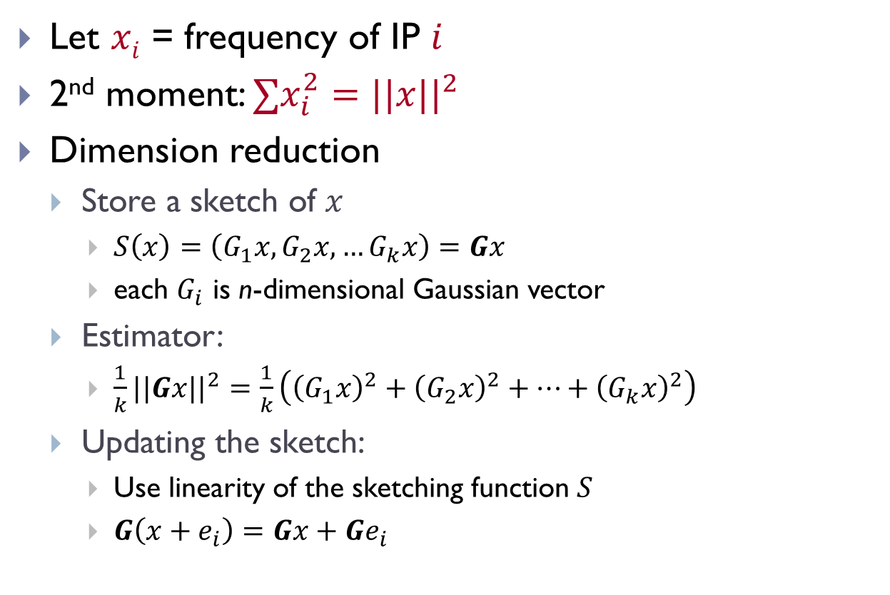



2nd frequency moment
Let $xi$ = frequency of IP $i$
2nd moment: $∑x_{i}^{2}=||x||^{2}$
Dimension reduction
  Store a sketch of $x$
    $S\left(x\right)=\left(G_{1}x, G_{2}x,…G_{k}x\right)=Gx$
    each $G_{i}$ is n-dimensional Gaussian vector
  Estimator:
    $\frac{1}{k}||Gx||^{2}=\frac{1}{k}\left({\left(G_{1}x\right)}^{2}+{\left(G_{2}x\right)}^{2}+…+{\left(G_{k}x\right)}^{2}\right)$
  Updating the sketch:
    Use linearity of the sketching function $S$
    $G\left(x+e_{i}\right)=Gx+Ge_{i}$
$$n$$
$$G$$
$$x$$
$$k$$

Slide 5
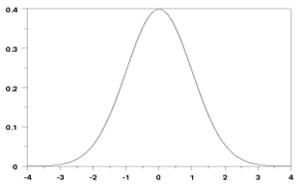
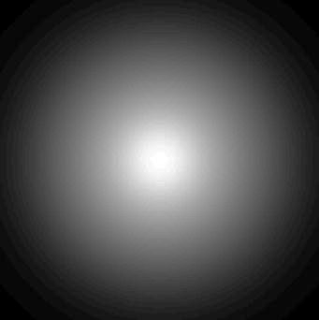

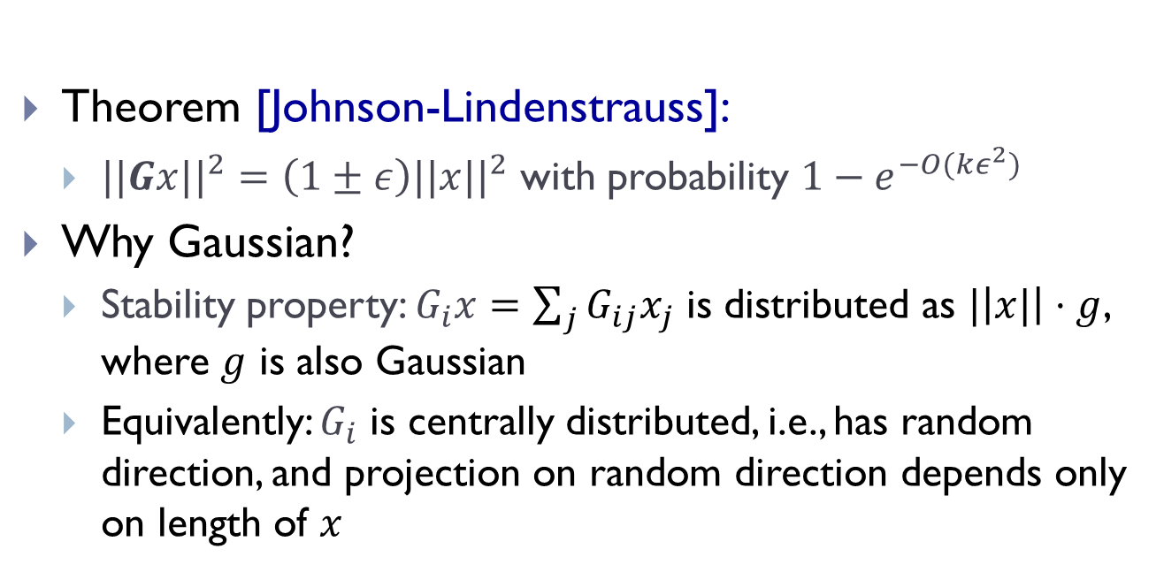
Correctness
pdf = ${\frac{1}{\sqrt{2π}}e}^{−g^{2}/2}$
$$E[g]=0$$
$$E[g^{2}]=1$$
Theorem [Johnson-Lindenstrauss]:
  $||Gx||^{2}=\left(1±ε\right)||x||^{2}$ with probability $1−e^{−O(kε^{2})}$
Why Gaussian?
  Stability property: $G_{i}x=\sum_{j}{G_{ij}x_{j}}$ is distributed as $|\left|x|\right|⋅g$, where $g$ is also Gaussian
  Equivalently: $G_{i}$ is centrally distributed, i.e., has random direction, and projection on random direction depends only on length of $x$
$$P\left(a\right)∙P\left(b\right)=$$
$$= \frac{1}{\sqrt{2π}}e^{−a^{2}/2}\frac{1}{\sqrt{2π}}e^{−b^{2}/2}$$
$$=\frac{1}{2π}e^{−{(a}^{2}+b^{2})/2}$$

Slide 6
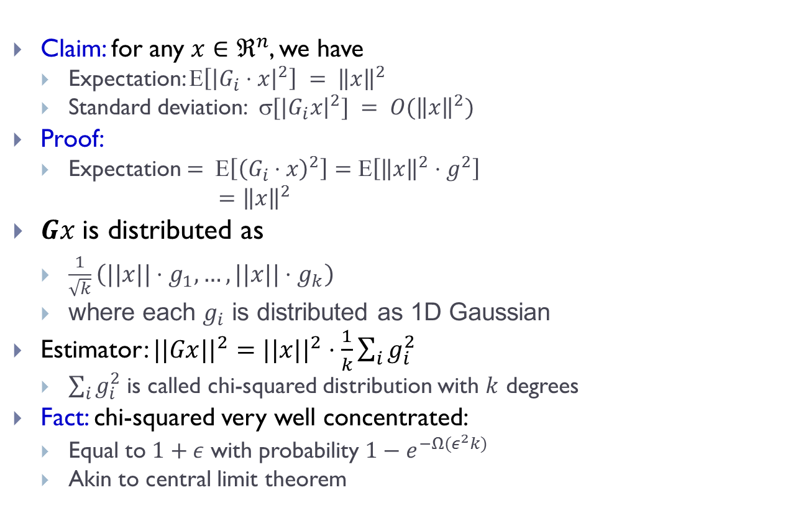
Proof [sketch]
pdf = ${\frac{1}{\sqrt{2π}}e}^{−g^{2}/2}$
$$E[g]=0$$
$$E[g^{2}]=1$$
Claim: for any $x∈ℜ^{n}$, we have
  Expectation: $\left[{\left|G_{i}⋅x\right|}^{2}\right] = {\left\|x\right\|}^{2}$
  Standard deviation: $[|G_{i}x{\left.​\right|}^{2}] = O({\left\|x\right\|}^{2})$
Proof:
  Expectation $= Ε\left[{\left(G_{i}⋅x\right)}^{2}\right]=Ε\left[{\left\|x\right\|}^{2}⋅g^{2}\right]$
  $={\left\|x\right\|}^{2}$
$Gx$is distributed as
  $\frac{1}{\sqrt{k}}\left(||x||{⋅g}_{1}, …,||x||⋅g_{k}\right)$
  where each $g_{i}$ is distributed as 1D Gaussian
Estimator: $||Gx||^{2}=||x||^{2}⋅\frac{1}{k}\sum_{i}{g_{i}^{2}}$
  $\sum_{i}{g_{i}^{2}}$ is called chi-squared distribution with $k$ degrees
Fact: chi-squared very well concentrated:
  Equal to $1+ε$ with probability ${1−e}^{−Ω(ε^{2}k)}$
  Akin to central limit theorem

Slide 7
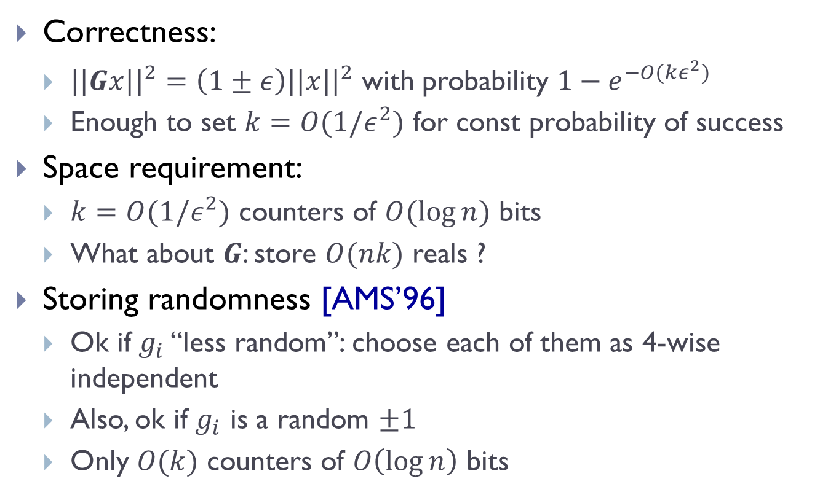
2nd frequency moment: overall
Correctness:
  $||Gx||^{2}=\left(1±ε\right)||x||^{2}$ with probability $1−e^{−O(kε^{2})}$
  Enough to set $k=O(1/ε^{2})$ for const probability of success
Space requirement:
  $k=O(1/ε^{2})$ counters of $O(\log{n})$ bits
  What about $G$: store $O(nk)$ reals ?
Storing randomness [AMS’96]
  Ok if $g_{i}$ “less random”: choose each of them as 4-wise independent
  Also, ok if $g_{i}$ is a random $±1$
  Only $O(k)$ counters of $O\left(\log{n}\right)$ bits

Slide 8

More efficient sketches?
Smaller Space:
  No: $Ω\left(\frac{1}{ε^{2}}\log{n}\right)$ bits [JW’11] $←$ David’s lecture
Faster update time:
  Yes: Jelani’s lecture

Slide 9
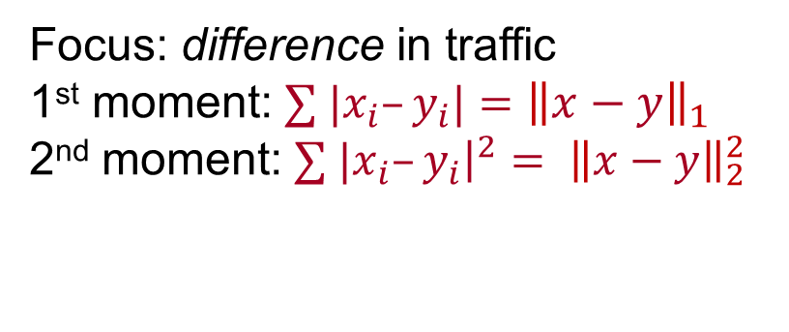




Streaming Scenario 2
131.107.65.14
80.97.56.20
18.0.1.12
$$x$$
18.0.1.12
IP | Frequency
131.107.65.14 | 1
18.0.1.12 | 1
80.97.56.20 | 1
IP | Frequency
131.107.65.14 | 1
18.0.1.12 | 2
$$y$$
Focus: difference in traffic
1st moment: $∑ |x_{i}–y_{i}|={\left\|x−y\right\|}_{1}$
2nd moment: $∑ |x_{i}–y_{i}{\left.​\right|}^{2}= {\left\|x−y\right\|}_{2}^{2}$
$${\left\|x−y\right\|}_{1}=2$$
$${\left\|x−y\right\|}_{2}^{2}=2$$
Similar Qs: average delay/variance in a network
differential statistics between logs at different servers, etc

Slide 10



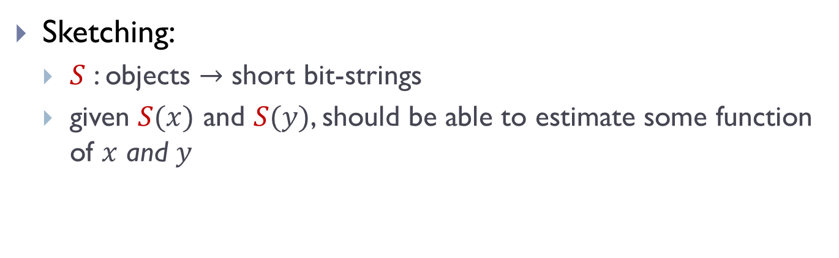


Definition: Sketching
Sketching:
  $S$ : objects $→$ short bit-strings
  given $S(x)$ and $S(y)$, should be able to estimate some function of $x$ and $y$
IP | Frequency
131.107.65.14 | 1
18.0.1.12 | 2
IP | Frequency
131.107.65.14 | 1
18.0.1.12 | 1
80.97.56.20 | 1
$$y$$
$$x$$
$$S$$
$$S$$
010110
010101
Estimate ${\left\|x−y\right\|}_{2}^{2}$ ?

Slide 11





Sketching for $ℓ_{2}$
As before, dimension reduction
  Pick $G$ (using common randomness)
  $S(x)=Gx$
Estimator: $||S(x)−S(y)||_{2}^{2}=||G\left(x−y\right)||_{2}^{2}$
IP | Frequency
131.107.65.14 | 1
18.0.1.12 | 2
IP | Frequency
131.107.65.14 | 1
18.0.1.12 | 1
80.97.56.20 | 1
$$y$$
$$x$$
$$S$$
$$S$$
010110
$$Gy$$
$$Gx$$
010101
$$||Gx−Gy||_{2}^{2}$$

Slide 12
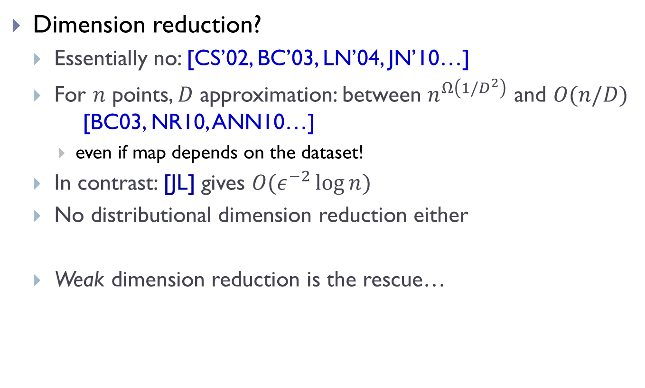
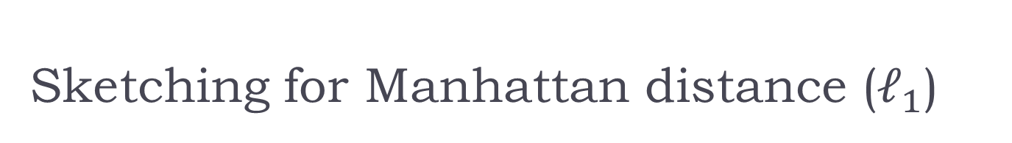
Sketching for Manhattan distance ($ℓ_{1}$)
Dimension reduction?
  Essentially no: [CS’02, BC’03, LN’04, JN’10…]
  For $n$ points, $D$ approximation: between $n^{Ω\left(1/D^{2}\right)}$ and $O(n/D)$ [BC03, NR10, ANN10…]
    even if map depends on the dataset!
  In contrast: [JL] gives $O(ε^{−2}\log{n})$
  No distributional dimension reduction either
  Weak dimension reduction is the rescue…

Slide 13
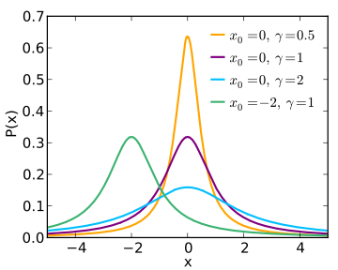
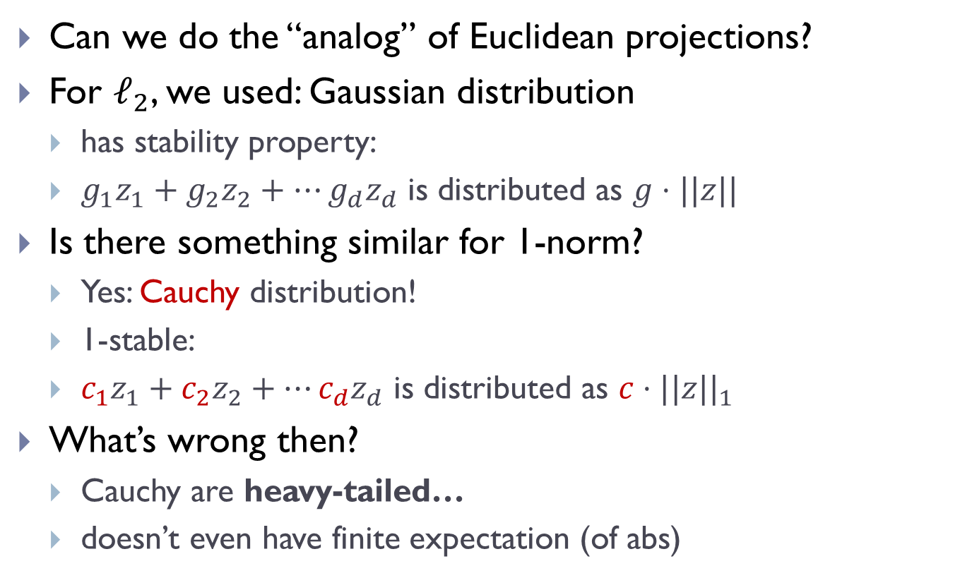

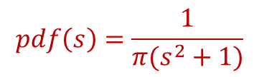
Dimension reduction for $ℓ_{1}$ ?
Can we do the “analog” of Euclidean projections?
For $ℓ_{2}$, we used: Gaussian distribution
  has stability property:
  $g_{1}z_{1}+g_{2}z_{2}+…g_{d}z_{d}$ is distributed as $g⋅||z||$
Is there something similar for 1-norm?
  Yes: Cauchy distribution!
  1-stable:
  $c_{1}z_{1}+c_{2}z_{2}+…c_{d}z_{d}$ is distributed as $c⋅||z||_{1}$
What’s wrong then?
  Cauchy are heavy-tailed…
  doesn’t even have finite expectation (of abs)
$$pdf\left(s\right)=\frac{1}{π(s^{2}+1)}$$

Slide 14
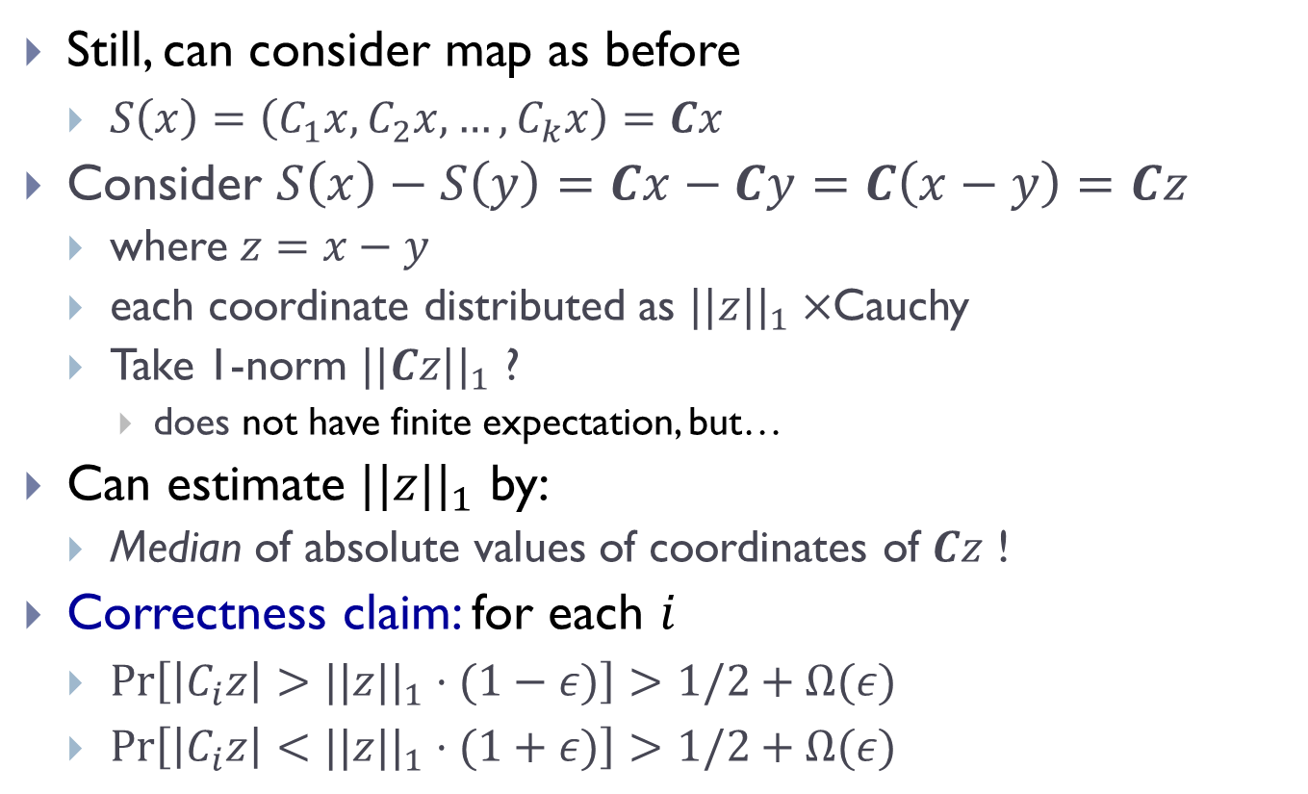

Sketching for $ℓ_{1}$ [Indyk’00]
Still, can consider map as before
  $S\left(x\right)=\left(C_{1}x, C_{2}x, …,C_{k}x\right)=Cx$
Consider $S\left(x\right)−S\left(y\right)=Cx−Cy=C\left(x−y\right)=Cz$
  where $z=x−y$
  each coordinate distributed as $||z||_{1}×$Cauchy
  Take 1-norm $||Cz||_{1}$ ?
    does not have finite expectation, but…
Can estimate $||z||_{1}$ by:
  Median of absolute values of coordinates of $Cz$ !
Correctness claim: for each $i$
  $Pr\left[\left|C_{i}z\right|>||z||_{1}⋅(1−ε)\right]>1/2+Ω(ε)$
  $Pr\left[\left|C_{i}z\right|<||z||_{1}⋅(1+ε)\right]>1/2+Ω(ε)$

Slide 15
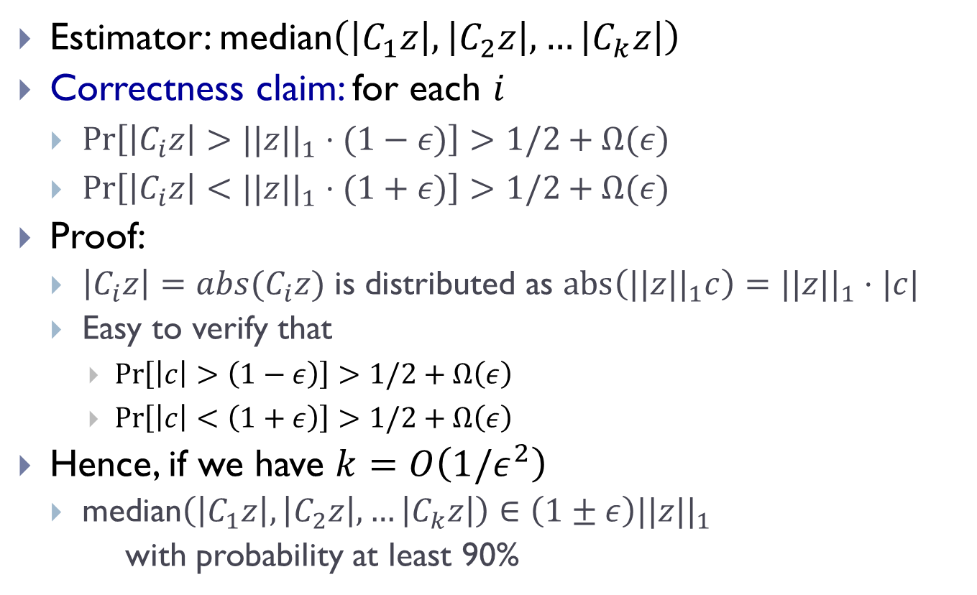
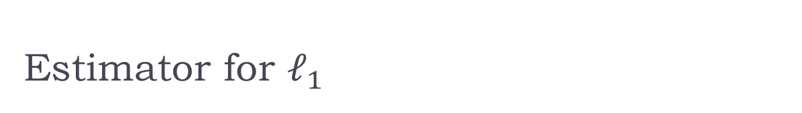
Estimator for $ℓ_{1}$
Estimator: median$\left(\left|C_{1}z\right|, \left|C_{2}z\right|,…\left|C_{k}z\right|\right)$
Correctness claim: for each $i$
  $Pr\left[\left|C_{i}z\right|>||z||_{1}⋅(1−ε)\right]>1/2+Ω(ε)$
  $Pr\left[\left|C_{i}z\right|<||z||_{1}⋅(1+ε)\right]>1/2+Ω(ε)$
Proof:
  $\left|C_{i}z\right|=abs(C_{i}z)$ is distributed as $abs\left(||z||_{1}c\right)=||z||_{1}⋅|c|$
  Easy to verify that
    $\operatorname{Pr}\left[\left|c\right|>\left(1−ε\right)\right]>1/2+Ω\left(ε\right)$
    $\operatorname{Pr}\left[\left|c\right|<\left(1+ε\right)\right]>1/2+Ω\left(ε\right)$
Hence, if we have $k=O\left(1/ε^{2}\right)$
  median$\left(\left|C_{1}z\right|, \left|C_{2}z\right|,…\left|C_{k}z\right|\right)∈\left(1±ε\right)||z||_{1}$
  with probability at least 90%

Slide 16
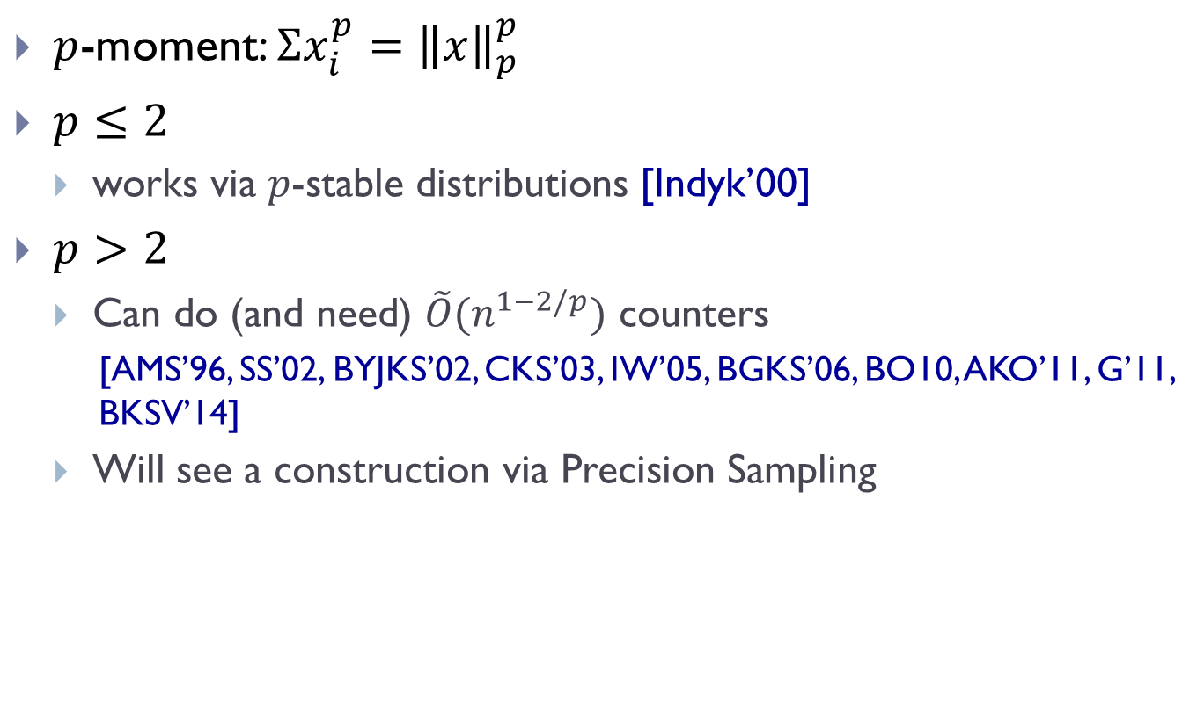

To finish the $ℓ_{p}$ norms…
$p$-moment: $Σx_{i}^{p}={\left\|x\right\|}_{p}^{p}$
$p≤2$
  works via $p$-stable distributions [Indyk’00]
$p>2$
  Can do (and need) $\tilde{O}(n^{1−2/p})$ counters
    [AMS’96, SS’02, BYJKS’02, CKS’03, IW’05, BGKS’06, BO10, AKO’11, G’11, BKSV’14]
  Will see a construction via Precision Sampling

Slide 17
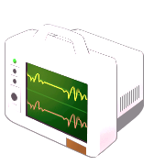

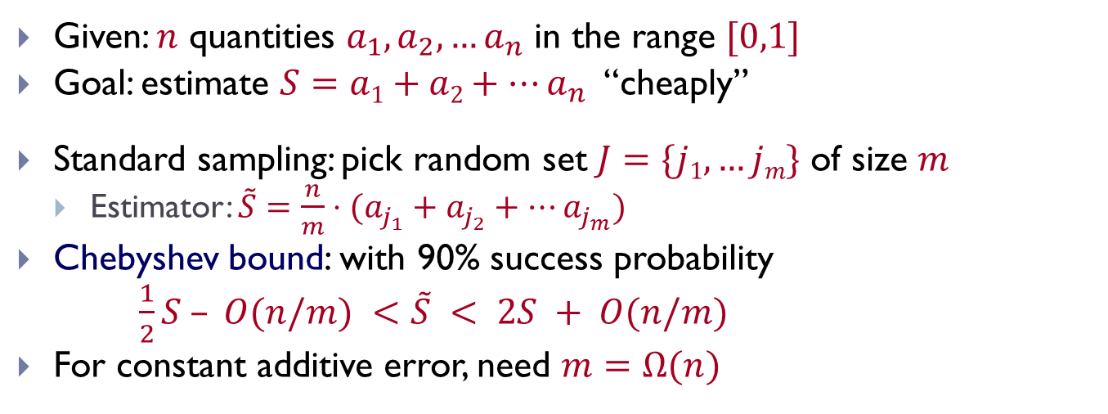
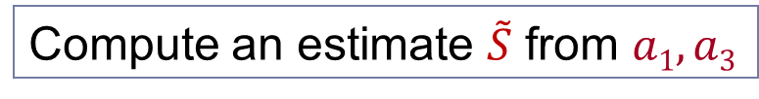
A task: estimate sum
Given: $n$ quantities $a_{1}, a_{2}, …a_{n}$ in the range $[0,1]$
Goal: estimate $S=a1+a2+…a_{n}$ “cheaply”
Standard sampling: pick random set $J=\{j1,…jm\}$ of size $m$
  Estimator: $\tilde{S}=\frac{n}{m}⋅(a_{j_{1}}+a_{j_{2}}+…a_{j_{m}})$
Chebyshev bound: with 90% success probability
$\frac{1}{2}S – O(n/m) <\tilde{S} < 2S + O(n/m)$
For constant additive error, need $m=Ω(n)$
Compute an estimate $\tilde{S}$ from $a1, a3$
a₁
a₃
a₁
a₂
a₃
a₄

Slide 18

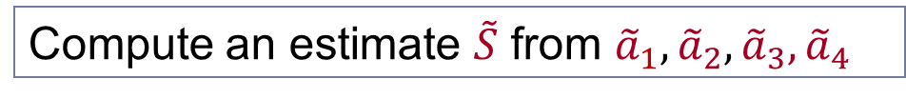
Precision Sampling Framework
Alternative “access” to $ai$’s:
  For each term $ai$, we get a (rough) estimate ${\tilde{a}}_{i}$
  up to some precision $ui$, chosen in advance: $|ai –{\tilde{a}}_{i}| < ui$
Challenge: achieve good trade-off between
  quality of approximation to $S$
  use only weak precisions $ui$ (minimize “cost” of estimating $\tilde{a}$)
Compute an estimate $\tilde{S}$ from ${\tilde{a}}_{1},{\tilde{a}}_{2}, {\tilde{a}}_{3}{,\tilde{a}}_{4}$
u₁
u₂
u₃
u₄
ã₁
ã₂
ã₃
ã₄
a₁
a₂
a₃
a₄

Slide 19
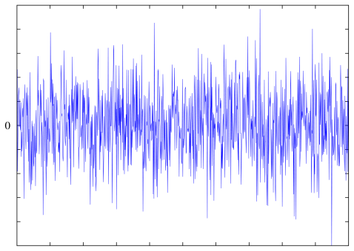
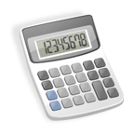

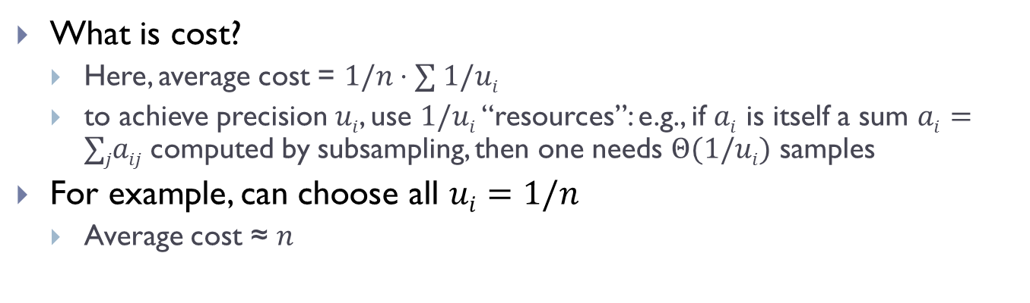
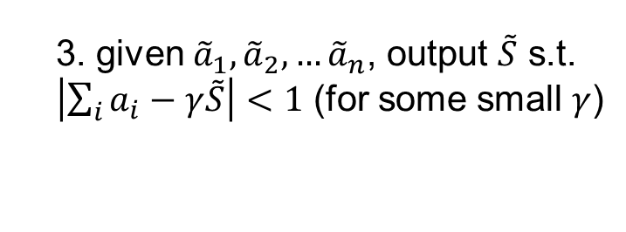


Formalization
Sum Estimator
Adversary
1. fix precisions $ui$
1. fix $a1,a2,…a_{n}$
  2. fix ${\tilde{a}}_{1}, {\tilde{a}}_{2}, …{\tilde{a}}_{n}$ s.t. $|a_{i}−{\tilde{a}}_{i}| < ui$
3. given ${\tilde{a}}_{1}, {\tilde{a}}_{2}, …{\tilde{a}}_{n}$, output $\tilde{S}$ s.t.
$\left|\sum_{i}{a_{i}}−γ\tilde{S}\right|<1$ (for some small $γ$)
What is cost?
  Here, average cost = $1/n⋅∑ 1/ui$
  to achieve precision $ui$, use $1/ui$ “resources”: e.g., if $ai$ is itself a sum $ai=∑jaij$computed by subsampling, then one needs $Θ(1/ui)$ samples
For example, can choose all $ui=1/n$
  Average cost ≈ $n$

Slide 20

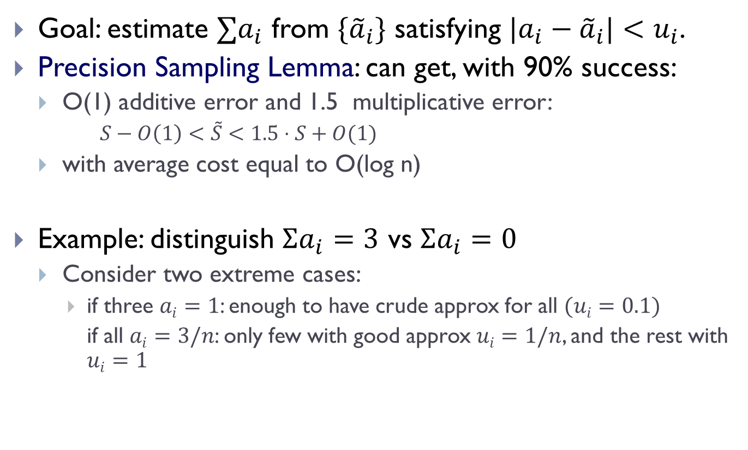



Precision Sampling Lemma
[A-Krauthgamer-Onak’11]
Goal: estimate $∑a_{i}$ from $\{{\tilde{a}}_{i}\}$ satisfying $|a_{i}−{\tilde{a}}_{i}|<u_{i}$.
Precision Sampling Lemma: can get, with 90% success:
  O(1) additive error and 1.5 multiplicative error:
    $S−O\left(1\right)<\tilde{S}<1.5⋅S+O(1)$
  with average cost equal to O(log n)
Example: distinguish $Σa_{i}=3$ vs $Σa_{i}=0$
  Consider two extreme cases:
    if three $ai=1$: enough to have crude approx for all $(ui=0.1)$
    if all $ai=3/n$: only few with good approx $ui=1/n$, and the rest with $ui=1$
$$ε$$
$$1+ε$$
$$S−ε<\tilde{S} <\left(1+ε\right)S+ε$$
$$O(ε^{−3}log⁡n)$$

Slide 21


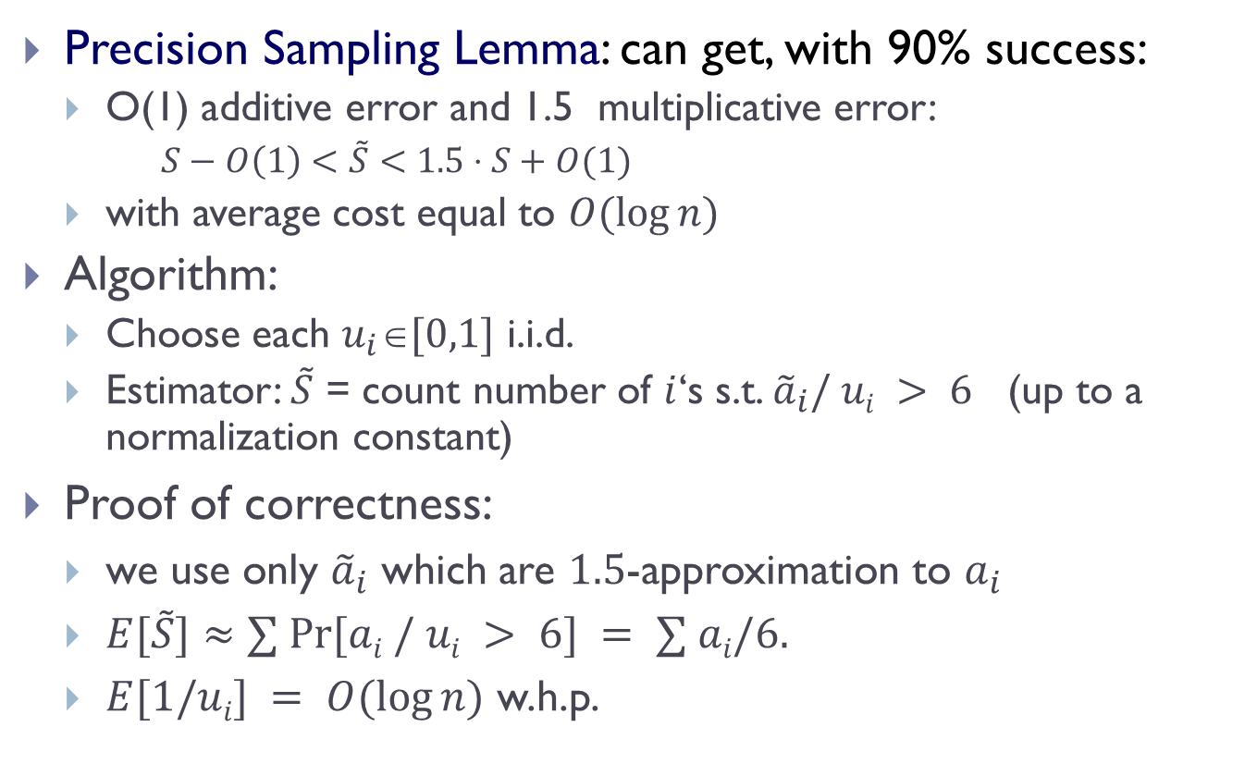


Precision Sampling Algorithm
Precision Sampling Lemma: can get, with 90% success:
  O(1) additive error and 1.5 multiplicative error:
    $S−O\left(1\right)<\tilde{S}<1.5⋅S+O(1)$
  with average cost equal to $O(log⁡n)$
Algorithm:
  Choose each $u_{i}[0,1]$ i.i.d.
  Estimator: $\tilde{S}$ = count number of $i$‘s s.t. ${\tilde{a}}_{i}/ ui > 6$ (up to a normalization constant)
Proof of correctness:
  we use only ${\tilde{a}}_{i}$ which are $1.5$-approximation to $a_{i}$
  $E[\tilde{S}]≈∑ Pr⁡[ai / ui > 6] = ∑ ai/6.$
  $E[1/ui] = O(log⁡n)$ w.h.p.
$$ε$$
$$1+ε$$
$$S−ε<\tilde{S}<\left(1+ε\right)⋅S+O\left(1\right)$$
$$O(ε^{−3}log⁡n)$$
concrete distrib. = minimum of $O(ε^{−3})$ u.r.v.
function of $[{\tilde{a}}_{i}/ui − 4/ε]+$ and $u_{i}$’s

Slide 22

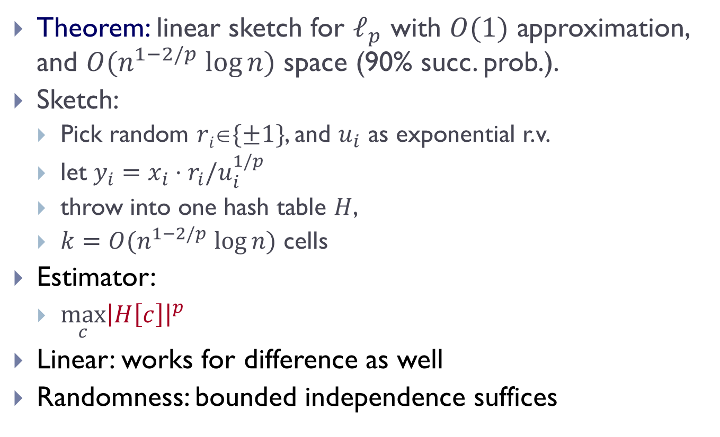

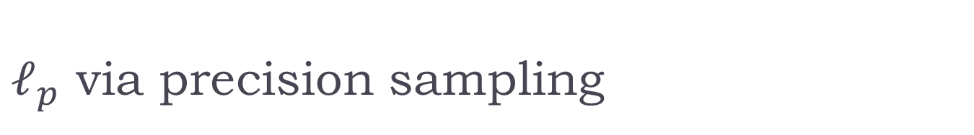



$ℓ_{p}$ via precision sampling
Theorem: linear sketch for $ℓ_{p}$ with $O(1)$ approximation, and $O(n^{1−2/p} log⁡n)$ space (90% succ. prob.).
Sketch:
  Pick random $ri\{±1\}$, and $u_{i}$ as exponential r.v.
  let $y_{i}=x_{i}⋅r_{i}/u_{i}^{1/p}$
  throw into one hash table $H$,
  $k=O(n^{1−2/p} log⁡n)$ cells
Estimator:
  $\max_{c}{{\left|H\left[c\right]\right|}^{p}}$
Linear: works for difference as well
Randomness: bounded independence suffices
$$u∼e^{−u}$$
$$x=$$
$$x1$$ | $$x2$$ | $$x3$$ | $$x4$$ | $$x5$$ | $$x6$$
$$y_{1}+y_{3}$$ | $$y_{4}$$ | $$y_{2}+y_{5}+y_{6}$$
$$H=$$

Slide 23
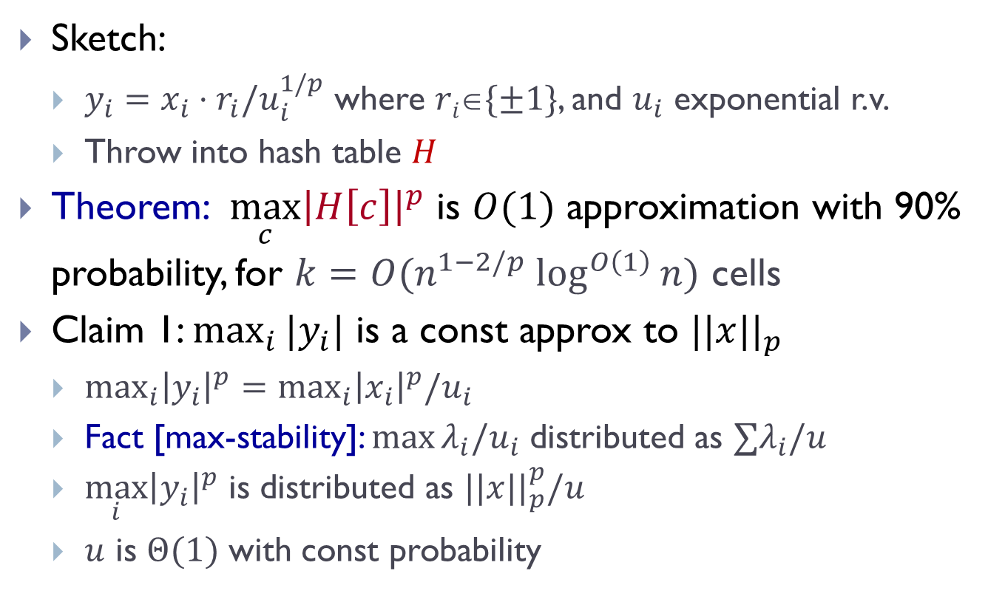

Correctness of $ℓ_{p}$ estimation
Sketch:
  $y_{i}=x_{i}⋅r_{i}/u_{i}^{1/p}$ where $ri\{±1\}$, and $u_{i}$ exponential r.v.
  Throw into hash table $H$
Theorem: $\max_{c}{{\left|H\left[c\right]\right|}^{p}}$ is $O(1)$ approximation with 90% probability, for $k=O(n^{1−2/p} \log^{O\left(1\right)}⁡n)$ cells
Claim 1: $\max_{i}{|y_{i}|}$ is a const approx to $||x||_{p}$
  $\max_{i}{{\left|y_{i}\right|}^{p}}=\max_{i}{{\left|x_{i}\right|}^{p}/u_{i}}$
  Fact [max-stability]: $\max{λ_{i}/u_{i}}$ distributed as $∑λ_{i}/u$
  $\max_{i}{{\left|y_{i}\right|}^{p}}$ is distributed as $||x||_{p}^{p}/u$
  $u$ is $Θ(1)$ with const probability

Slide 24

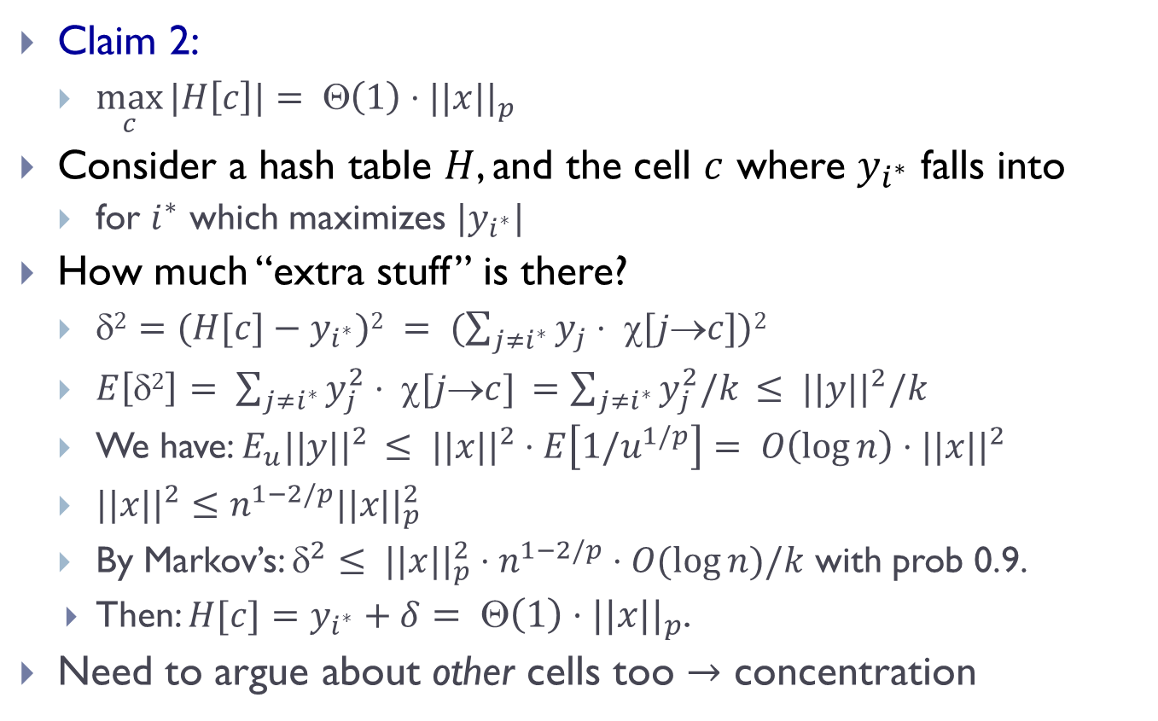



  Correctness (cont)
$$x1$$ | $$x2$$ | $$x3$$ | $$x4$$ | $$x5$$ | $$x6$$
$$y_{1}+y_{3}$$ | $$y_{4}$$ | $$y_{2}+y_{5}+y_{6}$$
Claim 2:
  $\max_{c}{|H\left[c\right]|}= Θ\left(1\right)⋅||x||_{p}$
Consider a hash table $H$, and the cell $c$ where $y_{i^{∗}}$ falls into
  for $i^{∗}$ which maximizes $|y_{i^{∗}}|$
How much “extra stuff” is there?
  $2=(H[c]−y_{i^{∗}})2 = (\sum_{j≠i^{∗}}{y_{j}}⋅ χ[j→c])2$
  $E\left[δ2\right]= \sum_{j≠i^{∗}}{y_{j}^{2}}⋅ χ[j→c] =\sum_{j≠i^{∗}}{y_{j}^{2}/k} ≤ ||y||^{2}/k$
  We have: $E_{u}||y||^{2} ≤ ||x||^{2}⋅E\left[1/u^{1/p}\right]= O\left(\log{n}\right)⋅||x||^{2}$
  $||x||^{2}≤n^{1−2/p}||x||_{p}^{2}$
  By Markov’s: $^{2}≤ ||x||_{p}^{2}⋅n^{1−2/p}⋅O(\log{n})/k$ with prob 0.9.
    Then: $H[c]=y_{i^{∗}}+δ= Θ\left(1\right)⋅||x||_{p}$.
  Need to argue about other cells too $→$ concentration
$$H=$$
$$y_{i} = x_{i}⋅r_{i}/u_{i}^{1/p}$$
where $r_{i}\{±1\}$
$u_{i}$ exponential r.v.

