Slide 1
Sampling in Graphs: node sparsifiers
Alexandr Andoni
(Microsoft Research)

Slide 2
Graph compression
$$≈$$
Why smaller graphs?
use less storage space
faster algorithms
easier visualization

Slide 3
Sparsification of edges
Preserve some structure: e.g., cuts
Also: distances, effective resistances, etc

Slide 4
Sparsification of nodes ?
Generally: not well-defined
natural to define properties on nodes…
Preserve a property with respect to a small set $K$ of “important nodes”
using a small graph
ideally: of size $poly(|K|)$, independent of $n$

Slide 5
Node sparsifiers
Cut (node) sparsifier [HKNR98, Moi09]
graph $H$ s.t. for each $K=S∪T$, we have
$mincut_{G}\left(S,T\right)=mincut_{H}(S,T)$
Flow (node) sparsifier [LM10]
graph $H$ s.t. for any multi-commodity flow $d$ on $K$:
max concurrent flow in $G$= max concurrent flow in $H$
$$G$$
$$H$$

Slide 6
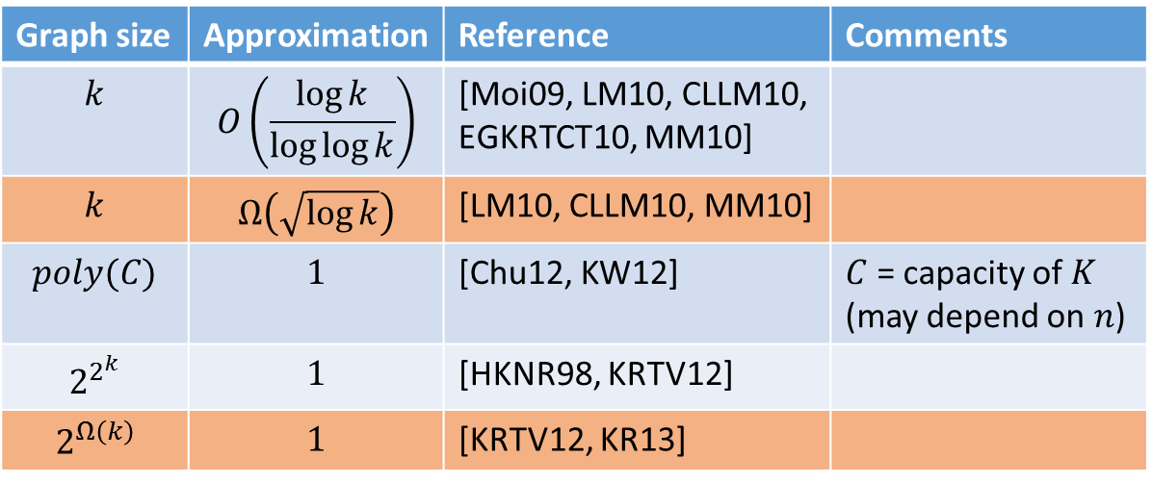
Results on cut sparsifiers
Graph size | Approximation | Reference | Comments
$$k$$ | $$O\left(\frac{\log{k}}{\log{\log{k}}}\right)$$ | [Moi09, LM10, CLLM10, EGKRTCT10, MM10]
$$k$$ | $$Ω\left(\sqrt{\log{k}}\right)$$ | [LM10, CLLM10, MM10]
$$poly(C)$$ | $$1$$ | [Chu12, KW12] | $C$ = capacity of $K$ (may depend on $n$)
$$2^{2^{k}}$$ | $$1$$ | [HKNR98, KRTV12]
$$2^{Ω\left(k\right)}$$ | $$1$$ | [KRTV12, KR13]
bipartite* graphs
$$poly(k/ε)$$ | $$1+ε$$ | [AGK’14] | bipartite* graphs
Similar results for flow (node) sparsifier

Slide 7
Small cut (node) sparsifiers
[A-Gupta-Krauthgamer’14]
Theorem: for bipartite graphs, can construct $1+ε$ approximate cut (node) sparsifier
sparsifier size: $poly(k/ε)$
Non-terminals form independent set

Slide 8
Main idea ?
Sampling edges doesn’t work here
Need to sample entire sub-structures of the graph

Slide 9
Sampling in Bipartite Graphs
Sample non-terminals, together with edges
reweight edges accordingly

Slide 10
Sampling in Bipartite Graphs
Sample non-terminals, together with edges
reweight edges accordingly
Uniform sampling doesn’t work

Slide 11
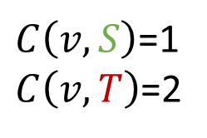
Non-uniform sampling
Non-terminal $v$ has sampling probability $p_{v}$
If $v$ sampled, weight edges by $1/p_{v}$
Expectation is right:
consider a partition $K=S∪T$
$mincut_{G}(S,T) = \sum_{v}{\min{\{C\left(v,S\right), C(v,T)\}}}$
$\hat{mincut_{H}} (S,T) = \sum_{v}{\frac{I_{v}}{p_{v}}⋅\min{\{C\left(v,S\right), C(v,T)\}}}$
$=1$ with probability $p_{v}$
$$S$$
$$v$$
$C\left(v,S\right)$=1
$C\left(v,T\right)$=2
$$T$$

Slide 12

How to choose $p_{v}$ ?
Want
1)$\hat{mincut_{H}}(S,T) = \sum_{v}{\frac{I_{v}}{p_{v}}⋅\min{\{C\left(v,S\right), C(v,T)\}}}$ concentrates
2) $\sum_{v}{p_{v}}$ small, $poly\left(\frac{k}{ε}\right)$
Issue: contribution can come from just a few terms

Slide 13
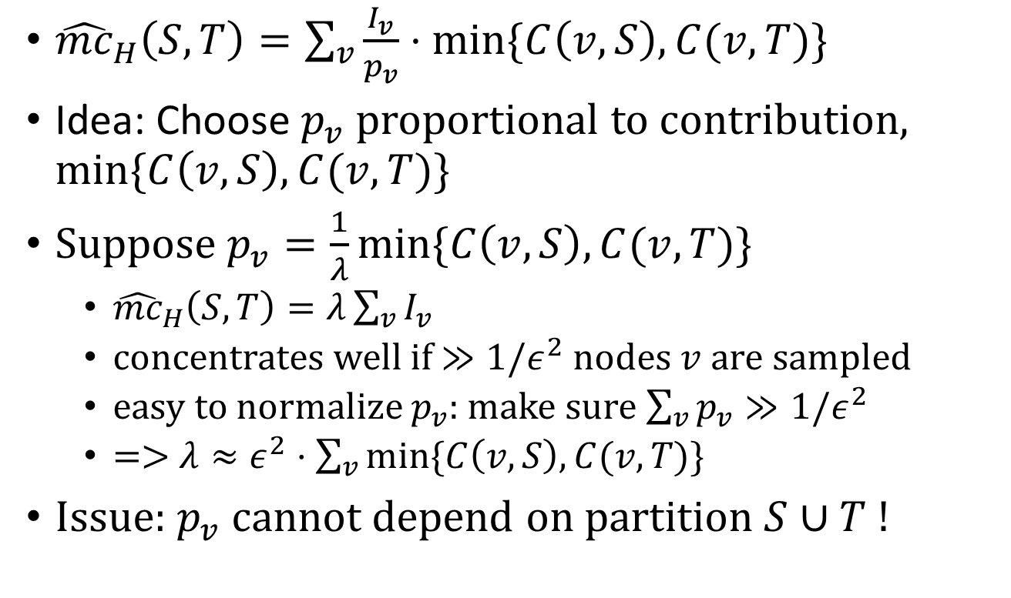
Tool: Importance sampling
${\hat{mc}}_{H}\left(S,T\right)=\sum_{v}{\frac{I_{v}}{p_{v}}⋅\min{\{C\left(v,S\right), C(v,T)\}}}$
Idea: Choose $p_{v}$ proportional to contribution, $\min{\{C\left(v,S\right), C(v,T)\}}$
Suppose $p_{v}=\frac{1}{λ}\min{\{C\left(v,S\right), C(v,T)\}}$
${\hat{mc}}_{H}\left(S,T\right)=λ\sum_{v}{I_{v}}$
concentrates well if $≫1/ε^{2}$ nodes $v$ are sampled
easy to normalize $p_{v}$: make sure $\sum_{v}{p_{v}}≫1/ε^{2}$
=> $λ≈ε^{2}⋅\sum_{v}{\min{\{C\left(v,S\right), C(v,T)\}}}$
Issue: $p_{v}$ cannot depend on partition $S∪T$ !

Slide 14
Importance sampling
Idea 2: for any $K=S∪T$, large fraction supported on some terminals $s∈S,t∈T$ !
$mincut\left(S,T\right)≈\sum_{v}{\min{\{c_{v,s}, c_{v,t}\}}}$ (up to $k^{2}$)
enough to “take care” of all pairs $s,t$
Will set $p_{v}$ to be proportional to the contribution of $v$ to the cut between $s,t$, for the “worst” possible $s,t$
then $p_{v}$ is $≈k^{2}$ factor approximation to “ideal” $p_{v}$
enough!

Slide 15
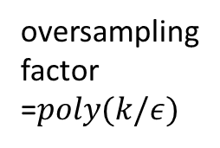
Actual Sampling
$p_{v}=F⋅\max_{s,t}{\frac{\min{\{c_{v,s},c_{v,t}\}}}{\sum_{u}{\min{\{c_{u,s},c_{u,t}\}}}}}$ (thresholded at 1)
1) $p_{v}$ good approximation to the contribution => concentration by importance sampling
2) $\sum_{v}{p_{v}}≤Fk^{2}$.
Apply union bound over all choices of cuts $S∪T$
oversampling
factor
=$poly(k/ε)$
if there were only two terminals $s,t$,
how important would $v$ be ?

Slide 16
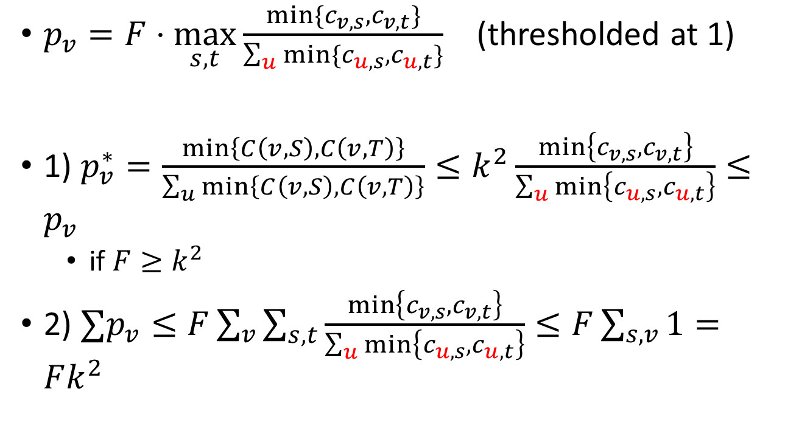
Checking importance sampling
$p_{v}=F⋅\max_{s,t}{\frac{\min{\{c_{v,s},c_{v,t}\}}}{\sum_{u}{\min{\{c_{u,s},c_{u,t}\}}}}}$ (thresholded at 1)
1) $p_{v}^{∗}=\frac{min\left\{C\left(v,S\right), C\left(v,T\right)\right\}}{\sum_{u}{min\left\{C\left(v,S\right), C\left(v,T\right)\right\}}}≤k^{2}\frac{\min\left\{c_{v,s},c_{v,t}\right\}}{\sum_{u}{\min\left\{c_{u,s},c_{u,t}\right\}}}≤p_{v}$
if $F≥k^{2}$
2) $∑p_{v}≤F\sum_{v}{\sum_{s,t}{\frac{\min\left\{c_{v,s},c_{v,t}\right\}}{\sum_{u}{\min\left\{c_{u,s},c_{u,t}\right\}}}}}≤F\sum_{s,v}{1}=Fk^{2}$

Slide 17
Flow (node) sparsifiers
Same $p_{v}$’s work also for flow sparsifier:
concentration => concentration of LP values
need to show concentration for both primal and dual LP
Also works when non-terminals = small independent graphs

Slide 18
Remarks
Node sparsifiers:
Via structure sampling: sample graph sub-structures
Assign probabilities using importance sampling
Works for bipartite graphs
beats the $2^{Ω(k)}$ lower bounds for exact sparsifiers!
OPEN: $poly(k/ε)$ size for general graphs?

Slide 19
Graph compression via sampling
$$≈$$
Seen:
I) Cut sparsifiers via sampling edges
II) Smaller sparsifiers by relaxing constraints
III) Small cut (node) sparsifiers for bipartite graphs, via structure sampling
Meta-open:
Structure sampling for node sparsifier in general graphs?
How to define “$≈$” without fixed terminal set $K$ ?

