Slide 1
Summer School on Hashing’14
Dimension Reduction
Alex Andoni
(Microsoft Research)

Slide 2
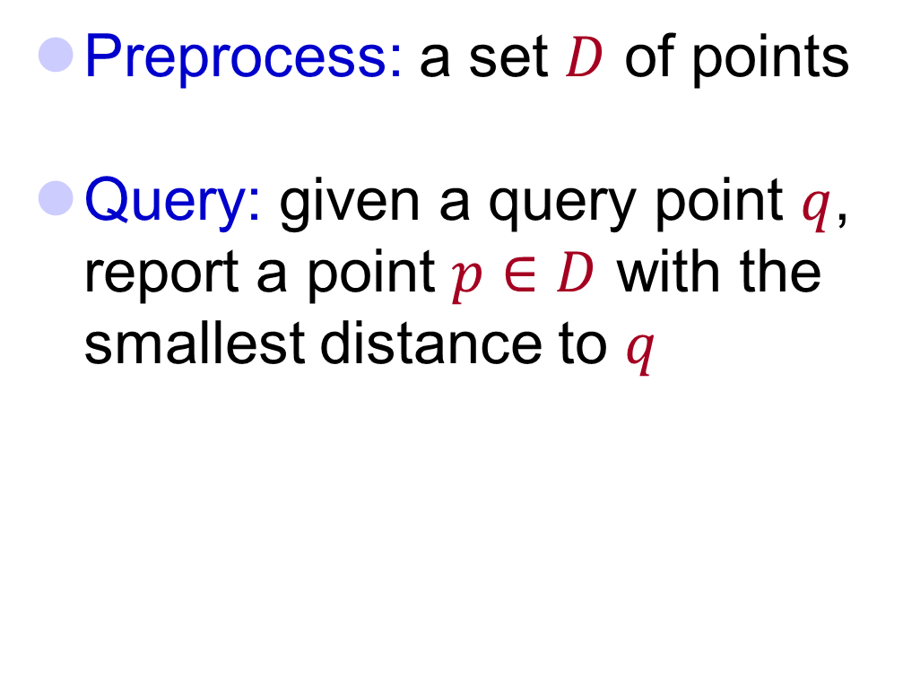


Nearest Neighbor Search (NNS)
Preprocess: a set $D$ of points
Query: given a query point $q$, report a point $p∈D$ with the smallest distance to $q$
$$p$$
$$q$$

Slide 3
Motivation
Generic setup:
  Points model objects (e.g. images)
  Distance models (dis)similarity measure
Application areas:
  machine learning: k-NN rule
  speech/image/video/music recognition, vector quantization, bioinformatics, etc…
Distance can be:
  Hamming, Euclidean, edit distance, Earth-mover distance, etc…
Primitive for other problems:
  find the similar pairs in a set D, clustering…
000000
011100
010100
000100
010100
011111
000000
001100
000100
000100
110100
111111
$$p$$
$$q$$

Slide 4
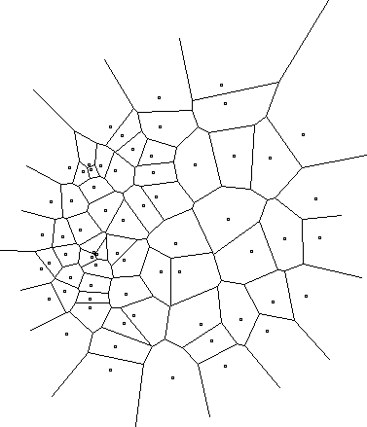
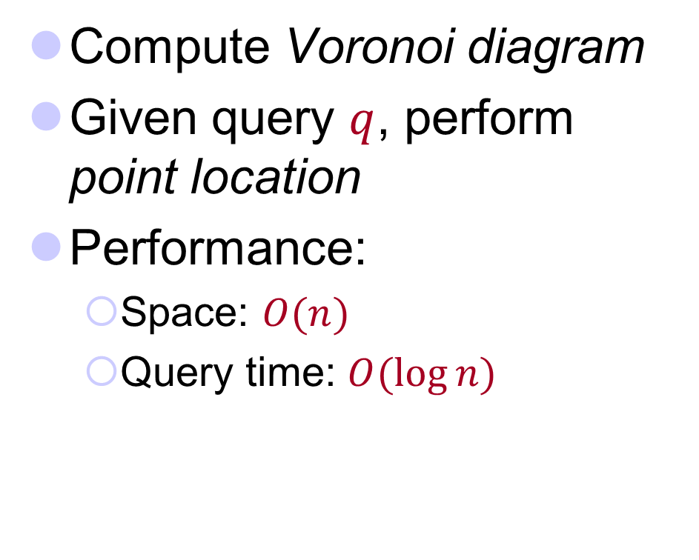
2D case
Compute Voronoi diagram
Given query $q$, perform point location
Performance:
  Space: $O(n)$
  Query time: $O(\log{n})$

Slide 5
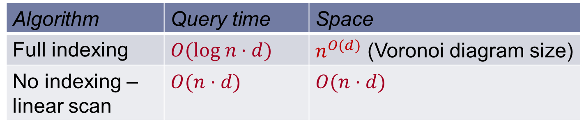

High-dimensional case
All exact algorithms degrade rapidly with the dimension $d$
Algorithm | Query time | Space
Full indexing | $$O(log n⋅d)$$ | $n^{O(d)}$ (Voronoi diagram size)
No indexing – linear scan | $$O(n⋅d)$$ | $$O(n⋅d)$$

Slide 6
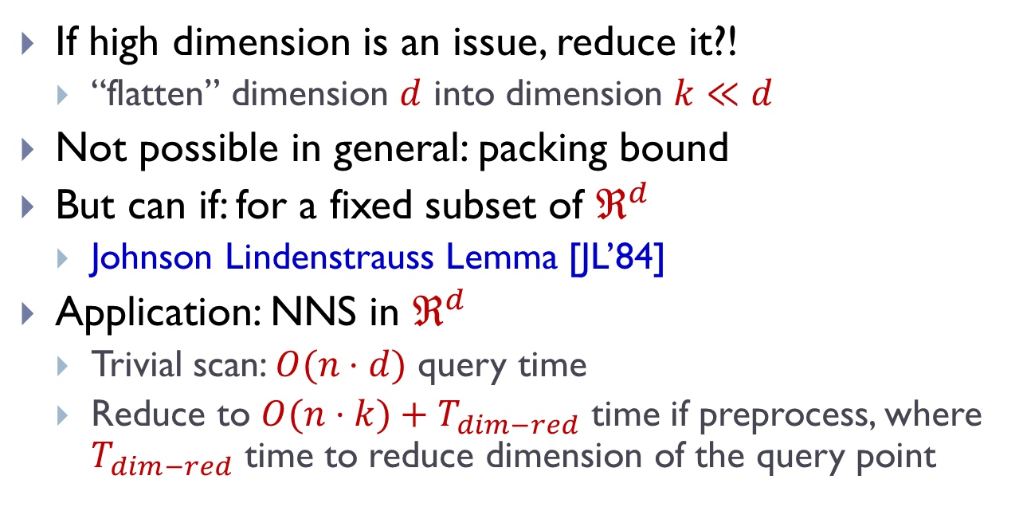
Dimension Reduction
If high dimension is an issue, reduce it?!
  “flatten” dimension $d$ into dimension $k≪d$
Not possible in general: packing bound
But can if: for a fixed subset of $ℜ^{d}$
  Johnson Lindenstrauss Lemma [JL’84]
Application: NNS in $ℜ^{d}$
  Trivial scan: $O(n⋅d)$ query time
  Reduce to $O(n⋅k)+T_{dim−red}$ time if preprocess, where $T_{dim−red}$ time to reduce dimension of the query point

Slide 7
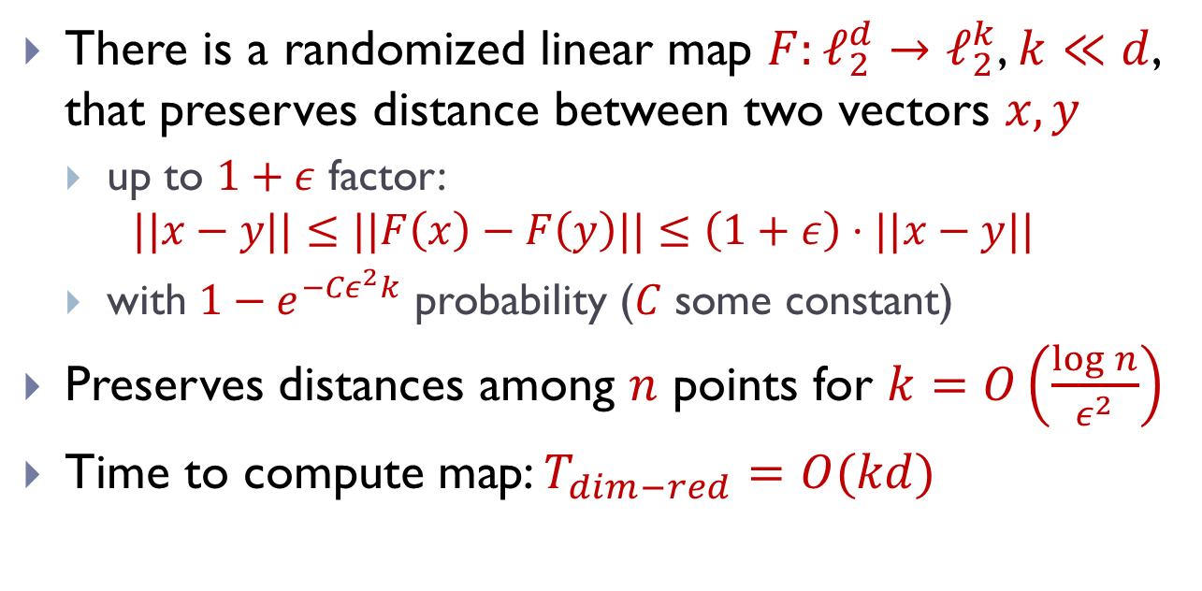
Johnson Lindenstrauss Lemma
There is a randomized linear map $F:ℓ_{2}^{d}→ℓ_{2}^{k}$, $k≪d$, that preserves distance between two vectors $x,y$
  up to $1+ε$ factor:
  $$||x−y||≤||F\left(x\right)−F\left(y\right)||≤\left(1+ε\right)⋅||x−y||$$
  with $1−e^{{−Cε}^{2}k}$ probability ($C$ some constant)
Preserves distances among $n$ points for $k=O\left(\frac{\log{n}}{ε^{2}}\right)$
Time to compute map: $T_{dim−red}=O(kd)$

Slide 8

Idea:
Project onto a random subspace of dimension $k$!

Slide 9
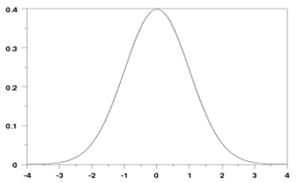
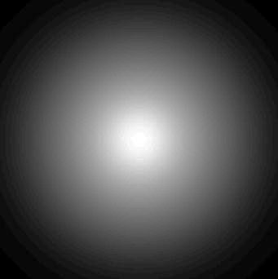

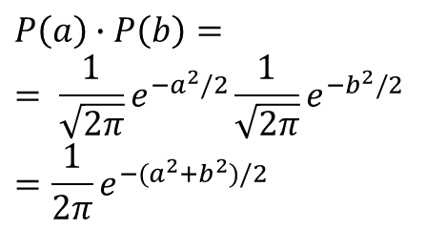
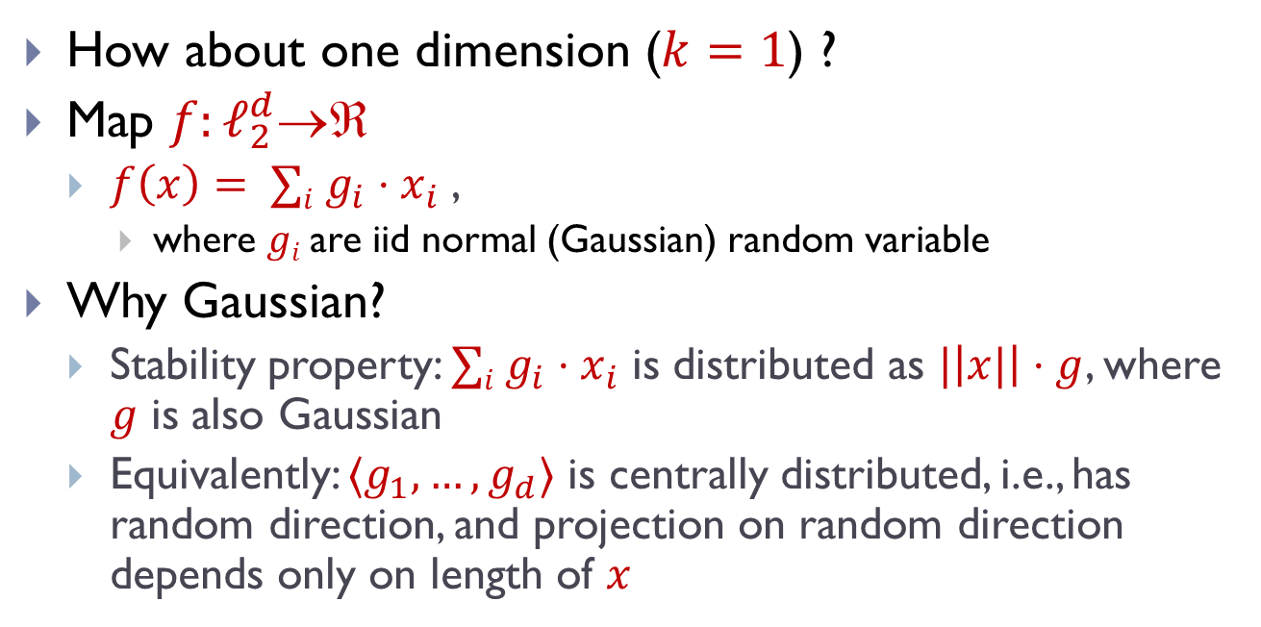
1D embedding
pdf = ${\frac{1}{\sqrt{2π}}e}^{−g^{2}/2}$
$$E[g]=0$$
$$E[g^{2}]=1$$
How about one dimension ($k=1$) ?
Map $f:ℓ_{2}^{d}$
  $f\left(x\right)= ∑i g_{i}⋅x_{i}$ ,
    where $gi$are iid normal (Gaussian) random variable
Why Gaussian?
  Stability property: $∑i g_{i}⋅x_{i}$ is distributed as $|\left|x|\right|⋅g$, where $g$ is also Gaussian
  Equivalently: $〈g_{1},…,g_{d}〉$ is centrally distributed, i.e., has random direction, and projection on random direction depends only on length of $x$
$$P\left(a\right)∙P\left(b\right)=$$
$$= \frac{1}{\sqrt{2π}}e^{−a^{2}/2}\frac{1}{\sqrt{2π}}e^{−b^{2}/2}$$
$$=\frac{1}{2π}e^{−{(a}^{2}+b^{2})/2}$$

Slide 10
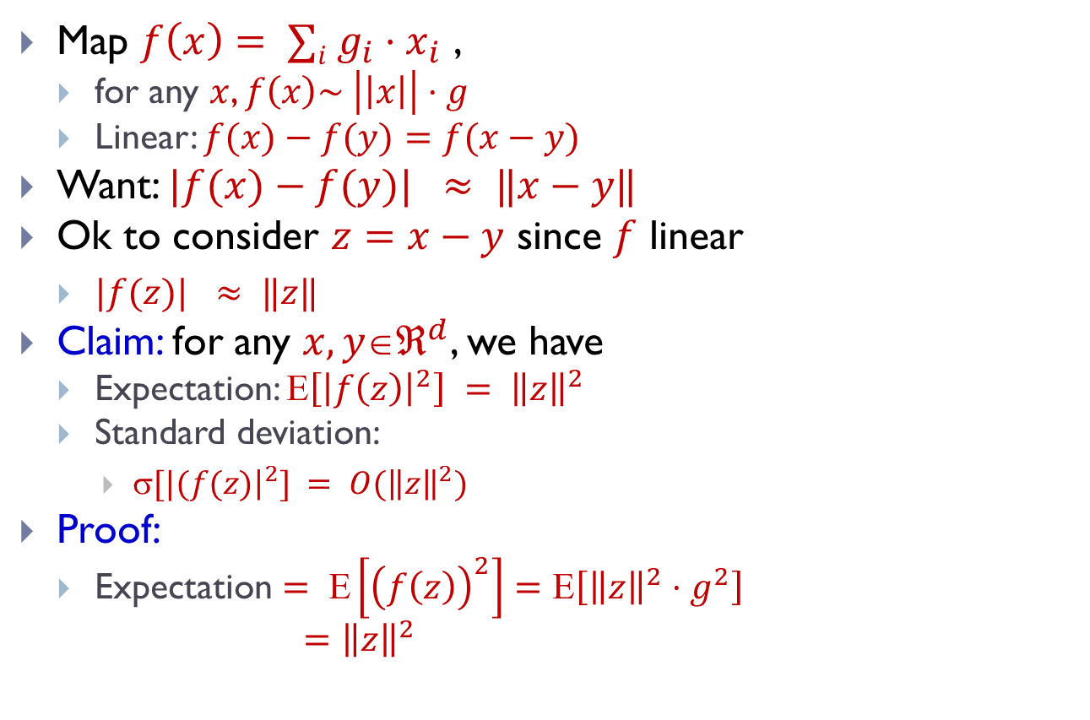
1D embedding
pdf = ${\frac{1}{\sqrt{2π}}e}^{−g^{2}/2}$
$$E[g]=0$$
$$E[g^{2}]=1$$
Map $f\left(x\right)= ∑i g_{i}⋅x_{i}$ ,
  for any $x$, $f\left(x\right)\sim \left|\left|x\right|\right|⋅g$
  Linear: $f(x)−f(y)=f(x−y)$
Want: $|f(x)−f(y)| ≈ ‖x−y‖$
Ok to consider $z=x−y$ since $f$ linear
  $|f(z)| ≈ ‖z‖$
Claim: for any $x,yℜ^{d}$, we have
  Expectation: $\left[{\left|f\left(z\right)\right|}^{2}\right] = {\left\|z\right\|}^{2}$
  Standard deviation:
    $[|(f(z){\left.​\right|}^{2}] = O({\left\|z\right\|}^{2})$
Proof:
  Expectation $= Ε\left[{\left(f\left(z\right)\right)}^{2}\right]=Ε\left[{\left\|z\right\|}^{2}⋅g^{2}\right]$
  $={\left\|z\right\|}^{2}$
2
2

Slide 11
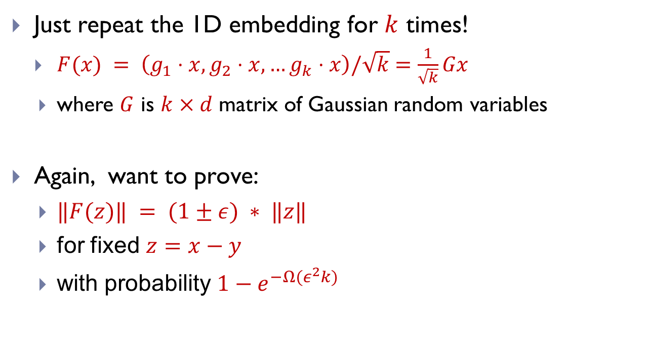
Full Dimension Reduction
  Just repeat the 1D embedding for $k$ times!
    $F(x) = \left(g_{1}⋅x, g_{2}⋅x,…g_{k}⋅x\right)/\sqrt{k}$ $=\frac{1}{\sqrt{k}}Gx$
    where $G$ is $k×d$ matrix of Gaussian random variables
  Again, want to prove:
    $‖F(z)‖ = (1±ε) ∗ ‖z‖$
    for fixed $z=x−y$
    with probability $1−e^{−Ω(ε^{2}k)}$

Slide 12
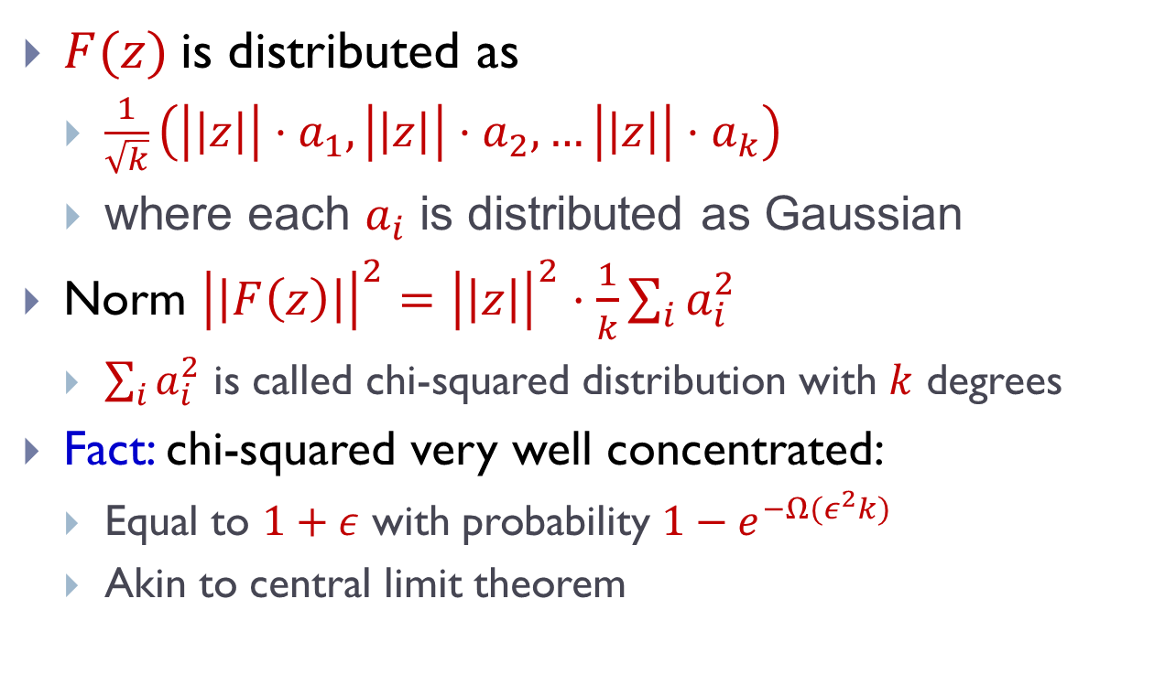
Concentration
$F(z)$is distributed as
  $\frac{1}{\sqrt{k}}\left(\left|\left|z\right|\right|{⋅a}_{1}, \left|\left|z\right|\right|⋅a_{2}, …\left|\left|z\right|\right|⋅a_{k}\right)$
  where each $a_{i}$ is distributed as Gaussian
Norm ${\left|\left|F\left(z\right)\right|\right|}^{2}={\left|\left|z\right|\right|}^{2}⋅\frac{1}{k}\sum_{i}{a_{i}^{2}}$
  $\sum_{i}{a_{i}^{2}}$ is called chi-squared distribution with $k$ degrees
Fact: chi-squared very well concentrated:
  Equal to $1+ε$ with probability ${1−e}^{−Ω(ε^{2}k)}$
  Akin to central limit theorem

Slide 13
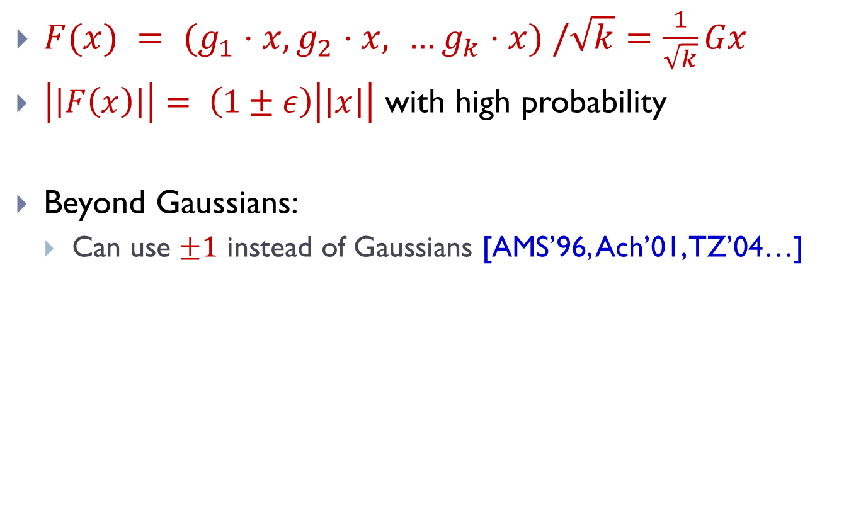
Johnson Lindenstrauss: wrap-up
$F(x) = (g_{1}⋅x, g_{2}⋅x, …g_{k}⋅x) /\sqrt{k}$ $=\frac{1}{\sqrt{k}}Gx$
$\left|\left|F\left(x\right)\right|\right|= \left(1±ε\right)\left|\left|x\right|\right|$ with high probability
Beyond Gaussians:
  Can use $±1$ instead of Gaussians [AMS’96, Ach’01, TZ’04…]

Slide 14
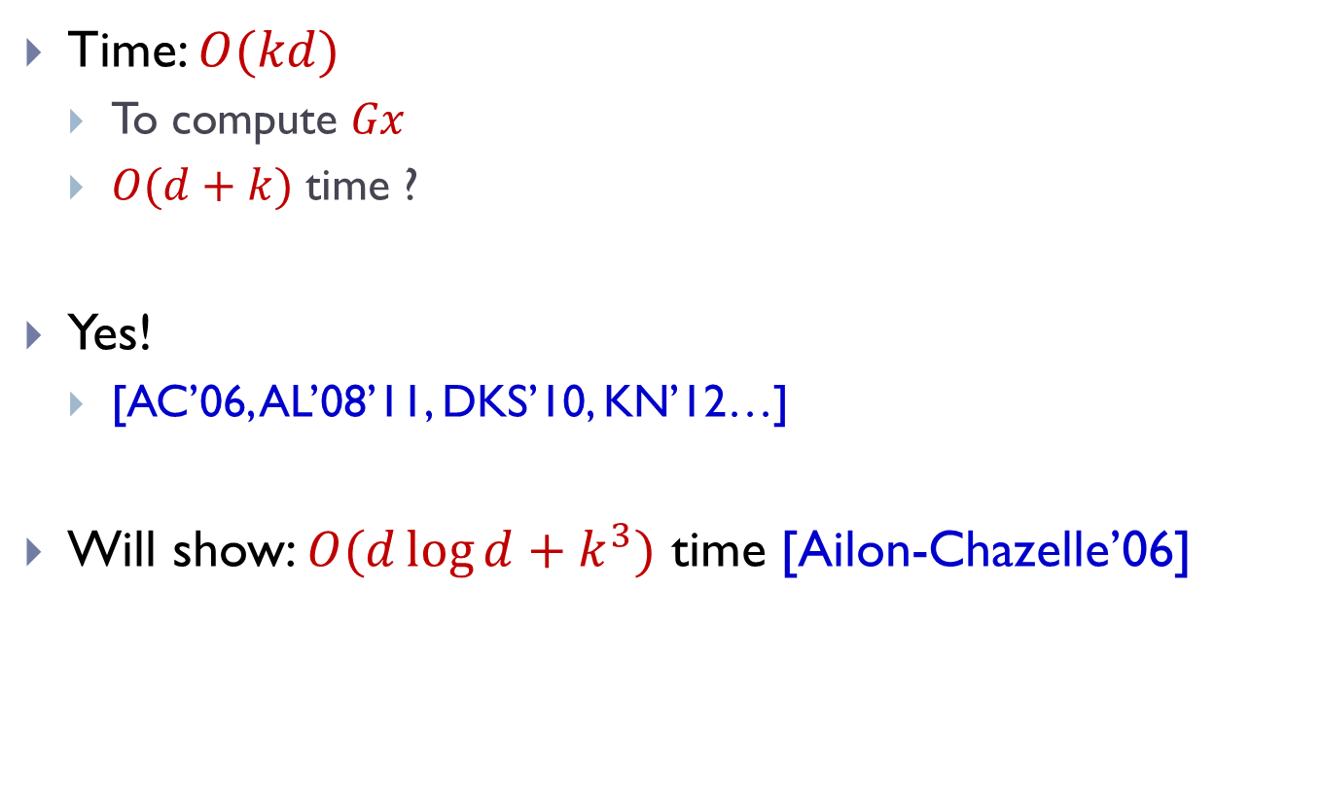
Faster JL ?
Time: $O(kd)$
  To compute $Gx$
  $O(d+k)$ time ?
Yes!
  [AC’06, AL’08’11, DKS’10, KN’12…]
Will show: $O(d\log{d}+k^{3})$ time [Ailon-Chazelle’06]

Slide 15


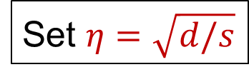

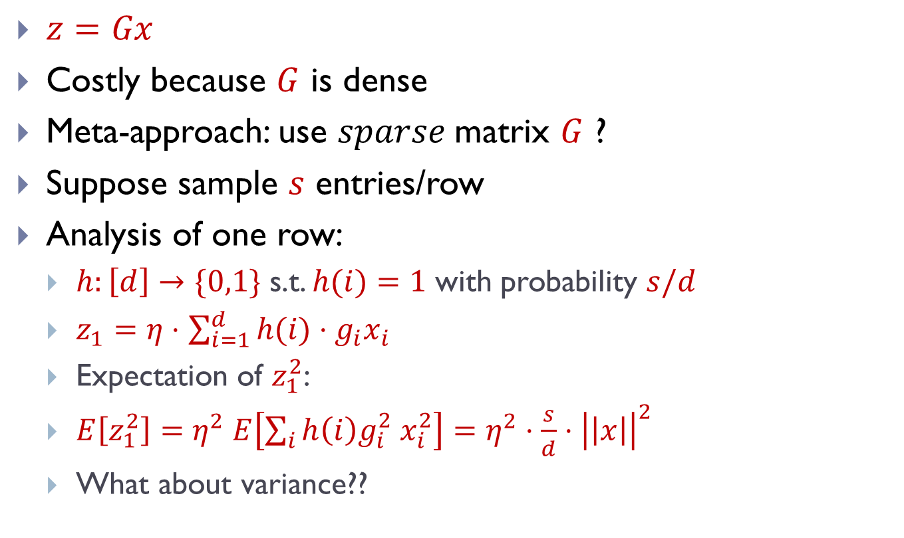



Fast JL Transform
$$d$$
$$G$$
$z=Gx$
Costly because $G$ is dense
Meta-approach: use $sparse$matrix $G$ ?
Suppose sample $s$ entries/row
Analysis of one row:
  $h:\left[d\right]→\{0,1\}$ s.t. $h(i)=1$ with probability $s/d$
  $z_{1}=η⋅$ $\sum_{i=1}^{d}{h(i)}⋅g_{i}x_{i}$
  Expectation of $z_{1}^{2}$:
  $E\left[z_{1}^{2}\right]=η^{2} E\left[\sum_{i}{h\left(i\right)g_{i}^{2} x_{i}^{2}}\right]=η^{2}⋅\frac{s}{d}⋅{\left|\left|x\right|\right|}^{2}$
  What about variance??
$$G$$
$$x$$
$$k$$
Set $η=\sqrt{d/s}$
normalization constant

Slide 16
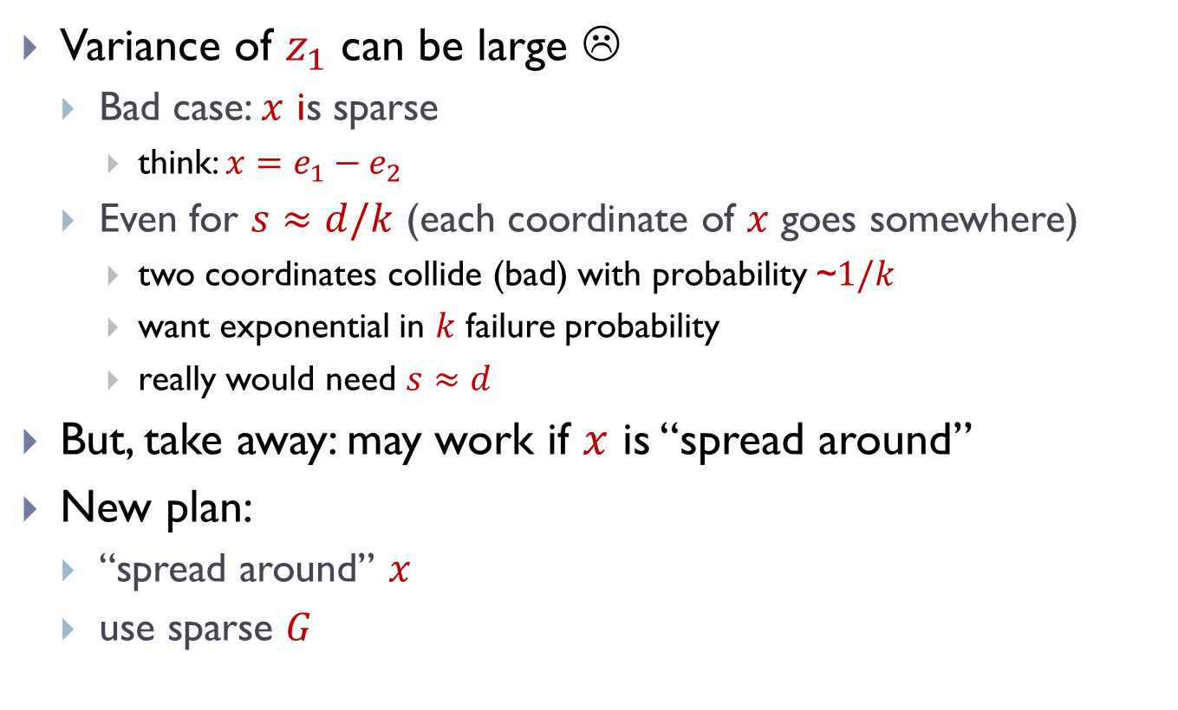
Fast JLT: sparse projection
$$d$$
Variance of $z_{1}$ can be large ☹
  Bad case: $x$ is sparse
    think: $x=e_{1}−e_{2}$
  Even for $s≈d/k$ (each coordinate of $x$ goes somewhere)
    two coordinates collide (bad) with probability ~$1/k$
    want exponential in $k$ failure probability
    really would need $s≈d$
But, take away: may work if $x$ is “spread around”
New plan:
  “spread around” $x$
  use sparse $G$
$$G$$
$$x$$
$$k$$

Slide 17
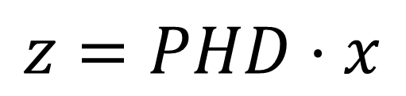

FJLT: full
$$z=PHD⋅x$$
$D$ = matrix with $±1$ r.v. on diagonal
$H$= Hadamard matrix:
  $Hx$ can be computed in time $O(d⋅log d)$
  $H$composed of $±\frac{1}{\sqrt{d}}$ only
$P$ = sparse matrix as before, size $k^{′}×d$, with $k^{′}≈k^{2}$
“spreading around”
Projection:
sparse matrix
Hadamard
(Fast Fourier Transform)
Diagonal

Slide 18
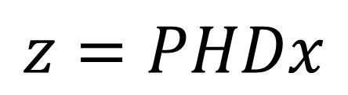

Spreading around: intuition
$$z=PHDx$$
$y=HDx$
Idea for Hadamard/Fourier Transform:
  “Uncertainty principle”: if the original $x$ is sparse, then the transform is dense!
  Though can “break” $x$’s that are already dense
“spreading around”
Projection:
sparse matrix
Hadamard
(Fast Fourier Transform)
Diagonal

Slide 19
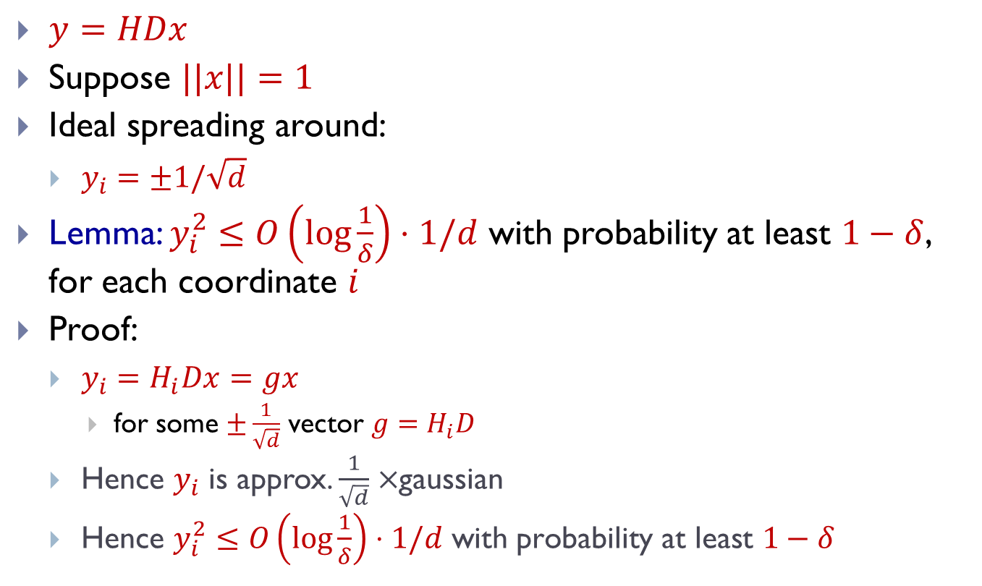
Spreading around: proof
$y=HDx$
Suppose $||x||=1$
Ideal spreading around:
  $y_{i}=±1/\sqrt{d}$
Lemma: $y_{i}^{2}≤O\left(\log{\frac{1}{δ}}\right)⋅1/d$ with probability at least $1−δ$, for each coordinate $i$
Proof:
  $y_{i}=H_{i}Dx=gx$
    for some $±\frac{1}{\sqrt{d}}$ vector $g=H_{i}D$
  Hence $y_{i}$ is approx. $\frac{1}{\sqrt{d}}×$gaussian
  Hence $y_{i}^{2}≤O\left(\log{\frac{1}{δ}}\right)⋅1/d \text{with} \text{probability} \text{at} \text{least} 1−δ$

Slide 20
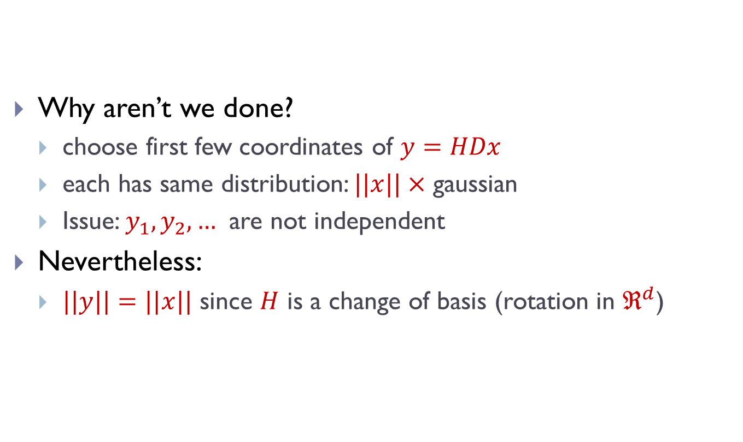

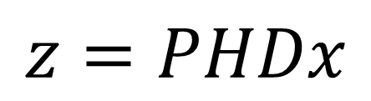
Why projection $P$?
$$z=PHDx$$
Why aren’t we done?
  choose first few coordinates of $y=HDx$
  each has same distribution: $||x||×$ gaussian
  Issue: $y_{1}, y_{2},…$ are not independent
Nevertheless:
  $||y||=||x||$ since $H$ is a change of basis (rotation in $ℜ^{d}$)

Slide 21
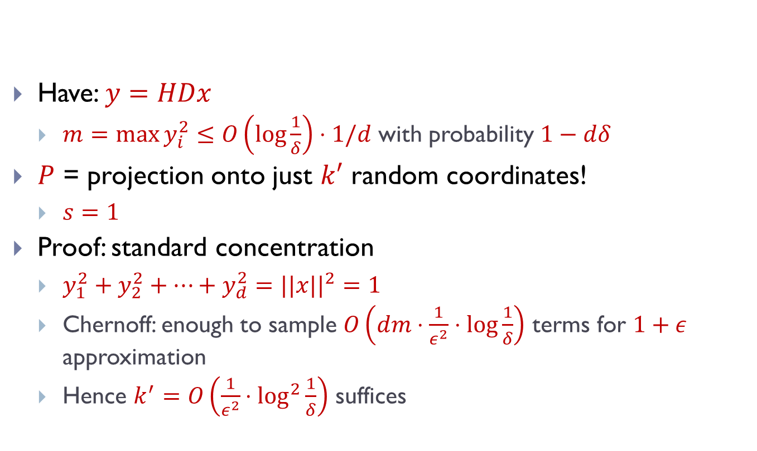

Projection $P$
$$z=PHDx$$
Have: $y=HDx$
  $m=\max{y_{i}^{2}}≤O\left(\log{\frac{1}{δ}}\right)⋅1/d$ with probability $1−dδ$
$P$ = projection onto just $k′$ random coordinates!
  $s=1$
Proof: standard concentration
  $y_{1}^{2}+y_{2}^{2}+…+y_{d}^{2}=||x||^{2}=1$
  Chernoff: enough to sample $O\left(dm⋅\frac{1}{ε^{2}}⋅log\frac{1}{δ}\right)$ terms for $1+ε$ approximation
  Hence $k^{′}=O\left(\frac{1}{ε^{2}}⋅\log^{2}{\frac{1}{δ}}\right)$ suffices

Slide 22
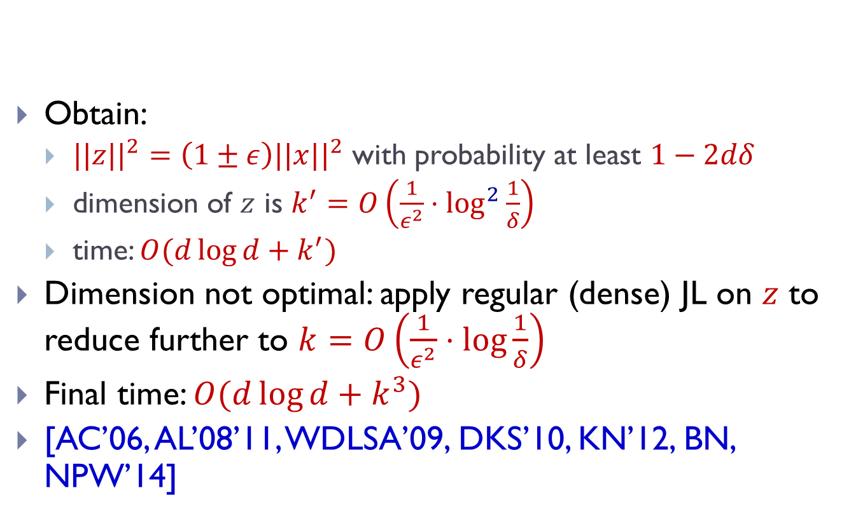
FJLT: wrap-up
$$z=PHDx$$
Obtain:
  $||z||^{2}=\left(1±ε\right)||x||^{2}$ with probability at least $1−2dδ$
  dimension of $z$ is $k^{′}=O\left(\frac{1}{ε^{2}}⋅\log^{2}{\frac{1}{δ}}\right)$
  time: $O(d\log{d}+k^{′})$
Dimension not optimal: apply regular (dense) JL on $z$ to reduce further to $k=O\left(\frac{1}{ε^{2}}⋅log\frac{1}{δ}\right)$
Final time: $O(d\log{d}+k^{3})$
[AC’06, AL’08’11, WDLSA’09, DKS’10, KN’12, BN, NPW’14]

Slide 23
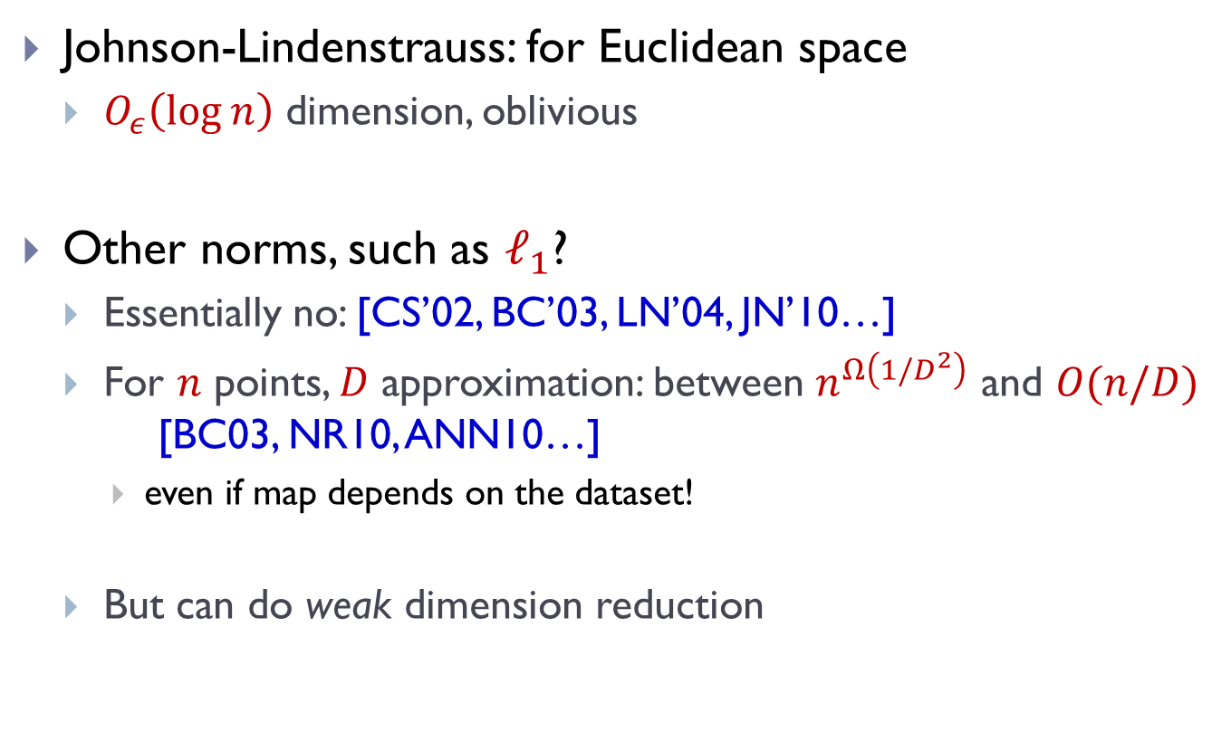
Dimension Reduction: beyond Euclidean
Johnson-Lindenstrauss: for Euclidean space
  $O_{ε}\left(\log{n}\right)$ dimension, oblivious
Other norms, such as $ℓ_{1}$?
  Essentially no: [CS’02, BC’03, LN’04, JN’10…]
  For $n$ points, $D$ approximation: between $n^{Ω\left(1/D^{2}\right)}$ and $O(n/D)$ [BC03, NR10, ANN10…]
    even if map depends on the dataset!
  But can do weak dimension reduction

Slide 24
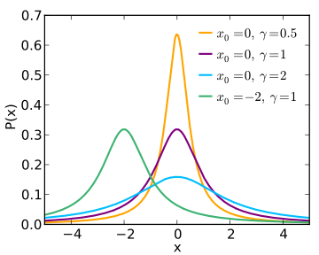
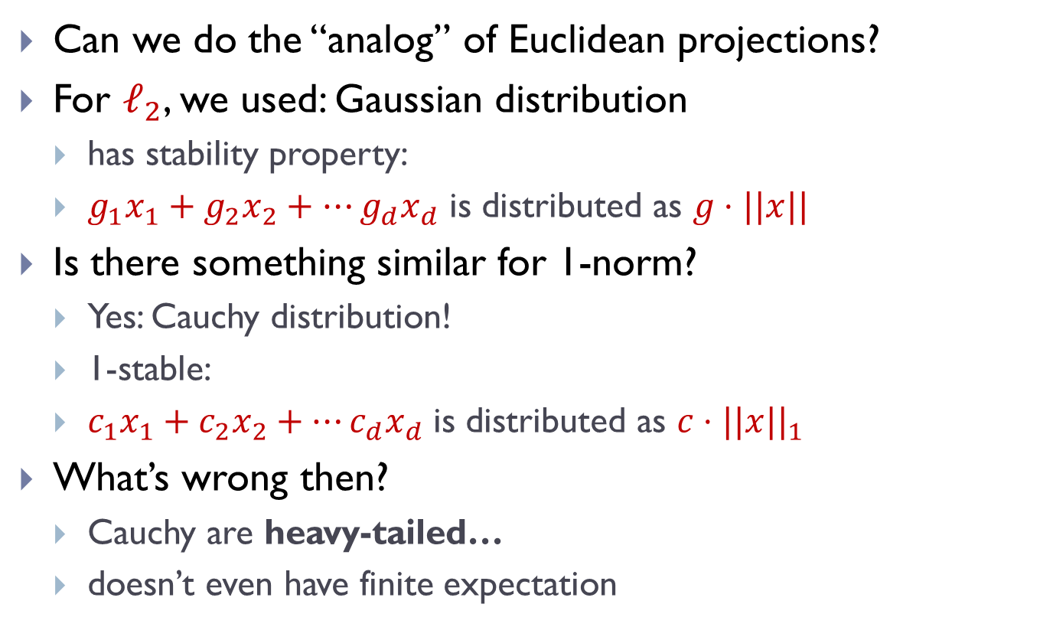
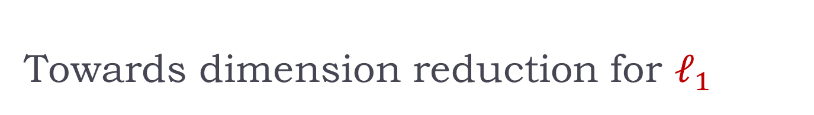
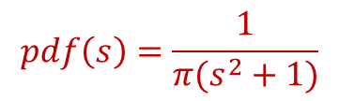
Towards dimension reduction for $ℓ_{1}$
Can we do the “analog” of Euclidean projections?
For $ℓ_{2}$, we used: Gaussian distribution
  has stability property:
  $g_{1}x_{1}+g_{2}x_{2}+…g_{d}x_{d}$ is distributed as $g⋅||x||$
Is there something similar for 1-norm?
  Yes: Cauchy distribution!
  1-stable:
  $c_{1}x_{1}+c_{2}x_{2}+…c_{d}x_{d}$ is distributed as $c⋅||x||_{1}$
What’s wrong then?
  Cauchy are heavy-tailed…
  doesn’t even have finite expectation
$$pdf\left(s\right)=\frac{1}{π(s^{2}+1)}$$

Slide 25
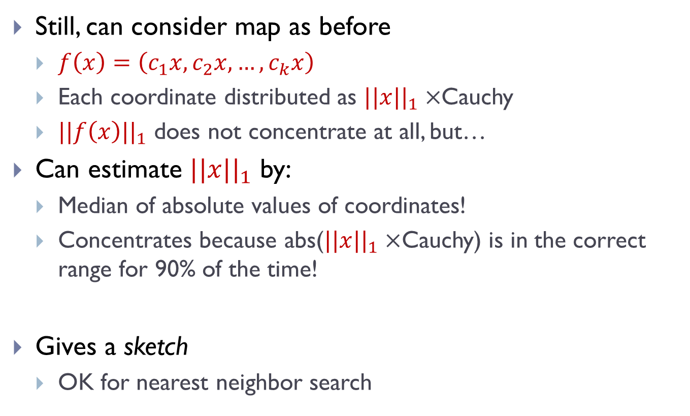
Weak embedding [Indyk’00]
Still, can consider map as before
  $f\left(x\right)=\left(c_{1}x, c_{2}x, …,c_{k}x\right)$
  Each coordinate distributed as $||x||_{1}×$Cauchy
  $||f\left(x\right)||_{1}$ does not concentrate at all, but…
Can estimate $||x||_{1}$ by:
  Median of absolute values of coordinates!
  Concentrates because abs($||x||_{1}×$Cauchy) is in the correct range for 90% of the time!
Gives a sketch
  OK for nearest neighbor search

