Slide 1
Algorithmic High-Dimensional Geometry 2
Alex Andoni
(Microsoft Research SVC)

Slide 2
The NNS prism
High dimensional
geometry
NNS
dimension reduction
space partitions
small dimension
embedding
sketching
…

Slide 3
Small Dimension

Slide 4
What if $d$ is small?
Can solve $1+ε$ approximate NNS with
$O(nd)$ space
${\left(\frac{O(d)}{ε}\right)}^{d}\log{n}$ query time
[AMNSW’98,…]
OK, if say $d=5$ !
Usually, $d$is not small…

Slide 5
What if $d$ is small?
“effectively”
Eg:
$k$-dimensional subspace of $ℜ^{d}$, with $k≪d$
Obviously, extract subspace and solve NNS there!
Not a robust definition…
More robust definitions:
KR-dimension [KR’02]
Doubling dimension [Assouad’83, Cla’99, GKL’03, KL’04]
Smooth manifold [BW’06, Cla’08]
other [CNBYM’01, FK97, IN’07, Cla’06…]

Slide 6
Doubling dimension
Definition: pointset $S$ has doubling dimension $λ$ if:
for any point $p∈S$, radius $r$, consider ball $B(p,r)$ of points within distance $r$ of $p$
can cover $B(p,r)$ by $2^{λ}$ balls $B\left(y_{1},r/2\right), B\left(y_{2},r/2\right)$, …
Sanity check:
$k$-dimensional subspace has $λ=O(k)$
n points always have dimension at most $O(\log{n})$
Can be defined for any metric space!
$2^{O(k)}$ balls to cover
$$r$$
$$p$$

Slide 7
NNS for small doubling dimension
Euclidean space [Indyk-Naor’07]
JL into dimension $k=O(λ)$ “works” !
Contraction of any pair happens with very small probability
Expansion of some pair happens with constant probability
Good enough for NNS!
Arbitrary metric
Navigating nets/cover trees [Krauthgamer-Lee’04, Har-Peled-Mendel’05, Beygelzimer-Kakade-Langford’06,…]
Algorithm:
A data-dependent tree: recursive space partition using balls $B\left(p,r\right)$
At query $q$, follow all paths that intersect with the ball $B(q,r)$

Slide 8
Embeddings

Slide 9
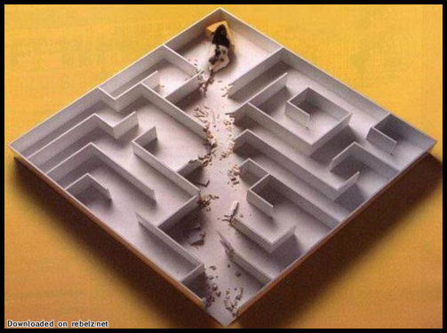
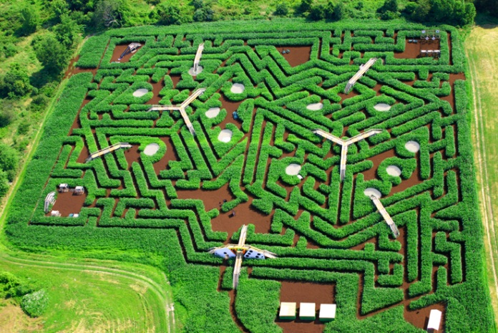
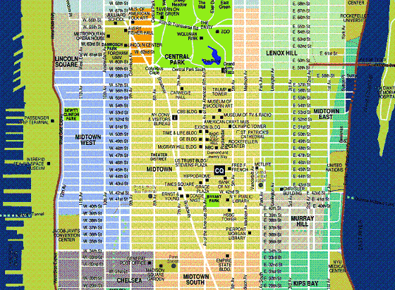
General Theory: embeddings
General motivation: given distance (metric) $M$, solve a computational problem $P$ under $M$
Hamming distance
Compute distance between two points
Euclidean distance (ℓ₂)
Nearest Neighbor Search
Edit distance between two strings
Diameter/Close-pair of set S
Earth-Mover (transportation) Distance
Clustering, MST, etc
$$f$$
Reduce problem
<$P$under hard metric>
to
<$P$under simpler metric>

Slide 10
Embeddings: landscape
Definition: an embedding is a map $f:MH$ of a metric $(M, d_{M})$ into a host metric $(H, ρ_{H})$ such that for any $x,yM$:
$d_{M}\left(x,y\right)≤ρ_{H}\left(f\left(x\right), f\left(y\right)\right)≤D⋅ d_{M}(x,y)$
where $D$ is the distortion (approximation) of the embedding $f$.
Embeddings come in all shapes and colors:
Source/host spaces $M, H$
Distortion $D$
Can be randomized: $H(f(x), f(y)) ≈ dM(x,y)$ with $1−$ probability
Time to compute $f(x)$
Types of embeddings:
From norm to the same norm but of lower dimension (dimension reduction)
From one norm ($ℓ_{2}$) into another norm ($ℓ_{1}$)
From non-norms (edit distance, Earth-Mover Distance) into a norm ($ℓ1$)
From given finite metric (shortest path on a planar graph) into a norm ($ℓ1$)
$H$ not a metric but a computational procedure $←$ sketches

Slide 11
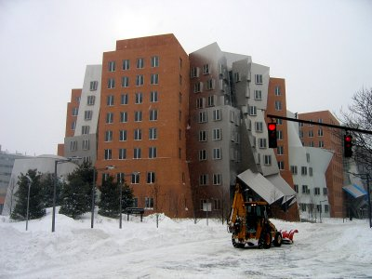
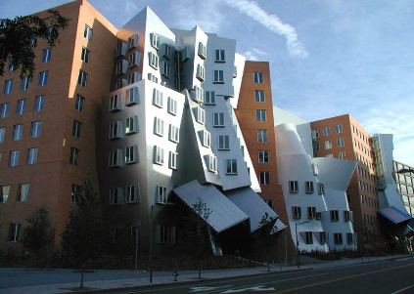
Earth-Mover Distance
Definition:
Given two sets $A, B$of points in a metric space
$EMD(A,B)$= min cost bipartite matching between $A$and $B$
Which metric space?
Can be plane, $ℓ_{2}, ℓ_{1}$…
Applications in image vision
Images courtesy of Kristen Grauman

Slide 12
Embedding EMD into $ℓ_{1}$
At least as hard as $ℓ_{1}$
Theorem [Cha02, IT03]: Can embed EMD over ${\left[Δ\right]}^{2}$ into $ℓ_{1}$ with distortion $O\left(\log{Δ}\right)$. Time to embed a set of $s$ points: $O\left(s\log{Δ}\right)$.
Consequences:
Nearest Neighbor Search: $O(c\log{Δ} )$ approximation with $O(sn^{1+1/c})$space, and $O(n^{1/c}⋅s\log{Δ})$ query time.
Computation: $O(log⁡Δ)$ approximation in $O\left(s\log{Δ}\right)$ time
Best known: $1+ε$approximation in $\tilde{O}\left(s\right)$ time [SA’12]
The higher-dimensional variant is still fastest via embedding [AIK’08]

Slide 13
High level embedding
Sets of size $s$in $\left[1…Δ\right]×[1…Δ]$box
Embedding of set $A$:
take a quad-tree
randomly shift it
Each cell gives a coordinate:
$f (A)c$=#points in the cell $c$
Need to prove
$$E\left[{\left|\left|f\left(A\right)−f\left(B\right)\right|\right|}_{1}\right]≈EMD(A,B)$$
0
0
0
0
0
2
1
1
1
2
2
2
0
1
2
0
0
1
0
0
$f\left(A\right)=$…2210…
0002…0011…0100…0000…
$f\left(B\right)=$…1202…
0100…0011…0000…1100…

Slide 14
Main Approach
Idea: decompose EMD over [Δ]² into EMDs over smaller grids
Recursively reduce to Δ=O(1)
≈
+

Slide 15
EMD over small grid
Suppose Δ=3
f(A) has nine coordinates, counting # points in each joint
f(A)=(2,1,1,0,0,0,1,0,0)
f(B)=(1,1,0,0,2,0,0,0,1)
Gives O(1) distortion

Slide 16
Decomposition Lemma [I07]
For randomly-shifted cut-grid G of side length k, we have:
EEMD_{Δ}(A,B) ≤ EEMD_{k}(A₁, B₁) + EEMD_{k}(A₂,B₂)+…
+ k*EEMD_{Δ/k}(A_{G}, B_{G})
EEMD_{Δ}(A,B) ≥ $\frac{1}{3}$Ε[ EEMD_{k}(A₁, B₁) + EEMD_{k}(A₂,B₂)+… ]
EEMD_{Δ}(A,B) ≥ Ε[ k*EEMD_{Δ/k}(A_{G}, B_{G}) ]
The distortion will
follow by applying the lemma
recursively to (A_{G},B_{G})
lower bound
on cost
upper
bound
k
Δ/k

Slide 17
Part 1: lower bound
For a randomly-shifted cut-grid G of side length k, we have:
EEMD_{Δ}(A,B) ≤ EEMD_{k}(A₁, B₁) + EEMD_{k}(A₂,B₂)+…
+ k*EEMD_{Δ/k}(A_{G}, B_{G})
Extract a matching π from the matchings on right-hand side
For each a∈A, with a∈A_{i}, it is either:
matched in EEMD(A_{i},B_{i}) to some b∈B_{i}
or a∈A_{i}\B_{i}, and it is matched
in EEMD(A_{G},B_{G}) to some b∈B_{j}
Match cost in 2nd case:
Move a to center (Δ)
paid by EEMD(A_{i},B_{i})
Move from cell i to cell j
paid by EEMD(A_{G},B_{G})
k
Δ/k

Slide 18
Parts 2 & 3: upper bound
For a randomly-shifted cut-grid G of side length k, we have:
EEMD_{Δ}(A,B) ≥ $\frac{1}{3}$Ε[ EEMD_{k}(A₁, B₁) + EEMD_{k}(A₂,B₂)+… ]
EEMD_{Δ}(A,B) ≥ Ε[ k*EEMD_{Δ/k}(A_{G}, B_{G}) ]
Fix a matching π minimizing EEMD_{Δ}(A,B)
Will construct matchings for each EEMD on RHS
Uncut pairs (a,b) are matched in respective (A_{i},B_{i})
Cut pairs (a,b) are matched
in (A_{G},B_{G})
and remain unmatched in their
mini-grids

Slide 19
Part 2: Cost?
EEMD_{Δ}(A,B) ≥ $\frac{1}{3}$Ε[ ∑_{i} EEMD_{k}(A_{i}, B_{i})]
Uncut pairs (a,b) are matched in respective (A_{i},B_{i})
Contribute a total ≤ EEMD _{Δ}(A,B)
Consider a cut pair (a,b) at distance $a−b=(d_{x},d_{y})$
Contribute ≤ 2k to ∑_{i} EEMD_{k}(A_{i}, B_{i})
Pr[(a,b) cut] = $1−(1−d_{x}/k)(1−d_{y}/k) ≤{\left|\left|a−b\right|\right|}_{1}/k$
Expected contribution ≤ Pr[(a,b) cut] $⋅2k≤ 2||a−b||1$
In total, contribute $2⋅$EEMD _{Δ}(A,B)
k
d_{x}

Slide 20
Wrap-up of EMD Embedding
In the end, obtain that
EMD(A,B) $≈$ sum of EMDs of smaller grids in expectation
Repeat $O(\log{Δ})$ times to get to $1×1$ grid
$O(\log{Δ})$ approximation it total!

Slide 21
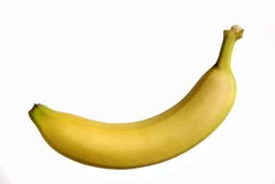
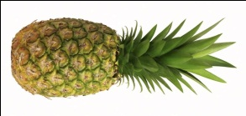
Embeddings of various metrics into $ℓ_{1}$
edit( banana ,
ananas ) = 2
Metric | Upper bound
Earth-mover distance ($s$-sized sets in 2D plane) | $$O\left(\log{s}\right)$$ [Cha02, IT03]
Earth-mover distance ($s$-sized sets in ${\left\{0,1\right\}}^{d}$) | $$O(\log{s}⋅\log{d})$$ [AIK08]
Edit distance over ${\left\{0,1\right\}}^{d}$ (#indels to transform x->y) | $$2^{\tilde{O}\left(\sqrt{\log{d}}\right)}$$ [OR05]
Ulam (edit distance between permutations) | $$O\left(\log{d}\right)$$ [CK06]
Block edit distance | $$\tilde{O}\left(\log{d}\right)$$ [MS00, CM07]
edit(1234567,
7123456) = 2

Slide 22
Non-embeddability into $ℓ_{1}$
Metric | Upper bound
Earth-mover distance ($s$-sized sets in 2D plane) | $$O\left(\log{s}\right)$$ [Cha02, IT03]
Earth-mover distance ($s$-sized sets in ${\left\{0,1\right\}}^{d}$) | $$O(\log{s}⋅\log{d})$$ [AIK08]
Edit distance over ${\left\{0,1\right\}}^{d}$ (#indels to transform x->y) | $$2^{\tilde{O}\left(\sqrt{\log{d}}\right)}$$ [OR05]
Ulam (edit distance between permutations) | $$O\left(\log{d}\right)$$ [CK06]
Block edit distance | $$\tilde{O}\left(\log{d}\right)$$ [MS00, CM07]
Lower bounds
$$Ω\left(\sqrt{\log{s}}\right)$$ [NS07]
$$Ω\left(\log{s}\right)$$ [KN05]
$$Ω\left(\log{d}\right)$$ [KN05,KR06]
$$\tilde{Ω}\left(\log{d}\right)$$ [AK07]
4/3 [Cor03]

Slide 23
Non-embeddability proofs
Via Poincaré-type inequalities…
[Enflo’69]: embedding ${\left\{0,1\right\}}^{d}$ into $ℓ_{2}$ (any dimension) must incur $Ω\left(\sqrt{d}\right)$ distortion
Proof [Khot-Naor’05]
Suppose $f$ is the embedding of ${\left\{0,1\right\}}^{d}$ into $ℓ_{2}$
Two distributions over pairs of points $x,y∈{\left\{0,1\right\}}^{d}$:
C: $x=y+e_{i}$ for random $y$ and index $i$
F: $x,y$ are random
Two steps:
$E_{C}\left[{\left|\left|x−y\right|\right|}_{1}\right]≤O\left(1/d\right)⋅E_{F}\left[{\left|\left|x−y\right|\right|}_{1}\right]$
$E_{C}\left[{\left|\left|f\left(x\right)−f\left(y\right)\right|\right|}_{2}^{2}\right]≥Ω\left(1/d\right)⋅E_{F}\left[{\left|\left|f\left(x\right)−f\left(y\right)\right|\right|}_{2}^{2}\right]$ (short diagonals)
Implies $Ω\left(\sqrt{d}\right)$ lower bound!

Slide 24
Other good host spaces?
What is “good”:
is algorithmically tractable
is rich (can embed into it)
$$ℓ_{2}, ℓ_{1}$$
sq-$ℓ2$
,etc
???
sq-ℓ₂=real space with distance: ||x-y||₂²
Metric | Lower bound into $ℓ_{1}$
Edit distance over ${\left\{0,1\right\}}^{d}$ | $$Ω\left(\log{d}\right)$$ [KN05, KR06]
Ulam (edit distance between permutations) | $$Ω\left(\log{d}\right)$$ [AK07]
Earth-mover distance ($s$-sized sets in ${\left\{0,1\right\}}^{d}$) | $$Ω\left(\log{s}\right)$$ [KN05]
sq-ℓ₂, hosts with very good LSH (lower bounds via communication complexity)
̃
[AK’07]
[AK’07]
[AIK’08]

Slide 25
The $ℓ_{∞}$ story
[Mat96]: Can embed any metric on $n$ points into $ℓ_{∞}^{n}$
Theorem [I’98]: NNS for $ℓ_{∞}^{d}$ with
$O_{δ}\left(\log{\log{d}}\right)$ approximation
$n^{1+δ}$ space, $δ>0$
$O(d\log{n})$ query time
Dimension $n$ is an issue though…
Smaller dimension?
Possible for some: Hausdorff,… [FCI99]
But, not possible even for $\{0,1\}^{d}$ [JL01]

Slide 26
Other good host spaces?
What is “good”:
algorithmically tractable
rich (can embed into it)
But: combination sometimes works!
$$ℓ_{2}, ℓ_{1}$$
sq-$ℓ2$
$$ℓ_{∞}^{low}$$
$$ℓ_{∞}^{n}$$
,etc

Slide 27
Meet our new host
α
d₁
[A-Indyk-Krauthgamer’09]
d₁
…
d₁
…
β
…
Iterated product space
$${\text{sq}\text{−ℓ}}_{2}^{γ}\left({\text{ℓ}}_{∞}^{β}\left({\text{ℓ}}_{1}^{α}\right)\right)$$
d_{∞,1}
d_{22,∞,1}
d_{∞,1}
d_{∞,1}
γ
$$x=\left(x_{1},…,x_{α}\right)∈R^{α}$$
$$d_{1}\left(x,y\right)=\sum_{i=1}^{α}{|x_{i}−y_{i}|}$$
$$x=\left(x_{1},…,x_{β}\right)∈{\text{ℓ}}_{1}^{α}×{\text{ℓ}}_{1}^{α}×…{\text{ℓ}}_{1}^{α}$$
$$d_{∞,1}\left(x,y\right)=\max_{i=1..β} d_{1}(x_{i},y_{i})$$
$$x=\left(x_{1},…,x_{γ}\right)∈{\text{ℓ}}_{∞}^{β}\left({\text{ℓ}}_{1}^{α}\right)×…×{\text{ℓ}}_{∞}^{β}\left({\text{ℓ}}_{1}^{α}\right)$$
$$d_{22,∞,1}\left(x,y\right)=\sum_{i=1}^{γ}{{\left(d_{∞,1}(x_{i},y_{i})\right)}^{2}}$$

Slide 28
Why ${\text{sq}\text{−ℓ}}_{2}^{γ}\left(ℓ_{∞}^{β}\left(ℓ_{1}^{α}\right)\right)$ ?
[Indyk’02, A-Indyk-Krauthgamer’09]
edit distance between permutations
ED(1234567,
7123456) = 2
Because we can…
Embedding: …embed Ulam into ${\text{sq}\text{−}ℓ}_{2}^{γ}\left(ℓ_{∞}^{β}\left(ℓ_{1}^{α}\right)\right)$ with constant distortion
dimensions = length of the string
NNS: Any t-iterated product space has NNS on n points with
${\left(\log{\log{n}}\right)}^{O\left(t\right)}$ approximation
near-linear space and sublinear time
Corollary: NNS for Ulam with $O{\left(\log{\log{n}}\right)}^{2}$ approx.
Better than via each $ℓ_{p}$ component separately!
Rich
Algorithmically
tractable

Slide 29
Sketching

Slide 30
Computational view
x
y
$${\left\{0,1\right\}}^{k}$$
$${\left\{0,1\right\}}^{k}×{\left\{0,1\right\}}^{k}→ℜ$$
$F:Mℜ^{k}$
Arbitrary computation $C:kxk_{+}$
Cons:
No/little structure (e.g., $(F,C)$ not metric)
Pros:
More expressability:
may achieve better distortion (approximation)
smaller “dimension” $k$
Sketch $F$ : “functional compression scheme”
for estimating distances
almost all lossy ($1+$ distortion or more) and randomized
F
F(x)
F(y)
$$d_{M}(x,y)≈\sqrt{\sum_{i=1}^{k}{{(F_{i}(x)−F_{i}(y))}^{2}}}$$
$$C(F\left(x\right), F\left(y\right))$$

Slide 31
Why?
1) Beyond embeddings:
can more do if “embed” into computational space
2) A waypoint to get embeddings:
computational perspective can give actual embeddings
3) Connection to informational/computational notions
communication complexity

Slide 32
Beyond Embeddings:
“Dimension reduction” in $ℓ_{1}$ !
Lemma [I00]: exists linear $F:ℓ_{1}ℜ^{k}$, and $C$
where $k=O(ε^{−2}⋅log⁡n)$
achieves: for any $x,yℓ_{1}$, with probability $1−1/n^{2}$:
$C\left(F\left(x\right), F\left(y\right)\right)= \left(1±ε\right)⋅ {\left\|x−y\right\|}_{1}$
$F\left(x\right)= \left(s_{1}⋅x, s_{2}⋅x, … s_{k}⋅x\right)/k=1/k⋅Sx$
Where $s_{i}=(s_{i1},s_{i2},…s_{id})$ with each $sij$ distributed from Cauchy distribution ($1$-stable distribution)
$C(F(x),F(y))=median(|F_{1}(x)−F_{1}(y)|,$
$|F_{2}(x)−F_{2}(y)|,$
$$…$$
$|F_{k}(x)−F_{k}(y)| )$
While $|s⋅x|$ does not have expectation, it has median!
$$pdf\left(s\right)=\frac{1}{π(s^{2}+1)}$$

Slide 33
Waypoint to get embeddings
Embedding of Ulam metric into ${\text{sq}\text{−}\text{ℓ}}_{2}^{γ}\left({\text{ℓ}}_{∞}^{β}\left({\text{ℓ}}_{1}^{α}\right)\right)$ was obtained via “geometrization” of an algorithm/characterization:
sublinear (local) algorithms: property testing & streaming [EKKRV98, ACCL04, GJKK07, GG07, EJ08]
sum of squares (sq-ℓ₂)
edit(X,Y)
max (ℓ∞)
sum (ℓ₁)
X
Y

Slide 34
Ulam: algorithmic characterization
[Ailon-Chazelle-Commandur-Lu’04, Gopalan-Jayram-
Krauthgamer-Kumar’07, A-Indyk-Krauthgamer’09]
E.g., a=5; K=4
Lemma: Ulam(x,y) approximately equals the number of “faulty” characters a satisfying:
there exists K≥1 (prefix-length) s.t.
the set of K characters preceding a in x differs much from
the set of K characters preceding a in y
X[5;4]
x=
123456789
y=
123467895
Y[5;4]

Slide 35
Connection to communication complexity
Enter the world of Alice and Bob…
Communication complexity model:
Two-party protocol
Shared randomness
Promise (gap) version
c = approximation ratio
CC = min. # bits to decide (for 90% success)
shared randomness
…
$$x$$
CC bits
$$y$$
sketch($x$)
Sketching model:
Referee decides based on sketch(x), sketch(y)
SK = min. sketch size to decide
Fact: SK ≥ CC
sketch($y$)
Referee
decide whether:
$d(x,y)  R$ or $d\left(x,y\right)>cR$

Slide 36
Communication Complexity
VERY rich theory [Yao’79, KN’97,…]
Some notable examples:
$ℓ_{1},ℓ_{2}$ are sketchable with $O\left(\frac{1}{ε^{2}}\right)$ bits! [AMS’96,KOR’98]
hence also everything than embeds into it!
$Ω\left(\frac{1}{ε^{2}}\right)$ is tight [IW’03,W’04, BJKS’08,CR’12]
$ℓ_{∞}^{d}$ requires $Ω(d/c^{2})$ bits [BJKS’02]
Coresets: sketches of sets of points for geometric problems [AHV04…]
Connection to NNS:
[KOR’98]: if sketch size is $s$, then NNS with $n^{O(s)}$ space and one memory lookup!
From the perspective of NNS lower bounds, communication complexity closer to ground truth
Question: do non-embeddability result say something about non-sketchability?
also Poincaré-type inequalities… [AK07,AJP’10]
Connections to streaming: see Graham Cormode’s lecture

Slide 37
High dimensional
geometry
???

Slide 38
Closest Pair
Problem: n points in d-dimensional Hamming space, which are random except a planted pair at distance ½-ε
Solution 1: build NNS and query $n$ times
LSH-type algo would give ~$dn^{2−Θ(ε)}$ [PRR89,IM98,D08]
Theorem [Valiant’12]: $O(dn^{1.8}/poly())$time
p₁
p₁⊗
p₁⊗+p₂⊗
p₂
p₂⊗
= M
Find max entry of
MM^{t}
using subcubic
MM algorithms
p_{n}
p_{n}⊗

Slide 39
What I didn’t talk about:
Too many things to mention
Includes embedding of fixed finite metric into simpler/more-structured spaces like $ℓ_{1}$
Tiny sample among them:
[LLR94]: introduced metric embeddings to TCS. E.g. showed can use [Bou85] to solve sparsest cut problem with $O(log⁡n)$approximation
[Bou85]: Arbitrary metric on $n$points into $ℓ_{1}$, with $O(log⁡n)$distortion
[Rao99]: embedding planar graphs into $ℓ_{1}$, with $O(\sqrt{\log{n}})$ distortion
[ARV04,ALN05]: sparsest cut problem with $\tilde{O}(\sqrt{\log{n}})$ approximation
[KMS98,…]: space partition for rounding SDPs for coloring
Lots others…
A list of open questions in embedding theory
Edited by Jiří Matoušek + Assaf Naor:
http://kam.mff.cuni.cz/~matousek/metrop.ps

Slide 40
High dimensional geometry via NNS prism
High dimensional
geometry
NNS
dimension reduction
space partitions
small dimension
embedding
sketching
+++

