Slide 1
Algorithmic High-Dimensional Geometry 1
Alex Andoni
(Microsoft Research SVC)

Slide 2
Prism of nearest neighbor search (NNS)
High dimensional
geometry
NNS
dimension reduction
space partitions
embeddings
…
???

Slide 3
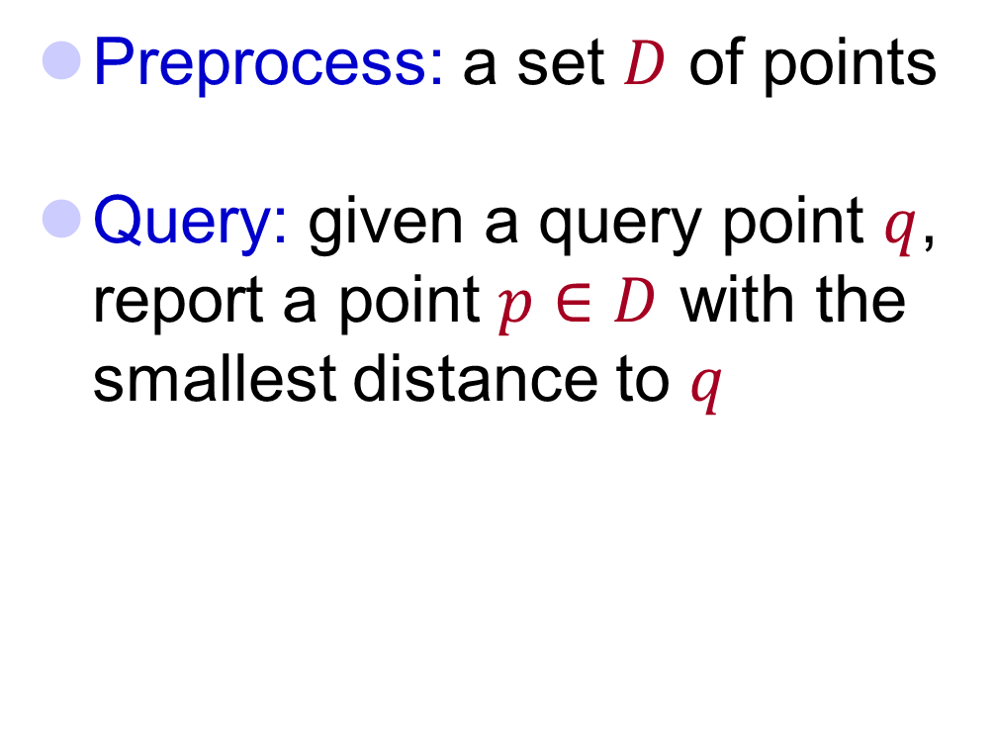


Nearest Neighbor Search (NNS)
Preprocess: a set $D$ of points
Query: given a query point $q$, report a point $p∈D$ with the smallest distance to $q$
$$p$$
$$q$$

Slide 4
Motivation
Generic setup:
  Points model objects (e.g. images)
  Distance models (dis)similarity measure
Application areas:
  machine learning: k-NN rule
  speech/image/video/music recognition, vector quantization, bioinformatics, etc…
Distance can be:
  Hamming, Euclidean, edit distance, Earth-mover distance, etc…
Primitive for other problems:
  find the similar pairs in a set D, clustering…
000000
011100
010100
000100
010100
011111
000000
001100
000100
000100
110100
111111
$$p$$
$$q$$

Slide 5
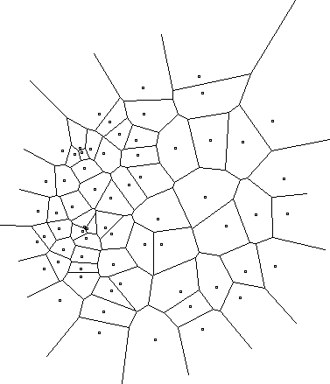
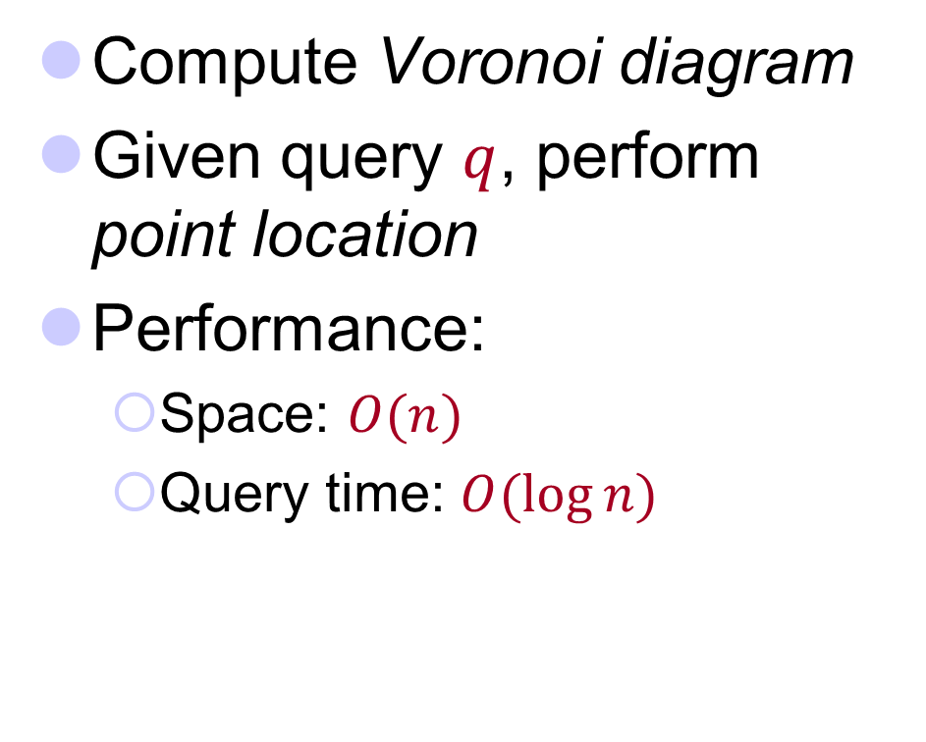
2D case
Compute Voronoi diagram
Given query $q$, perform point location
Performance:
  Space: $O(n)$
  Query time: $O(\log{n})$

Slide 6
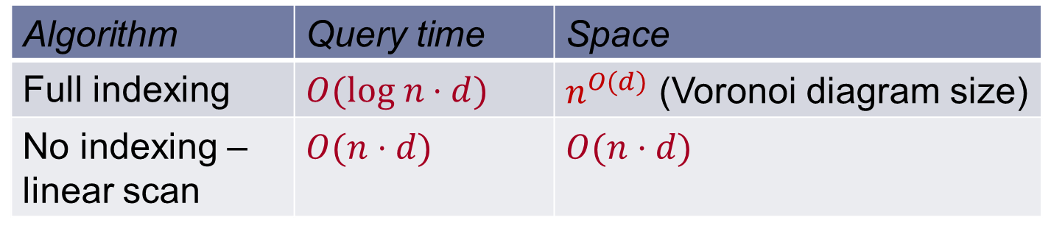

High-dimensional case
All exact algorithms degrade rapidly with the dimension $d$
Algorithm | Query time | Space
Full indexing | $$O(log n⋅d)$$ | $n^{O(d)}$ (Voronoi diagram size)
No indexing – linear scan | $$O(n⋅d)$$ | $$O(n⋅d)$$

Slide 7


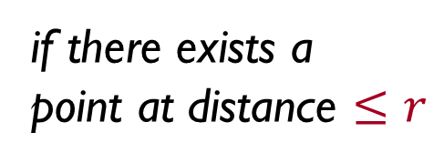

Approximate NNS
c-approximate
r-near neighbor: given a new point $q$, report a point $pD$ s.t. $\left\|p−q\right\|≤r$
Randomized: a point $p$ returned with 90% probability
$$cr$$
if there exists a
point at distance $≤r$
r
p
cr
q

Slide 8
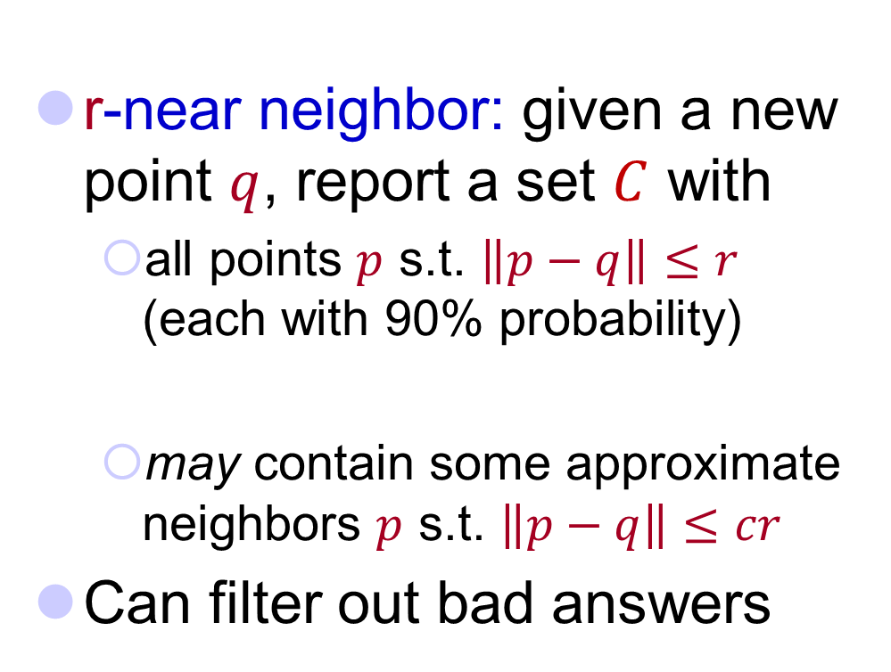
Heuristic for Exact NNS
c-approximate
r-near neighbor: given a new point $q$, report a set $C$ with
  all points $p$ s.t. $\left\|p−q\right\|≤r$ (each with 90% probability)
  may contain some approximate neighbors $p$ s.t. $\left\|p−q\right\|≤cr$
Can filter out bad answers
r
p
cr
q

Slide 9
Approximation Algorithms for NNS
A vast literature:
  milder dependence on dimension
    [Arya-Mount’93], [Clarkson’94], [Arya-Mount-Netanyahu-Silverman-We’98], [Kleinberg’97], [Har-Peled’02], [Chan’02]…
  little to no dependence on dimension
    [Indyk-Motwani’98], [Kushilevitz-Ostrovsky-Rabani’98], [Indyk’98, ‘01], [Gionis-Indyk-Motwani’99], [Charikar’02], [Datar-Immorlica-Indyk-Mirrokni’04], [Chakrabarti-Regev’04], [Panigrahy’06], [Ailon-Chazelle’06], [A-Indyk’06], …

Slide 10
Dimension Reduction

Slide 11
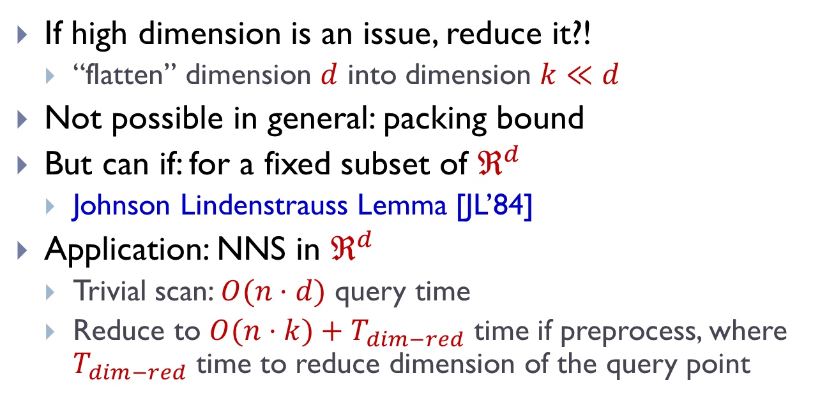
Motivation
If high dimension is an issue, reduce it?!
  “flatten” dimension $d$ into dimension $k≪d$
Not possible in general: packing bound
But can if: for a fixed subset of $ℜ^{d}$
  Johnson Lindenstrauss Lemma [JL’84]
Application: NNS in $ℜ^{d}$
  Trivial scan: $O(n⋅d)$ query time
  Reduce to $O(n⋅k)+T_{dim−red}$ time if preprocess, where $T_{dim−red}$ time to reduce dimension of the query point

Slide 12
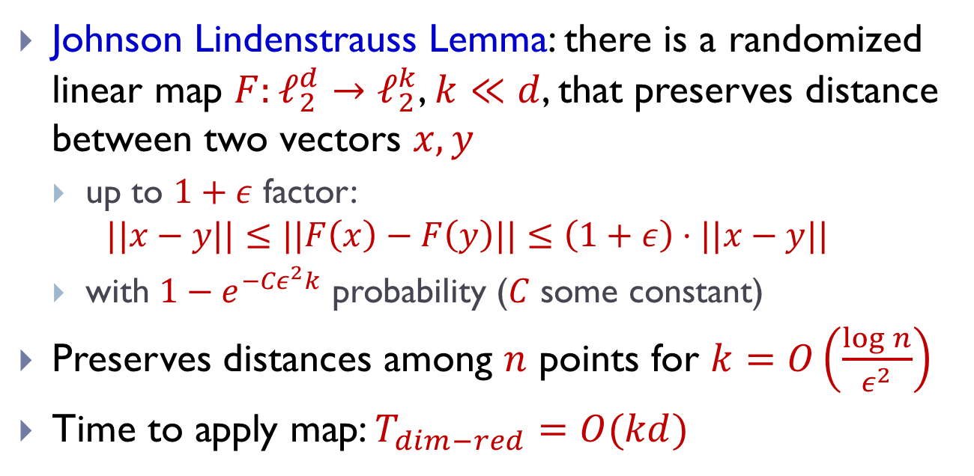
Dimension Reduction
Johnson Lindenstrauss Lemma: there is a randomized linear map $F:ℓ_{2}^{d}→ℓ_{2}^{k}$, $k≪d$, that preserves distance between two vectors $x,y$
  up to $1+ε$ factor:
  $$||x−y||≤||F\left(x\right)−F\left(y\right)||≤\left(1+ε\right)⋅||x−y||$$
  with $1−e^{{−Cε}^{2}k}$ probability ($C$ some constant)
Preserves distances among $n$ points for $k=O\left(\frac{\log{n}}{ε^{2}}\right)$
Time to apply map: $T_{dim−red}=O(kd)$

Slide 13

Idea:
Project onto a random subspace of dimension $k$!

Slide 14
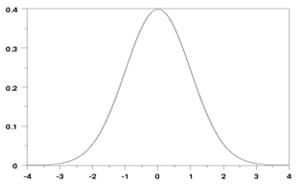
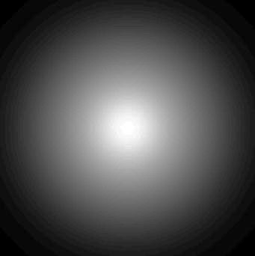

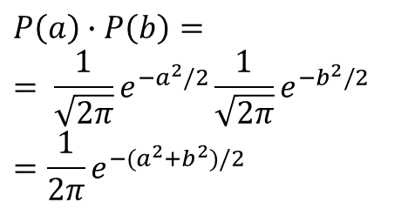
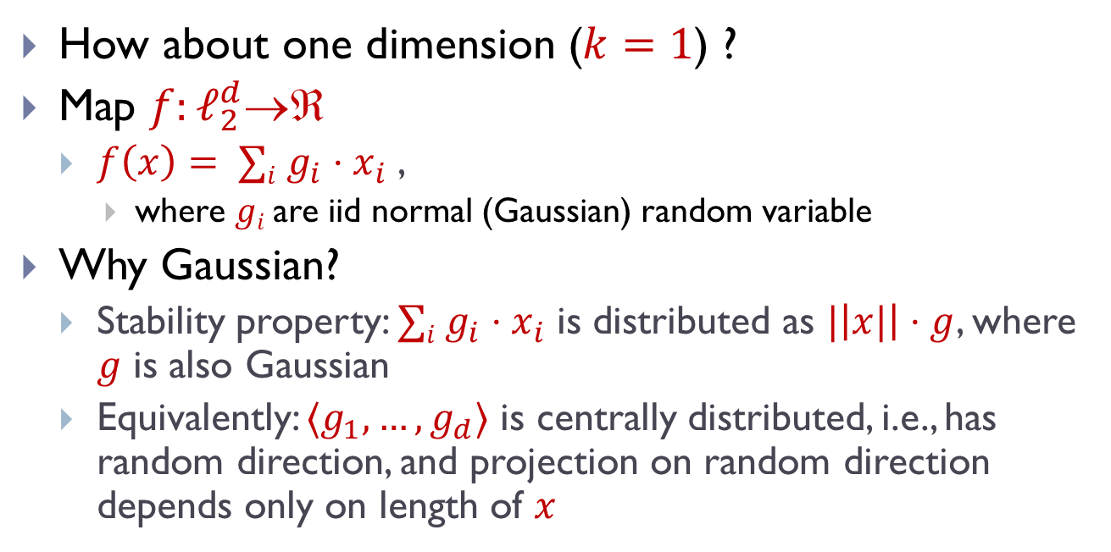
1D embedding
pdf = ${\frac{1}{\sqrt{2π}}e}^{−g^{2}/2}$
$$E[g]=0$$
$$E[g^{2}]=1$$
How about one dimension ($k=1$) ?
Map $f:ℓ_{2}^{d}$
  $f\left(x\right)= ∑i g_{i}⋅x_{i}$ ,
    where $gi$are iid normal (Gaussian) random variable
Why Gaussian?
  Stability property: $∑i g_{i}⋅x_{i}$ is distributed as $|\left|x|\right|⋅g$, where $g$ is also Gaussian
  Equivalently: $〈g_{1},…,g_{d}〉$ is centrally distributed, i.e., has random direction, and projection on random direction depends only on length of $x$
$$P\left(a\right)∙P\left(b\right)=$$
$$= \frac{1}{\sqrt{2π}}e^{−a^{2}/2}\frac{1}{\sqrt{2π}}e^{−b^{2}/2}$$
$$=\frac{1}{2π}e^{−{(a}^{2}+b^{2})/2}$$

Slide 15
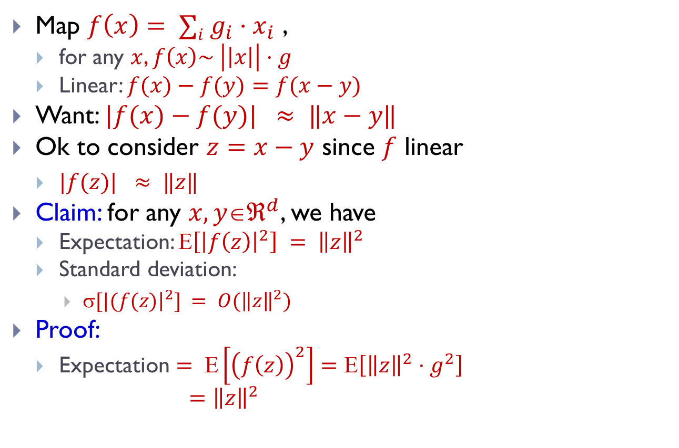
1D embedding
pdf = ${\frac{1}{\sqrt{2π}}e}^{−g^{2}/2}$
$$E[g]=0$$
$$E[g^{2}]=1$$
Map $f\left(x\right)= ∑i g_{i}⋅x_{i}$ ,
  for any $x$, $f\left(x\right)\sim \left|\left|x\right|\right|⋅g$
  Linear: $f(x)−f(y)=f(x−y)$
Want: $|f(x)−f(y)| ≈ ‖x−y‖$
Ok to consider $z=x−y$ since $f$ linear
  $|f(z)| ≈ ‖z‖$
Claim: for any $x,yℜ^{d}$, we have
  Expectation: $\left[{\left|f\left(z\right)\right|}^{2}\right] = {\left\|z\right\|}^{2}$
  Standard deviation:
    $[|(f(z){\left.​\right|}^{2}] = O({\left\|z\right\|}^{2})$
Proof:
  Expectation $= Ε\left[{\left(f\left(z\right)\right)}^{2}\right]=Ε\left[{\left\|z\right\|}^{2}⋅g^{2}\right]$
  $={\left\|z\right\|}^{2}$
2
2

Slide 16
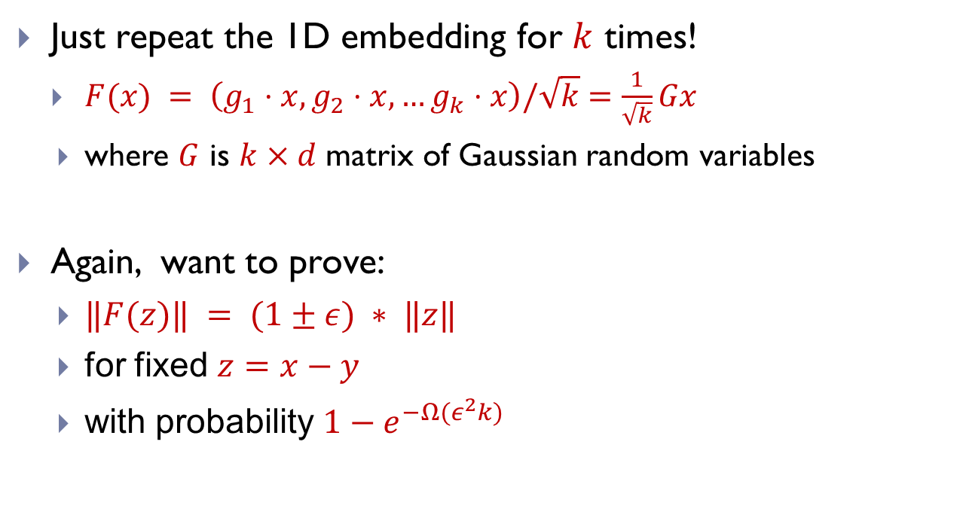
Full Dimension Reduction
  Just repeat the 1D embedding for $k$ times!
    $F(x) = \left(g_{1}⋅x, g_{2}⋅x,…g_{k}⋅x\right)/\sqrt{k}$ $=\frac{1}{\sqrt{k}}Gx$
    where $G$ is $k×d$ matrix of Gaussian random variables
  Again, want to prove:
    $‖F(z)‖ = (1±ε) ∗ ‖z‖$
    for fixed $z=x−y$
    with probability $1−e^{−Ω(ε^{2}k)}$

Slide 17
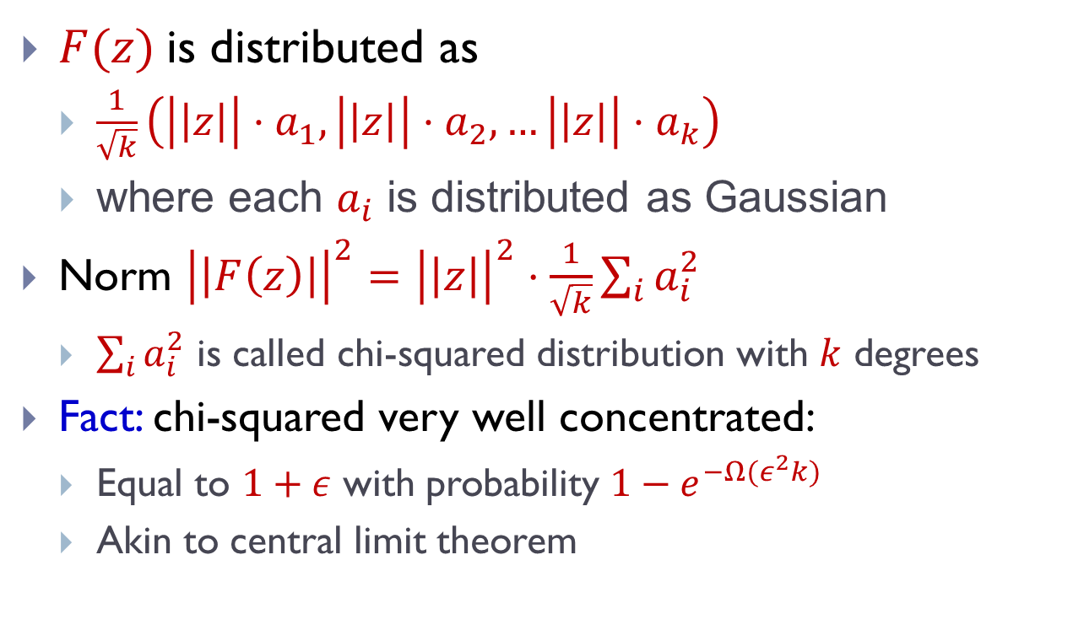
Concentration
$F(z)$is distributed as
  $\frac{1}{\sqrt{k}}\left(\left|\left|z\right|\right|{⋅a}_{1}, \left|\left|z\right|\right|⋅a_{2}, …\left|\left|z\right|\right|⋅a_{k}\right)$
  where each $a_{i}$ is distributed as Gaussian
Norm ${\left|\left|F\left(z\right)\right|\right|}^{2}={\left|\left|z\right|\right|}^{2}⋅\frac{1}{\sqrt{k}}\sum_{i}{a_{i}^{2}}$
  $\sum_{i}{a_{i}^{2}}$ is called chi-squared distribution with $k$ degrees
Fact: chi-squared very well concentrated:
  Equal to $1+ε$ with probability ${1−e}^{−Ω(ε^{2}k)}$
  Akin to central limit theorem

Slide 18
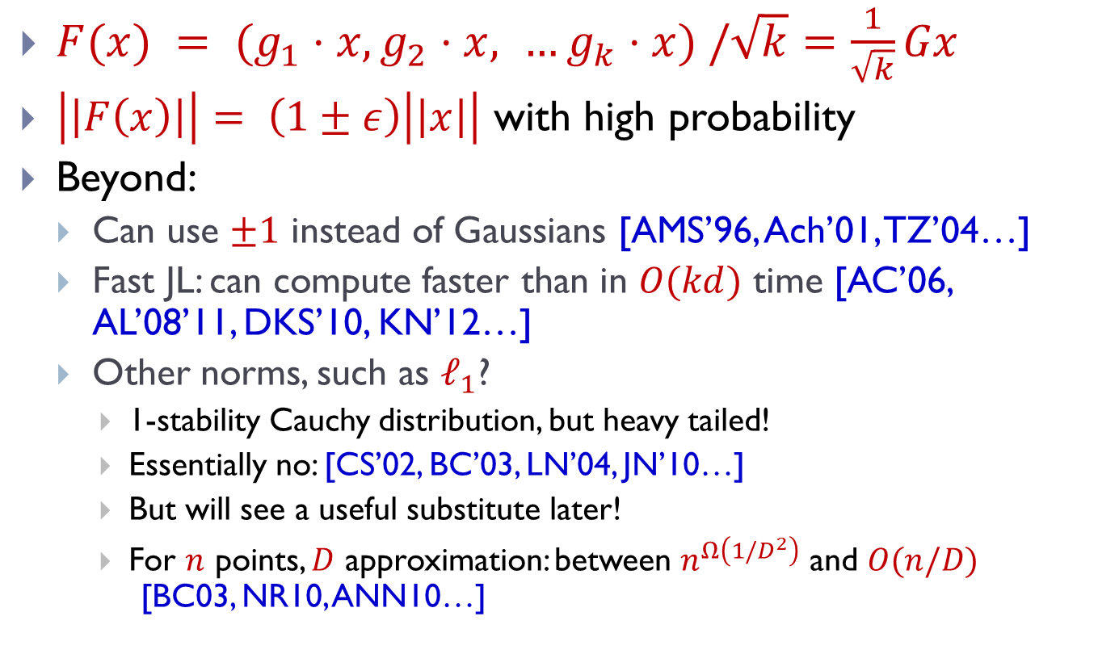
Dimension Reduction: wrap-up
$F(x) = (g_{1}⋅x, g_{2}⋅x, …g_{k}⋅x) /\sqrt{k}$ $=\frac{1}{\sqrt{k}}Gx$
$\left|\left|F\left(x\right)\right|\right|= \left(1±ε\right)\left|\left|x\right|\right|$ with high probability
Beyond:
  Can use $±1$ instead of Gaussians [AMS’96, Ach’01, TZ’04…]
  Fast JL: can compute faster than in $O(kd)$ time [AC’06, AL’08’11, DKS’10, KN’12…]
  Other norms, such as $ℓ_{1}$?
    1-stability Cauchy distribution, but heavy tailed!
    Essentially no: [CS’02, BC’03, LN’04, JN’10…]
    But will see a useful substitute later!
    For $n$ points, $D$ approximation: between $n^{Ω\left(1/D^{2}\right)}$ and $O(n/D)$ [BC03, NR10, ANN10…]

Slide 19
Space Partitions

Slide 20




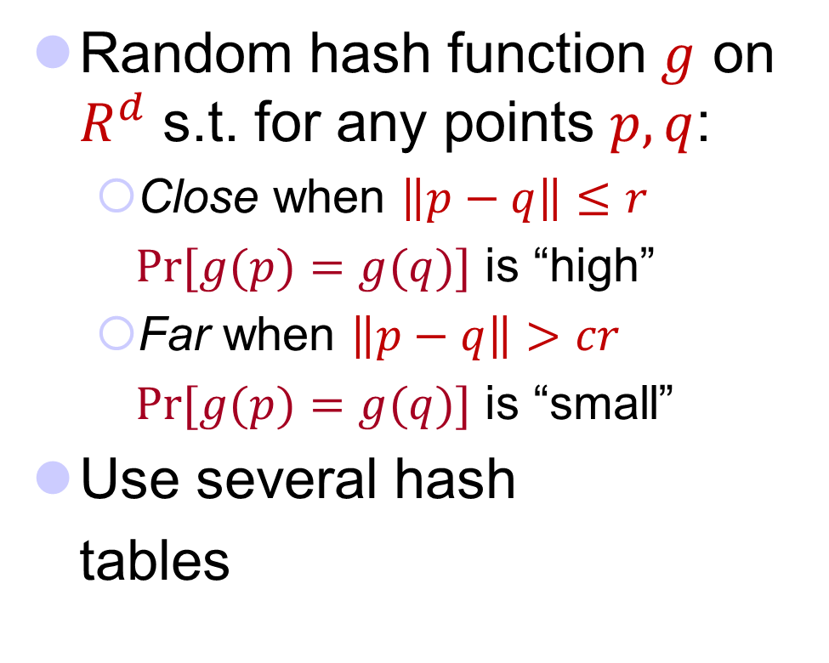






Locality-Sensitive Hashing
[Indyk-Motwani’98]
q
Random hash function $g$ on $R^{d}$ s.t. for any points $p,q$:
  Close when $\left\|p−q\right\|≤r$
  $Pr⁡[g(p)=g(q)]$ is “high”
  Far when $\left\|p−q\right\|>cr$
  $Pr⁡[g(p)=g(q)]$ is “small”
Use several hash
tables
p
q
$$P1=$$
“not-so-small”
$$P2=$$
: $nρ$, where
$$Pr⁡[g(p)=g(q)]$$
1
$$P_{1}=P_{2}^{ρ}$$
$$P1$$
$$P2$$
$$dist(p,q)$$
$$r$$
$$cr$$

Slide 21



NNS for Euclidean space
[Datar-Immorlica-Indyk-Mirrokni’04]
Hash function $g$ is usually a concatenation of “primitive” functions:
  $g\left(p\right)=\left\langle h_{1}(p),h_{2}(p),…,h_{k}(p)\right\rangle$
LSH function $h(p)$:
  pick a random line $ℓ$, and quantize
  project point into $ℓ$
  $h\left(p\right)=\left\lfloor \frac{p⋅ℓ}{w}+b\right\rfloor$
    $ℓ$ is a random Gaussian vector
    $b$ random in $[0,1]$
    $w$ is a parameter (e.g., 4)
$ρ=1/c$
$$ℓ$$
$$p$$

Slide 22

Putting it all together
Data structure is just $L=n^{ρ}$ hash tables:
  Each hash table uses a fresh random function $g\left(p\right)=\left\langle h_{1}(p),…,h_{k}(p)\right\rangle$
  Hash all dataset points into the table
Query:
  Check for collisions in each
  of the hash tables
Performance:
  $O\left(nL\right)=O(n^{1+1/c})$ space
  $O\left(L\right)=O(n^{1/c})$ query time
Notes:
Draw L hash tables

Slide 23

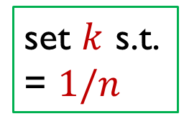








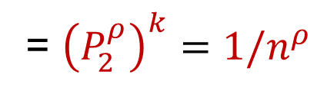
Analysis of LSH Scheme
Choice of parameters $k,L$ ?
  $L$ hash tables with $g\left(p\right)=\left\langle h_{1}(p),…,h_{k}(p)\right\rangle$
Pr[collision of far pair] = $P_{2}^{k}$
Pr[collision of close pair] = $P_{1}^{k}$
Hence $L=O(n^{ρ})$ “repetitions” (tables) suffice!
set $k$ s.t.
= $1/n$
= ${\left(P_{2}^{ρ}\right)}^{k}={1/n}^{ρ}$
$$P_{1}$$
$$P_{1}^{2}$$
$$P_{2}$$
$$k=1$$
$$P_{2}^{2}$$
$$k=2$$
$$r$$
$$cr$$

Slide 24
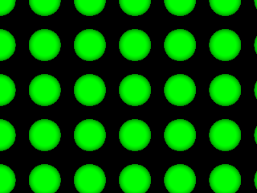
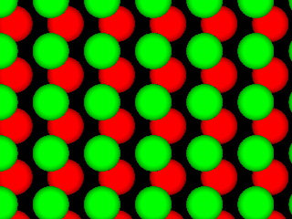
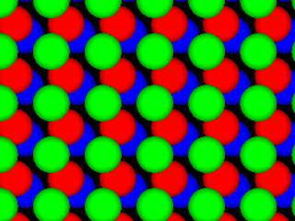
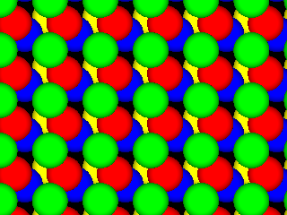
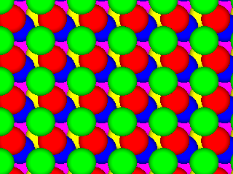
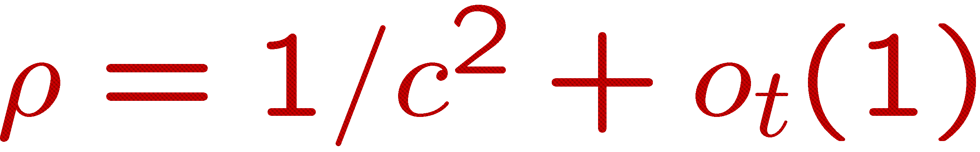
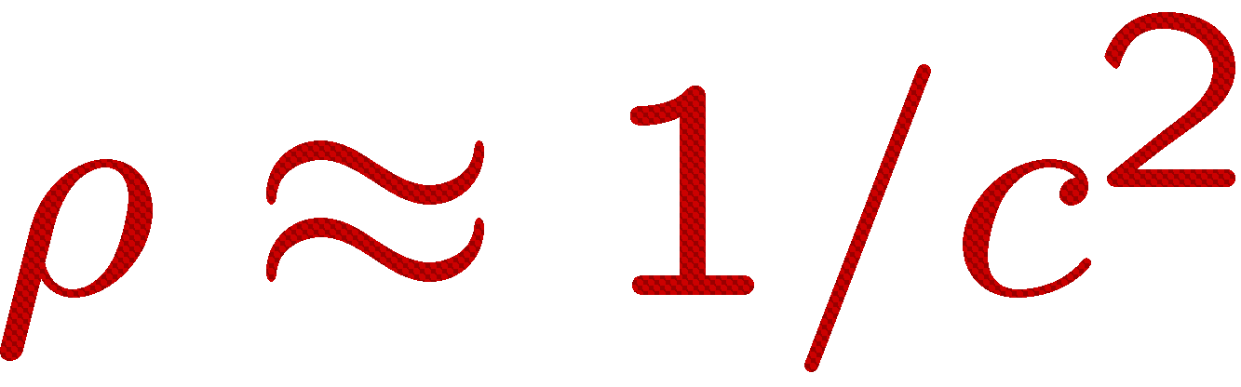
Better LSH ?
[A-Indyk’06]
Regular grid → grid of balls
  p can hit empty space, so take more such grids until p is in a ball
Need (too) many grids of balls
  Start by projecting in dimension t
Analysis gives
Choice of reduced dimension t?
  Tradeoff between
    # hash tables, n^{ρ}, and
    Time to hash, t^{O(t)}
  Total query time: dn^{1/c2+o(1)}
p
2D
p
R^{t}

Slide 25

Proof idea
p
Claim: , i.e.,
  P(r)=probability of collision when ||p-q||=r
Intuitive proof:
  Projection approx preserves distances [JL]
  P(r) = intersection / union
  P(r)≈random point u beyond the dashed line
  Fact (high dimensions): the x-coordinate of u has a nearly Gaussian distribution
  → P(r) ≈ exp(-A·r²)
r
q
p
q
P(r)
x
$P\left(r\right)=\exp\left(−Ar^{2}\right)={\left[exp⁡(−A{(cr)}^{2}\right]}^{1/c^{2}}={P(cr)}^{1/c^{2}}$
u

Slide 26


Open question:
More practical variant of above hashing?
Design space partitioning of $ℜ^{t}$ that is
  efficient: point location in poly(t) time
  qualitative: regions are “sphere-like”
$$p$$
[Prob. needle of length 1 is not cut]
≥
1/c²
[Prob needle of length c is not cut]

Slide 27
Time-Space Trade-offs
space
query
time
Space | Time | Comment | Reference
low
high
$$≈n$$ | $$n^{σ}$$ | $$σ=2.09/c$$ | [Ind’01, Pan’06]
 |  | $$σ=O(1/c^{2})$$ | [AI’06]
$$n^{1+ρ}$$ | $$n^{ρ}$$ | $$ρ=1/c$$ | [IM’98]
medium
medium
 |  | $$ρ=1/c^{2}$$ | [DIIM’04, AI’06]
 |  | $$ρ≥1/c^{2}$$ | [MNP’06, OWZ’11]
$$n^{1+o({1/c}^{2})}$$ | ω(1) memory lookups | [PTW’08, PTW’10]
1 mem lookup
high
low
$$n^{4/ε^{2} }$$ | $$O(d log n)$$ | $$c=1+ε$$ | [KOR’98, IM’98, Pan’06]
$$n^{o(1{/ε}^{2})}$$ | ω(1) memory lookups | [AIP’06]

Slide 28
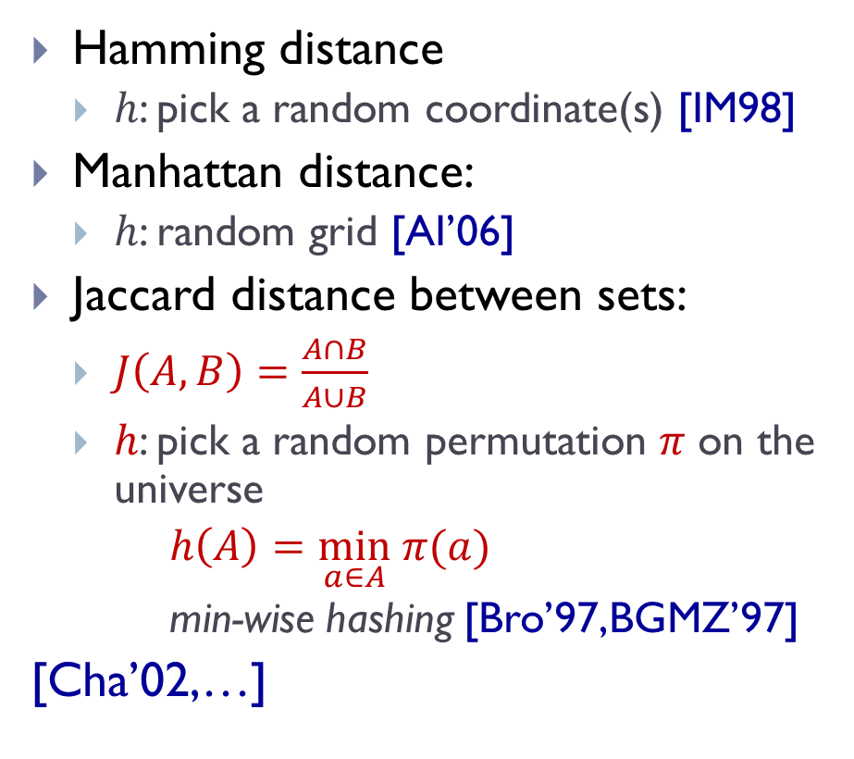

LSH Zoo
To be or not to be
To Simons or not to Simons
Hamming distance
  $h$: pick a random coordinate(s) [IM98]
Manhattan distance:
  $h$: random grid [AI’06]
Jaccard distance between sets:
  $J\left(A,B\right)=\frac{A∩B}{A∪B}$
  $h$: pick a random permutation $π$ on the universe
  $h\left(A\right)=\min_{a∈A} π(a)$
  min-wise hashing [Bro’97,BGMZ’97]
[Cha’02,…]
Simons
Simons
not
not
not
not
be
or
to
be
or
to
1
…01111…
…11101…
1
…21102…
…01122…
{be,not,or,to}
{not,or,to,
Simons}
be
to
$π$=be,to,Simons,or,not

Slide 29
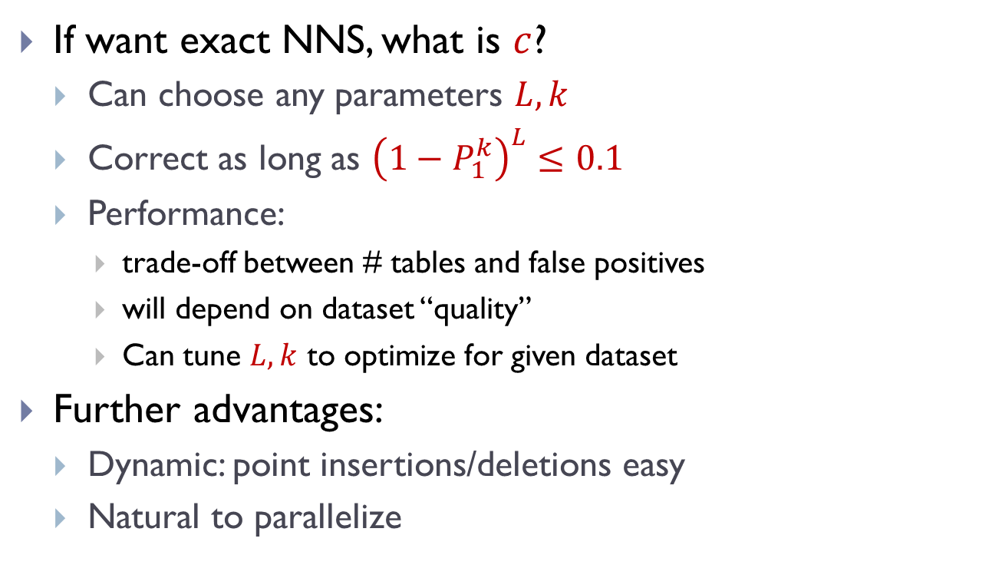


LSH in the wild
$$k$$
fewer tables
fewer false
positives
If want exact NNS, what is $c$?
  Can choose any parameters $L,k$
  Correct as long as ${\left(1−P_{1}^{k}\right)}^{L}≤0.1$
  Performance:
    trade-off between # tables and false positives
    will depend on dataset “quality”
    Can tune $L,k$ to optimize for given dataset
Further advantages:
  Dynamic: point insertions/deletions easy
  Natural to parallelize
safety not
guaranteed
$$L$$

Slide 30

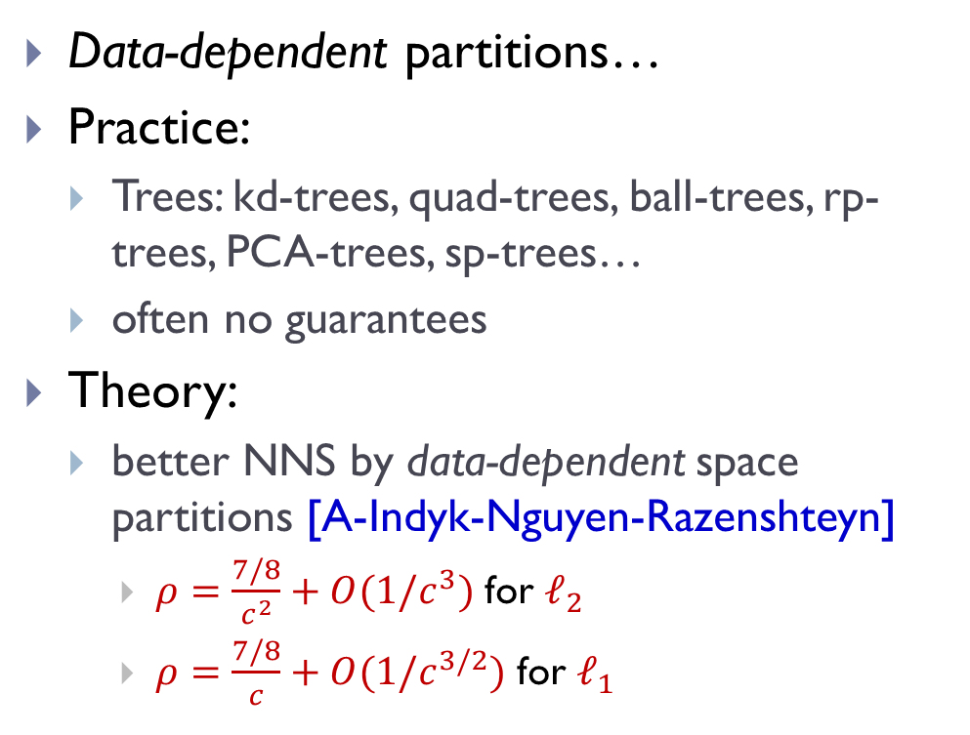


Space partitions beyond LSH
$$ℓ$$
Data-dependent partitions…
Practice:
  Trees: kd-trees, quad-trees, ball-trees, rp-trees, PCA-trees, sp-trees…
  often no guarantees
Theory:
  better NNS by data-dependent space partitions [A-Indyk-Nguyen-Razenshteyn]
    $ρ=\frac{7/8}{c^{2}}+O(1/c^{3})$ for $ℓ_{2}$
    $ρ=\frac{7/8}{c}+O(1/c^{3/2})$ for $ℓ_{1}$
cf. $ρ=\frac{1}{c^{2}}$ [AI’06, OWZ’10]
cf. $ρ=\frac{1}{c}$ [IM’98, OWZ’10]

Slide 31
Recap for today
High dimensional
geometry
NNS
dimension reduction
space partitions
small dimension
embedding
sketching
…

