Slide 1
Advanced Algorithms (4995-2) Nearest Neighbor Search
Alex Andoni
4/23/20

Slide 2
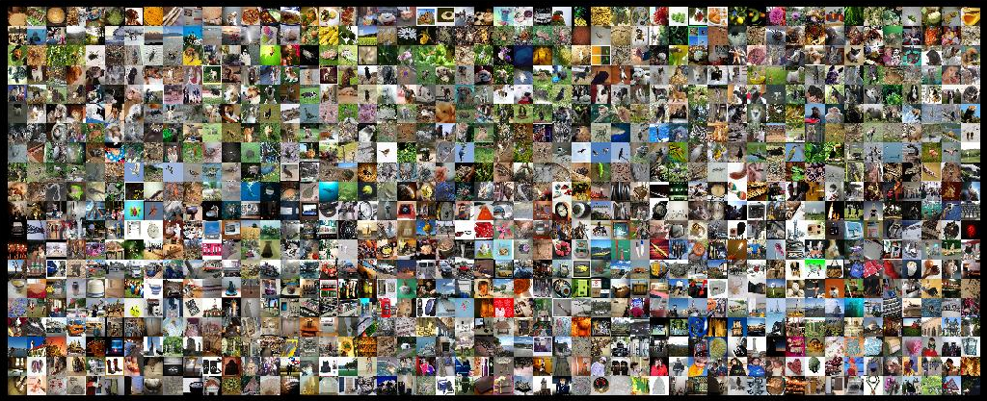
Find pairs of similar images
how should we measure similarity?
Naïvely: about $n^{2}$ comparisons
Can we do better?

Slide 3
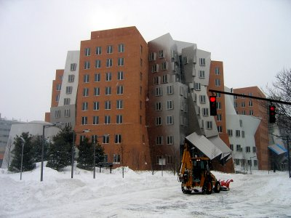
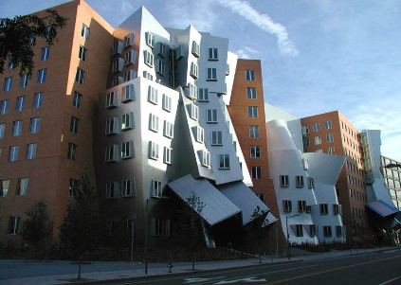
Measuring similarity
000000
011100
010100
000100
010100
011111
000000
001100
000100
000100
110100
111111
objects $⇒$ high-dimensional vectors
$${\left\{0,1\right\}}^{d}$$
Hamming dist.
$$R^{d}$$
Euclidean dist.
Sets of points
Earth-Mover
Distance
similarity $⇒$ distance b/w vectors
Image courtesy of Kristen Grauman

Slide 4
Nearest Neighbor Search (NNS)
Preprocess: a set $P$ of points
Query: given a query point $q$, report a point $p^{∗}∈P$ with the smallest distance to $q$
Primitive for: finding all similar pairs
But also clustering problems, and many other problems on large set of multi-feature objects
Applications:
speech/image/video/music recognition, signal processing, bioinformatics, etc…
$$p^{∗}$$
$$q$$
$n$: number of points
$d$: dimension

Slide 5
Preamble: How to check for an exact match ?
Dictionary problem:
hashing
NNS for 1-dimensional vectors ?
1.1
2
3.5
5
6
7
7.3
Preprocess:
Sort the points
Query:
Perform binary search
000000
000000
000000
000000
000000
000000
000000
001100
000100
000100
110100
111111
000000
011100
010100
000100
010100
011111
001100
011100
001100
001100
001100
001100
…
Query time | Space
$$O(\log{n})$$ | $$O(n)$$

Slide 6
High-dimensional case
$${\left\{0,1\right\}}^{d}$$
Hamming dist.
$$n=1,000,000,000$$
$d=400$
Underprepared: no preprocessing
Algorithm | Query time | Space
No indexing | $$O(n⋅d)$$ | $$O(n⋅d)$$
Overprepared: store an answer for every possible query
Full indexing | $$O(d)$$ | $$2^{d}$$
unaffordable if $d≫\log{n}$
Curse of dimensionality: would refute a (very) strong version of $P≠NP$ conjecture [Williams’04]
Best indexing ? | $$O(d)$$ | $$O(n⋅d)$$
A little better indexing ? | $$n^{0.99}$$ | $$O(n^{2})$$

Slide 7
Relaxed problem: Approximate Near Neighbor Search
$r$-near neighbor: given a query point $q$, report a point $p^{′}∈P$ s.t. $\left\|p′−q\right\|≤r$
as long as there is some point within distance $r$
Remarks:
In practice: used as a filter
Randomized algorithms: each point reported with 90% probability
Can use to solve nearest neighbor too
[HarPeled-Indyk-Motwani’12]
$c$-approximate
similar
$$cr$$
not similar
$$r$$
$$p^{∗}$$
$$cr$$
$$q$$
$$p^{′}$$
kind of…
either way

Slide 8
Approach: Locality Sensitive Hashing
[Indyk-Motwani’98]
Map: points $→$ codes: s.t.
“similar” $⇔$ “exact match”
$$q$$
$$p′$$
randomized
$$p$$
$$q$$
Map $g$ on $R^{d}$ s.t. for any points $p,q$
for similar pairs (when $\left\|q−p\right\|≤r$ )
$$g(q)=g(p)$$
for dissimilar pairs (when $\left\|q−p′\right\|>cr$ )
$$g\left(q\right)≠g\left(p^{′}\right)$$
$$P1=$$
$Pr⁡[g(q)=g(p)]$ is not-too-low
$$P2=$$
$Pr⁡[g(q)=g(p)]$ is low
several h-tables
Use a hash table on $g(p)$ for $p∈P$
$$Pr⁡[g(q)=g(p)]$$
$$ρ=\frac{\log{1/P_{1}}}{\log{1/P_{2}}}$$
1
$nρ$, where
$$P1$$
$$P2$$
$$\left\|q−p\right\|$$
How to construct good maps?
$$r$$
$$cr$$

Slide 9
Locality sensitive hash functions
Hash function $g$ is usually a concatenation of “primitive” functions:
$g\left(p\right)=\left\langle h_{1}(p),h_{2}(p),…,h_{k}(p)\right\rangle$
Example: Hamming space ${\left\{0,1\right\}}^{d}$
$h\left(p\right)=p_{j}$ , i.e., choose $j^{th}$ bit for a random $j$
Hence $g(p)$ is a projection on $k$ random bits
$\operatorname{Pr}\left[h\left(p\right)=h\left(q\right)\right]= 1 –\frac{Ham\left(p,q\right)}{d}$
$P_{1}=1−\frac{r}{d}≈e^{−r/d}$
$P_{2}=1−\frac{cr}{d}≈e^{−cr/d}$
$ρ=\frac{\log{1/P_{1}}}{\log{1/P_{2}}}=\frac{r/d}{cr/d}=\frac{1}{c}$

Slide 10
Full algorithm
Data structure is just $L=n^{ρ}$ hash tables:
Each hash table uses a fresh random function $g_{i}\left(p\right)=\left\langle h_{i,1}(p),…,h_{i,k}(p)\right\rangle$
Hash all dataset points into the table
Query:
Check for collisions in each of the hash tables
until we encounter a point within distance $cr$
Guarantees:
Space: $O\left(nL\right)=O(n^{1+ρ})$, plus space to store points
Query time: $O\left(L⋅(k+d)\right)=O(n^{ρ}⋅d)$ (in expectation)
50% probability of success.
Notes:
Draw L hash tables

Slide 11
Analysis of LSH Scheme
Choice of parameters $k,L$ ?
$L$ hash tables with $g\left(p\right)=\left\langle h_{1}(p),…,h_{k}(p)\right\rangle$
Pr[collision of far pair] = $P_{2}^{k}$
Pr[collision of close pair] = $P_{1}^{k}$
Hence $L=O(n^{ρ})$ “repetitions” (tables) suffice!
In expectation, only
$≤n⋅P_{2}^{k}=1$ false positives per table
set $k$ s.t.
= $1/n$
= ${\left(P_{2}^{ρ}\right)}^{k}={1/n}^{ρ}$
$$P_{1}$$
$$P_{1}^{2}$$
$$P_{2}$$
$$k=1$$
$$P_{2}^{2}$$
$$k=2$$
$$r$$
$$cr$$

Slide 12
Analysis: Correctness
Let $p^{∗}$ be an $r$-near neighbor
If does not exists, algorithm can output anything
Algorithm fails when:
near neighbor $p^{∗}$ is not in the searched buckets $g_{1}\left(q\right), g_{2}\left(q\right), …,g_{L}\left(q\right)$
Probability of failure:
Probability $q,p^{∗}$ do not collide in a hash table: $≤1−P_{1}^{k}$
Probability they do not collide in $L$ hash tables at most
$${\left(1−P_{1}^{k}\right)}^{L}={\left(1−\frac{1}{n^{ρ}}\right)}^{n^{ρ}}≤1/e$$

Slide 13
Analysis: Runtime
Runtime dominated by:
Hash function evaluation: $O(L⋅k)$ time
Distance computations to points in buckets
Distance computations:
Only worry only about far points, at distance $>cR$
In one hash table, we have
Probability a far point collides is at most $P_{2}^{k}=1/n$
Expected number of far points in a bucket: $n⋅\frac{1}{n}=1$
Over $L$ hash tables, expected number of far points is $L$
Total: $O\left(Lk\right)+O\left(Ld\right)=O(n^{ρ}d)$ in expectation

Slide 14
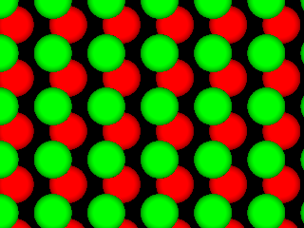
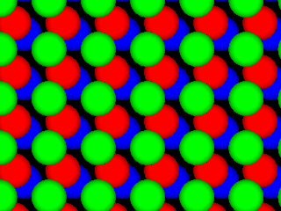
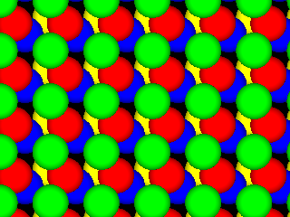
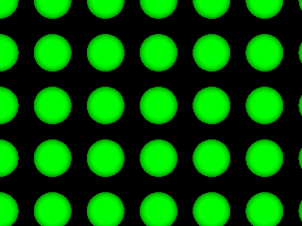
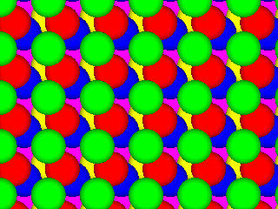
LSH maps (Euclidean space)
[Datar-Indyk-Immorlica-Mirrokni’04, A.-Indyk’06]
Space | Time | Exponent | $$c=2$$
$$n^{1+ρ}$$ | $$n^{ρ}$$ | $$ρ=1/c$$ | $$ρ=1/2$$
 |  | $$ρ≈1/c^{2}$$ | $$ρ=1/4$$
 |  | $$ρ≈\frac{1}{2c^{2}}−1$$ | $$ρ=1/7$$
$$q$$
$$p$$
$$p′$$
Even better LSH maps?
NO: example of isoperimetry
[Motwani-Naor-Panigrahy’06, O’Donell-Wu-Zhou’11]
Example question:
Among bodies in $R^{d}$ of volume 1, which has the lowest perimeter?
Can get better maps, if $g$ allowed to (mildly) depend on the dataset
[A-Indyk-Nguyen-Razenshteyn’14, A-Razenshteyn’15]

Slide 15
Some other LSH algorithms
To be or not to be
To search or not to search
sketch
search
not
not
not
not
Hamming distance
$g$: pick a random coordinate(s) [IM’98]
Manhattan distance:
$g$: cell in a randomly shifted grid
Jaccard distance between sets:
$J\left(A,B\right)=\frac{A∩B}{A∪B}$
$g$: pick a random permutation $π$ on the words
$g\left(A\right)=\min_{a∈A} π(a)$
min-wise hashing
[Broder’97, Christiani-Pagh’17]
be
or
to
be
or
to
1
…01111…
…11101…
1
…21102…
…01122…
{be,not,or,to}
{not,or,to,search}
be
to
for $π$=be,to,search,or,not

Slide 16
A data-dependent LSH
[A.-Razenshteyn-Shekel-Nosatzki’17]
Hamming space
$n^{ρ}$ random decision trees, of height $k$
in each node sample a random coordinate
LSH Forest++:
LSH Forest [Bawa-Condie-Ganesan’05]
In a tree, split until $O(1)$bucket size
++: store $t$ points closest to
the mean of P
query compared against the $t$ points
Theorem: obtains $ρ≈\frac{0.72}{c}$
for $t,c$ large enough
$$n^{1+ρ}$$ | $$n^{ρ}$$ | $$ρ=1/c$$ | [Indyk-Motwani’98]
$$x=00110110$$
coor 3
coor 2
coor 5
coor 7

Slide 17
NNS for other distances?
Earth Mover Distance (Wasserstein):
Given two sets A, B of points in a metric space
EMD(A,B) = min cost bipartite matching between A and B
Applications in image vision
$$S$$
010110
$EMD(A,B)$ small or large?
$$S$$
010101

Slide 18
Tool: metric embeddings
Metric Embedding:
Map sets into vectors in $ℓ_{1}$ preserving the distance (approximately)
Then use algorithms for $ℓ_{1}$ !
Say, EMD over ${\left[s\right]}^{2}$
Theorem [Cha02, IT03]: Exists a map $f$ mapping all $A⊂{\left[s\right]}^{2}$ into $ℓ_{1}$ with approximation $O(log⁡s)$:
i.e., for any $A,B⊂{\left[s\right]}^{2}$ we have:
$$EMD\left(A,B\right)≤||f\left(A\right)−f\left(B\right)||_{1}≤O(\log{s})⋅EMD(A,B)$$
Implies NNS: $O\left(\log{s}\right)$-approximation

Slide 19
Embeddability into $ℓ_{1}$
edit( banana ,
ananas ) = 2
Metric | Upper bound
Earth-mover distance ($s$-sized sets in 2D plane) | $$O\left(\log{s}\right)$$ [Cha02, IT03]
Earth-mover distance ($s$-sized sets in ${\left\{0,1\right\}}^{d}$) | $$O(\log{s}⋅\log{d})$$ [AIK08]
Edit distance over ${\left\{0,1\right\}}^{d}$ (#indels to transform x->y) | $$2^{\tilde{O}\left(\sqrt{\log{d}}\right)}$$ [OR05]
Ulam (edit distance between permutations) | $$O\left(\log{d}\right)$$ [CK06]
Block edit distance | $$\tilde{O}\left(\log{d}\right)$$ [MS00, CM07]
edit(1234567,
7123456) = 2

Slide 20
Non-embeddability into $ℓ_{1}$
Metric | Upper bound
Earth-mover distance ($s$-sized sets in 2D plane) | $$O\left(\log{s}\right)$$ [Cha02, IT03]
Earth-mover distance ($s$-sized sets in ${\left\{0,1\right\}}^{d}$) | $$O(\log{s}⋅\log{d})$$ [AIK08]
Edit distance over ${\left\{0,1\right\}}^{d}$ (#indels to transform x->y) | $$2^{\tilde{O}\left(\sqrt{\log{d}}\right)}$$ [OR05]
Ulam (edit distance between permutations) | $$O\left(\log{d}\right)$$ [CK06]
Block edit distance | $$\tilde{O}\left(\log{d}\right)$$ [MS00, CM07]
Lower bounds
$$Ω\left(\sqrt{\log{s}}\right)$$ [NS07]
$$Ω\left(\log{s}\right)$$ [KN05]
$$Ω\left(\log{d}\right)$$ [KN05,KR06]
$$\tilde{Ω}\left(\log{d}\right)$$ [AK07]
4/3 [Cor03]

