Slide 1
Embedding and Sketching
Alexandr Andoni (MSR)

Slide 2
Definition by example
Problem: Compute the diameter of a set S, of size n, living in d-dimensional ℓ₁^{d}
Trivial solution: O(d * n²) time
Will see solution in O(2^{d} * n) time
Algorithm has two steps:
  1. Map f:ℓ₁^{d}→ℓ∞^{k}, where k=2^{d} such that, for any x,y∈ℓ₁^{d}
    ║x-y║₁ = ║f(x)-f(y)║∞
  2. Solve the diameter problem in ℓ∞ on pointset f(S)

Slide 3
Step 1: Map from ℓ₁ to ℓ∞
Want map f: ℓ₁→ ℓ∞ such that for x,y∈ℓ₁
  ║x-y║₁ = ║f(x)-f(y)║∞
Define f(x) as follows:
  2^{d} coordinates c=(c(1),c(2),…c(d)) (binary representation)
  f(x)|_{c} = ∑_{i}(-1)^{c(i)} * x_{i}
Claim: ║f(x)-f(y)║∞ = ║x-y║₁
  ║f(x)-f(y)║∞ = max_{c} ∑_{i}(-1)^{c(i)} *(x_{i}-y_{i})
  = ∑_{i}max_{c(i)} (-1)^{c(i)} *(x_{i}-y_{i})
  = ║x-y║₁

Slide 4
Step 2: Diameter in ℓ∞
Claim: can compute the diameter of n points living in ℓ∞^{k} in O(nk) time.
Proof:
  diameter(S) = max_{xy∈S} ║x-y║∞
  = max_{xy∈S} max_{c} |x_{c}-y_{c}|
  = max_{c} max_{xy∈S} |x_{c}-y_{c}|
  = max_{c} (max_{x∈S} x_{c} - min_{y∈S} y_{c})
Hence, can compute in O(k*n) time.
Combining the two steps, we have O(2^{d} * n) time.

Slide 5
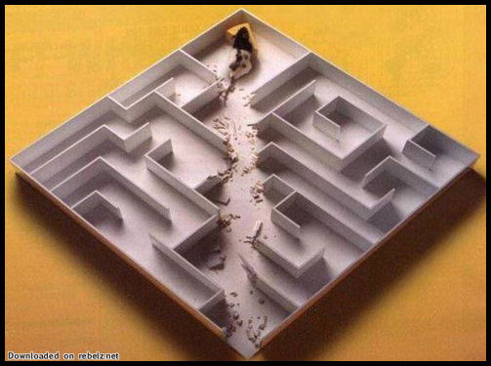
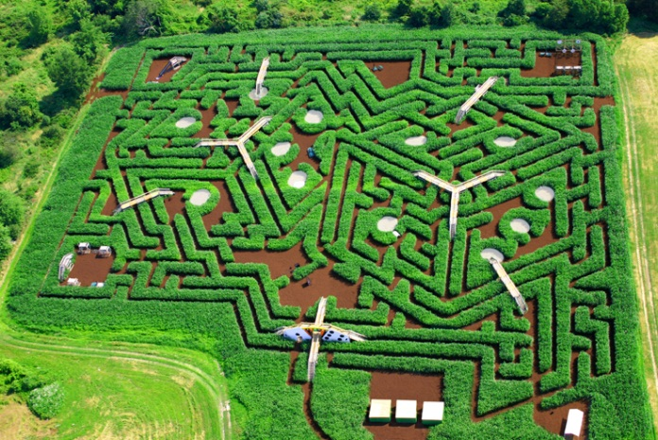
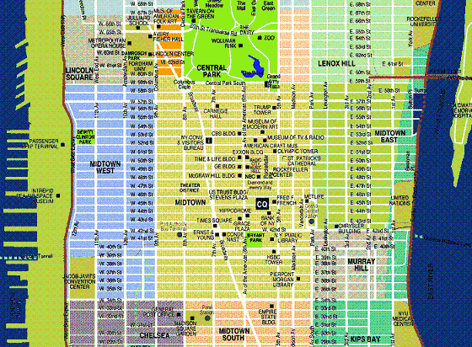
What is an embedding?
The above map f is an “embedding from ℓ₁ to ℓ∞”
General motivation: given metric M, solve a computational problem P under M
Euclidean distance (ℓ₂)
Compute distance between two points
ℓ_{p} norms, p=1, ∞, …
Diameter/Close-pair of a point-set S
Edit distance between two strings
Nearest Neighbor Search
Earth-Mover (transportation) Distance
Clustering, MST, etc
f
Reduce problem
<P under hard metric>
to
<P under simpler metric>

Slide 6
Embeddings
Definition: an embedding is a map f:M→H of a metric (M, d_{M}) into a host metric (H, ρ_{H}) such that for any x,y∈M:
  d_{M}(x,y) ≤ ρ_{H}(f(x), f(y)) ≤ D * d_{M}(x,y)
  where D is the distortion (approximation) of the embedding f.
Embeddings come in all shapes and colors:
  Source/host spaces M,H
  Distortion D
  Can be randomized: ρ_{H}(f(x), f(y)) ≈ d_{M}(x,y) with 1-δ probability
  Can be non-oblivious: given set S⊂M, compute f(x) (depends on entire S)
  Time to compute f(x)
Types of embeddings:
  From a norm (ℓ₁) into another norm (ℓ∞)
  From norm to the same norm but of lower dimension (dimension reduction)
  From non-norms (edit distance, Earth-Mover Distance) into a norm (ℓ₁)
  From given finite metric (shortest path on a planar graph) into a norm (ℓ₁)
  From given finite metric (shortest path on a given planar graph) into a norm (ℓ₁)

Slide 7
Dimension Reduction
Johnson Lindenstrauss Lemma: for ε>0, given n vectors in d-dimensional Euclidean space (ℓ₂), can embed them into k-dimensional ℓ₂, for k=O(ε⁻² log n), with 1+ε distortion.
Motivation:
  E.g.: diameter of a pointset S in ℓ₂^{d}
  Trivially: O(n² * d) time
  Using lemma: O(nd*ε⁻² log n + n² *ε⁻² log n) time for 1+ε approximation
  MANY applications: nearest neighbor search, streaming, pattern matching, approximation algorithms (clustering)…

Slide 8
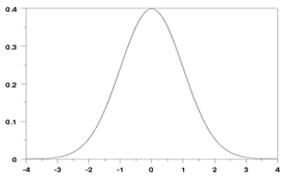
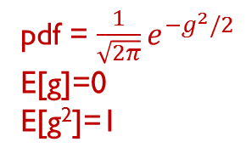
Embedding 1
Map f: ℓ₂^{d}→ℜ (ℓ₂ of one dimension)
  f(x) = ∑_{i} g_{i} * x_{i}, where g_{i} are iid normal (Gaussian) random vars
Want: |f(x)-f(y)| ≈ ‖x-y‖
Claim: for any x,y∈ℓ₂, we have
  Expectation: Ε_{g}[|f(x)-f(y)|²] = ‖x-y‖²
  Standard dev: σ[|(f(x)-f(y)|²] = O(‖x-y‖²)
Proof:
  Prove for z=x-y, since f linear: f(x)-f(y)=f(z)
  Let g=(g₁, g₂,…g_{d})
  Expectation = Ε[(f(z))²] = Ε[(∑_{i} g_{i}*z_{i})²]
  = Ε[∑_{i} g_{i}²*z_{i}²]+Ε[∑_{i≠j} g_{i}g_{j}*z_{i}z_{j}]
  = ∑_{i} z_{i}² = ‖z‖²
2
2
pdf = ${\frac{1}{\sqrt{2π}}e}^{−g^{2}/2}$
E[g]=0
E[g²]=1

Slide 9

Embedding 1: proof (cont)
Variance of estimate |f(z)|² = (g⋅z)²
  ≤ Ε[((∑_{i} g_{i} z_{i})²)²] = Ε[
  = Ε_{g} [g₁⁴z₁⁴+g₁³g₂z₁³z₂+…]
Surviving terms:
  Ε_{g}[∑_{i} g_{i}⁴ z_{i}⁴] = 3∑_{i} z_{i}⁴
  Ε_{g}[∑_{i<j} g_{i}² g_{j}² z_{i}²z_{j}²]
Total: 3∑_{i} z_{i}⁴+ 6 ∑_{i<j} z_{i}²z_{j}² = 3(∑_{i} z_{i}²)² = 3‖z‖₂⁴
(g₁z₁+g₂z₂+…+g_{d}z_{d}) *
(g₁z₁+g₂z₂+…+g_{d}z_{d}) *
(g₁z₁+g₂z₂+…+g_{d}z_{d}) *
(g₁z₁+g₂z₂+…+g_{d}z_{d})]
0
pdf = ${\frac{1}{\sqrt{2π}}e}^{−g^{2}/2}$
E[g]=0
E[g²]=1
E[g³]=0
E[g⁴]=3
6*
  = 6 ∑_{i<j} z_{i}²z_{j}²

Slide 10
Embedding 2
So far: f(x)=g⋅x, where g=(g₁,…g_{d}) multi-dim Gaussian
  Expectation: Ε_{g}[|f(z)|²] = ‖z‖²
  Variance: Var[|f(z)|²] ≤ 3‖z‖⁴
Final embedding:
  repeat on k=O(ε⁻² * 1/δ) coordinates independently
  F(x) = (g₁⋅x, g₂⋅x, … g_{k}⋅x) / √k
For new F, obtain (again use z=x-y, as F is linear):
  Ε[‖F(z)‖²] = (Ε[(g₁z)²] + Ε[(g₂z)²] +…) / k = ‖z‖₂²
  Var[‖F(z)‖²] ≤ 1/k*3‖z‖⁴
By Chebyshev’s inequality:
  Pr[(‖F(z)‖² - ‖z‖²)² > (ε‖z‖²)²] ≤ O(1/k * ‖z‖²)/(ε‖z‖²)²≤ δ
=> σ[|(f(z)|²] = O(‖z‖²)

Slide 11
Embedding 2: analysis
  Lemma [AMS96]: F(x) = (g₁⋅x, g₂⋅x, … g_{k}⋅x) / √k
  where k=O(ε⁻² * 1/δ)
  achieves: for any x,y∈ℓ₂ and z=x-y, with probability 1- δ:
    -ε‖z‖² ≤ ‖F(z)‖² - ‖z‖² ≤ ε‖z‖²
    hence ‖F(x)-F(y)‖ = (1±ε) * ‖x-y‖
Not yet what we wanted: k=O(ε⁻² * log n) for n points
  analysis needs to use higher moments
On the other hand, [AMS96] Lemma uses 4-wise independence only
  Need only O(k*log n) random bits to define F

Slide 12
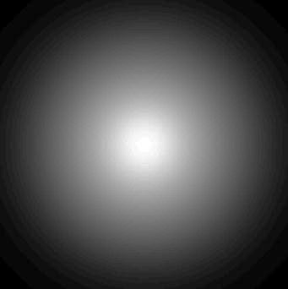
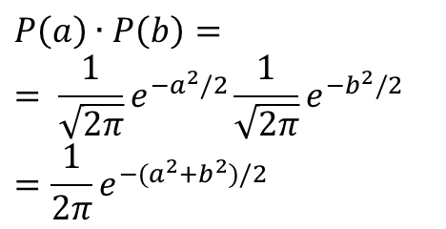
Better Analysis
  As before: F(x) = (g₁⋅x, g₂⋅x, … g_{k}⋅x) / √k
  Want to prove: when k=O(ε⁻² * log 1/δ)
    ‖F(x)-F(y)‖ = (1±ε) * ‖x-y‖ with 1-δ probability
    Then, set δ=1/n³ and apply union bound over all n² pairs (x,y)
    Again, ok to prove ‖F(z)‖ = (1±ε) * ‖z‖ for fixed z=x-y
    Fact: the distribution of a d-dimensional Gaussian variable g is centrally symmetric (invariant under rotation)
    Wlog, z=(‖z‖,0,0…)
$$P\left(a\right)∙P\left(b\right)=$$
$$= \frac{1}{\sqrt{2π}}e^{−a^{2}/2}\frac{1}{\sqrt{2π}}e^{−b^{2}/2}$$
$$=\frac{1}{2π}e^{−{(a}^{2}+b^{2})/2}$$

Slide 13
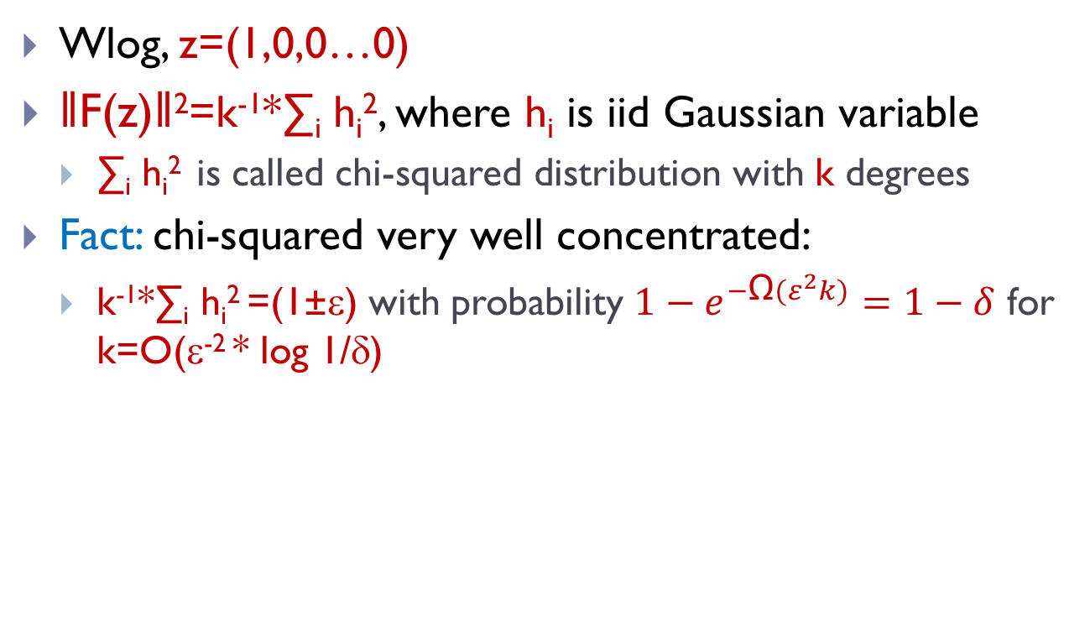
Better Analysis (continued)
Wlog, z=(1,0,0…0)
‖F(z)‖²=k⁻¹*∑_{i} h_{i}², where h_{i} is iid Gaussian variable
  ∑_{i} h_{i}² is called chi-squared distribution with k degrees
Fact: chi-squared very well concentrated:
  k⁻¹*∑_{i} h_{i}² =(1±ε) with probability ${1−e}^{−\text{Ω}(ε^{2}k)}=1−δ$ for k=O(ε⁻² * log 1/δ)

Slide 14
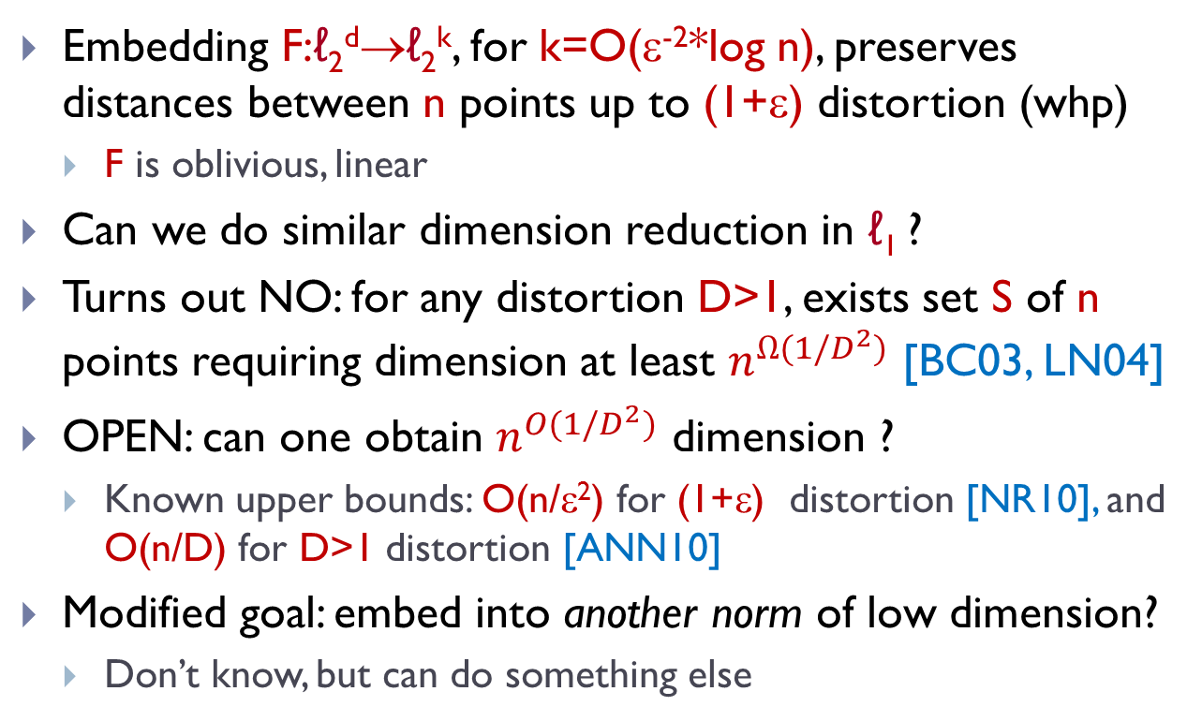
Dimension Reduction: conclusion
Embedding F:ℓ₂^{d}→ℓ₂^{k}, for k=O(ε⁻²*log n), preserves distances between n points up to (1+ε) distortion (whp)
  F is oblivious, linear
Can we do similar dimension reduction in ℓ₁ ?
Turns out NO: for any distortion D>1, exists set S of n points requiring dimension at least $n^{Ω(1/D^{2})}$ [BC03, LN04]
OPEN: can one obtain $n^{O(1/D^{2})}$ dimension ?
  Known upper bounds: O(n/ε²) for (1+ε) distortion [NR10], and O(n/D) for D>1 distortion [ANN10]
Modified goal: embed into another norm of low dimension?
  Don’t know, but can do something else

Slide 15

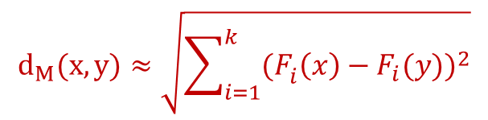
Sketching
x
y
{0,1}^{k}
{0,1}^{k}x{0,1}^{k}→ℜ
F:M→ℜ^{k}
Arbitrary computation C:ℜ^{k}xℜ^{k}→ℜ₊
  Cons:
    No/little structure (e.g., (F,C) not metric)
  Pros:
    May achieve better distortion (approximation)
    Smaller “dimension” k
Sketch F : “functional compression scheme”
  for estimating distances
  almost all lossy ((1+ε) distortion or more) and randomized
E.g.: a sketch still good enough for computing diameter
F
F(x)
F(y)
$$d_{M}(x,y)≈\sqrt{\sum_{i=1}^{k}{{{(F}_{i}^{}\left(x\right)−F_{i}(y))}^{2}}}$$
$$C(F\left(x\right), F\left(y\right))$$

Slide 16
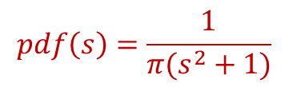
Sketching for ℓ₁ via p-stable distributions
  Lemma [I00]: exists F:ℓ₁→ℜ^{k}, and C
  where k=O(ε⁻² * log 1/δ)
  achieves: for any x,y∈ℓ₁ and z=x-y, with probability 1- δ:
    C(F(x), F(y)) = (1±ε) * ‖x-y‖₁
F(x) = (s₁⋅x, s₂⋅x, … s_{k}⋅x)/k
  Where s_{i}=(s_{i1},s_{i2},…s_{id}) with each s_{ij} distributed from Cauchy distribution
  C(F(x),F(y))=median(|F₁(x)-F₁(y)|,
  |F₂(x)-F₂(y)|,
  …
  |F_{k}(x)-F_{k}(y)| )
Median because: even Ε[F₁(x)-F₁(y)|] is infinite!
$$pdf\left(s\right)=\frac{1}{π(s^{2}+1)}$$

Slide 17
Why Cauchy distribution?
It’s the “ℓ₁ analog” of the Gaussian distribution (used for ℓ₂ dimensionality reduction)
  We used the property that, for g =(g1,g2,…gd) ~ Gaussian
  g*z=g₁z₁+g₂z₂+…g_{d}z_{d} distributed as
  g'*(||z||,0,…0)=||z||₂*g’₁, i.e. a scaled (one-dimensional) Gaussian
Well, do we have a distribution S such that
  For s₁₁,s₁₂,…s_{1d}∈S,
  s₁₁z₁+s₁₂z₂+…s_{1d}z_{d} ~ ||z||₁*s’₁, where s’₁∈S
Yes: Cauchy distribution!
  In general called “p-stable distribution”
  Exist for p∈(0,2]
F(x)-F(y)=F(z)=(s’₁||z||₁,…s’_{d}||z||₁)
Unlike for Gaussian, |s’₁|+|s’₂|+…|s’_{k}| doesn’t concentrate

Slide 18
Bibliography
[Johnson-Lindenstrauss]: W.B.Jonhson, J.Lindenstrauss. Extensions of Lipshitz mapping into Hilbert space. Contemporary Mathematics. 26:189-206. 1984.
[AMS96]: N. Alon, Y. Matias, M. Szegedy. The space complexity of approximating the frequency moments. STOC’96. JCSS 1999.
[BC03]: B. Brinkman, M. Charikar. On the impossibility of dimension reduction in ell_1. FOCS’03.
[LN04]: J. Lee, A. Naor. Embedding the diamond graph in L_p and Dimension reduction in L_1. GAFA 2004.
[NR10]: I. Newman, Y. Rabinovich. Finite volume spaces and sparsification. http://arxiv.org/abs/1002.3541
[ANN10]: A. Andoni, A. Naor, O. Neiman. Sublinear dimension for constant distortion in L_1. Manuscript 2010.
[I00]: P. Indyk. Stable distributions, pseudorandom generators, embeddings and data stream computation. FOCS’00. JACM 2006.

