Slide 1
Lecture 10:
Sketching
S3: Nearest Neighbor Search
Notes:
Left to the title, a presenter can insert his/her own image pertinent to the presentation.

Slide 2
Plan
PS2 due yesterday, 7pm
Sketching
Nearest Neighbor Search
Scriber?

Slide 3
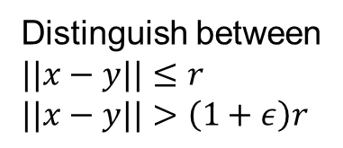


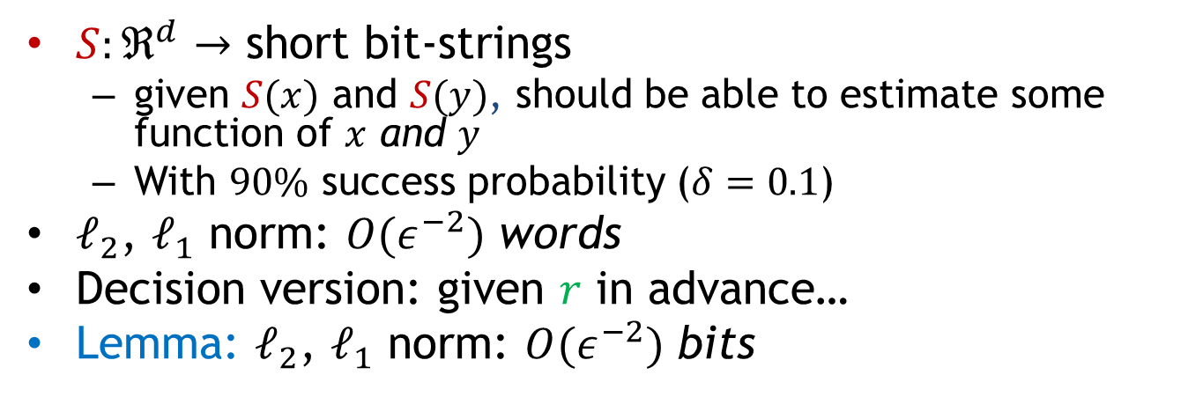



Sketching
$S:ℜ^{d}$ $→$ short bit-strings
  given $S(x)$ and $S(y)$, should be able to estimate some function of $x$ and $y$
  With $90\%$ success probability ($δ=0.1$)
$ℓ_{2}$, $ℓ_{1}$ norm: $O(ε^{−2})$ words
Decision version: given $r$ in advance…
Lemma: $ℓ_{2}$, $ℓ_{1}$ norm: $O(ε^{−2})$ bits
$$x$$
$$y$$
$$S$$
$$S$$
010110
010101
Estimate $||x−y||_{2}$
Distinguish between
$$||x−y||≤r$$
$$||x−y||>\left(1+ε\right)r$$

Slide 4
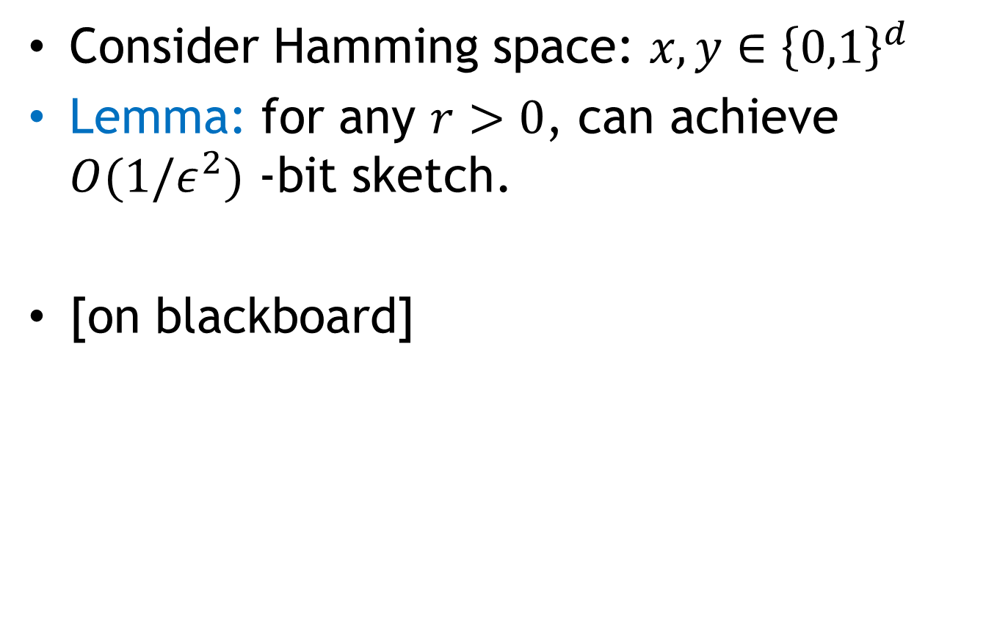
Sketching: decision version
Consider Hamming space: $x,y∈{\left\{0,1\right\}}^{d}$
Lemma: for any $r>0$, can achieve $O(1/ε^{2})$ -bit sketch.
[on blackboard]

Slide 5
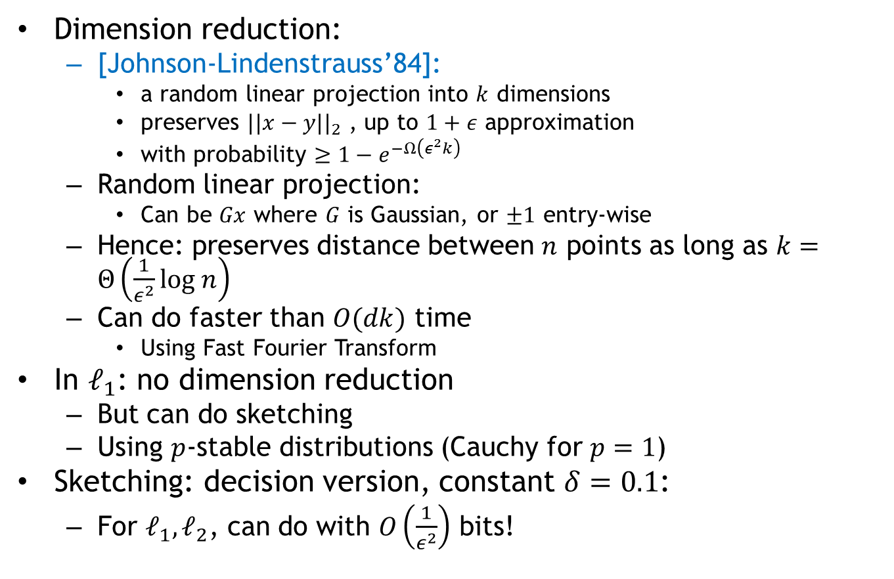
Conclusion
Dimension reduction:
  [Johnson-Lindenstrauss’84]:
    a random linear projection into $k$ dimensions
    preserves $||x−y||_{2}$ , up to $1+ε$ approximation
    with probability $≥1−e^{−Ω\left(ε^{2}k\right)}$
  Random linear projection:
    Can be $Gx$ where $G$ is Gaussian, or $±1$ entry-wise
  Hence: preserves distance between $n$ points as long as $k=Θ\left(\frac{1}{ε^{2}}log n\right)$
  Can do faster than $O(dk)$ time
    Using Fast Fourier Transform
In $ℓ_{1}$: no dimension reduction
  But can do sketching
  Using $p$-stable distributions (Cauchy for $p=1$)
Sketching: decision version, constant $δ=0.1$:
  For $ℓ_{1},ℓ_{2}$, can do with $O\left(\frac{1}{ε^{2}}\right)$ bits!

Slide 6
Section 3:
Nearest Neighbor Search

Slide 7


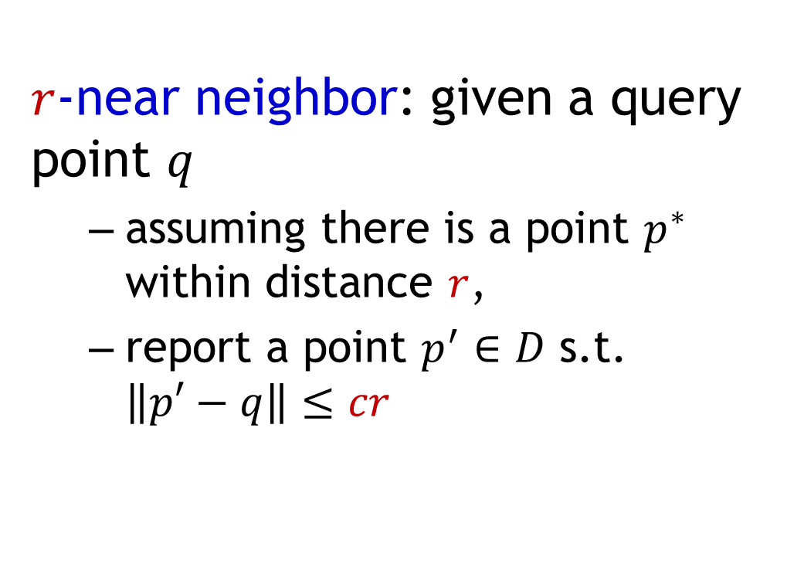


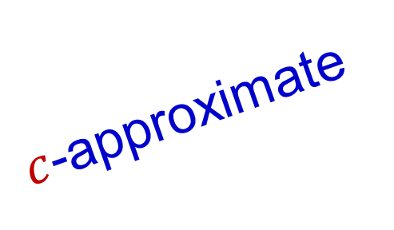
Approximate NNS
$c$-approximate
$r$-near neighbor: given a query point $q$
  assuming there is a point $p^{∗}$ within distance $r$,
  report a point $p^{′}∈D$ s.t. $\left\|p′−q\right\|≤cr$
$$r$$
$$p^{∗}$$
$$cr$$
$$q$$
$$p^{′}$$

Slide 8
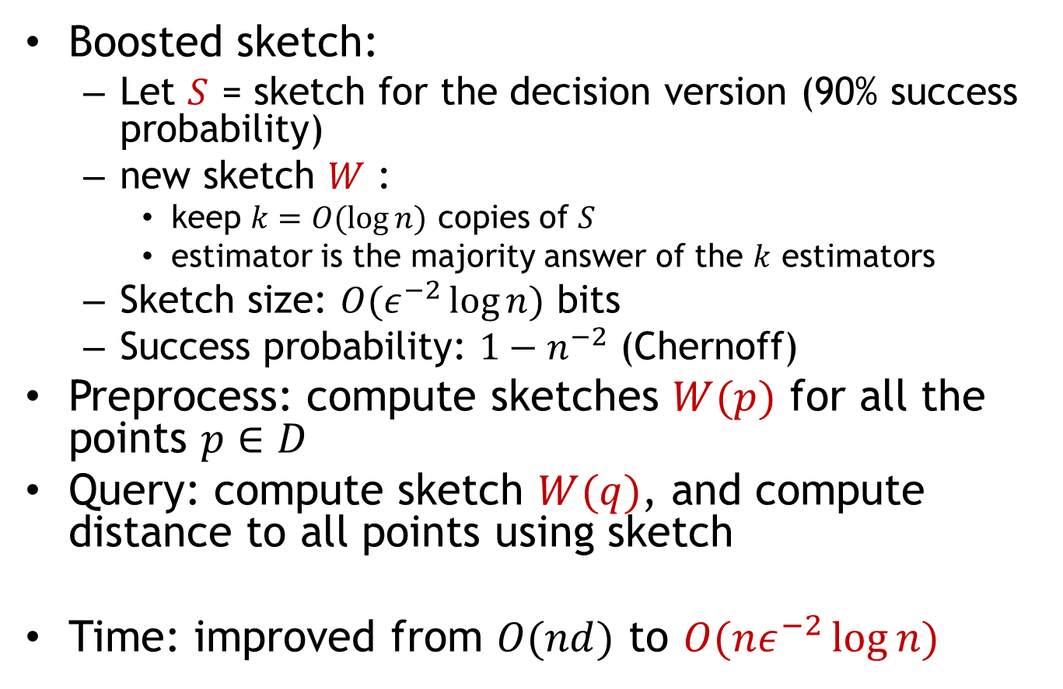
NNS: approach 1
Boosted sketch:
  Let $S$ = sketch for the decision version (90% success probability)
  new sketch $W$ :
    keep $k=O(\log{n})$ copies of $S$
    estimator is the majority answer of the $k$ estimators
  Sketch size: $O(ε^{−2}\log{n})$ bits
  Success probability: $1−n^{−2}$ (Chernoff)
Preprocess: compute sketches $W(p)$ for all the points $p∈D$
Query: compute sketch $W(q)$, and compute distance to all points using sketch
Time: improved from $O(nd)$ to $O(nε^{−2}\log{n})$

Slide 9
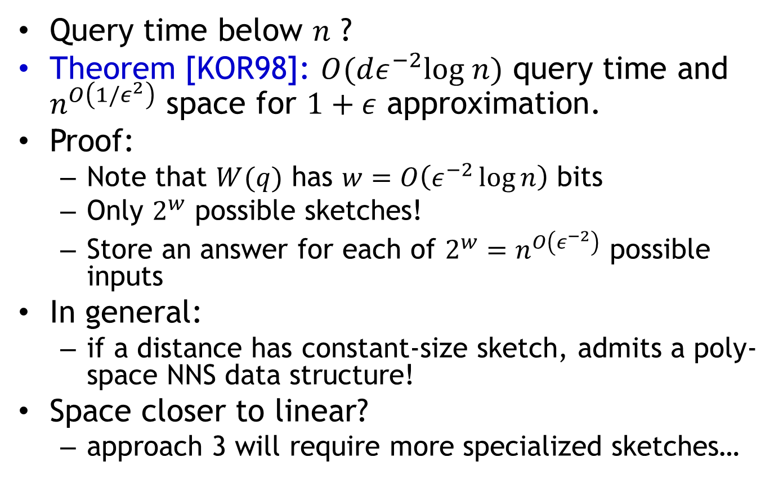
NNS: approach 2
Query time below $n$ ?
Theorem [KOR98]: $O(dε^{−2}log n)$ query time and $n^{O\left(1/ε^{2}\right)}$ space for $1+ε$ approximation.
Proof:
  Note that $W(q)$ has $w=O\left(ε^{−2}\log{n}\right)$ bits
  Only $2^{w}$ possible sketches!
  Store an answer for each of $2^{w}=n^{O\left(ε^{−2}\right)}$ possible inputs
In general:
  if a distance has constant-size sketch, admits a poly-space NNS data structure!
Space closer to linear?
  approach 3 will require more specialized sketches…

