Slide 1
Sketching, Sampling and other Sublinear Algorithms:
Algorithms for parallel models
Alex Andoni
(MSR SVC)

Slide 2

Parallel Models
Data cannot be seen by one machine
Distributed across many machines
MapReduce, Hadoop, Dryad,…
Algorithmic tools for the models?
  very incipient!

Slide 3
Types of problems
0. Statistics: 2nd moment of the frequency
1. Sort n numbers
2. s-t connectivity in a graph
3. Minimum Spanning Tree on a graph
… many more!

Slide 4

Computational Model
$M$ machines
$S$ space per machine
$M⋅S$ ≈ O(input size)
  cannot replicate data much
Input: $n$ elements
Output: O(input size)=O(n)
  doesn’t fit on a machine: $S≪n$
Round: shuffle all (expensive!)
Notes:
Machines churning data

Slide 5

Model Constraints
Main goal:
  number of rounds $R=O(1)$
  for $S>\sqrt{n}$
    holds when $S>M$
Resources bounded by $S$
  $O(S)$ in/out communication/round
  $O(S)$ run-time/round
Model essentially that of:
  Bulk-Synchronous Parallel [Valiant’90]
  Map Reduce Framework [Feldman-Muthukrishnan-Sidiropoulos-Stein-Svitkina’07, Karloff-Suri-Vassilvitskii’10, Goodrich-Sitchinava-Zhang’11]

Slide 6
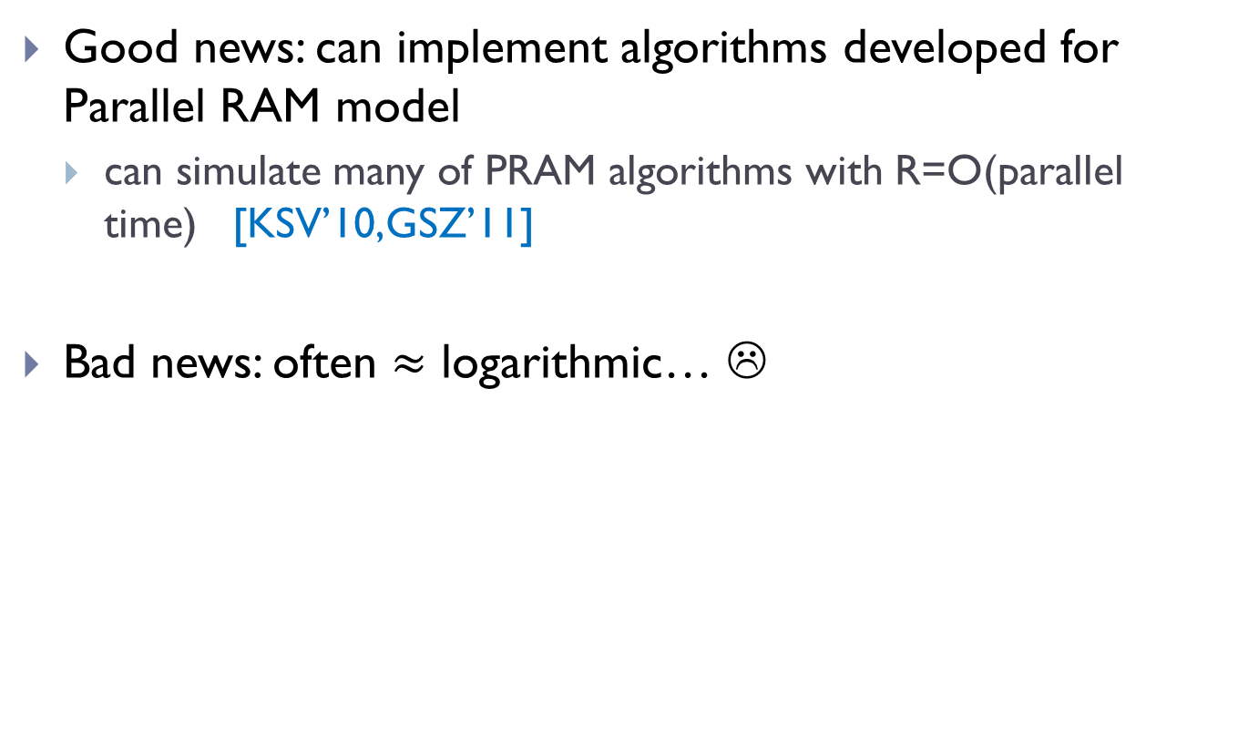
PRAMs
Good news: can implement algorithms developed for Parallel RAM model
  can simulate many of PRAM algorithms with R=O(parallel time) [KSV’10,GSZ’11]
Bad news: often $≈$ logarithmic… ☹

Slide 7
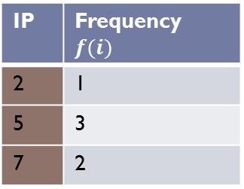
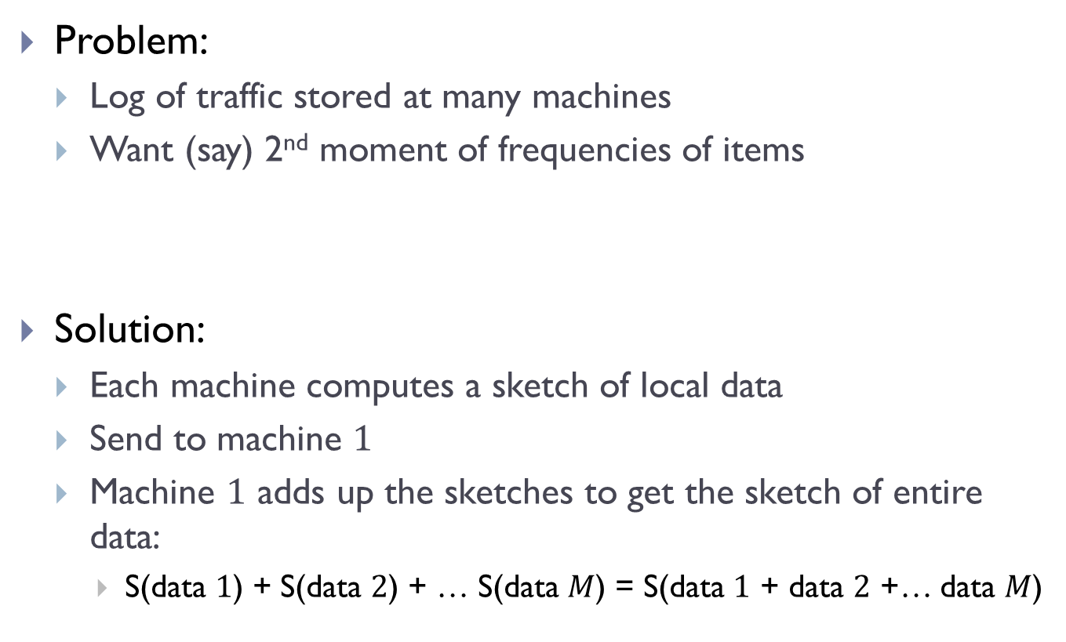


Problem 0: Statistics
Problem:
  Log of traffic stored at many machines
  Want (say) 2nd moment of frequencies of items
Solution:
  Each machine computes a sketch of local data
  Send to machine $1$
  Machine $1$ adds up the sketches to get the sketch of entire data:
    S(data $1$) + S(data $2$) + … S(data $M$) = S(data $1$ + data $2$ +… data $M$)
IP | Frequency $f(i)$
2 | 1
5 | 3
7 | 2
$${f(i)}^{2}$$
1
9
4
$F_{2}=$1+9+4=14

Slide 8
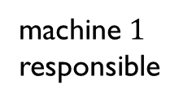
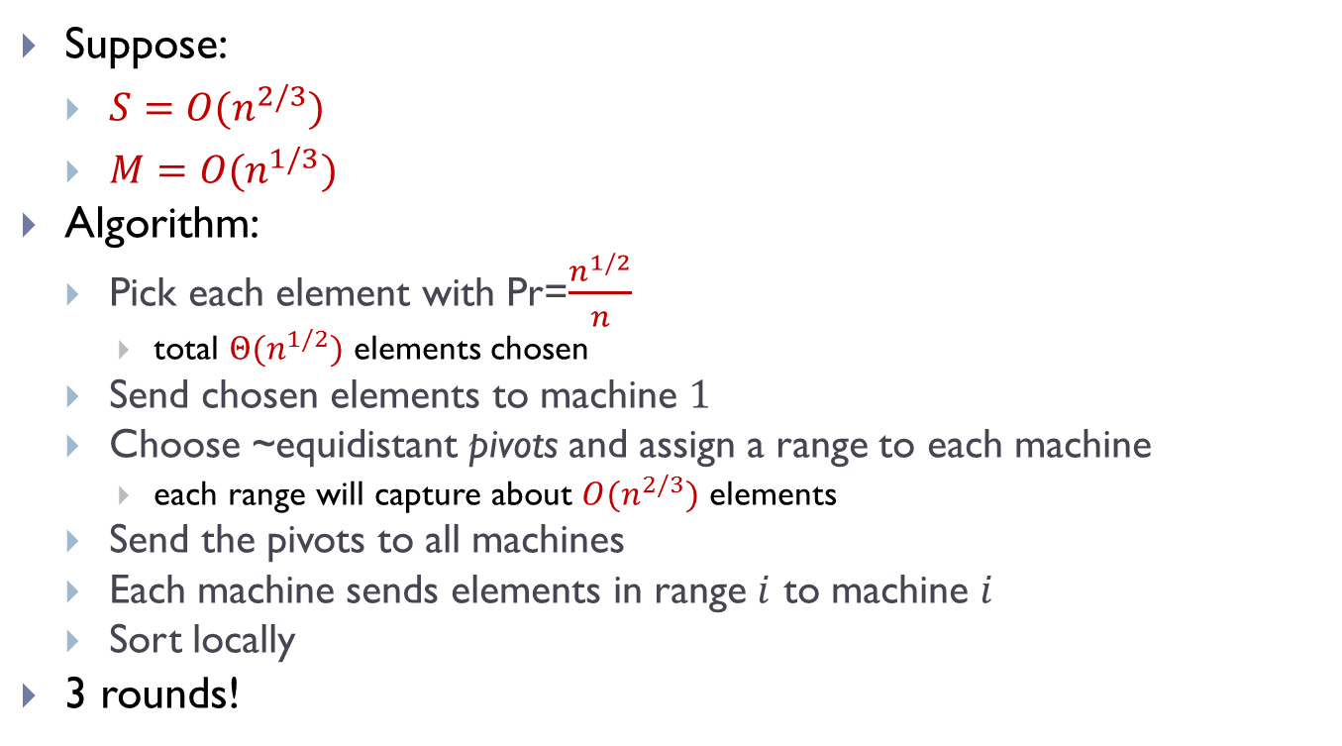
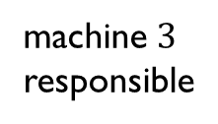
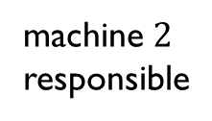
Problem 1: sorting
Suppose:
  $S={O(n}^{2/3})$
  $M={O(n}^{1/3})$
Algorithm:
  Pick each element with Pr=$\frac{n^{1/2}}{n}$
    total $Θ(n^{1/2})$ elements chosen
  Send chosen elements to machine $1$
  Choose ~equidistant pivots and assign a range to each machine
    each range will capture about $O(n^{2/3})$ elements
  Send the pivots to all machines
  Each machine sends elements in range $i$ to machine $i$
  Sort locally
3 rounds!
machine $1$
responsible
machine $2$
responsible
machine $3$
responsible

Slide 9

Problem 2: graph connectivity
Dense: if $S≥n^{1+ε}$
  Can do in $O\left(\frac{1}{ε}\right)$ rounds [KSV’10…]
Sparse: if $S<n$
  Hard: big open question to do s-t connectivity in $≪\log{n}$ rounds.
VS

Slide 10
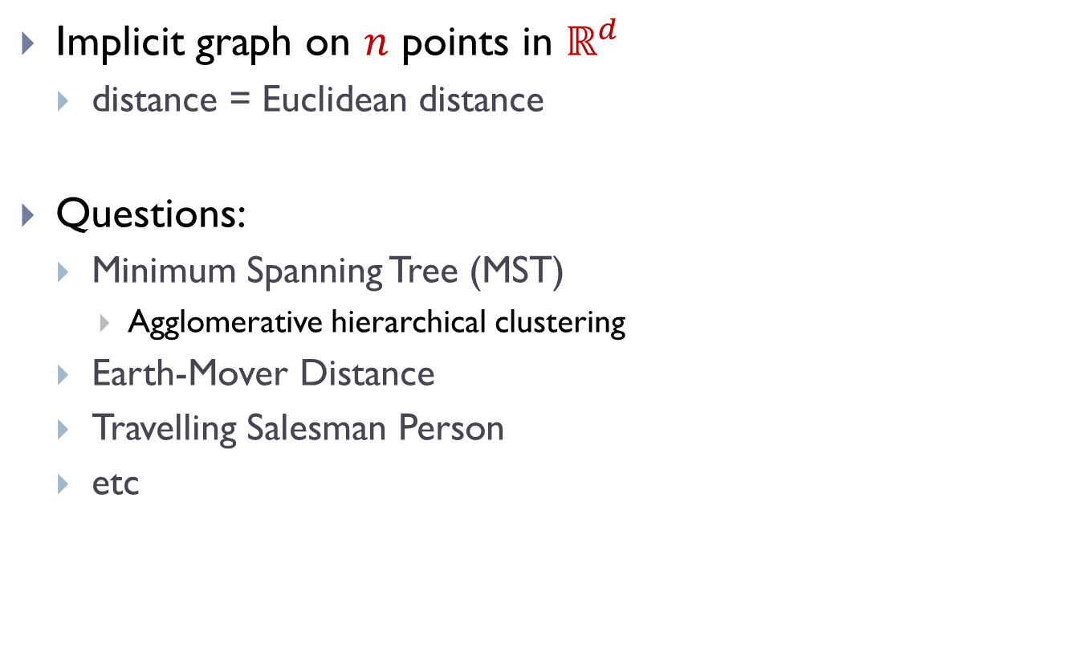
Problems 3: geometric graphs
Implicit graph on $n$ points in $ℝ^{d}$
  distance = Euclidean distance
Questions:
  Minimum Spanning Tree (MST)
    Agglomerative hierarchical clustering
  Earth-Mover Distance
  Travelling Salesman Person
  etc
Notes:
pictures of problems!

Slide 11
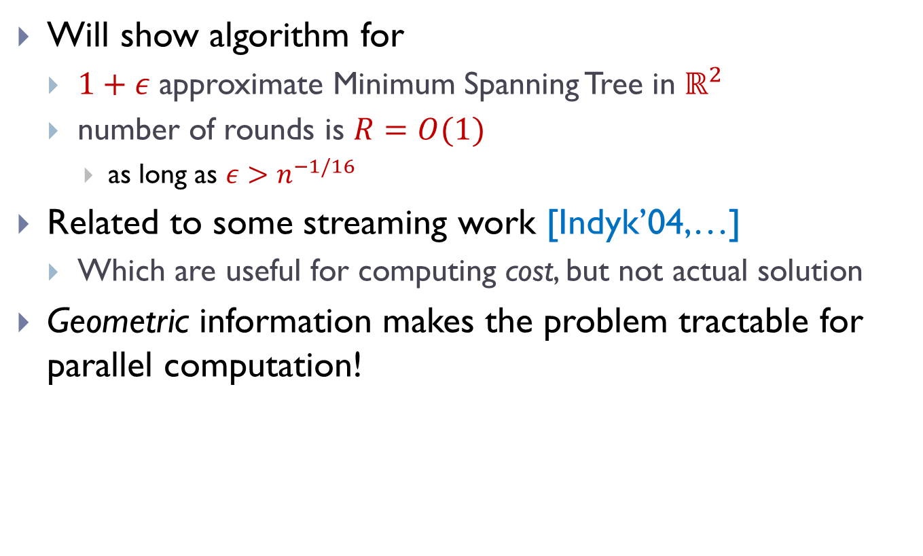
Problem: Geometric MST
[A-Nikolov-Onak-Yaroslavtsev’??]
Will show algorithm for
  $1+ε$ approximate Minimum Spanning Tree in $ℝ^{2}$
  number of rounds is $R=O(1)$
    as long as $ε>n^{−1/16}$
Related to some streaming work [Indyk’04,…]
  Which are useful for computing cost, but not actual solution
Geometric information makes the problem tractable for parallel computation!

Slide 12
General Approach
Partition the space hierarchically in a “nice way”
In each part
  Compute a pseudo-solution to the problem
  Sketch the pseudo-solution with small space
  Send the sketch to be used in the next level/round

Slide 13
MST algorithm: attempt 1
Partition the space hierarchically in a “nice way”
In each part
  Compute a pseudo-solution to the problem
  Sketch the pseudo-solution with small space
  Send the sketch to be used in the next level/round
quad trees!
compute MST
send any point as a representative

Slide 14
Troubles
Quad tree can cut MST edges
  forcing irrevocable decisions
Choose a wrong representative

Slide 15
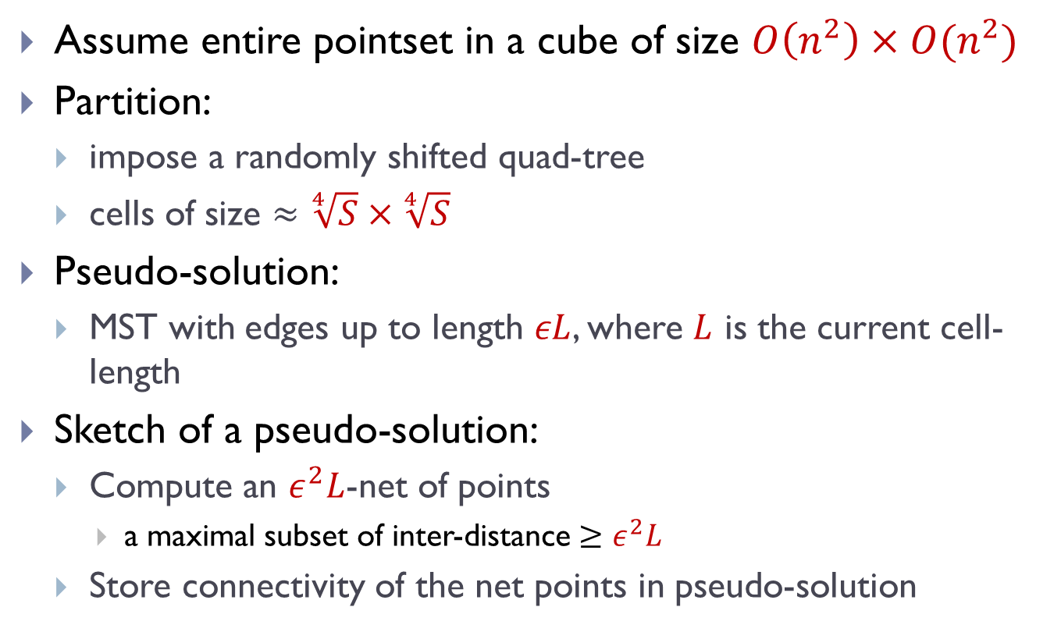
MST algorithm: final
Assume entire pointset in a cube of size $O\left(n^{2}\right)×O(n^{2})$
Partition:
  impose a randomly shifted quad-tree
  cells of size $≈\sqrt[4]{S}×\sqrt[4]{S}$
Pseudo-solution:
  MST with edges up to length $εL$, where $L$ is the current cell-length
Sketch of a pseudo-solution:
  Compute an $ε^{2}L$-net of points
    a maximal subset of inter-distance $≥ε^{2}L$
  Store connectivity of the net points in pseudo-solution

Slide 16
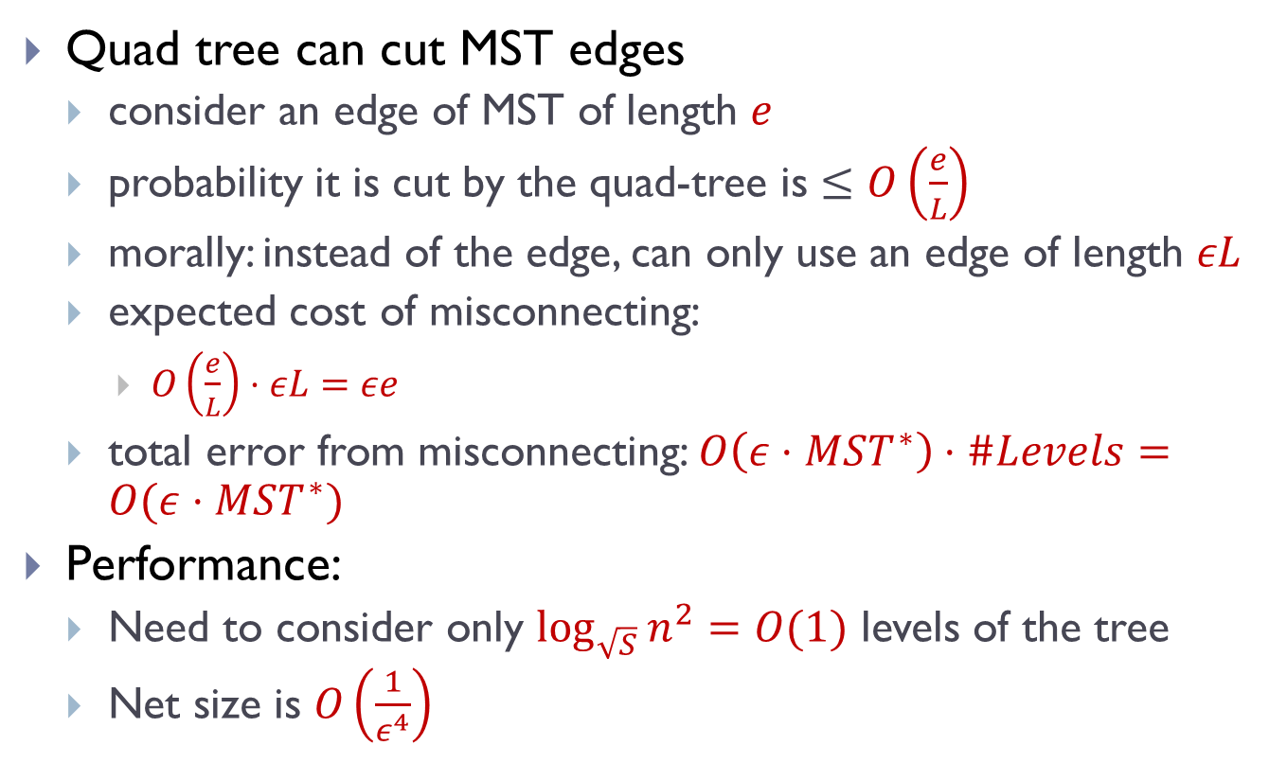
MST algorithm: Glimpse of analysis
Quad tree can cut MST edges
  consider an edge of MST of length $e$
  probability it is cut by the quad-tree is $≤O\left(\frac{e}{L}\right)$
  morally: instead of the edge, can only use an edge of length $εL$
  expected cost of misconnecting:
    $O\left(\frac{e}{L}\right)⋅εL=εe$
  total error from misconnecting: $O\left(ε⋅MST^{∗}\right)⋅\#Levels=O(ε⋅MST^{∗})$
Performance:
  Need to consider only $\log_{\sqrt{S}}{n^{2}}=O(1)$ levels of the tree
  Net size is $O\left(\frac{1}{ε^{4}}\right)$

Slide 17

Finale
Gotta love your models:
  Streaming:
    sub-linear space
    see all data sequentially
  Parallel computing:
    sub-linear space per machine
    data distributed over many machines
    communication (rounds) expensive
Algorithmic tools in development!

