Slide 1
Sketching, Sampling and other Sublinear Algorithms: Streaming
Alex Andoni
(MSR SVC)

Slide 2
A scenario
Challenge:
compute something on the table,
using small space.
131.107.65.14
18.9.22.69
Example of “something”:
# distinct IPs
max frequency
other statistics…
131.107.65.14
80.97.56.20
18.9.22.69
80.97.56.20
IP | Frequency
131.107.65.14 | 3
18.9.22.69 | 2
80.97.56.20 | 2
IP | Frequency
131.107.65.14 | 3
18.9.22.69 | 2
80.97.56.20 | 2
128.112.128.81 | 9
127.0.0.1 | 8
257.2.5.7 | 0
7.8.20.13 | 1
131.107.65.14

Slide 3
Sublinear: a panacea?
Sub-linear space algorithm for solving Travelling Salesperson Problem?
Sorry, perhaps a different lecture
Hard to solve sublinearly even very simple problems:
Ex: what is the count of distinct IPs seen
Will settle for:
Approximate algorithms: 1+ε approximation
true answer ≤ output ≤ (1+ε) * (true answer)
Randomized: above holds with probability 95%
Quick and dirty way to get a sense of the data
IP | Frequency
131.107.65.14 | 3
18.9.22.69 | 2
80.97.56.20 | 2
128.112.128.81 | 9
127.0.0.1 | 8
257.2.5.7 | 0
8.3.20.12 | 1

Slide 4
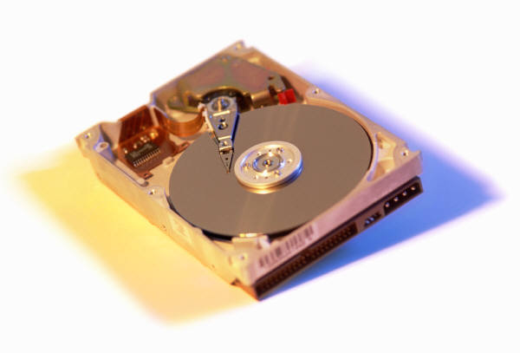
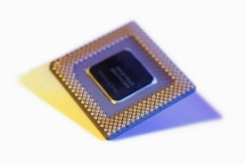
Streaming data
Data through a router
Data stored on a hard drive, or streamed remotely
More efficient to do a linear scan on a hard drive
Working memory is the (smaller) main memory
2
2

Slide 5
Application areas
Data can come from:
Network logs, sensor data
Real time data
Search queries, served ads
Databases (query planning)
…
Notes:
pictures

Slide 6
Problem 1: # distinct elements
Problem: compute the number of distinct elements in the stream
Trivial solution: $O(m)$space for $m$ distinct elements
Will see: $O(log⁡m)$ space (approximate)
2
5
7
5
5
i | Frequency
2 | 1
5 | 3
7 | 1

Slide 7
Distinct Elements: idea 1
[Flajolet-Martin’85, Alon-Matias-Szegedy’96]
Algorithm DISTINCT:
Initialize:
minHash=1
hash function h into [0,1]
Process(int i):
if (h(i) < minHash)
minHash = h(index);
Output: 1/minHash-1
Algorithm:
Hash function $h:U→\left[0,1\right]$
Compute $minHash=\min_{i∈S} h(i)$
Output is $\frac{1}{minHash}−1$
“Analysis”:
repeats of the same element i don’t matter
$E\left[segment\right]=\frac{1}{m+1}$, for $m$ distinct elements
5
7
2
$$0$$
$$1$$
$$h(5)$$
$$h(7)$$
$$h(2)$$
$$1/(m+1)$$

Slide 8
Distinct Elements: idea 2
Algorithm DISTINCT:
Initialize:
minHash2=0
hash function h into [0,1]
Process(int i):
if (h(i) < 1/2^minHash2)
minHash2 = ZEROS(h(index));
Output: 2^minHash2
Algorithm DISTINCT:
Initialize:
minHash=1
hash function h into [0,1]
Process(int i):
if (h(i) < minHash)
minHash = h(index);
Output: 1/minHash-1
Store $minHash$approximately
Store just the count of
trailing zeros
Need only $O(log⁡log⁡n)$ bits
Randomness: 2-wise enough!
$O(log⁡n)$ bits
Better accuracy using more space:
error $1+ε$
repeat $O(1/ε^{2})$ times with different hash functions
HyperLogLog: can also with just one hash function [FFGM’07]
x=0.0000001100101
ZEROS(x)

Slide 9
Problem 2: max count
heavy hitters
Problem: compute the maximum frequency of an element in the stream
Bad news:
Hard to distinguish whether an element repeated (max = 1 vs 2)
Good news:
Can find “heavy hitters”
elements with frequency > total frequency / s
using space proportional to s
2
5
7
5
5
IP | Frequency
2 | 1
5 | 3
7 | 1

Slide 10
Heavy Hitters: CountMin
[Charikar-Chen-FarachColton’04, Cormode-Muthukrishnan’05]
Algorithm CountMin:
Initialize(r, L):
array Sketch[L][w]
L hash functions h[L], into {0,…w-1}
Process(int i):
for(j=0; j<L; j++)
Sketch[j][ h[j](i) ] += 1;
Output:
foreach i in PossibleIP {
freq[i] = int.MaxValue;
for(j=0; j<L; j++)
freq[i] = min(freq[i],
Sketch[j][h[j](i)]);
}
// freq[] is the frequency estimate
2
5
7
5
5
11
$$h_{3}\left(2\right)$$
$$h_{1}(2)$$
$$h_{2}(2)$$
 | 1
 |  |  | 1
1
1 | 1
 |  |  | 2
1 | 1
1 | 2
 | 1 |  | 2
1 | 1 | 1
2 | 2
 | 1 |  | 3
1 | 2 | 1
3 | 2
 | 1 |  | 4
1 | 3 | 1
$$L$$
$$w$$
freq$\left[2\right]=1$
freq$\left[5\right]=3$
freq$\left[7\right]=1$
freq$\left[11\right]=1$

Slide 11
Heavy Hitters: analysis
5
$$w$$
Algorithm CountMin:
Initialize(r, L):
array Sketch[L][w]
L hash functions h[L], into {0,…w-1}
Process(int i):
for(j=0; j<L; j++)
Sketch[j][ h[j](i) ] += 1;
Output:
foreach i in PossibleIP {
freq[i] = int.MaxValue;
for(j=0; j<L; j++)
freq[i] = min(freq[i],
Sketch[j][h[j](i)]);
}
// freq[] is the frequency estimate
3 | 2
 | 1 |  | 4
1 | 3 | 1
3
$$L$$
= frequency of 5, plus “extra mass”
Expected “extra mass” ≤ total mass / w
Chebyshev: true with probability >1/2
$L=O(\log{m})$ to get high probability (for all $m$ elements)
Compute heavy hitters from freq[]

Slide 12
Problem 3: Moments
Problem: compute frequency moment
variance $F_{2}=\sum_{i}{{f(i)}^{2}}$ or
higher moments $F_{k}=\sum_{i}{{f(i)}^{k}}$ for $k>2$
Skewness (k=3), kurtosis (k=4), etc
a different proxy for max: $\lim_{k→∞}{\sqrt[k]{F_{k}}}=\max_{i}{f(i)}$
IP | Frequency $f(i)$
2 | 1
5 | 3
7 | 2
$${f(i)}^{2}$$
1
9
4
$${f(i)}^{4}$$
1
81
16
$F_{2}=$1+9+4=14
$$\sqrt{F_{2}}=3.74$$
$F_{4}=$1+81+16=98
$$\sqrt[4]{F_{4}}=3.15$$

Slide 13
$F_{2}$ moment
Use Johnson-Lindenstrauss lemma! (2nd lecture)
Store sketch $S=Gf$
$f$ = frequency vector
$G$ = $k$ by $n$ matrix of Gaussian entries
Update on element $i$:
$G(f+e_{i})=Gf+Ge_{i}$
Guarantees:
$k=O(1/ε^{2})$ counters (words)
$O(k)$ time to update
Better: $±1$ entries, $O(1)$ update [AMS’96, TZ’04]
$F_{k}$: precision sampling => next

Slide 14
Scenario 2: distributed traffic
Statistics on traffic difference/aggregate between two routers
Eg: traffic different by how many packets?
Linearity is the power!
Sketch(data $1$) + Sketch(data $2$) = Sketch(data $1$ + data $2$)
Sketch(data $1$) - Sketch(data $2$) = Sketch(data $1$ - data $2$)
131.107.65.14
35.8.10.140
18.9.22.69
18.9.22.69
IP | Frequency
131.107.65.14 | 1
18.9.22.69 | 1
35.8.10.140 | 1
IP | Frequency
131.107.65.14 | 1
18.9.22.69 | 2
Two sketches should be sufficient to compute
something on the difference or sum

Slide 15
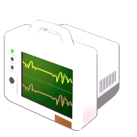
Common primitive: estimate sum
Given: $n$ quantities $a_{1}, a_{2}, …a_{n}$ in the range $[0,1]$
Goal: estimate $S=a1+a2+…a_{n}$ “cheaply”
Standard sampling: pick random set $J=\{j1,…jm\}$ of size $m$
Estimator: $\tilde{S}=\frac{n}{m}⋅(a_{j_{1}}+a_{j_{2}}+…a_{j_{m}})$
Chebyshev bound: with 90% success probability
$\frac{1}{2}S – O(n/m) <\tilde{S} < 2S + O(n/m)$
For constant additive error, need $m=Ω(n)$
Compute an estimate $\tilde{S}$ from $a1, a3$
a₁
a₃
a₁
a₂
a₃
a₄

Slide 16
Precision Sampling Framework
Alternative “access” to $ai$’s:
For each term $ai$, we get a (rough) estimate ${\tilde{a}}_{i}$
up to some precision $ui$, chosen in advance: $|ai –{\tilde{a}}_{i}| < ui$
Challenge: achieve good trade-off between
quality of approximation to $S$
use only weak precisions $ui$ (minimize “cost” of estimating $\tilde{a}$)
Compute an estimate $\tilde{S}$ from ${\tilde{a}}_{1},{\tilde{a}}_{2}, {\tilde{a}}_{3}{,\tilde{a}}_{4}$
u₁
u₂
u₃
u₄
ã₁
ã₂
ã₃
ã₄
a₁
a₂
a₃
a₄

Slide 17
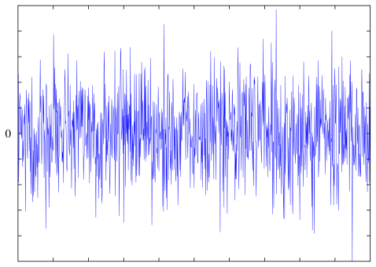
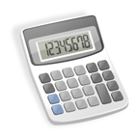
Formalization
Sum Estimator
Adversary
1. fix precisions $ui$
1. fix $a1,a2,…a_{n}$
2. fix ${\tilde{a}}_{1}, {\tilde{a}}_{2}, …{\tilde{a}}_{n}$ s.t. $|a_{i}−{\tilde{a}}_{i}| < ui$
3. given ${\tilde{a}}_{1}, {\tilde{a}}_{2}, …{\tilde{a}}_{n}$, output $\tilde{S}$ s.t.
$\left|\sum_{i}{a_{i}}−\tilde{S}\right|<1$.
What is cost?
Here, average cost = $1/n⋅∑ 1/ui$
to achieve precision $ui$, use $1/ui$ “resources”: e.g., if $ai$ is itself a sum $ai=∑jaij$computed by subsampling, then one needs $Θ(1/ui)$ samples
For example, can choose all $ui=1/n$
Average cost ≈ $n$

Slide 18
Precision Sampling Lemma
[A-Krauthgamer-Onak’11]
Goal: estimate ∑a_{i} from {ã_{i}} satisfying |a_{i}-ã_{i}|<u_{i}.
Precision Sampling Lemma: can get, with 90% success:
O(1) additive error and 1.5 multiplicative error:
S – O(1) < S̃ < 1.5*S + O(1)
with average cost equal to O(log n)
Example: distinguish Σa_{i}=3 vs Σa_{i}=0
Consider two extreme cases:
if three a_{i}=1: enough to have crude approx for all (u_{i}=0.1)
if all a_{i}=3/n: only few with good approx u_{i}=1/n, and the rest with u_{i}=1
ε
1+ε
S – ε < S̃ < (1+ ε)S + ε
O(ε⁻³ log n)

Slide 19
Precision Sampling Algorithm
Precision Sampling Lemma: can get, with 90% success:
O(1) additive error and 1.5 multiplicative error:
S – O(1) < S̃ < 1.5*S + O(1)
with average cost equal to O(log n)
Algorithm:
Choose each u_{i}∈[0,1] i.i.d.
Estimator: S̃ = count number of i‘s s.t. ã_{i} / u_{i} > 6 (up to a normalization constant)
Proof of correctness:
we use only ã_{i} which are 1.5-approximation to a_{i}
E[S̃] ≈ ∑ Pr[a_{i} / u_{i} > 6] = ∑ a_{i}/6.
E[1/u_{i}] = O(log n) w.h.p.
ε
1+ε
S – ε < S̃ < (1+ ε)S + ε
O(ε⁻³ log n)
concrete distrib. = minimum of O(ε⁻³) u.r.v.
function of [ã_{i} /u_{i} - 4/ε]⁺ and u_{i}’s

Slide 20
Moments ($F_{k}$) via precision sampling
Theorem: linear sketch for $F_{k}$ with $O(1)$ approximation, and $O(n^{1−2/k} log⁡n)$ space (90% succ. prob.).
Sketch:
Pick random $ui[0,1], ri\{±1\}$, and let $y_{i}=x_{i}⋅r_{i}/u_{i}^{1/k}$
throw into one hash table $H$,
$m=O(n^{1−2/k} log⁡n)$ cells
Estimator:
$\max_{j}{{\left|H\left[j\right]\right|}^{p}}$
Randomness: $O(1)$ independence suffices
x=
x₁ | x₂ | x₃ | x₄ | x₅ | x₆
y₁+y₃ | y₄ | y₂+y₅+y₆
H=

Slide 21
Streaming++
LOTS of work in the area:
Surveys
Muthukrishnan: http://algo.research.googlepages.com/eight.ps
McGregor: http://people.cs.umass.edu/~mcgregor/papers/08-graphmining.pdf
Chakrabarti: http://www.cs.dartmouth.edu/~ac/Teach/CS49-Fall11/Notes/lecnotes.pdf
Open problems: http://sublinear.info
Examples:
Moments, sampling
Median estimation, longest increasing sequence
Graph algorithms
E.g., dynamic graph connectivity [AGG’12, KKM’13,…]
Numerical algorithms (e.g., regression, SVD approximation)
Fastest (sparse) regression […CW’13,MM’13,KN’13,LMP’13]
related to Compressed Sensing

