Slide 1
Sketching, Sampling and other Sublinear Algorithms: Euclidean space: dimension reduction and NNS
Alex Andoni
(MSR SVC)

Slide 2
A Sketching Problem
Sketching:
$f$:objects $→$ short bit-strings
given $f(p)$ and $f(q)$ should be able to deduce if $p$ and $q$ are “similar”
Why?
reduce space and time to compute similarity
To be or not to be
To sketch or not to sketch
$$f$$
$$f$$
$$f$$
$$f$$
010110
010101
be
to
similar?
similar?

Slide 3
Sketch from LSH
$$Pr⁡[g(p)=g(q)]$$
1
LSH often has property:
$Pr\left[h\left(p\right)=h(q)\right]≈similarity\left(p,q\right)$
Sketching from LSH:
$f\left(p\right)=\left\langle h_{1}\left(p\right), h_{2}\left(p\right),…h_{k}(p)\right\rangle$
Estimate $similarity\left(p,q\right)$ by the fraction of collisions between $f\left(p\right),f(q)$
$k$ controls the variance of the estimate
$$dist(p,q)$$
[Broder’97]: for
Jaccard coefficient

Slide 4
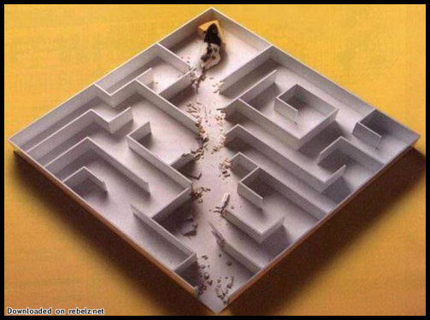
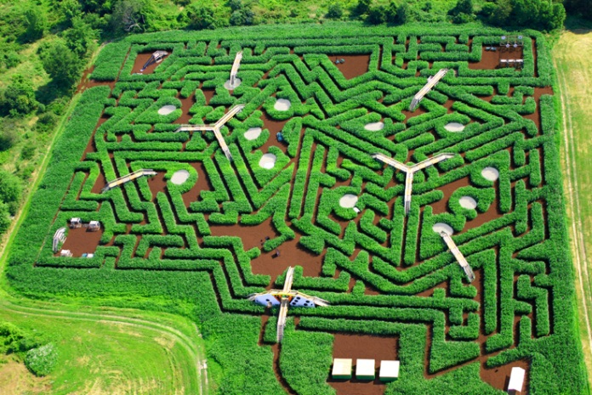
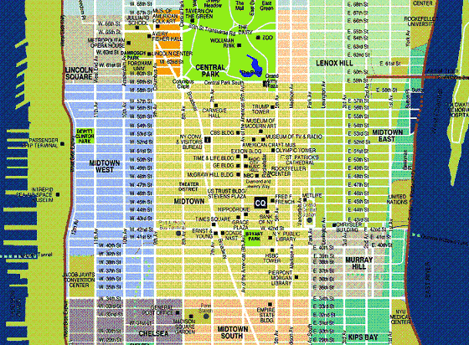
General Theory: embeddings
The above map $f$is an embedding
General motivation: given distance (metric) $M$, solve a computational problem $P$ under $M$
Hamming distance
Compute distance between two points
Euclidean distance (ℓ₂)
Nearest Neighbor Search
Edit distance between two strings
Diameter/Close-pair of set S
Earth-Mover (transportation) Distance
Clustering, MST, etc
f
Reduce problem
<P under hard metric>
to
<P under simpler metric>

Slide 5
Embeddings: landscape
Definition: an embedding is a map $f:MH$ of a metric $(M, d_{M})$ into a host metric $(H, ρ_{H})$ such that for any $x,yM$:
$dM(x,y) ≤ H(f(x), f(y)) ≤ D ∗ dM(x,y)$
where $D$ is the distortion (approximation) of the embedding $f$.
Embeddings come in all shapes and colors:
Source/host spaces $M, H$
Distortion $D$
Can be randomized: $H(f(x), f(y)) ≈ dM(x,y)$ with $1−$ probability
Time to compute $f(x)$
Types of embeddings:
From norm to the same norm but of lower dimension (dimension reduction)
From non-norms (edit distance, Earth-Mover Distance) into a norm (ℓ₁)
From given finite metric (shortest path on a planar graph) into a norm (ℓ₁)
$H$ not a metric but a computational procedure $←$ sketches

Slide 6
Dimension Reduction
Johnson Lindenstrauss Lemma: there is a linear map $F:ℓ_{2}^{d}→ℓ_{2}^{k}$, $k≪d$, that preserves distance between two vectors $x,y$
up to $1+ε$ distortion
with $1−e^{{−Cε}^{2}k}$ probability ($C$ some constant)
Preserves distances among $n$ points for $k=O(ε^{−2}\log{n})$
Motivation:
E.g.: diameter of a pointset $S$ in $d$-dimensional Euclidean space
Trivially: $O(n^{2}⋅ d)$ time
Using lemma: $O(nd⋅ε^{−2}\log{n}+ n^{2}⋅ε^{−2}log⁡n)$ time for $1+$ approximation
MANY applications: nearest neighbor search, streaming, pattern matching, approximation algorithms (clustering)…

Slide 7
Main intuition
The map can be simply a projection onto a random subspace of dimension $k$

Slide 8
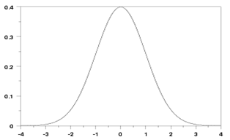
1D embedding
How about one dimension ($k=1$) ?
Map $f:ℓ_{2}^{d}$
$f\left(x\right)= ∑i g_{i}⋅x_{i}$ ,
where $gi$are iid normal (Gaussian) random variable
Why Gaussian?
Stability property: $∑i g_{i}⋅x_{i}$ is distributed as $|\left|x|\right|⋅g$, where $g$ is also Gaussian
Equivalently: $〈g_{1},…,g_{d}〉$ is centrally distributed, i.e., has random direction, and projection on random direction depends only on length of $x$
pdf = ${\frac{1}{\sqrt{2π}}e}^{−g^{2}/2}$
E[g]=0
E[g²]=1
$$P\left(a\right)∙P\left(b\right)=$$
$$= \frac{1}{\sqrt{2π}}e^{−a^{2}/2}\frac{1}{\sqrt{2π}}e^{−b^{2}/2}$$
$$=\frac{1}{2π}e^{−{(a}^{2}+b^{2})/2}$$

Slide 9
1D embedding
Map $f\left(x\right)= ∑i g_{i}⋅x_{i}$ ,
for any $x$, $f\left(x\right)\sim \left|\left|x\right|\right|⋅g$
Linear: $f(x)−f(y)=f(x−y)$
Want: $|f(x)−f(y)| ≈ ‖x−y‖$
Claim: for any $x,yℜ^{d}$, we have
Expectation: $\left[{\left|f\left(x\right)−f\left(y\right)\right|}^{2}\right] = {\left\|x−y\right\|}^{2}$
Standard deviation:
$[|(f(x)−f\left(y\right){\left.​\right|}^{2}] = O({\left\|x−y\right\|}^{2})$
Proof:
Prove for $z=x−y$ since $f$ linear
Expectation $= Ε\left[{\left(f\left(z\right)\right)}^{2}\right]=Ε\left[{\left|\left|z\right|\right|}^{2}⋅g^{2}\right]$
$={\left\|z\right\|}^{2}$
pdf = ${\frac{1}{\sqrt{2π}}e}^{−g^{2}/2}$
E[g]=0
E[g²]=1
2
2

Slide 10
Full Dimension Reduction
Just repeat the 1D embedding for $k$ times!
$F(x) = (g1x, g2x, … gkx) / √k$ $=\frac{1}{√k}Gx$
where $G$ is $k×d$ matrix of Gaussian random variables
Want to prove:
$‖F(x)−F(y)‖ = (1±ε) ∗ ‖x−y‖$
with probability $1−e^{−Ω(ε^{2}k)}$
OK to prove $\left\|F\left(z\right)\right\|= \left(1±ε\right)⋅‖z‖$ for fixed $z=x−y$

Slide 11
Concentration
$F(z)$is distributed as
$\frac{1}{√k}\left(\left|\left|z\right|\right|{⋅a}_{1}, \left|\left|z\right|\right|⋅a_{2}, …\left|\left|z\right|\right|⋅a_{k}\right)$
where each $a_{i}$ is distributed as Gaussian
Norm ${\left|\left|F\left(z\right)\right|\right|}^{2}={\left|\left|z\right|\right|}^{2}⋅\frac{1}{√k}\sum_{i}{a_{i}^{2}}$
$\sum_{i}{a_{i}^{2}}$ is called chi-squared distribution with $k$ degrees
Fact: chi-squared very well concentrated:
Equal to $1+ε$ with probability ${1−e}^{−Ω(ε^{2}k)}$
Akin to central limit theorem

Slide 12
Dimension Reduction: wrap-up
$F(x) = (g_{1}⋅x, g_{2}⋅x, …g_{k}⋅x) /√k$ $=\frac{1}{√k}Gx$
$\left|\left|F\left(x\right)\right|\right|= \left(1±ε\right)\left|\left|x\right|\right|$ with high probability
Extra:
Linear: can update $F(x)$ as $x$ changes
Can use $±1$ instead of Gaussians [AMS’96, Ach’01, TZ’04…]
Fast JL: can compute faster than $O(kd)$ time [AC’06, AL’07’09, DKS’10, KN’10’12…]

Slide 13
NNS for Euclidean space
[Datar-Immorlica-Indyk-Mirrokni’04]
Can use dimensionality reduction to get LSH for $ℓ_{2}$
LSH function $h(p)$:
pick a random line $ℓ$, and quantize
project point into $ℓ$
$h\left(p\right)=\left\lfloor \frac{p⋅ℓ}{w}+b\right\rfloor$
$ℓ$ is a random Gaussian vector
$b$ random in $[0,1]$
$w$ is a parameter (e.g., 4)
$ρ=1/c$
$$ℓ$$
$$p$$

Slide 14
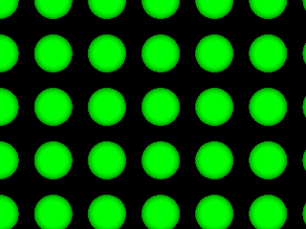
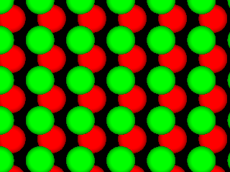
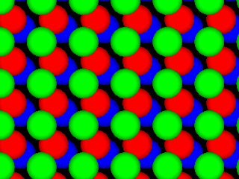
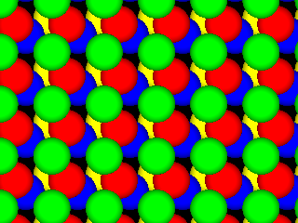
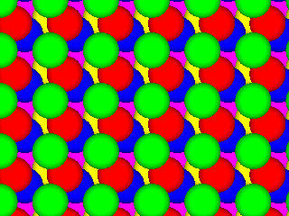
Near-Optimal LSH
[A-Indyk’06]
Regular grid → grid of balls
p can hit empty space, so take more such grids until p is in a ball
Need (too) many grids of balls
Start by projecting in dimension t
Analysis gives
Choice of reduced dimension t?
Tradeoff between
# hash tables, n^{ρ}, and
Time to hash, t^{O(t)}
Total query time: dn^{1/c2+o(1)}
p
2D
p
R^{t}

Slide 15
Open question:
More practical variant of above hashing?
Design space partitioning of $ℜ^{t}$ that is
efficient: point location in poly(t) time
qualitative: regions are “sphere-like”
$$p$$
c²
[Prob. needle of length 1 is not cut]
≥
[Prob needle of length c is not cut]

Slide 16
Time-Space Trade-offs
space
query
time
Space | Time | Comment | Reference
low
high
$$≈n$$ | $$n^{σ}$$ | $$σ=2.09/c$$ | [Ind’01, Pan’06]
 |  | $$σ=O(1/c^{2})$$ | [AI’06]
$$n^{1+ρ}$$ | $$n^{ρ}$$ | $$ρ=1/c$$ | [IM’98]
medium
medium
 |  | $$ρ≈1/c^{2}$$ | [DIIM’04, AI’06]
n^{1+o(1/c2)} | ω(1) memory lookups | [PTW’08, PTW’10]
one hash
table lookup!
high
low
$$n^{1+σ }$$ | $$O(d log n)$$ | $$σ=σ(c)$$ | [KOR’98, IM’98, Pan’06]
n^{o(1/ε2)} | ω(1) memory lookups | [AIP’06]

Slide 17
NNS beyond LSH
$$ℓ$$
Data-dependent partitions…
Practice:
Trees: kd-trees, quad-trees, ball-trees, rp-trees, PCA-trees, sp-trees…
often no guarantees
Theory:
can improve standard LSH by random data-dependent space partitions [A-Indyk-Nguyen-Razenshteyn’??]
tree-based approach to max-norm ($ℓ_{∞}$)

Slide 18
Finale
Dimension Reduction in Euclidean space
$F(x)=\frac{1}{√k}Gx$, random projection preserves distances
only $O(ε^{−2}\log{n})$ dimensions for distance among $n$ points!
NNS for Euclidean space
Random projections gives LSH
Even better with ball partitioning
Or better with cool lattices?

