Slide 1
Sketching, Sampling and other Sublinear Algorithms:
Nearest Neighbor Search
Alex Andoni
(MSR SVC)

Slide 2
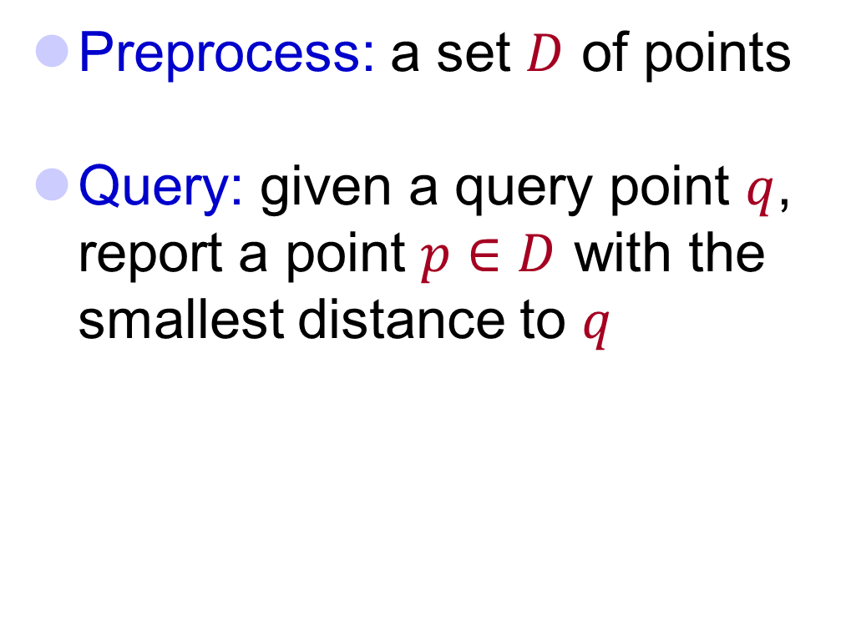


Nearest Neighbor Search (NNS)
Preprocess: a set $D$ of points
Query: given a query point $q$, report a point $p∈D$ with the smallest distance to $q$
$$p$$
$$q$$

Slide 3
Motivation
Generic setup:
  Points model objects (e.g. images)
  Distance models (dis)similarity measure
Application areas:
  machine learning: k-NN rule
  speech/image/video/music recognition, vector quantization, bioinformatics, etc…
Distance can be:
  Hamming, Euclidean, edit distance, Earth-mover distance, etc…
Primitive for other problems:
  find the similar pairs in a set D, clustering…
000000
011100
010100
000100
010100
011111
000000
001100
000100
000100
110100
111111
$$p$$
$$q$$

Slide 4
Lecture Plan
Locality-Sensitive Hashing
LSH as a Sketch
Towards Embeddings

Slide 5
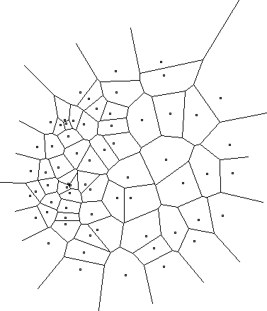
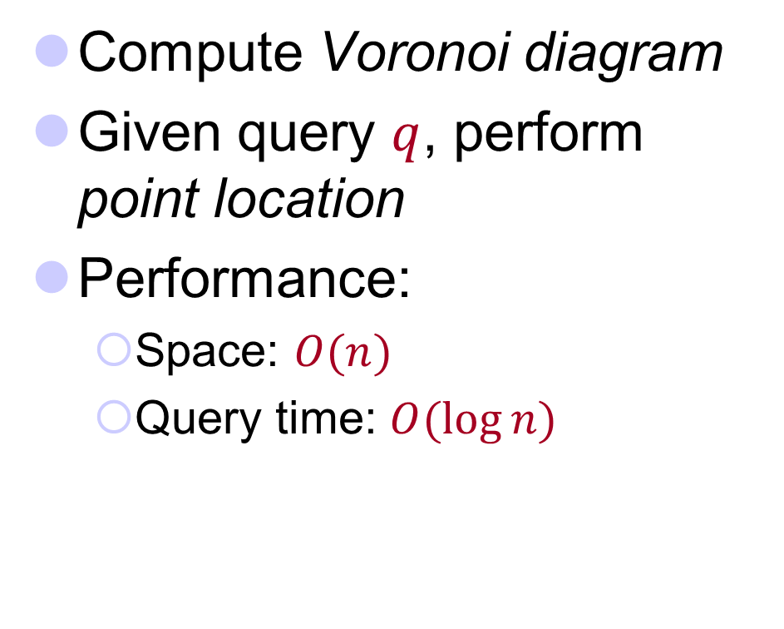
2D case
Compute Voronoi diagram
Given query $q$, perform point location
Performance:
  Space: $O(n)$
  Query time: $O(\log{n})$

Slide 6
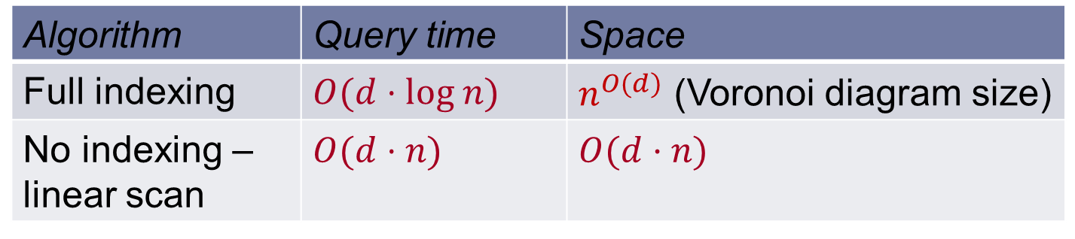

High-dimensional case
All exact algorithms degrade rapidly with the dimension $d$
In practice:
  When $d$is “low-medium”, kd-trees work reasonably
  When $d$is “high”, state-of-the-art is unsatisfactory
Algorithm | Query time | Space
Full indexing | $$O(d⋅log n)$$ | $n^{O(d)}$ (Voronoi diagram size)
No indexing – linear scan | $$O(d⋅n)$$ | $$O(d⋅n)$$

Slide 7


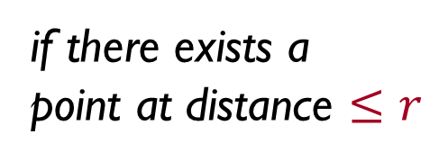

Approximate NNS
c-approximate
r-near neighbor: given a new point $q$, report a point $pD$ s.t. $\left\|p−q\right\|≤r$
Randomized: a point $p$ returned with 90% probability
$$cr$$
if there exists a
point at distance $≤r$
r
p
cr
q

Slide 8
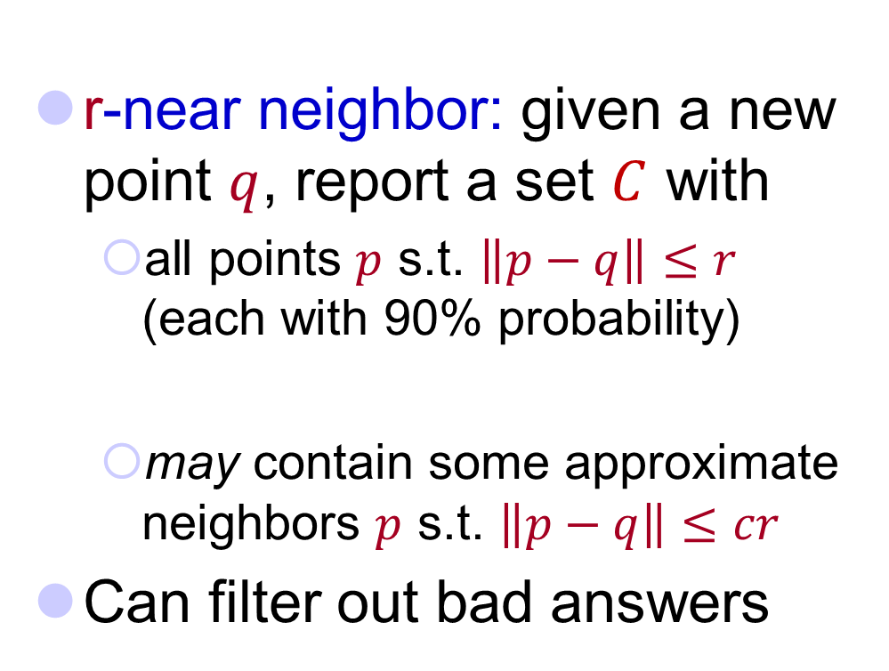
Heuristic for Exact NNS
c-approximate
r-near neighbor: given a new point $q$, report a set $C$ with
  all points $p$ s.t. $\left\|p−q\right\|≤r$ (each with 90% probability)
  may contain some approximate neighbors $p$ s.t. $\left\|p−q\right\|≤cr$
Can filter out bad answers
r
p
cr
q

Slide 9
Approximation Algorithms for NNS
A vast literature:
  milder dependence on dimension
    [Arya-Mount’93], [Clarkson’94], [Arya-Mount-Netanyahu-Silverman-We’98], [Kleinberg’97], [Har-Peled’02],…[Aiger-Kaplan-Sharir’13],
  little to no dependence on dimension
    [Indyk-Motwani’98], [Kushilevitz-Ostrovsky-Rabani’98], [Indyk’98, ‘01], [Gionis-Indyk-Motwani’99], [Charikar’02], [Datar-Immorlica-Indyk-Mirrokni’04], [Chakrabarti-Regev’04], [Panigrahy’06], [Ailon-Chazelle’06], [A-Indyk’06],… [A-Indyk-Nguyen-Razenshteyn’??]

Slide 10




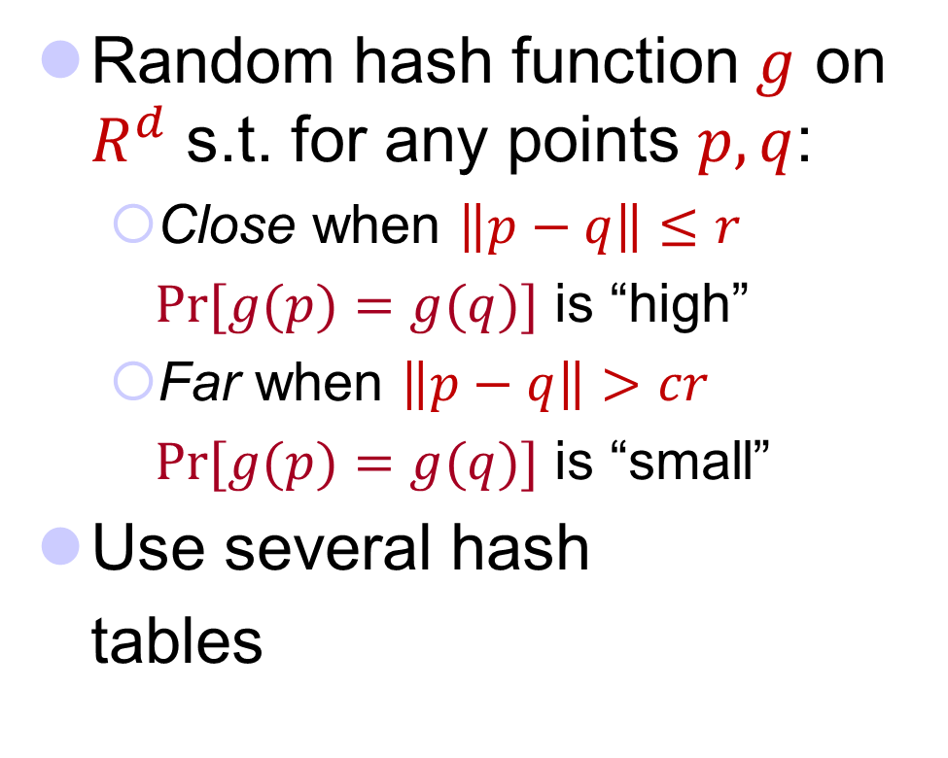





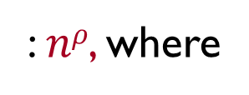
Locality-Sensitive Hashing
[Indyk-Motwani’98]
q
Random hash function $g$ on $R^{d}$ s.t. for any points $p,q$:
  Close when $\left\|p−q\right\|≤r$
  $Pr⁡[g(p)=g(q)]$ is “high”
  Far when $\left\|p−q\right\|>cr$
  $Pr⁡[g(p)=g(q)]$ is “small”
Use several hash
tables
p
q
$$P1=$$
“not-so-small”
$$P2=$$
: $nρ$, where
$$Pr⁡[g(p)=g(q)]$$
$$ρ=\frac{\log{1/P_{1}}}{\log{1/P_{2}}}$$
1
$$P1$$
$$P2$$
$$dist(p,q)$$
$$r$$
$$cr$$

Slide 11
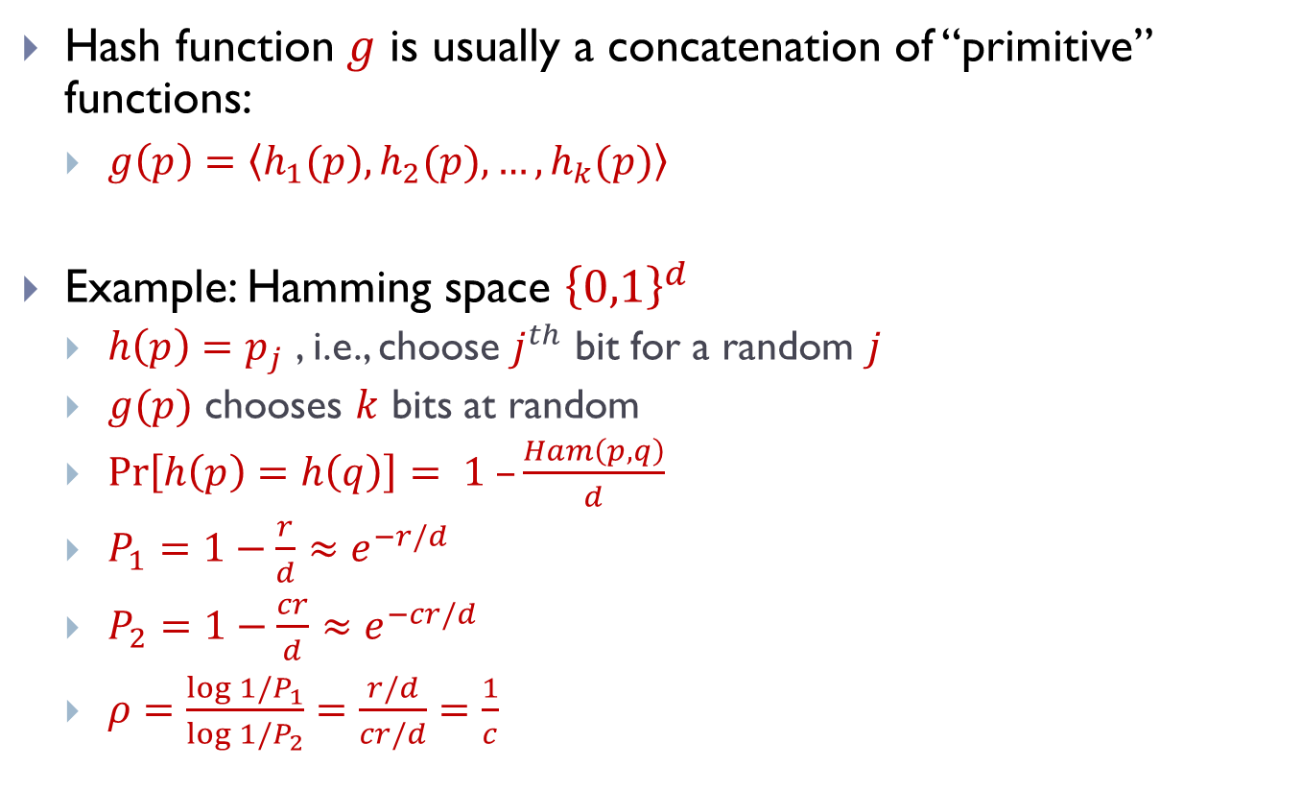
Locality sensitive hash functions
Hash function $g$ is usually a concatenation of “primitive” functions:
  $g\left(p\right)=\left\langle h_{1}(p),h_{2}(p),…,h_{k}(p)\right\rangle$
Example: Hamming space ${\left\{0,1\right\}}^{d}$
  $h\left(p\right)=p_{j}$ , i.e., choose $j^{th}$ bit for a random $j$
  $g(p)$ chooses $k$ bits at random
  $\operatorname{Pr}\left[h\left(p\right)=h\left(q\right)\right]= 1 –\frac{Ham\left(p,q\right)}{d}$
  $P_{1}=1−\frac{r}{d}≈e^{−r/d}$
  $P_{2}=1−\frac{cr}{d}≈e^{−cr/d}$
  $ρ=\frac{\log{1/P_{1}}}{\log{1/P_{2}}}=\frac{r/d}{cr/d}=\frac{1}{c}$

Slide 12
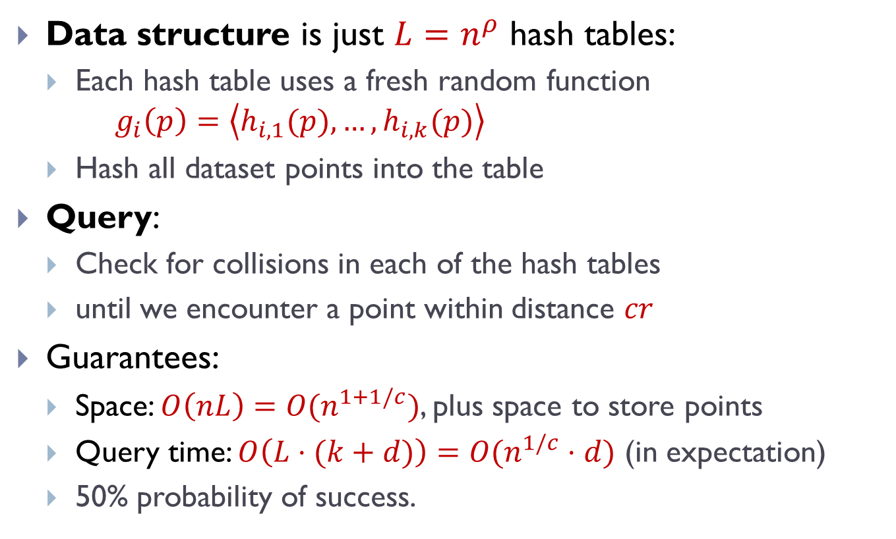
Formal description
Data structure is just $L=n^{ρ}$ hash tables:
  Each hash table uses a fresh random function $g_{i}\left(p\right)=\left\langle h_{i,1}(p),…,h_{i,k}(p)\right\rangle$
  Hash all dataset points into the table
Query:
  Check for collisions in each of the hash tables
  until we encounter a point within distance $cr$
Guarantees:
  Space: $O\left(nL\right)=O(n^{1+1/c})$, plus space to store points
  Query time: $O\left(L⋅(k+d)\right)=O(n^{1/c}⋅d)$ (in expectation)
  50% probability of success.
Notes:
Draw L hash tables

Slide 13
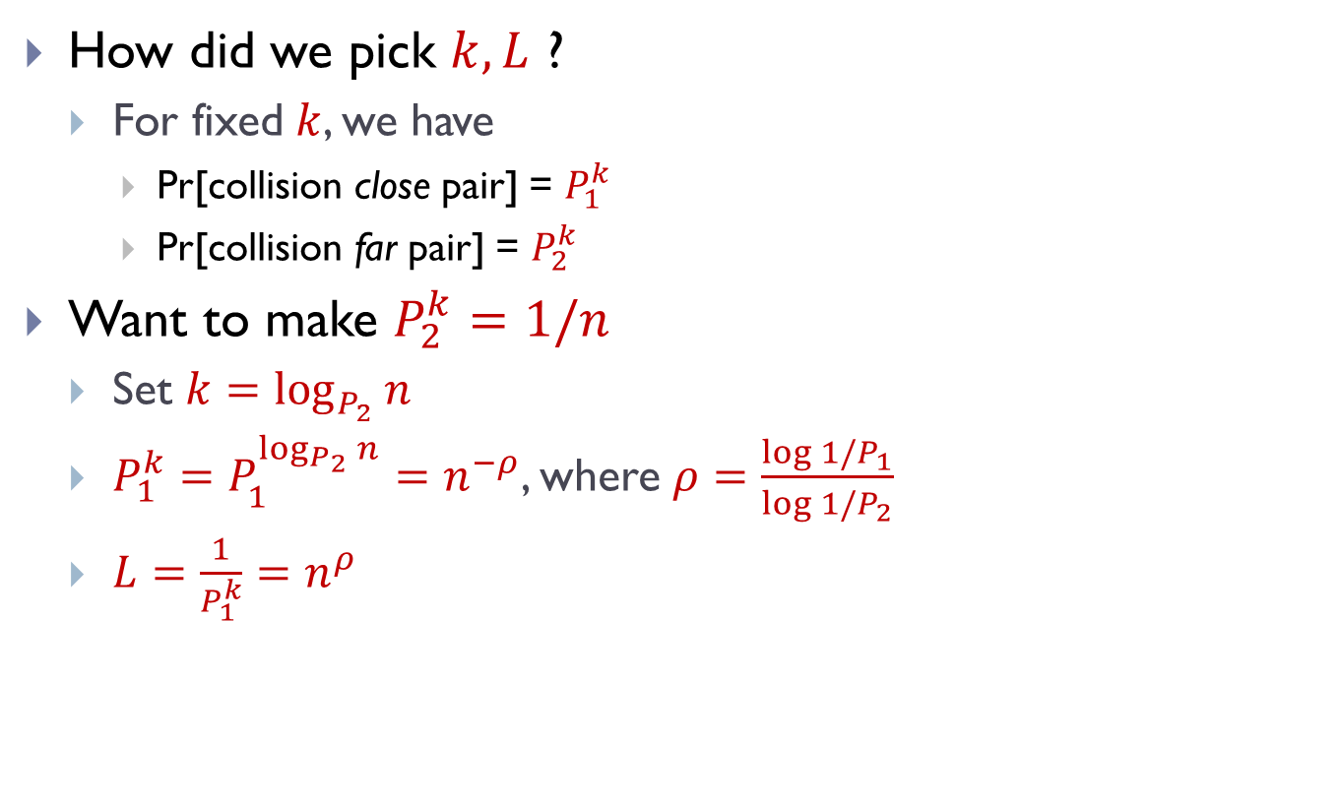
Analysis of LSH Scheme
How did we pick $k, L$ ?
  For fixed $k$, we have
    Pr[collision close pair] = $P_{1}^{k}$
    Pr[collision far pair] = $P_{2}^{k}$
Want to make $P_{2}^{k}=1/n$
  Set $k=\log_{P_{2}}{n}$
  $P_{1}^{k}=P_{1}^{\log_{P_{2}}{n}}=n^{−ρ}$, where $ρ=\frac{\log{{1/P}_{1}}}{\log{{1/P}_{2}}}$
  $L=\frac{1}{P_{1}^{k}}=n^{ρ}$

Slide 14
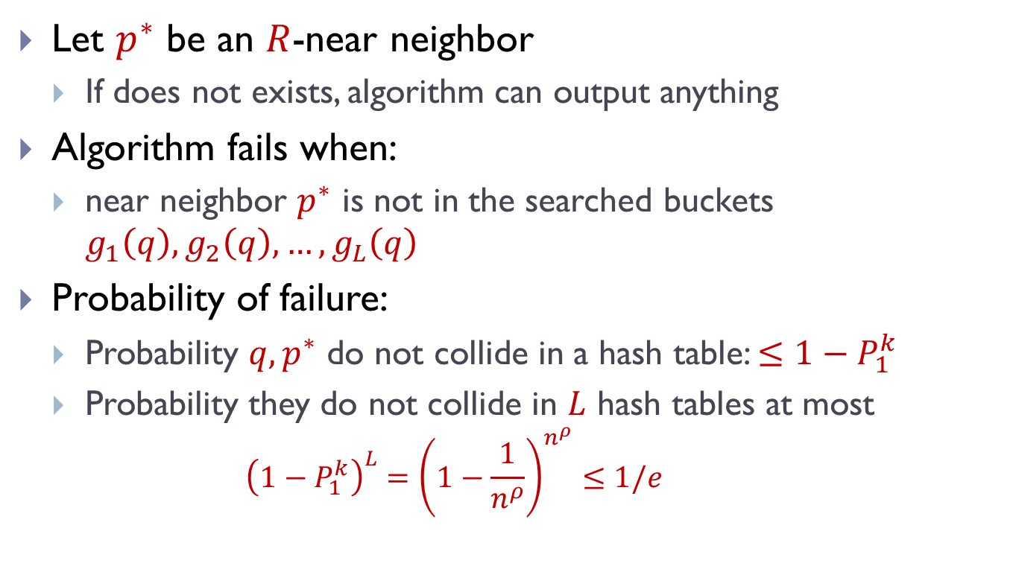
Analysis: Correctness
Let $p^{∗}$ be an $R$-near neighbor
  If does not exists, algorithm can output anything
Algorithm fails when:
  near neighbor $p^{∗}$ is not in the searched buckets $g_{1}\left(q\right), g_{2}\left(q\right), …,g_{L}\left(q\right)$
Probability of failure:
  Probability $q,p^{∗}$ do not collide in a hash table: $≤1−P_{1}^{k}$
  Probability they do not collide in $L$ hash tables at most
    $${\left(1−P_{1}^{k}\right)}^{L}={\left(1−\frac{1}{n^{ρ}}\right)}^{n^{ρ}}≤1/e$$

Slide 15
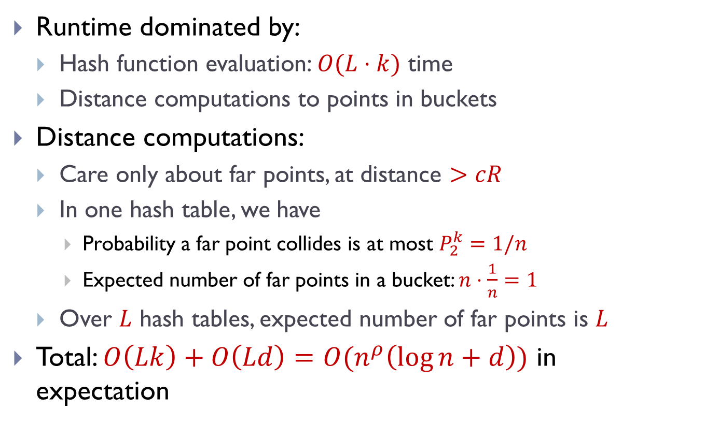
Analysis: Runtime
Runtime dominated by:
  Hash function evaluation: $O(L⋅k)$ time
  Distance computations to points in buckets
Distance computations:
  Care only about far points, at distance $>cR$
  In one hash table, we have
    Probability a far point collides is at most $P_{2}^{k}=1/n$
    Expected number of far points in a bucket: $n⋅\frac{1}{n}=1$
  Over $L$ hash tables, expected number of far points is $L$
Total: $O\left(Lk\right)+O\left(Ld\right)=O(n^{ρ}\left(\log{n}+d\right))$ in expectation

Slide 16
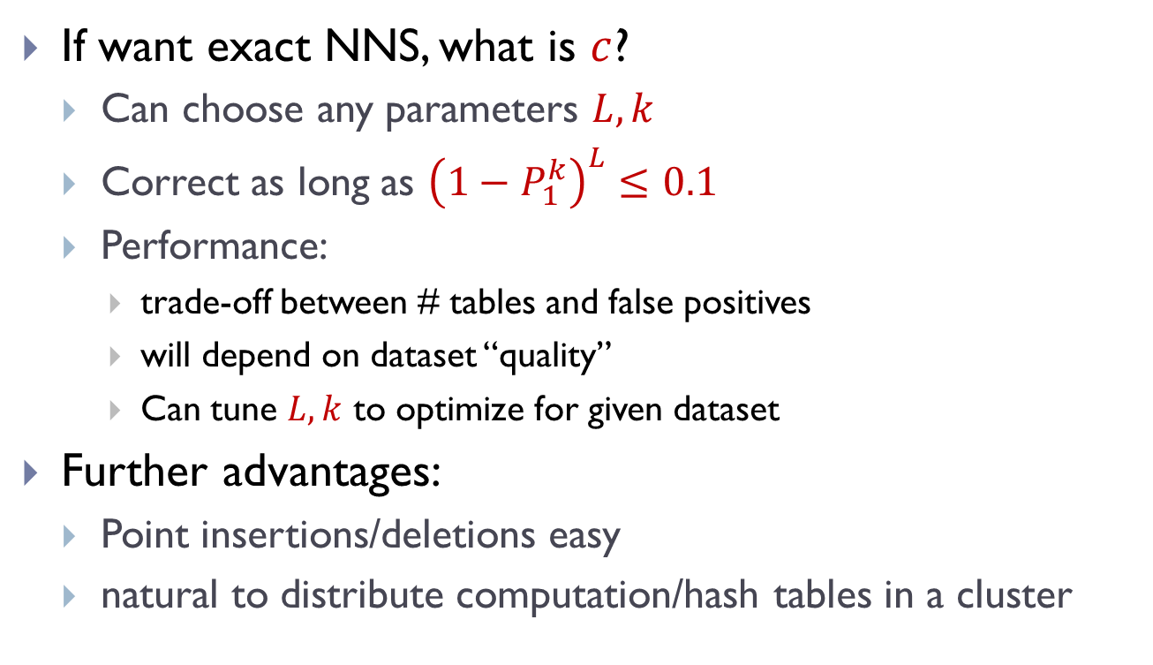


LSH in the wild
$$k$$
fewer tables
fewer false
positives
If want exact NNS, what is $c$?
  Can choose any parameters $L,k$
  Correct as long as ${\left(1−P_{1}^{k}\right)}^{L}≤0.1$
  Performance:
    trade-off between # tables and false positives
    will depend on dataset “quality”
    Can tune $L,k$ to optimize for given dataset
Further advantages:
  Point insertions/deletions easy
  natural to distribute computation/hash tables in a cluster
safety not
guaranteed
$$L$$

Slide 17

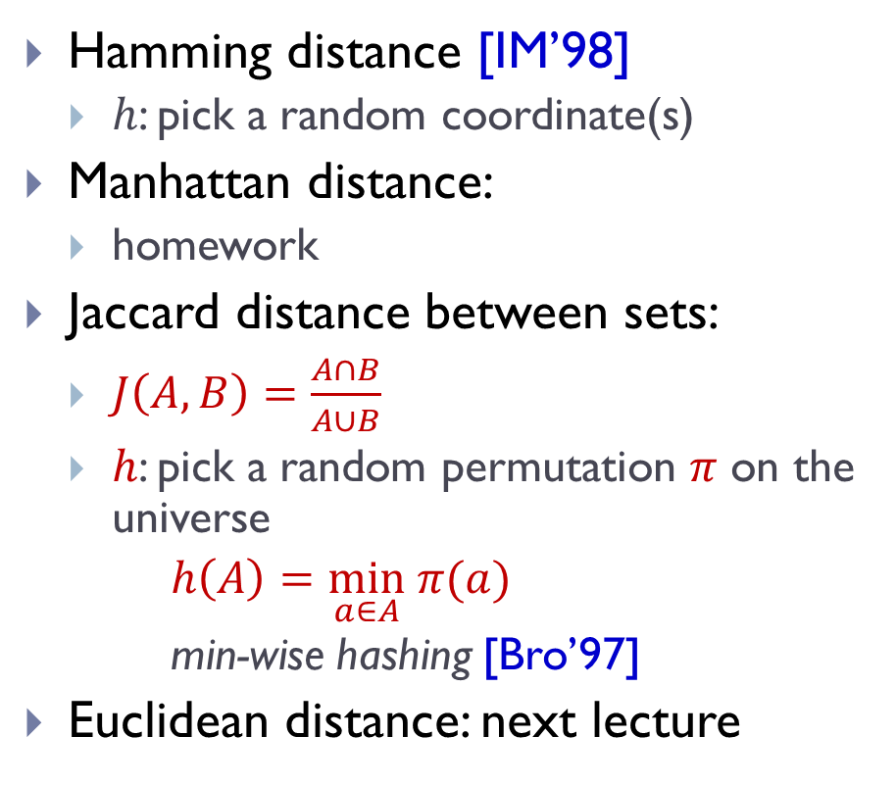
LSH Zoo
To be or not to be
To sketch or not to sketch
Hamming distance [IM’98]
  $h$: pick a random coordinate(s)
Manhattan distance:
  homework
Jaccard distance between sets:
  $J\left(A,B\right)=\frac{A∩B}{A∪B}$
  $h$: pick a random permutation $π$ on the universe
  $h\left(A\right)=\min_{a∈A} π(a)$
  min-wise hashing [Bro’97]
Euclidean distance: next lecture
sketch
sketch
not
not
not
not
be
or
to
be
or
to
1
…01111…
…11101…
1
…21102…
…01122…
{be,not,or,to}
{not,or,to,
sketch}
be
to
$π$=be,to,sketch,or,not

