Slide 1
An In-Vivo Stereoscopic Imaging Device with Pan/Tilt and Integrated Lighting
Peter K. Allen and Dennis Fowler
Departments of Computer Science & Surgery
Columbia University

Slide 2
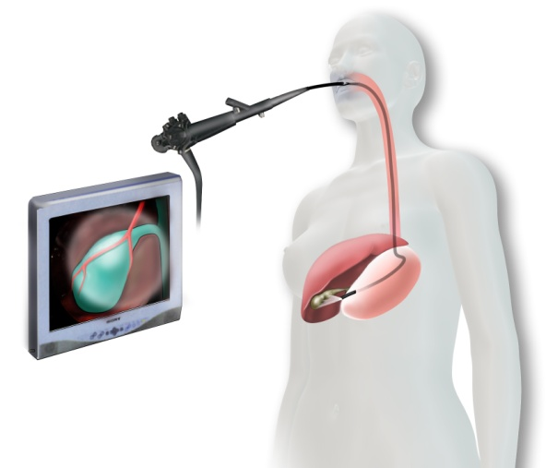
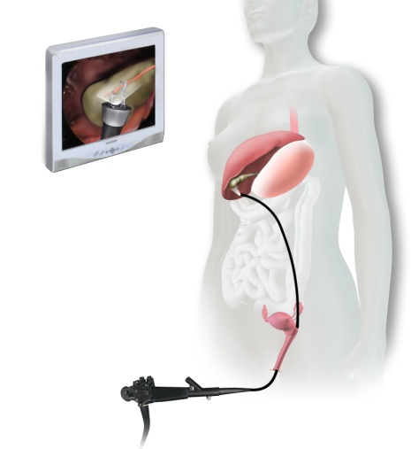
Surgical Robotics: Research Goals
Create simple-to-use and cost-effective surgical robots
Convert more “major access” operations to “minimal access” operations. Focus on abdominal surgery.
Reduce the invasiveness of current minimal access interventions
  SPA: Single Port Access for laparoscopic surgery
  NOTES: Natural Orifice Translumenal Endoscopic Surgery
  Use natural body openings with robotic platforms

Slide 3
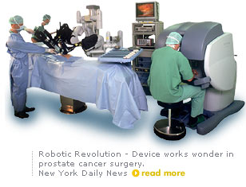
Current Generation Robotic Surgery
Devices such as DaVinci®
Huge leap in robotics, but:
  Large footprint in the OR
  Cost is extremely high
  Requires multiple incisions
  Multiple assistants needed
  Uses traditional endoscope with
  limited mobility within body cavity
  Has not reduced the invasiveness of robotic MIS
  While this paradigm has been enormously successful, and has spurred development of new methods and devices, it is ultimately limiting in what it can achieve

Slide 4
Next-Generation Robotic Surgery
Surgery will be radically different in the future
New thrusts in computer & robotic technologies can make automated surgery, if not feasible, an approachable goal.
Vision: teams of insertable robots performing surgical tasks in the body under both surgeon & computer control.
Remotize sensors and effectors in the body cavity where they can perform surgical & imaging tasks unfettered by traditional endoscopic instrument design.

Slide 5
The Way It Was
Telescopes
Notes:
2

Slide 6
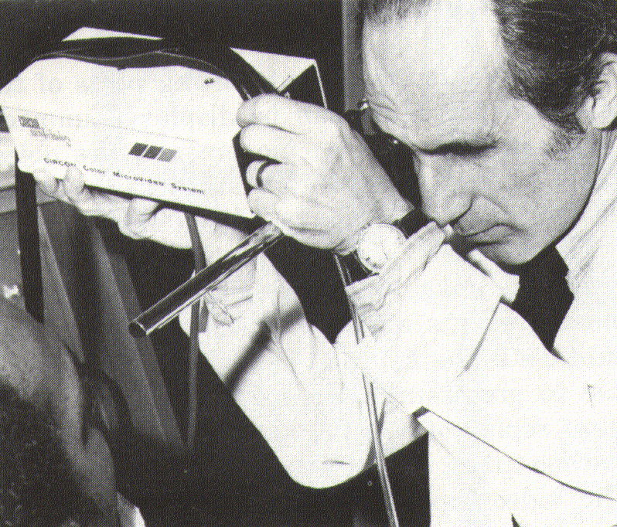
Laparoscopic Imaging:
The Way It Was
1970’s TV
Camera

Slide 7
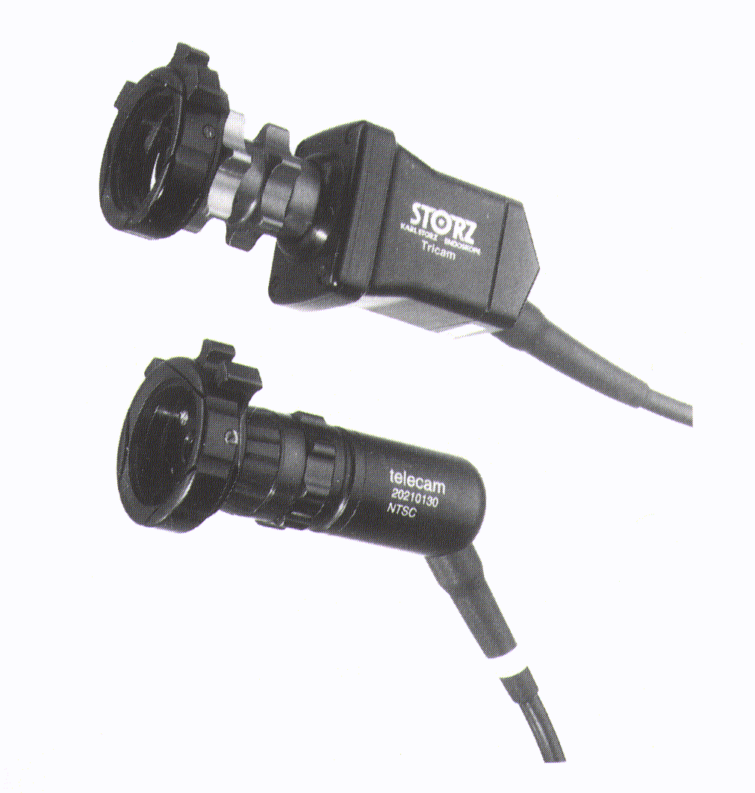
Laparoscopic Imaging:
The Way It Is
The turning point
  1986
  Computer chip video camera

Slide 8
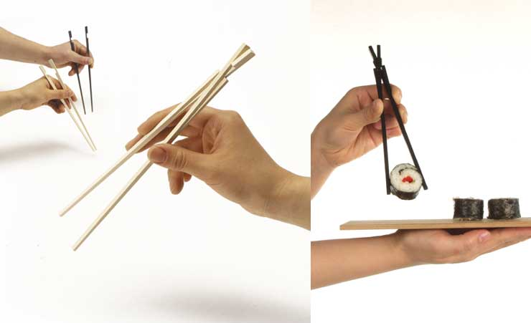
Building New In-vivo Devices
Current minimal access surgery adheres to the Chopstick Paradigm:
Pushing long sticks into small openings

Slide 9
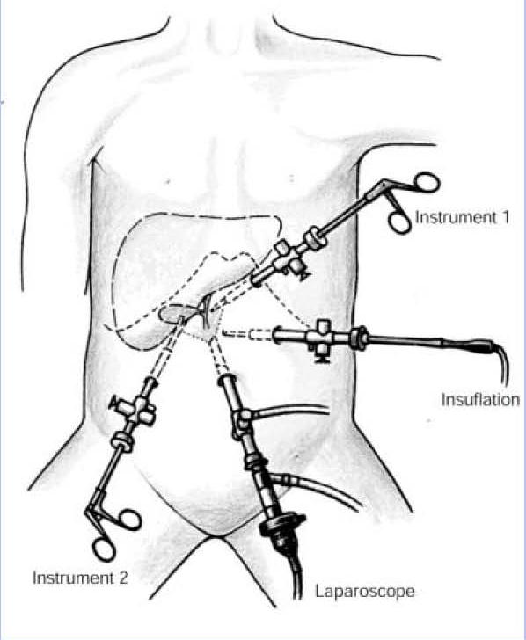
Our Focus: New in-vivo Imaging Devices
Can we improve on the traditional laparoscope?
Laparoscope Issues:
  Narrow angle imaging
  Limited workspace
  Multiple incisions for camera placements
  Counter intuitive motion for control
  Trained assistants needed to control the camera
  Multiple incisions for camera placements
  Additional incisions needed for laparoscopic instruments.

Slide 10
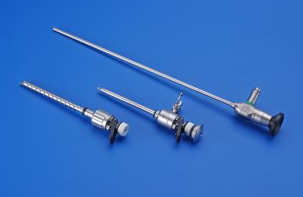
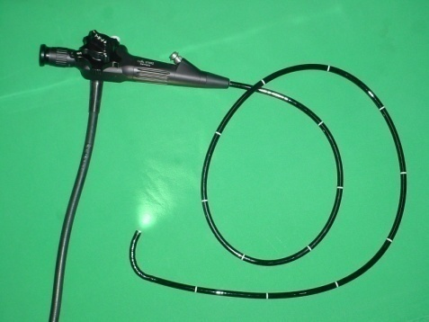
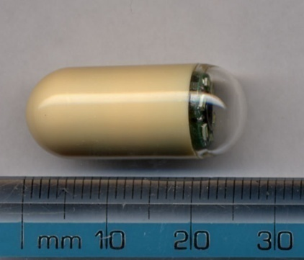
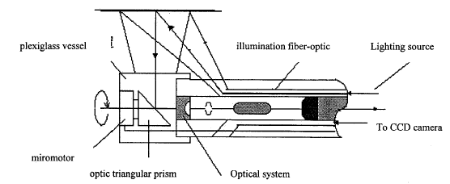
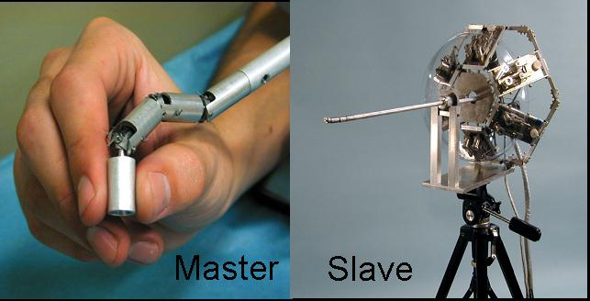
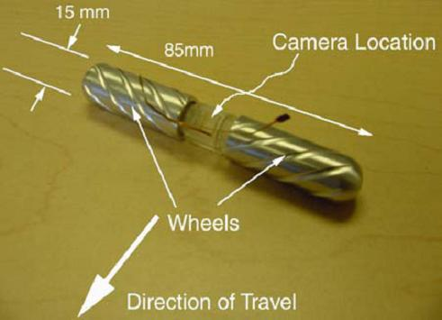
In-Vivo Imaging Devices
Rod-lens by Hopkins and cold light source of fiber optics by Karl Storz.
Flexible endoscope using fiber optics to delivery light and transmit image.
Pill camera without locomotion.
Endoscope with rotating mirror.
Endoscope positioned by multilink arm with piezoelectric actuators.
Mobile robots, U. Nebraska
Karl Storz Endoscope
Flexible Endoscope
Pill camera
Gao et al., 1998
Ikuta et. al., 2002
U. Nebraska

Slide 11
Columbia Imaging Device:
Design Goals
Device must be fully insertable into body cavity, leaving the insertion port free for other sensors and tooling
Device diameter must be restricted to 15 mm diameter for use with standard trocars.
Pan and Tilt degrees of freedom needed to increase internal imaging field of view
Image Zoom function required
Integrated lighting
Simple intuitive control interface to operator
Real-time computer control of DOF’s to allow tracking and visual servoing
User friendly 2D/3D display system
Low cost and possible disposal use

Slide 12
Columbia Imaging Device Overview
Design 0: Paper design, 2 cameras, 5-DOF
Device 0: Single camera prototype, 3-DOF, tested in surgical trainer
Device I: Single camera, pan/tilt/lighting, tested in animals
Device II: Single camera, pan/tilt/zoom, tested in animals
Device III: Stereo cameras, pan/tilt, tested in animals

Slide 13
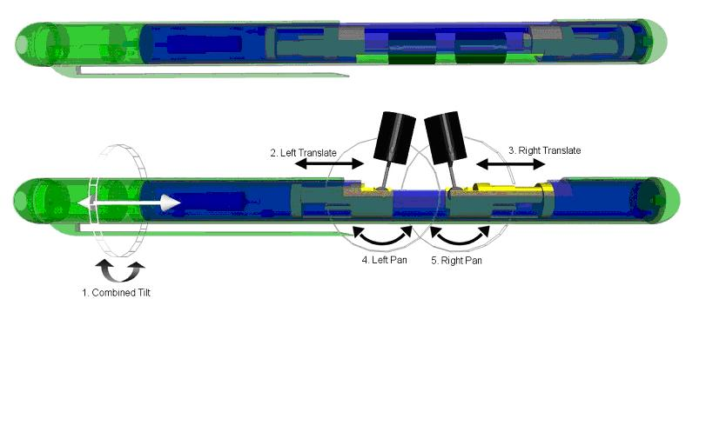
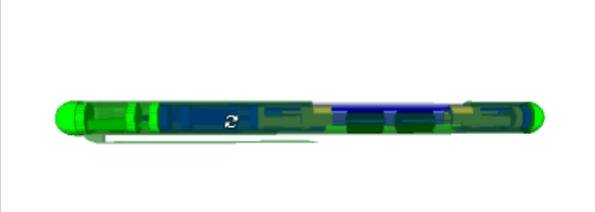
Design 0
Stereo cameras with 6 DOF are desirable – full mobility
Difficult to achieve in small actuated package
Compromise – 3 DOF per camera
  Cameras share tilt axis (1 DOF)
  Independent translation (2 DOF)
  Independent pan
  (2 DOF)
Design of 5-DOF insertable camera device

Slide 14
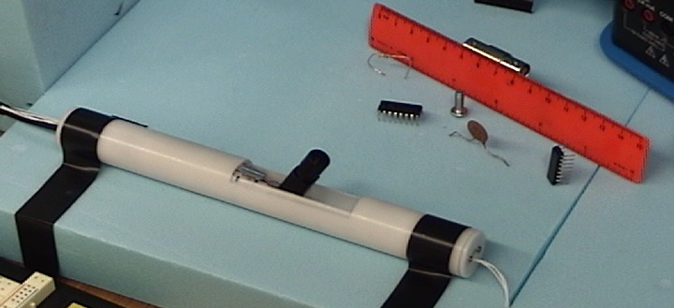
Device I: Single Camera
Diameter: 22 mm; Length: 190 mm
Camera opening: 58 mm
3 DOF: Pan: 120°; Tilt: 130°; Translation: 50 mm
Video

Slide 15
Initial Testing and Validation
Does new imaging device improve surgery visualization?
6 fellows & surgeons performed MISTELS* tests with standard laparoscope and the new robotic camera
5 of 6 subjects showed no significant difference in MISTELS task performance with the robotic camera compared to the standard laparoscope
Mean score of 999 +/- 69 using a laparoscope
Mean score of 953 +/- 68 for the robotic camera: statistically insignificant difference
*McGill Inanimate System for the Training and Evaluation of Laparoscopic Skill

Slide 16
Device I: Design Goals
Need to reduce size to fit 12mm trocar
Motors are major determinant of device size
Removing a camera reduced motor count by 2
Translation DOF is least useful. Removing this also reduced motor count by 1
Include integrated light source
Make imaging head modular
Tradeoff: Degrees-of-freedom for compactness

Slide 17
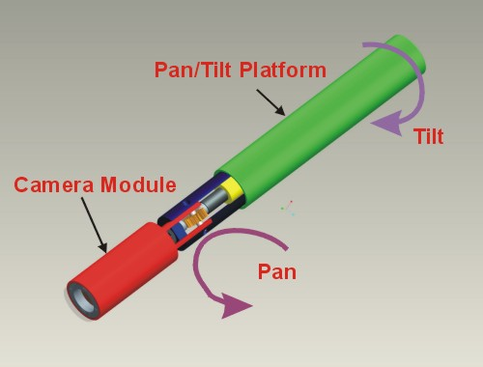
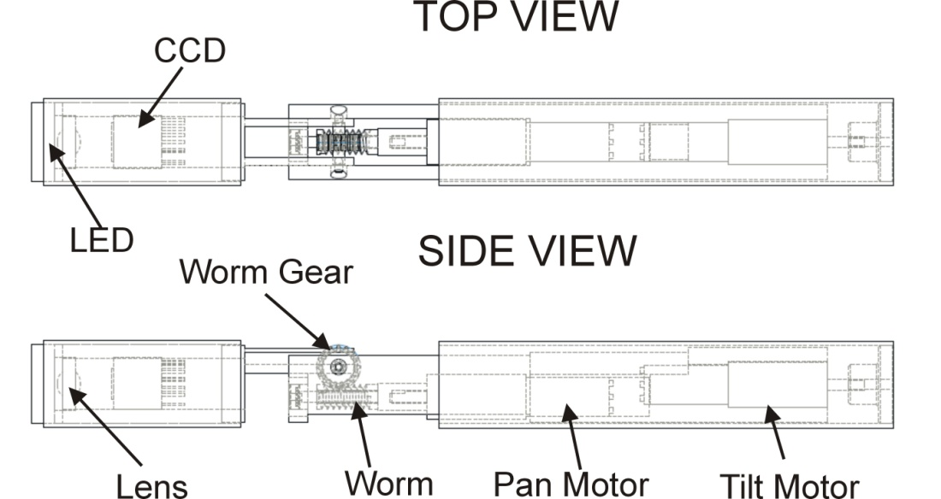
Device I: Single Camera

Slide 18
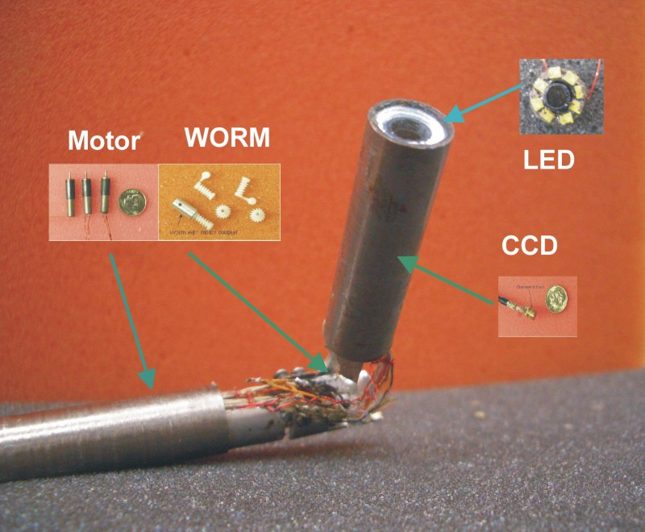
Device I: Single Camera*
110 mm in length and 11 mm in diameter.
130 degree Pan, 90 degree Tilt.
Integrated 8 LED light source.
6.5 mm CCD sensor.
Fully sealed camera head.
Joystick control.
*Tie Hu, Peter K. Allen, Nancy Hogle and Dennis Fowler Surgical Imaging Device with Pan, Tilt, Zoom, and Lighting, Intl. Journal of Robotics Research, 2009

Slide 19
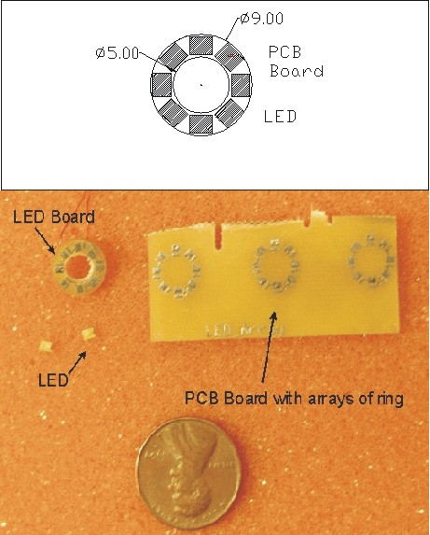
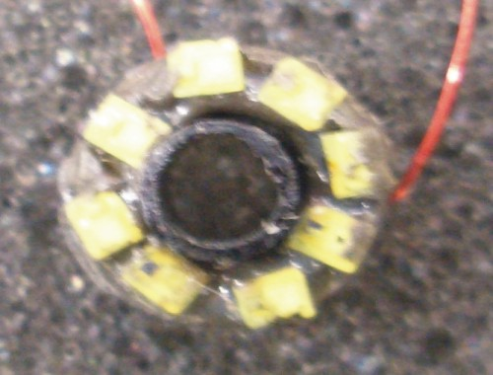
LED Light Source
Light-emitting diode (LED) as a light source in laparoscopy:
  Lower power
  Higher efficiency
  Compact package
  Longer lifespan
  Lower cost
Luxeon portable PWT white LED(LXCL_PWT1)
  2.0 X1.6 X 0.7 mm
  26 lumens of light at 350 mA
8 PWT LED in a printed circuit board with 9mm diameter.
  208 lumens light at 8.4 w

Slide 20
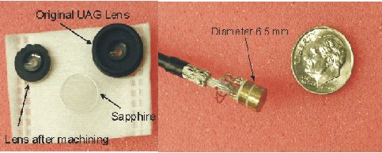
Lens and Camera Unit
Pin hole lens (PTS 5.0 from Universe Kogaku America)
  Focal length 5.0 mm.
  F number 4.
  Angle of view D-H-V(85.4-68.3-50.9 ).
6.5 mm CCD camera sensor.
  NET USA Inc, CSH-1.4-V4-END-R1.
  450 TV lines in horizontal resolution and 420 TV lines in vertical resolution.
Fully sealed package to isolate body fluid and moisture.

Slide 21
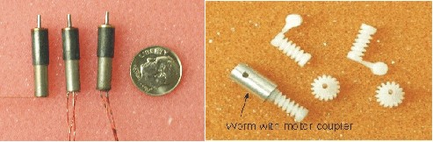
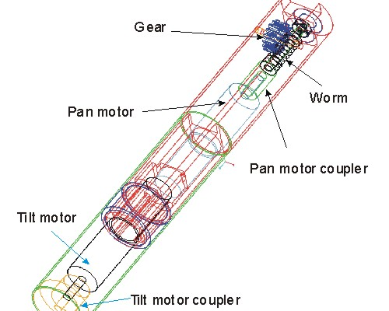
Pan/Tilt Mechanism
Miniature Brushless DC motor (0513G, Faulhaber Group).
  25mNm torque.
  5.8 mm in diameter.
Miniature worm gear (Kleiss Gear Inc.)
  gear ratio 16:1.

Slide 22
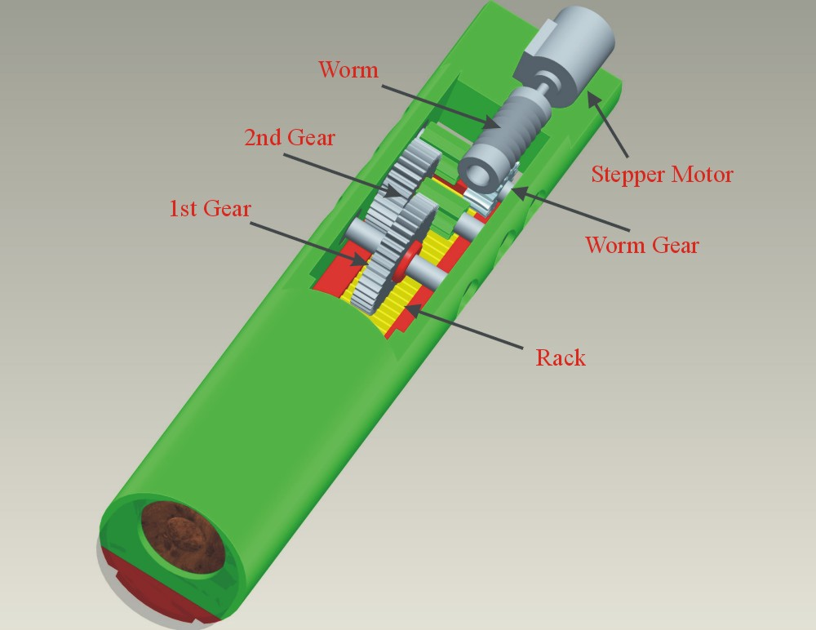
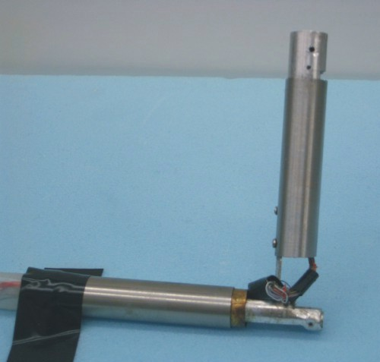
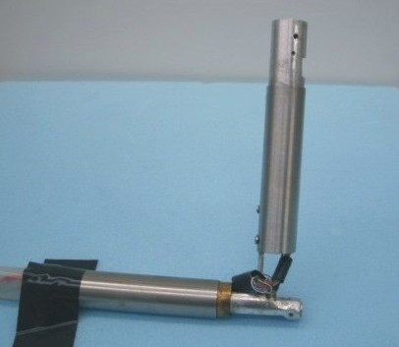
Device II:
Pan, Tilt, Zoom
Mechanical zoom: linear motion of camera head
Stepper motor drives rack and pinion mechanism
Can only achieve ~ 2x zoom

Slide 23
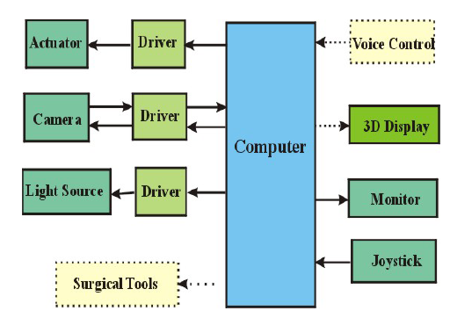
System Architecture

Slide 24
Mounting the Camera
Camera attached to insuflated abdominal wall
Attachment methods:
  Suturing: small stitch through abdomen
  Magnets
  “Fish Hook” which grabs the abdominal wall
  Intelligent trocar for attachment

Slide 25
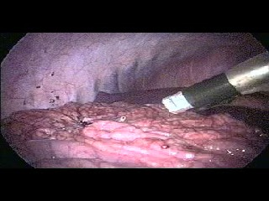
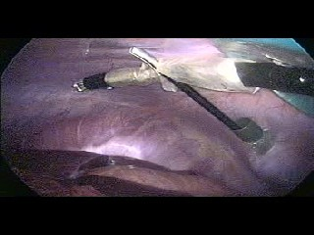
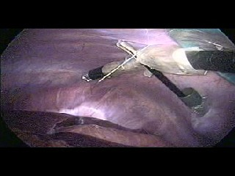
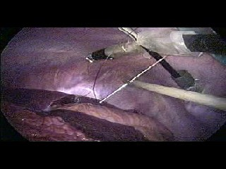
Suturing the Camera

Slide 26
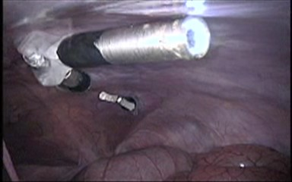
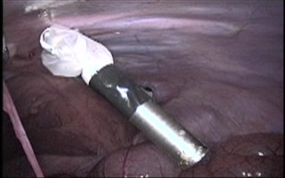
Working Device in the body

Slide 27
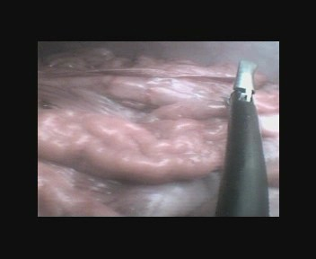
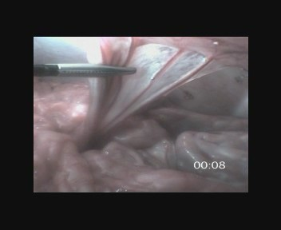
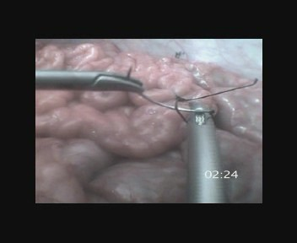
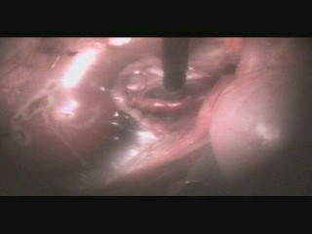
In-Vivo Animal Experiments
Appendectomy
Video
Bowel Running
Suturing
Nephrectomy

Slide 28
Procedure Timings
Procedure Device Time (min)
Running Bowel Laparoscope 4:20
Running Bowel Robot 3:30
Appendectomy Laparoscope 2:20
Appendectomy Robot 2:20
Suturing Laparoscope 5:00
Suturing Robot 4:00
Nephrectomy Laparoscope 18:00
Nephrectomy Robot 21:00

Slide 29
Intelligent Software
Position/Velocity control of axes
Intuitive Joystick Control
Real-Time Image Processing:
  Digital Zoom
  Image rotation/stabilization
  Distortion Correction
  Picture-in-Picture
  Visual Servoing/Tracking
  3D Stereo output

Slide 30
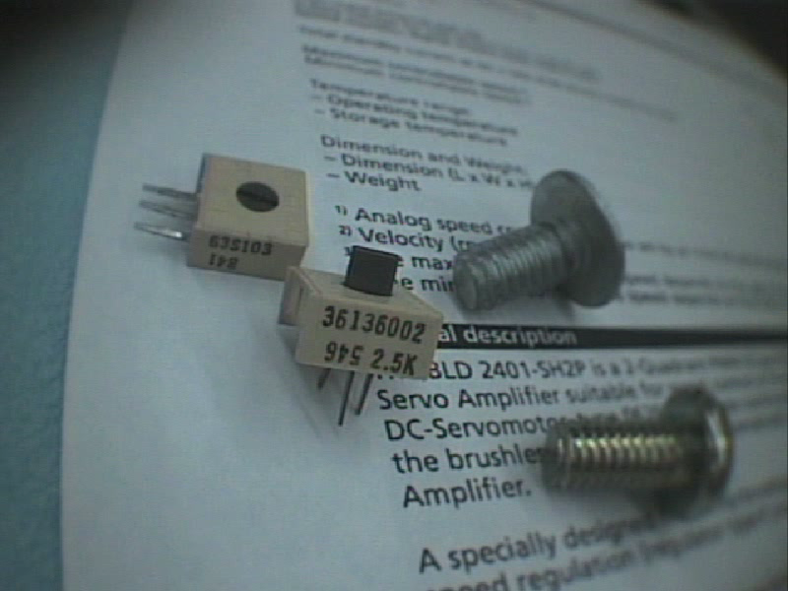

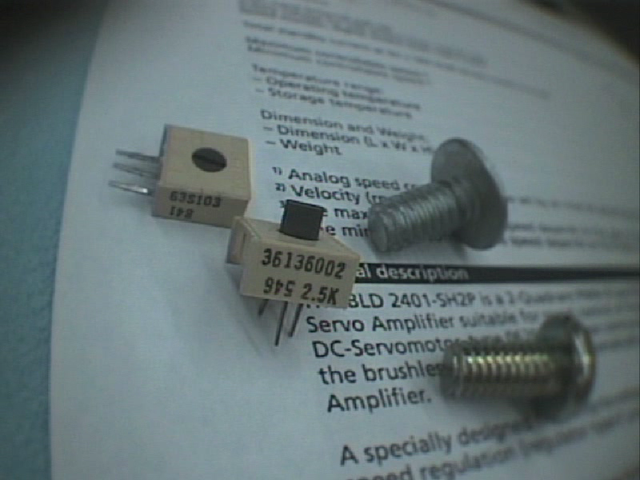
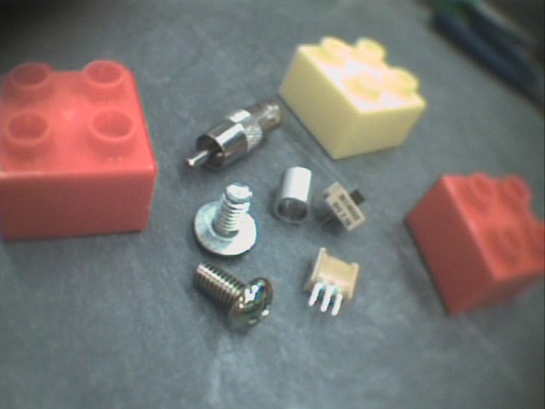
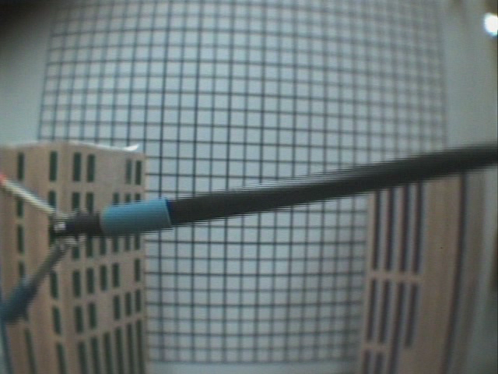
Image Processing
Zoom :
Picture in Picture :
Rotation :
Distortion Correction :

Slide 31
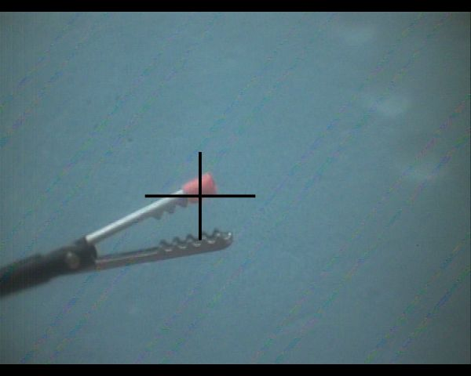
Tracking Instruments using Color Markers
Place colored marker on instrument
Convert RGB to HSV space
Hue value of a pixel is much less susceptible to lighting changes
Record hue value of marker to be tracked
Search entire image for hue values within epsilon range
Centroid of matched pixels gives position of tracker in the image
If target is detected, localize search to a smaller neighborhood
Tracking performed in real-time at 25 fps

Slide 32
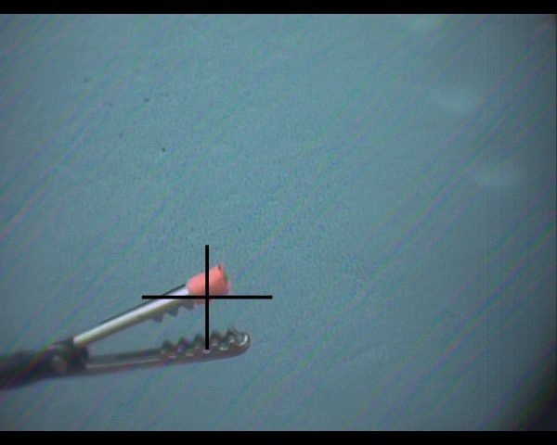
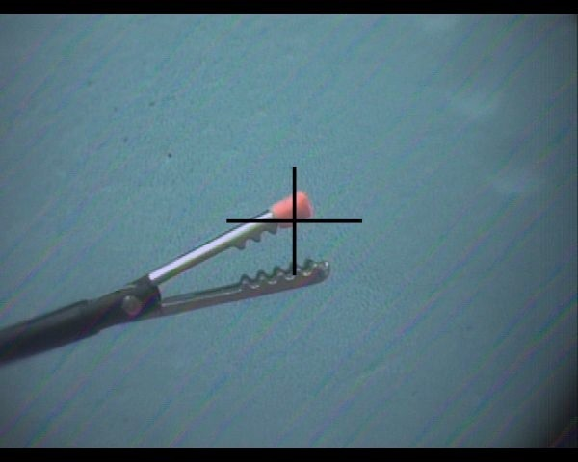
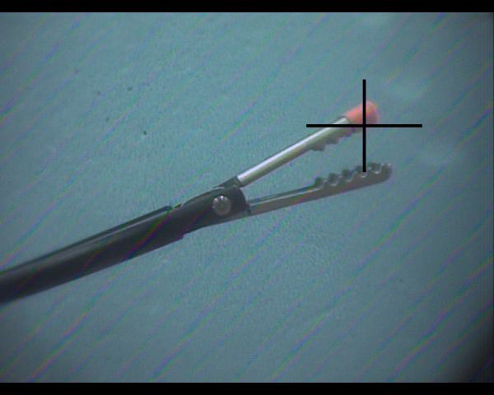
Visual Servoing
Allows shared autonomy with surgeon
The feedback from the tracker can be used to drive motors to keep the tool in the center of the image
PD controller used
( E_{x} , E_{y} ): offset error of tracker from center of image
Pan speed ∝ ( α_{x} * E_{x} ) – ( β_{x} * dE_{x}/dt )
Tilt speed ∝ ( α_{y} * E_{y} ) – ( β_{y} * dE_{y}/dt )
Video

Slide 33
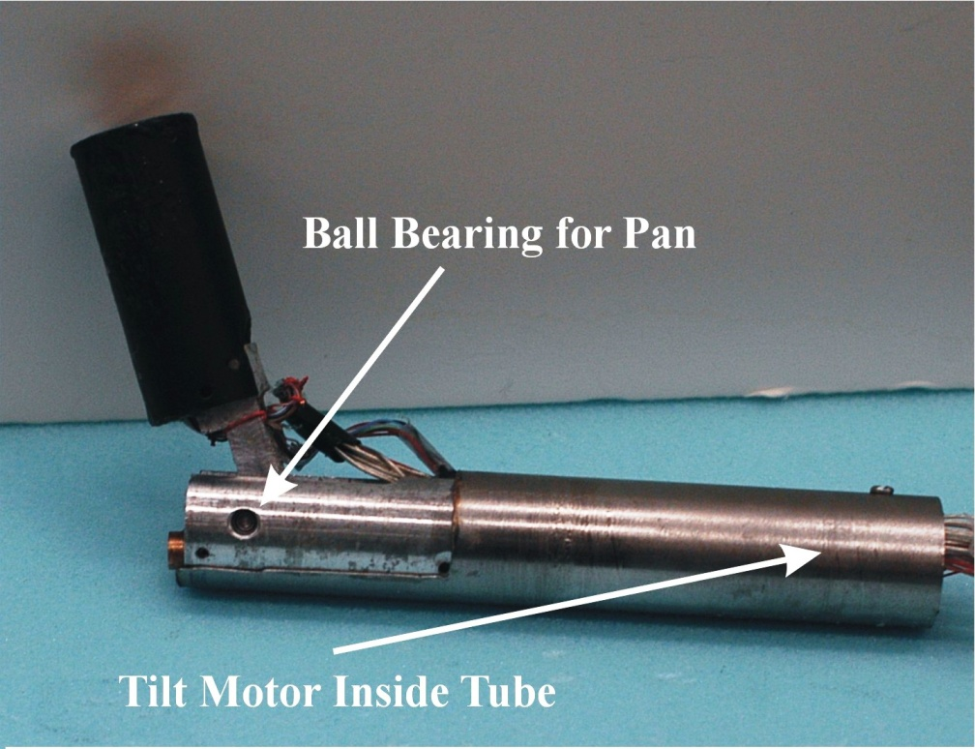
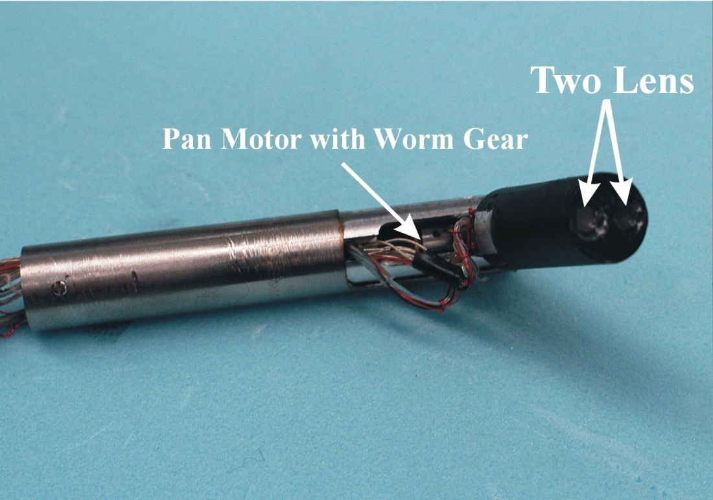
Device III: Stereo Imaging*
A stereo imaging device with similar mechanical design.
15 mm in diameter and 120 mm in length.
6.5mm Inter-Pupillary Distance (IPD)
*T. Hu, P. Allen,, T. Nadkarni, N. Hogle, D. Fowler, Insertable Stereoscopic 3D surgical imaging device, IEEE BIOROB 2008

Slide 34
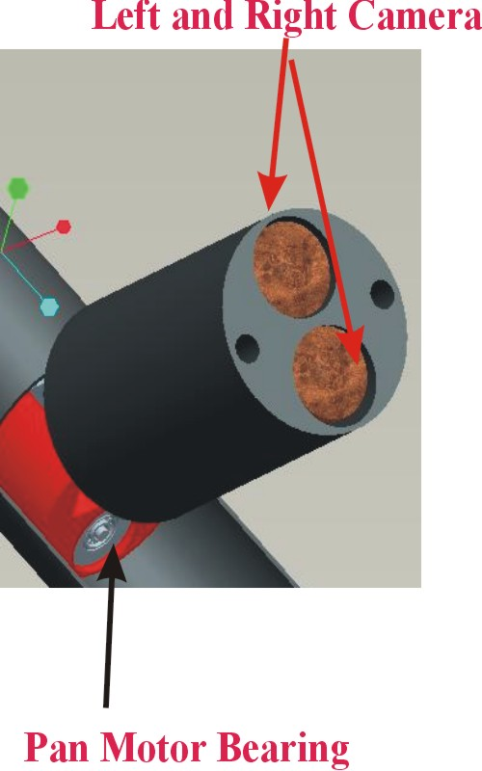
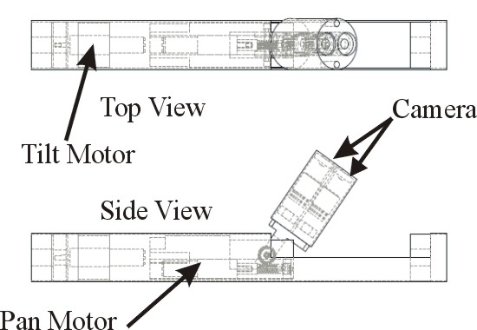
Stereo Camera

Slide 35



3D Displays
eMagin Z800 Head-Mounted VR Display
Uncomfortable
Single User
RealD Crystal Eyes shutter glasses
Uncomfortable over longer periods
Need to maintain Line Of Sight with
synchronizing emitter
True Vision back projected 3D display
Low incremental cost for additional users
Bigger display size
Passive polarization, lightweight glasses

Slide 36





Visual Servoing with Stereo
When using stereo cameras the pixel disparity E_{p} between stereo images is used to damp the motors
Speed Damping ∝ ( γ * E_{p} )
Damping is applied to both Pan and Tilt motors
Prevents the motors from oscillating when instrument is too close to camera

Slide 37

Device III: Stereo Imaging

Slide 38
Device III (Stereo) Timings
Procedure Device Time (min)
Running Bowel Laparoscope 5:35
Running Bowel Robot 3:14
Appendectomy Laparoscope 1:57
Appendectomy Robot 1:38
Suturing Laparoscope 4:30
Suturing Robot 2:12
Nephrectomy Robot 9:59

Slide 39


3D Trajectory Reconstruction
The Flock of Birds (FoB) sensor can transmit the position of its sensor w.r.t. its base
Accuracy within 1.8mm
Refresh rate up to 144Hz
By placing an optical marker on the FoB sensor we can track its position in the image
By tracking the sensor using stereo cameras we can compute its 3D trajectory

Slide 40


Trajectory Reconstruction
We traced a trajectory in 3D space using the FoB sensor
At the same time the sensor was being tracked by our stereo cameras
The tracking results were used to predict the 3D position of the sensor
Using this data we plotted the trajectory of the sensor
average reprojection error ~3mm
FOB Sensed Trajectory
Stereo Reconstruction of Trajectory

Slide 41
Recap:
New device is easier and more intuitive to use than a standard laparoscope.
Insertion port available for tooling
Joystick operation requires no specialized operator training.
Pan/Tilt functions provide large imaging volume not restricted by fulcrum point of standard laparoscope
Time to perform procedures was better or equivalent to a standard laparoscope.
Automatic Tracking and Visual Servoing assist surgeon
3D vision system significantly improves the visualization and depth perception of the surgeon.
Trajectories can be tracked over time with 3D reconstruction
Cost effective, perhaps single-use or modular replacement

Slide 42
Acknowledgements
Austin Reiter
Dennis Fowler
Tie Hu
Andrew Miller
Tejas Nadkarni
Nancy Hogle
Nabil Simaan
Kai Xu
Roger Goldman
Jienan Ding
This work was supported by NIH grants 1R21EB004999-01A1 and 5R21EB007779-02

