Slide 1
Visual Manipulation Relationship Network for Autonomous Robotics
Hanbo Zhang, Xuguang Lan, Xinwen Zhou, Zhiqiang Tian, Yang Zhang and Nanning Zheng
Khawla AlHamdan
2018 IEEE-RAS 18th International Conference on Humanoid Robots (Humanoids)
Beijing, China, November 6-9, 2018

Slide 2
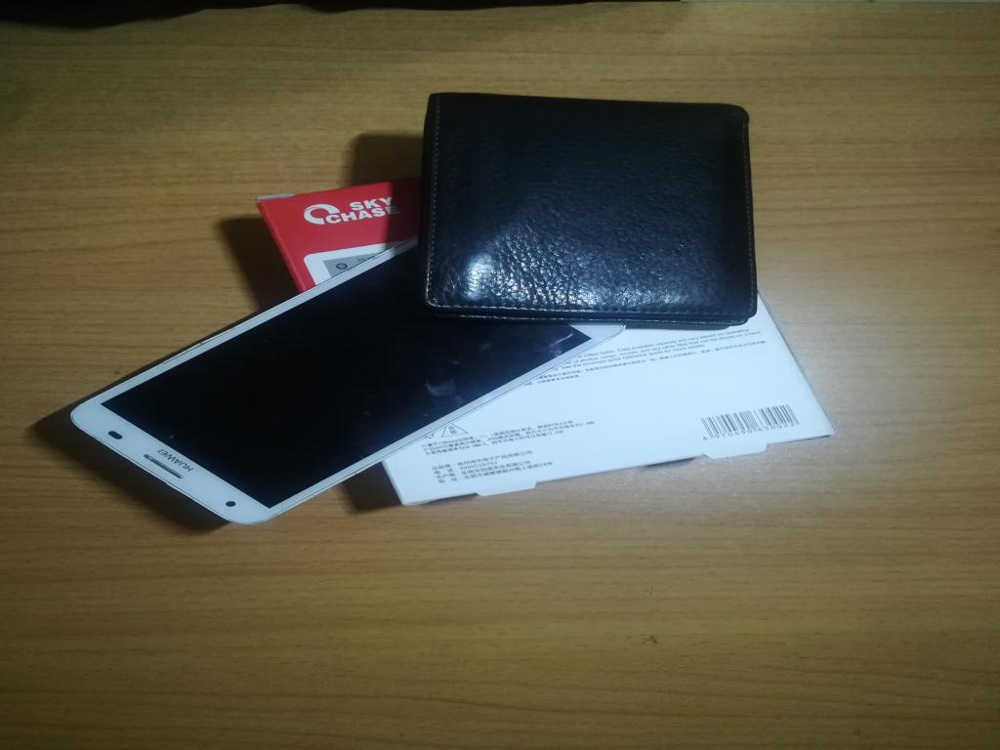
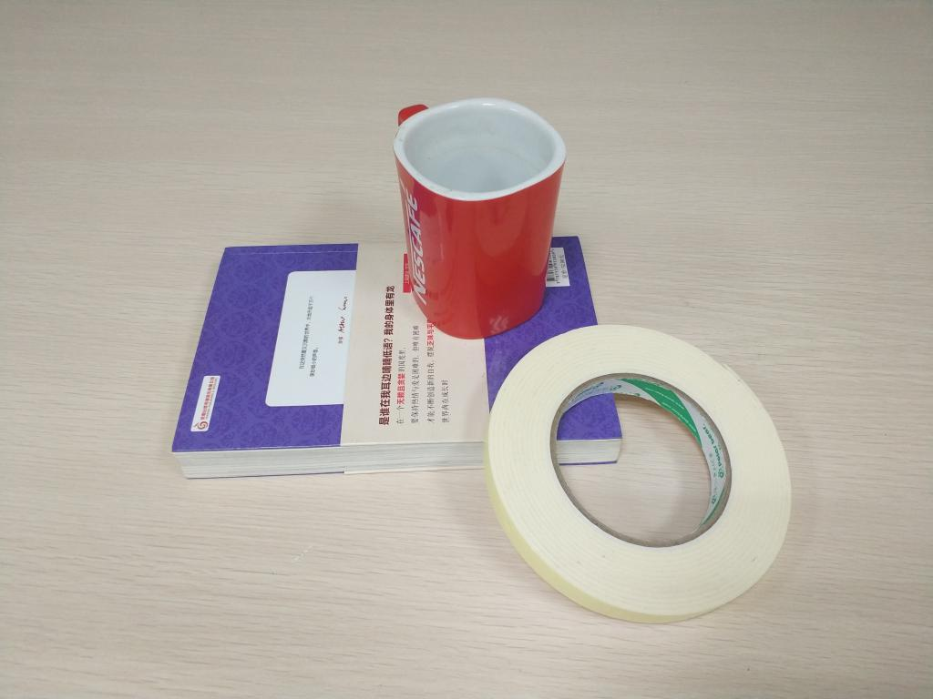

Slide 3
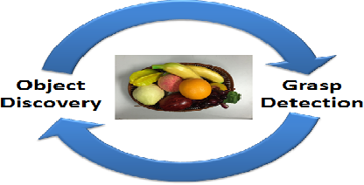
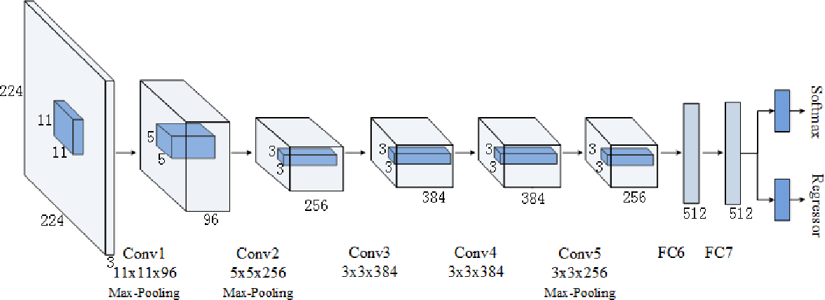
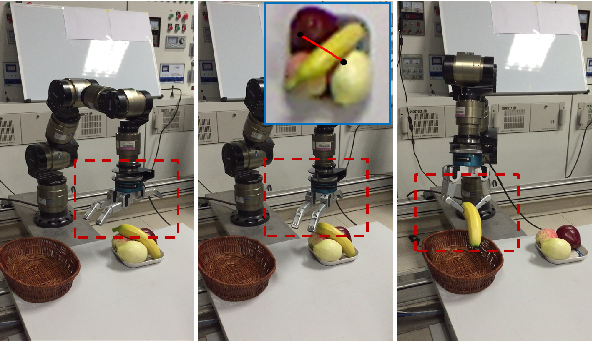
Object discovery and grasp detection with a shared convolutional neural network
IEEE International Conference on Robotics and Automation (ICRA)

Slide 4
What this paper work on.
Manipulation relationship recognition
Visual Manipulation Relationship Network (VMRN)
VMRD (Visual Manipulation relationship Dataset)

Slide 5
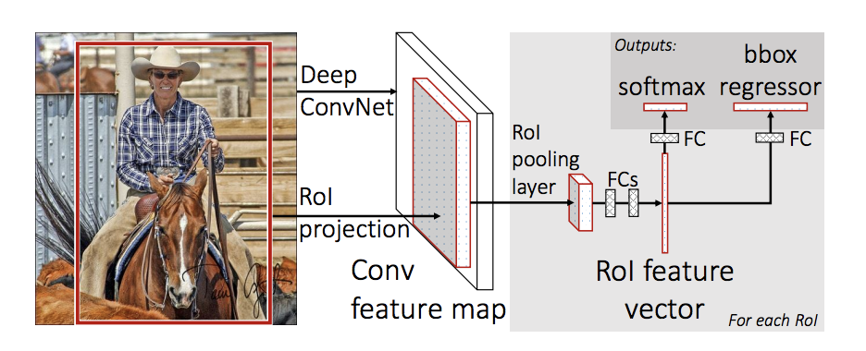
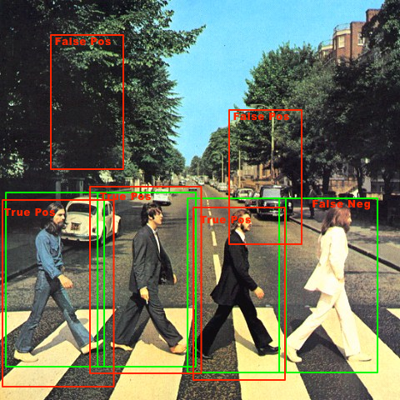
Background:
Object Detection
Sliding window
Deep feature
Object Pairing Pooling Layer (OP²L)

Slide 6
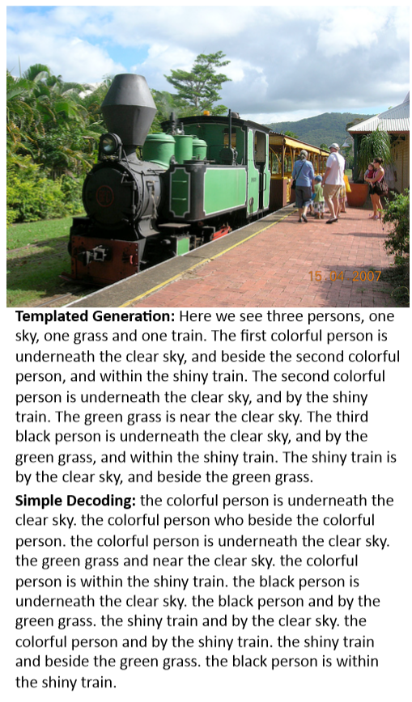
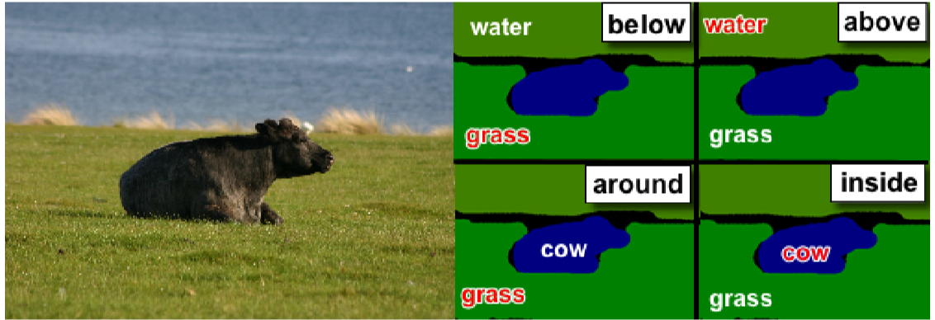
Background:
Visual Relationship Detection
Spatial relationship
Image and Video
Deep learning

Slide 7
Background:
Spatial Relation Reasoning
Cloud Points

Slide 8
Visual Manipulation Relationship Network (VMRN)
2 stages :
object detection result
recognition result of the manipulation relationship

Slide 9
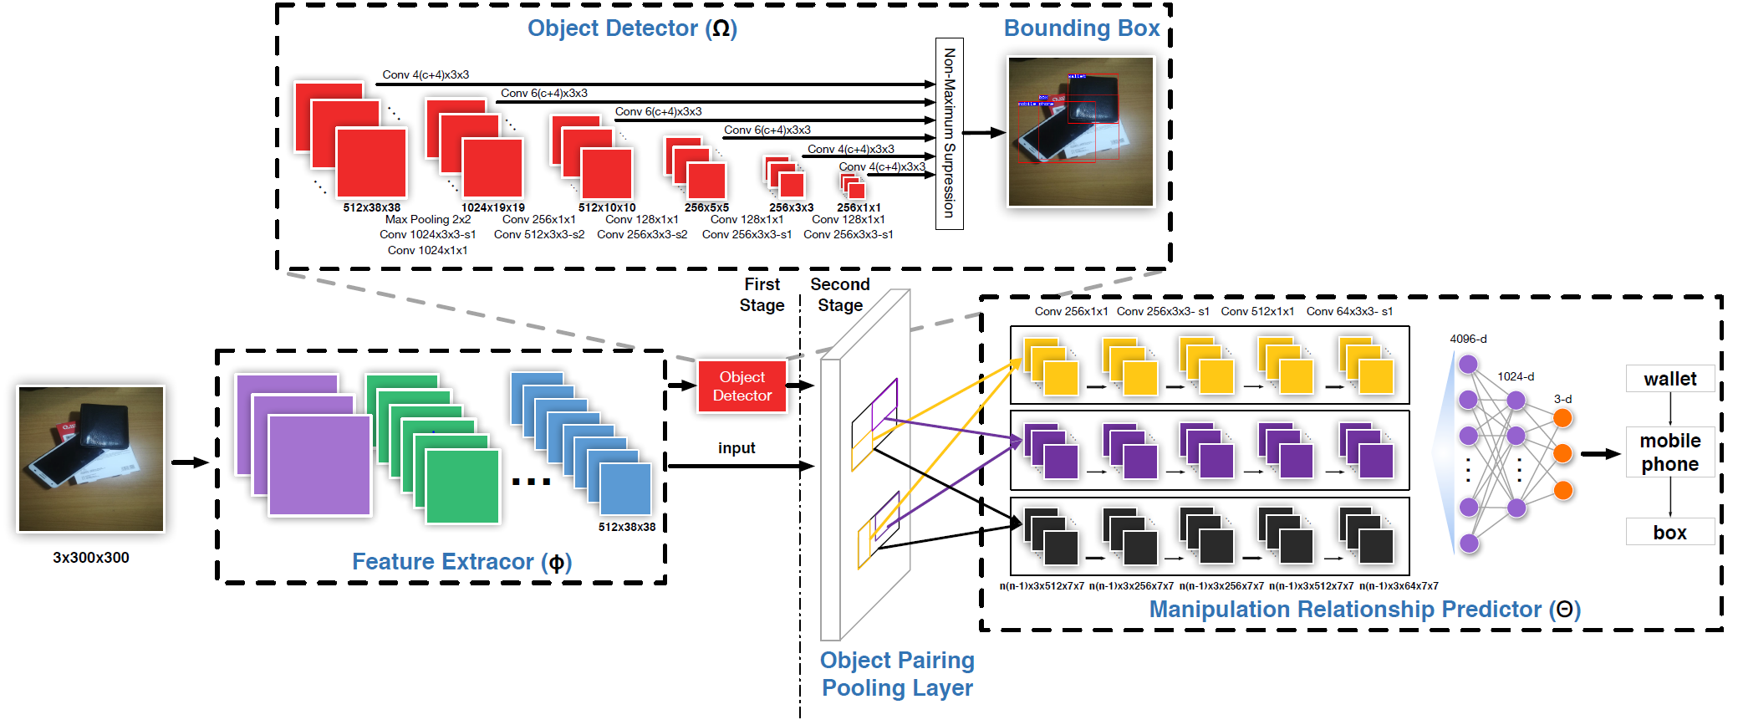
Visual Manipulation Relationship Network (VMRN)

Slide 10
Object Detector
SSD (Single Shot Detector )
(cls; xmin; ymin; xmax; ymax)
Convolution Feature Maps
(VGG16 or ResNet50)

Slide 11
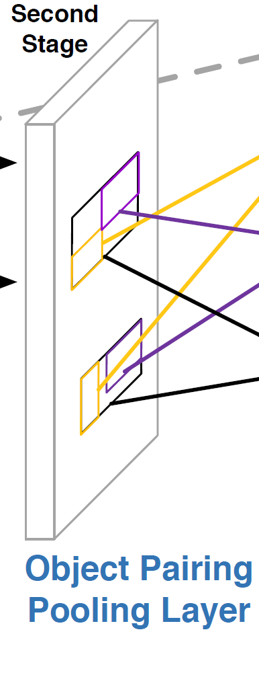
Object Pairing Pooling Layer (OP²L)
Object Location
(cls; xmin; ymin; xmax; ymax)
mini-batch
predicting manipulation relationships
Shared Feature map
CNN(I; Ф)

Slide 12
Object Pairing Pooling Layer (OP²L)

Slide 13
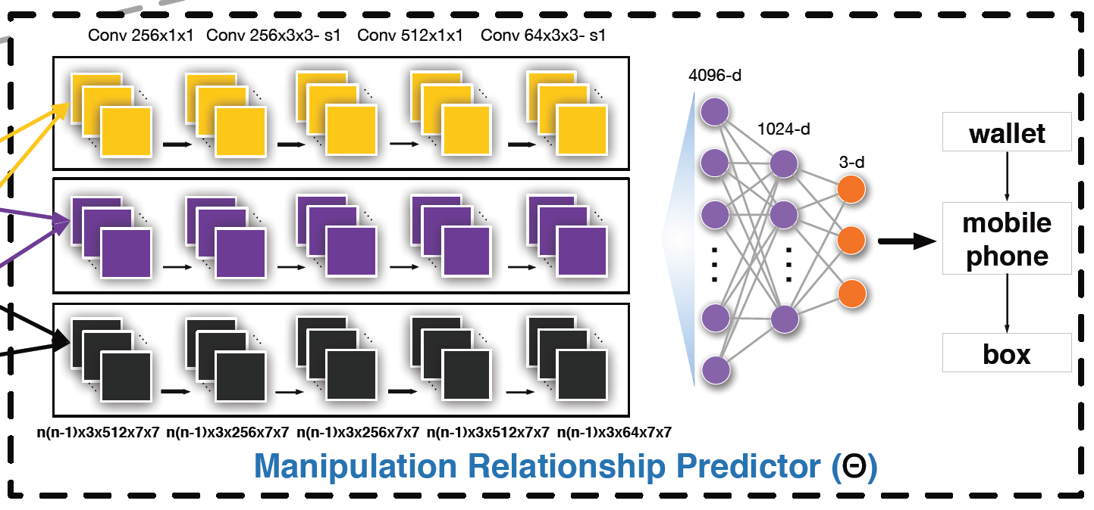
Manipulation Relationship Predictor

Slide 14
Manipulation Relationship Tree

Slide 15
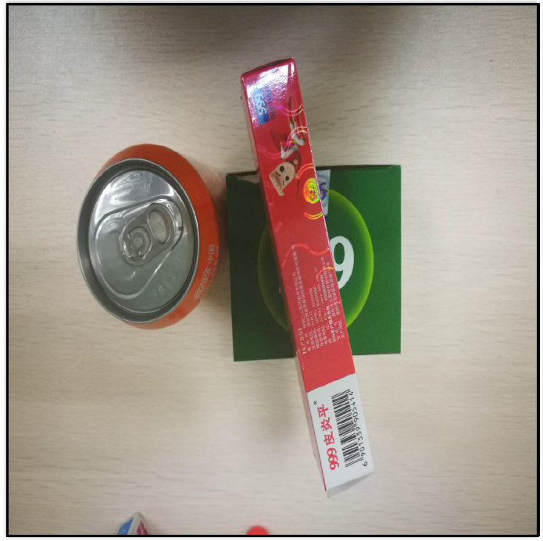
Manipulation Relationship Tree
Relation between objects:
Object1 is the parent of Object2
Object2 is the parent of Object1
Object1 and Object2 has no relation.
Labeling Criterion

Slide 16
Visual Manipulation Relationship Network (VMRN)
2 stages :
object detection result
recognition result of the manipulation relationship

Slide 17
Visual Manipulation Relationship Dataset (VMRD)
5185 images
17000 object
51530 the manipulation relationship

Slide 18
ACCURACY OF OBJECT DETECTION AND VISUAL MANIPULATION RELATIONSHIP RECOGNITION

Slide 19
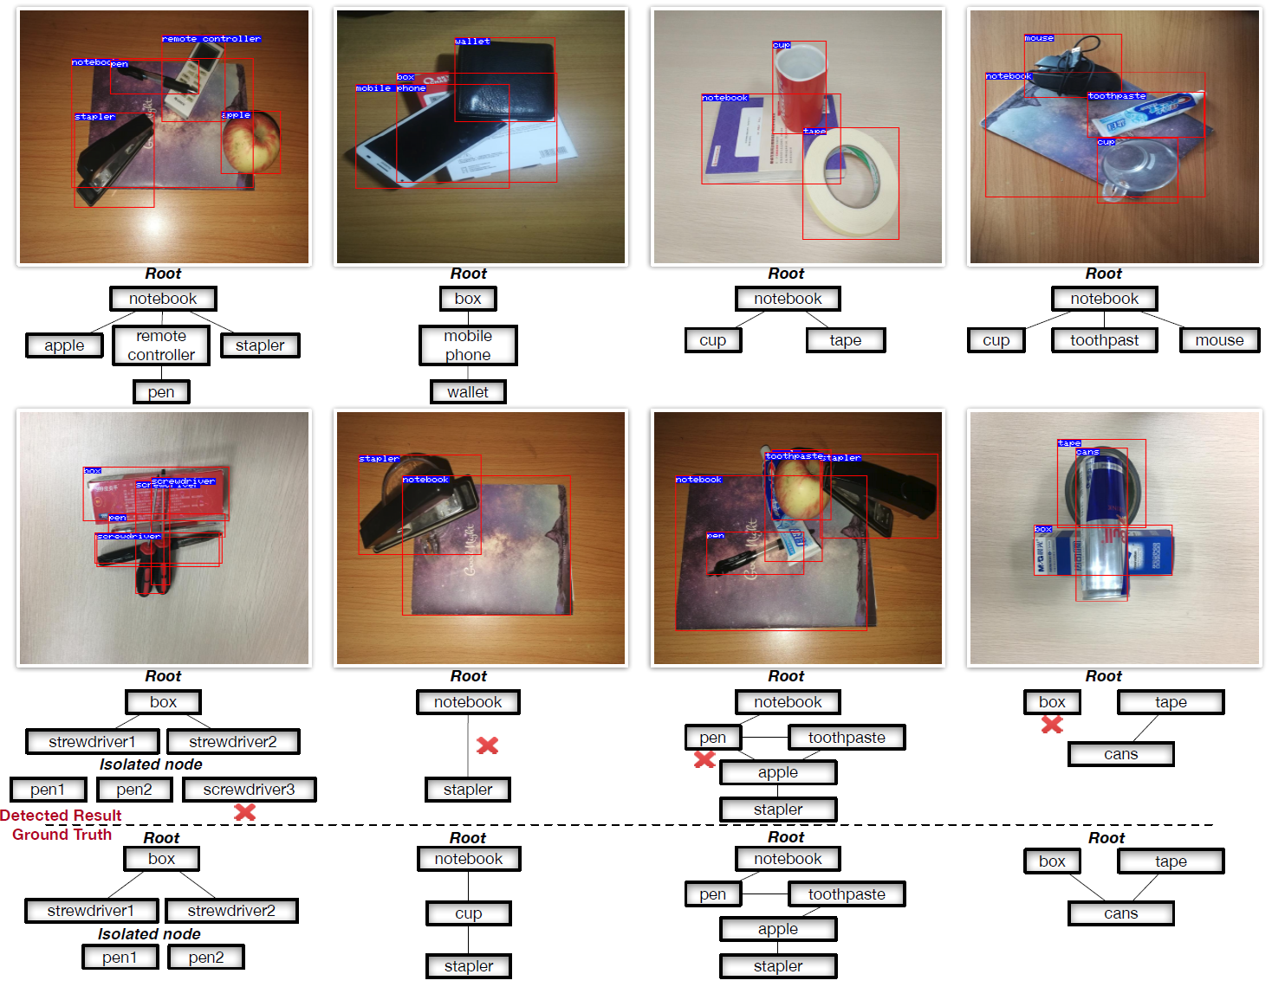

Slide 20
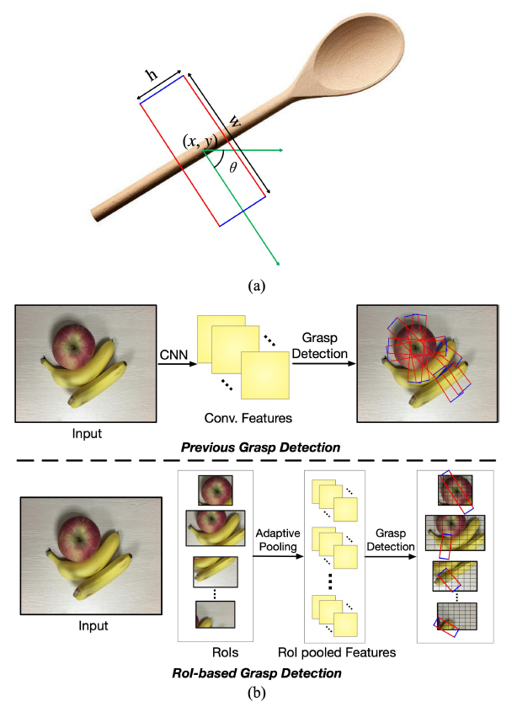
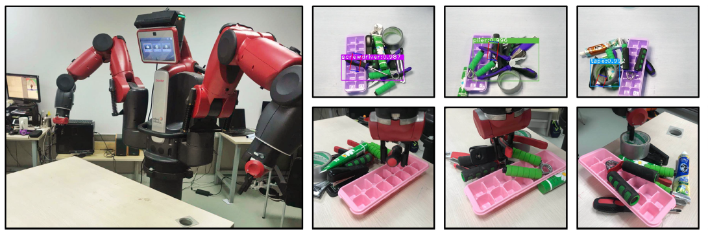
ROI-based Robotic Grasp Detection for Object Overlapping Scenes
Region of Interest (ROI)

Slide 21
Thank You

