Slide 1
User Feedback in Latent Space Robotic Skill Learning
Rok Pahic, Zvezdan Lon ˇ carevi ˇ c, Ale ´ s Ude, Bojan Nemec and Andrej Gams
Presented by: Shilin Ni

Slide 2
Challenge
Learning actions from scratch?
Search space is too large.
Learning by demonstration?
The demonstration might not be applicable for the current situation and further adjustment is required.
Some skills can’t be directly transferred to robots due to their nature.
We could use Reinforcement Learning (RL) for autonomous refinement after the initial demonstration!
Use LbD to reduce the search space.
It is widely used in robotics training. Let the robots learn the hard-to-engineer behaviors.
[2]

Slide 3
Curse of dimensionality
The high number of degree of freedom of humanoid robots with continuous states and actions increases the dimensionality beyond the range of practical use.
[2]

Slide 4
How to solve this problem?
Use policy search to find good parameters, then scale RL into continuous actions in high dimensions using parametrized policies.
Use LbD to reduce the search space.
[2]

Slide 5
Concerns for RL
It is hard to design an appropriate award function.
Noise are unavoidable in the real-world. Feedback received through sensors may not be accurate.
[2]

Slide 6
These make it impractical for non-experts to use RL for continuous learning in everyday human environment.
[2]

Slide 7
Intro
Use discrete, user-assigned reward for RL of robotic throwing, with an emphasis on learning in the feature space.
Show that for certain tasks, RL with discrete user feedback can be effectively applied for robot learning.
[2]
Notes:
Use naïve human feedback to replace reward function

Slide 8
Related Work
Baseline: Policy search on dynamic movement primitives (DMPs), using an expert-defined reward.
By running RL in the latent space of a deep auto-encoder network, we could dramatically reduce the dimensionality.
The use of auto-encoder network may also reduce the accuracy of the representation.
Use Inverse Reinforcement Learning (IRL) to reconstruct a reward function given a policy or history of behavior.
Many examples of using human feedback, but mostly with an action space composed of discrete actions.
[2]
Notes:
baseline for comparison of RL

Slide 9
Use case
Learn to throw a ball into a basket using PoWER RL algorithm.
Use a Mitsubishi PA-10 robot with 3 DoF.
This task is selected because it’s easy for users to estimate & for researchers to model.
[2]

Slide 10
TRAJECTORY REPRESENTATION
Configuration space
Latent space of a deep auto-encoder network
[2]
Notes:
Apply policy search in 2 spaces

Slide 11
Configuration Space
Use DMP-framework to encode the trajectories of motion.
[2]
Notes:
W is the weights from the initial demonstration, g=goal, y0 = starting position. (20+2)*3DoF

Slide 12
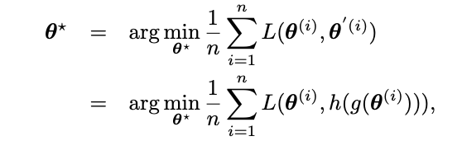
Latent Space*
Activation function for each hidden layer
autoencoder parameters
[2]

Slide 13
Database for training
Generate the desired range, height and hitting angle of the throw for each example.
Search for the points on this trajectory that can be reached with the desired robot end-effector position and velocity.
Optimize the ball release position to have the minimal weighted norm of the joint velocity vector.
Produce minimal-jerk trajectories bounded so that the desired end-effector position has 0 initial and final velocities, and a maximal velocity at the desired time.
[2]
Notes:
Train latent space of the autoencoder

Slide 14
Learning Algorithm: PoWer
Policy Learning by Weighting Exploration with the Returns (PoWER) is an algorithm for policy learning that is particularly well-suited for dynamic motor primitives. The resulting algorithm is an EM-based algorithm applicable to complex motor learning tasks.
[3]

Slide 15
Reward functions
Exact Reward
Combine with importance sampler to sort the samples’ frequencies with respect to their rewards in a descending order, and take 3 best trails to update the policy.
Unsigned Reward
Discrete, Five-star scale
Doesn’t know in which direction to change the throw
Importance sampler randomly takes 3 trails with highest rewards
Signed Reward
[1, 2, 3, -1, -2]^{T}
[2]
Notes:
Throw k, Ld=distance to the basket, Lk=length of k-th trial

Slide 16
User Study & simulated learning experiments
Human Rewards:
Participants give rewards to each throw.
Use the given rewards to update the policy.
Simulated human rewards:
[2]

Slide 17
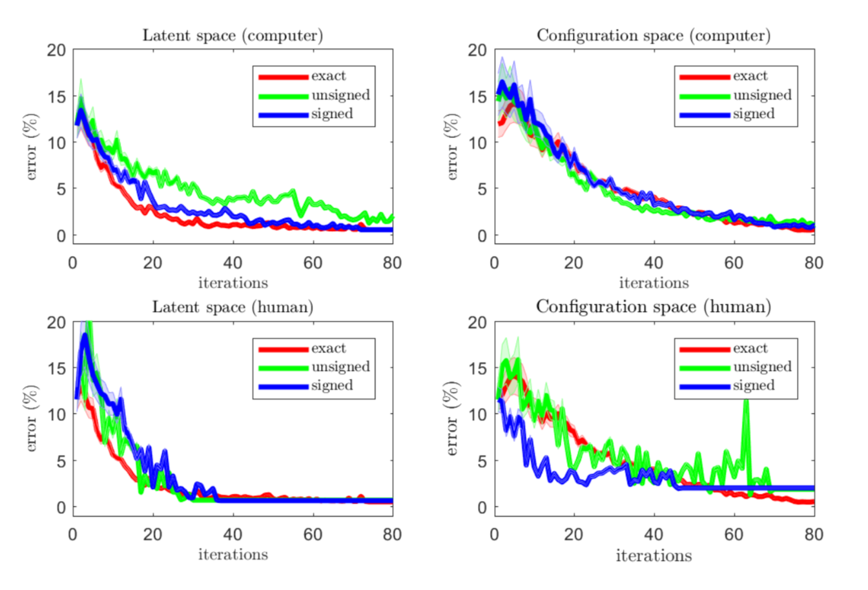
Results
Throwing converges over time.
Exact Reward doesn’t make it converge faster.
Latent space RL is faster than Configuration space RL.
[2]

Slide 18
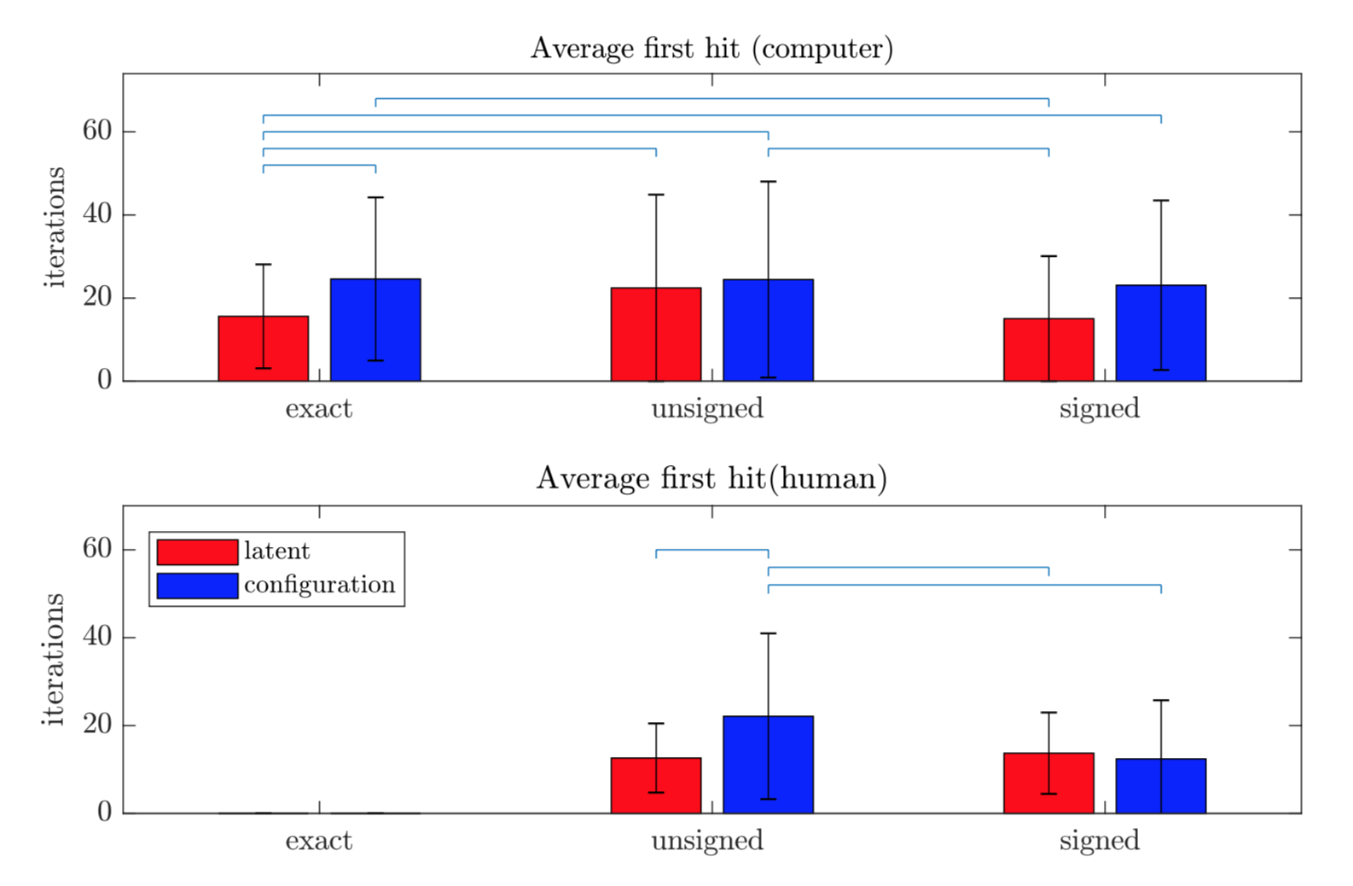
Results
Exact Reward performs statistically significantly better in latent space.
[2]

Slide 19
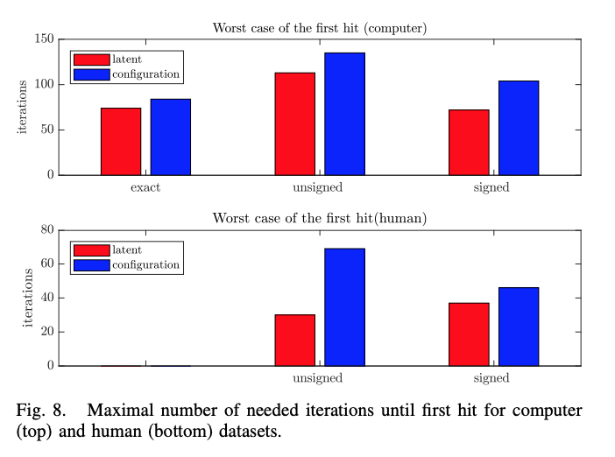
Results
Computer needs double iterations in the worst case.
It always takes longer in configuration space than in latent space in the worst case.
[2]

Slide 20
Summary
Using user-assigned reward, the throwing error converges to zero in practice.
We applied it in both the configuration and latent spaces.
Learning in latent space is faster.
Learning with signed rewards in configuration space is faster than unsigned rewards.
Human intelligence is a factor in learning.
[2]

Slide 21
Concerns
PoWER Algorithm only measures the terminal reward. Though it makes it easier for users to assign a reward, some tasks require intermediate rewards, which is difficult for humans to provide feedback.
If the reward is not straightforward, human-assigned rewards are very likely not perform better than expert-defined rewards. This approach is limited.
The simulated human rewards are not justified. It’s possible that by modifying the simulated human rewards, the computer can perform better.
[2]

Slide 22
Reference
[1] https://en.wikipedia.org/wiki/Importance_sampling
[2] http://www.cs.columbia.edu/~allen/S19/learning_HITL_throwing_policy.pdf
[3] https://papers.nips.cc/paper/3545-policy-search-for-motor-primitives-in-robotics.pdf

