Slide 1
A robot with style: can robotic attitudes influence human actions?
Vannucci F., Di Cesare G., Rea F., Sandini G., Sciutti A.
Presented by Lingyu An

Slide 2
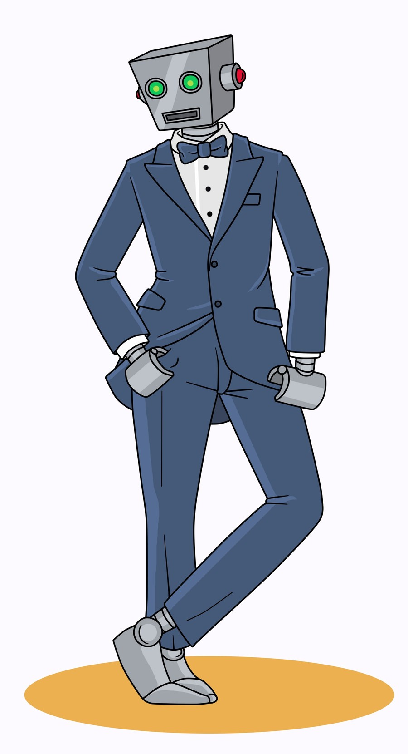
A robot with style?
Notes:
In this context, we do not mean a robot with good fashion sense, but the style of an action, i.e. how it is performed
Why is this important?
Style has a strong influence on interaction between humans.
The same gesture can have different connotations when it is performed aggressively or kindly,
and humans are very sensitive to these subtle differences in others' behaviors.
We can classify these different styles in which actions are taken as vitality forms

Slide 3
Vitality Forms
Vitality forms represent how an action is performed and characterize all human interactions.
The same action can have different interpretations depending on its vitality form.
How do they influence our responses?
Notes:
In spite of their importance in social life, to date it is not clear whether the vitality forms expressed by the agent can influence the execution of a subsequent action performed by the receiver. [1]
Studies have been done recently in trying to determine this.
One from 2017 focused on human-human interactions.

Slide 4
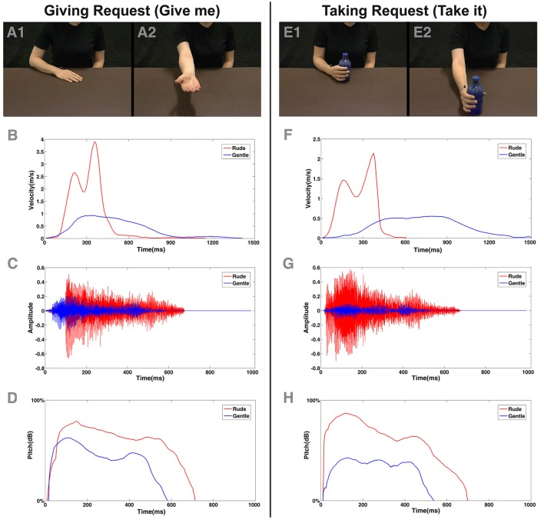
[ 1 ]
Notes:
Subjects were shown a video clip of a request
If the stimulus was a giving request (give me), participants had to reach for, grasp, and move the bottle close to the monitor; otherwise, if the stimulus was a taking request (take it), participants had to reach, grasp, and move the bottle close to their body [1]
The participant’s hand movement was tracked by sensors attached to the hand.
This study found that vitality forms expressed by the actors influenced the kinematic parameters of the participants' actions regardless to the modality by which they are conveyed.
This seems important for human-human interactions, but why apply to robots?

Slide 5
Why is this important?
In the future, robots will possibly play many social roles. Easier communication between humans and robots would allow robots to carry out their responsibilities more efficiently.
Interactive humanoid robots could be a key tool to serve the investigation of the psychological and neuroscientific bases of social interaction. [2]
Notes:
More organic communication -
Policeman robot and teacher robot? - would need to be commanding or assertive
Other study from 2017:
Investigating the behavioral and neural mechanisms supporting natural interaction poses substantial problems.
In particular, the unconscious processes such as unintentional movements or gazing are very difficult—if not impossible—to restrain or control in a quantitative way for a human agent.
Moreover, during an interaction, participants influence each other continuously in a complex way, resulting in behaviors that go beyond experimental control. [2]
Robots can establish an interaction with a human partner, contingently reacting to his actions without losing the controllability of the experiment or the naturalness of the interactive scenario.[2]

Slide 6
How do we give robots “style”?
Develop a motor control system that moves the robot end-effector with a velocity profile respecting the regularities of the human motion.
Use this system to generate human-like movement in the iCub robot and refine to include vitality forms.
Notes:
This is done by:
Recording the kinematic data of a trained actor passing an object with gentle and rude vitality forms.
Remapping the captured motion into a movement of a kinematic chain of two links, 4 degrees of freedom (1 at the elbow and 3 at the shoulder).
This kinematic representation resembles the kinematic chain of the humanoid iCub
3. Then remapping the movement into robot kinematics by keeping into account the difference between actor’s and robot’s arm length
To generate a robotic voice we recorded the voice of a human actor that pronounces the following motor command: “take it” in rude and gentle forms.
We then manipulated some physical properties e.g. the pitch and duration.
Alter the volume in order to match the corresponding gentle and rude vitality forms of the human voice.
After this is done, first experiment

Slide 7
First Experiment
Goal:
To verify that the created action and speech vitality forms would be perceived in the same manner as those produced by a human actor
Notes:
This study consisted of two different experiments.
After creating the vitality forms, subjects were asked to rate different stimuli in terms of rudeness.

Slide 8
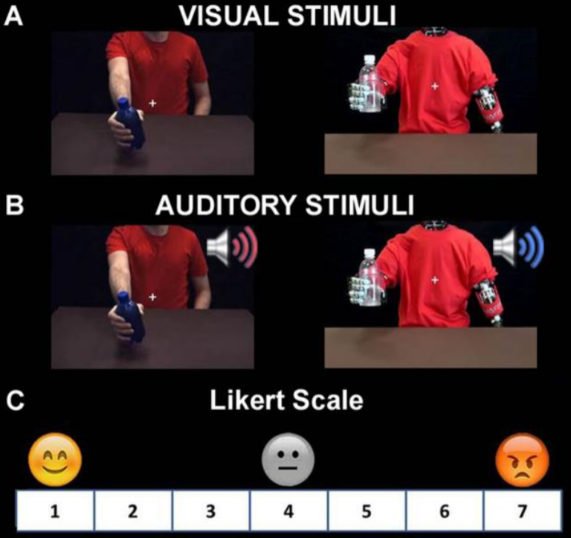
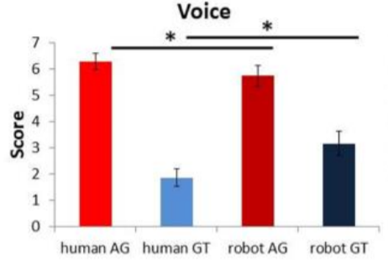
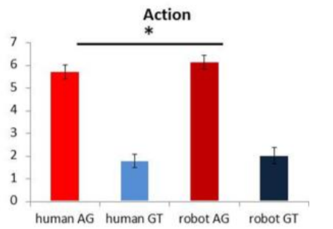
Notes:
Left:
(20)Participants were asked to watch video of actions performed either with a rude or a gentle style
or to listen to instructions given with a rude or gentle voice modulation and to rate from 1 (very gentle) to 7 (very rude) the actor’s behavior.
The agent could be either a human male actor or the iCub robot, exhibiting the voices and kinematics we have generated.
Right:
Subjective evaluation of robot behaviors with different vitality, conveyed with different vocal (left) or action features (left) . Gentle and rude between the robot and actor seem to be perceived almost in the same manner by participants.

Slide 9
Second Experiment
Goal:
To analyze the effect of vitality forms expressed on participants during a real human-robot interaction.
Notes:
After the subjective evaluation of the generated vitality forms, a behavioral study was carried out to test the same stimuli during a real human-robot interaction.
10 participants; all with some form of experience in interaction with the iCub.
Done to minimize the influence of a potential novelty effect on participants’ behavior.

Slide 10
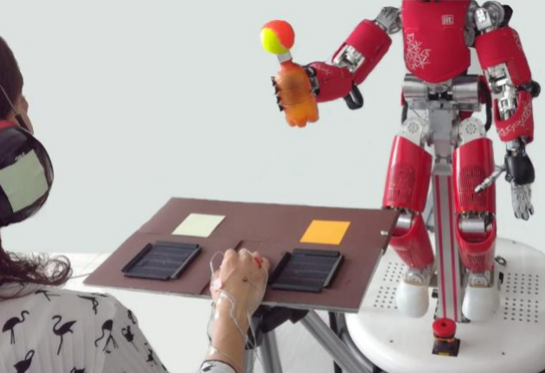
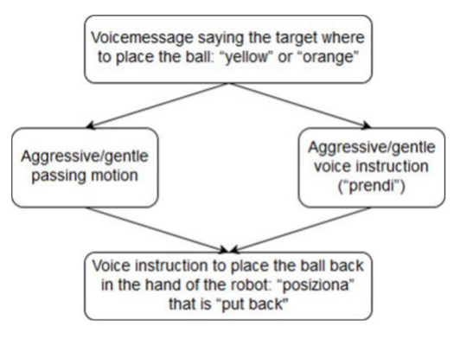
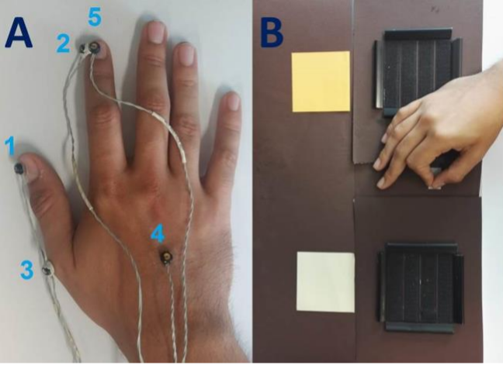
Flowchart showing the sequence of
one trial with the possible variations
Notes:
After the iCub action execution (passing the object) or word pronunciation (“take it”) participants had to take a ball held by the robot at approximately 30 cm from their right hand.
Participants wore headphones to hear the robotic voice indications, covered by hearing protectors to avoid experimental biases due to the noise of the moving motors.
The face of the robot was covered since the salience of the information had to be conveyed only either by the action or by the speech.
The voice messages that indicated the target or the repositioning of the ball, were designed to be neutral and to avoid any influence on the participant.
Also the return movement was programmed to respect biological motion but peak velocity speed was reduced to show neutral vitality.
We gathered kinematic data of each participant through an Optotrak tracking system (NDI) with 5 active infrared markers (sampling rate 100 Hz) placed on the right hand
From marker 4, at the center of the back of the participant’s hand, we analyzed the speed and acceleration of hand motion.
With markers 1 (tip of the thumb) & 2 (tip of the index) we analyzed the dynamics of finger aperture

Slide 11
Results
Successful porting of the human actions to the joint space of the robot with accurate timing. The iCub could execute very precise movements, closely resembling the ones of the human actor.
The robot voices consistently replicated the differences in the features of the gentle and rude human voice.
Notes:
For the first part

Slide 12
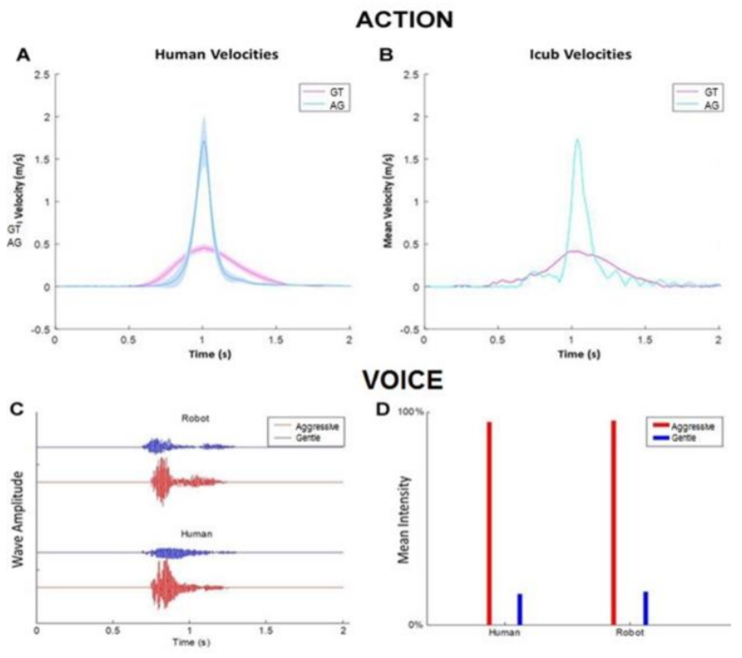
Action:
velocity profiles of the movements performed by the human actor (A) and robot (B).
Voice:
graphs show the wave amplitude (C) and the mean intensity (D) relative to the action verb “take it”
pronounced by human and iCub robot in gentle and rude way.
Notes:
As we saw earlier, Gentle and rude between the robot and actor seem to be perceived almost in the same manner by participants.
This is confirmed by two Two Way Repeated Measures ANOVA on the ratings for the different voices and movies, with Agent (human/robot) and Style (gentle/aggressive) as factors.
For both type of stimuli (auditory and actions)
the difference between Style is highly significant (voice: F(1,19) = 682.5, p<0.001; action: F(1,19)=298.7, p<0.001 ),
whereas the difference between Agents is not significant (voice: F(1,19)=0.76, p=0.39; action: F(1,19)=0.84, p=0.37).

Slide 13
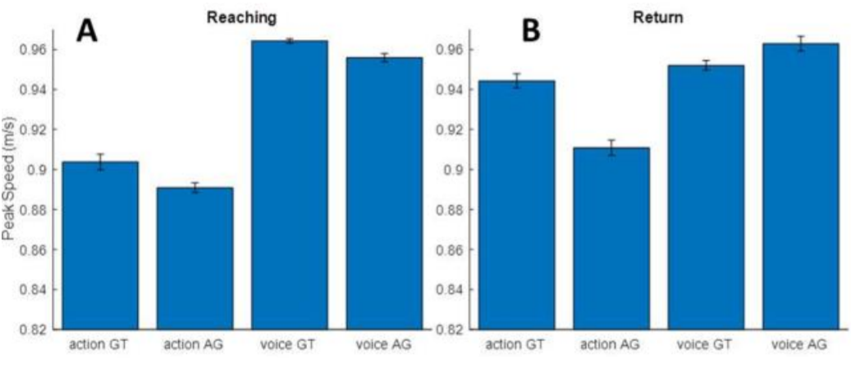
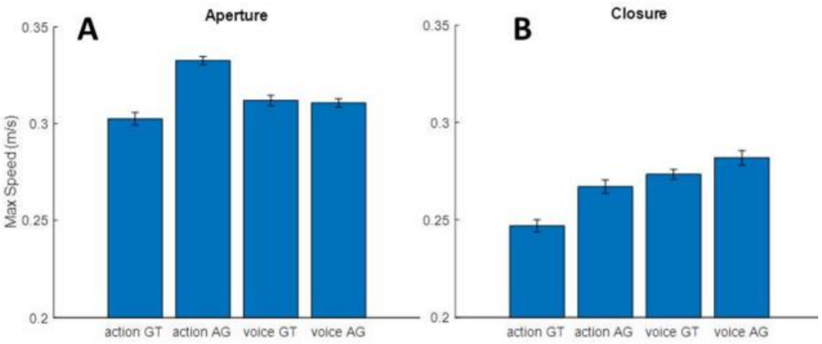
Mean among all participants of the maximum hand speed for the reaching (A) and return (B) phase of the movement.
Mean among all participants of the maximum aperture
speed (A) and closure speed (B) for the reaching phase of the movement.
Notes:
Robot voices tend to appear on average more gentle than the corresponding human voices. Conversely, the actions exhibit the same level of aggressiveness and kindness for the two agents.
A Bonferroni post-hoc highlights a significant difference between the ratings for aggressive styles between human and robot (p = 0.002) and a significant difference
between the ratings for gentle styles in the voice modality only (p<0.001).
The behavioral reactions, however, show only minor differences between the two types of robot actions,
with just a tendency to show an increase in hand acceleration and speed of grasp aperture in response to an aggressive rather than a gentle robot behavior. Moreover, participants’ motor response was significantly faster and more accelerated in response to robot’s voice rather than robot’s action
A Two-Way Repeated Measures ANOVA confirms again significant difference only between action and voice (F(1,9) = 16.83, p<0.01).

Slide 14
Summary
The kinematics parameters of the robot motion and properties of its voice are adequate to express different attitudes.
The subjective recognition of the “style” of the robot is similar for both modalities of communication: action and voice.
Notes:
It is possible to endow a humanoid robotic action and voice with different vitality forms, conveying the impression of a rude or a gentle action.

Slide 15
Thoughts
Only two vitality forms tested - how would a broad spectrum of different forms be implemented in robots?
Robot’s actions were created using kinematic data recorded by a human actor and are fixed
Notes:
In everyday interactions, we use a multitude of different vitality forms to communicate depending on the situation.
How would these vitality forms be generated without a human actor?

Slide 16
Questions?

Slide 17
References
[1] G. Di Cesare, E. De Stefani, M. Gentilucci, and D. De Marco, “Vitality Forms Expressed by Others Modulate Our Own Motor Response: A Kinematic Study,” Front. Hum. Neurosci., 2017.
[2] A. Sciutti and G. Sandini, “Interacting with Robots to Investigate the Bases of Social Interaction,” IEEE Trans. Neural Syst. Rehabil. Eng., pp. 1–1, 2017.
Notes:
Thanks for reading!

