Slide 1
One-Shot Hierarchical Imitation Learning of Compound Visuomotor Tasks
（and two related papers）
Tianhe Yu, Pieter Abbeel, Sergey Levine, Chelsea Finn
Yuchen Mo
Feb 26, 2019

Slide 2
Contents
Objectives & General approaches
Model
Phase predictor
Domain-adaptive meta-learning
One-shot skill composition
Experiments
Contributions & Future improvements

Slide 3
Objective
“Learning multi-stage vision-based tasks on a real robot from a single video of a human performing the task, while leveraging demonstration data of subtasks with other objects.”
What we have during meta-training:
Both videos of humans and teleoperated episodes performing primitive skills (w/o label)
What we have during meta-testing:
A single video of a human performing multi-stage task
What we want:
Imitate the multi-stage task
Notes:
Previous work for compound task learning: use demonstrations that are labeled, or segmented into individual activities, commands, descriptions. Or assume a library of pre-specified primitives.
Ours: a dataset of demonstrations that are not labeled by activity or command.

Slide 4
Method
Consider we have a phase predictor for each primitive, then our objective can be decomposed into:
- Decomposes the test-time human video into primitives using a primitive phase predictor
- Computes a sequence of policies for each primitive
- Sequentially executes each policy

Slide 5
General approach
Learn a phase predictor
For each premitive, perform imitation learning
One-shot composition of primitives

Slide 6
Phase predictor
Remember our input dataset: a dataset of demonstrations of primitives w/o label
Question:
1. How to segment human demonstrations of compound tasks?
2. When to transit from one policy to the next?
3. What if our human and robot demonstrations are different in length?
Solution:
Given a video of a partial demonstration or execution of any primitive, we predict how much temporal progress has been made towards the completion of that primitive
Notes:
w/o label: without any label for the particular primitive that was executed in that segment
Obj1: (So that the robot can learn a seq of policies in meta-test time)

Slide 7
Phase predictor
Two predictors for human/robot demonstration data
Training data: first t frames of human/robot demonstration in meta-training dataset
Training label: t/T, where T is total length of this demonstration
Objective: Minimize MSE
Network: VGG-16 + LSTM, swish nonlinearity, layer norm + dropout
Notes:
These two predictors are the same except for the data

Slide 8
Imitation learning
Domain-adaptive meta-learning (DAML) is an extention to model-agnostic meta-learning (MAML)
Imitation learning assumes meta-training and meta-test tasks are sampled from the same distribution, and that there exists a common structure among tasks. Thus, meta-learning corresponds to structure learning.
Notes:
Imitation learning: to infer a policy from a single human demonstration
(It can be explained with probablistic graph models.)

Slide 9
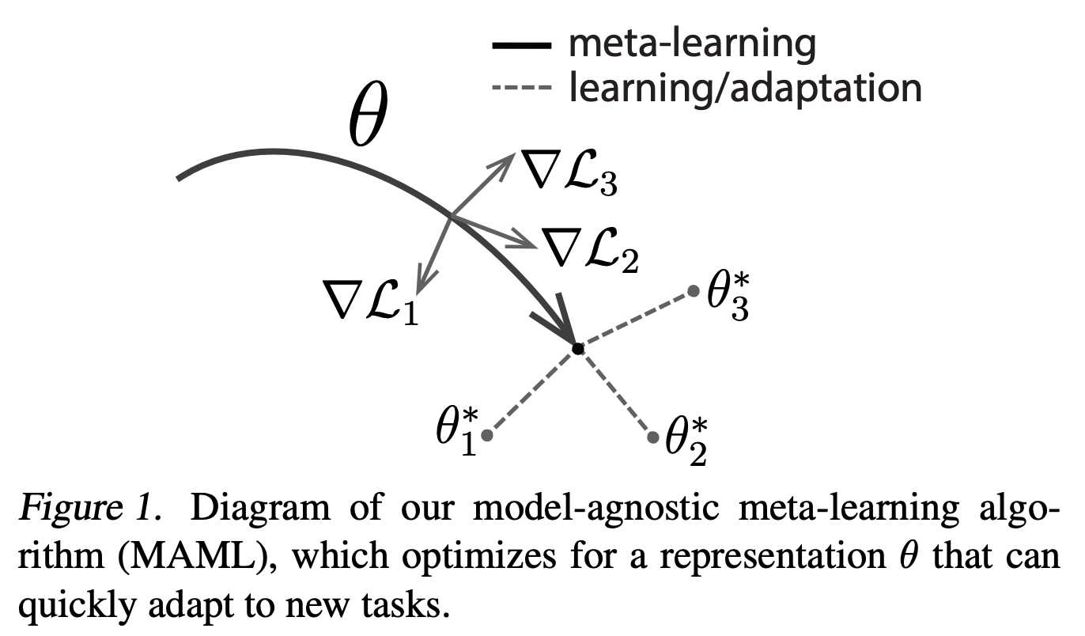
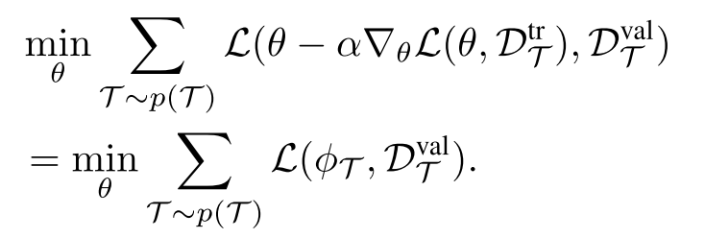
Model-Agnostic Meta-Learning for Fast Adaptation of Deep Networks (MAML)
(Chelsea Finn, Pieter Abbeel, Sergey Levine)
Aims to learn a shared structure across tasks, by learning a set of parameters of a neural network that: with one or few more gradient descent steps, the model will generalize effectively to one of those tasks
T: task D_{T}: labeled data for task T
theta: initial model parameters
L(theta, D): loss function
Meta training:
Meta testing:
Notes:
Figure 1. In the parameter space

Slide 10
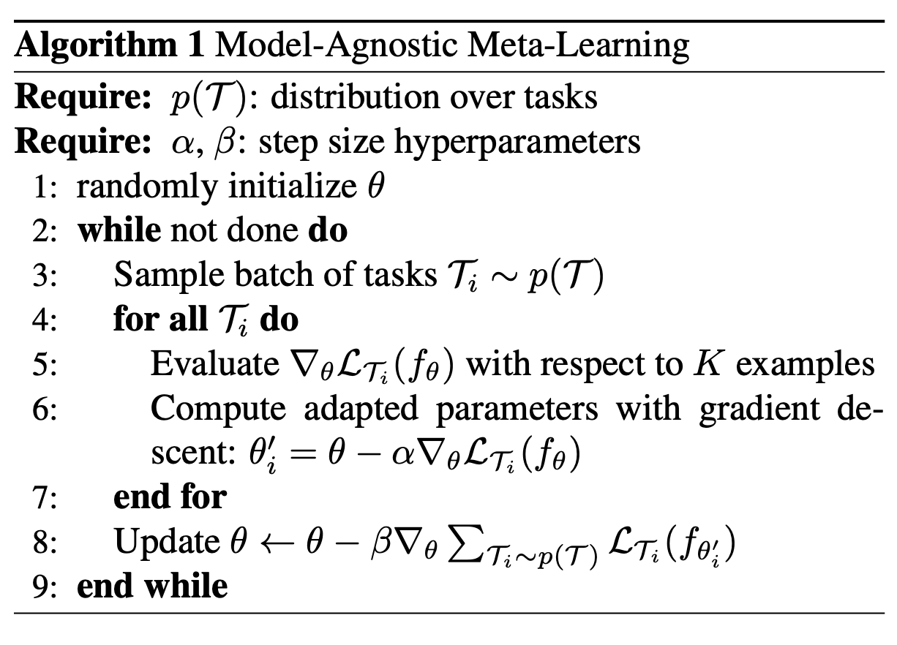
MAML (cont.)
large alpha, small beta
randomly init theta
while:
sample some tasks
for each task i:
calculate grad on training set w/ param theta
do gradient descent (stored in theta_i’)
end for
for each task i, calculate its gradient on validation data w/ param theta_i’.
Update the ‘global param’ theta w/ their sum.
end while
Notes:
MAML itself has reinforcement learning version but not mentioned in this paper.

Slide 11
Domain-Adaptive Meta-Learning (DAML)
DAML learns to translate from a video of a human performing a task to a policy that performs that task.
Add ‘adaptive objective’ to MAML objective function:
d^{h}, d^{r}: human/robot demostration
L_{𝜓}: a learned critic s.t. gradient descent on L_{𝜓} => effective adaption
Where for a policy ɸ and demonstration d^{r}, L_{BC} is behavior cloning loss defined as
Notes:
Inner -> Outer
Loss of domain transferring => Loss of robot cloning behavior => Loss of the task
Minimize not only theta but also the domain transferring param phi
Previous DAML: different meta-learning tasks means different objects
This paper: primitives performed w/ different sets of objects

Slide 12
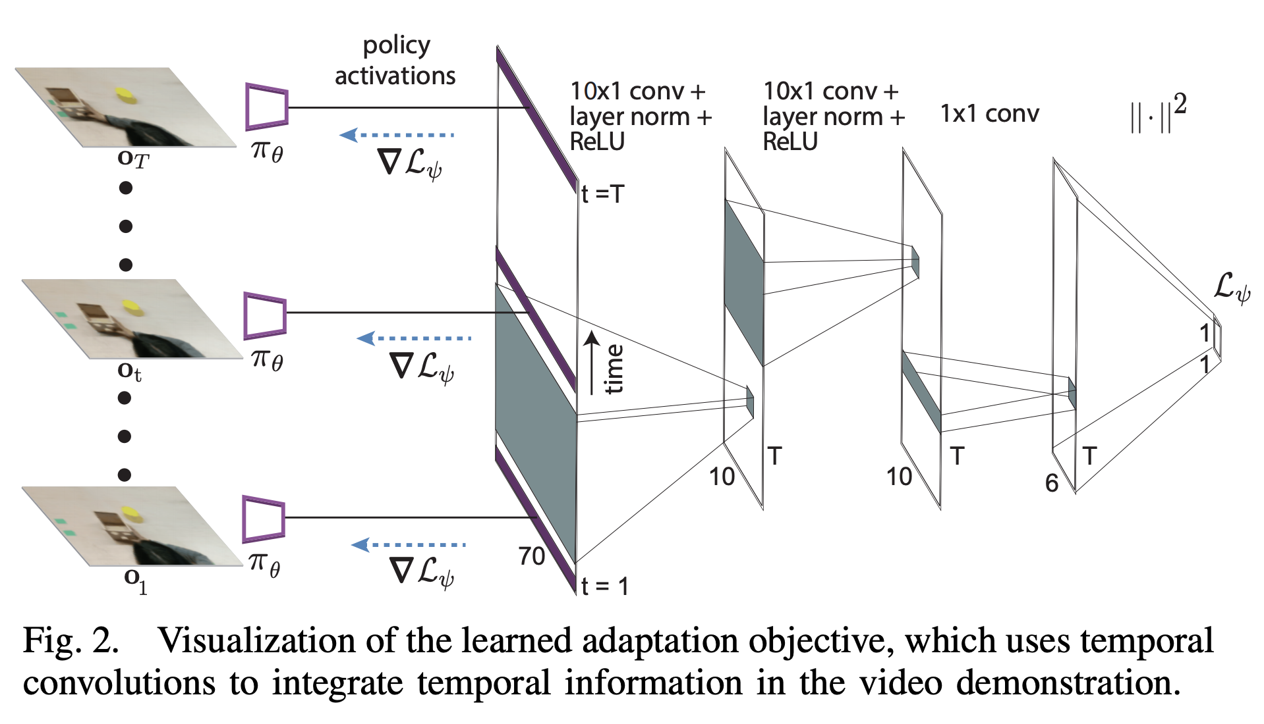
One-Shot Imitation from Observing Humans via Domain-Adaptive Meta-Learning (DAML)
Tianhe Yu, Chelsea Finn, Annie Xie, Sudeep Dasari, Tianhao Zhang, Pieter Abbeel, Sergey Levine
Notes:
An example of L\psi, a NN. \psi are its parameters

Slide 13
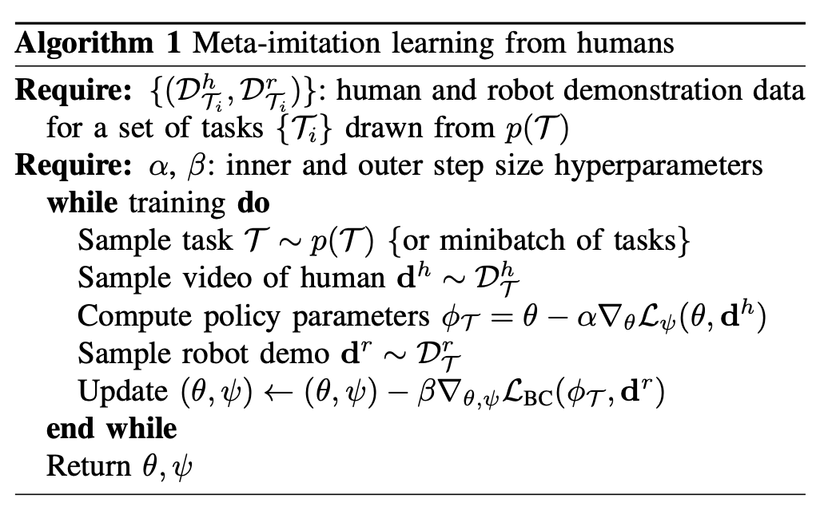
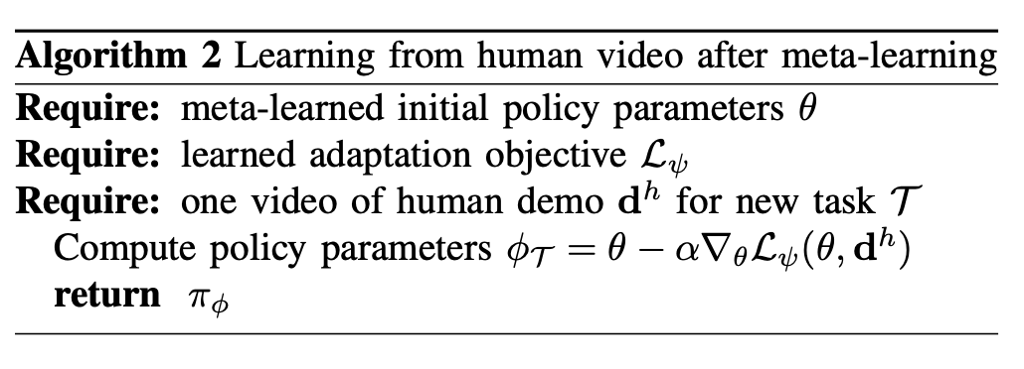
One-Shot Imitation from Observing Humans via Domain-Adaptive Meta-Learning (DAML)
Tianhe Yu, Chelsea Finn, Annie Xie, Sudeep Dasari, Tianhao Zhang, Pieter Abbeel, Sergey Levine
L_{𝜓}: a learned critic s.t. gradient descent on L_{𝜓} => effective adaption… What?

Slide 14
Composition
Composition algorithm:
Feed human demonstration into human phase predictor frame by frame, till output > 1-ε => get a primitive segment. Repeat 1 till the end.
Given those primitive demonstrations, translate them into policies w/ DAML one-shot imitator => get policies
Run policies sequentially, feed observed images into robot phase predictor, change policy when output > 1-ε
What we have now:
1. Human phase predictor
2. Robot phase predictor
3. DAML one-shot imitator
Notes:
3. learn robot policy of a specific premitive from human demnstration

Slide 15
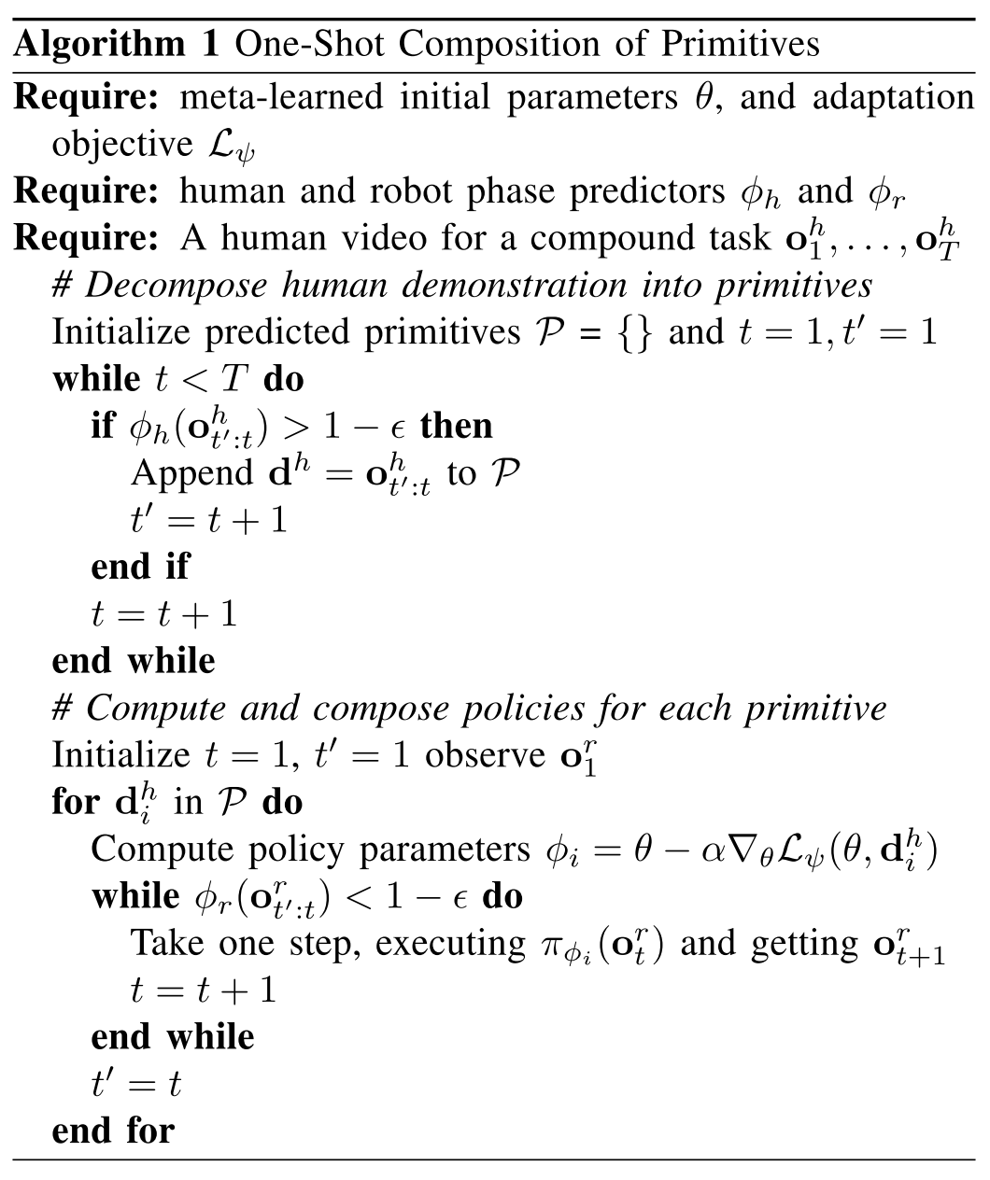
Composition
Composition algorithm:
Feed human demonstration into human phase predictor frame by frame, till output > 1-ε => get a primitive segment. Repeat 1 till the end.
Given those primitive demonstrations, translate them into policies w/ DAML one-shot imitator => get policies
Run policies sequentially, feed observed images into robot phase predictor, change policy when output > 1-ε

Slide 16
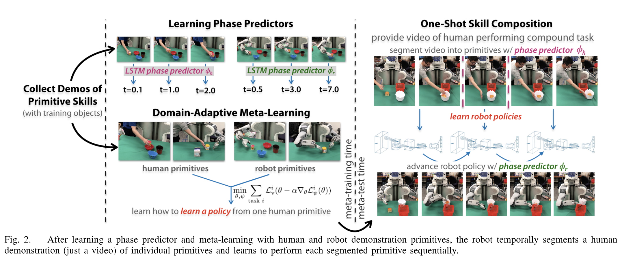
Model summary

Slide 17
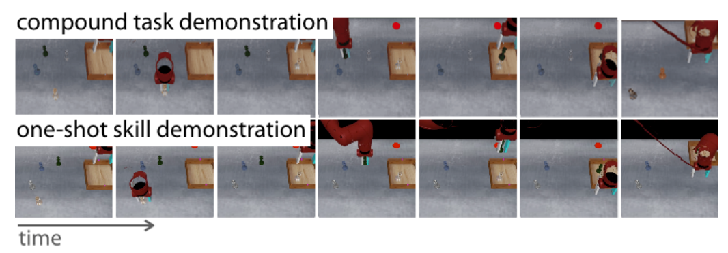
Experiments (Simulated Order Fulfillment in MuJoCo, Sawyer arm)
Notes:
Demonstration: Picking and placing a single object into the bin, and pushing the bin to the goal. The other objects are distractors.
Human demonstration is given by an expert policy using proximal policy optimization (PPO). Actually, it gives demonstration for each primitive and they concatenate them together to generate more test data.
Success is defined as having the correct objects in the bin and the bin at the target.
Sliding window: that fixed-length windows are an appropriate representation of primitives
Results: Phase prediction and gradient-based meta learning are essential for good performance.
Failures: Caused by the one-shot imitator on grasping. Requires precise visual object localization and precise control.

Slide 18
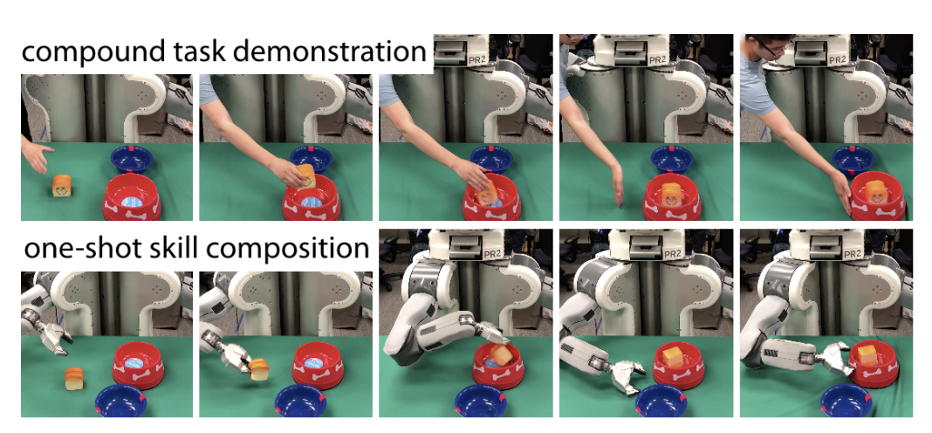
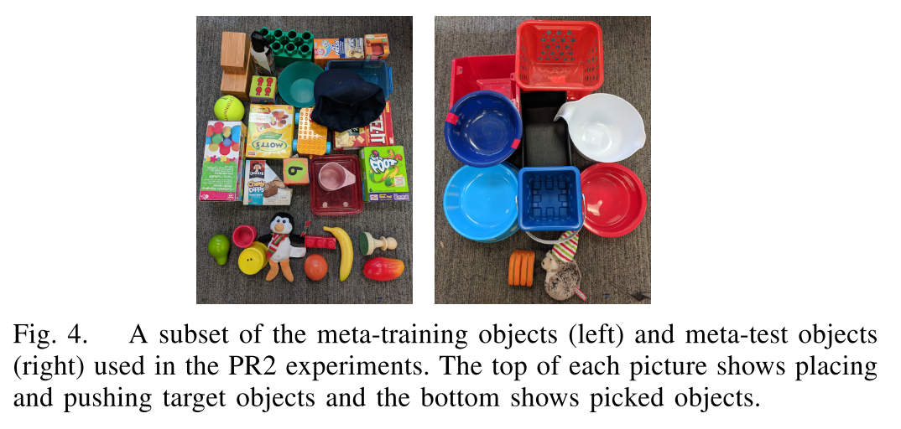
Experiments (PR2 Kitchen Serving)

Slide 19
Demo
https://sites.google.com/view/one-shot-hil

Slide 20
Contributions & Future improvements
Contributions:
1. Meta-learning from unlabeled demonstrations of primitive tasks.
2. End-to-end video=>policy at test time
Improvements:
1. The performance of one-shot imitation learning methods, potentially incorporate reinforcement learning or other forms of online feedback
2. More unstructured demonstration data, such as human and robot demonstrations of temporally-extended tasks that are from distinct sources
Notes:
rather than full-length long tasks, and needs no label
convey motions or subtasks that are difficult to describe, such as the transitions from one subtask to another; it also does not require the human to have any knowledge of the grammar of commands
2. provide the ability to scale to large, unlabeled datasets. May remove the need for an expert to decide the set of skills that constitute primitives during training

Slide 21
Thank you for listening!
Q&A?

