Slide 1
Can a Humanoid Robot Spot a Liar?
2018 IEEE-RAS 18th International Conference on Humanoid Robotics
Beijing, China, November 6-9, 2018
by A.M. Aroyo, J. Gonzalez-Billandon, A. Tonelli, A. Sciutti, M. Gori, G. Sandini and F. Rea
presented by Kaylah Kennedy

Slide 2
Motivation
Lie Detection is a necessary skill for several social positions including teachers, reporters, law enforcement, etc
Robots with this skill could greatly assist professionals in these positions by automating the process of lie detection with less invasive techniques (such as eye blinking and pupil dilation)

Slide 3
Typical Lying Cues
Lying requires more cognitive load as liars have to build a plausible story and monitor its coherence
This cognitive load has a measurable effect on traits such as eye blinking, pupil dilation, and response time

Slide 4
Overview
Inspired by literature on human-human interaction, this work investigates whether the behavioral cues associated to lying – including eye movements and response temporal features – are apparent also during human-humanoid interaction and can be leveraged by the robot to detect deception
Using the results of this study, the authors then propose machine learning models that could be used to train an interactive robotic platform to detect deception

Slide 5
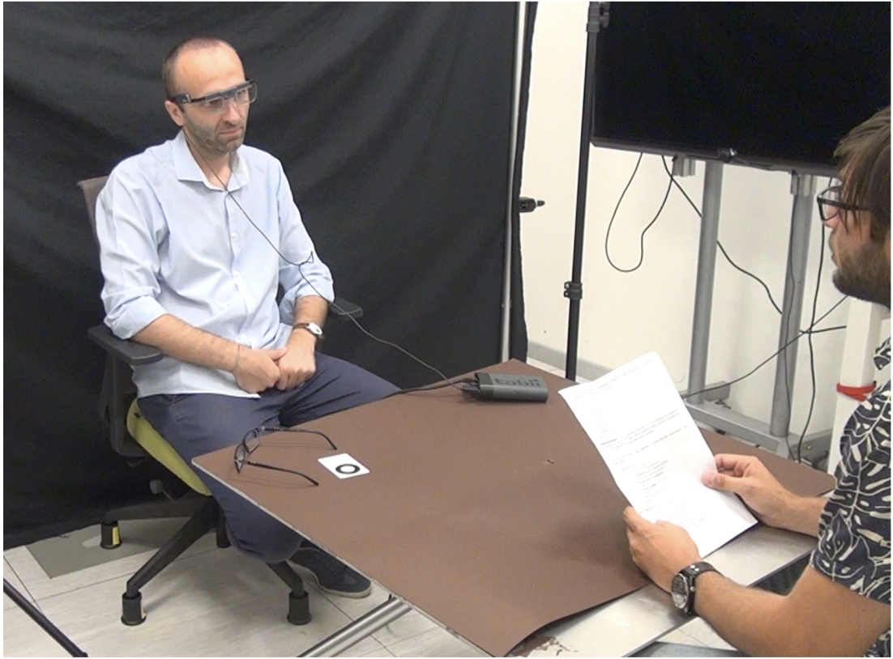
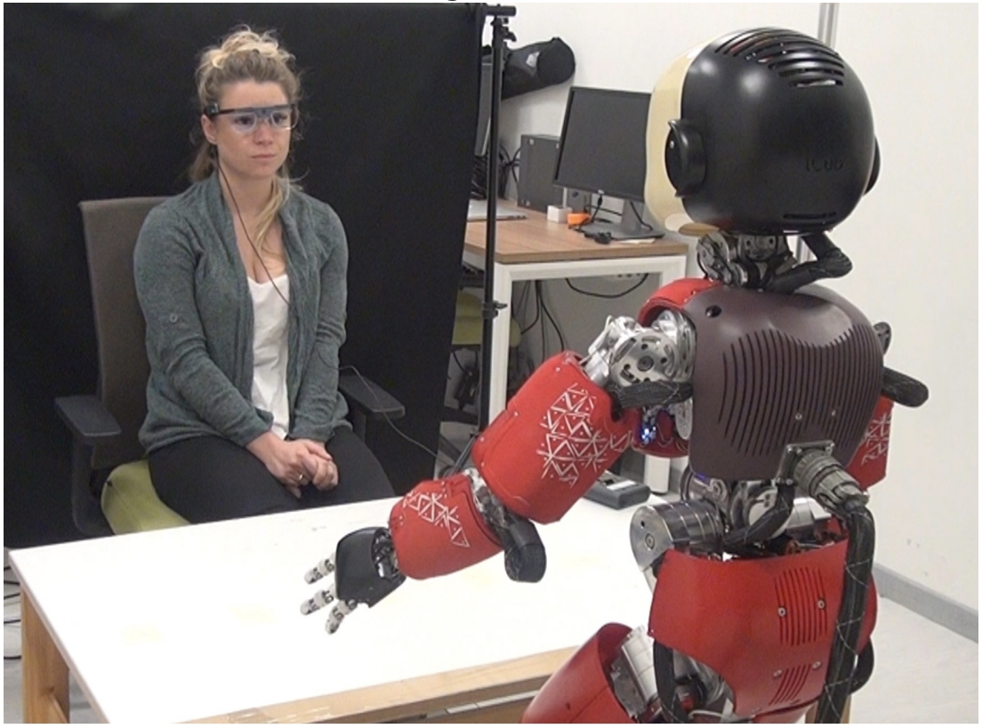
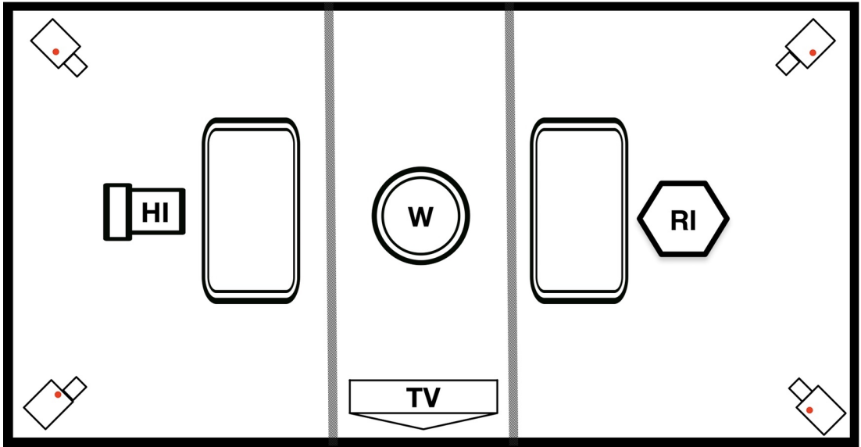
Setup of Experiment
The experiment room was setup as an interrogation room divided into 3 zones with black curtains with the participant seated in the middle on a rotating chair
participants were monitored with cameras, heart-rate chest sensor, microphone, and Tobii Eyetracker glasses which recorded pupil dilation and eye movements

Slide 6
Procedure
Before starting the experiment, participants filled out a questionnaire in order to identify particular psychological features that could influence the results
Participants were told that they were witnesses of two crimes and must help investigators find out who’s responsible
Experiment is separated into three phases:
General questions
Participants were asked to truthfully and quickly answer 20 general questions
First question session
10 questions asked by the robot investigator
Second question session
10 questions asked by the human investigator

Slide 7
Procedure Pt. 2
After completing general questions, participants “randomly” picked a role from a box
The participants thought their role was random but in fact the experimenters had chosen their roles a priori
Participants were either truth-tellers or protectors
They were then shown a video for each round of interrogation, each recording a theft
The participants then went through the two question sessions in which the interrogator asked a mix of yes/no and open-ended questions based on what they saw in the video

Slide 8
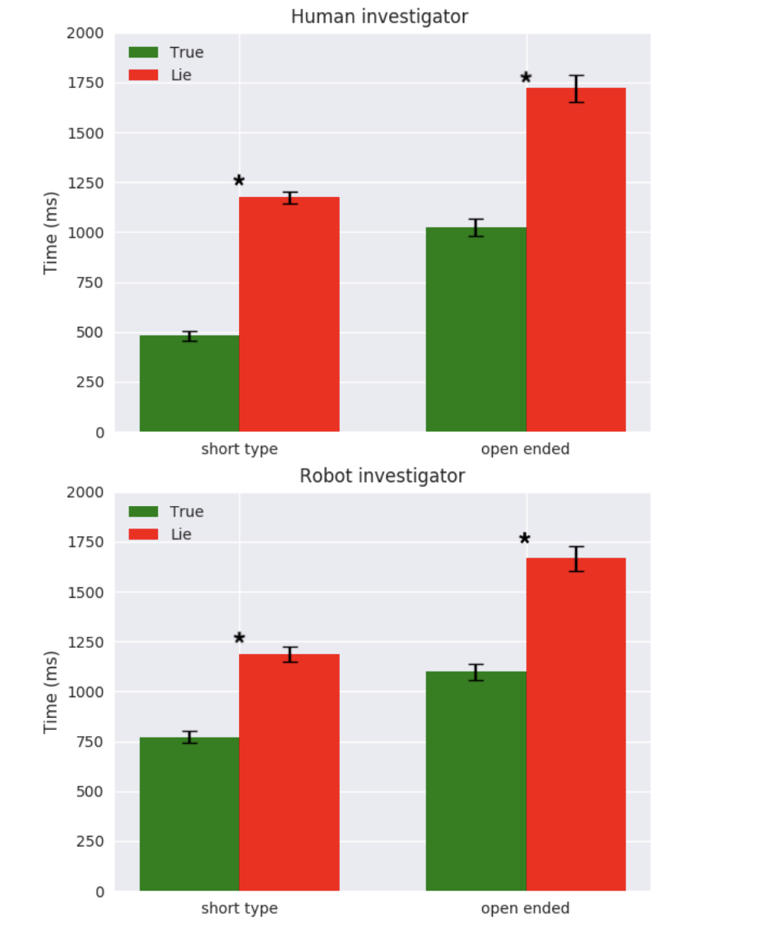
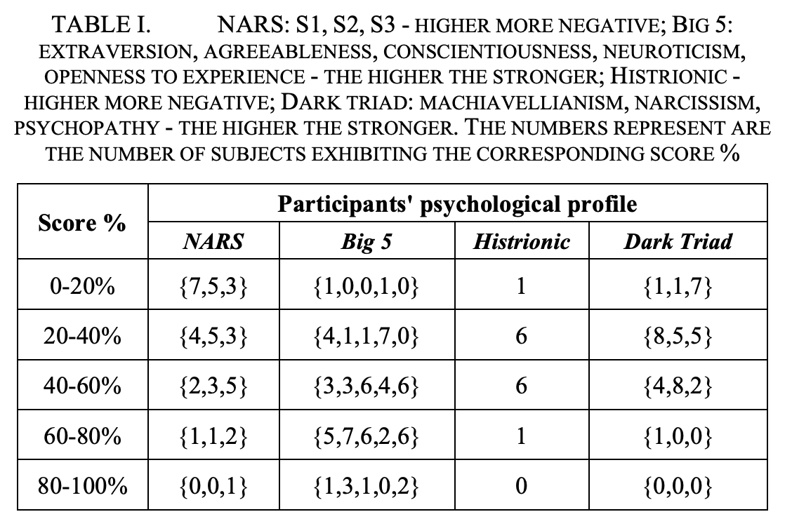
Results
A psychological profile was made for each participant based on their score on the questionnaire
There is a statistically significant difference in the response time when participants have to say the truth with respect to saying a lie
There are also significant differences in the average pupil dilatation for both eyes while telling the truth rather than a lie.
There were no significant differences between the time participants spent talking with the robot or human investigator

Slide 9
Machine Learning System
The system was defined as a binary classification system with an robotic autonomous system identifying either true or false answers
The dataset used to train the model was extracted from the data gathered in the experiment
It was then split into the sub-datasets D1 and D2 in order to address two different levels of lie: (i) detect future lies on known participants p1; (ii) detect lies on unprecedented participants p2.

Slide 10
Datasets
D1 is a set of participants' answers without any participant identification
D2 is a set of participants with their answers, and each answer is associated to the corresponding participant.
The D1 dataset is used to demonstrate the possibility to spot future lies from already known participants, but not on unseen participants.
The D2 dataset is instead used to try to obtain a general lie detector using a subset of participants as test set
The literature on deception detection and evidences from the post-analysis provide a starting point to select the features that can be used to create the input vector X

Slide 11
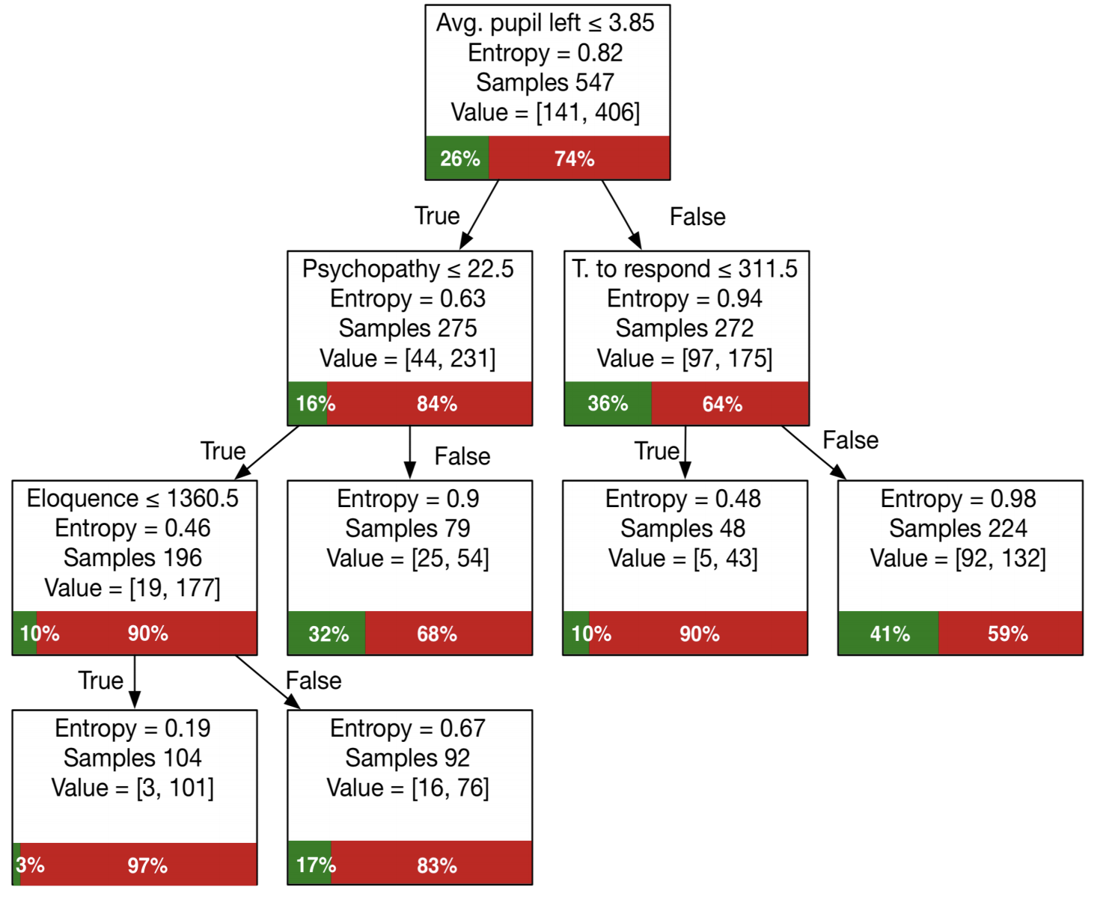
D1 ML Model
To detect future lies of a known person, a decision tree classifier was trained on D1
The learned tree can be directly translated into a set of rules to produce an expert system that can be easily ported

Slide 12
D2 ML Model
The second algorithm used was a multilayer perceptron (MLP) with one hidden layer
A binary cross entropy loss function with Adam optimization was used to train the network
The MLP was trained on D2 to demonstrate the possibility to spot lies answer on unseen person.

Slide 13
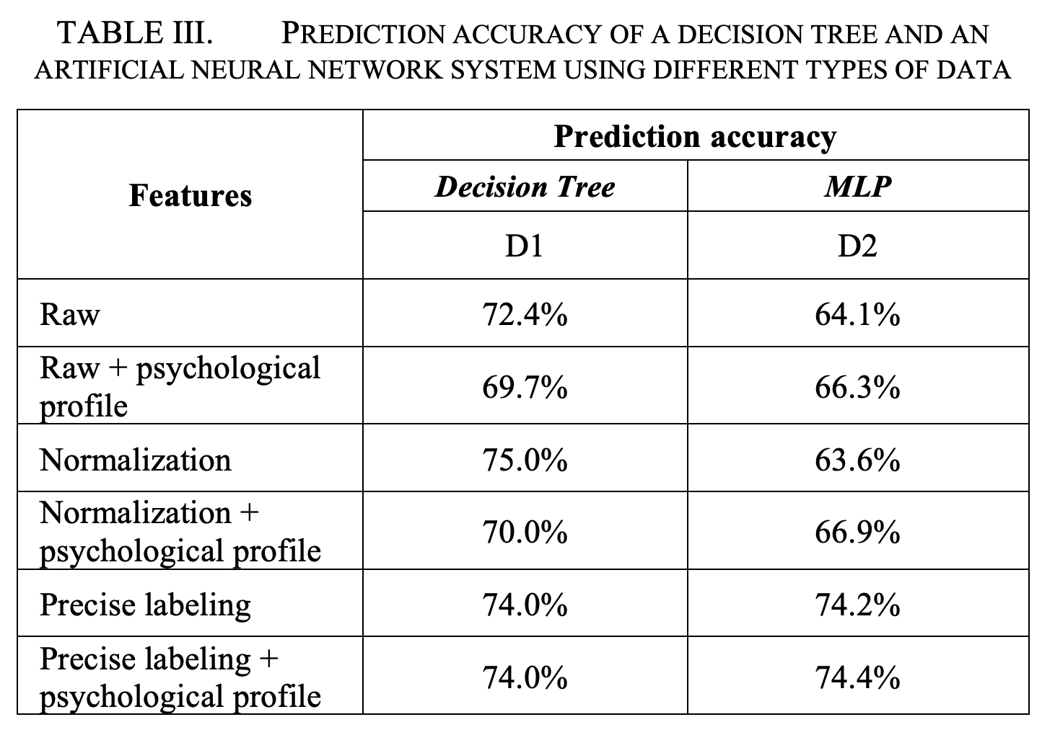
Accuracies of Models
Different refinements were made to the data such as:
Psychological scores from the pre-questionnaire were added to the input vector X
In order to find a connection between the psychological profile of the participants and the behavioral cues, a regression analysis was run on the difference between lie and truth per each participant. Eloquence correlates with openness to experience with F(1,12)=6.13, p=0.19. Another behavioral trait that correlates with the time to respond is neuroticism F(1,12)=8.37, p=0.013.
Response time and eloquence were normalized with the baseline data of the experiment to remove speaking differences of participants
The last improvement of the dataset was inspired from the analysis of the experiment's videos, it could be observed that some participants chose to deceive using avoidance (e.g., "I don’t know") or telling a true statement followed by a lie. These different strategies introduced more variability in the dataset producing ambiguity in the data labeling
A new labeling of the dataset was made depending the different strategies to lie. The lie class was refined by manual labeling using video of the experiments so to identify clear lie

Slide 14
Summary
This research demonstrates that the same set of behavioral cues studied in previous human literature can be used to detect lies and more importantly can be extracted with non-invasive measures.
The results also suggest there are no main differences between an interrogation performed by a human and a robot

Slide 15
Next Steps
Future work will be focused on refining the experimental methodology, in particular with the aim of better motivating participants to deceive, for instance by providing monetary rewards in case of successful deception of the interrogators.
This might constitute a significant drive towards the increase in the effort associated with the deception act. By consequence this could develop into stronger cognitive load associated with the deceit and hence exhibit more evident behavioral cues
Efforts could also be made to explore the effects of the appearance of robots on participants’ deceptive behaviors (e.g., virtual agent on screen)
A bigger sample size will be helpful in order to increase the accuracy of the ML models

Slide 16
Thank You! Any questions?

