Slide 1
Autonomous Narration of Humanoid Robot Kitchen Task Experience
by Qingxiaoyang Zhu, Vittorio Perera, Mirko Wächter, Tamim Asfour, & Manuela Veloso

Slide 2
Why do we need narration?
“...progress in humanoid robotics research has led to robots that are able to perform complex tasks with a certain level of autonomy...However, robot capabilities are still limited in regard to how they externalize their internal state and world state...”

Slide 3
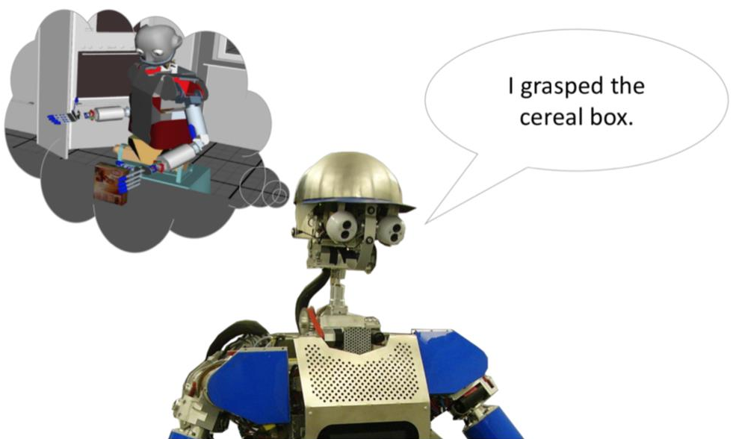
Why do we need narration?
grasp
vitaliscereal
1490757888
03/28/17
23:24:48.011

Slide 4
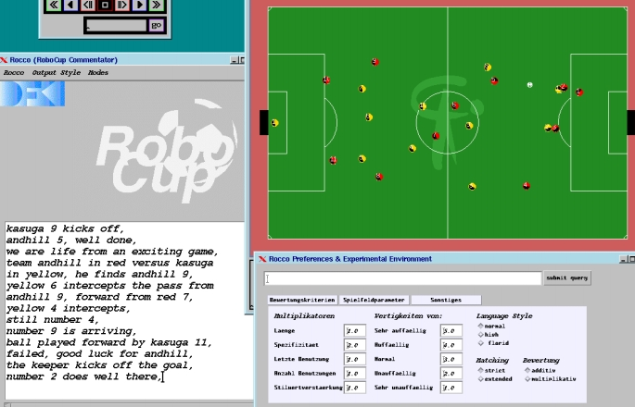
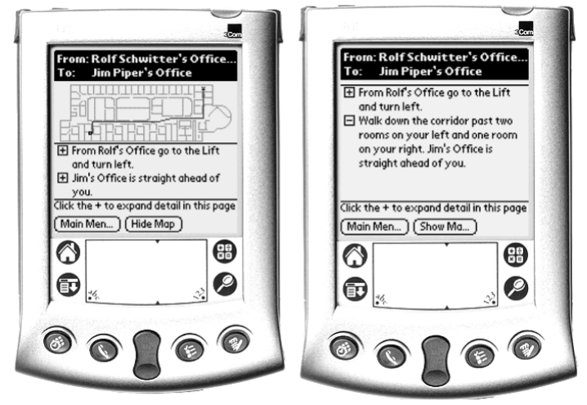
Related works
R. Dale, S. Geldof, and J.-P. Prost, “Using natural language generation in automatic route,” Journal of Research and practice in Information Technology, vol. 37, no. 1, p. 89, 2005.
D. Voelz, E. André, G. Herzog, and T. Rist, “Rocco: A robocup soccer commentator system,” RoboCup-98: Robot Soccer World Cup II

Slide 5
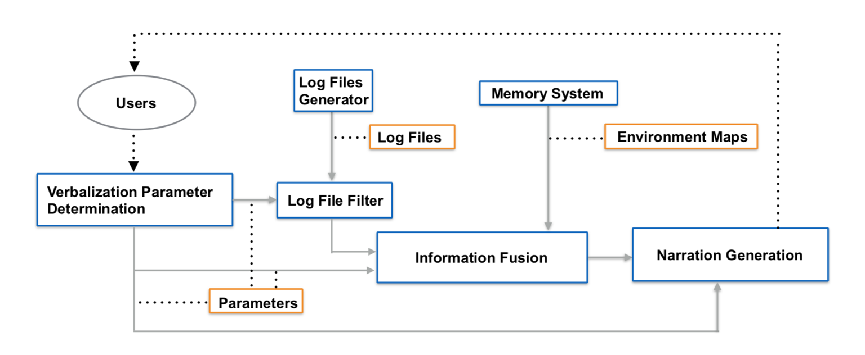
Modular verbalization system

Slide 6
Modeling of the Robot Experience
I_{action} = <ID, Name, List_{para}, T_{start}, T_{stop}>
I_{platform} = <ID, Pose_{start}, Pose_{stop}, T_{start}, T_{stop}>
I_{end_effector} = <ID, Range, HandID,
Position_{start_world}, Position_{start_base},
Position_{stop_world}, Position_{stop_base},
T_{start}, T_{stop}>
I_{end_effector_grasp} = <ID, Object, T_{happen}>
grasp
vitaliscereal
1490757888
03/28/17
23:24:48.011

Slide 7
Fusion of log files and maps
location is represented using nearest prominent facility or manually defined marks
Static Kitchen Map p = (n, x, y)
Static Marks Map p = (m, x, y, z, r)
Dynamic Objects Map p = (a, r, x, y, z, c)
M = (m, t)

Slide 8
Fusion of log files and maps
Euclidean distance based nearest neighbor
(3409.55,7100.15,-1.56999) to (2932.31,5618.54,2.3293)
can be represented as
“The robot moved from a point near sideboard, then arrived at a point near the control table”
angular distance based nearest neighbor

Slide 9
Narration generation
template based approach
takes the log information and environmental information fusion and converts this into natural language descriptions
user interest dictates the verbalization space, which is adjusted with 3 parameters (E, A, S):
semantic, E
abstraction, A
specificity, S

Slide 10
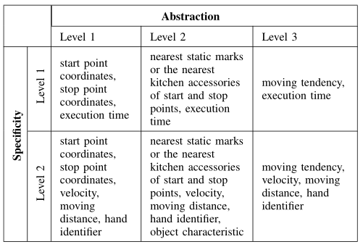
Narration generation
semantic
abstraction
specificity

Slide 11
Algorithm for verbalization
Input: query user
Output: narrative
record the history of robot’s behavior
determine values of verbalization parameters
determine time and objects of interest
filter log files according to users’ interest
load maps from memory system
annotate locations with conspicuous marks
choose appropriate corpus
generate narration for past experience

Slide 12
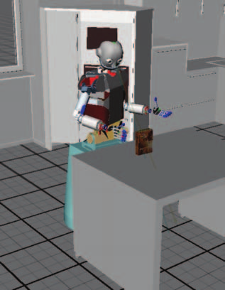
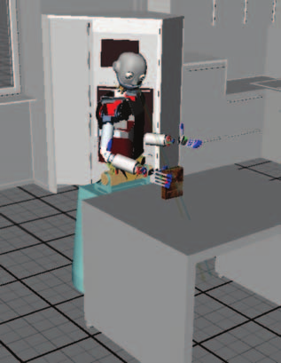
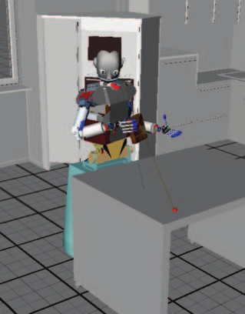
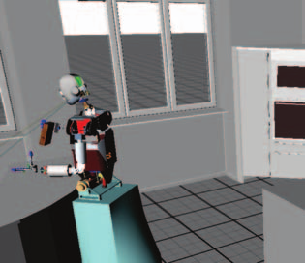
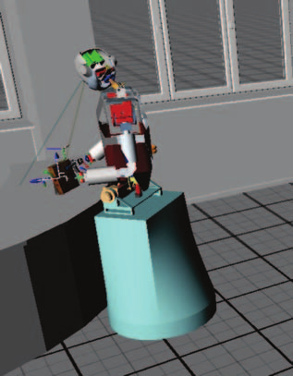
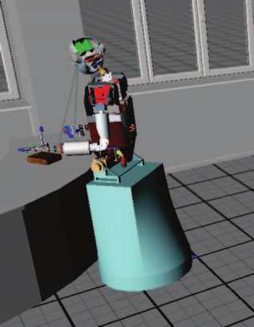
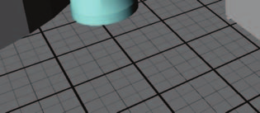
Verbalization
Natural & detailed verbalization
Preferences: semantic level 3, abstraction level 2,
specificity level 2
I grasped vitaliscereal.
I moved my right hand from tableCenter to tableCorner1 for a total of 99.198570 mm with a speed of 19.839714 mm/s.
I started in the vicinity of sideboard and arrived around the vicinity of
controltable. I moved a total of 1.556575 meter with a speed 1.556575 m/s and rotated 223.412857 degrees with a speed 223.412857 degree/s which took 1.000000 seconds.

Slide 13
Verbalization
Concise verbalization
Preferences: semantic level 2
I moved from sideboard2 to the sink. It took 1 seconds.
I picked up green cup on the sink with my right hand. It took 4 seconds.
I moved from sink to placesetting1. It took 1 seconds.
I put down the green cup. It took 1 seconds.

Slide 14
Conclusion
verbalization system allows robot to store past experiences, generate explanation of those based on user preferences
explanations not limited to sensorimotor related experiences, also include high level execution plans
future work: automatic determination of user preferences from dialog, learned templates

Slide 15
What I think
paper was vague in methodology
scalability depends on application
additional robots
larger spaces
display design issues
top-down processing
proximity compatibility principle

Slide 16
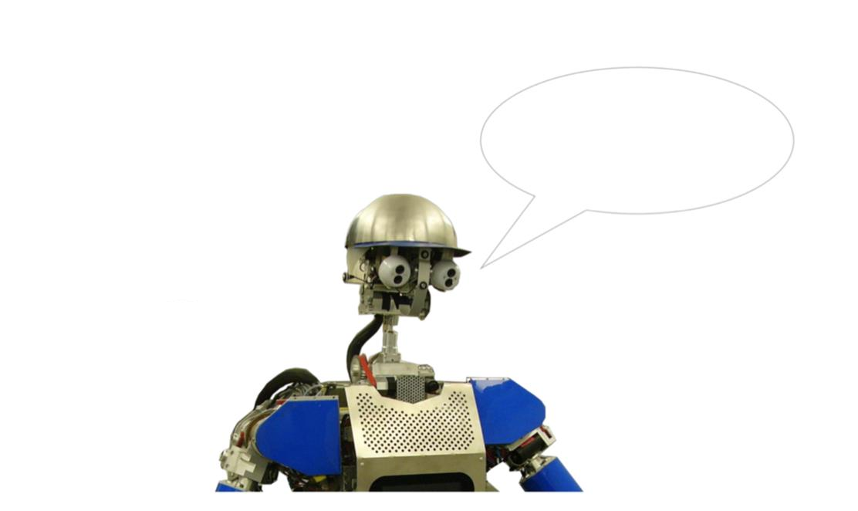
Questions?

