Slide 1
Humanoid Motion Planning for Dual-Arm Manipulation and Re-Grasping Tasks
Nikolaus Vahrenkamp, Dmitry Berenson, Tamim Asfour, James Kuffner, Rudiger Dillmann
Institute for Anthropometrics, University of Karlsruhe
The Robotics Institute, Carnegie Mellon University
Zhengyang Du
zd2219
Vahrenkamp, N., Berenson, D., Asfour, T., Kuffner, J., & Dillmann, R. (2009). Humanoid motion planning for dual-arm manipulation and re-grasping tasks. 2009 IEEE/RSJ International Conference on Intelligent Robots and Systems. doi:10.1109/iros.2009.5354625

Slide 2
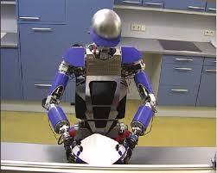
Overview
Goal
Having two arms for reaching the object effectively increasing the reachable space without moving in the workspace.
Develop computationally efficient motion planning approaches for dual-arm grasping and re-grasping tasks
Both in Simulation and ARMAR-III Robot
https://ieeexplore.ieee.org/stamp/stamp.jsp?arnumber=6202433

Slide 3
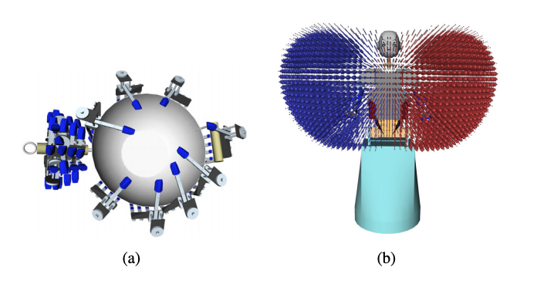
Novel Inverse Kinematics (IK) Solver for ARMAR-III
The IK solver has to consider that ARMAR-III has two 7 DoF arms and a 3 DoF hip
Apply a combination of gradient descent in pre-computed reachability spaces (6D) and random-sampling of free parameters
Present two probabilistically complete RRT-based motion planning algorithms (J⁺-RRT and IK-RRT)

Slide 4
Advantages and Disadvantages for both of the Algorithms
For J⁺-RRT (Extension the single-tree RRT-JT):
Advantage: Does not require IK solver. Can be used for robots where no efficient IK solver available.
Disadvantage: Usually takes a long time to find a path in cluttered environments.
For IK-RRT (Bidirectional RRT):
Advantage: Low computation cost
Disadvantage: Require an efficient IK solver

Slide 5
Single Arm IK Solver
Randomized IK Solver
All possible elbow positions are computed and depending on the parameterization, the best one is chosen. Either the one with the lowest accumulated joint movement or a random solution out of a set of possible results is selected.
Reachability Space
Represented by a grid of voxels in 6D pose space. Each voxel has the probability of whether an IK query can be answered successfully.
Can be created by computing a large number of IK requests and counting the successful queries or randomly sampling joint values and use forward kinematics to validate the end-effector pose

Slide 6
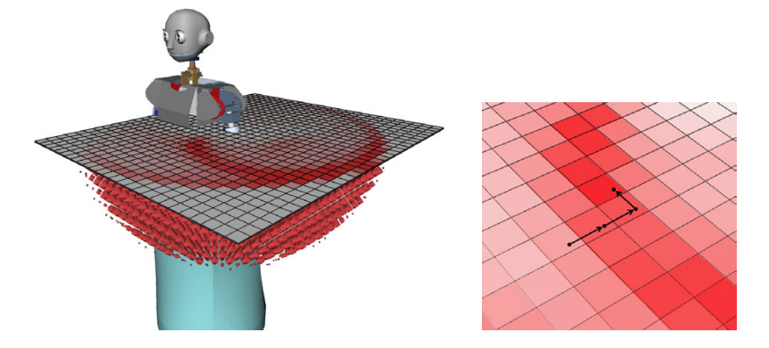
Gradient Descent in Reachability Space (Search for the local max)
While a object pose is found and the corresponding reachability space entry is above certain threshold, the gradient descent can be applied
Only looking for neighbor voxels that have the highest probability to a successful query
Only used with some probability on top of the original algorithm to avoid loosing the probability completeness

Slide 7
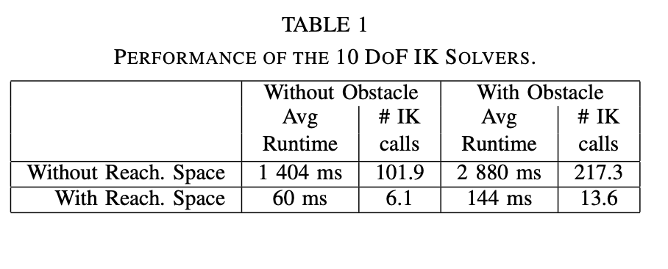
Performance with/without Reachability Space and Obstacle
15 associated grasping poses for grasping the wok and find a valid configuration to bring the end-effector to one of the 15 poses
The table below shows the performance after 100 IK queries for randomly generated object poses

Slide 8
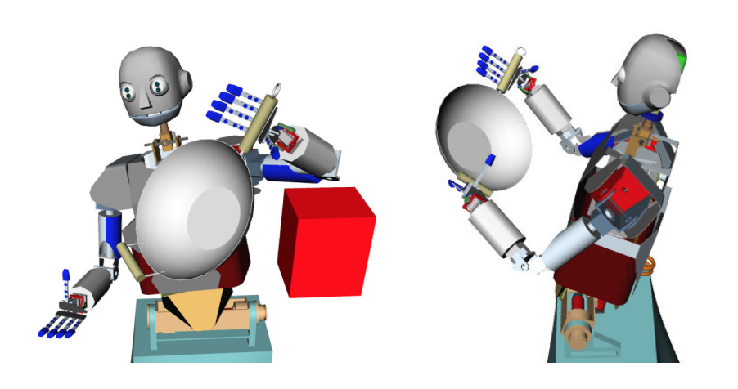
Dual Arm IK Solver
For the robot to re-grasp or hand-off the object, a 23 dimensional solution vector is finally generated
Reachability Space is used in order to speed up the computation
The IK solver is called only when the IK-probability of the grasping poses in the right and left reachability spaces above a threshold

Slide 9
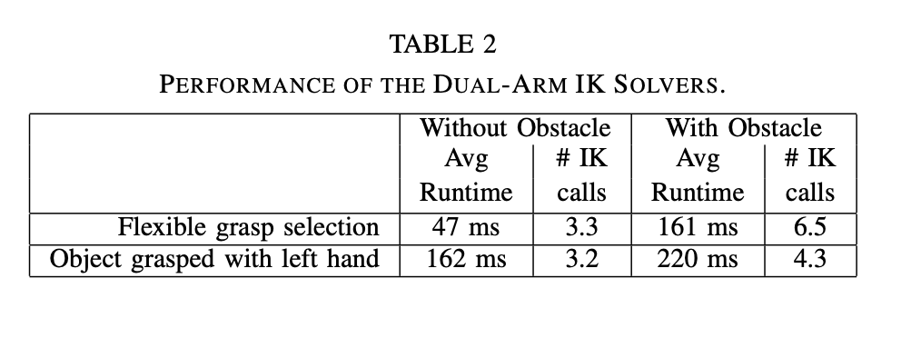
Performance of Dual Arm IK Solver
First row is for both arms to find a feasible grasp selection
Second row is when the object is already grasped with the left hand
100 IK queries

Slide 10
Motion Planning For Single Arm Reaching Motion
A set of feasible grasps (Transformations between the end effector and the final grasping position, grasps type, and quality description) is already stored in the database
Jacobian Pseudoinverse-Based RRT (J⁺-RRT) and IK-RRT
Input: Grasp set for the object
Output: A joint-space trajectory

Slide 11
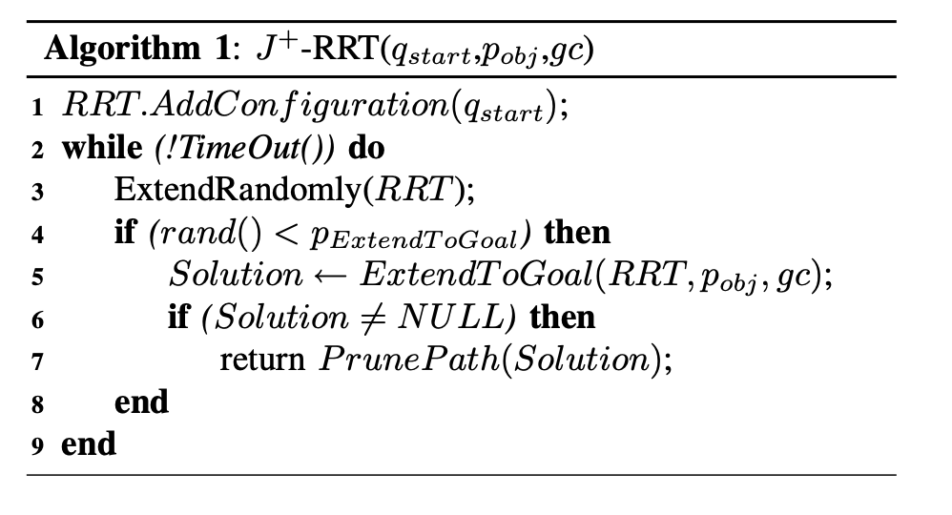
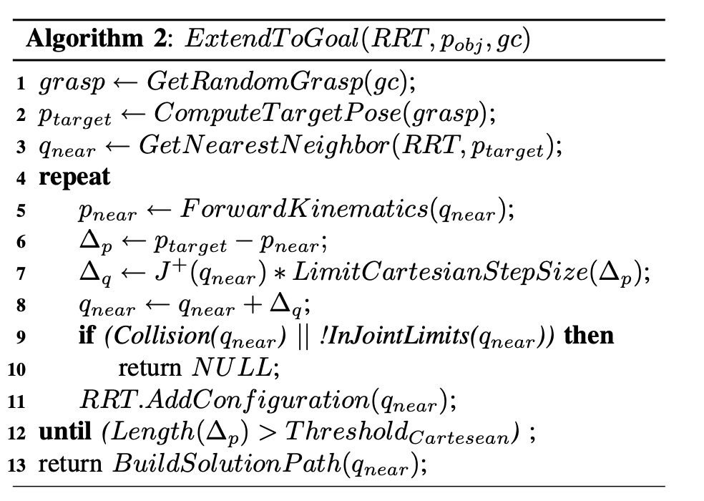
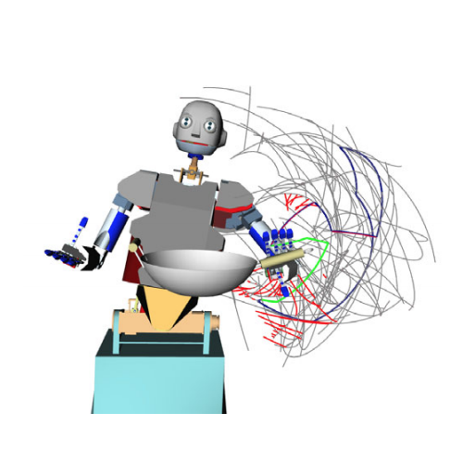
Jacobian Pseudoinverse-Based RRT (J⁺-RRT)

Slide 12
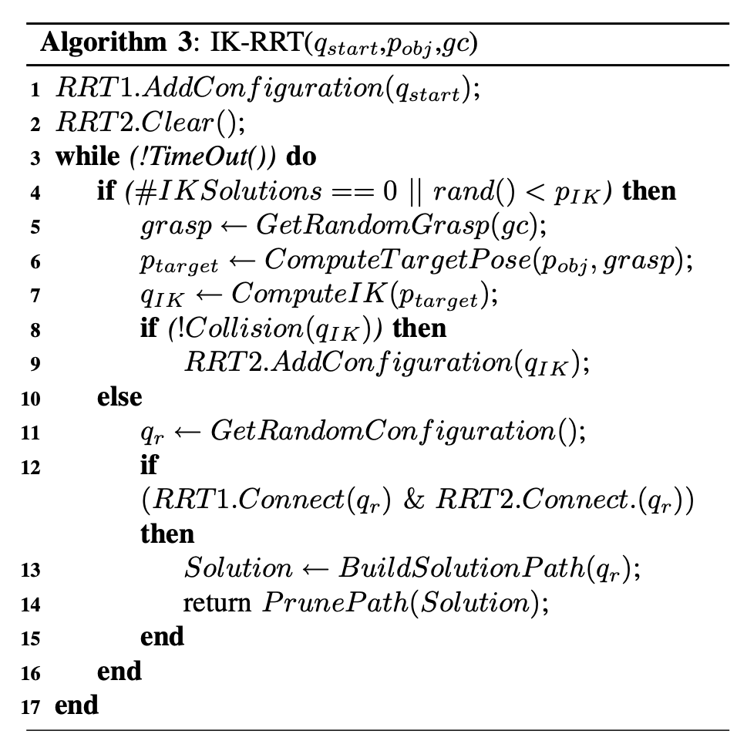
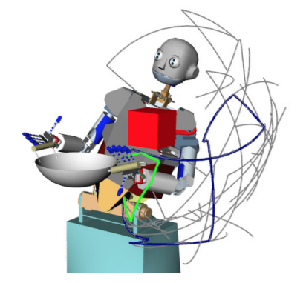
IK-RRT (Bidirectional)

Slide 13
Motion Planning For Dual Arm Re-Grasping
The dual-arm J⁺-RRT is an extension of the J⁺-RRT presented before
Since the object is grasped in one hand, the new poses are implicitly defined by the set of grasps and they lead to a set of transformations between the two hands for defining the configuration for re-grasping
DualArmExtenedToGoal function now selects the random grasp and the configuration with the minimum distance between the two end-effector poses and tries to move both arms towards the re-grasping pose

Slide 14
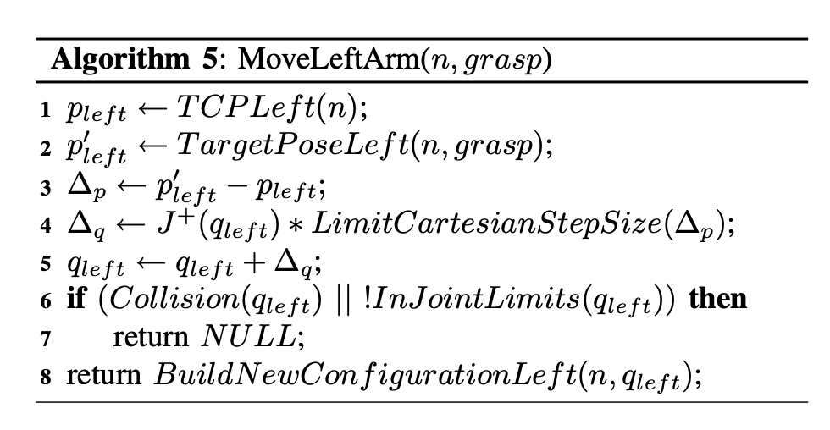
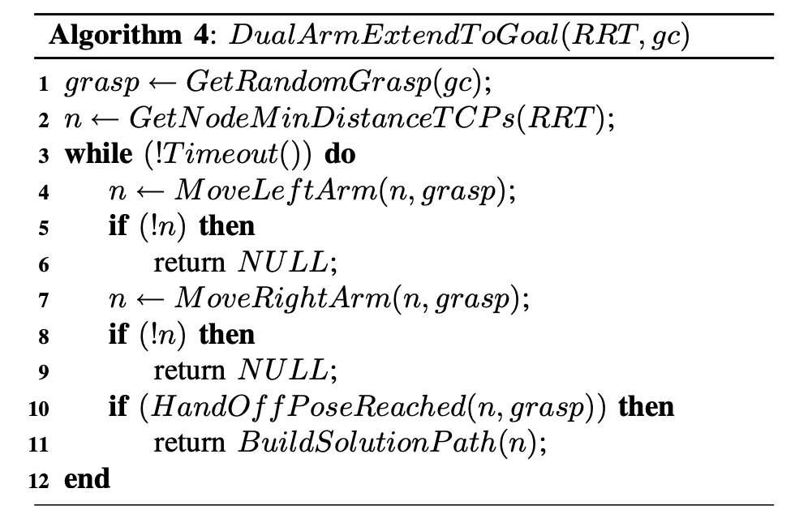
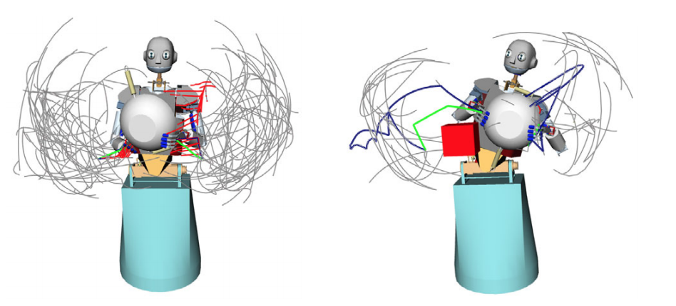

Slide 15
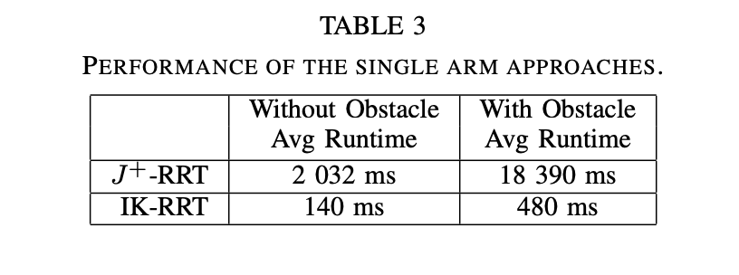
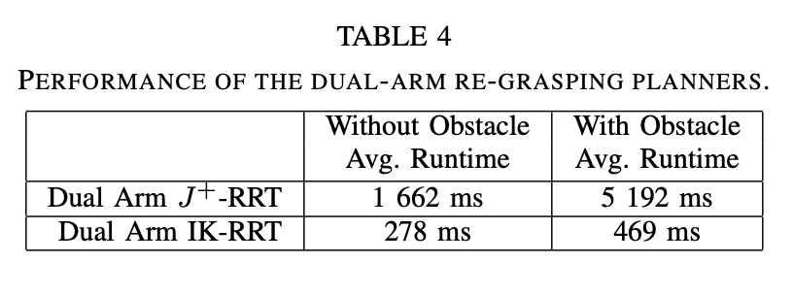
Results
Single Arm Reaching
100 test runs
Dual-Arm Re-Grasping
100 test runs

Slide 16
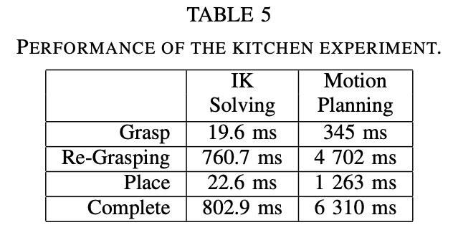
Dual-Arm Motion Planning in a Kitchen Scenario
Right hand to grasp a wok and re-grasping have to be planned to place the wok in a cabinet
IK problem and the collision-free motion planning are considered separately
Since in this experiment an IK solution that is not reachable was never observed, so the disadvantage of separating the IK and collision-free motion planning does not affect the applicability
https://www.youtube.com/watch?v=EwrFO_3Cl2Q
https://www.youtube.com/watch?v=1u4PR-pfghU

Slide 17
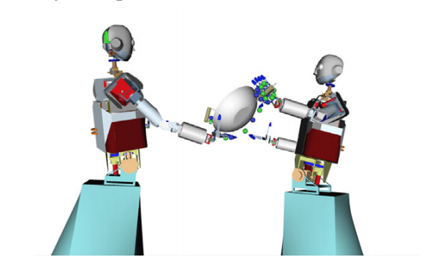
Hand-off with Two Robots
We can apply similar algorithms for the two robots hand off the object and from algorithmic point of view the only difference is the additional hip joints of the second robot

Slide 18
Conclusion
Two strategies are investigated and compared for single and dual arms reaching and re-grasp motion (J⁺-RRT and IK-RRT)
The planning algorithms already included the search for a suitable and collision-free configuration for the grasping and re-grasping so the planner implicitly cover the search for the configuration
IK-RRT performed better than Jacobian-based planners

Slide 19
THANK YOU!

