Slide 1
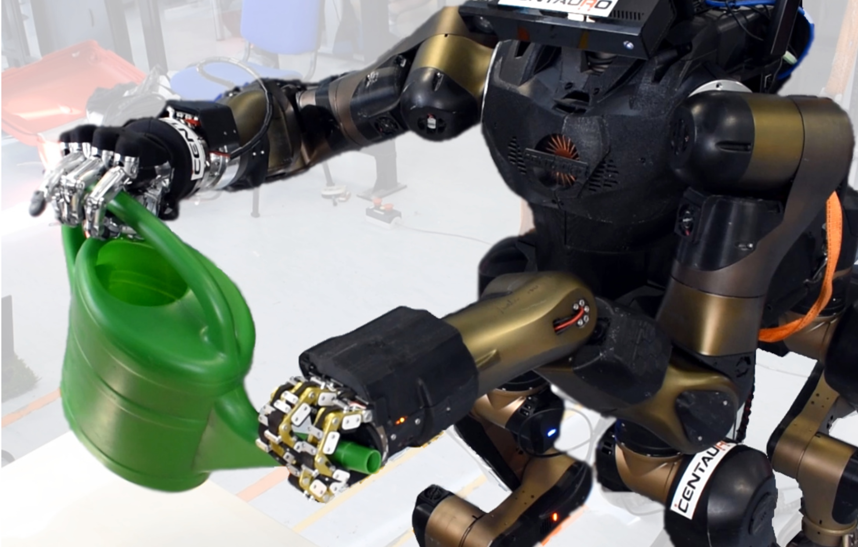
Autonomous Dual-Arm Manipulation of Familiar Objects
Dmytro Pavlichenko, Diego Rodriguez, Max Schwarz, Christian Lenz, Arul Selvam Periyasamy and Sven Behnke
^{Xipeng Xie UNI:xx2297}

Slide 2
Autonomous Dual-Arm Manipulation of Familiar Objects

Slide 3
Autonomous Dual-Arm Manipulation of Familiar Objects
Why?

Slide 4
Autonomous Dual-Arm Manipulation of Familiar Objects
a complete software pipeline

Slide 5
System Overview

Slide 6
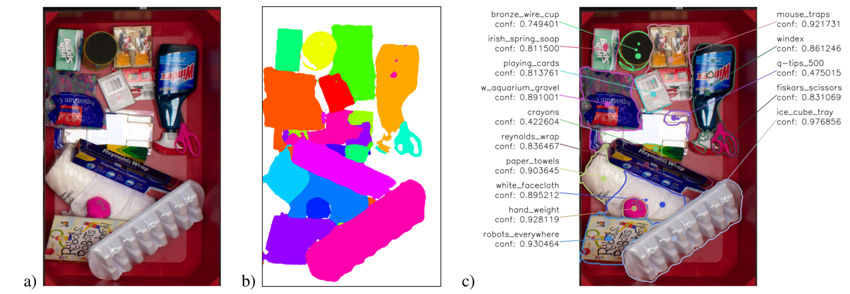
Semantic Segmentation
Fast Object Learning and Dual-arm Coordination for Cluttered Stowing, Picking, and Packing
Max Schwarz, Christian Lenz, Germa ́n Mart ́ın Garc ́ıa, Seongyong Koo, Arul Selvam Periyasamy, Michael Schreiber, and Sven Behnke

Slide 7
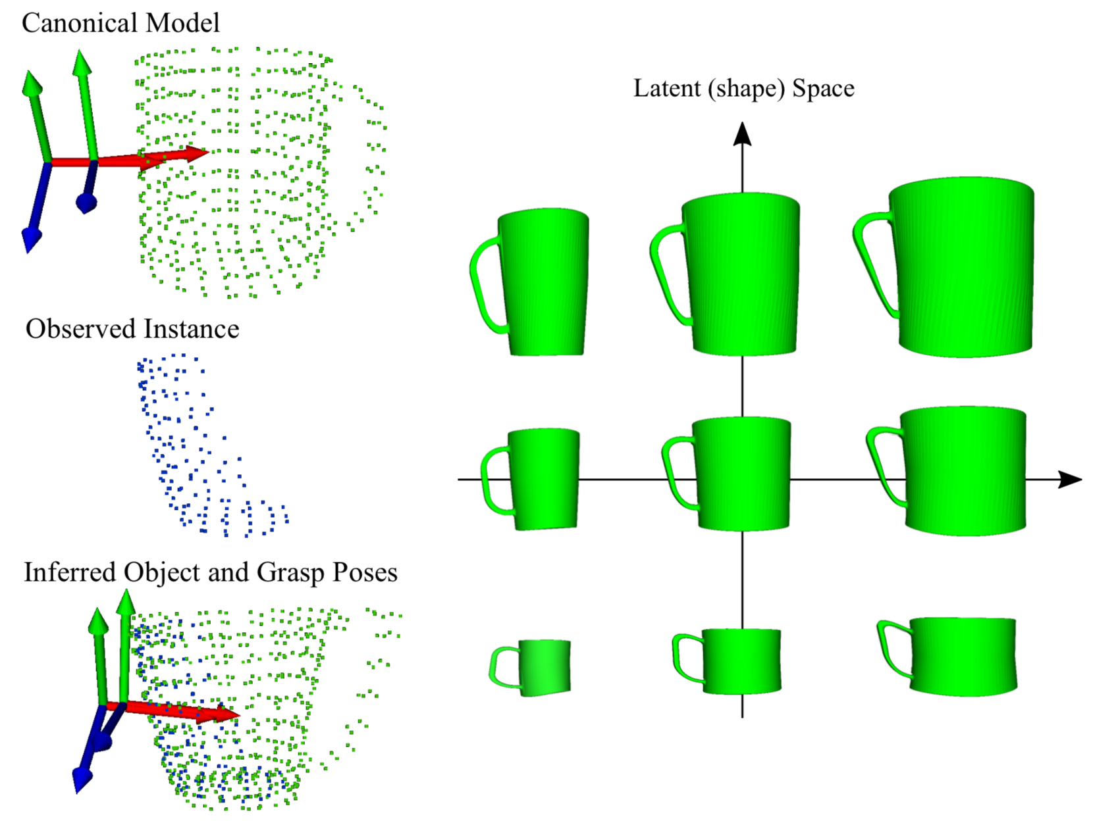
Pose Estimation & Grasp Generation
- Based on the observation that objects within a category are often similar in their shapes and usage, we propose an approach for transferring grasping skills from known instances to novel instances of an object category.
- The known object instances are modeled using a canonical shape and a transformation which deforms it to match the instance shape. The principle axes of variation of these deformations define a low-dimensional latent space. New instances can be generated through interpolation and extrapolation in this shape space.
Transferring Grasping Skills to Novel Instances by Latent Space Non-Rigid Registration
Diego Rodriguez, (Corbin Cogswell, Seongyong Koo, and Sven Behnke)

Slide 8
Trajectory Optimization
kinematic chain closure
constraint !!
-The input is an initial trajectory Θ which consists of N keyframes in joint space with J joints.
- is a cost for the transition from the configuration θi to θi+1.
qo : obstacle cost; ql : joint limit cost; qc: constraint cost
qd : duration cost; qt : torque cost
is designed so that:

Slide 9
Trajectory Optimizationçç
- The initial translation between two end effector is measured in the first configuration θ0 of the trajectory. Then, for each evaluated configuration θj, the corresponding translation tj between eef1 and eef2 is computed. The deviation from the desired translation is thus defined as: . . Finally, we select the largest component
- where t_{max} is the maximum allowed deviation of the transla- tion component and C_{ct} ≫ 1 is a predefined constant.

Slide 10
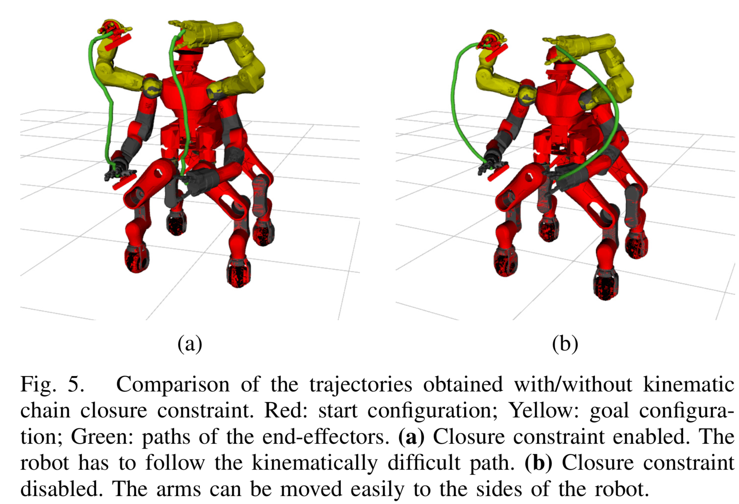
Evaluation
A. Trajectory Optimization

Slide 11
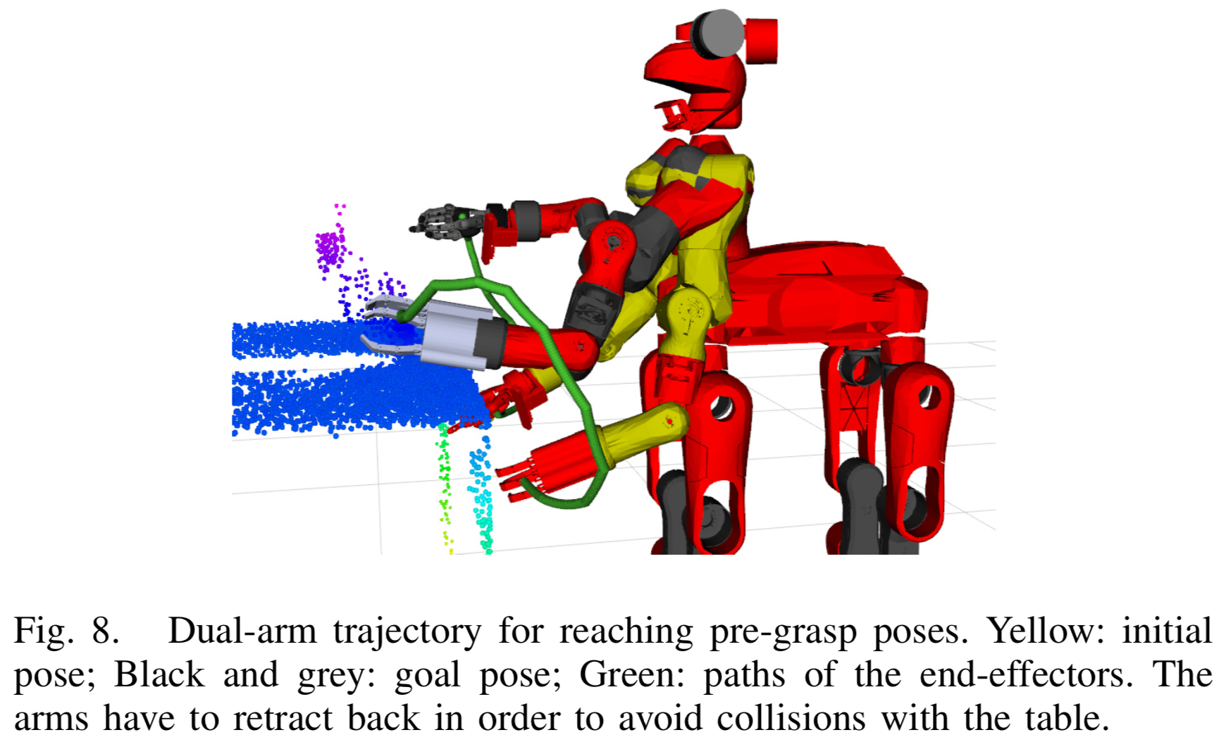
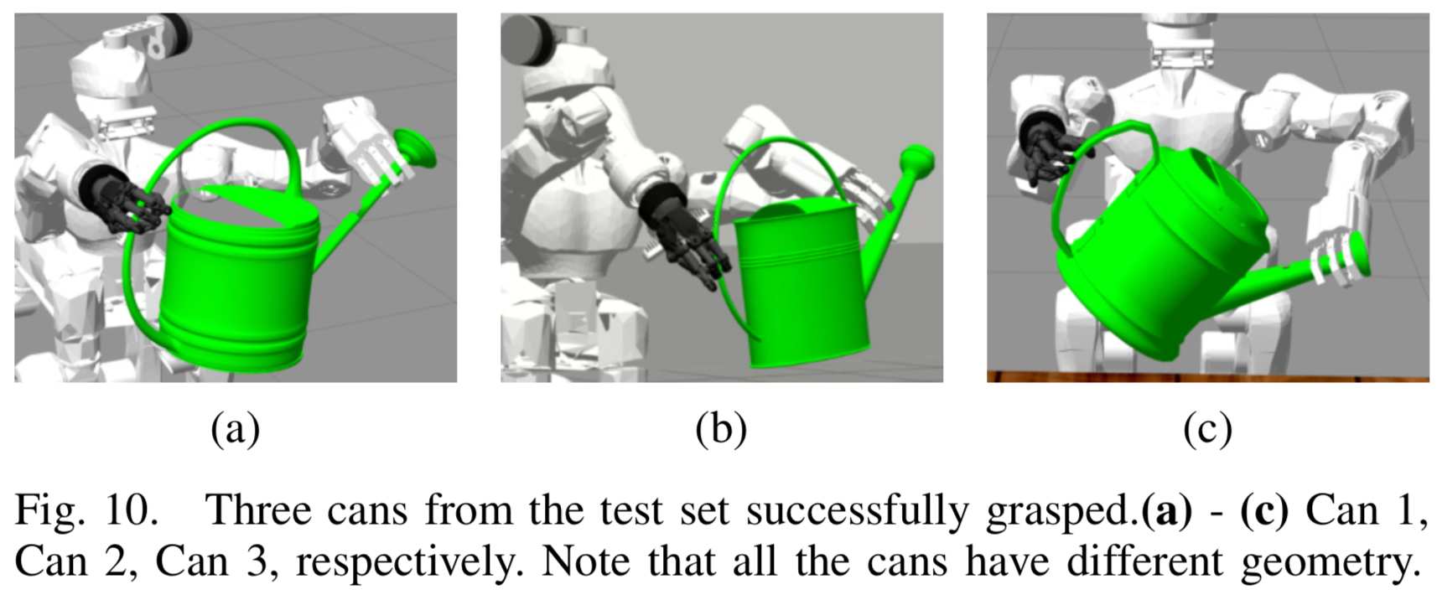
Evaluation
B. Dual-Arm Picking in Simulation

Slide 12
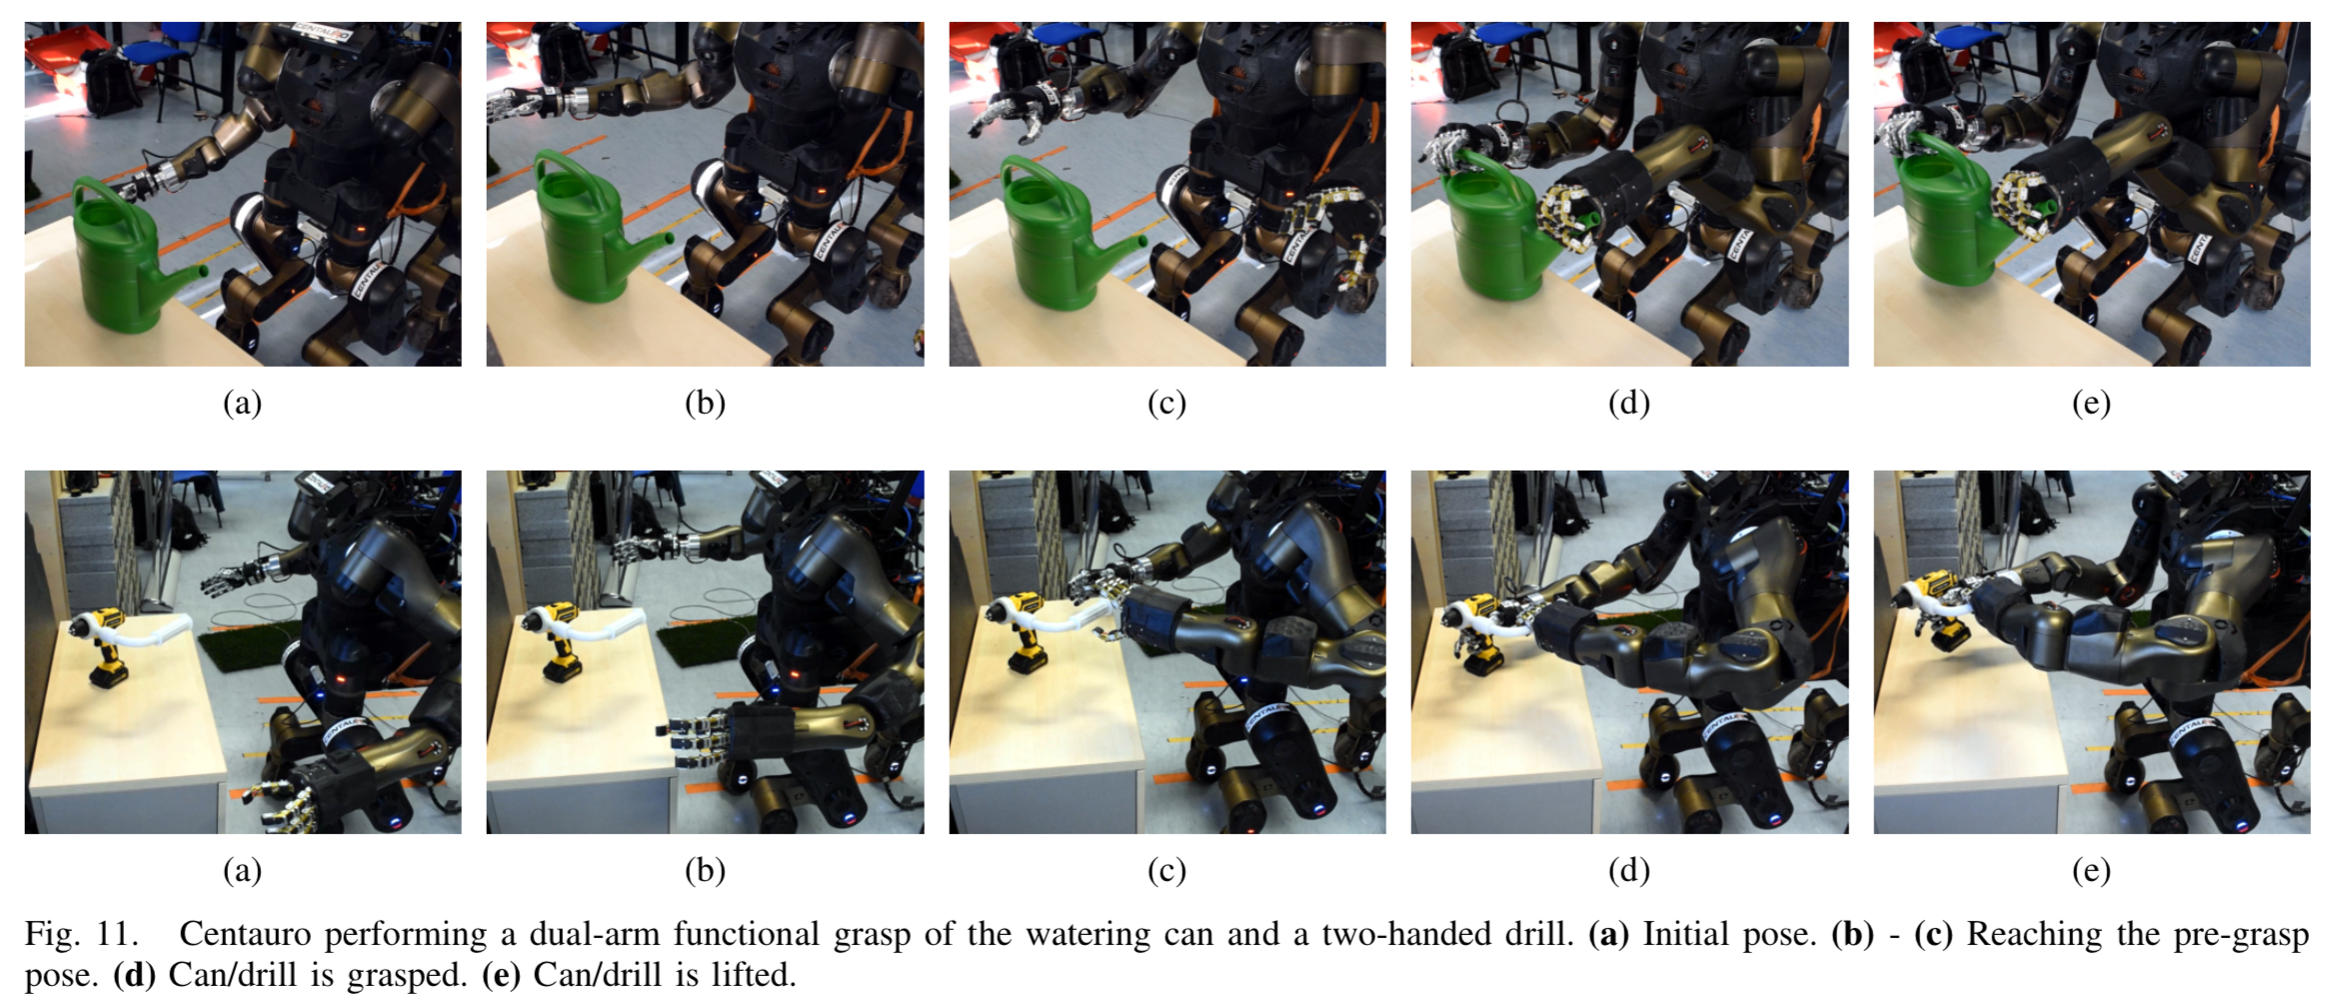
Evaluation
C. Real-Robot Experiments

Slide 13
Conclusion
Developed an integrated approach for autonomous dual-arm pick tasks of unknown objects of a know category.
Performed a set of experiments in simulation and with the real robot to evaluate the integrated system: The experiment on trajectory optimization showed that our method can solve the tasks of planning for two arms reliably and fast. However, with introduction of the closure constraint, the runtime grew significantly. Nevertheless, we demonstrated that the method is capable of producing feasible trajectories even under multiple complex constraints. In the simulation experiment, the robot successfully grasped three previously unseen watering cans with two hands from different poses.
On real-robot experiments, successfully grasped and lifted several times a watering can and a two-handed drill. These experiments demonstrated that our system can be successfully applied to solve tasks in the real world in an on-line fashion.

Slide 14
Thank you! Questions?

