Slide 1
Deep Learning Based BCI Control of a Robotic Service Assistant Using Intelligent Goal Formulation
Presented by Bingqing Wei

Slide 2
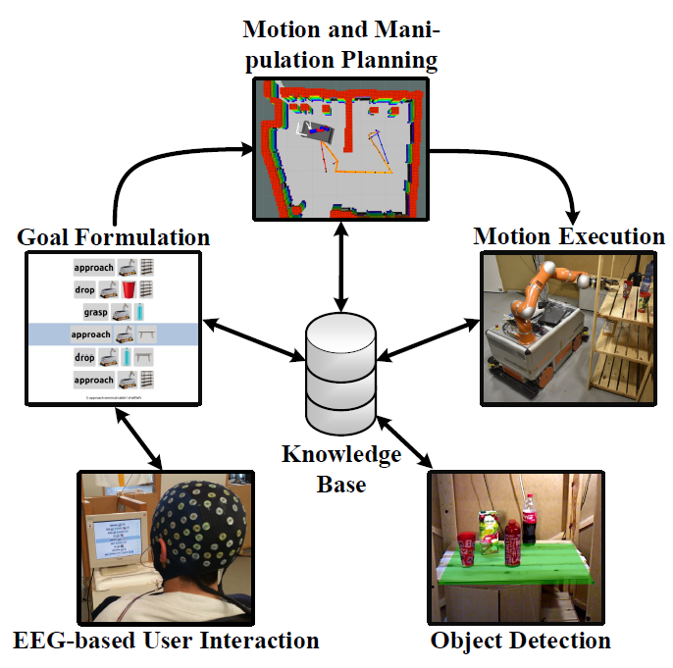

Slide 3
Key Components
BCI – brain control interface
non-invasive neuronal signal recording
co-adaptive deep learning for prediction
Goal Formulation Planning
Domain-independent planning
Adaptive graphical goal formulation interface
Dynamic knowledge base
Robot motion generation
Perception

Slide 4
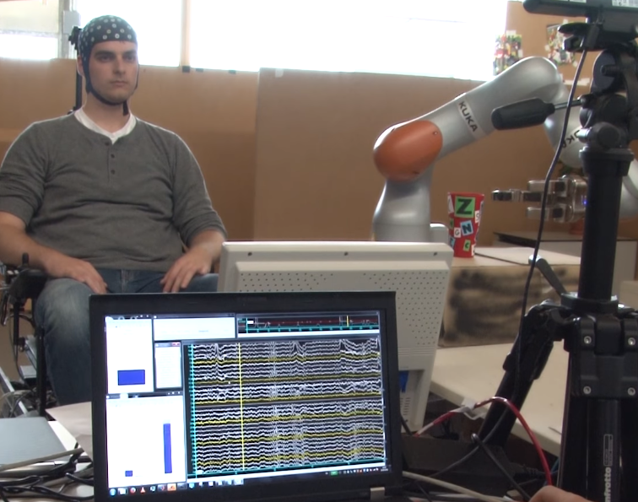
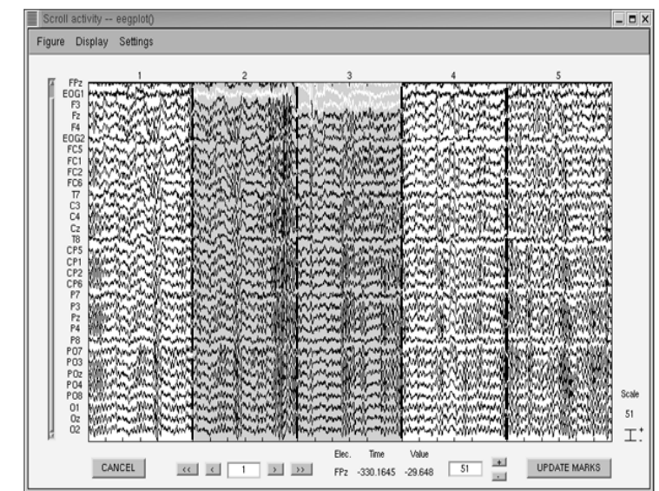
Decoding EEG Signals
Preprocessing
40 Hz lowpass filtered EEG data
eliminates all signals below 40 Hz (mostly noise)
EEG data representation
2D array (width: number of time steps, height: number of electrodes)
M(i, j) – voltage of jth electrode at time i
Assumption:
EEG signals are assumed to approximate a linear superposition of spatially global voltage patterns caused by multiple dipolar current sources in the brain. Unmixing of these global patterns using a number of spatial filters is therefore typically applied to the whole set of relevant electrodes as a basic step in many successful examples of EEG decoding.
In short: using Conv2D makes the relative position of data points along height in the 2D array irrelevant

Slide 5
Deep Learning --- ConvNet
Targets—5 mental tasks – 5 most discernible brain patterns
Sequential right-hand finger tapping: select
Synchronous movement of all toes: go down
Object rotation: go back
Word generation: go up
Rest: rest (do nothing)
Problems
What if a user is left handed (include that in the dataset and pray that the model can learn to generalize)
Noises in EEG: blinking, swallowing
During data collection: forbidden. During evaluation, a t-test is performed

Slide 6
Structure of ConvNet - Input
Crops & Super-crop
Using shifted time windows (crops), crop size is ~2 s (522 samples (data points) @ 250 Hz)
Speed up training: 239 crops combined into one super-crop, generates 239 predictions
One training batch consists of 60 super-crops
What the heck is happening here? – Multi-crop prediction

Slide 7
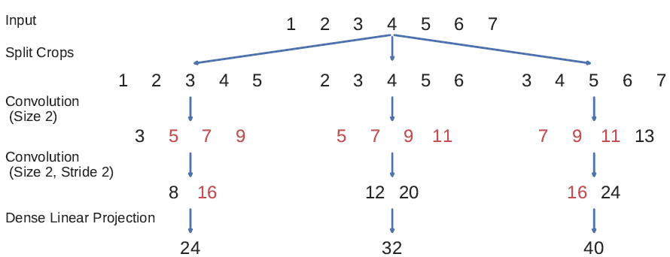
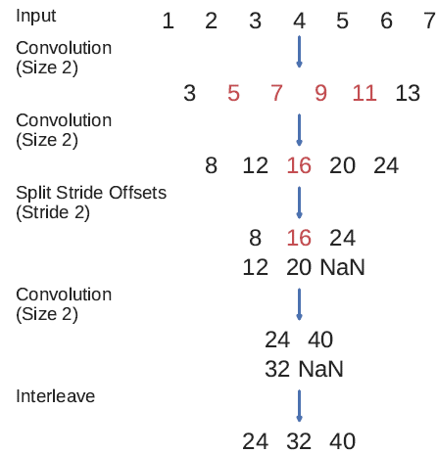
Intuition: Dynamic Programming
The speed up is not about reducing the number of input (because super-crops are longer than normal crops), it’s about Dynamic Programming!
Optimized approach
Naïve approach
3 Crop
1 Super-crop

Slide 8
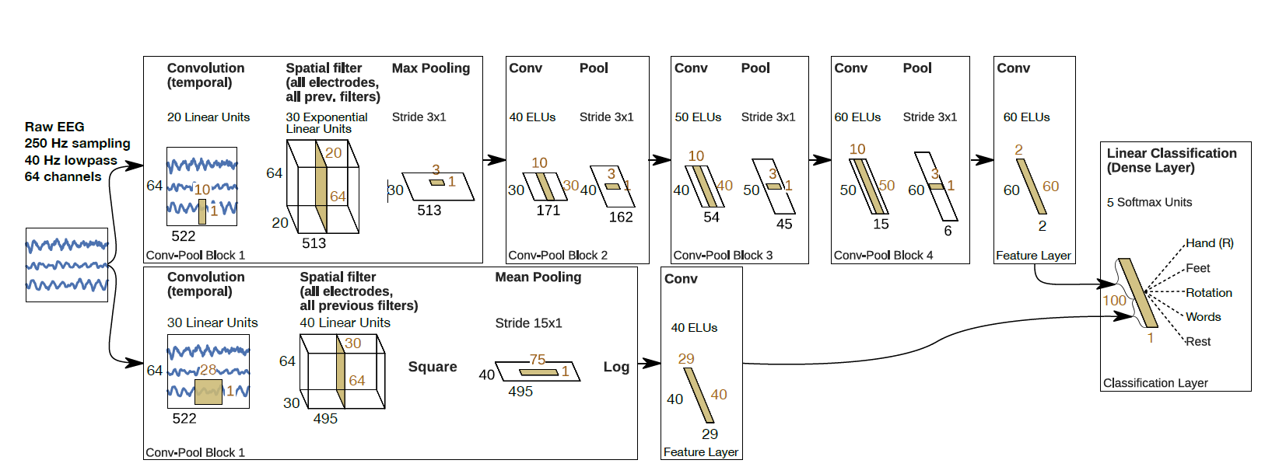
Structure of ConvNet Not deep, but has tons of trainable parameters (kernel size is large)
Conv over dimension of time & Conv over dimension of space
ELU performs better than ReLU

Slide 9
Loss function
In another paper published by the same authors (Jan 2018)
To make the ConvNet focus on features which are stable for several neighboring crops
In this paper (March 2018)
Categorical cross entropy loss (with softmax as the activation function for the last layer)
The simpler, the better? Not explained in the paper.

Slide 10
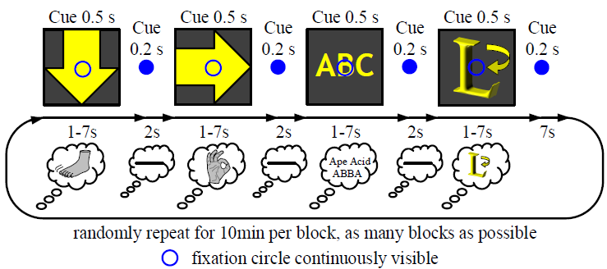
Offline Training
*Cued*
Adam optimizer, Learning rate 1e-3, 100 epochs, 80/20 dataset split. 60 super-crops per batch.
To keep training realistic, the training process include a 20% error rate, i. e. on average every fifth action is purposefully erroneous. (I presume this paves way for online training when the labels of the data can be erroneous)
Collecting Data
Participants are aware of not in control of GUI
Minimize eye movements – participants are instructed to look at a fixation circle
At the same time GUI action corresponding to the cued mental task is displayed
The ‘rest’ mental task is implicitly taking place for 2s after every other task to allow users to blink and swallow.

Slide 11
Online Co-Adaptive Training
*Cued*
Online: collecting data while training
Co-Adaptive:
Participants are aware of being in control of GUI and instructed to count the errors they make. Participants and ConvNet adapt to each other.
‘In doing so, the participants are aware of their performance, which potentially triggers learning processes and asserts their vigilance’
Learning rate 1e-4
45 super-crops per batch.

Slide 12
Online Training
The authors seem to have made a mistake here, it’s not really ‘training’, it should be called Online Evaluation
It’s used to evaluate online co-adaptive training
No cues for the mental tasks and let the participants select instructed goals in the GUI.
Participants have to confirm the execution of every planned action, BCI decoding accuracies for label-less instructed tasks are assessed by manually rating each decoding.

Slide 13
Online Decoding Pipeline
GPU Nvidia Titan Black 6GB vram (trash GPU)
GPU server stores 600 samples until the decoding process is initiated
Subsequent decoding steps are performed whenever 125 new samples have accumulated
Predictions are stored in a ring buffer (max size: 14 predictions – 7s of data). The algorithm extracts the mental task with the largest mean prediction. Buffer continues to grow if significance level is not reached
Two sample t-test is used to determine if the predictions significant deviate from 0.05. Once significance is reached then action is performed and the ring buffer is cleared

Slide 14
Why the decoder works: the magic of ring-buffer
Two sample t-test:
Gives you a value to determine if two groups of data points have the same mean (regardless of variance).
Once the significance level is reached, the null hypothesis that the predictions have same mean is rejected.
The author is very obscure about how the operations are actually implemented. It should be their focus.

Slide 15
Goal Formulation Planning
Why do we need it
Whereas many automated planning approaches seek to find a sequence of actions to accomplish a predefined task, the intended goal in this paper is determined by the user.
By using a dynamic knowledge base that contains the current world state and referring expressions that describe objects based on their type and attributes
The knowledge base is able to adapt the set of possible goals to changes in the environment
5 cameras in the experiment
PDDL files (describes the environment) are updated constantly

Slide 16
Planning Domain Definition Language
Planning domain D = (T, C_d, P, O)
T is the type system, i.e. a type hierarchy, e.g. furniture and robot are of super-type base, and bottle and cup.
C_d contains a set of domain constant symbols
P specifies attributes or relations between objects, e.g. position (describes the relation between objects of type vessel and base)
O defines the actions such as grasp and move
Problem Description ∏=(D, C_t, I)
D is the planning domain
C_t are the additional task-dependent constant symbols
I is the initial state, e.g. cup01 of type cup and relation between cup01 and shelf 01
Example
Action(put, x, y) ^ cup(x) ^ shelf(y)
Just like Lambda Expression

Slide 17
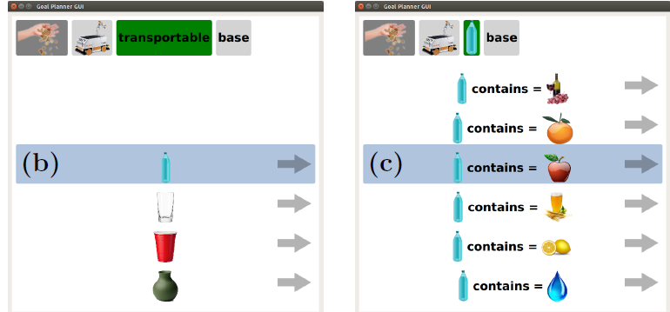
Human and Machine Understandable Reference
Building a reference: Which cup? Which shelf?
E.g. We want to refer to cup01 by cup(x) ^contains(x, water)
Given a set (denote as A) of sets:
green cup(cup_01, cup_02), cup with water(cup_02, cup_03),
cup on the floor(cup_01, cup_03)….
Find a subset of A that has no intersection among any pairs of them
NP-Hard
Domain Independent: no ‘hard-code’
How to test it? Simulation.
Solution: Greedy Selection + Reference Number + Random Selection

Slide 18
Robot Motion Generating
Navigation planning of the mobile base, the authors used the sampling-based planning framework BI^2RRT.
Probabilistic roadmap planner to realize pick, place, pour and drink motions
Sample poses in the task space which contains all possible end-effector poses.
Poses are then connected by edges based on a user-defined radius
Apply an A^* based graph search to find an optimal path between two nodes using Euclidean distance as the cost and heuristic function
Used robot’s Jacobian matrix to compute the joint velocities based on end-effector velocities.
Collision checks ensures there are no undesired contacts between the environment and the robot.

Slide 19
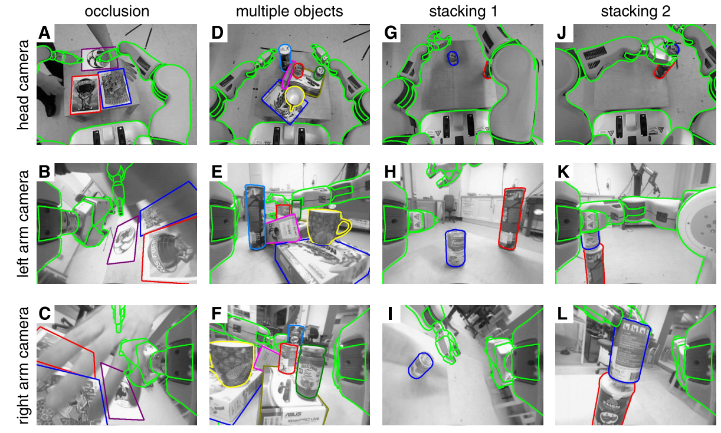
Perception
Object detection: using SimTrack
Tracking objects in realtime
Knowledge base provides data storage (of PDDL files) and establishes the communication by a domain and problem description based PDDL files
The poses and locations are stored and continuously updated in the knowledge base

Slide 20
Pouring Liquids
Detection of the liquid level
Uses Asus Xtion Pro camera which determines depth based on active structured light
Opaque Liquids: milk and orange juice, reflect the infrared light and the extracted liquid level represents the real liquid level
Transparent Liquids: water and apple juice, the infrared light are refracted and the depth value is incorrect. Using the following equation to calculate the actual depth.

Slide 21
Face Detection
Segment the image based on the output of a face detection algorithm that uses Haar cascades
Detect the position of the mouth of the user, considering only the obtained image batch. The paper additionally considered the position of the eyes in order to obtain a robust estimation of the face orientation, hence compensating for changing angles of the head
Result: Not so good, needs the user to adjust his/her head.

Slide 22
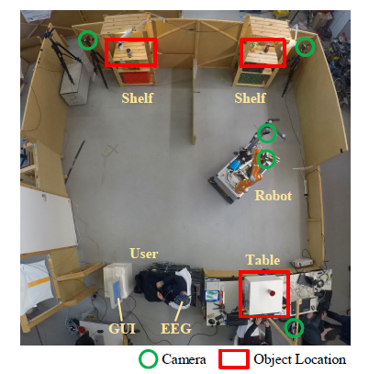
Scene setup
3 cameras to observe the scene and liquid levels to report to the knowledge base
2 cameras carried by the robot
One at the base to perform collision checks
Second one is mounted at robot’s end-effector and used for face & mouth detection
OmniRob (10 DOF, 3 for base & 7 for manipulator)

Slide 23
Results BCI Decoding – offline training & online training
Offline training
Overall accuracy 63.19%
Online Co-Adaptive Training
Accuracy 76.9% (evaluated in the ‘online training’ phase)
The authors think it’s a great achievement: from cued offline to uncued online
Not objective, but subjective (accuracy is evaluated during online ‘training’ phase, number of errors are counted by the user)

Slide 24
Results BCI Decoding – Online Decoding (real life experiment)
4 participants
All right handed
Three females
Aged 26.75 +- 5.9
133 runs are recorded
43 runs are simulated
38 runs are discarded due to technical issues with online decoding
Accuracy varies greatly
Subjective measurements

Slide 25
Results – Robot Motion Planning
Fetch & Carry
59 out of 60 successful
1 fail due to low-level motion planning algorithm fails to generate a solution path within prescribed planning time
258.7 +- 28.21s for achieving the goal state
Drinking
13 executions (3 repeated), success rate 77%
Pouring
10 executions, success rate 100%

Slide 26
Videos
https://www.youtube.com/watch?v=Ccor_RNHUAA

Slide 27
Reference
EEGLAB: an open source toolbox for analysis of single-trial EEG dynamics including independent component analysis
Deep learning with convolutional neural networks for brain mapping and decoding of movement-related information from the human EEG
Deep Learning Based BCI Control of a Robotic Service Assistant Using Intelligent Goal Formulation
SimTrack: A Simulation-based Framework for Scalable Real-time Object Pose Detection and Tracking

