Slide 1
Robot Programming Through Augmented Trajectories in Augmented Reality
Camilo Perez Quintero, Sarah Li, Matthew KXJ Pan, Wesley P. Chan, H.F. Machiel Van der Loos and Elizabeth Croft
2018 IEEE/RSJ International Conference on Intelligent Robots and Systems (IROS)
James Gong
4/23/19
Notes:
Introduce self

Slide 2
Background
Next generation of industrial manufacturing will involve robots working in a complementary fashion alongside skilled human workers
Augmented reality: facilitate interaction by enhancing the physical world with virtual information
Enables new human-robot interaction (HRI) possibilities
Notes:
Industrial robots need to be re-programmed for a new task

Slide 3
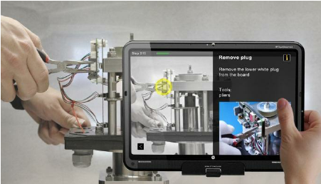
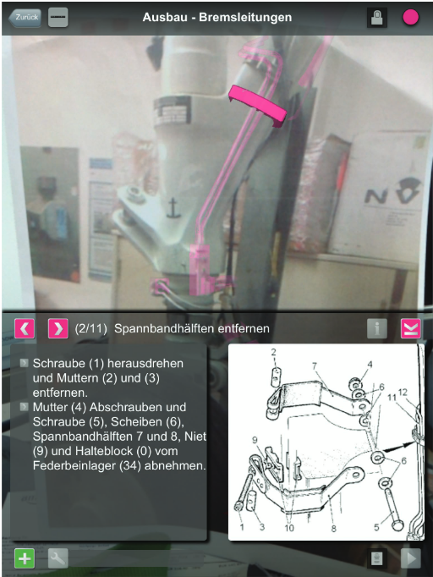
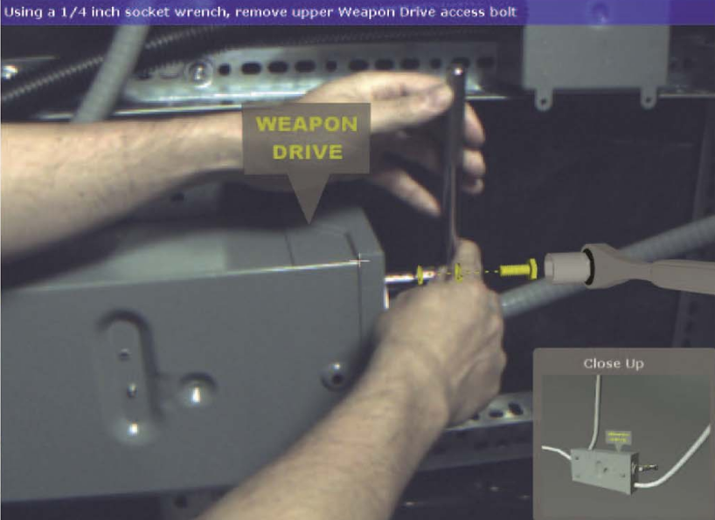
Augmented Reality
Industrial applications
Assembly
Training
Maintenance
Repair
Mobile device and head-mounted AR
In these applications, the human still performs the work
Webel et al. 2013
Notes:
Web-based application
Human still doing the work

Slide 4
Augmented Reality as an HRI interface
AR
Shared space
Novel HRI interface
Notes:
Interaction methods and interfaces for HRI
Human operators’ intentions and interprets the task descriptions into a sequence of robot motions complying with the robot capabilities and the working requirements
Overlapping space that can be perceived by both the human user and the robot system

Slide 5
Fang et al. (2013)
AR enables user to interact with the spatial environment prior to actual task execution
Notes:
Web-based application
Human still doing the work

Slide 6
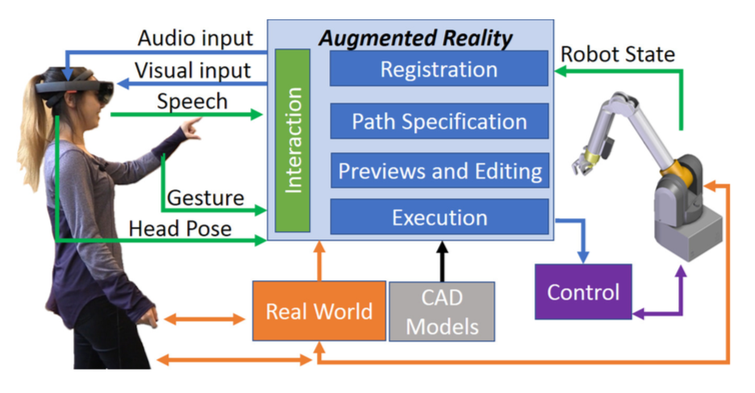
System
Microsoft Hololens
First untethered mixed reality head-mounted display
Robot arm
Barrett Whole-Arm Manipulator (WAM)
7-DOF
MYO armband
1-DOF control input to move end effector along path
Notes:
Web-based application
Human still doing the work

Slide 7
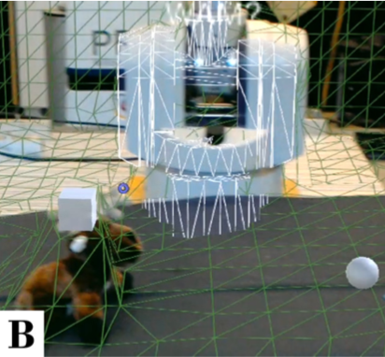
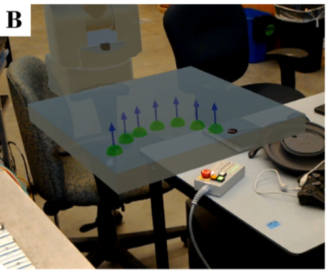
Trajectory planning
Free space trajectory
Traditional methods non-intuitive and visually non-collocated
Two trajectory planning modes:
Free space trajectories
Pick and place task
Cube and sphere mark two anchor points
Path is automatically generated
Surface trajectories
Way-points set by the user via points set on the intersection between the surface of the 3D mesh and a ray coming from the virtual cursor
Path interpolated from way points
Path calculation based on B-splines
Surface trajectory

Slide 8
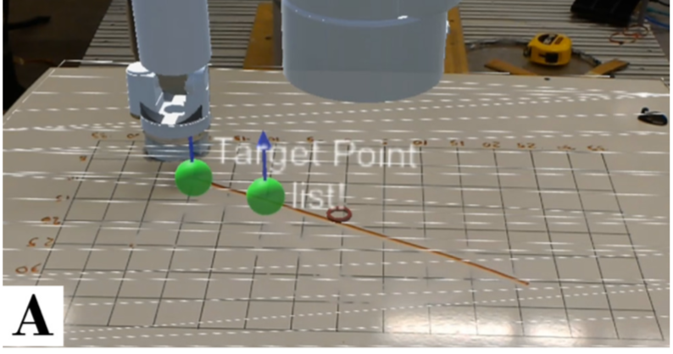
Interaction
“Set point”
“Lock path”
User speech input
Utilizing Hololens SDK libraries
Speech commands to change state
Virtual cursor controlled by head pose
Pinch hand gesture
Editing virtual paths

Slide 9
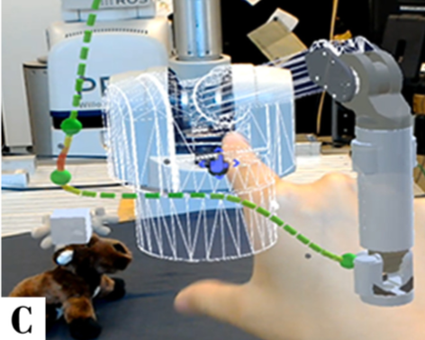
Preview and editing
“Generate”
“Edit”
User speech input
Virtual preview of robot motion
Initial position = current joint state of the real robot
Path can by dynamically changed using pinch gesture

Slide 10
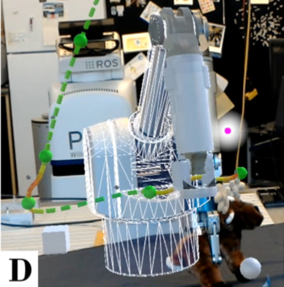
Execution
“Pause”
“Reset”
User speech input
Real robot executes planned trajectory
Autonomously or semi-autonomously
User can control progression of motion through MYO band 1-DOF interface

Slide 11
Video
https://youtu.be/amV6P72DwEQ

Slide 12
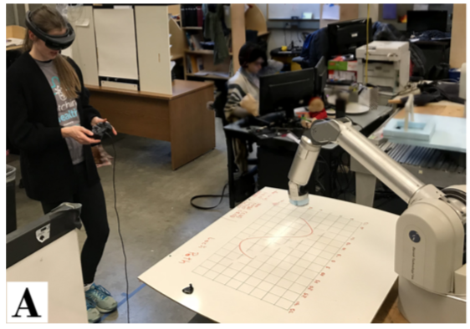
Experiment
10 test users
AR robotic interface and kinesthetic interface
Surface contact task
Erasing sinusoid and straight line on white board
Free space task
Pick up a plush toy and place it in a box

Slide 13
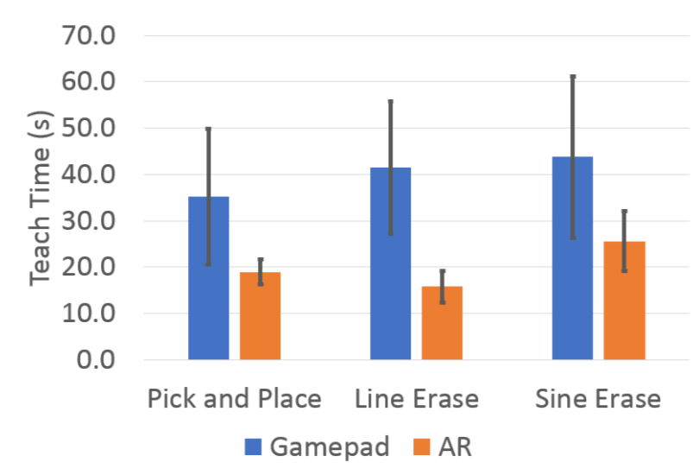
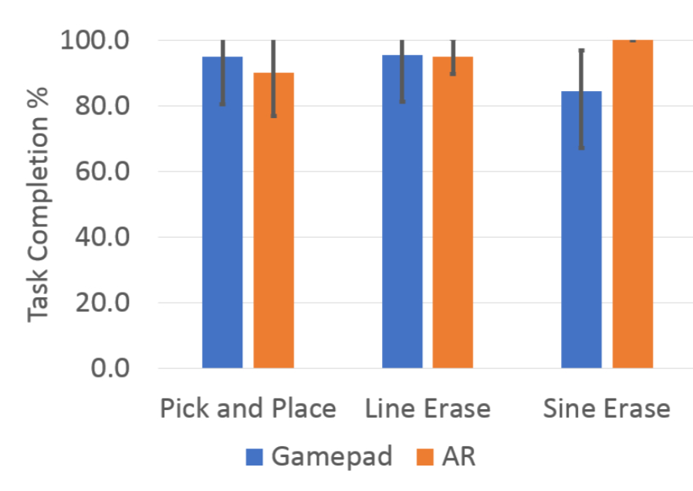
Results
Average task completion time taken was significantly less using the AR interface
Users placed more way-points using the AR robotic system
NASA Task Load Index
Kinesthetic interface requires a lower mental load
However kinesthetic interface requires significantly increased physical effort
Trade-off between physical and mental workload
Notes:
simply changing the orientation of their head
trade-off between physical and mental workload

Slide 14
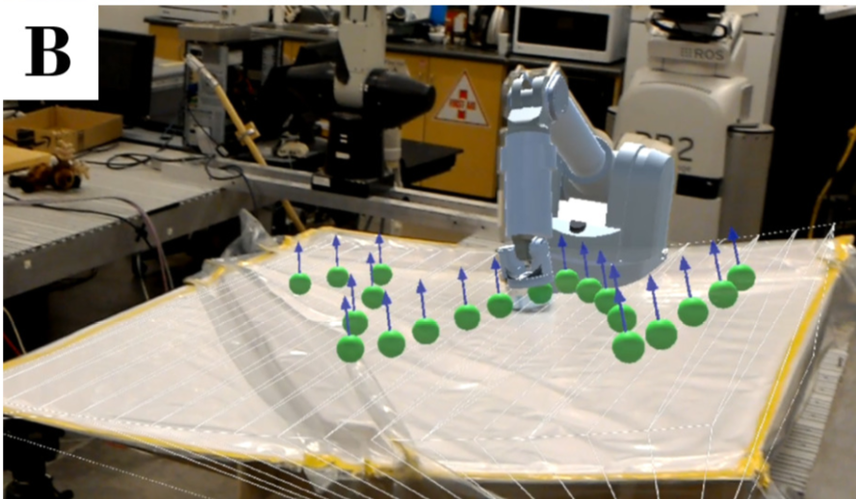
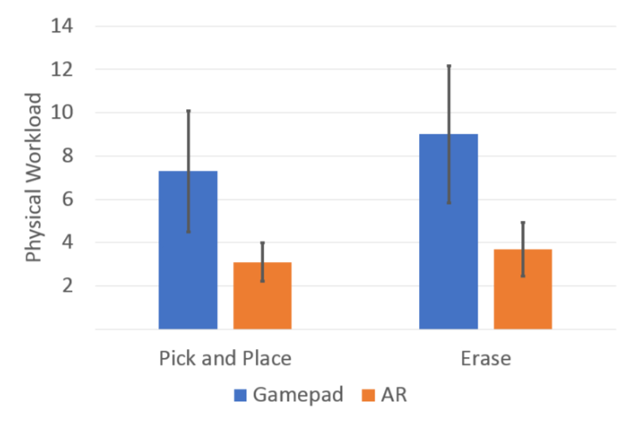
Case Study: Carbon-fiber-reinforcement-polymer Manufacturing
Reduce wrinkles during the pleating step of the carbon-fiber-reinforcement-polymer vacuum bagging process
Able to remove majority of wrinkles

Slide 15
Conclusion
Novel AR robotic interface for trajectory interaction
Validated system compared to kinesthetic teaching
Future improvements
More agile path specification methods, such as setting multiple waypoints at once
Force visualization and control, instead of constant force applied in normal direction

