Slide 1
Affordance Detection for Task-Specific Grasping Using Deep Learning
COMS 6731 Humanoid Robotics
2017 IEEE-RAS 17th International Conference on Humanoid Robotics
Birmingham, UK November 15-17, 2017
by Mia Kokic, Johannes A. Stork, Joshua A, Haustein, Danica Kragic
presented by Irene Chen
Notes:
Introduce self

Slide 2
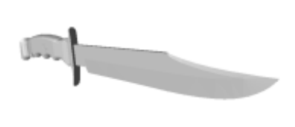
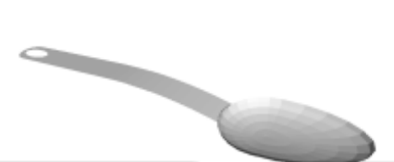
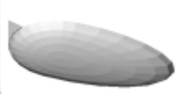
What are object affordances?
: the part of a tool that performs the task
Task: Make incision
Task: Screw a screw
Task: Hold soup
Notes:
: the properties of an object that define it’s functionality
Part Attributes: shape, size, material

Slide 3
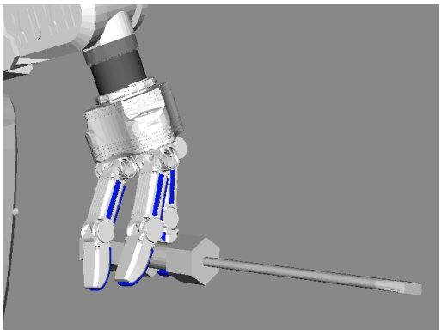
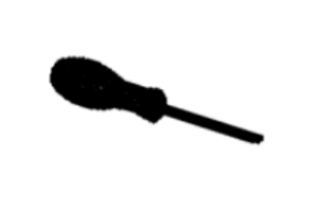
Overview
Problem: Task-Specific Grasping
Input: object (in form of point cloud) and task
Output: stable grasp that fulfills the task
Grasps are modeled as tuple g = (phi, T) where phi is hand configuration and T is the pose of the hand
Input
Output
Task
Unscrew a screw
Task-Oriented Grasping Algorithm
Object
Notes:
Robot should understand that the blade is sharp and rigid and thus affors the task cutting
Thus the robot should then learn to grasp the handle (and not the blade)
Example
Input: Task(cut), Object(knife)
Output: Grasp applied on the handle and hand aligned with main axis of knife

Slide 4
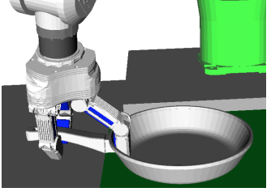
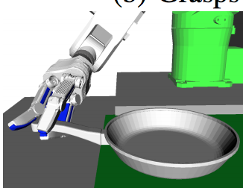
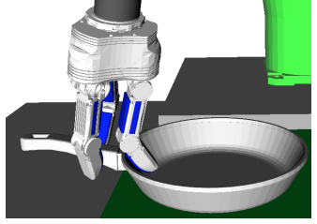
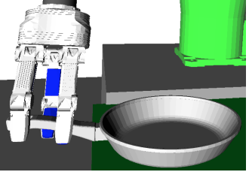
Purpose (Why is this important to us?)
--> For a given task, cannot simply grasp in any manner
Goal:
Figure out how to indicate to a robot what and how to grasp an object so that a task can be successfully executed post-grasp
Notes:
Important to understand that for a given task, cannot grasp in any manner
For a robot task specific grasping is a challenging problem
Grasp planned without any task constraints
Grasp computed with contact constraint (only considering object affordance)
Grasp computed with orientation constraint only
Grasp computed with both contact and orientation constraints
Why is this important?
For a robot, task specific grasping is a challenging problem
Describe how to grasp in terms of grasp constraints (contact location and hand approach) to generalize task specific grasping to novel scenerios
Avoids feature engineering by using deep learning
Goo beacuase allows it to be generalized to novel scenerios and more feasible approach to high dimension problem

Slide 5
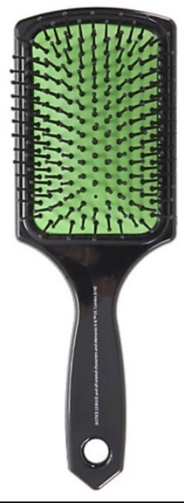
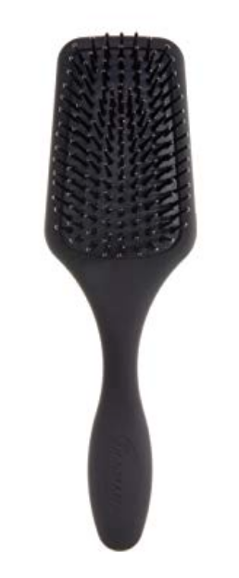
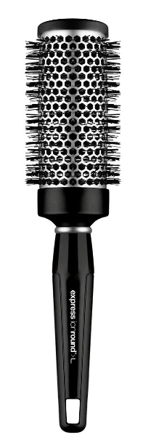
Previous Approaches
Semantic Grasping
Uses a semantic affordance map to relate local geometry to a set of predefined semantic grasps that are appropriate for different tasks
Figure: Example of a semantic affordance map
Example:
Object: Hairbrush
Manipulation Task: Brush hair
Semantic Constraints: grasp the handle
H. Dang and P. K. Allen, “Semantic grasping: Planning robotic grasps functionally suitable for an object manipulation task,” in 2012 IEEE/RSJ International Conference on Intelligent Robots and Systems (IROS). IEEE, 2012, pp. 1311–1317.

Slide 6
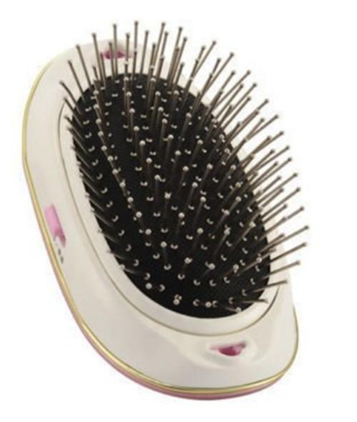
Possible downsides to semantic grasping?
A semantic affordance map on each object class is built using a representative object of that class, which limits the capability of their method to deal with objects with large shape variance inside the class
No handle
Where to perform grasp?

Slide 7
Previous Approaches
Part-based Grasping
Objects are segmented into parts labeled with semantic information (affordances) which are used for generating and transfering robotic grasps
Paddles
Handles

Slide 8
Possible downsides to part-based grasping?
Segmentation fails for some objects due to a big variance in shape. Limited object variance by requiring every object to have n parts.
ie. Hairbrush must always consist of a paddle and a handle.
Cannot be segmented into paddle and handle.
The affordance part and the graspable part are the same part!

Slide 9
Current Approach
Main idea: model relations between object, task and a grasp, using object affordances
Use convolutional neural networks (CNNs) for object affordance detection for task-specific grasping on full and partial point clouds
Encode object affordances, object class, and object orientation to formulate grasp constraints

Slide 10
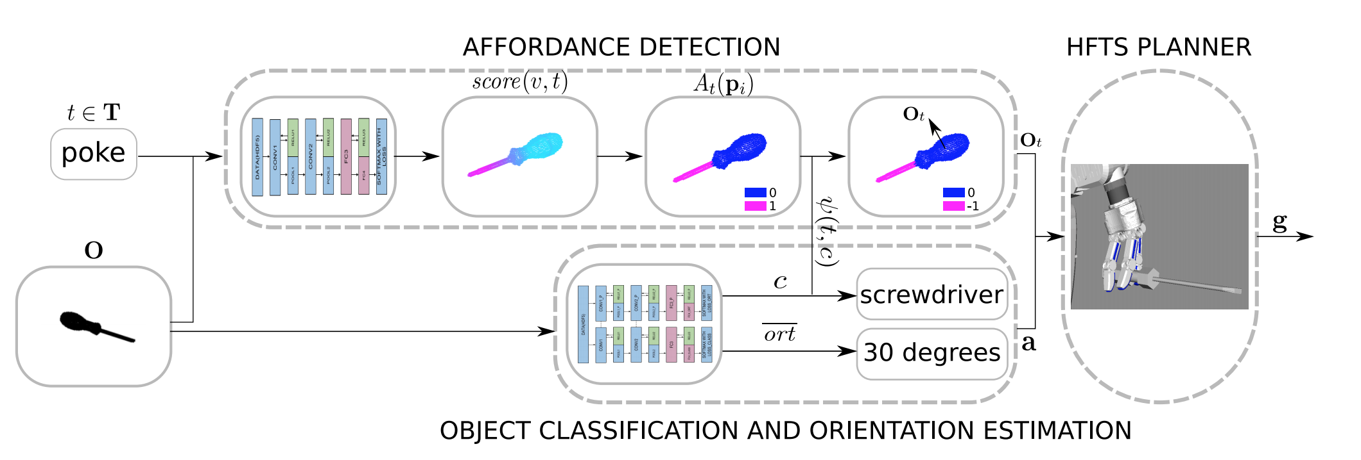
System Overview (Process Pipeline)
Stage 1: Uses 2 CNNs in parallel, one for affordance detection AFF-CNN and one for object classification and orientation estimation CO-CNN
Stage 2: Outputs of Stage 1 (contact constraint and approach direction constraint) used by grasp-planner to compute a task specific grasp
Input
Stage 1
Stage 2
Output
Affordance Detection → Contact Location
Grasp Planner
Grasp
Orientation
→
Approach Direction
Notes:
Contact constraint efines part of object surface that robot can grasp with respect to the part that affords the task, -1 if affords the task and 0 if doesn’t afford the task
Approach direction constraint describes 3D angle of approach to the object, which depends on the detected orientation
Downfall, both object require knowledge about full object geometry
One object can afford multiple tasks but we defineconstraints for most common combinations of object classes and tasks they can afford (based on human knowledge)

Slide 11
Input
Object O = binary voxel grid where a voxel is assigned a 1 if a point in the object point cloud exists in that voxel’s volume
Task $t ∈T$
T = {cut, poke, pound, pour, support}
Input
Stage 1
Stage 2
Output
Affordance Detection → Contact Location
Grasp Planner
Grasp
Orientation
→
Approach Direction

Slide 12
Stage 1: Affordance Detection
From affordances to contact locations…
ANN-CNN→ $score(v, t)$ → $A_{t}\left(p\right)∈\left\{0,1\right\}$ & $Ψ\left(t,c\right)∈\left\{0,−1\right\}$ → $O_{t}$
Input
Stage 1
Stage 2
Output
Grasp Planner
Grasp
Orientation
→
Approach Direction
Notes:
INSERT PIC From Affordance Detection to
ANN-CNN → Score Function → Voxels segmented into parts that afford the task and don’t → convert back to point cloud for each point, obtain the binary value based on segmentation → define preference for fingertip placement, object that belongs to the class affords the task, then the function psi defines if fingers are allowed to touvh that part (need input from CO-CNN since based on classification of object) parts of object that will be grasped has a neutral score
EXAMPLE, PEN AND SCREWDRIVER BOTH AFFORD TASK POKE BUT FOR PEN, THE ENTIRE BODY AFFORDS THE TASK AND WILL HAVE A NEUTRAL PREFERENCE, AND THE PART THAT AFFODS TASK FOR THE SCREWDRIVER → PREFERENCE FOR PLACING OUR FINGERS ON HANDLE, RATHER THAN ON THE SHANK WHEN USING TO POKE.
Output of ANN-CNN is used to compute a score function score(v,t) that assigns an affordance score to each voxel (larger score means that the point represented by the voxel affords the task

Slide 13
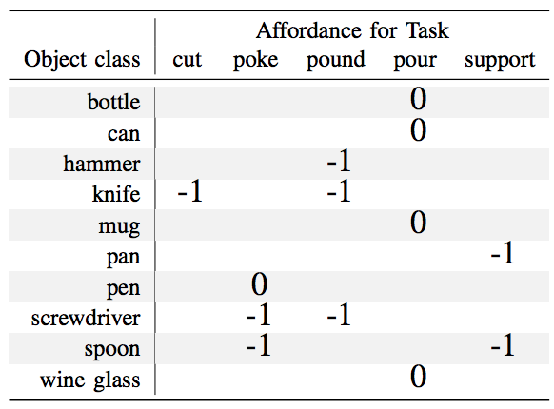
Stage 1: From Affordances to Contact Locations
Output of AFF-CNN used to compute $score(v, t)$ that assigns affordance score to each voxel $v∈V$
Object affords a task if it has certain parts
Affordance labels for each task
cut — thin parts with a flat edge such as blades
poke — long pointy parts such as shanks of tools
pound — parts of compact solid mass such as hammer heads or tool handles
pour — parts such as containers typically found on mugs, cups and wine glasses
support — thin and flat vessels usually used to serve food such as plates, spoon heads etc.
Scoring function used to segment object into voxels that afford the task, and voxels that do not
Convert voxel grid back to point cloud, each point assigned binary value based on segmentation
$A_{t}\left(p\right)∈\left\{0,1\right\}$
Obtain contact location by determining preference for fingertip placement
For a specific task, we define if the fingers are allowed to touch the part that affords the class:
Object that should be grasped:
Notes:
INSERT PIC From Affordance Detection to
ANN-CNN → Score Function
Larger score indicates that the points represented by voxel affords the task
Voxels segmented into parts that afford the task and don’t → affordance labels for each task help to establish task-object relations
convert back to point cloud for each point, obtain the binary value based on segmentation → define preference for fingertip placement, object that belongs to the class affords the task, then the function psi defines if fingers are allowed to touvh that part (need input from CO-CNN since based on classification of object) parts of object that will be grasped has a neutral score
EXAMPLE, PEN AND SCREWDRIVER BOTH AFFORD TASK POKE BUT FOR PEN, THE ENTIRE BODY AFFORDS THE TASK AND WILL HAVE A NEUTRAL PREFERENCE, AND THE PART THAT AFFODS TASK FOR THE SCREWDRIVER → PREFERENCE FOR PLACING OUR FINGERS ON HANDLE, RATHER THAN ON THE SHANK WHEN USING TO POKE.
Output of ANN-CNN is used to compute a score function score(v,t) that assigns an affordance score to each voxel (larger score means that the point represented by the voxel affords the task

Slide 14
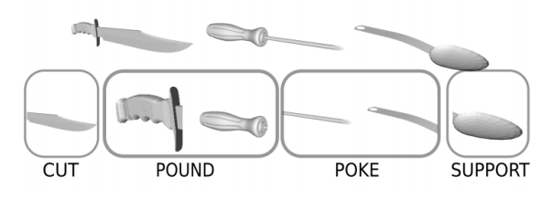
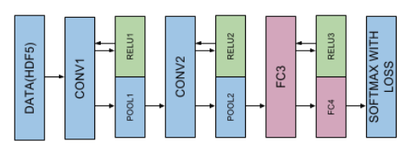
Implementation Details: Affordance Detection
Training phase
Dataset 3D CAD models from ShapeNet and ModelNet40
Trained on full point clouds only
Trained on set of object parts labeled with respective task
Network Architecture
LeNet-5
Notes:
The object parts are represented as sub-volumes of the complete voxel grid of an object and are upscaled to maximal expansion inside the 50 ˆ 50 ˆ 50 grid. To increase the size of our training set we augment it by scaling, rotating and translating each part.
Choice of architecture was based on the ratio of the number of training examples and classes
The network consists of two convolutional layers and two fully connected layers with pooling and ReLU (Rectified Linear Unit) layers in between. The output of the last layer corresponds to the number of affordance labels, k “ 5.

Slide 15
Stage 1: Object Classification and Orientation Estimation
From Orientation to approach direction
C = {bottle, can, hammer, knife, mug, pan, pen, screwdriver, spoon, wine glass}
Input
Stage 1
Stage 2
Output
Affordance Detection → Contact Location
Grasp Planner
Grasp

Slide 16
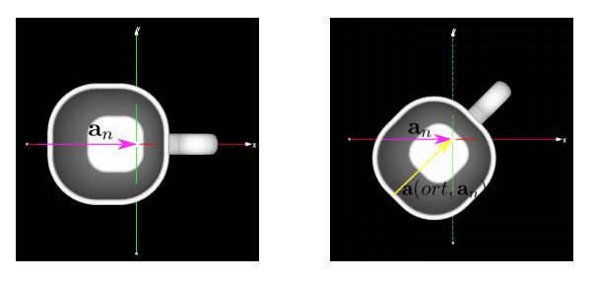
Stage 1: From Orientation to Approach Direction
Manually align objects from training set that belong to same class and define preferred approach direction for each class
Use CO-CNN to classify the object and estimate rotation along the axis
Use estimated orientation and approach direction for the task-class pair to determine preferred approach direction
Notes:
Assume that reference frame of input point cloud is aliged with the nominal class reference frame
Can use co-cnn to classify the objet and then estimate rotation along the axis

Slide 17
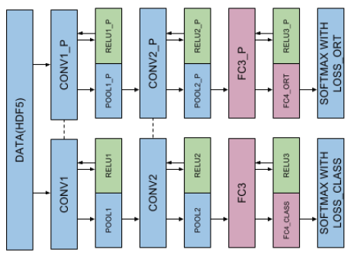
Implementation Details: Object Classification and Orientation Estimation
Training phase
Dataset 3D CAD models from ShapeNet and ModelNet40
Trained on both full and partial point clouds only
Manually label each object with class
Manually align all meshes of object with nominal class reference frame
Rotate instances for 10 degrees
Network architecture
Two joint LeNet-5 networks
Class
Orientation

Slide 18
Stage 2: Grasp Planning
Integrated fingertip grasp and motion planner
Hierarchical Fingertip Space grasp planner (HFTS)
Input
Stage 1
Stage 2
Output
Affordance Detection → Contact Location
Grasp Planner
Grasp
Orientation
→
Approach Direction

Slide 19
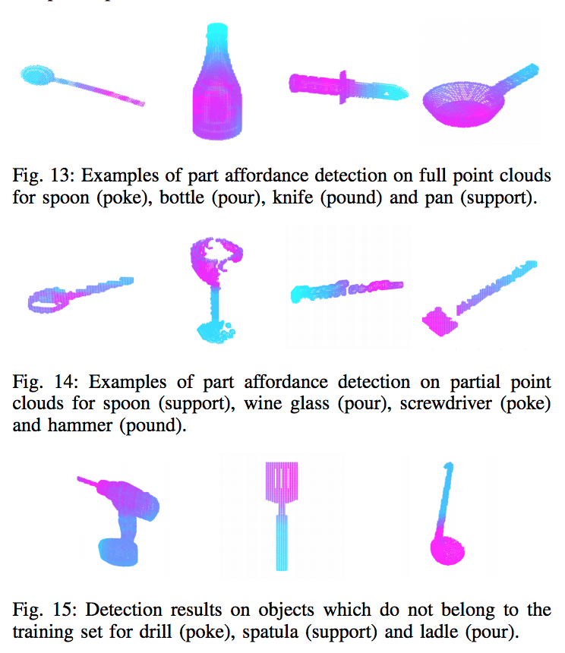
Experimental Evaluation
Affordance detection
Training
70:30
10000 instances
10 object classes, ~1000 instances per class
Evaluated on full and partial point clouds

Slide 20
Experimental Evaluation
Object Classification
Accuracy decreases by 23% on partial point clouds
Orientation Estimation
Accuracy decreases by 13% for partial point clouds

Slide 21
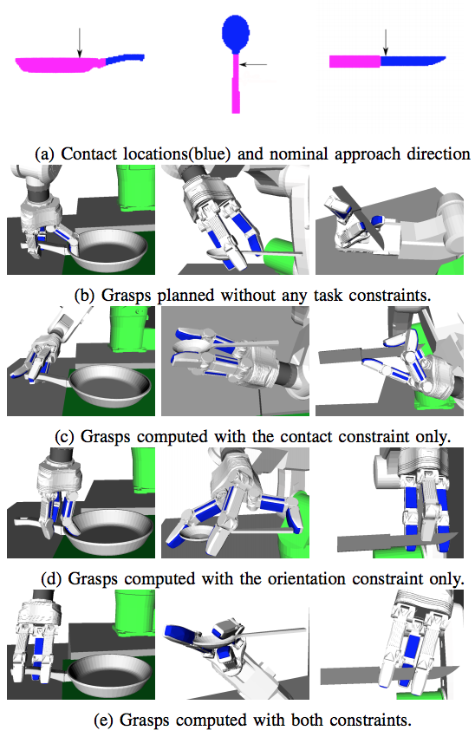
Experimental Evaluation: Grasp Planning
Grasp planning
Apply grasp planning for a Schunk-SDH hand mounted on a KUKA KR5 six 850 manipulator
Qualitative evaluation for grasps computed with objects for tasks:
Support
Poke
pound

Slide 22
Conclusion
Overview of main contributions
Proposed a system for computing a stable, task-specific grasp on an object by encoding and detecting part affordances, class and orientation of an object and formulating these quantities as grasp constraints
Evaluated the affordance detection, object classification and orientation estimation performance on full and partial point clouds
Showed examples for grasps in simulation using a standard optimization-based planner
Used a fingertip grasp planner as a proof of concept

Slide 23
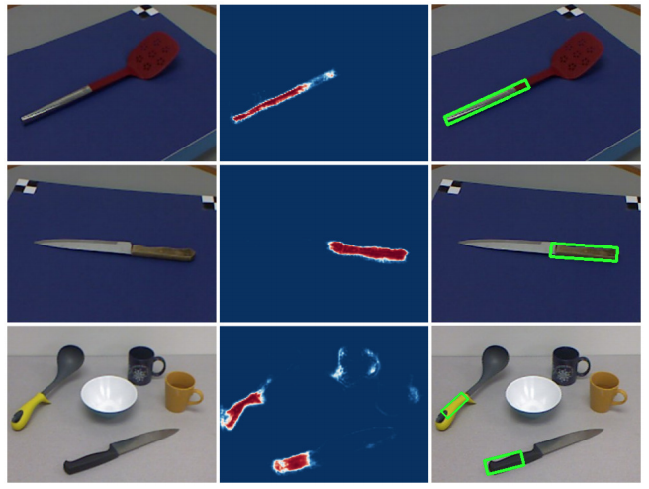
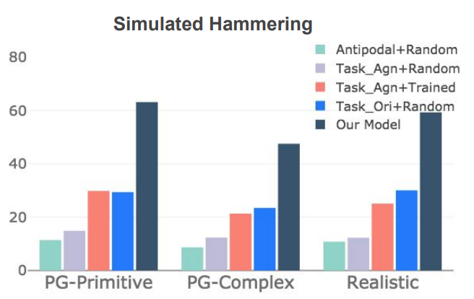
Thoughts?
The F1 scores for the cut task are low for full and partial point clouds since shape of handle and blade are very similar
Possibly implement use of RGB-D dataset in detecting object affordances as described in this paper to help decide the affordance part better
This approach to the task-specific grasping problem doesn’t consider how the task is to be performed downstream
Could try to train the algorithm alongside manipulation policy to ensure success in performing the task post-grasp
A. Myers, C. L. Teo, C. Fermuller, and Y. Aloimonos, “Affordance ¨ detection of tool parts from geometric features,” in 2015 IEEE International Conference
Notes:
Requires the entire view of the object, unrealistic for real world applications where robot usually only gets partial point clouds
Possibly use Boltzmann machine generative network completion using nodes by modeling the probability distribution of data
Not just use shape (point clouds)
Might grasp correct part but might fail during manipulation ie swing/sweep
We compare our method to 4 baselines: 1) Antipodal+Random: Use a sampled antipodal grasp with a random action uniformly sampled with x, y, z positions in [−5, 5] in terms of centimeters and θ in [− π 20 , π 20 ]. 2) Task Agn+Random: A task-agnostic grasp from DexNet 2.0 [35] with a random action. 3) Task Agn+Trained: Same as above but with a manipulation policy trained with our method. This is akin to the current best solution. 4) Task Ori+Random: An ablative version of our model with task-oriented grasps executed with a randomized action.

Slide 24
Thank You. Any Questions?

