Slide 1
A Survey of Autonomous Human Affect Detection Methods for Social Robots Engaged in Natural HRI (2015)
Derek McColl^{[1]}, Alexander Hong^{[1][2]}, Naoaki Hatakeyama^{[1]}, Goldie Nejat^{[1]}, Beno Benhabib^{[2]}
[1] Autonomous Systems and Biomechatronics Laboratory, University of Toronto
[2] Computer Integrated Manufacturing Laboratory, University of Toronto
Vivek Kumar
SEAS ‘20
4/9/2019

Slide 2
Natural HRI
Detect common human communication cues/modalities for more natural social interaction.
Affect: a complex combination of emotions, moods, interpersonal stances, attitudes, and personality traits that influence behavior.
A robot capable of interpreting affect will be better at sustaining more effective and engaging interactions with users.

Slide 3
Timeline
1
2
3
4
5
6
7
Facial Expression
Body Language
Voice
Physiological Signals
Combination
Future Work
Affect Categorization Models
HRI Scenarios: Collaborative HRI, Assistive HRI, Mimicry HRI, General HRI

Slide 4
Affect Categorization Models

Slide 5
Categorical Models
Classifies affect into discrete states.
Darwin (1872), Tomkins (1962): [joy/happiness, surprise, anger, fear, disgust sadness/anguish, dis-smell, shame], neutral
Ekman: Facial Action Coding System (FACS), codifies facial expression with action units (AU)
Clearly distinguish affect, but may have trouble with inclusion and combination.
https://en.wikipedia.org/wiki/Facial_Action_Coding_System

Slide 6
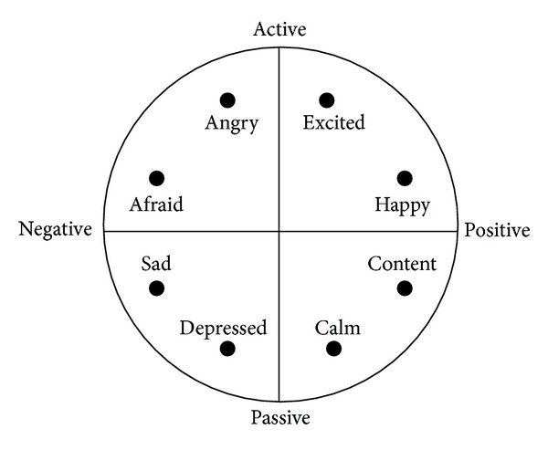
Dimensional Models
Classifies affect into dimensional space.
Wundt (1897), Schlosberg (1954): [pleasure/displeasure, arousal/calm, relaxation/tension]
Valence: positive or negative affectivity
Arousal: calming or exciting
Russell: two-dimensional circumplex model with valence and arousal dimensions.
https://researchgate.net

Slide 7
Facial Affect Recognition

Slide 8
Experiment: iCat
Summary: iCat plays chess and provides real-time affective (empathetic) feedback to the opponent (change in facial expression, comment, bad move on purpose).
Affect Classifier: Support Vector Machine (SVM)
Input: smile probability (faceAPI), eye gaze (faceAPI), game state
Output: positive, neutral, negative valence, action
Experiment: three groups of 40 chess players- no empathetic response, random empathetic response, adaptive empathetic response. Results tallied from interviews of chess players afterwords.
https://azure.microsoft.com/en-us/services/cognitive-services/face/

Slide 9
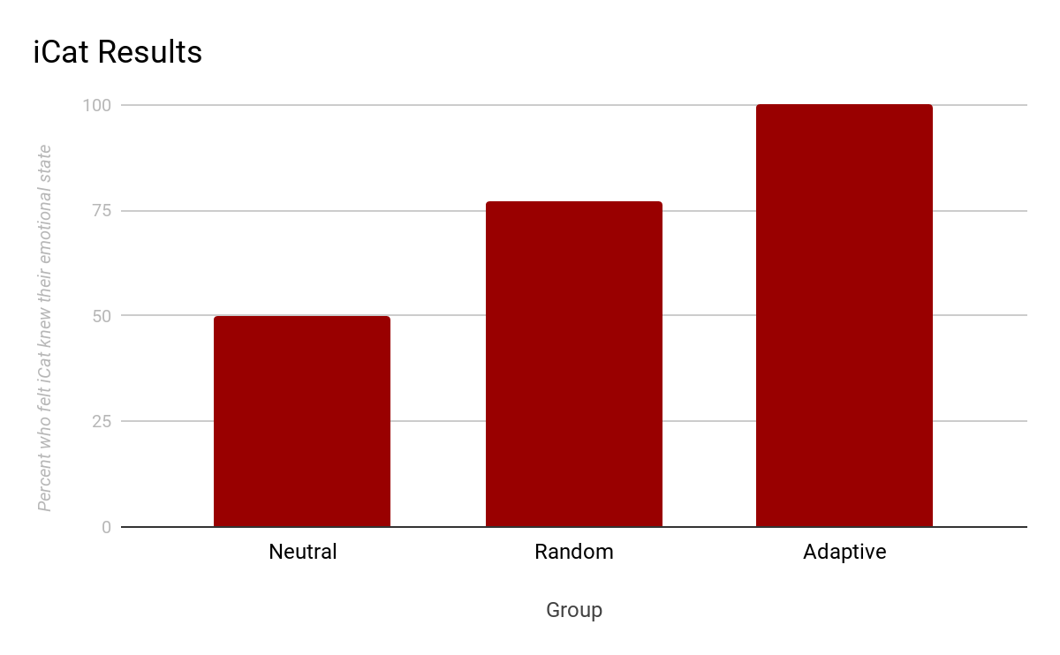
Results: iCat
Demo: https://www.youtube.com/watch?v=Qk2_rlWvHts

Slide 10
Experiment: AIBO
Summary: make AIBO respond to human affect with sound, light, or motions in a dog-like manner.
Affect Classifier: Probabilistic FACS lookup
Input: camera stream, obtain feature points and AUs, map to facial expression
Output: categorical [joy, sadness, surprise, anger, fear, disgust, neutral]
Experiment: Alongside Q-learning, AIBO adapts its behavior to the human’s affective state over time. This is characterized by appropriate affect recognition.

Slide 11
Results: AIBO
AIBO appeared to achieve a friendly personality when treated with positive affects (joy).
Demo: https://www.youtube.com/watch?v=z9mWWU-T6WU

Slide 12
Body Language Affect Recognition

Slide 13
Experiment: Nadine
Summary: Nadine implements a gesture classification system (GUHRI) and the appropriate response.
Affect Classifier: Large Margin Nearest Neighbors
Input: Action gesture from Kinect sensor and CyberGlove (skeleton joint locations)
Output: confidence, praise (affects), or responsive output gesture: wave, shake hand
Experiment: 25 participants of varying body type (race, gender, etc), who performed one of the designated output gestures.
https://en.wikipedia.org/wiki/Kinect
http://www.cyberglovesystems.com/

Slide 14
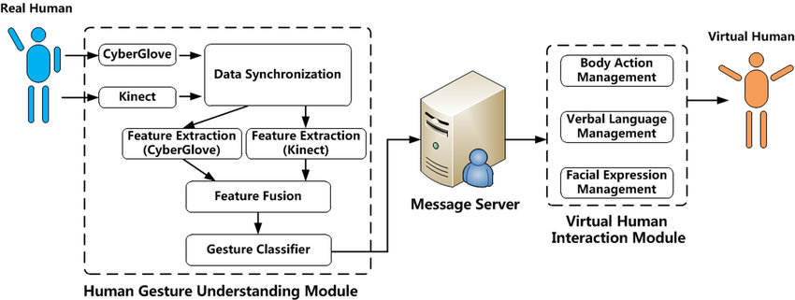
GUHVI System Architecture

Slide 15
Nadine: Results
Gesture recognition rate of 90-97%, followed by appropriate response.
Demo: https://www.youtube.com/watch?v=usif8BOBHgA

Slide 16
Voice Affect Recognition

Slide 17
Feature Extraction from Human Voice: OpenEar (OE) Baseline
Fundamental Frequency: the lowest frequency of a periodic waveform. For any given waveform, we find period T such that is minimized:
Energy: area squared magnitude of waveform-
Mel-frequency Cepstral Coefficient (MFCC): power spectrum
Phase distortion: a change in the shape of waveform
Jitter/Shimmer: variations in signal frequency/amplitude
http://geniiz.com/wp-content/uploads/sites/12/2012/01/26-TUM-Tools-openEAR.pdf

Slide 18
Experiment: Nao
Summary: adults speak with Nao about a variety of topics, and Nao attempts to classify positive or negative valence from the user’s voice.
Affect Classifier: Support Vector Machine (SVM)
Input: fundamental frequency, energy, MFCCs, phase distortion, jitter, shimmer, etc.
Output: positive or negative valence
Experiment: 22 adults speak with NAO wearing a microphone, with pre-coded, highly aroused voice signals.

Slide 19
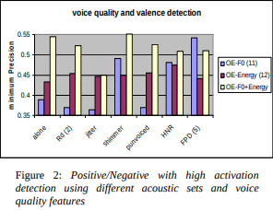
Results: Nao
RD: relaxation coefficient
P-unvoiced: unvoiced consonants
HNR: harmonicity
FPD: functions of phase distortion
Demo: https://www.youtube.com/watch?v=p1ID-gvUnWs

Slide 20
Affective Physiological Signal Recognition

Slide 21
Physiological Signals
Heart Rate
Affect
Skin Cond.
Muscle Tension

Slide 22
Experiment: Robotic Arm
Summary: an affect detection system for a robotic arm when the human and arm are engaged in a collaborative task.
Affect Classifier: Hidden Markov Model (HMM)
Input: heart rate (EKG), skin conductance, muscle tension (forehead, MyoScan)
Output: arousal (low, medium, high); valence (low, medium, high)
Experiment: 36 participants with tasks: pick-and-place; reach-and-grab; varying speed and obstacles.

Slide 23
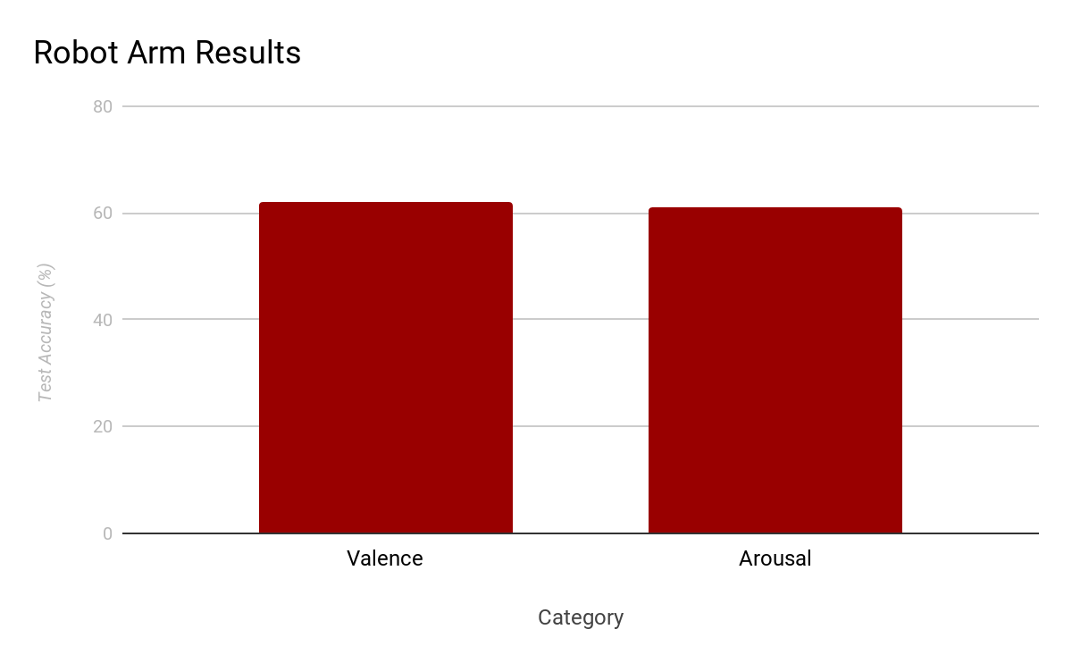
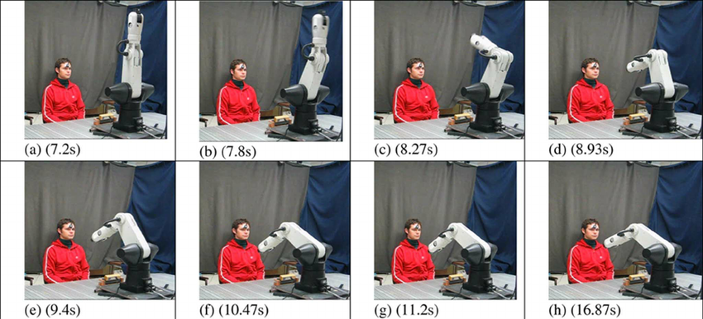
Results: Robotic Arm

Slide 24
Experiment: Basketball
Summary: attach a basketball net to a robotic arm, and move it based on the player’s anxiety level.
Affect Classifier: Support Vector Machine (SVM)
Input: heart rate (EKG), skin conductance, muscle tension (neck, MyoScan), skin temperature
Output: anxiety classification (low, medium, high)
Experiment: a basketball game with the robot. The robot varies the difficulty based on the anxiety level of the players.

Slide 25
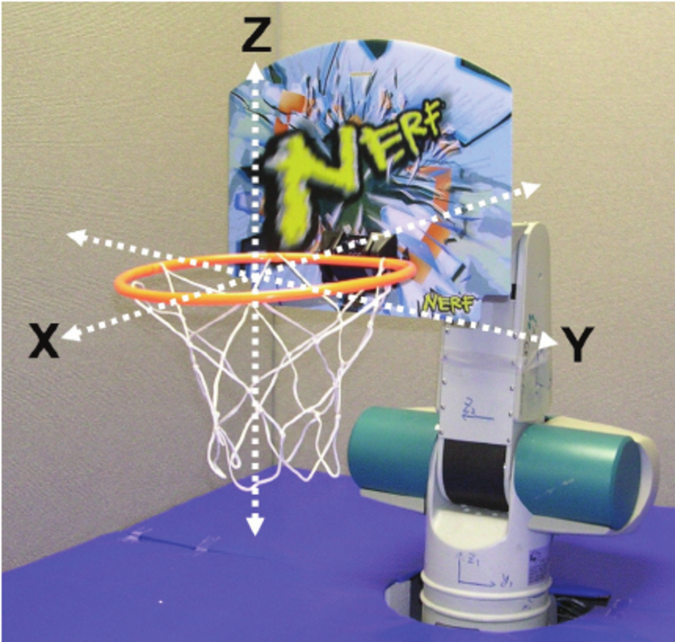
Results: Basketball
79% of participants reported proper anxiety change.
https://researchgate.net

Slide 26
Multimodal Affect Recognition

Slide 27
Experiment: Maggie
Summary: a general purpose interactable robot.
Affect Classifier: Decision Tree/Decision Rule, Bayes’s Theorem
Input: voice features (see voice section), CERT/SHORE face detection
Output: categorical [happy, neutral, sad, surprise]
Experiment: 40 students pose with voice and facial affective state.
https://www.iis.fraunhofer.de/en/ff/sse/ils/tech/shore-facedetection.html
http://mplab.ucsd.edu/~marni/Projects/CERT.htm

Slide 28
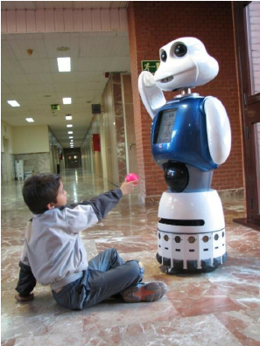
Results: Maggie
DT | CERT
DR | SHORE
1
Voice Classification
56%
57%
2
Facial Classification
76%
63%
3
Overall Classification
77-83%
https://researchgate.net

Slide 29
Conclusion

Slide 30
Future Work
Improve affect categorization models
Improve sensors (most frequent- Kinect, webcams, etc)
Use transfer learning
Develop systems that are robust to age and cultural backgrounds

Slide 31
Popular Resources
Cohn-Kanade database
CMU database
JAFFE database
DaFEx database
EmoVoice
EmoDB database

