Slide 1
Unsupervised Perceptual Rewards For Imitation Learning
Pierre Sermanet, Kelvin Xu & Sergey Levine
Presented by: Mehmet Emre Sonmez

Slide 2
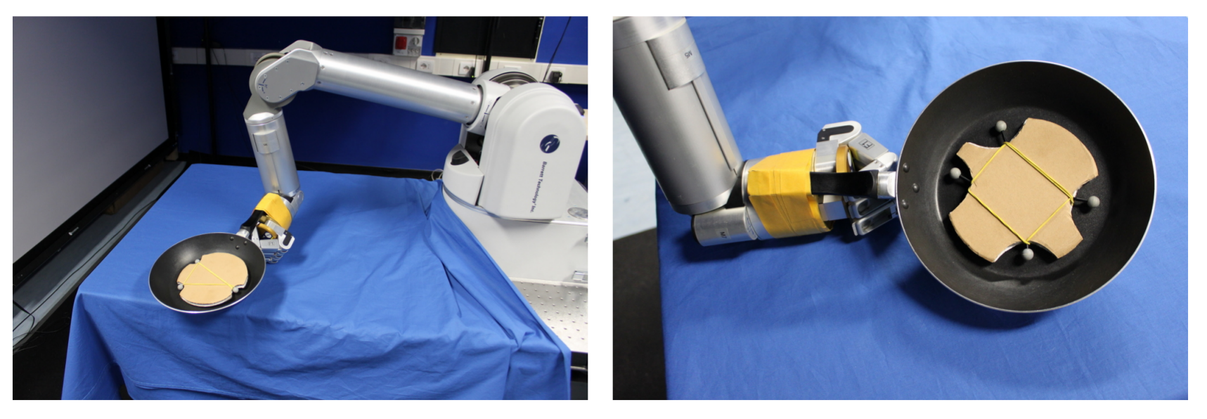
Robot Learning Recap
Learning from Demonstration (LfD)
Video demonstration
Kinesthetic Teaching
Shortcomings:
Difficult to demonstrate
Joint mapping (human demonstrator vs robot design)
Reinforcement Learning (RL)
Trial and error
Reward function gives feedback to robot about exploration
Shortcomings:
Reward function design
Exploration space

Slide 3
Motivation
Problems:
Reward function design is difficult & sub-optimal
Exploration space is too large
Questions:
How do we generalize reward functions?
How do we learn from few demonstrations?
Goal:
Develop a scalable and efficient imitation learning method
Approach:
Use deep learning to visually infer rewards from sample demonstrations
Divide tasks into subtasks to learn quicker

Slide 4
Human Inspiration
When learning a task through social imitation, humans:
Make use of extensive prior knowledge
E.g: opening a jar vs opening a water bottle. If I know how to do one, I can probably figure out the the other
Technical application: use pre-trained CNN to extract visual knowledge about a scene / state
Observe first, then do trial and error
Trial and error allow us to fine tune behavior, same for machines

Slide 5
Convolutional Neural Net (CNN) Background

Slide 6
What’s wrong with Rewards?
Manual design is difficult and imperfect!
How would you design a reward for pouring into a glass?
Weight of liquid in glass?
Angle of pour?
For opening a door?
Rotation of handle?
Angle of opening?
Need special hardware?
Pancake with sensors?
Door handle with sensor?

Slide 7
Previous Works
Image based rewards:
Specify target image and measure distance from target image
Problems?
Does not generalize (semantically similar but visually different examples)
Target image does not tell learner what aspect of the image is important
Inverse reinforcement learning (IRL):
Analyzing a set of demonstrations to come up with a reward function that would lead to to shown behavior
Problems?
Can’t scale to high dimensions

Slide 8
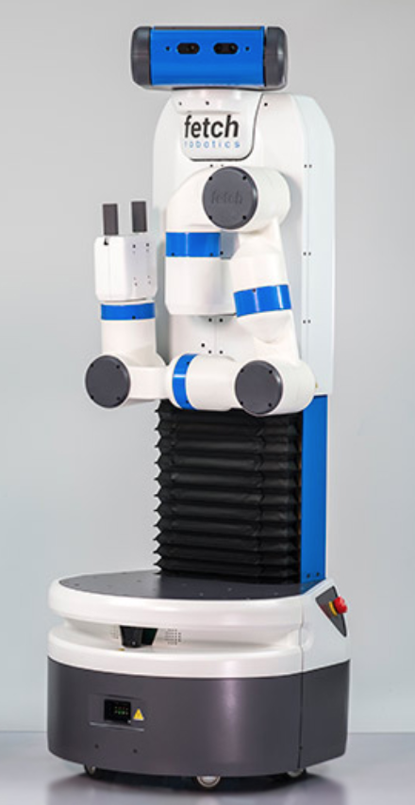

Slide 9
How it all works
Training videos are transformed into a sequence of image features over time
A probability distribution of features is calculated from these sequences
Videos are divided into segments that represent sub-tasks
For each segment, most important visual features are selected
A reward for each segment is learned from the probabilities of features. These are combined to make a smooth reward function
The function is used to train the learning agent

Slide 10
1. Extract Image Features
Neural net named “Inception” used in ImageNet classification competition
Each layer in a CNN extracts features that are at a different level of abstraction (e.g. edges, shapes, object classes)
Method uses all activation layers after the first 5 conv layers

Slide 11
2. Model a Probability Distribution
We have for each feature s_{t}:
a sequence of activations over time τ = {s1 , . . . , sT }
We want to approximate a distribution:
where R(s_{t}) is the unknown reward function
not possible when we don’t know system dynamics
How to overcome?
Assume all sequences are feasible
Assume activation at time t_{i+1} is independent of activation at time t_{i} →
Simple learning rule:
fit mean and variance of each feature as a Gaussian
Use log of the resulting Gaussian as reward
Can use Naïve Bayes

Slide 12
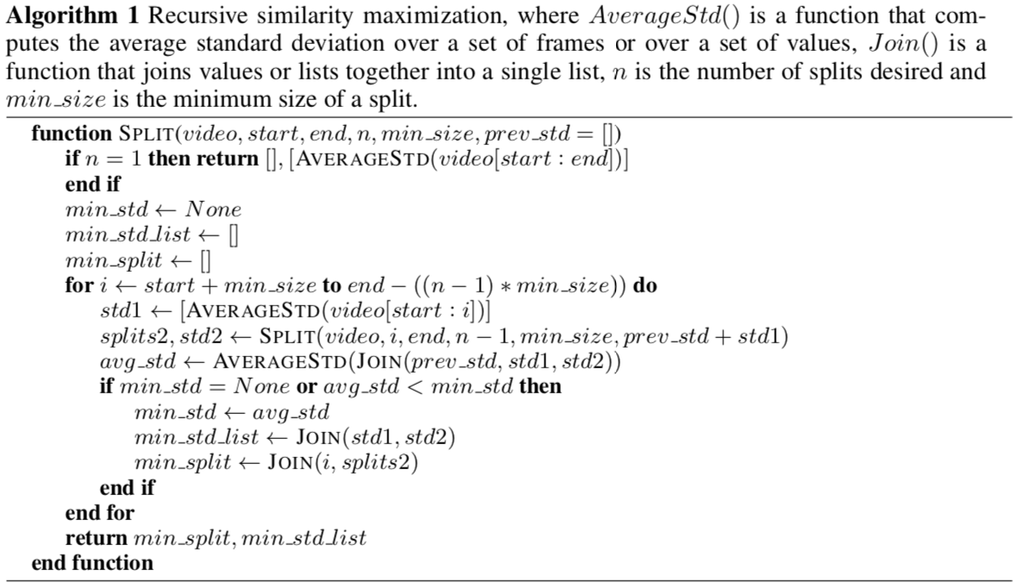
3. Divide Videos into Segments
Manually supply number of segments
Find optimal division by minimizing the std of features between each frame in a segment

Slide 13
4. Select Most Important Features
Why?
Some features like lighting or background are irrelevant
How?
Normalize each feature by feature averages
Using examples where sub-goal is accomplished vs not accomplished, compute simple heuristic that measures change in the activation
If change is large, it means feature was important to the accomplishment of the goal

Slide 14
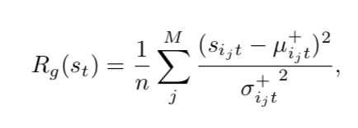
5. Learn Reward Function
Use “M” most important features to define R_{g} for each sub goal g:
Combine rewards for each sub-goal into one function:
Later goals are more important (weighted more heavily)
This is the log-probability of an independent Gaussian distribution over the relevant features
n is the number of intermediate goals

Slide 15
6. Train Learning Agent
A method called Policy Improvement with Path Integrals (PI²) is used to train the agent efficiently using the generated reward function
PI² is a stochastic exploration method that scales well to high dimensions
It only takes 1 parameter: exploration noise
It is an episodic policy improvement algorithm that iteratively improves policy based on rewards

Slide 16
Qualitative Findings
1) Regular Execution
2) Partial Execution
3) Task already completed

Slide 17
Qualitative Findings
1) Human Execution
2) Robot Execution
3) Robot Execution (different door)

Slide 18
Quantitative Results: Step Discovery
Ground truth examples provided by subjective division of the task into 2 or 3 steps by humans
Jaccard similarity (intersection / union) is used as evaluation measure
2 step tasks are easier to discover (Why? 1 strong visual change in each example task, some subtasks are subtle)
Random baseline would perform worse is step times were less uniform

Slide 19
Quantitative Results: Reward Accuracy
Compared to baseline of random 1 or 0 rewards at each time step, much more accurate
Meaningful? No set threshold for “good” accuracy but tests showed door opening could be learned to succeed 100%

Slide 20
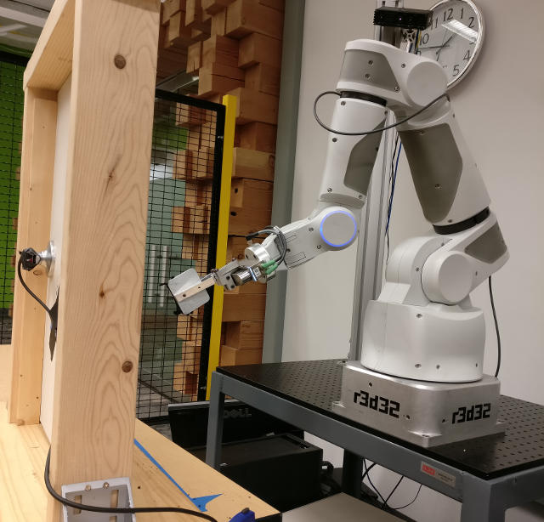
Real World Door Opening
7 DoF robotic arm with 2 finger gripper
Adapted an imperfect kinesthetic demo succeeding about 10% of the time
Training data for reward function had videos of opening other doors and humans performing the task (normally training data is set of robot poses)
Camera placed above shoulder of robot is used in training
Compared to training using sensor in door

Slide 21
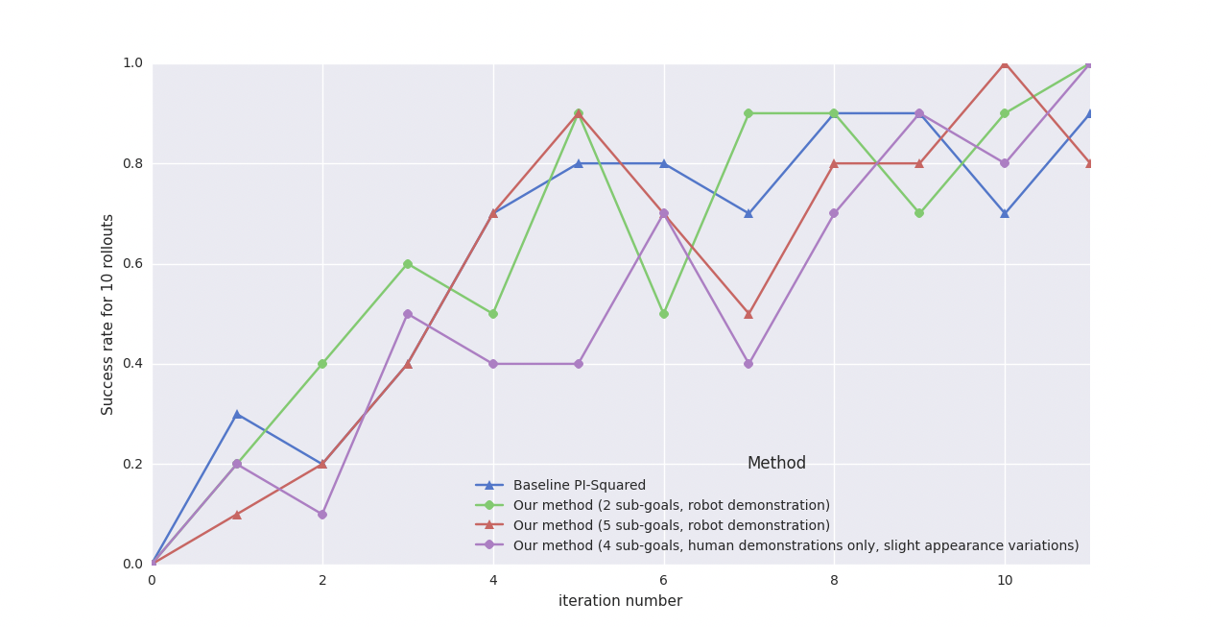
Results

Slide 22
Summary
Using pre-trained CNN’s, vision-based rewards can be learned from few real world demonstrations
Major improvement over manual reward design!
Don’t need sensors for reward, less hardware!
Equal performance can be obtained from robot or human demonstration, which makes generation of training data much easier
Trainer does not need access to robot!
Rewards generalize well to new scenes without retraining
Factors like lighting & colors don’t affect learning!

Slide 23
Questions?

