Slide 1
Transformable Semantic Map Based Navigation using Autonomous Deep Learning Object Segmentation
Yuki Furuta, Kentaro Wada, Masaki Murooka,
Shunichi Nozawa, Yohei Kakiuchi, Kei Okada and Masayuki Inaba
Presented By: Vaibhav Darbari

Slide 2
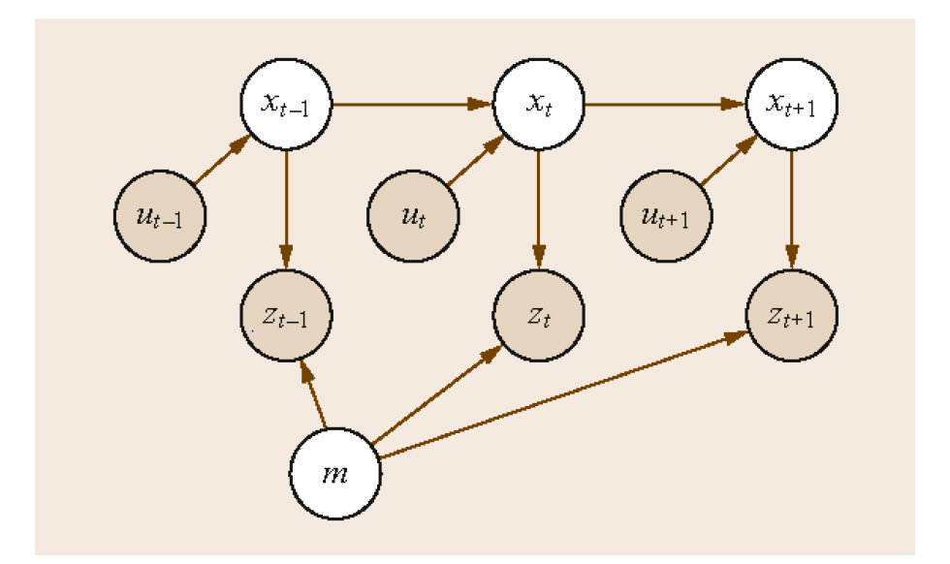
Simultaneous Localisation & Mapping (SLAM)
Robot builds a map of its environment and simultaneously localizes itself with respect to the computed map.
The problem statement:
Given:
The robot’s controls U0:k = {u1,u2,u3,u4,..uk}
Relative observations
To Compute:
Map of features m = {m1,m2,m3….mn}
Path of robot X 0:k = {x0,x1,x2….xk}
Full SLAM: P(x1:t,m|z 1:t, u1:t), entire path and map
Online SLAM: P(xt,m|z1:t,u1:t), most recent pose and map

Slide 3
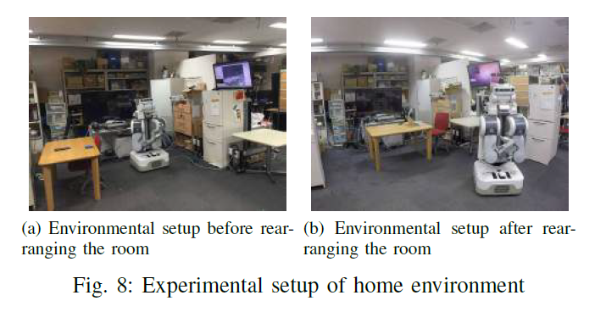
So…. What’s the problem?
Geometric maps alone are insufficient to tackle changes in environment!
Moreover, the maps generated may be specific to a robot as it depends on the kind of sensors on the robot.

Slide 4
Related Work
Localization :- Fox et al. [1] performed high precision self localization but did not consider spatial relationship between objects.
Semantics :- Kuipers et al. [2] represented environment as a topological map derived from theory on mapping and symbolization by human. Okada et al. [3] showed that symbolic representation of map has high intuitiveness for performing various tasks with a ‘spot’, which is a meaningful location for manipulation. The shortcoming of these approaches is that the annotations and symbol extraction are manual or hard coded.
Segmentation:- Conventionally used segmentation models like SLIC superpixels[4], SIFT matching & clustering and state of the art deep learning segmentation models based on fully convolutional networks (FCN) [5]

Slide 5
Challenges:
Geometry free representation for navigation
Deal with dynamic changes in environment
Solution:
Generating deep learning enabled semantic map from annotated world
Object based navigation using learned semantic map representation
Semantic maps are invariant to robot platform
Novelty
Robots autonomously generate dataset for self supervised learning
Transfer existing geometric map to semantic map which is invariant to changes in object location

Slide 6
How it all works?
A self supervised annotated image dataset is autonomously generated by the robot from annotated world
The robot then performs a 2D image segmentation with deep learning enabled architecture.
This is followed by 3D Object segmentation for object based Navigation.
Finally, the new representation is employed by a “task compiler” to perform a daily assistive task in the modified environment.

Slide 7
1) Generating Dataset from Annotated World
Why?
Commonly used image processing datasets like ImageNet do not accurately depict what the robot sees as:-
Robot needs to recognize objects distinctive in each environment
Image obtained from robot sensor is not segmented at all and may be noisy.
Solution: Autonomous annotated image generation from annotated world!
Robots have a RGB-D sensor such as Microsoft Kinect
In this phase, It is assumed that robot knows its pose in world coordinate system
In the annotated world, locations, bounding boxes & labels of all objects are known.
The goal is to generate annotated object image from sensor data.

Slide 8
First, bounding boxes are calculated as shown in (a) then only the point clouds inner to the bounding boxes are selected which are then projected into the perspective of RGB camera as shown in (b)
Finally annotated images are generated by applying labelled mask images to color images

Slide 9
Some issues
Candidate annotated images still contain noise derived from various sources like: sensor noise, motion blur noise etc.
To address these types of noise, remove images captured when camera is moving fast. Threshold used was 0.01 m/s for both translational and rotational velocity.
Many duplicate images are also present which increase computation load.
To resolve this issue, only the first image at each pose is kept and the rest are discarded.

Slide 10
2) 2D Object Segmentation With Deep Learning Enabled Architecture
Use Fully Convolutional Networks for 5 object classes segmentation problem.
Even though there are only 5 object classes the setup is not easy. The dataset used is not labelled by a human but by the robot itself!
Therefore the dataset includes images whose label values are incorrect. The causes of failure may include mis-localization in SLAM, undetectable camera movement, difference between annotated and real world.

Slide 11
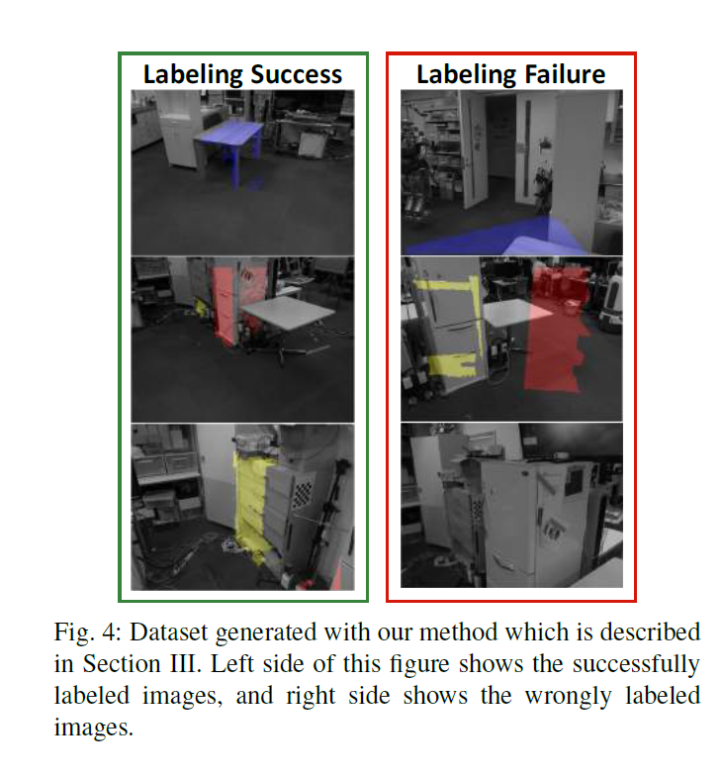
In order to deal with uncertainties in the dataset unreasonable training signals need to be considered at learning phase to tackle mislabelled data.
Gradient clipping strategy is used to solve the problem to suppress exploding gradient. In this study L2 norm threshold was set to 5 for gradient clipping
Dataset split into 8:2 (training/validation) with 418 sets of RGB-label images
Adam solver used to minimize loss function with hyper-parameters α= 1e-5 & β = 0.9

Slide 12
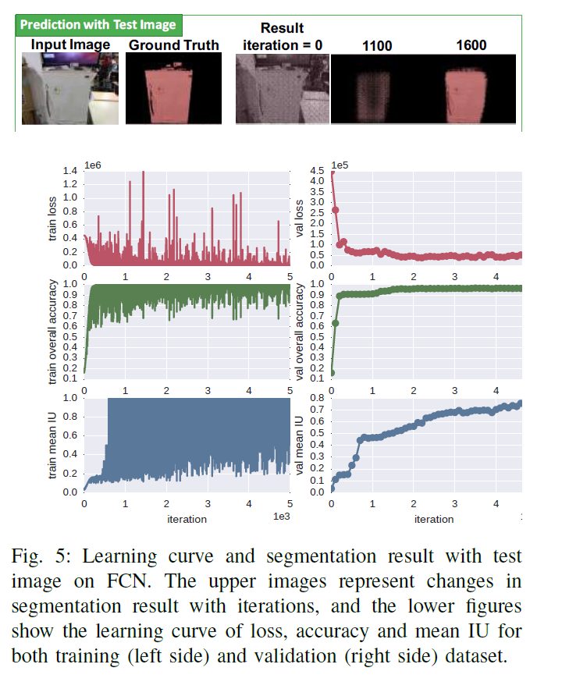

Slide 13
3) 3D object Segmentation System for Object Based Navigation
Object is segmented for object based navigation task by detecting and localizing target object and then fitting a box to estimate object center and size for localization.

Slide 14
4) Experiments
Three experiments were carried out to gauge the efficacy of the proposed system
A PR2 robot performs autonomous image dataset generation from annotated world by letting robot move about
A PR2 robot performs a daily assistive task (getting a can from fridge) with rearranged environment
A HRP2 performs the same task with same framework to show the independence from robot type

Slide 15
a) Acquisition Phase
Used Willow garage’s PR2 with head mounted Microsoft Kinect RGB-D sensor. The task is to move around a room with a base and look around with a constantly moving head.
Transformations from robot to object bounding boxes updated at 60Hz.
Images captured when camera moving faster than 0.01 m/s are filtered as are images closer than 0.03m from previous camera position
After 250 minutes, 450,973 color images and 445,611 depth images captured. Among these, 417 filtered data were generated as annotated images

Slide 16
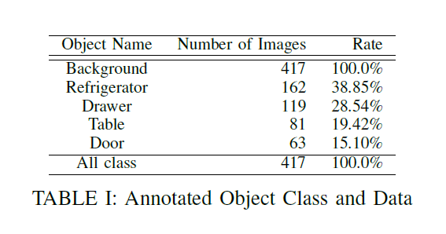

Slide 17
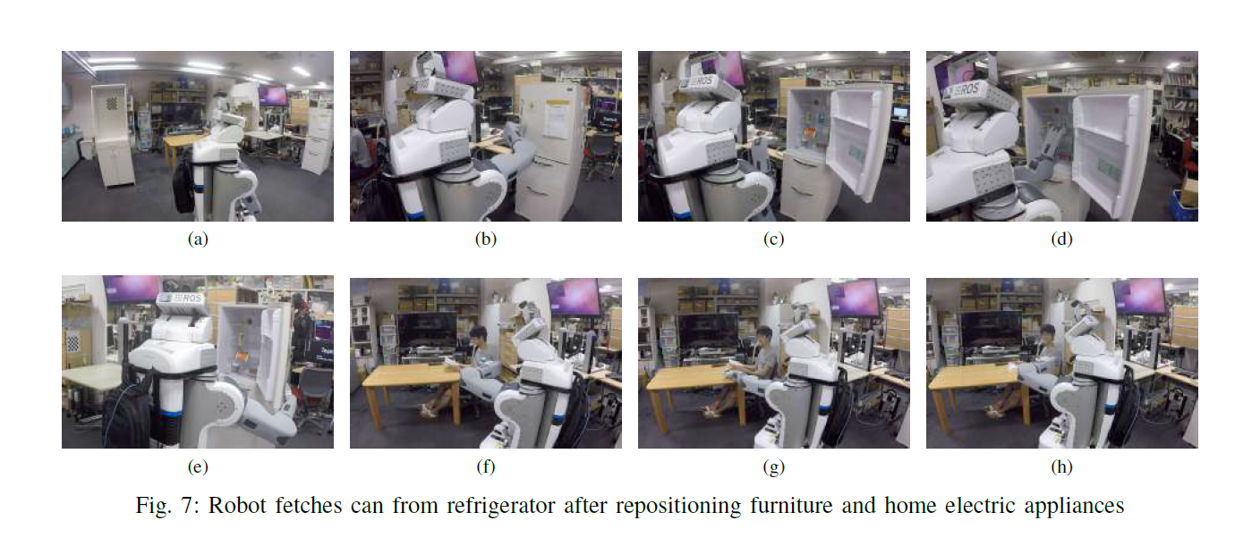
b) Task Execution Phase
In this experiment, PR2 fetches a can from refrigerator before and after the room is rearranged. The setup consists of a table, a refrigerator, and a coffee can inside the refrigerator.

Slide 18
Action transition graph generated by task compiler

Slide 19
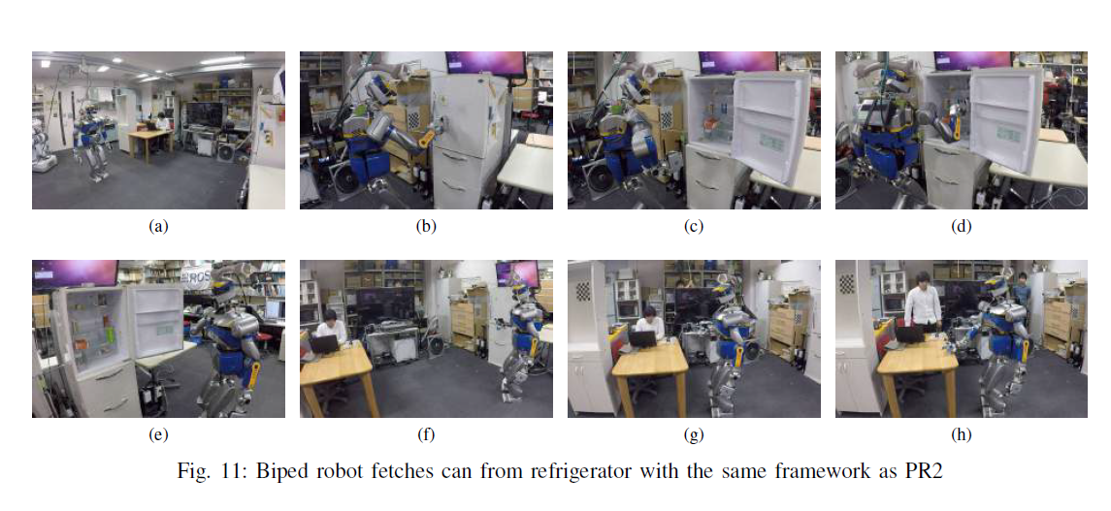
c) HRP2 performs the same task with same framework

Slide 20
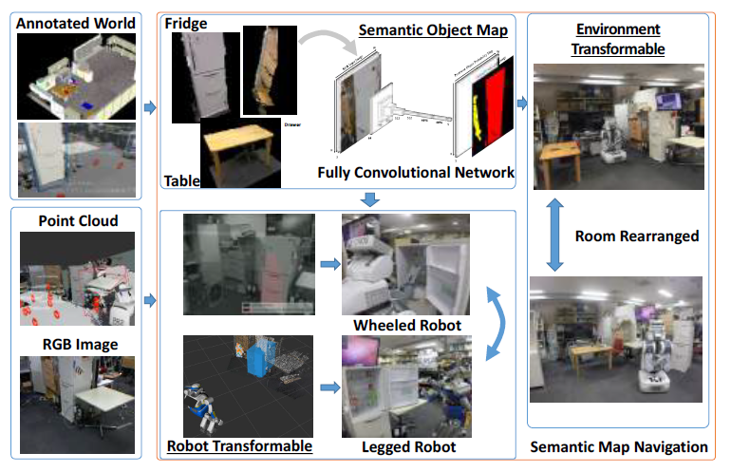
Complete Pipeline at a glance

Slide 21
Summary
This paper presents a novel framework to generate semantic map for navigation in dynamic environment by self-supervised dataset generation from annotated world and segmenting & labelling objects with deep learning.
The approach was tested in dynamic home environment on multiple robot platforms to confirm the feasibility of the proposed technique.
Demo: http://www.cs.columbia.edu/~allen/S19/NEWER_SLIDES/transformable_video.mp4

Slide 22
Potential Improvements
Problems: The current system is restricted to 5 object classes thus restraining the general applicability of the system. Moreover, the semantic mapping does not provide any feedback to the SLAM pipeline to correct drifts.
One way to improve the current pipeline is to incorporate an end to end pipeline which simultaneously caters to SLAM and semantic segmentation while also tackling scale drifts as done in CNN-SLAM proposed by Tateno et al. [6].
CNN-SLAM demo: https://www.youtube.com/watch?v=z_NJxbkQnBU

Slide 23
Questions?

Slide 24
References
D. Fox, W. Burgard, and S. Thrun. Markov localization for mobilerobots in dynamic environments. Vol. 11, pp. 391–427, 1999.
B. Kuipers and Y. Byun. A robot exploration and mapping strategy based on a semantic hierarchy of spatial representations. Robotics and autonomous systems, Vol. 8, No. 1, pp. 47–63, 1991.
K. Okada, M. Kojima, Y. Sagawa, T. Ichino, K. Sato, and M. Inaba.Vision based behavior verification system of humanoid robot for daily environment tasks. In 2006 6th IEEE-RAS International Conference on Humanoid Robots, pp. 7–12. IEEE, 2006.
R. Achanta, A. Shaji, K. Smith, A. Lucchi, P. Fua, and S. S¨usstrunk. Slic superpixels compared to state-of-the-art superpixel methods. IEEE transactions on pattern analysis and machine intelligence, Vol. 34, No. 11, pp. 2274–2282, 2012.
J. Long, E. Shelhamer, and T. Darrell. Fully convolutional networks for semantic segmentation. In Proceedings of the IEEE Conference on Computer Vision and Pattern Recognition, pp. 3431–3440, 2015.
K. Tateno, F. Tombari, I. Laina and N. Navab, "CNN-SLAM: Real-Time Dense Monocular SLAM with Learned Depth Prediction," 2017 IEEE Conference on Computer Vision and Pattern Recognition (CVPR), Honolulu, HI, 2017, pp. 6565-6574. doi: 10.1109/CVPR.2017.695

