Slide 1
SemanticFusion and ElasticFusion
Dyson Robotics Lab, Imperial College London
Presented by Varun Chanddra

Slide 2
Authors
SemanticFusion: 2016
John McCormac, Ankur Handa, Andrew Davison, and Stefan Leutenegger.
Dyson Robotics Lab, Imperial College London
ElasticFusion: 2015
Thomas Whelan, Stefan Leutenegger, Renato F. Salas-Moreno , Ben Glocker and Andrew J. Davison.
Dyson Robotics Laboratory and Department of Computing at Imperial College London.

Slide 3
What are these ?
ElasticFusion
SemanticFusion
Real-time dense visual SLAM (Simultaneous Localization and Mapping).
Surfel-based maps of room-size environments.
Without a pose graph, focuses on optimizing the map.
Uses RGB-D camera.
Provides a dense semantic 3D map.
Uses CNN to label the 2D frames.
Uses SLAM to get correspondences from 2D frames to a 3D map.

Slide 4
What are these ?
ElasticFusion
SemanticFusion

Slide 5
Why ?
Sharing the same semantic and geometric understanding.
Interaction
Example: Understands your commands.
Query information.
Example: How many chairs do we have in the room?
Commands.
Example: Fetch me the mug on the nearest table.

Slide 6
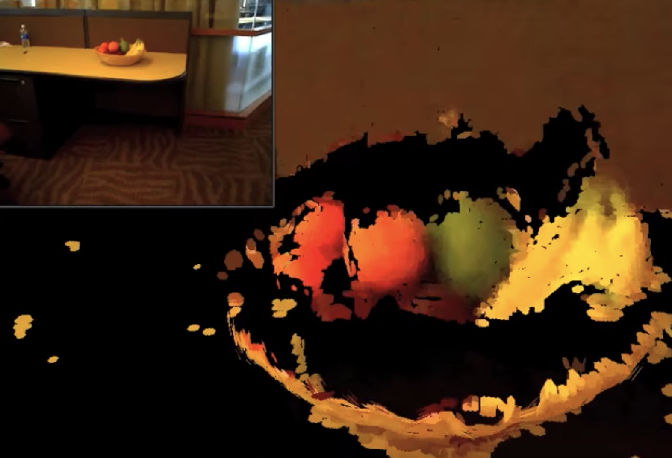
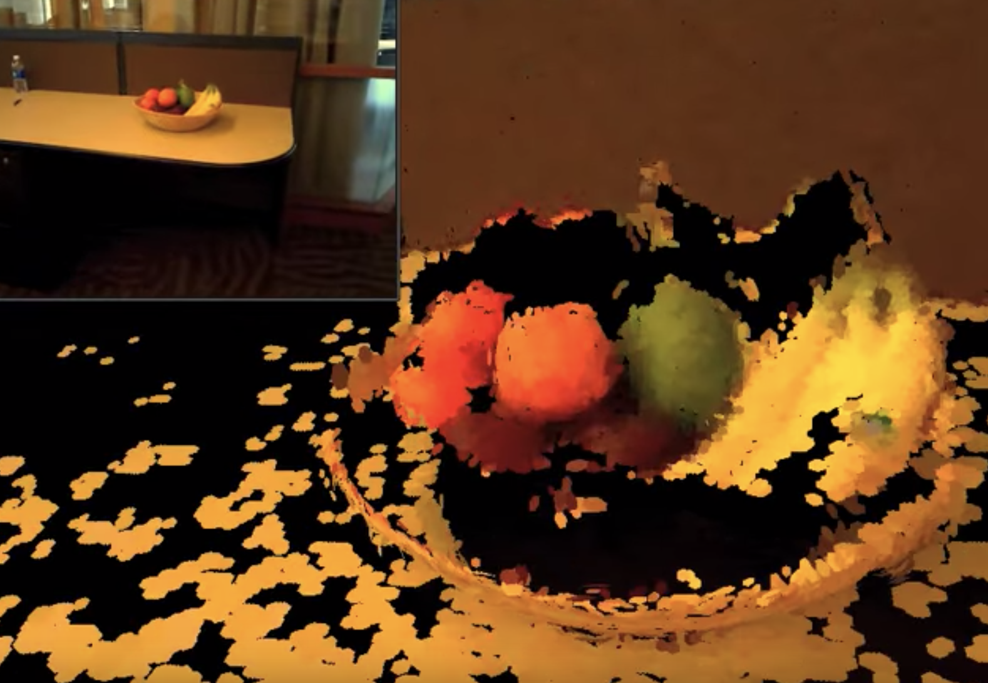
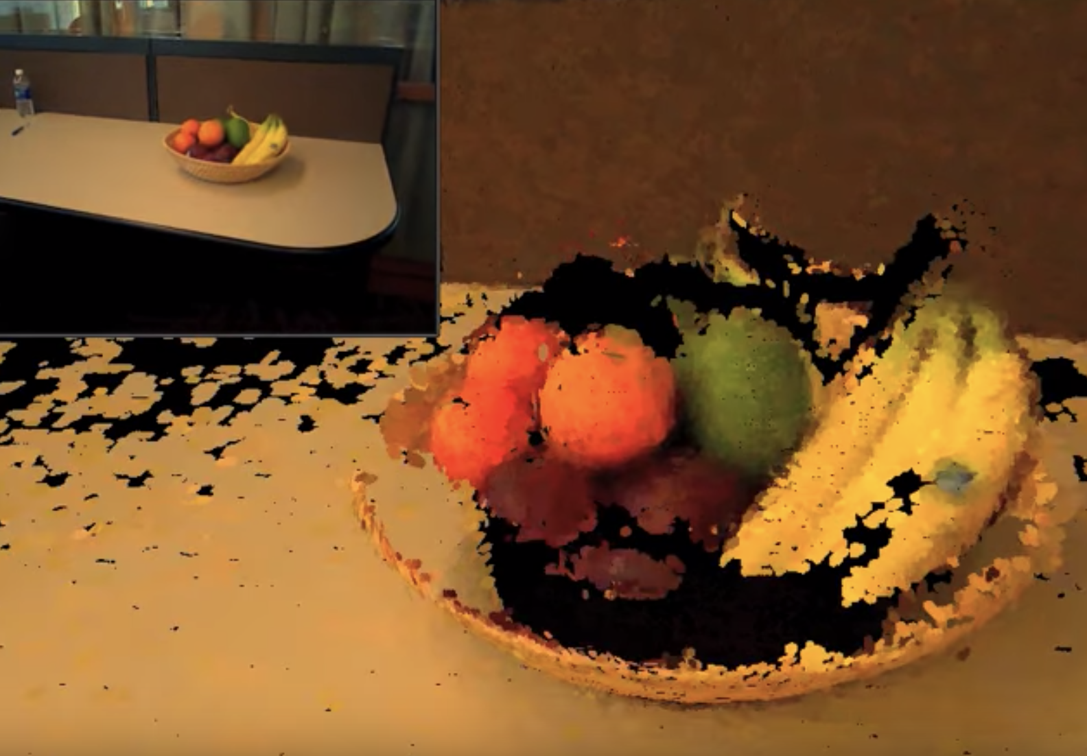
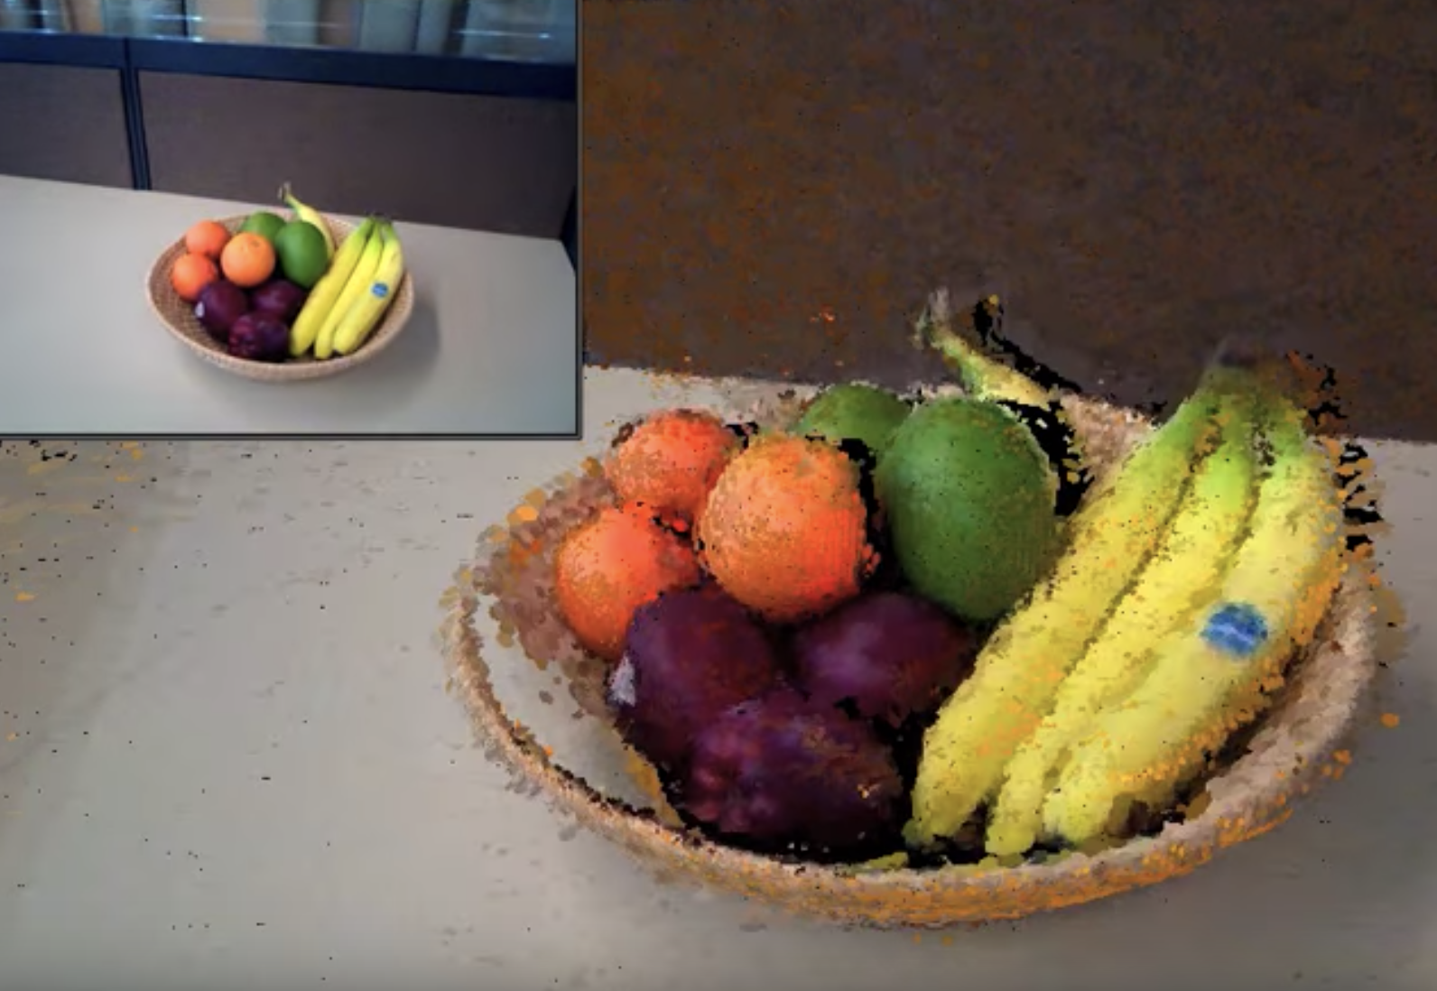
What are Surfels ?
Surfel : Surface :: Pixel : Picture
Primitives without explicit connectivity
Surfel attributes:
Depth
Texture
Normal
Others

Slide 7
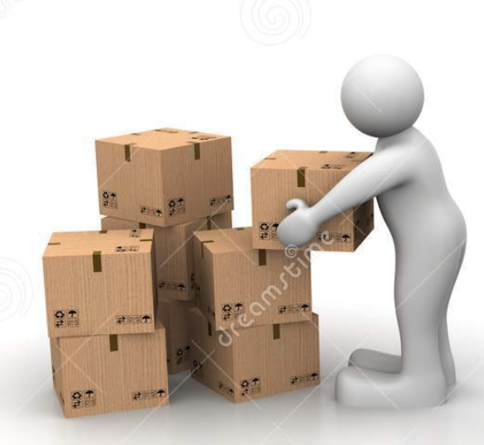
SemanticFusion - Components
Real-time SLAM:
Provide 2D to 3D correspondence.
Provide a map.
CNN:
Gives pixelwise class probabilities for RGB-D images.
Deconvolutional Semantic Segmentation network architecture proposed by Noh et. al. [17].
Bayesian update scheme:
Tracks the class probability distribution of each surfel.
Uses SLAM correspondence to update probabilities based on CNN predictions.

Slide 8
SLAM - Tracking
To yield new camera pose T_{WC} , tracking is done by combining
ICP – Geometric method.
RGB Alignment – Photometric method.
New surfels are added to the map using the pose.
Existing surfels are refined.
Map is optimized when a loop closure is detected.

Slide 9
SLAM - Tracking
Each Surfel consists of : Position, normal, color, radius, last updated time.
Threshold time ‘t’ : Surfels last updated before t are considered inactive and wont be used for pose estimation and depth map fusion.

Slide 10
SLAM - Tracking
Geometric pose:
Photometric pose:
Joint optimization:
w_{rgb} = 0.1

Slide 11
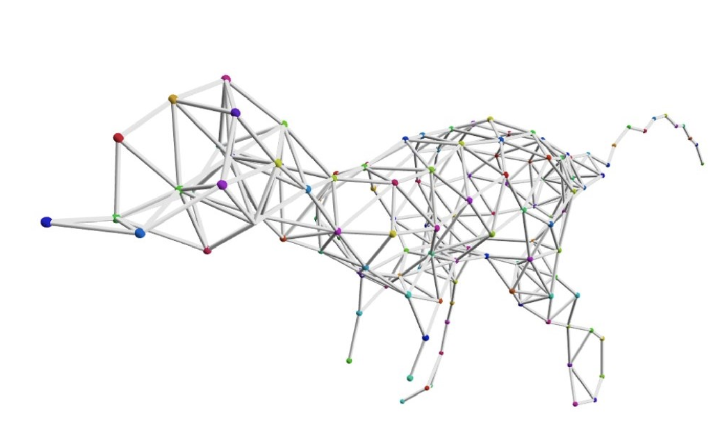
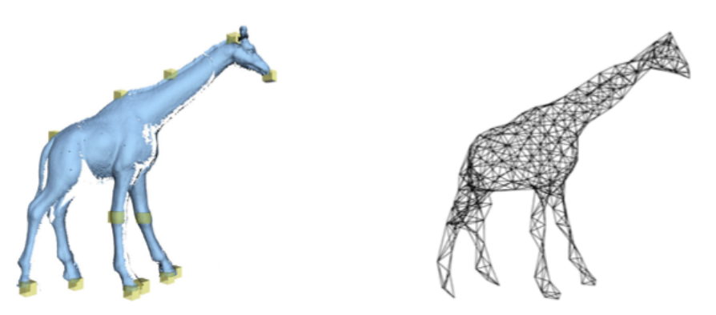
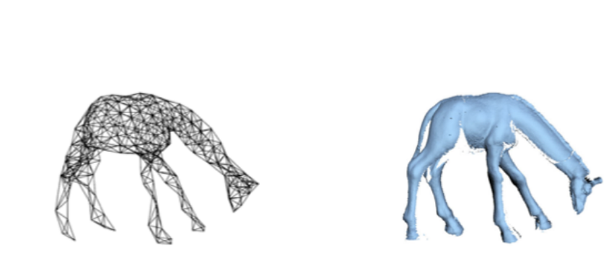
Deformation Graph
Space is discretized as a graph.
Edges between nodes which influence.
Constraints applied on nodes.

Slide 12
Deformation Graph in ElasticFusion
Surfels are the nodes. A surfel has 4 surfels which influence it.
The influencers are the surfels closest to it temporally.
Each surfel’s position is deformed by:
Normals are updated as follows
Each neighbor is assigned a weight
based on Euclidean distance.

Slide 13
Deformation Graph Optimization
Given a set of surface correspondences, parameters of deformation graph are optimized by the following equations.
Maximizing rigidity :
Smooth deformation across graph
Minimizers error on constraints
Pin inactive areas

Slide 14
Loop Closures
Local loop closure ensures locally consistent maps.
Find match between active and inactive surfels using tracking techniques.
Deformation is carried out, if the match is good enough.
Constraints are generated.
Global loop closure.
Randomized fern encoding approach for appearance based place recognition.
Encoding contains RGB, depth, pose, initialization time.
If a match is found, registration is performed using tracking and constraints are generated to deform the map.

Slide 15
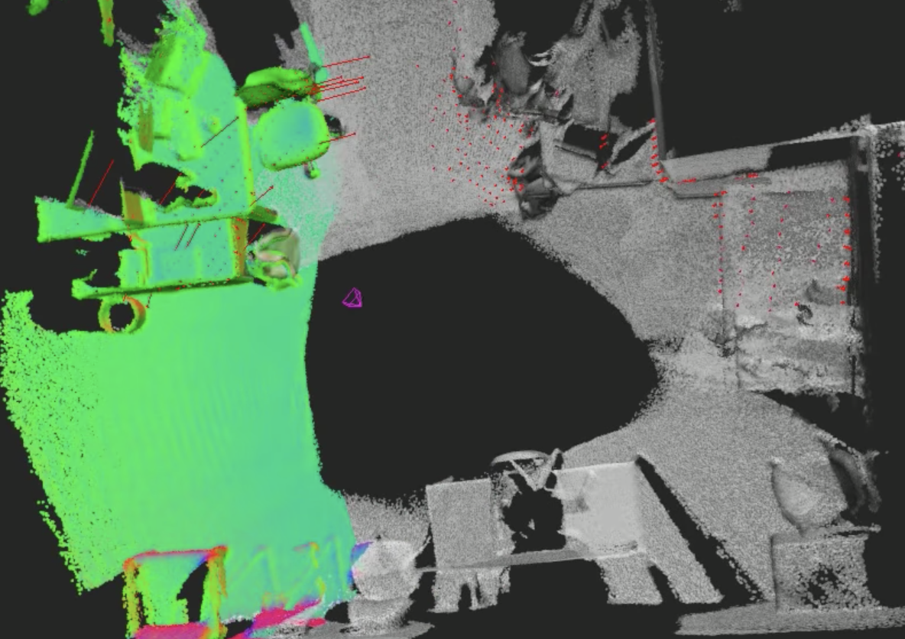
Global loop closure

Slide 16
CNN Architecture
Modified network to accept Depth data as well in the 4th channel.
Depth filters in the network were initialized to average of RGB filters.
Lacks of training datasets with depth modality.
Converted 0-255 to 0 – 8m by multiplying it with 32.

Slide 17
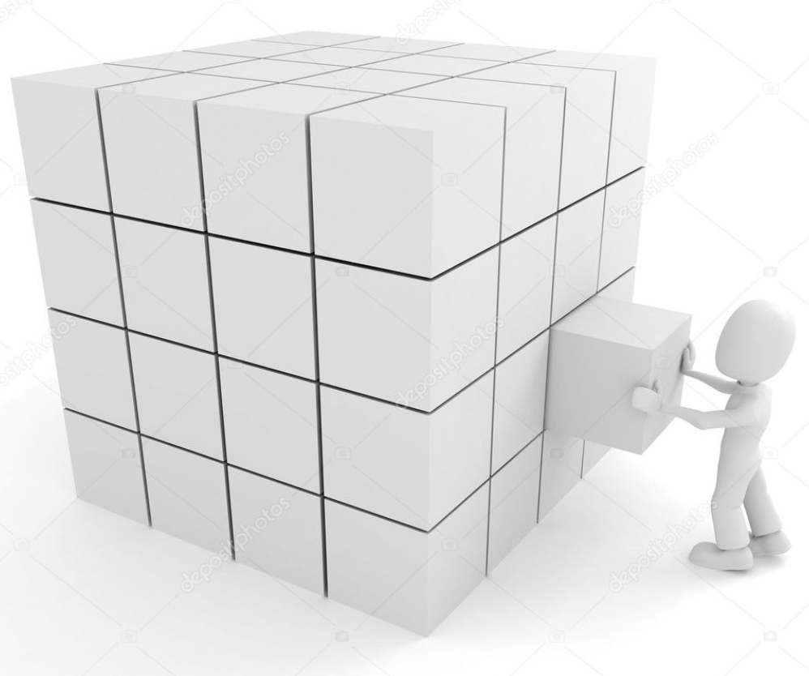
Semantic Label Fusion
Each surfel stores a discrete probability distribution over the class labels.
Initialized uniformly.
P( O_{u} = l_{i} | I_{k} ) , probability distribution for ‘u’ pixel in ‘k’ image.
Using the pose, we update the probability distribution of a surfel.
For every surfel at a given 3D location, pixel co-ordinates are calculated using the pose matrix.
SLAM correspondences allow the fusing of label hypothesis from multiple images in a Bayesian way.

Slide 18
Map Regularization
Use map geometry to regularize predications using fully connected CRF with Gaussian edge potentials to surfels.
CRF predicts a label by taking into account the context ( Neighbors ).
CRF is used to incrementally update the probability distributions.
Minimize the Gibbs energy of a labelling x in a fully connected graph for each surfel.
Each surfel is a node.

Slide 19
Experiments
Network Training
SGD with a learning rate of 0.01, momentum 0.9 and weight decay 5 x 10⁻⁴
After 10k iterations learning rate was 0.001, mini batch size of 64.
Trained in total for 20k iterations.
Reconstruction dataset
NYUv2 doesn’t have a dataset representative of a scanning motion.
Created a new RGBD dataset with loopy motion, both locally and globally.
Annotate the model using a 3D tool, surfels were annotated and labels for 2D frames were generated by projection.
CNN and CRF update frequency
Prediction was done was on every 10th frame. Acc : 49 – 51 %, Freq : 25 Hz

Slide 20
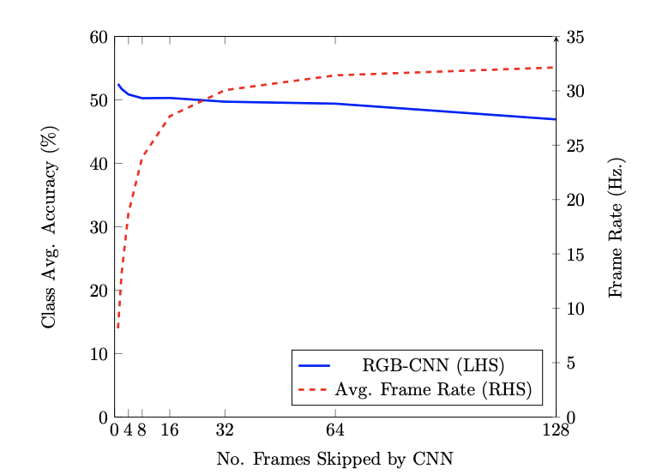
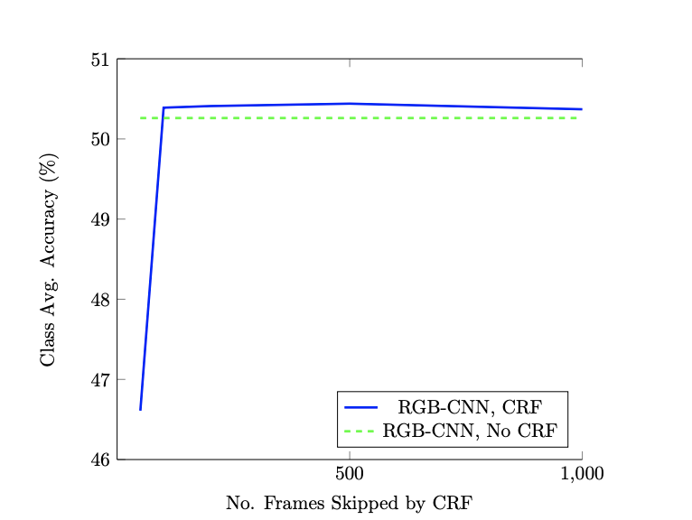
Accuracy
Semantically fusing predictions from different views was better than single frame predictions.

Slide 21
Performance

Slide 22
Performance

Slide 23
Conclusions
Using a SLAM system to provide pixel-wise correspondences between frames allows the fusion of per-frame 2D segmentations into a coherent 3D semantic map.
Incorporation of such a map led to a significant improvement in the corresponding 2D segmentation accuracy.
Viewpoint variation in the frames provide better results.
Our own reconstruction-focused dataset shows a much larger improvement in labelling accuracy via fusion than the NYU dataset with less varied trajectories.

Slide 24
Thank you !
Video

