Slide 1
Data Dreaming for
Object Detection
Paper by Maximilian Sieb, Katerina Fragkiadaki
Presented by Cindy Le
Original paper can be found at https://www.cs.cmu.edu/~katef/papers/datadreamHumanoids2018.pdf

Slide 2
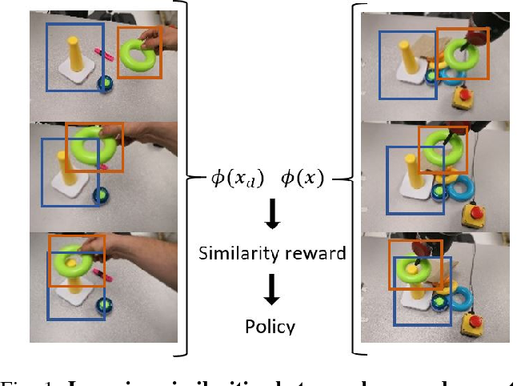
Introduction
Imitation learning allows robots to acquire manipulation skills from human demonstrations.
The simplest way is through human demonstration.
The key problem is defining what it means for manipulations to be similar.
Fig. 1: Learning similarities between human demonstration and robot trials.

Slide 3
Previous Works
Visual imitation learning
has been considered an integral part in the field of robotics.
mostly have additional assumptions, such as that demonstrations are given in the workspace of the agent and the actions/decisions of the demonstrator can be imitated directly.
T. Zhang, Z. McCarthy, O. Jow, D. Lee, K. Goldberg, and P. Abbeel. Deep imitation learning for complex manipulation tasks from virtual reality teleoperation. CoRR, abs/1710.04615, 2017.
A. Y. Ng and S. J. Russell. Algorithms for inverse reinforcement learning. In Proceedings of the Seventeenth International Conference on Machine Learning, ICML ’00, pages 663–670, San Francisco, CA, USA, 2000. Morgan Kaufmann Publishers Inc.
Synthetic data augmentation
has been very successful in multiple machine perception tasks.
G. Ghiasi, Y. Yang, D. Ramanan, and C. Fowlkes. Parsing occluded people. In CVPR, 2014.

Slide 4
Problem Statement
To learn a policy that imitates a human based on a single demonstration of a manipulation task.
A reinforcement learning problem wherein the robot is given a reward based on the similarity between the visual observations x resulting from its execution of the task, and the visual observations xd obtained during the human’s visual demonstration of the task.

Slide 5
The Reward Function for Reinforcement Learning
φ: a function that maps the observation x into a latent embedding space in which high perceptual similarity between visual frames is demonstrated as small Euclidean distance between their corresponding feature embeddings; to be learned.
A smooth version of the L1-Loss, and is less sensitive towards outliers than the L2-Loss.

Slide 6
Methodology

Slide 7
Object Detection
Obtain ground truth masks through background subtraction.
Collect human demonstrations and detect bounding boxes of all relevant objects.
Use fine-tune Mask R-CNN to predict the synthetically generated object labels, namely masks and bounding boxes.

Slide 8
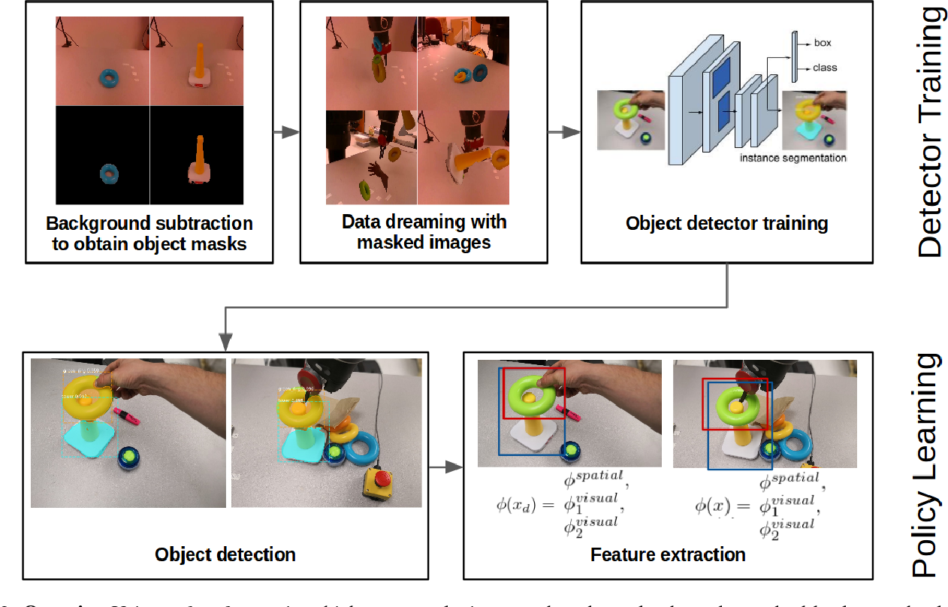
Object Detection via Data Dreaming
Create a large synthetic dataset by translating, scaling, rotating and changing the pixel intensity of RGB masks of the objects in the scene.

Slide 9
Object-Centric Appearance Feature Learning
The 3D position of the object is given by the centroid of the X, Y, Z point cloud.
An Intel RealSense camera provides the robot with Cartesian X, Y, and Z coordinates for each pixel in the RGB-D image.
Learn a feature mapping that pulls temporally close RGB frames together in the embedding space, and pushes temporally far frames away from each other.
Temporally close neighbors in each object tube are closer to each other in the embedding space than any temporally distant pair of boxes within the same object tube.
Train the network on multiple views of the human demonstration.
Feed the depth as a separate input channel into the network.

Slide 10
Policy Learning from Demonstration
Given the reward function (shown in a previous slide), we learn a policy for imitating the demonstrated manipulation using PILQR.
The input to the policy consists of the joint angles, end- effector position, the object location and appearance features.
Learn a separate time-dependent policy for each set of objects and initial object locations.
For more detail about PILQR, please refer to: Y. Chebotar, K. Hausman, M. Zhang, G. Sukhatme, S. Schaal, and S. Levine. Combining Model-Based and Model-Free Updates for Trajectory-Centric Reinforcement Learning. 2017.

Slide 11
Experiments

Slide 12
Questions to be answered by experiments
How much does the proposed object-centric RGB encoding benefit reward shaping over frame-centric feature encodings of previous works?
How well do appearance and location features contribute to reward shaping?
How much does the proposed object-centric RGB encoding benefit policy learning for sample efficient visual imitation over previous alternatives?

Slide 13
Task 1
Rotate a cylindrically shaped object around one of its principal axis.

Slide 14
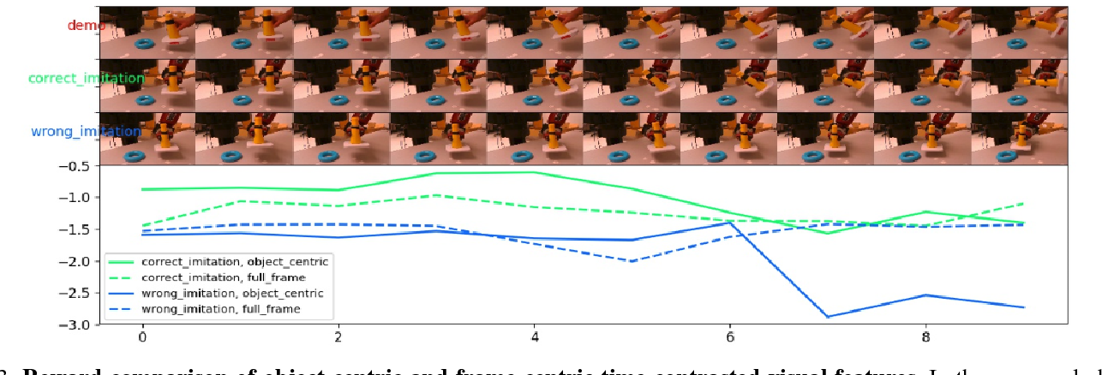
Result 1 - reward shaping
Fig. 3: Reward comparison of object-centric and frame-centric time-contrasted visual features. In the proposed object-centric feature representation, while the robot’s correct execution is attributed with a high reward, wrong execution is penalized heavily. Frame-centric features cannot discriminate between correct and wrong execution. Note that the robot’s hand has not been seen at all during training time.

Slide 15
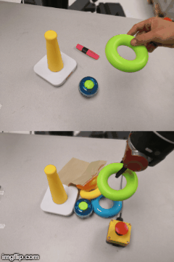
Task 2
Ring-on-Tower: The robot needs to learn how to put a ring on top of a cylindrical tower given a human demonstration.

Slide 16
Result 2 - reward shaping
Fig. 4: Reward comparison of spatial arrangement features. The reward decreases once the ring is not stacked on top of the tower. The reward also generalizes well to a ring of different color and smaller size.

Slide 17
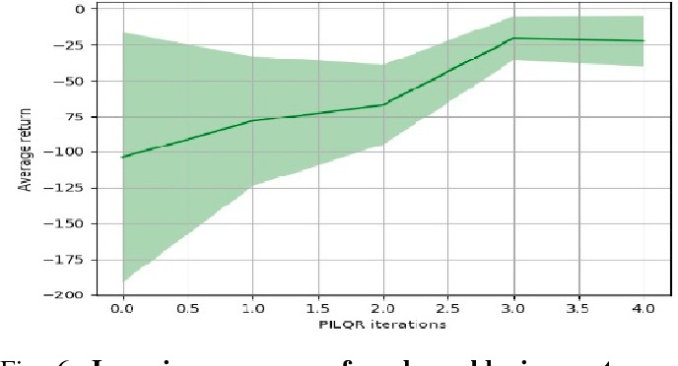
Result 2 - policy learning
Fig. 6: Learning progress of real world ring-on-tower task. We see that the robot quickly learns to imitate the demonstrated behaviour. Note that the reward does not converge to zero since the robot does not start in the exact same initial position as the learner and is therefore not able to perfectly match the entire object trajectory for all time steps.

Slide 18
Task 3
Block-on-Block: The robot needs to learn how to stack a cube onto another cube given a video of a VR demonstration of the robot agent.

Slide 19
Result 3 - policy learning
Fig. 7: Average success rate of block-on-block task. The robot learns to stack the block for both our method and the blob detector baseline. It fails to do so for the TCN baseline. Our method imitates the original trajectory more closely due to to higher precision of the trained object detector.

Slide 20
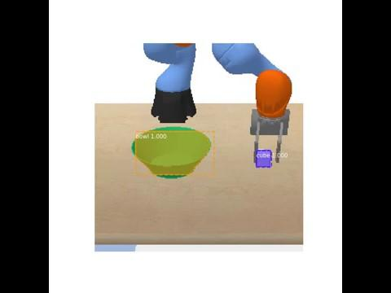
Policy learning - task 3
Block-in-Bowl: The robot needs to learn how to place a cube inside a bowl given a video of a VR demonstration of the robot agent.

Slide 21
Policy learning - results 3
Fig. 8: Average success rate of block-in-bowl task with occluders. The robot learns to place the block into the bowl for both our method and the blob detector baseline. It fails to do so for the TCN baseline. Due to the occlusions introduced into the setup, the blob detector shows much more variance because the detections are further off with respect to the ground truth state compared to our trained object detector.

Slide 22
Conclusion

Slide 23
Conclusion
The learned state representation encodes how the relevant objects are arranged in the scene, and how the state of the objects changes during the manipulation.
The features are learned in an efficient manner by training state-of-the-art object detector architectures using dreamed data by augmenting object RGB-masks obtained automatically through background subtraction.
Showed the effectiveness of the learned state representation by employing it on a trajectory optimization method and showed a Baxter robot could learn a task within a few minutes using a single demonstration.

Slide 24
Limitations
It cannot handle full object occlusions.
Rely on per-frame object detections provided by our iterative data dreaming and tracking-by-detection.
The within-object appearance features are far less discriminative of task completion than the cross-object spatial features.
Future directions include end-to-end visual object tracking in manipulation environments and multiscale entity graphs.

