Slide 1
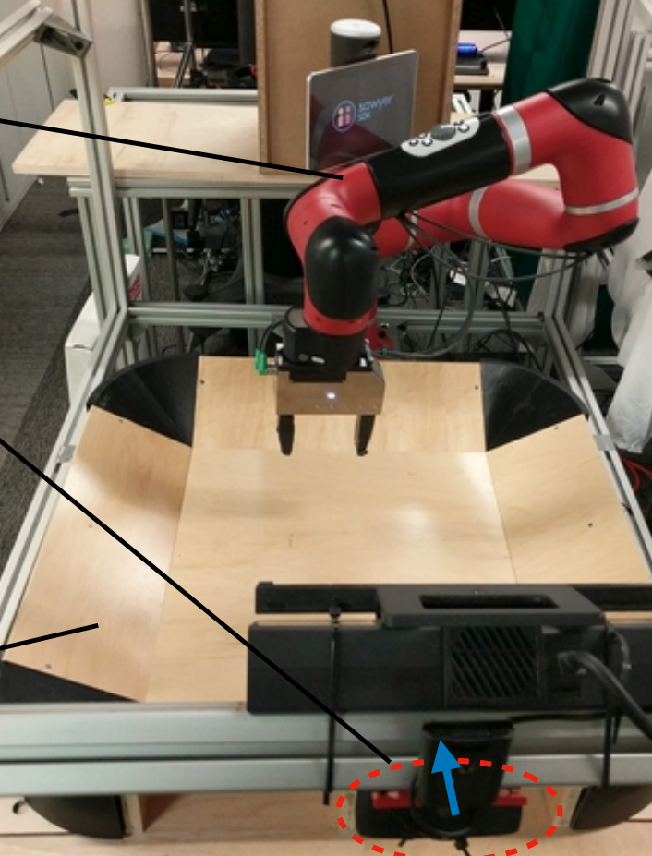
Visual Foresight: Model-Based Deep Reinforcement Learning for Vision-Based Robotic Control
Authors: Frederik Ebert*, Chelsea Finn*, Sudeep Dasari, Annie Xie, Alex Lee, Sergey Levine | Published December 2018
Presented By:
Jerry Zhang
UNI: jz2977
COMS6731: Humanoid Robotics Student Talk
Professor Peter Allen
Paper Link: https://arxiv.org/pdf/1812.00568.pdf

Slide 2
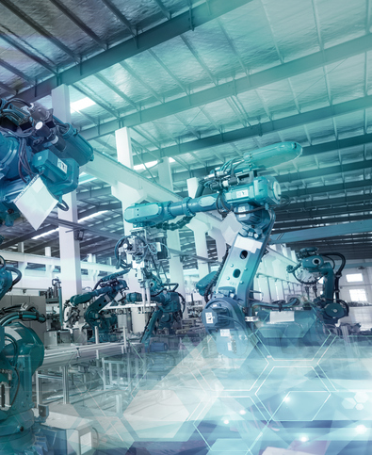
1
Project Overview
2
Visual Model Predictive Control
AGENDA
3
Cost Functions
4
Results
5
Discussion

Slide 3
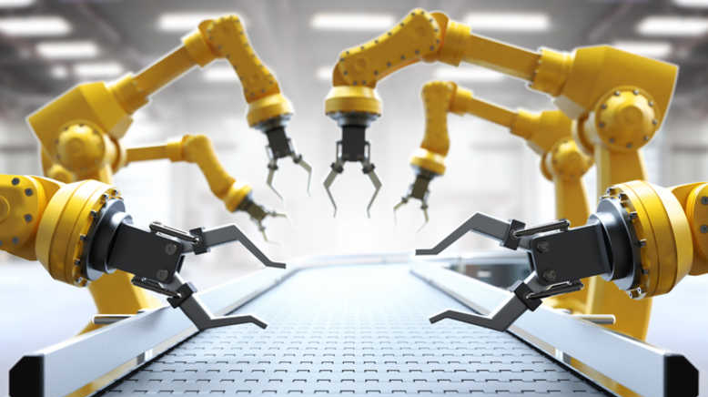
Project Overview

Slide 4
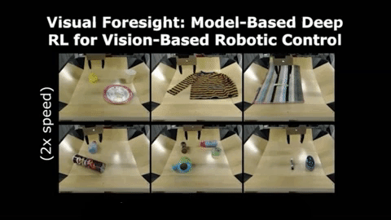
_______________________________________________________
PURPOSE
To present a novel deep reinforcement learning method for real-world robotics applications (e.g robotic manipulation) that generalizes effectively to new tasks and objects.
Enable a robot to perform a range of object manipulation tasks from raw pixel observations
Project Overview | Theory | Approach | Results | Next Steps
Notes:
Deep reinforcement learning (RL) algorithms can learn complex robotic skills from raw sensory inputs, but have yet to achieve the kind of broad generalization and applicability demonstrated by deep learning methods in supervised domains. We present a deep RL method that is practical for real-world robotics tasks, such as robotic manipulation, and generalizes effectively to never-before-seen tasks and objects. In these settings, ground truth reward signals are typically unavailable, and we therefore propose a self-supervised model-based approach, where a predictive model learns to directly predict the future from raw sensory readings, such as camera images. At test time, we explore three distinct goal specification methods: designated pixels, where a user specifies desired object manipulation tasks by selecting particular pixels in an image and corresponding goal positions, goal images, where the desired goal state is specified with an image, and image classifiers, which define spaces of goal states. Our deep predictive models are trained using data collected autonomously and continuously by a robot interacting with hundreds of objects, without human supervision. We demonstrate that visual MPC can generalize to never-before-seen objects—both rigid and deformable—and solve a range of user-defined object manipulation tasks using the same model.
. Learning a model to predict the future, and then using this model to act, falls under the general umbrella of model-based reinforcement learning
However, model-based RL methods that directly operate on raw image frames have not been studied as extensively

Slide 5
OVERVIEW: Video Model Predictive Control (Visual MPC)
_______________________________________________________________________________________
Def: a model-based reinforcement learning approach to end-to-end learning of robotic manipulation
Three Phase Approach
Unsupervised Data Collection
Model Training
Test Time Control
Project Overview | Theory | Approach | Results | Next Steps
Notes:
(top) At training time, interaction data is collected autonomously and used to train a video-prediction model.
(bottom) At test time, this model is used for sampling-based planning. In this work we discuss three different choices for the planning objective.
They describe deep NN architectures that are effective for predicting pixel level observations amid occlusions and with novel objects
. Learning a model to predict the future, and then using this model to act, falls under the general umbrella of model-based reinforcement learning
However, model-based RL methods that directly operate on raw image frames have not been studied as extensively

Slide 6
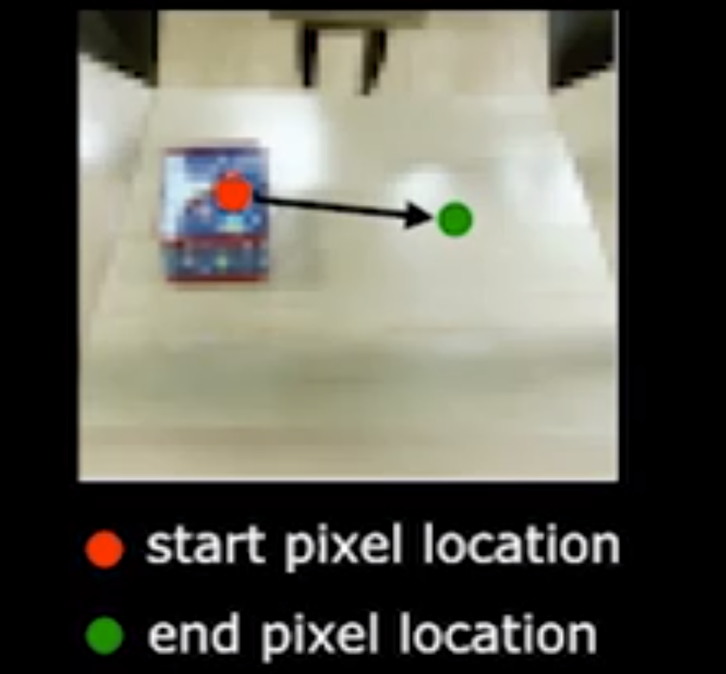
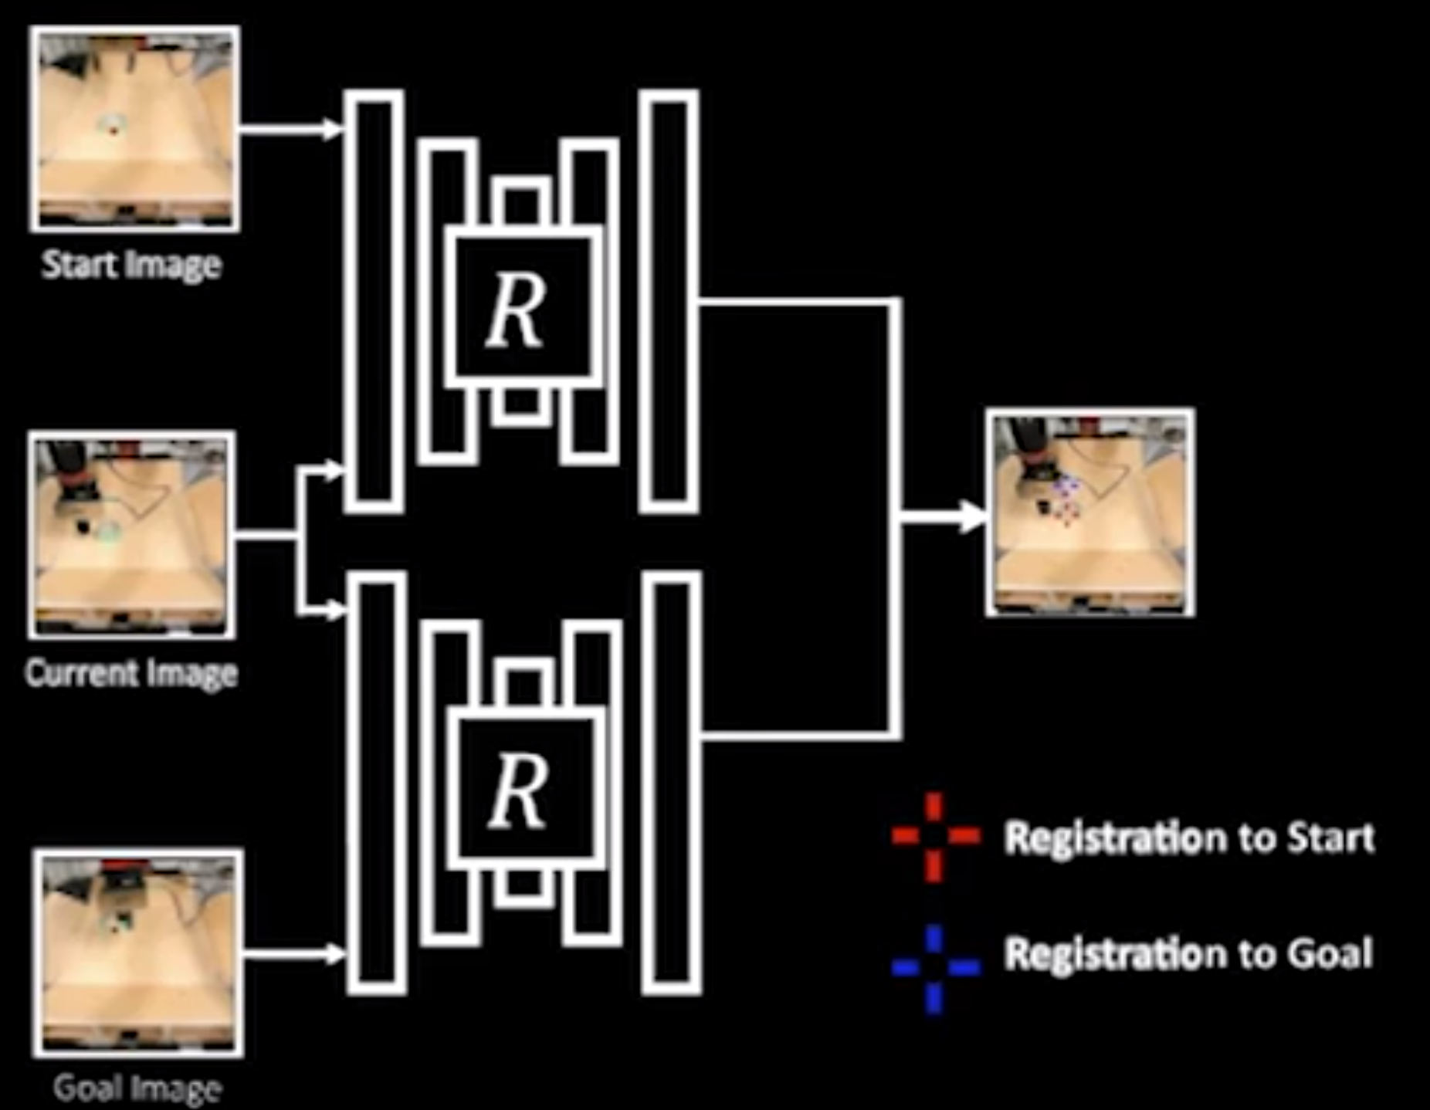
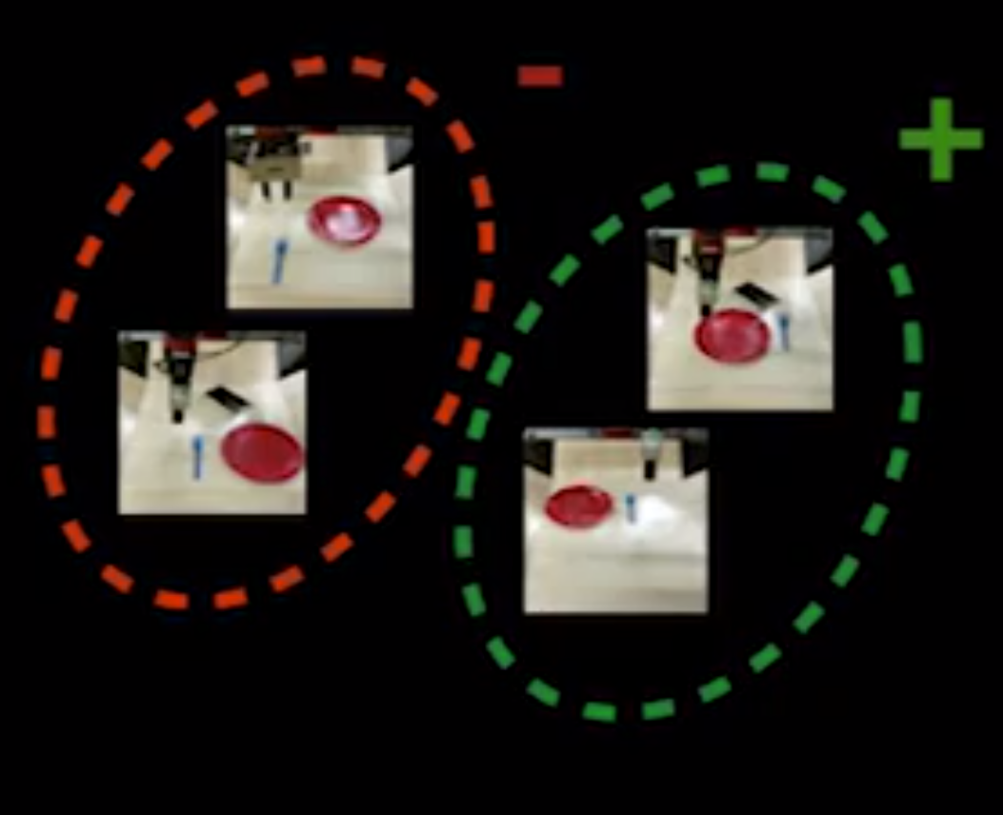
OVERVIEW: Cost Functions
_______________________________________________________________________________________
Methods to evaluate and specify progress/goals of robotic experiments
1. Pixel Distance Cost 2. Registration Based Cost 3. Classifier Based Cost
Project Overview | Theory | Approach | Results | Next Steps
Notes:
Designated Pixels
where a user specifies desired object manipulation tasks by selecting particular pixels in an image and corresponding goal positions
Goal Images
where the desired goal state is specified with an image
Image Classifiers
which define spaces of goal states

Slide 7
_______________________________________________________
Manipulation of previously unseen objects
Handling multiple objects
Pushing objects around obstructions
Handling clutter
Manipulating deformable objects such as cloth
Recovering from larger perturbations
Grasping and maneuvering objects to user-specified locations in 3D-Space
Experiments
Project Overview | Theory | Materials + Methods | Results | Next Steps

Slide 8
_______________________________________________________
RESULTS
A visual model predictive controller can generalize* to never-before-seen objects—both rigid and deformable*—and solve a range of user-defined object manipulation tasks using the same model.
*with many clear limitations
Purpose | Theory | Materials + Methods | Results | Next Steps

Slide 9
_______________________________________________________
Related Works
Model Based Reinforcement Learning:
M. Zhang, S. Vikram, L. Smith, P. Abbeel, M. J. Johnson, and S. Levine, “Solar: Deep structured latent representations for model-based reinforcement learning,” arXiv:1808.09105, 2018
C. Finn, X. Y. Tan, Y. Duan, T. Darrell, S. Levine, and P. Abbeel, “Deep spatial autoencoders for visuomotor learning,” in International Conference on Robotics and Automation (ICRA), 2016
Self- Supervised Robotic Learning
S. Levine, P. Pastor, A. Krizhevsky, J. Ibarz, and D. Quillen, “Learning hand-eye coordination for robotic grasping with deep learning and large-scale data collection,” International Journal of Robotics Research (IJRR), 2016
L. Pinto and A. Gupta, “Supersizing self-supervision: Learning to grasp from 50k tries and 700 robot hours,” in International Conference on Robotics and Automation (ICRA), 2016.
Sensory Prediction Models
J. T. Betts, “Survey of numerical methods for trajectory optimization,” Journal of guidance, control, and dynamics, 1998.
Optical Flow
T. Zhou, S. Tulsiani, W. Sun, J. Malik, and A. A. Efros, “View synthesis by appearance flow,” in European conference on computer vision, 2016.
S. Meister, J. Hur, and S. Roth, “Unflow: Unsupervised learning of optical flow with a bidirectional census loss,” arXiv:1711.07837, 2017
Purpose | Theory | Materials + Methods | Results | Next Steps

Slide 10
Visual MPC

Slide 11
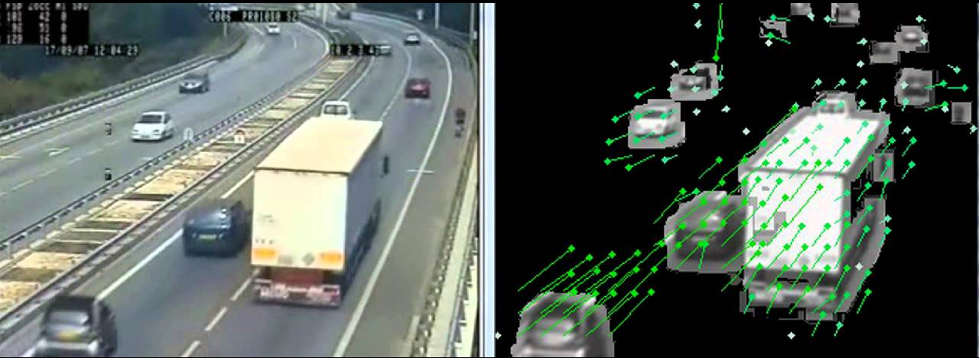
Theory: Optical Flow
____________________________________________________________________________________________________________________
Def: Tracking apparent motion of objects in a video
Assumptions:
Pixel intensities do not rapidly change between consecutive frames
Groups of pixels move together
Optical Flow Field
Vector field in a plane that can be visualized as a collection of arrows with given magnitude and direction corresponding to tracking objects between video frames
Project Overview | Theory | Materials + Methods | Results | Next Steps

Slide 12
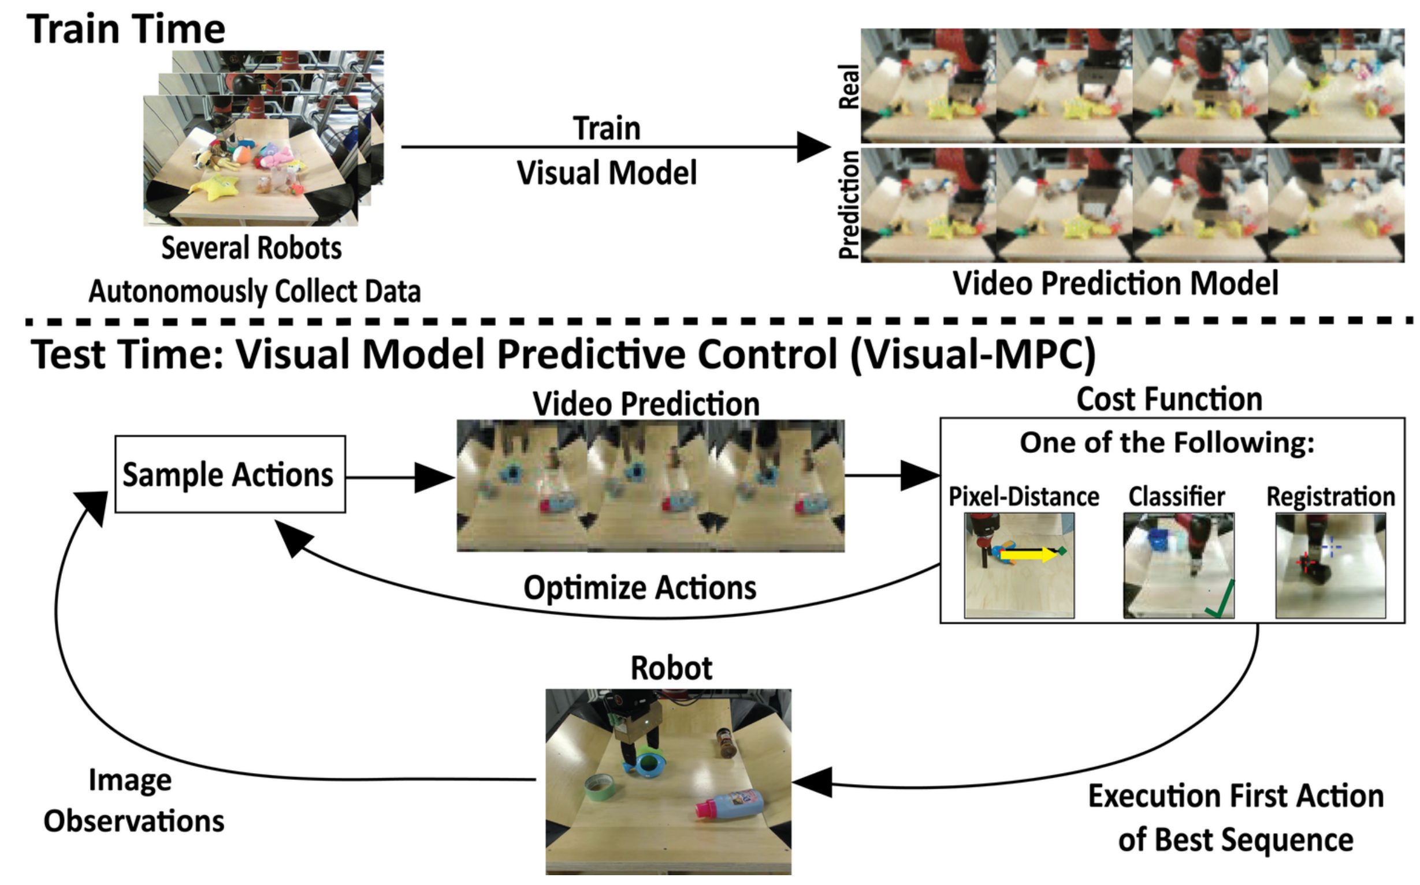
3 Phases of Visual MPC
____________________________________________________________________________________________________________________
Unsupervised Data Collection
At training time, data is collected autonomously by applying random actions sampled from a pre-specified distribution. It is important that this distribution allows the robot to visit parts of the state space that are relevant for solving the intended tasks.
2. Model Training
Also during training time, we train a video prediction model on the collected data. The model takes as input an image of the current timestep and a sequence of actions, and generates the corresponding sequence of future frames.
3. Test Time Control
We use a sampling-based, gradient free optimization procedure to find the sequence of actions that minimizes a cost function
Project Overview | Visual MPC | Cost Functions | Results | Discussion

Slide 13
Unsupervised Data Collection
____________________________________________________________________________________________________________________
Data is collected autonomously by applying random actions sampled from a pre-specified distribution.
Collected 20,000 trajectories of pushing motions and 15,000 trajectories with gripper control, where the robot randomly picks and moves objects using the grasping reflex
The data collection process is fully autonomous, requiring human intervention only to change out the objects in front of the robot.
The action space consisted of relative movements of the end-effector in cartesian space along the x, y, and z axes, and for some parts of the dataset we also added azimuthal rotations of the gripper and a grasping action.
Project Overview | Visual MPC | Cost Functions | Results | Discussion
Notes:
It is important that this distribution allows the robot to visit parts of the state space that are relevant for solving the intended tasks
To train both our video-prediction and registration models, we ….

Slide 14
Model Training | RNN Structure
____________________________________________________________________________________________________________________
Project Overview | Visual MPC | Cost Functions | Results | Discussion
Notes:
The model, which is implemented as a recurrent neural network (RNN) gθ parameterized by θ, has a hidden state ht and takes in a previous image and an action at each step of the rollout. Future images ˆIt+1 are generated by warping the previous generated image ˆIt or the previous true image It, when available, according to a 2-dimensional flow field Fˆ t+1←t. A simplified illustration of model’s structure is given in the figure. It is also summarized in the following two equations
In the EQ. the bilinear sampling operator interpolates the pixel values bilinearly with respect to a location (x, y) and its four neighbouring pixels in the image
the first time-step the real image is transformed, whereas at later timesteps previously generated images are transformed in order to generate multi-frame predictions. The model is trained with gradient descent on a l2 image reconstruction loss, denoted by L

Slide 15
Forward Pass of Recurrent SNA model
____________________________________________________________________________________________________________________
Project Overview | Visual MPC | Cost Functions | Results | Discussion
Notes:
A forward pass of the RNN is illustrated
We use a series of stacked convolutional LSTMs and standard convolutional layers interleaved with average-pooling and upsampling layers. The result of this computation is the 2 dimensional flow-field Fˆ t+1←t which is used to transform a current image It or ˆIt. M
Skip connection neural advection model. To enable effective tracking of objects through occlusions, we can add temporal skip connections to the model: we now transform pixels not only from the previously generated image ˆIt, but from all previous images ˆI1, ... ˆIt, including the context image I0, which is a real image. All these transformed images can be combined to a form the predicted image ˆIt+1 by taking a weighted sum over all transformed images, where the weights are given by masks Mt with the same size as the image and a single channel

Slide 16
Cost Functions

Slide 17
Video Prediction For Control
____________________________________________________________________________________________________________________
Project Overview | Visual MPC | Cost Functions | Results | Discussion

Slide 18
Planning Cost Functions
____________________________________________________________________________________________________________________
Pixel Distance Cost Registration Based Cost Classifier Based Cost
Project Overview | Visual MPC | Cost Functions | Results | Discussion

Slide 19
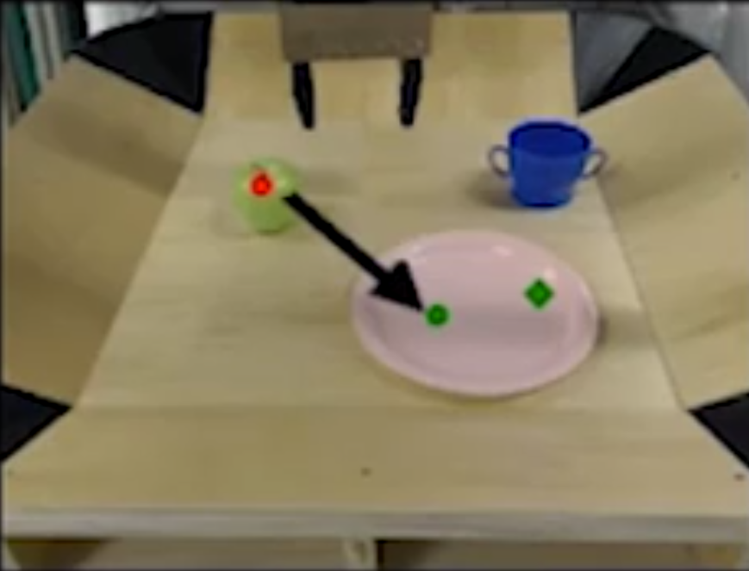
Pixel Distance Cost
____________________________________________________________________________________________________________________
Starting pixel location
Ending pixel location
Common Failure Mode: Execution will fail if actions do not go according to plan, because system is not tracking the object
Project Overview | Visual MPC | Cost Functions | Results | Discussion
Notes:
A convenient way to define a robot task is by choosing one or more designated pixels in the robot’s camera view and choosing a destination where each pixel should be moved. For example, the user might select a pixel on an object and ask the robot to move it 10 cm to the left

Slide 20
Pixel Distance Cost
____________________________________________________________________________________________________________________
Given distribution over pixel positions, $P_{0}$
Model predicts distributions over its positions $P_{t}$ at time $t∈\{1,….,T \}$
$$c=\sum_{t=1,…, T}{c_{t} }= \sum_{T=1,…,T}{𝔼_{{\hat{d}}_{t}\sim P_{t}}\left[{\left\|{\hat{d}}_{t} −d_{g}\right\|}_{2}\right]}$$
$$c:total cost$$
$$c_{t}:cost per time step$$
$$d_{t}:distance at time t$$
$$d_{g}:distance to goal point$$
Project Overview | Visual MPC | Cost Functions | Results | Discussion

Slide 21
Registration Based Cost
____________________________________________________________________________________________________________________
Allows robot to keep track of how the current scene relates to the initial and goal scenes
Thus allows imperfect controllers to retry the task until it succeeds
Project Overview | Visual MPC | Cost Functions | Results | Discussion

Slide 22
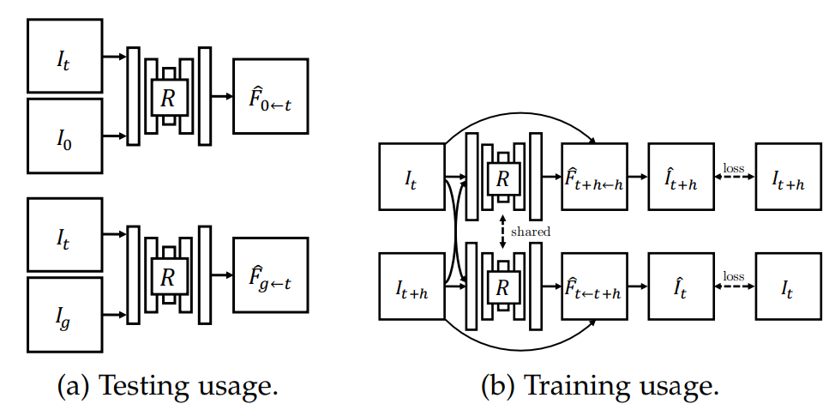
Registration Based Cost
____________________________________________________________________________________________________________________
At test time the registration network registers the current image It to the start image I0 (top) and goal image Ig (bottom), inferring the flow-fields ${\hat{F}}_{0←t}$ and ${\hat{F}}_{g←t}$
The registration network is trained by warping images from randomly selected timesteps along a trajectory to each other.
Project Overview | Visual MPC | Cost Functions | Results | Discussion
Notes:
During Testing, separately register the current image It to the start image I0 and to the goal image Ig by passing it into the registration network R, implemented as a fully-convolutional neural network
For training, two images are sampled at random times steps t and t + h along the trajectory and the images are warped to each other in both directions.
The network, which outputs Fˆ t←t+h and Fˆ t+h←t, is trained to minimize the photometric distance
between ˆIt and It and ˆIt+h and It+h, in addition to a smoothness regularizer that penalizes abrupt changes in the outputted flow-field
The network R is implemented as a fully convolutional network taking in two images stacked along the channel dimension

Slide 23
Registration Based Cost
____________________________________________________________________________________________________________________
A mechanism is proposed to estimate which image is registered correctly, allowing us to utilize only the successful registration for evaluating the planning cost.
This mechanism gives a high weight $λ_{i}$ to pixel distance costs $c_{i}$associated with a designated pixel ${\hat{d}}_{i,t}$ that is tracked successfully and a low, ideally zero, weight to a designated pixel where the registration is poor
Project Overview | Visual MPC | Cost Functions | Results | Discussion

Slide 24
Classifier Based Cost
____________________________________________________________________________________________________________________
Framework for quickly specifying visual goals.
Well-suited for tasks that can be completed in multiple ways.
Ex. for a task of rearranging a pair objects into relative positions, i.e. pushing the first object to the left of the second object, the absolute positions of the objects do not matter nor does the arm position.
A classifier-based cost function allows the planner to discover any of the possible goal states
Project Overview | Visual MPC | Cost Functions | Results | Discussion
Notes:
Framework for quickly specifying visual goals. Our goal classifier is meta-trained with positive and negative examples for diverse tasks (left), which allows it to meta-learn that some factors matter for goals (e.g., relative positions of objects), while some do not (e.g. position of the arm).
At meta-test time, this classifier can learn goals for new tasks from a few of examples of success (right - the goal is to place the fork to the right of the plate). The cost can be derived from the learned goal classifier for use with visual MPC.

Slide 25
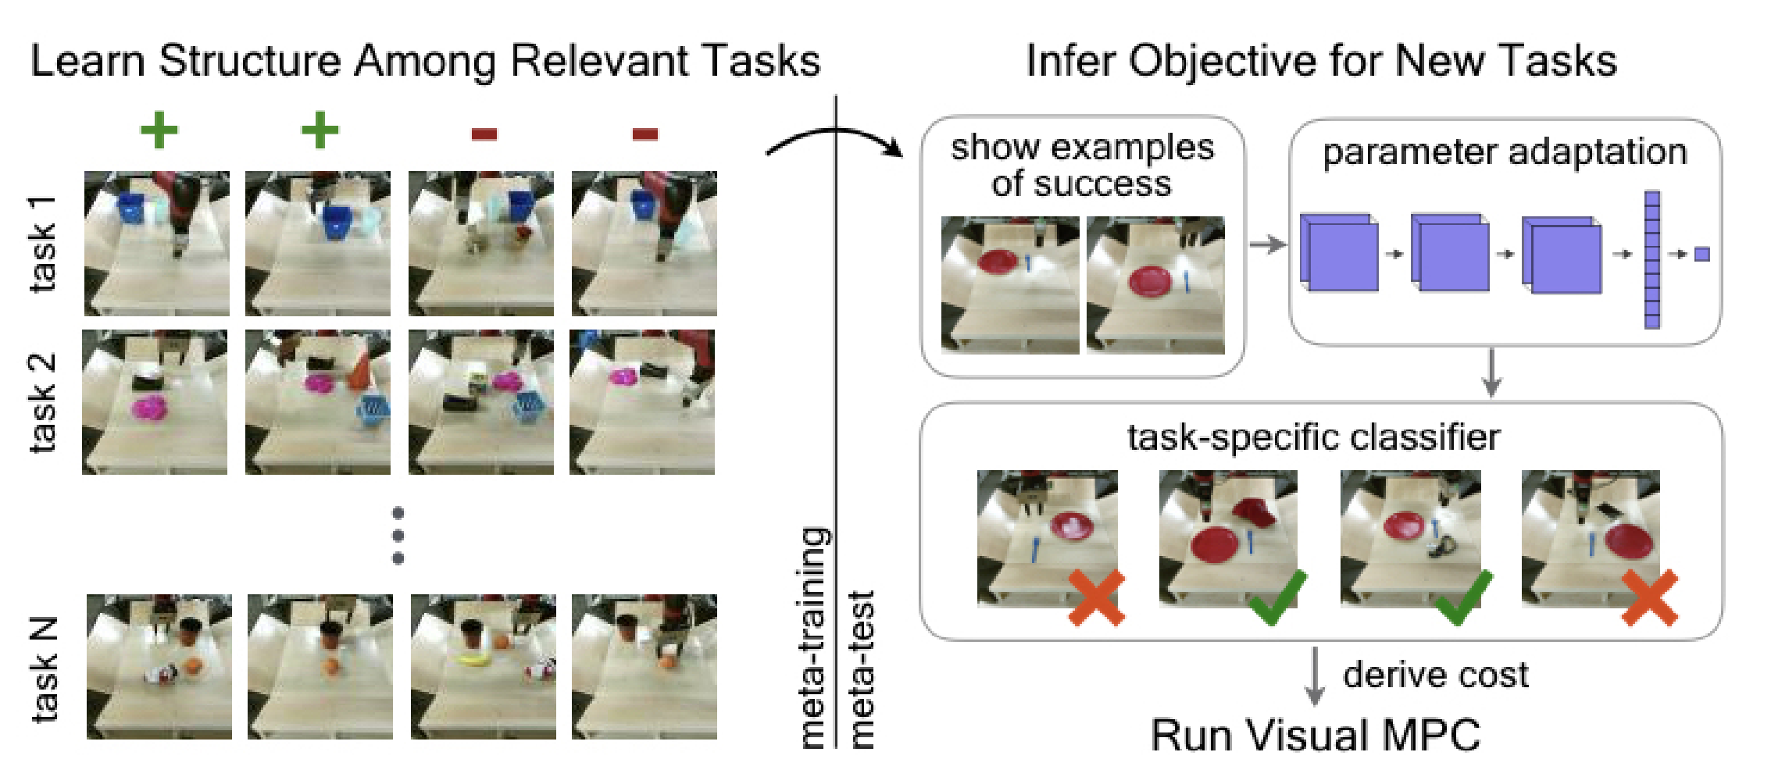
Classifier Based Cost
____________________________________________________________________________________________________________________
Project Overview | Visual MPC | Cost Functions | Results | Discussion
Notes:
Framework for quickly specifying visual goals. Our goal classifier is meta-trained with positive and negative examples for diverse tasks (left), which allows it to meta-learn that some factors matter for goals (e.g., relative positions of objects), while some do not (e.g. position of the arm).
At meta-test time, this classifier can learn goals for new tasks from a few of examples of success (right - the goal is to place the fork to the right of the plate). The cost can be derived from the learned goal classifier for use with visual MPC.
I did not show the equations, but if you’re interested, they use an adam objective optimizer to find the parameters for the classifier during training, and are updated via gradient descent for new tasks during test time
our classifier is represented by a convolutional neural network, consisting of three convolutional layers, each followed by layer normalization and a ReLU non-linearity. After the final convolutional layer, a spatial soft-argmax operation extracts spatial feature points, which are then passed through fully-connected layer

Slide 26
When to use which Cost Function?
____________________________________________________________________________________________________________________
Pixel w/ Registration Cost Function
- When moving objects precisely to target locations
Very robust against clutter/distractor objects as well
Pixel w/o Registration Cost Function
- Used to increase robustness and allow for closed-loop control, so long as an image of the goal can be incorporated
Classifier-based Cost Function
When solving more abstract tasks (ex. When absolute position of object is not relevant)
Project Overview | Visual MPC | Cost Functions | Results | Discussion

Slide 27
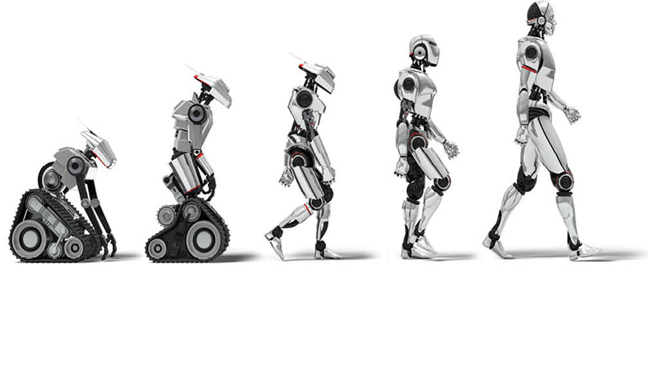
Results

Slide 28
Video Prediction For Control
____________________________________________________________________________________________________________________
Project Overview | Visual MPC | Cost Functions | Results | Discussion

Slide 29
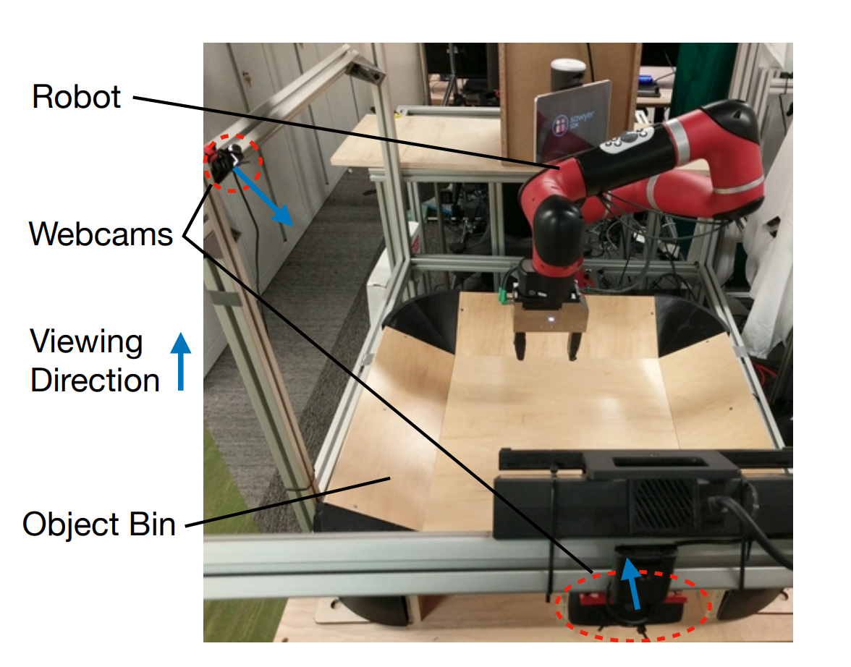
Multi-view Visual MPC
____________________________________________________________________________________________________________________
The visual MPC algorithm as described so far is only able to solve manipulation tasks specified in 2D
We use a combination of two views, taken from two cameras arranged appropriately, to jointly define a 3D task
Project Overview | Visual MPC | Cost Functions | Results | Discussion

Slide 30
Results: Pixel-Based Cost
____________________________________________________________________________________________________________________
Project Overview | Visual MPC | Cost Functions | Results | Discussion

Slide 31
Results: Pixel-Based Cost
____________________________________________________________________________________________________________________
Project Overview | Visual MPC | Cost Functions | Results | Discussion

Slide 32
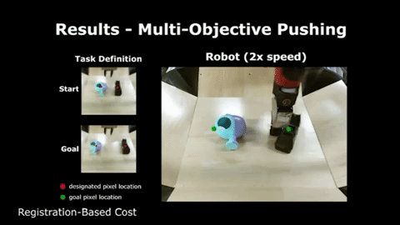
Results: Registration-Based Cost
____________________________________________________________________________________________________________________
Project Overview | Visual MPC | Cost Functions | Results | Discussion

Slide 33
Results: Registration-Based Cost
____________________________________________________________________________________________________________________
Project Overview | Visual MPC | Cost Functions | Results | Discussion

Slide 34
Results: Registration-Based Cost
____________________________________________________________________________________________________________________
Project Overview | Visual MPC | Cost Functions | Results | Discussion

Slide 35
Results: Registration-Based Cost
____________________________________________________________________________________________________________________
Project Overview | Visual MPC | Cost Functions | Results | Discussion

Slide 36
Results: Classifier-Based Cost Function
____________________________________________________________________________________________________________________
Project Overview | Visual MPC | Cost Functions | Results | Discussion

Slide 37
Results: Classifier-Based Cost Function
____________________________________________________________________________________________________________________
Project Overview | Visual MPC | Cost Functions | Results | Discussion

Slide 38
Results: Classifier-Based Cost Function
____________________________________________________________________________________________________________________
Project Overview | Visual MPC | Cost Functions | Results | Discussion

Slide 39
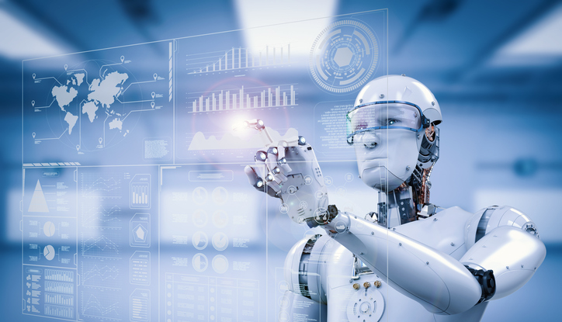
Discussion

Slide 40
Evaluating Registration-Based Cost Functions
____________________________________________________________________________________________________________________
Project Overview | Visual MPC | Cost Functions | Results | Discussion
Notes:
Evaluating Registration-Based Cost Functions
Success rate for long-distance pushing experiment with 20 different object/goal configurations and short-distance experiment with 15 object/goal configurations. Success is defined as bringing the object closer than 15 pixels to the goal, which corresponds to around 7.5cm.

Slide 41
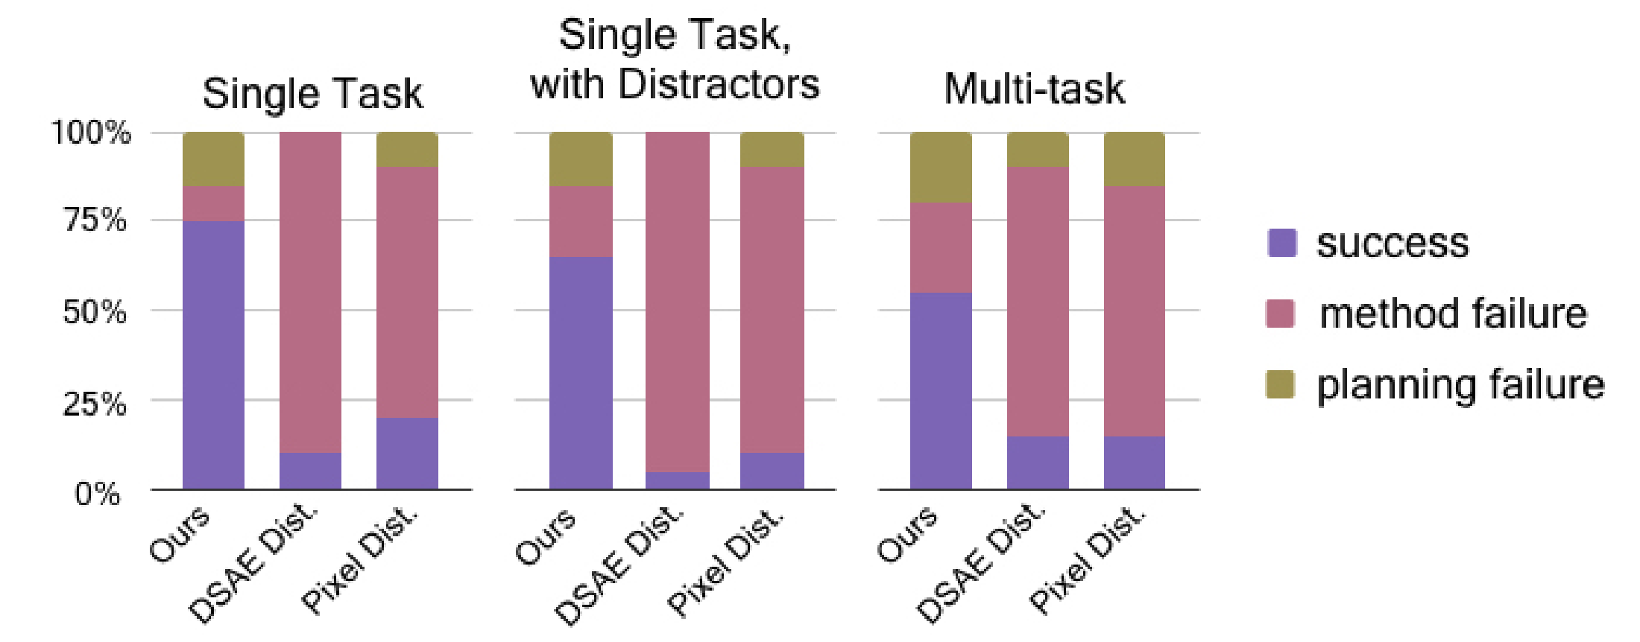
Evaluating Classifier-Based Cost Function
____________________________________________________________________________________________________________________
Project Overview | Visual MPC | Cost Functions | Results | Discussion
Notes:
Quantitative performance of visual planning for object rearrangement tasks across different goal specification methods: our meta-learned classifier, DSAE and pixel error.

Slide 42
Evaluating Multi-Task Performance
__________________________________________________________________________________________________________________
Project Overview | Visual MPC | Cost Functions | Results | Discussion
Notes:
Results for a multi-task experiment of 10 hard object pushing and grasping tasks, along with 6 cloth folding tasks, evaluating using a single model. Values indicate the percentage of trials that ended with the object pixel closer than 15 pixels to the designated goal. Higher is better.

Slide 43
Limitations
____________________________________________________________________________________________________________________
A human input “Binary Token” to tell robot if object is rigid or deformable
Limited action space (minimally structured robotic domain) | x,y,z,azimuthal movement
No general motion, no robotic manipulation framework (only uses primitive reflex grasp)
Cannot handle partially visible domains (target objects need to be visible throughout execution)
Tasks can only be of medium duration and touch one or two objects
Project Overview | Visual MPC | Cost Functions | Results | Discussion

Slide 44
Thank you for Listening!
____________________________________________________________________________________________________________________
Questions?

