Slide 1
Mobile Manipulation, Tool Use, and Intuitive Interaction for Cognitive Service Robot Cosero
Jörg Stückler, imageMax Schwarz and Sven Behnke*
Institute for Computer Science VI, Autonomous Intelligent Systems, University of Bonn, Bonn, Germany

Slide 2
System Overview
Cognitive Service Robot Cosero:
2 anthropomorphic arms
Yaw joint in the torso to enlarge workspace of the arms
Linear actuator in the trunk will move the upper body vertical .9m
Omnidirectional drive
Festo FinRay fingers on rotary joints
Microsoft Kinect RGB-D camera for sensing 3D environment
Infrared distance sensors attached to the palm in each gripper for measuring object’s distance from the gripper

Slide 3
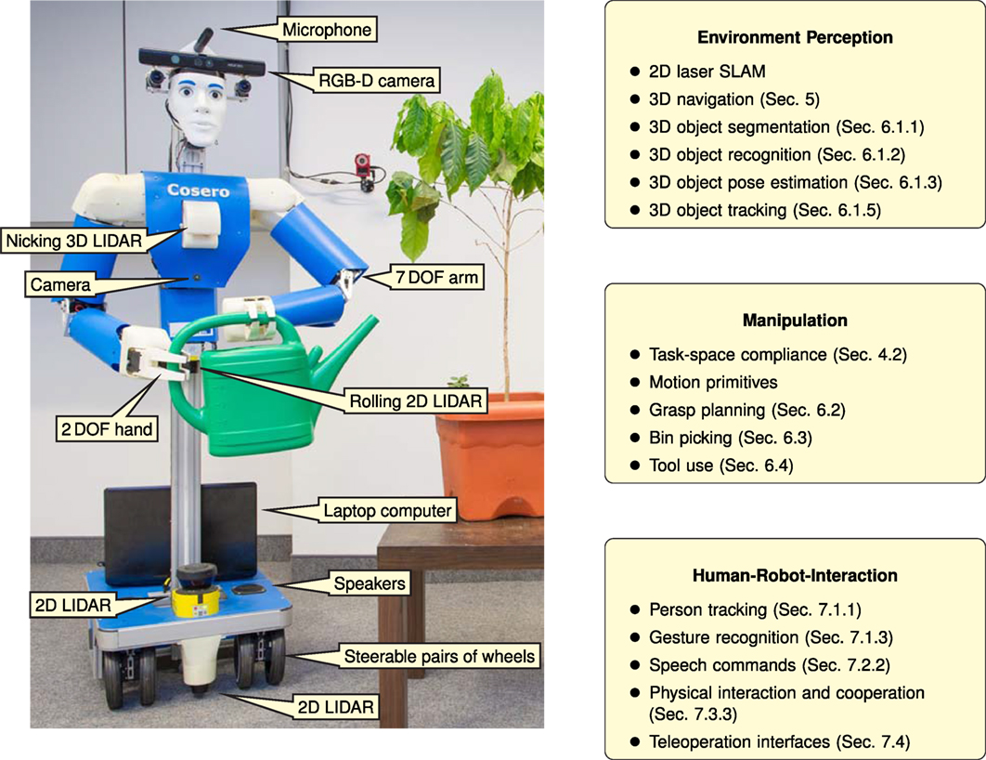
Cosero: cognitive service robot
[Stückler 2012]

Slide 4
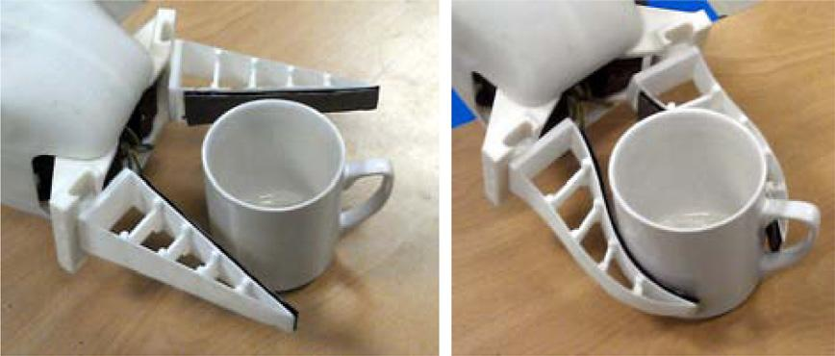
CONFORMABLE GRIPPER

Slide 5
Components of a Humanoid Service Robot
Mechatronic Design
Software and Control Architecture
Navigation
Manipulation
Perception
Grasping
Tool Use
Interaction
People Recogntion
Gesture Recognition
Dialog System
Cooperative tasks
Teleioperation

Slide 6
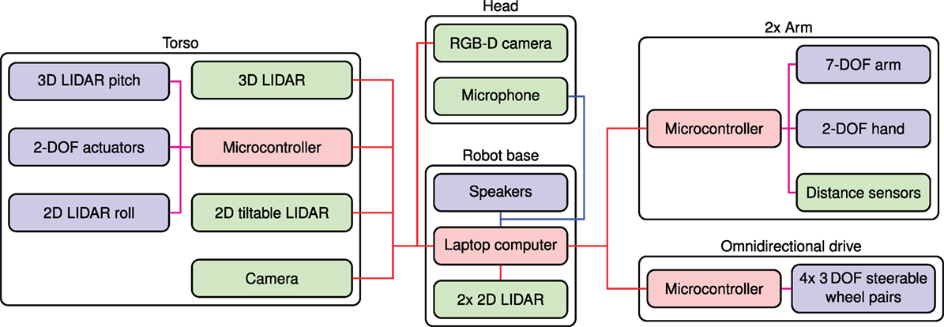
Overview of the mechatronic design of Cosero
Sensors are colored green, actuators blue, and other components red.
USB connections are shown in red, analog audio links are shown in blue,
and the low-level servo connections are shown in magenta.

Slide 7
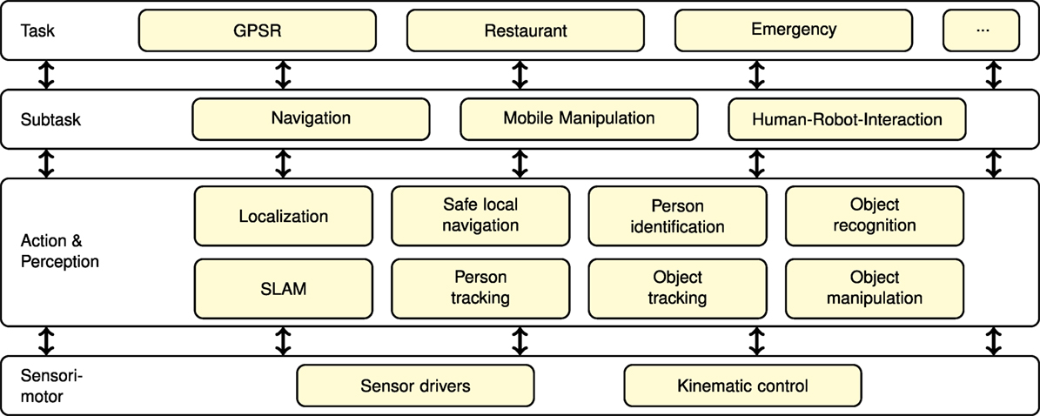
Software Architecture

Slide 8
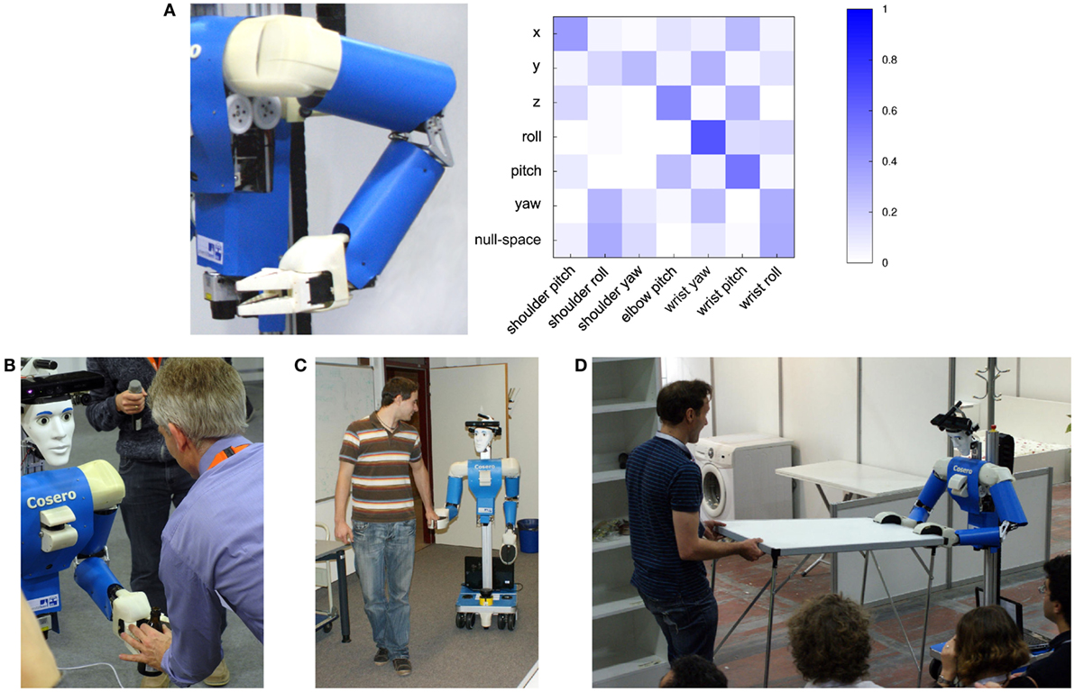
Compliant Arm Control
(A) Activation matrix for compliant control in an example arm pose. The task-space dimensions correspond to forward/backward (x), lateral (y), vertical (z), and rotations around the x-axis (roll), y-axis (pitch), and z-axis (yaw); Examples for use of compliance in physical human–robot interaction: (B) object hand over from robot to user signaled by the user pulling on the object. (C) Cosero is guided by a person. (D) Cosero follows the motion of a person to cooperatively carry a table.
(A) Activation matrix for compliant control in an example arm pose. The task-space dimensions correspond to forward/backward (x), lateral (y), vertical (z), and rotations around the x-axis (roll), y-axis (pitch), and z-axis (yaw); Examples for use of compliance in physical human–robot interaction: (B) object hand over from robot to user signaled by the user pulling on the object. (C) Cosero is guided by a person. (D) Cosero follows the motion of a person to cooperatively carry a table.

Slide 9
Surfel Grid Maps for Navigation
2D floor map can cause problems with 3D humanoid navigation.
(A) Panorama image of an office. (B) 3D surfel map learned with our approach (surfel orientation coded by color). (C) Navigation map derived from 3D surfel map. Localization is done by Monte Carlo Localization (particle filter) using either 3D surfels or 2D camera line features.

Slide 10
Object Perception
Heuristic: most household objects are found in a finite set of locations- specifically on horizontal support planes.
Tabletops
Shelves
This reduces computational search for object pose and geometry.
The experiments conducted are limited to the above two assumed locations

Slide 11
Real-time 3D Perception
Utilizing the Microsoft Kinect for its depth camera
High frame rates allows for processing of images with 160x120 resolution at 20Hz
Tasks:
Compute Normals
Extract Horizontal Points
Detect Support Plane
Detect Object Candidates
Track Objects
Notes:
5 steps will be elaborated in the following slides

Slide 12
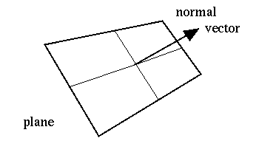
Compute Normals
Directly compute the normal vector over the neighboring pixels in x and y image space
For every point compute local surface normals from the cross product of two tangents to the surface
Create two maps of tangential vectors- one for rows and one for columns
For each map compute the difference vectors between corresponding 3D points
Compute an integral image for each channel and then compute the average tangential vector.
Runtime = linear

Slide 13
2. Extract Horizontal Points
Extract all points with vertical normals
The resulting points are lying on the horizontal surface
Allows for efficiently segmenting the complete depth into planes
Looking at just horizontal planes saves computations

Slide 14
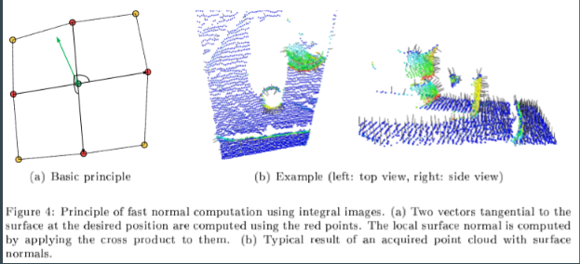
3. Detect Support Plane
Find the most dominant horizontal plane and the points supporting it
The support plane will be horizontal
Only look at points and support planes lower than 1 meter and closer than 3 meters from the robot

Slide 15
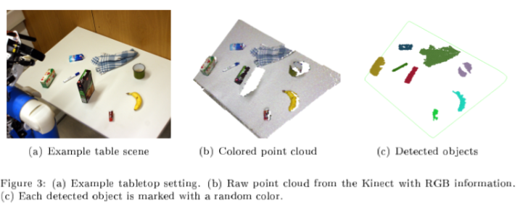
4. Detect Object Candidate
Extract the points above the horizontal support plane
Apply Euclidean clustering to get sets of points and object candidates

Slide 16
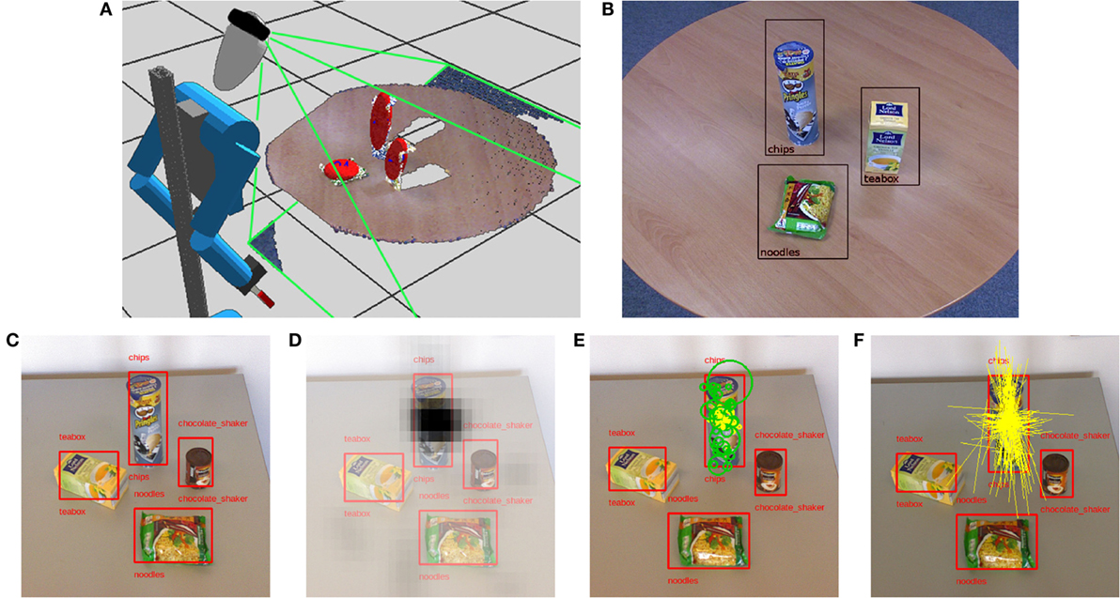
OBJECT PERCEPTION
(A) Cosero capturing a tabletop scene with its RGB-D camera. The visible volume is indicated by the green lines. Each object is represented by an ellipse fitted to its points, indicated in red. (B) RGB image of the tabletop with recognized objects. (C) We recognize objects in RGB images and find location and size estimates. (D) Matched features vote for position in a 2D Hough space. (E) From the features (green dots) that consistently vote at a 2D location, we find a robust average of relative locations (yellow dots). (F) We also estimate principal directions (yellow lines).

Slide 17
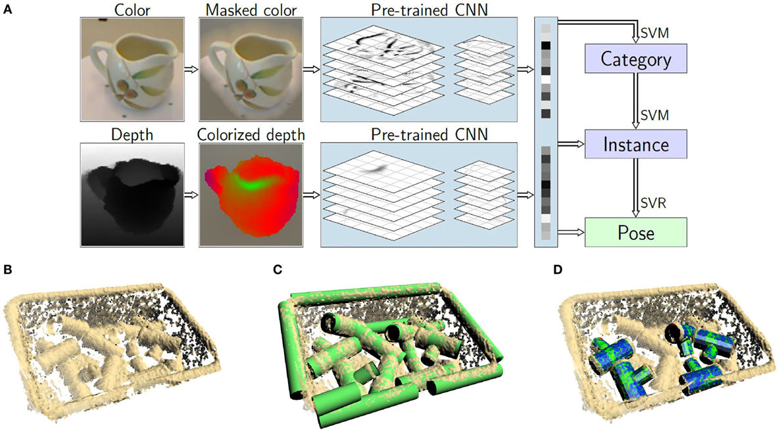
Object Perception
(A) Object categorization, instance recognition, and pose estimation based on features extracted by a pretrained convolutional neural network. Depth is converted to a color image by rendering a canonical view and encoding distance from the object vertical axis; object detection based on geometric primitives. (B) Point cloud captured by Cosero’s Kinect camera. (C) Detected cylinders. (D) Detected objects

Slide 18
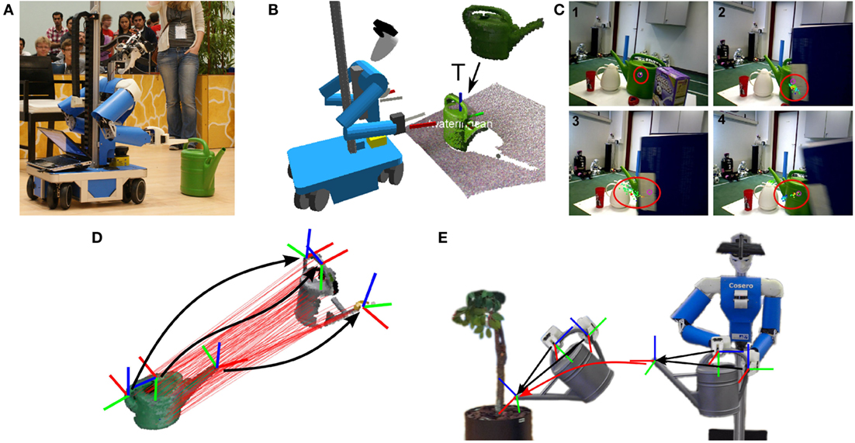
Object Tracking
(A) Cosero approaching a watering can. (B) We train multiview 3D models of objects using multiresolution surfel maps. The model is shown in green in the upper part. The model is registered with the current RGB-D frame to estimate its relative pose T, (C) Joint object detection and tracking using a particle filter, despite occlusion. (D) an object manipulation skill is described by grasp poses and motions of the tool tip relative to the affected object. (E) Once these poses are known for a new instance of the tool, the skill can be transferred.

Slide 19
Bluetooth low energy tag localization
(A) Used Bluetooth tags (Estimote and StickNFind). (B) Signal strength-based tag localization by lateration. (C) Localization experiment with multiple tags.

Slide 20
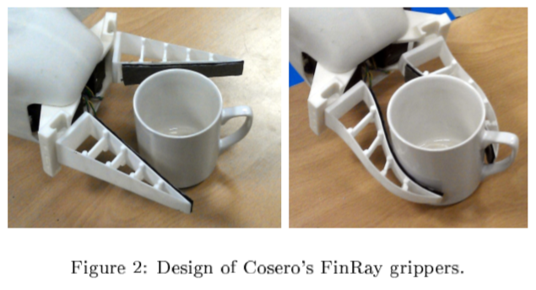
Efficient Grasp Planning
Overview: Finding feasible, collision-free grasps from the raw object point cloud
Collision free
Feasible

Slide 21
Efficient Grasp Planning
Grasping can be from the side or from above
Side grasp:
Approach the object along its vertical axis with the grippers aligned horizontally
Pre-grasp pose is reached, side-grasp motion primitive approaches the object, close gripper
Top grasp:
Pitch the end effector by 45 degrees downward to grasp object with the fingertips
Reach pre-grasp pose and then establish pitch orientation
Use IR distance sensors in the grippers to determine any premature contact with the object or support plane

Slide 22
Planning Collision-Free Grasps
Grasp planner selects a feasible collision-free grasp for the object of interest
Will sample grasp candidates, remove infeasible and colliding grasps, and ranks the remaining grasps to find the best one
First find out the shape and pose of the object
Side grasp: pre-grasp pose is sampled on an ellipse in the horizontal plane and grasp the object as low as possible (half the height of the gripper + .03m)
Top grasp: sample it on all points in height range of 2cm below the highest point of the object

Slide 23
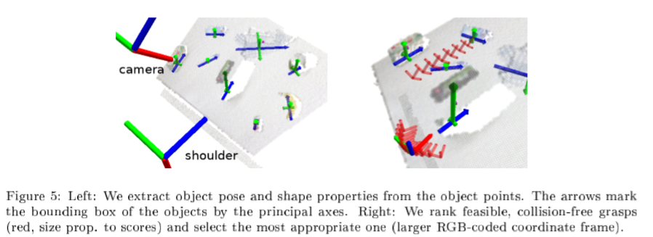
Filtering for Feasible and Collision-Free Grasps
Post processing: filter out grasps based on the following:
Grasp width - reject grasps if the object will not fit into the gripper
Object height - reject side grasps if the object is too low
Reachability - reject grasps outside of the arm’s workspace
Collisions - reject grasps that collide during the reaching or grasping
Grasps
that
satisfy
Criteria

Slide 24
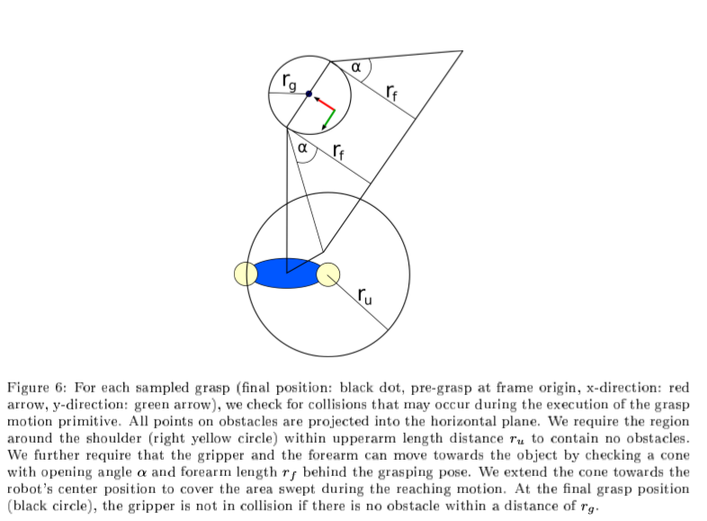
Searching
For
Collisions

Slide 25
Ranking of Grasps
Once there are collision-free grasps then the grasps get ranked:
Distance to object center - favor grasps with smaller distance to object center
Grasp width - favor grasps widths closest to .08m
Grasp orientation - favor grasps with smallest angle between line toward shoulder and grasping direction
Distance from robot - favor grasps with smaller distance to the shoulder

Slide 26
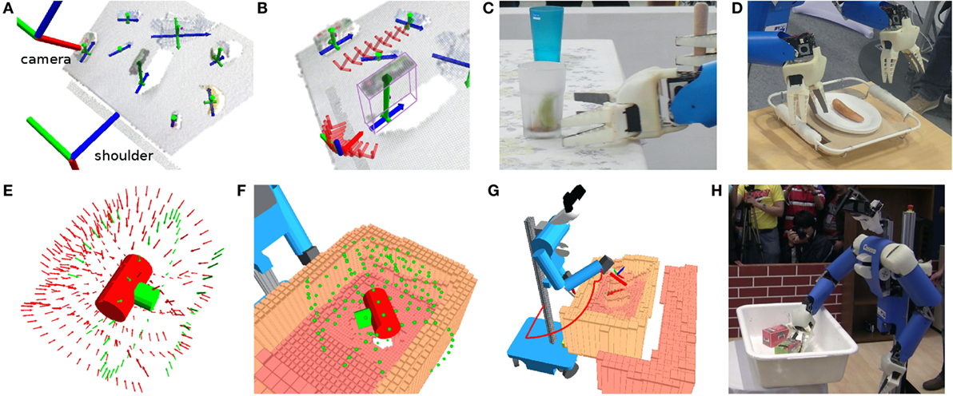
Grasp and motion planning
(A) Object shape properties. principal axes of the object. (B) We rank feasible, collision-free grasps (red) and select the most appropriate one (large, RGB). (C) Example side grasp. (D) Example top grasp; motion planning for bin picking: (E) Grasps are sampled on shape primitives,checked for collision-free approach. (F) filter out grasps that are not feasible. (G) Arm motion is planned. (H) Bin picking demonstration at RoboCup

Slide 27
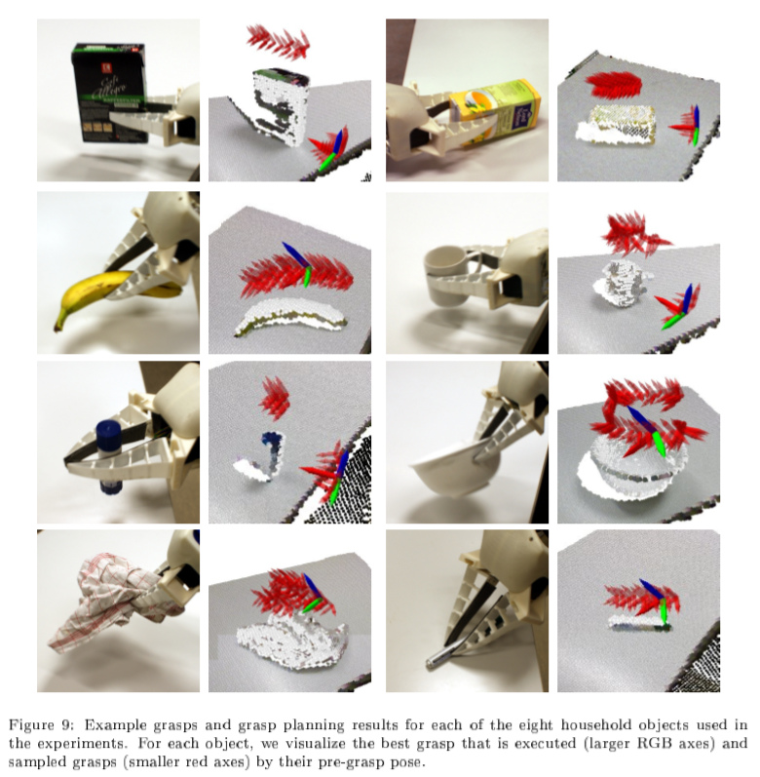
Experiments &
Robustness
8 household objects and executed 12 grasps each
Didn’t just use rigid objects- tried clothes
Later tried this with a shelf, not just table
Sometimes only top grasp or only side grasp are feasible (not both)

Slide 28
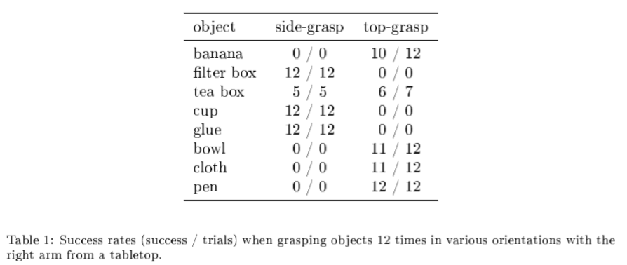
Experiments & Robustness: Table

Slide 29
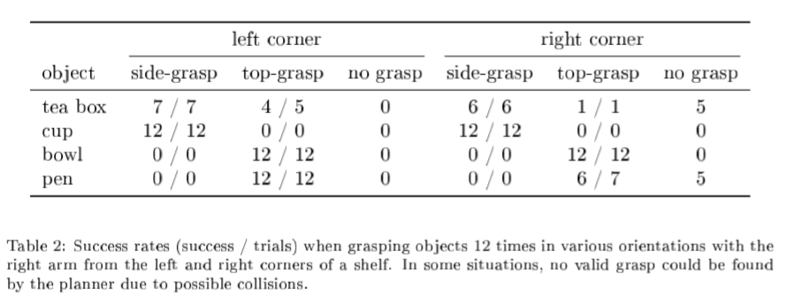
Experiments & Robustness: Shelf

Slide 30
Performance Evaluation
Fast & Robust
The motivation behind all of this is to have more anthropomorphic robots- robots that can grasp every day items in your home
Paper presents efficient means to “perceive objects on planar surfaces and to plan feasible, collision-free graps on the object of interest”
Achieves this very fast: in real-time
Analyzes the many grasp options, rejects the bad, and prioritizes the better
Robust: can pick up a variety of household objects
If there is a failure the robot will try to pick up the object again
Caveat: lots of assumptions about object pose and potential grasps

Slide 31
Tool Use
(A) Grasping sausages with a pair of tongs. Cosero perceives position and orientation of the sausages in RGB-D images. (B) Bottle opening. (C) Plant watering skill transfer to unknown watering can

Slide 32
Tool use at RoboCup 2014
(A) Bottle opener, (B) Dustpan and swab, and (C) Muddler.
Adaptive tool use

Slide 33
Physical Human Robot Interaction
Object Hand over
Guiding the robot by hand
Cooperative tasks: carrying a table

Slide 34
Person perception
(A) Persons are detected as legs (cyan spheres) and torsos (magenta spheres) in two horizontal laser range scans (cyan and magenta dots. Detections are fused in a multi-hypothesis tracker (red and cyan boxes). Faces are detected with a camera mounted on a pan-tilt unit. We validate tracks as persons (cyan box) when they are closest to the robot and match the line-of-sight toward a face (red arrow). (B) Enrollment of a new face. (C) Gesture recognition. Faces are detected in the amplitude image. 3D point cloud with the resulting head, upper body, and arm segments (green, red, and yellow) and the locations of the hand, elbow, and shoulder (green, light blue, and blue spheres)

Slide 35
HRI: Dialog system
Speech recognition
Speech synthesis
Semantic binding of spech to grounded objects
Synthesis of Body Language and Gestures
robot moves head, torso towards people, objects
robot can also generate pointing gestures like a human

Slide 36
Handheld teleoperation interface
(A) Complete GUI with a view selection column on the left, a main view in the center, a configuration column on the right, and a log message window on the bottom center. Two joystick control UIs on the lower corners for controlling robot motion with the thumbs. (B) Skill-level teleoperation user interface for navigation in a map (placed in center and right UI panel). The user may either select from a set of named goal locations or choose to specify a goal pose on a map. The user specifies navigation goal poses by touching onto the goal position and dragging toward the desired robot orientation.

Slide 37
Videos
Bin Picking
German RoboCup
Kitchen Competition
RoboCup II

Slide 38
Summary
A complete system: Mobile manipulator with HRI
Solutions to all the problems:
Locomotion
Path and motion planning
Perception
Grasping
Human interfacing
But many, many heuristics and simplifications to make it work!
Project idea: take one of these “simple solutions” and make it better!!!

