Slide 1
Accelerated Robot Learning Via Human BCI
Iretiayo Akinola and Zizhao Wang

Slide 2
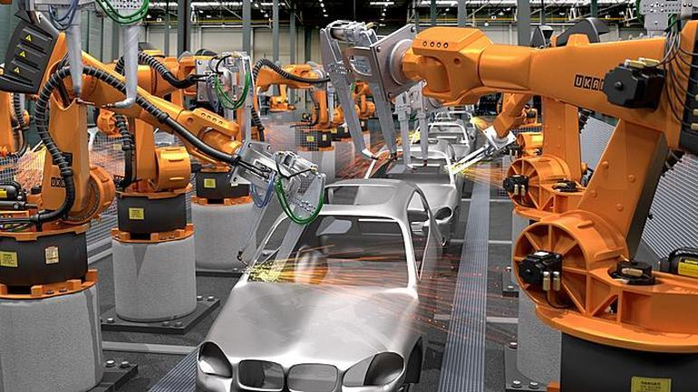
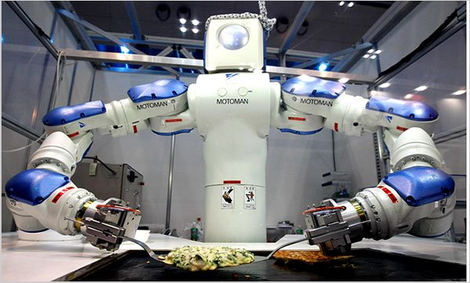
Robot Learning
Robotics: see, think, act
Direct programming can be hard for different tasks
Degree of structure and consistency
Perception
Manipulation
Deformation
Vacuum robots
Lawn mowing
Pool cleaning
Manufacturing robots
Home-cleaning robot
Cooking Robot
Laundry Robot Warehouse Robot
Notes:
It is impossible to pre-program all the necessary knowledge into a robot operating in a diverse, dynamic and un- structured environment.

Slide 3
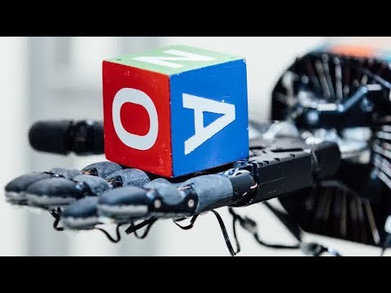
Robot Learning
Robotics: see, think, act
Direct programming can be hard for different tasks
Degree of structure and consistency
Perception
Manipulation
Deformation
Vacuum robots
Lawn mowing
Pool cleaning
Manufacturing robots
Home-cleaning robot
Cooking Robot
Laundry Robot Warehouse Robot
Notes:
It is impossible to pre-program all the necessary knowledge into a robot operating in a diverse, dynamic and un- structured environment.

Slide 4
Robot Learning
LfD
RL
HR
Alternatives to direct programming are learning-based methods:
Learning from Demonstration
Reinforcement Learning
Learning from Human Feedback
Notes:
It is impossible to pre-program all the necessary knowledge into a robot operating in a diverse, dynamic and un- structured environment.

Slide 5
Robot Learning
LfD
RL
HR
Alternatives to direct programming are learning-based methods:
Learning from Demonstration
Reinforcement Learning
Learning from Human Feedback
Notes:
It is impossible to pre-program all the necessary knowledge into a robot operating in a diverse, dynamic and un- structured environment.

Slide 6
Learning from Demonstration (LfD)
LfD
RL
HR
LfD Dataset (D): a set of state-action pairs
Goal: Learn
Assumptions: Human Teacher exists, Demonstration is possible
Key Considerations:
Demonstration mode
State representation
Policy Derivation method
Supervised learning/Function approximation
Collect Demonstrations
D = {(s,a)}
Derive policy from D

Slide 7
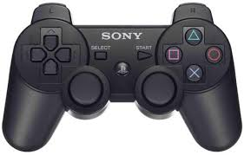
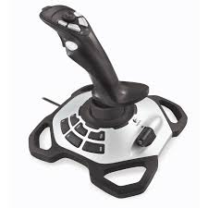
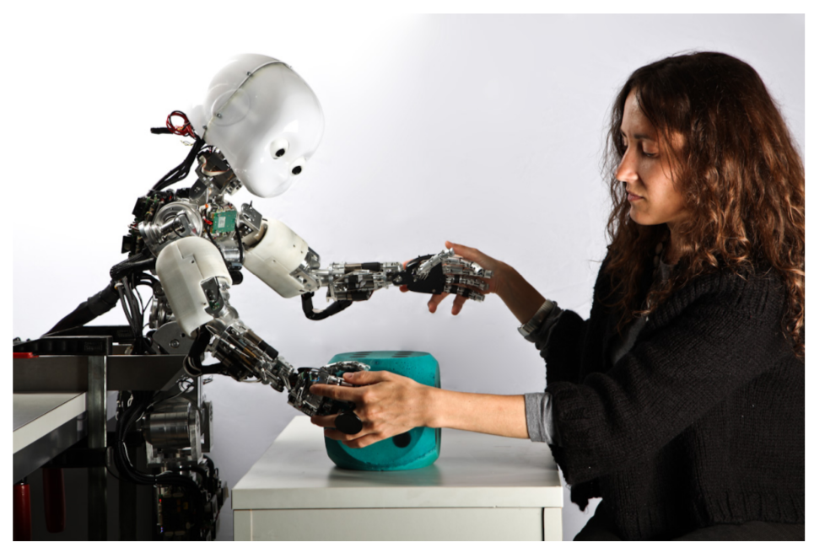
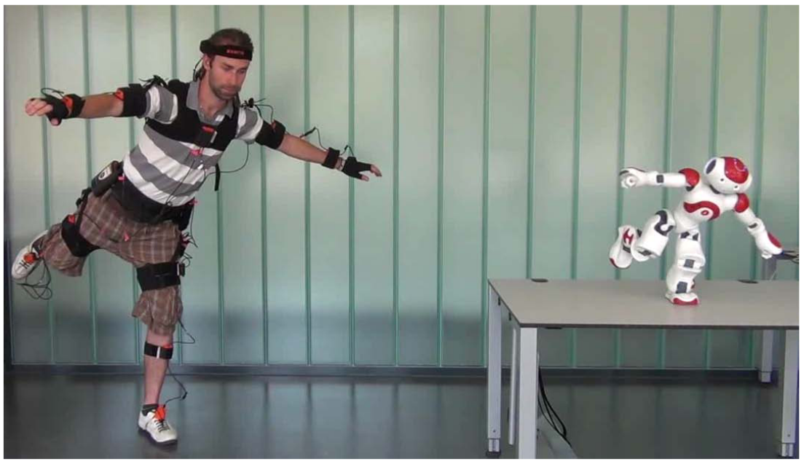
Learning from Demonstration (LfD)
LfD
RL
HR
Learning from Demonstration data
Learns a mapping from state to action
Demonstration modes
Teleoperation
Kinesthetic teaching (e.g. in motion trajectory learning)
Camera recording a human teacher
Robotic teachers
Kinesthetic Teaching
Motion Capture

Slide 8
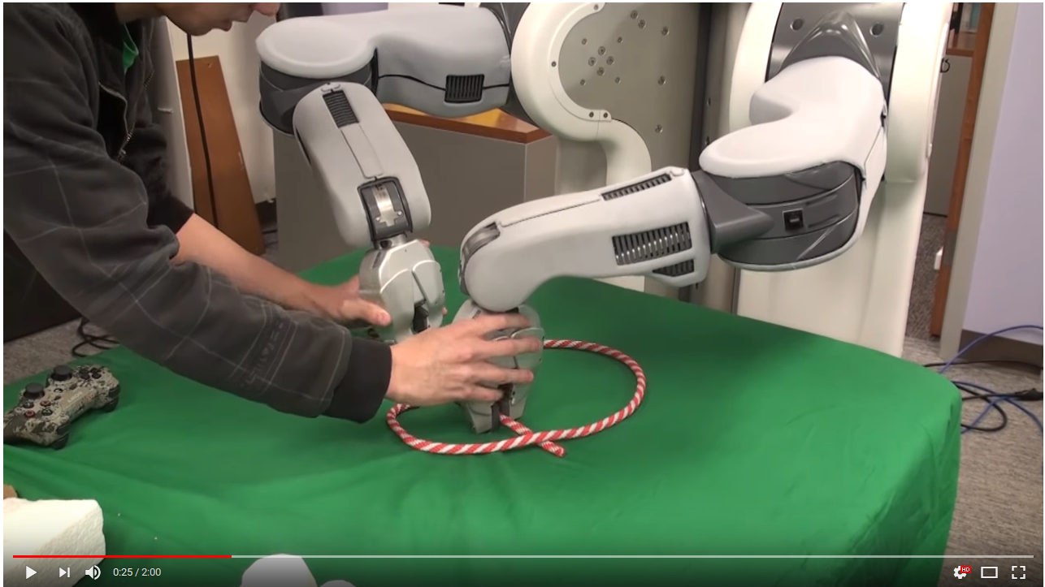
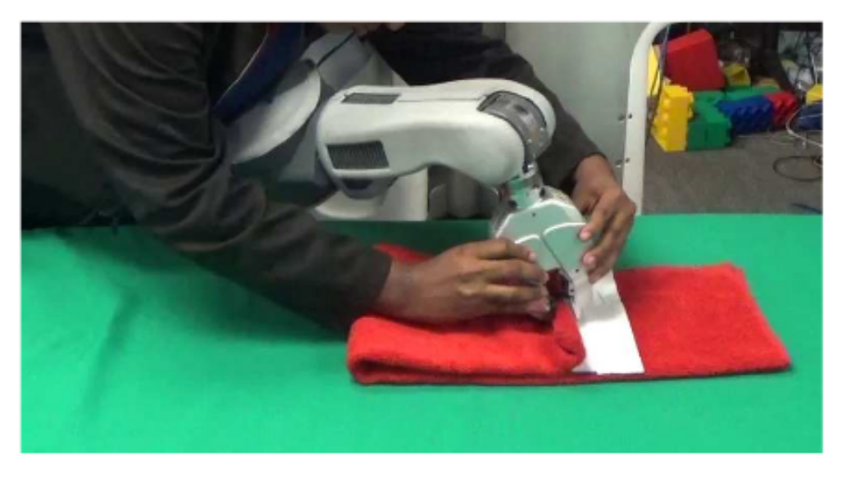
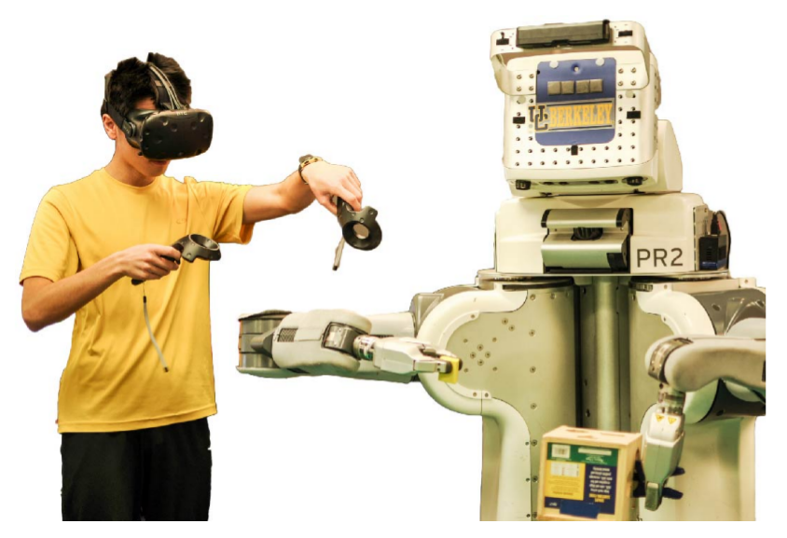
Case-Study: LfD
LfD
RL
HR
Demonstration mode: Virtual Reality
~30mins of demonstration
Demonstration Data
State representation: Images, Depth, gripper points
Action representation: Joint velocities, gripper open/close
Policy Derivation method
Neural Network
Zhang, McCarthy et al. 2017
Notes:
To prevent visual artifacts from the demonstrator, virtual reality is now replacing kinesthetic teaching
Images from: Robot Learning From Human Teachers Sonia Chernova and Andrea L. Thomaz (2014)
Learning by Doing: Kinesthetic,
Learning from observation: MoCap
Learning by Critique: IRL

Slide 9
LfD
LfD
RL
HR
Pros
Supervised Learning
No need for manual reward function
Exploration not an issue
Cons
Might not generalize well- Covariate shift
Volume of demonstration
Some tasks are difficult to demonstrate
Suboptimal Demonstrations. Limited human patience and inconsistent user input
Performance of the robot can be limited by that of the teacher.
Collect Demonstrations
D = {(s,a)}
Derive policy from D
Notes:
final policy performance achieved by these methods is limited by the quality of the dataset and the performance of the teacher.
This occurs because of “covariate shift” a known challenge, where the states encountered during training differ from the states encountered during testing, reducing robustness.

Slide 10
Robot Learning
LfD
RL
HR
Alternatives to direct programming are learning-based methods:
Learning from Demonstration
Reinforcement Learning
Learning from Human Feedback
Notes:
It is impossible to pre-program all the necessary knowledge into a robot operating in a diverse, dynamic and un- structured environment.

Slide 11
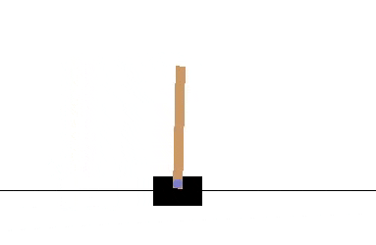
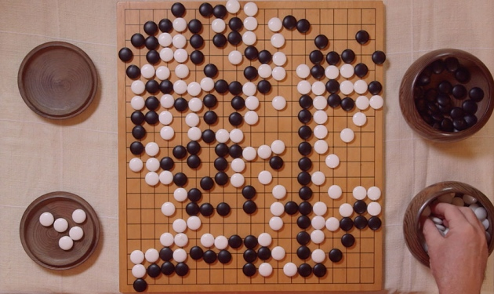
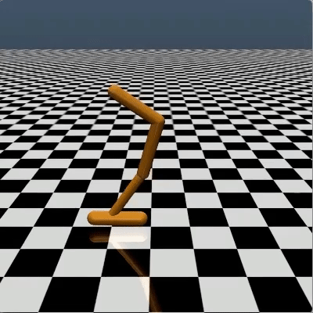
Reinforcement Learning
Learning by trial and Error
Maximize cumulative rewards
Learn a policy
Reinforcement Learning Progress
Classical Control
Games: Atari, Go
Robotics
continuous space, complex transition dynamics, complex rewards
Notes:
Reinforcement Learning is one of main pillars of Robot Learning
Robotics: continuous space, complex transition dynamics, complex rewards

Slide 12
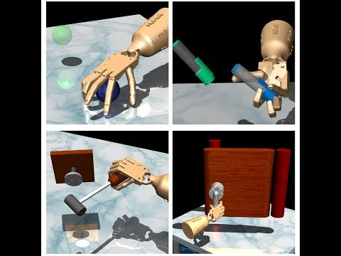
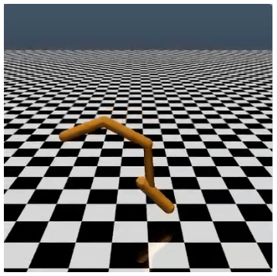
Reinforcement Learning
RL
Robotics
continuous space
complex transition dynamics
complex rewards

Slide 13
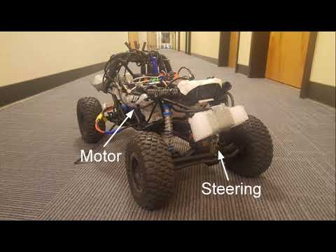
Reinforcement Learning in Robotics
RL
Indoor Navigation

Slide 14
Reinforcement Learning in Robotics
RL
Indoor Navigation

Slide 15
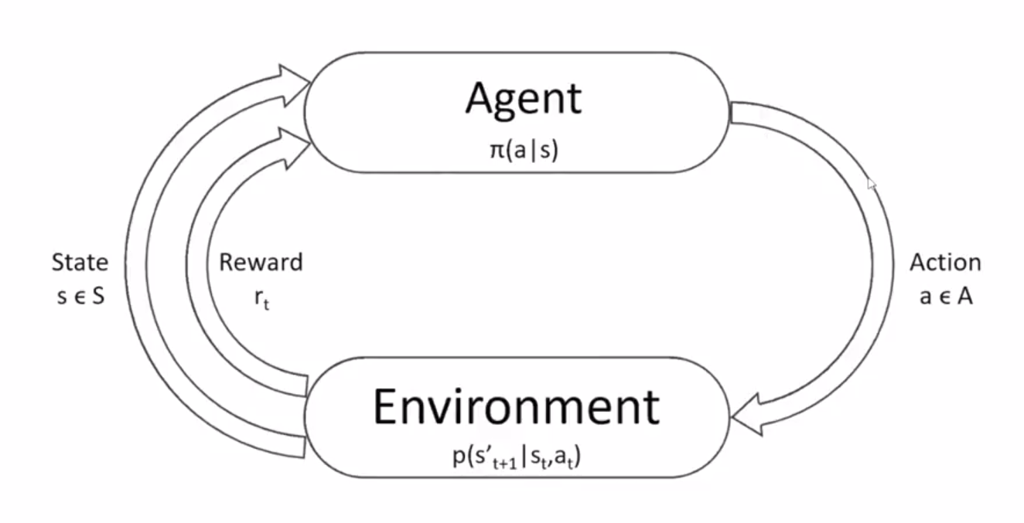
Reinforcement Learning Formulation
RL
Markov Decision Process

Slide 16
Reinforcement Learning Formulation
LfD
RL
HR
The goal of RL is to get a policy:
Notes:
Explore, Exploit or Listen

Slide 17
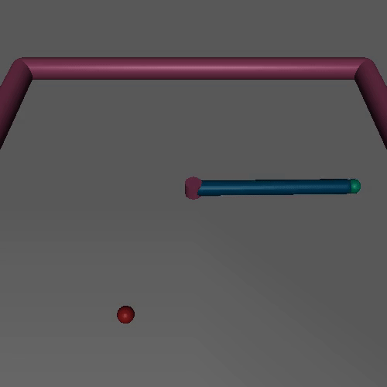
Reinforcement Learning Formulation
RL
The goal of RL is to get a policy:
Reward function:
Joint states
Joint Torque
Notes:
Theta is the parameter of the network.

Slide 18
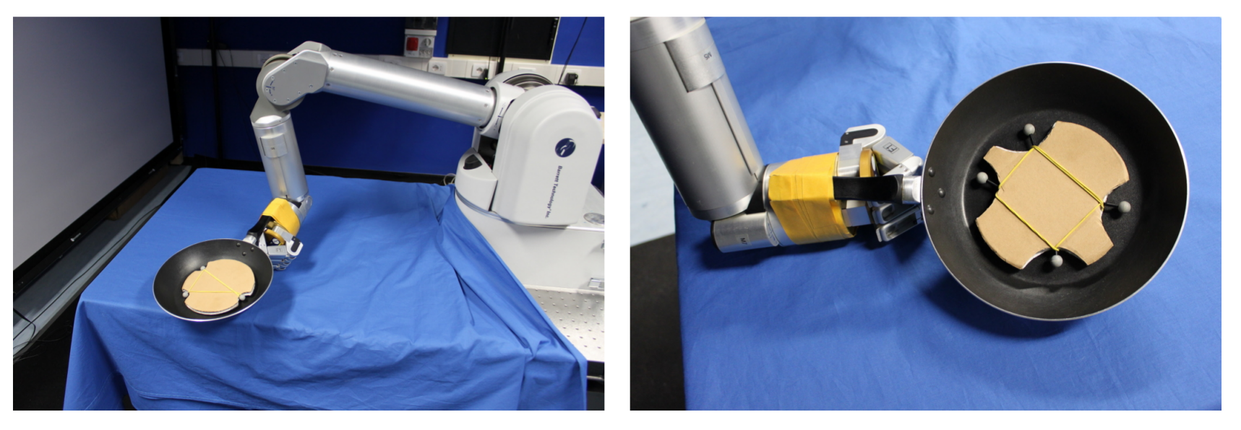
Reinforcement Learning in Robotics
RL
Pancake Flipping Task
Notes:
Reinforcement Learning Recent Enablers
Simulators are better, nice interfaces

Slide 19
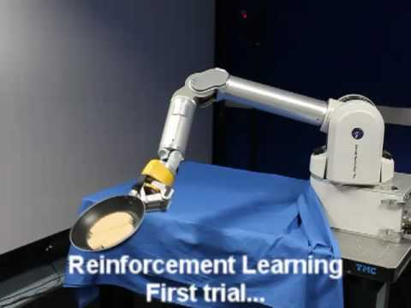
Reinforcement Learning in Robotics
RL
Pancake Flipping Task
Notes:
Reinforcement Learning Recent Enablers
Simulators are better, nice interfaces

Slide 20
Reinforcement Learning in Robotics
RL
Pancake Flipping Task
Reward
Orientational reward
Positional reward
Notes:
Reinforcement Learning Recent Enablers
Simulators are better, nice interfaces

Slide 21
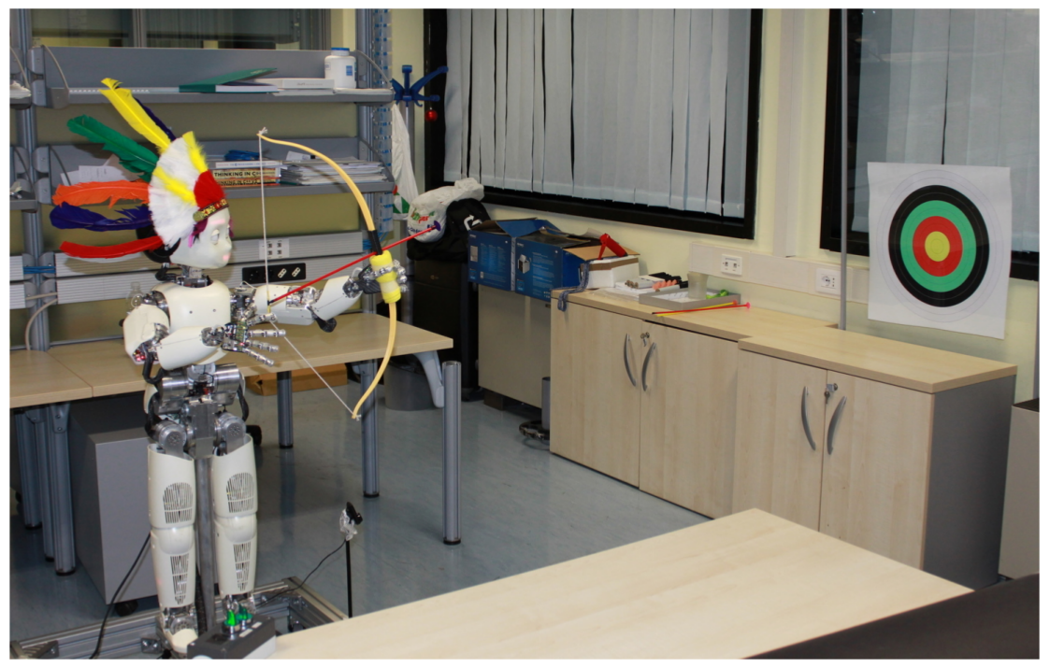
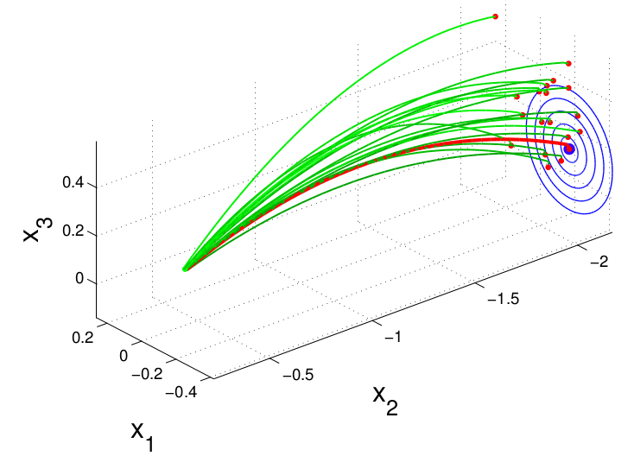
Reinforcement Learning in Robotics
RL
Archery Task
Notes:
Reinforcement Learning Recent Enablers
Simulators are better, nice interfaces

Slide 22
Reinforcement Learning
RL
Pros
Fully autonomous
Skills not explicit coded
No demonstration needed
Cons
Reward definition: Where does the R come from?
Curse of Dimensionality: Exploration cost increases exponentially with dimension
Generalization issues: Simulation to Real??
Convergence

Slide 23
Reinforcement Learning
RL
Pros
Fully autonomous
Skills not explicit coded
No demonstration needed
Cons
Reward definition: Where does the R come from?
Curse of Dimensionality: Exploration cost increases exponentially with dimension
Generalization issues: Simulation to Real??
Convergence

Slide 24
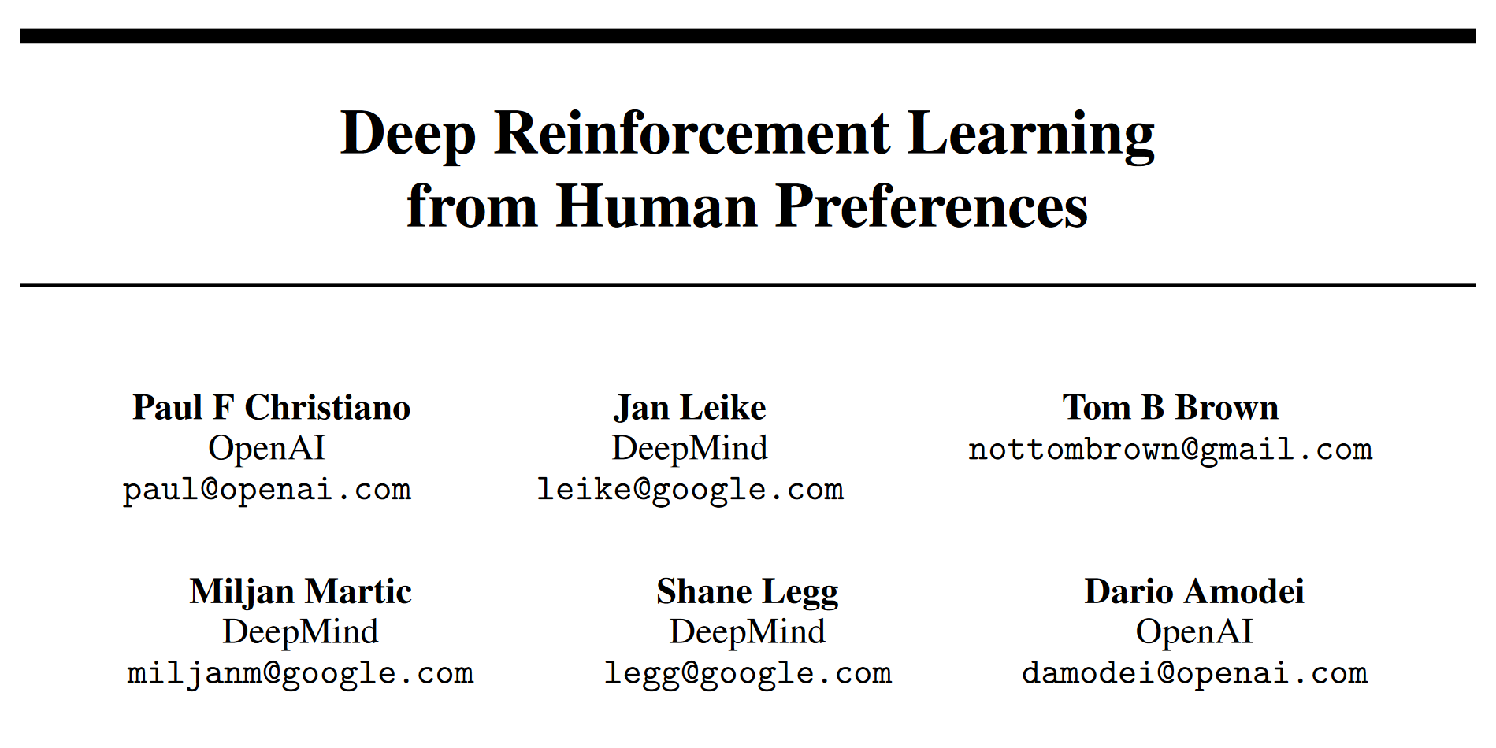
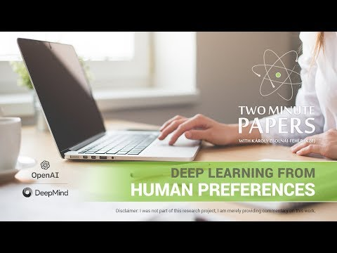
Reward definition: Where does the R come from?

Slide 25
Sparse Reward
RL
Easy to specify
Rare training signal

Slide 26
Robot Learning
LfD
RL
HR
Alternatives to direct programming is learning-based methods:
Learning from Demonstration
Reinforcement Learning
Learning from Human Feedback
Notes:
It is impossible to pre-program all the necessary knowledge into a robot operating in a diverse, dynamic and un- structured environment.

Slide 27
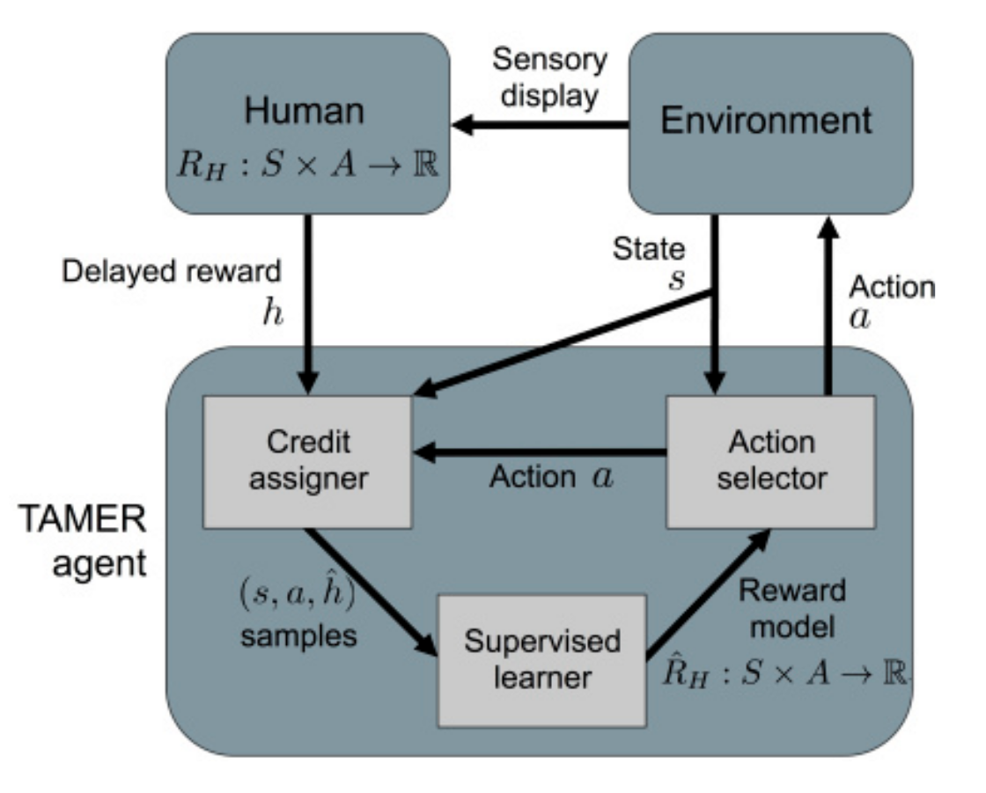
RL from Human Reinforcement
LfD
RL
HR
RL:
HR:
Human Agent provides:
real time positive and negative rewards
Reduces the number of states it explores
Significantly improves the learning speed
No reward function engineering
Training An Agent Manually with Evaluative Feedback (TAMER)
Notes:
In RL, you maximize sum of discounted rewards. In HR, you maximise the immediate feedback from humans
real time positive and negative rewards in in response to robot actions
provide anticipatory guidance input that restricts action selection choice and guides the learner towards performing the desired behavior
The tamer framework guides the design of agents whose behavior can be shaped through signals of approval and disapproval, a natural form of human feedback.

Slide 28
RL vs Human Reinforcement?

Slide 29
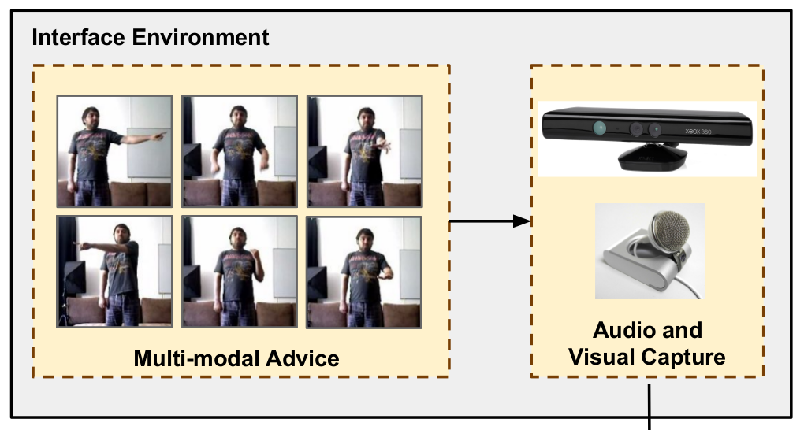
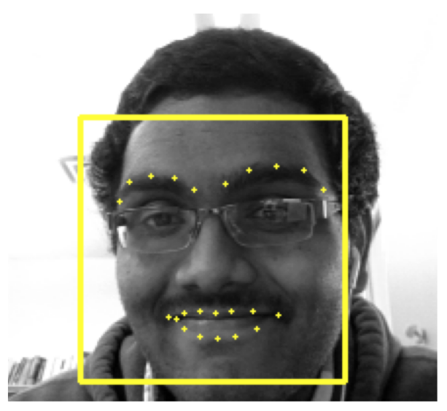
Interactive RL Modes
LfD
RL
HR
Clicker
Facial
Gesture
Audio
Hybrid
Actor-Critic RL with Human Rewards- Jagodnik etal (2017)
Multimodal Input- Cruz etal (2017)
Face-Valuing- Veeriah etal (2016)

Slide 30
Can we replace Mouse Clicks with Brain Signals?
HR
Humans have a high level understanding of the task
Humans brain signals vary when observing robot performing a task in error or not
Can we learn the reward function directly from brain signals?
Notes:
Human brain signals vary when observing a robot perform task

Slide 31
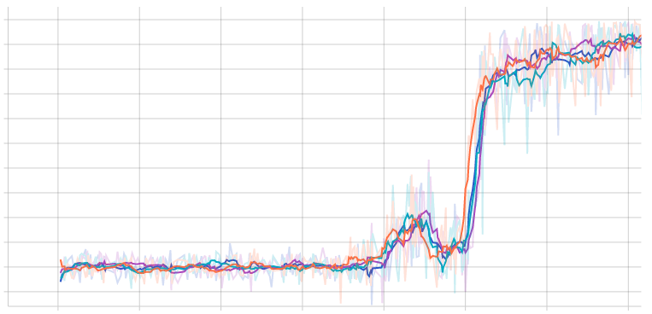
Learning from Feedback + Reinforcement Learning
RL with sparse rewards struggles
Exploration Convergence Refining

Slide 32
Brain Guided RL

Slide 33
Brain Guided RL

Slide 34
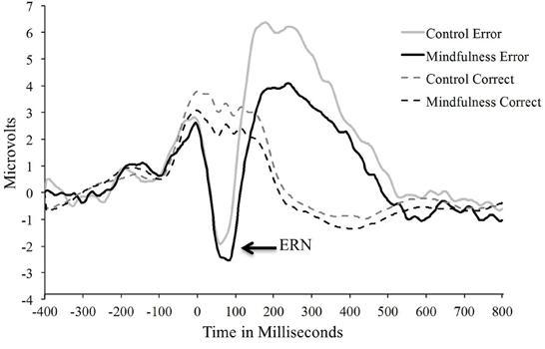
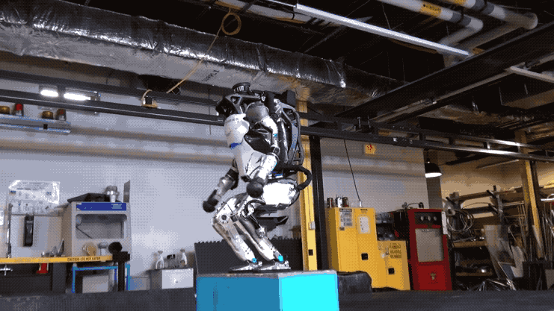
Error-related Potentials

Slide 35
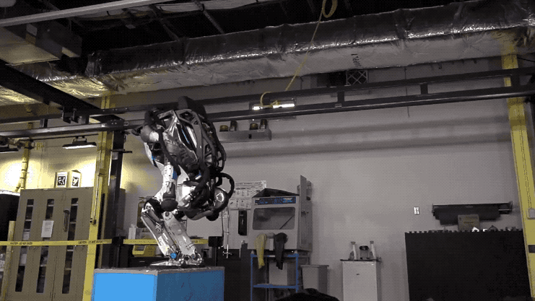
Error-related Potentials

Slide 36
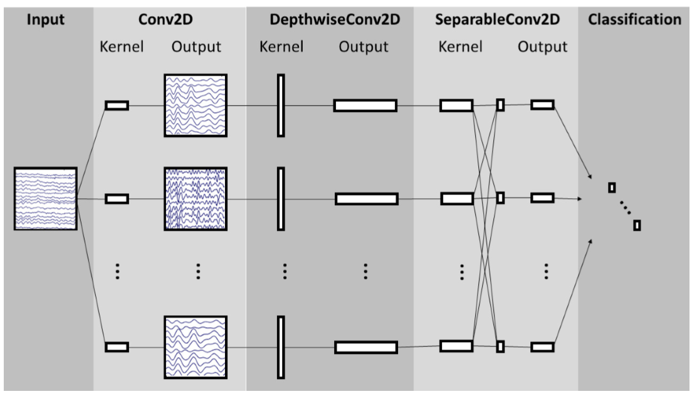
Detect ErrP - EEGNet

Slide 37
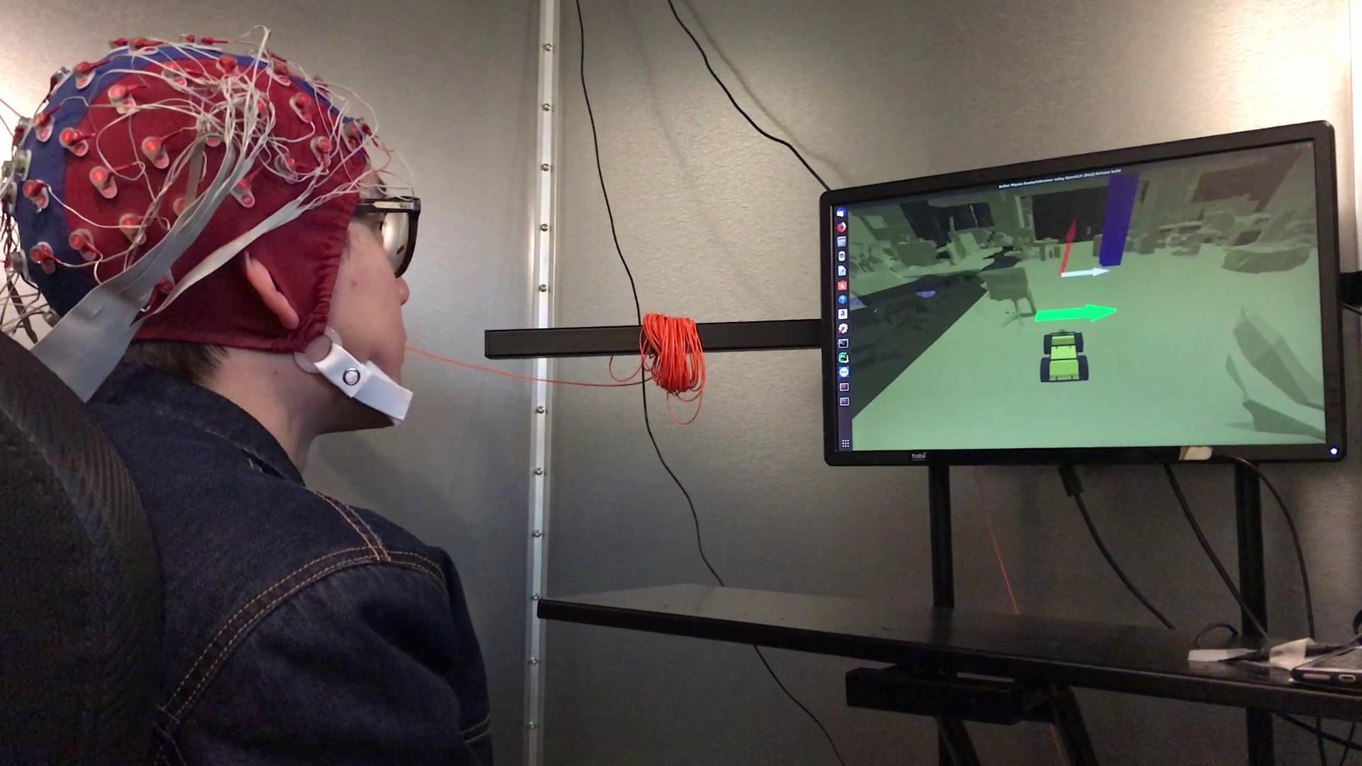
ErrP Calibration

Slide 38
Quiz
When you get feedback (good/bad), how will you treat and utilize it for RL?
It is praise/penalty, i.e, rewards in RL settings.
It is whether the action is optimal/suboptimal, i.e., Q values in RL.
Other thoughts

Slide 39
Quiz
When you get feedback (good/bad), how will you treat and utilize it for RL?
It is praise/penalty, i.e, rewards in RL settings.
It is whether the action is optimal/suboptimal, i.e., Q values in RL.
Other thoughts

Slide 40
Learning from Human Feedback

Slide 41
Learning from Human Feedback
 | a1 | a2 | a3 | ...
s1 | good | bad | bad
s2 | bad | unknown | good
s3 | bad | unknown | unknown
...

Slide 42
Learning from Human Feedback
comes from the EEG classifier and has low accuracy (60%)

Slide 43
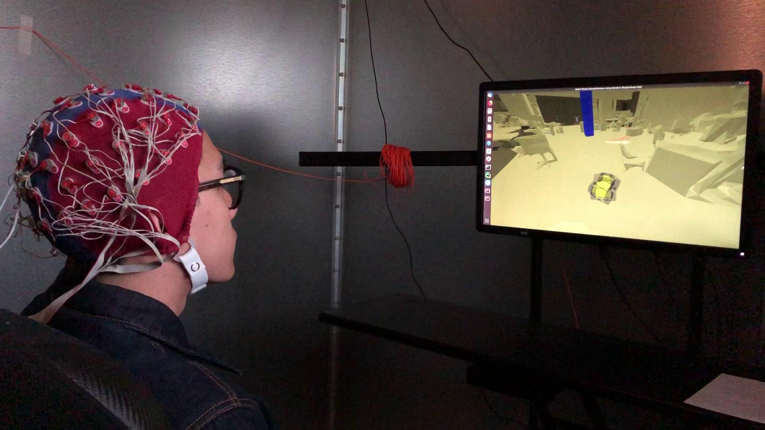
Learning from Human Feedback
HF Agent

Slide 44
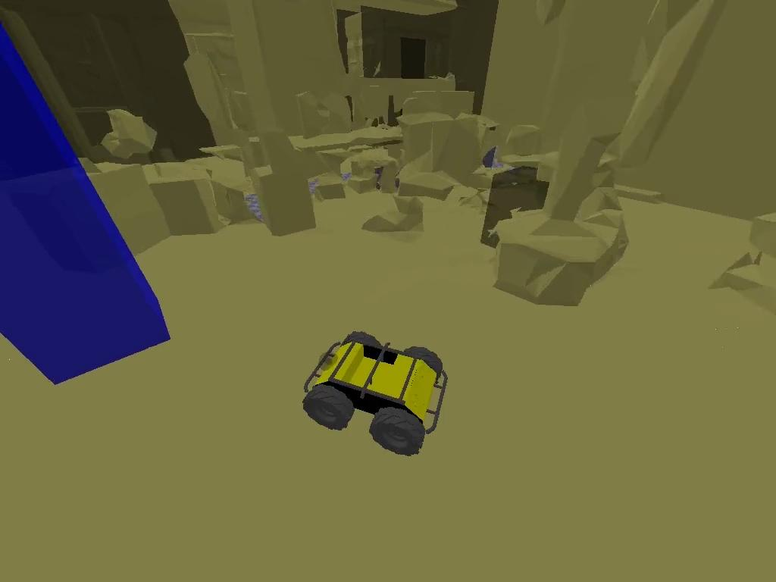
HF policy is Limited

Slide 45
RL from Sparse Reward

Slide 46
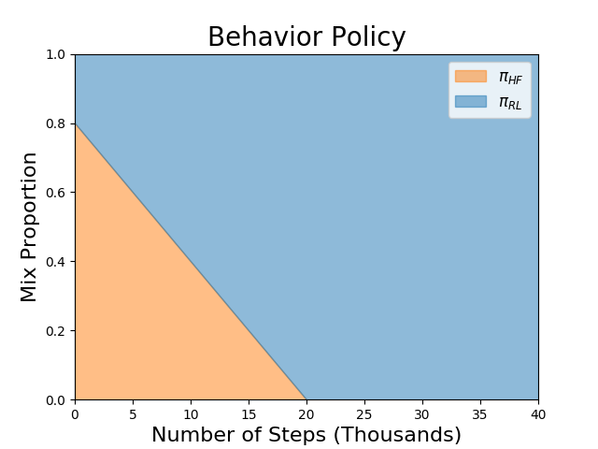
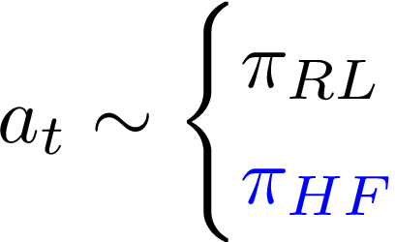
RL from Sparse Reward

Slide 47
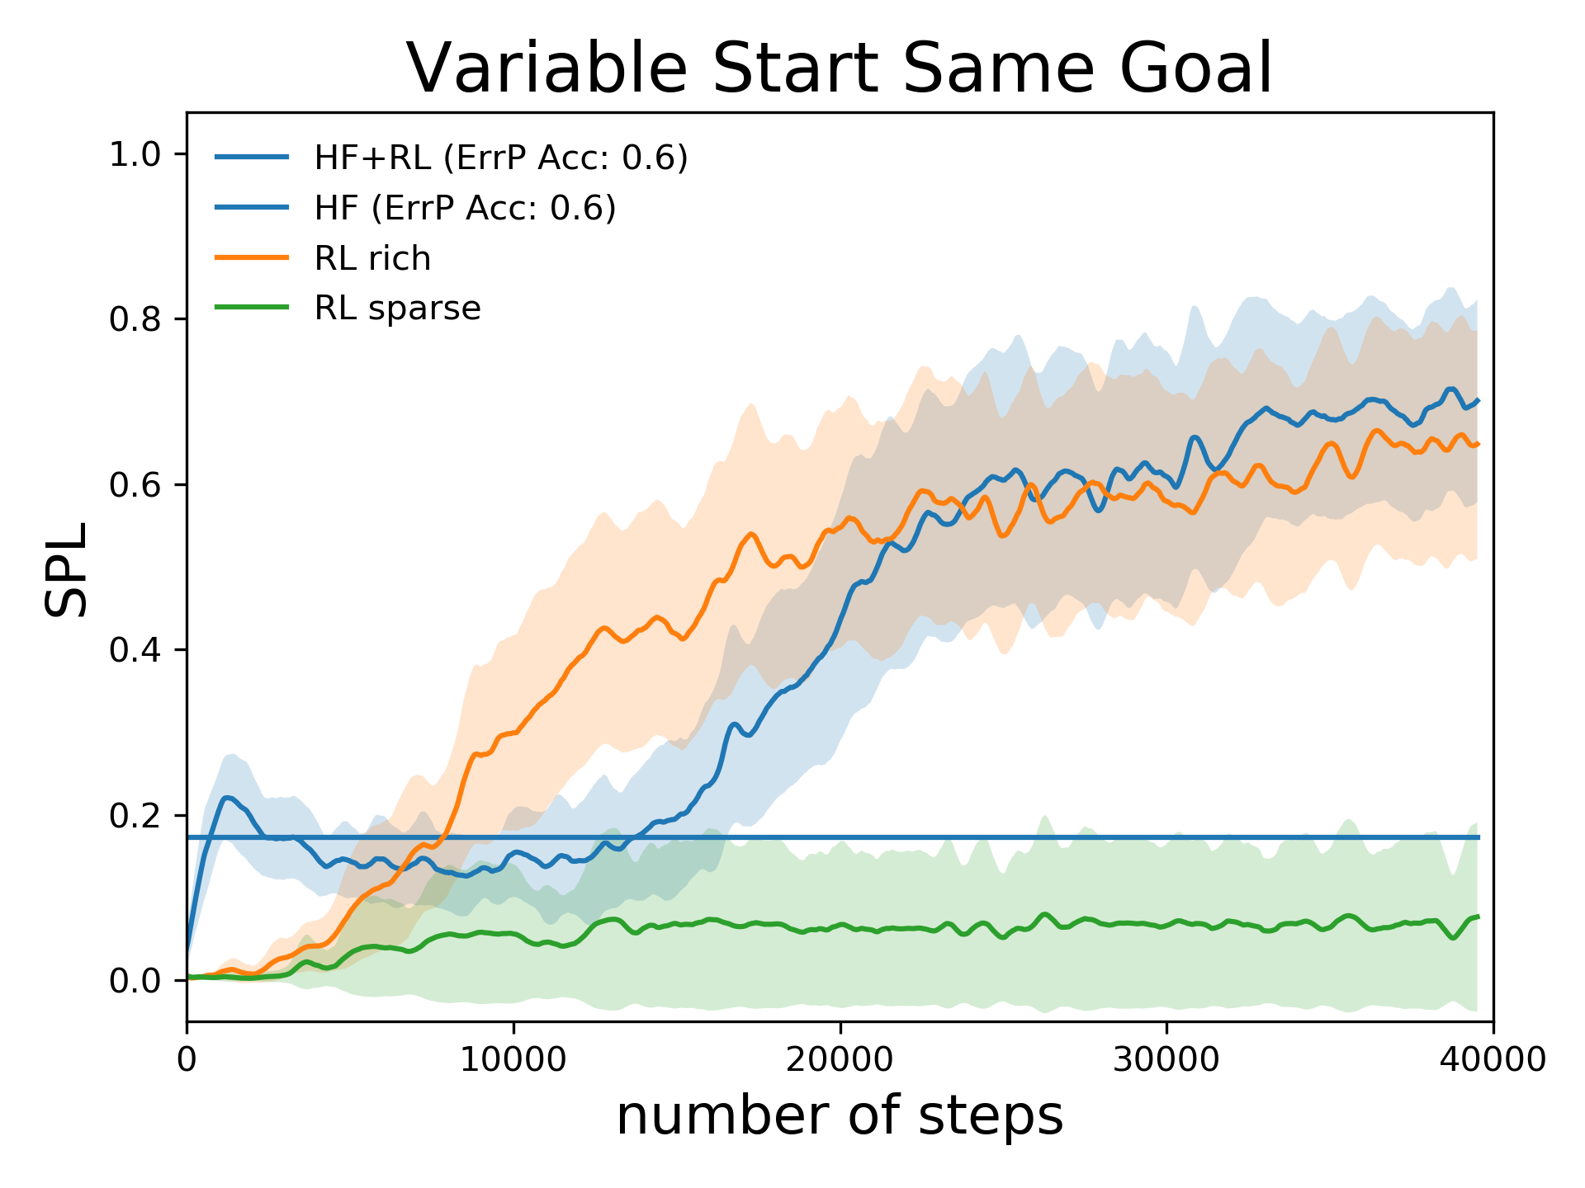
Learning from Simulated Feedback
Two baselines
RL with sparse rewards
RL with human-designed rich rewards

Slide 48
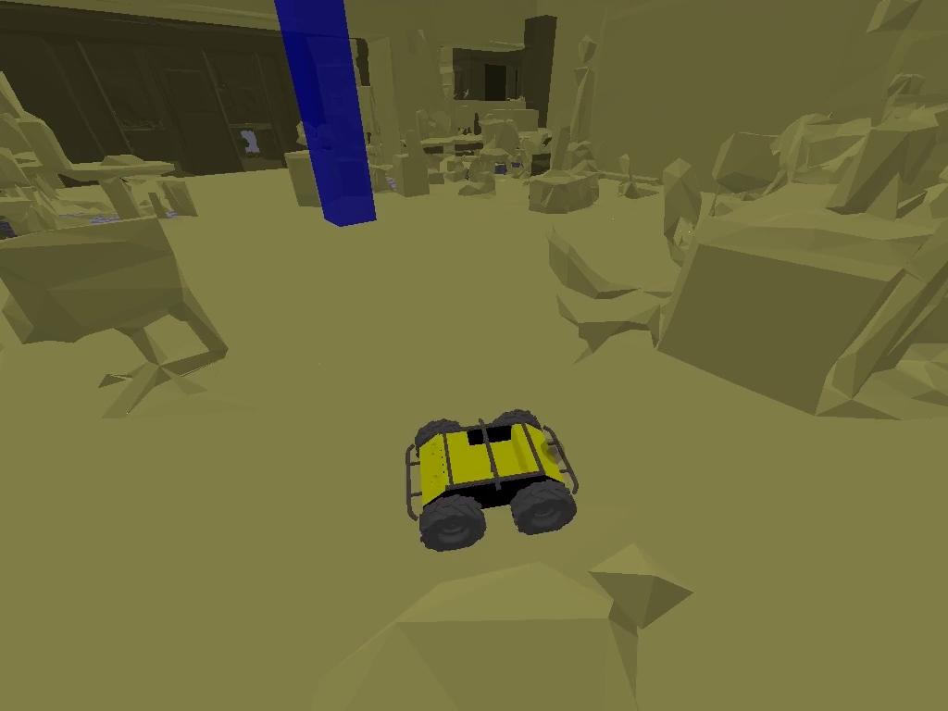
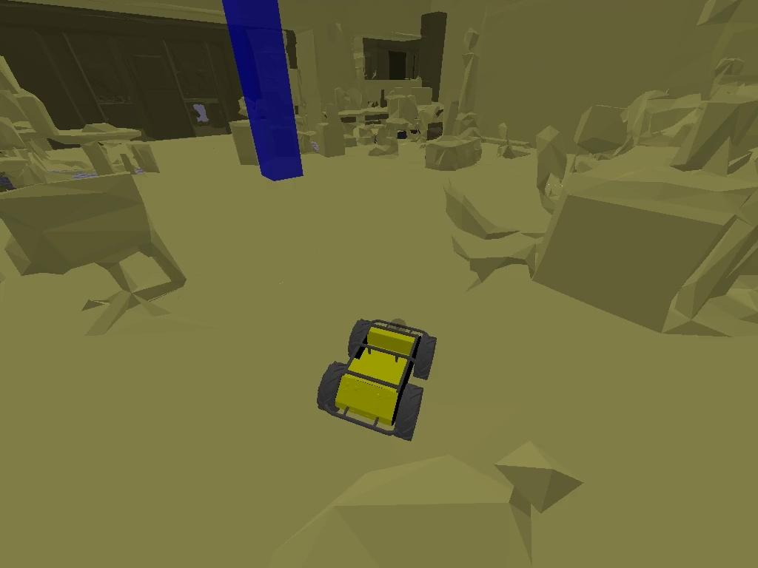
Robot Navigation Policy
RL Sparse | Our Method

Slide 49
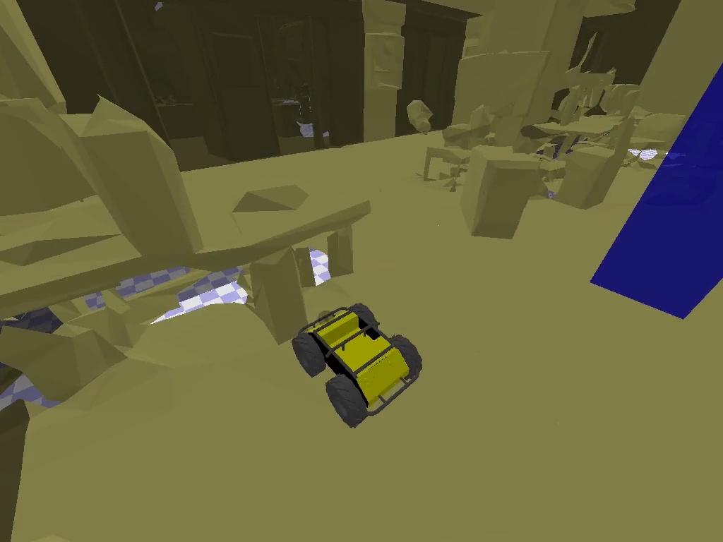
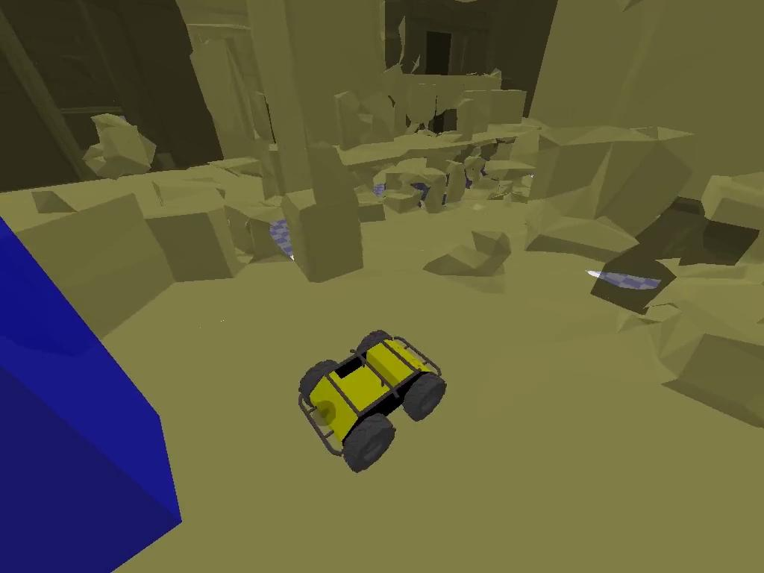
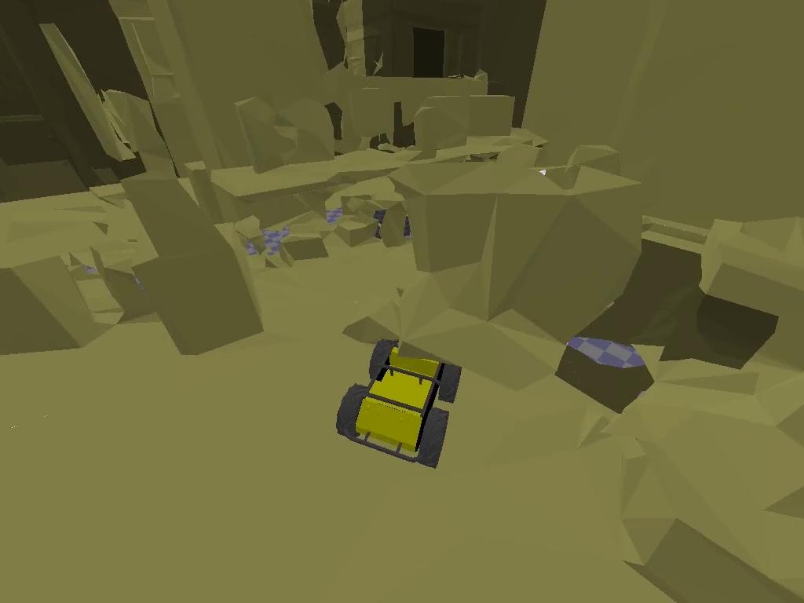
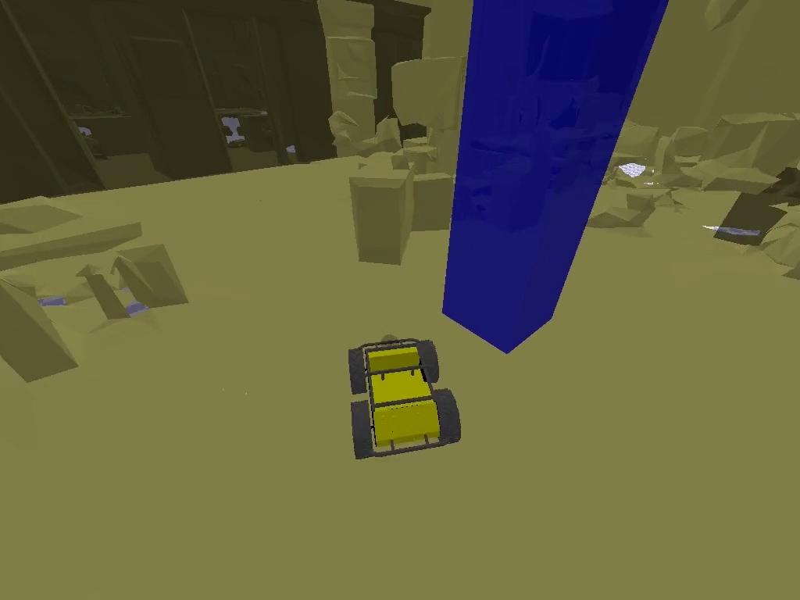
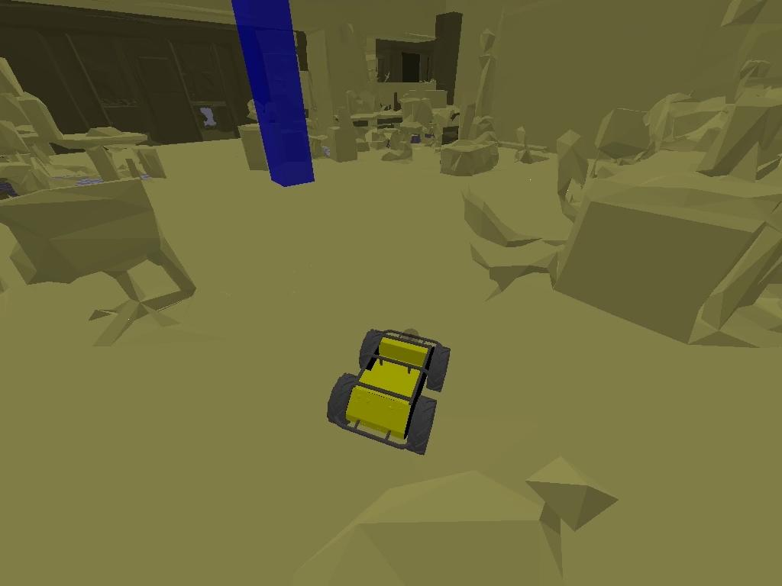
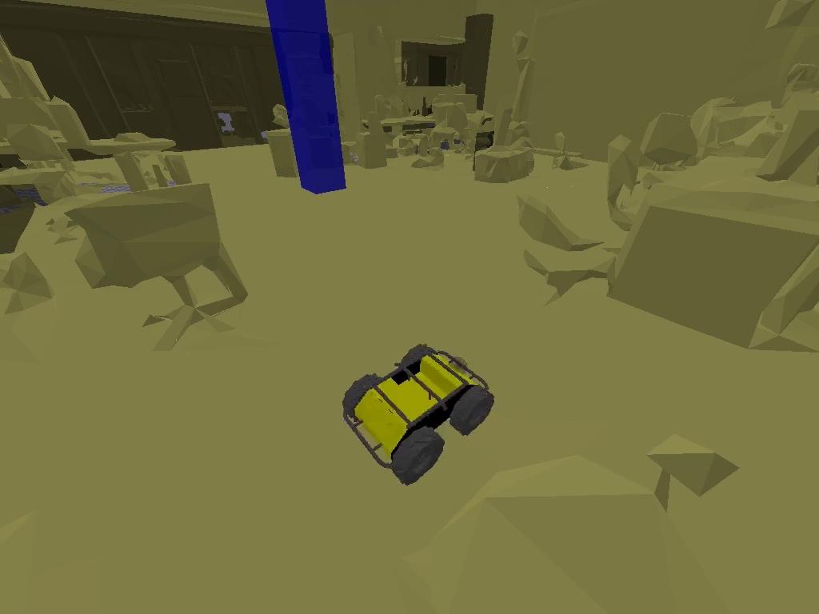
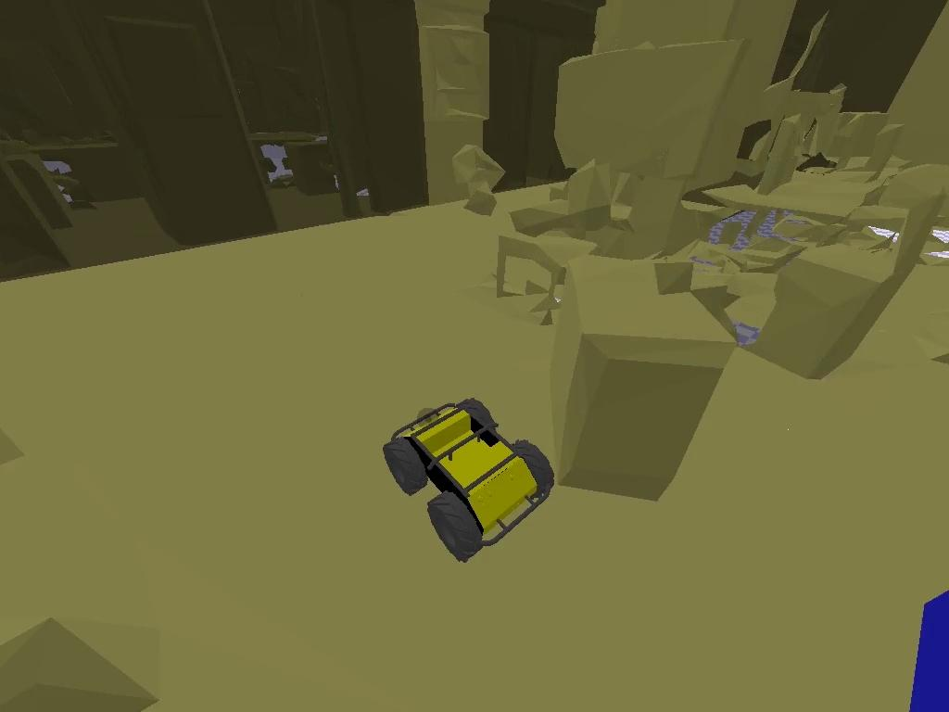
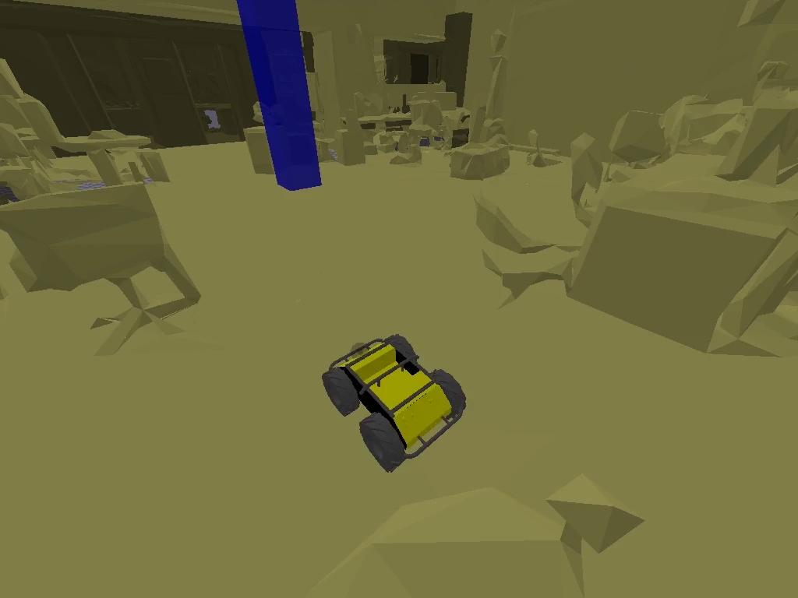
Real Experiment Results
 | Subject 1 | Subject 2 | Subject 3 | Subject 4 | Subject 5
ErrP Acc | 66% | 60% | 67% | 62% | 62%
HF only
HF+RL

Slide 50
Real Experiment Results
 | Subject 1 | Subject 2 | Subject 3 | Subject 4 | Subject 5
ErrP Acc | 66% | 60% | 67% | 62% | 62%
HF only
HF+RL
 | Subject 1 | Subject 2 | Subject 3 | Subject 4 | Subject 5
ErrP Acc | 66% | 60% | 67% | 62% | 62%
HF only
HF+RL
 | Subject 1 | Subject 2 | Subject 3 | Subject 4 | Subject 5
ErrP Acc | 66% | 60% | 67% | 62% | 62%
HF only
HF+RL
 | Subject 1 | Subject 2 | Subject 3 | Subject 4 | Subject 5
ErrP Acc | 66% | 60% | 67% | 62% | 62%
HF only
HF+RL

Slide 51
References
“Robot Learning From Human Teachers”, Sonia Chernova and Andrea L. Thomaz (2014)
“Deterministic Policy Gradient Algorithms” (David Silver et al. 2014)
“Continuous control with deep reinforcement learning” (Lillicrap etal Deepmind 2016)
"CARLA: An open urban driving simulator." Dosovitskiy, Alexey, German Ros, Felipe Codevilla, Antonio Lopez, and Vladlen Koltun. (2017).
“Self-supervised Deep Reinforcement Learning with Generalized Computation Graphs for Robot Navigation” Kahn, Gregory, Adam Villaflor, Bosen Ding, Pieter Abbeel, and Sergey Levine. (ICRA 2018)
“Deep Imitation Learning for Complex Manipulation Tasks from Virtual Reality Teleoperation” (Carthy et al. 2017)
“Imitation Learning: A Survey of Learning Methods” (Hussein et al. 2017)

