Slide 1
COMS E6998-3 Term Project Presentation
Advanced Topics in Programming Languages
and Compilers, Fall 2012
MIPLex: Adapting Dynamic Code Modification to the MIPL Language
YoungHoon Jung
jung@cs.columbia.edu

Slide 2
Background
MIPL is
Designed for Large Matrix Computation
Dynamic and Weak Typing
Boolean/Double/Matrix/String
Prolog Compatible
Automatic Conversion of Facts and Matrices
Providing ‘job’, which is
function like sub routines
able to return multiple values
Distributed over Hadoop

Slide 3
Motivation
job some_algorithm(A, B, C, D, E) {
I = 0.
while (I < 1000) {
…
A = B + C.
if (I == 0)
A *= D.
A += E.
…
I += 1.
}
}
job some_algorithm(A, B, C, D, E) {
I = 0.
…
A = B + C.
A *= D.
A += E.
…
while (I < 999) {
…
A = B + C.
A += E.
…
I += 1.
}
}

Slide 4
What we want is …
job some_algorithm(A, B, C, D, E) {
I = 0.
while (I < 1000) {
…
A = B + C.
if (I == 0) {
A *= D.
}
A += E.
…
I += 1.
}
}
job some_algorithm(A, B, C, D, E) {
I = 0.
while (I < 1000) {
…
A = B + C.
once {
A *= D.
}
A += E.
…
I += 1.
}
}

Slide 5
Typical Initialization
Runs only once during the entire program execution.
Solution: a boolean variable & an if clause
class SomeClass {
boolean initialized = false;
void someMethod(…) {
if (!initialized) {
do some initialization;
initialized = true;
}
rest of operations;
}
}

Slide 6
Introducing ‘once’ keyword to MIPLex
spot-scope ‘once’ (or anonymous) with a method-call lifecycle
global-scope ‘once’ (or named) with a program-execute lifecycle
job do_some_job(A, B, C) {
once {
do some initialization.
}
do rest jobs.
}
job do_another_job(A, B, C) {
while (A < 100) once do some.
do rest jobs.
}
job do_some_job(A, B, C) {
once (“Init A”) {
do some initialization.
}
once (“Init B”) {
do some initialization.
}
}
job do_another_job(A, B, C) {
once (“Init A”) {
do some initialization.
}
}

Slide 7
Implementing ‘once’ in JVM
1. Naïve approach – solve with a boolean and an if
class SomeClass {
boolean initialized = false;
void someMethod(…) {
if (!initialized) {
do some initialization;
initialized = true;
}
rest of operations;
}
}

Slide 8
Implementing ‘once’ in JVM
2. approach w/o if – generating two class files for one ‘once’ at compile time
class SomeClass {
void someMethod(…) {
do some initialization;
rest of operations;
reload this class;
}
}
class SomeClassWOInit {
void someMethod(…) {
rest of operations;
}
}
Drawbacks – This requires 2^n class implementations if there are n initializations.

Slide 9
Implementing Init in JVM
3. Dynamic Code Modification approach – Removing the code at runtime
class SomeClass {
void someMethod(…) {
do some initialization;
modify codes;
reload affected classes;
rest of operations;
}
}
class SomeClass {
void someMethod(…) {
rest of operations;
}
}
Drawbacks – The generated target code should have code generating functionality.
Can’t replace the method currently running.
Notes:
Redefine class: http://www.java.net/node/644003

Slide 10
Sample MIPL Program
job dosome(X, Y) {
T = X.
once {
T += Y.
}
@T.
}
a(1, 0).
b(0, 1).
[c] <- dosome(a, b).
c(*)?
[d] <- dosome(a, b).
d(*)?
Definition of a Job that takes two arguments
Only at the first call, this Job returns the sum of the two matrices.
After that it simple returns the first matrix
Fact a is converted into a matrix (1, 0)
Fact b is converted into a matrix (0, 1)
Call the Job and prints the returned matrix
Again, call the Job and prints the returned matrix

Slide 11
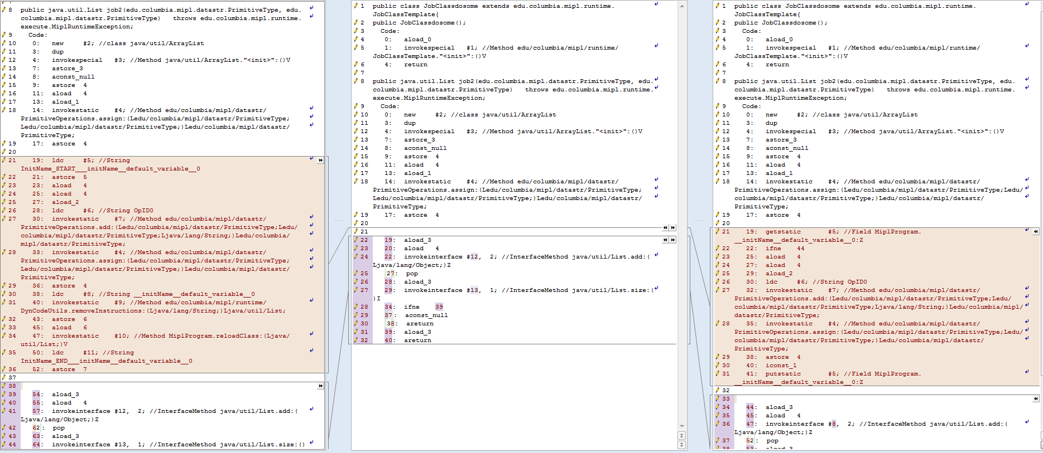
Generated Bytecode
Dynamic Code
Generated Code
if (boolean)

Slide 12
Dynamic Code (to be removed)
19: ldc #5; //String InitName_START___initName__default_variable__0
21: astore 5
23: aload 4
25: aload 4
27: aload_2
28: ldc #6; //String OpID0
30: invokestatic #7; //Method add()
33: invokestatic #4; //Method assign()
36: astore 4
38: ldc #8; //String __initName__default_variable__0
40: invokestatic #9; //Method removeInstructions()
43: astore 6
45: aload 6
47: invokestatic #10; //Method MiplProgram.reloadClass()
50: ldc #11; //String InitName_END___initName__default_variable__0
52: astore 7

Slide 13
Branch Code (inserted if)
19: getstatic #5; //Field MiplProgram.__initName__default_0:Z
22: ifne 44
25: aload 4
27: aload 4
29: aload_2
30: ldc #6; //String OpID0
32: invokestatic #7; //Method add()
35: invokestatic #4; //Method assign()
38: astore 4
40: iconst_1
41: putstatic #5; //Field MiplProgram.__initName__default_0:Z

Slide 14
Non-immediate Effectiveness
Since the modified code will be effective from the next call…
job a_job() {
I = 0.
while (I < 100) {
once {
initialization.
}
I = I + 1.
}
}
job a_job() {
once (“A”) {
initialization.
}
once (“A”) {
initialization.
}
}

Slide 15
Implementing Init in JVM
4. Improved DynCode Modification approach – Executing the rest parts of the first call
class SomeClass {
void someMethod(…) {
do some initialization;
modify codes;
reload affected classes;
get the address by call;
jump to the rest part;
rest of operations;
}
}
class SomeClass {
void someMethod(…) {
get address;
return;
rest of operations;
}
}
class SomeClass {
void someMethod(…) {
rest of operations;
}
}
Notes:
Redefine class: http://www.java.net/node/644003

Slide 16
Getting Code Address in Java
Forbidden Operation
Solution
Requires to turn the JVM verifier off
Probably portable across other JVMs
Label | Instr. | Comments
 | JSR target | jump to Target and place the address of Target on the stack
Target: | ISTORE 1 | store an int value from stack into variable #1
 | ILOAD 1 | load an int value from a local variable #1 to stack
 | IRETURN | return an integer from a method
Var #1
Target Addr
Target Addr
LocalVariableTable
Stack
Returned Value

Slide 17
Long-Jumping with an Address in Java
Uses the calculated address in the local variable table
Label | Instr. | Comments
 | RET 1 | continue execution from address taken from a local variable #1
 | …
 | …
 | … | rest of instructions in the same method of the new class

Slide 18
How to find instructions to remove or change?
Option 1. pre-calculating bytecode offsets
Pros: No additional code required
Cons: Complicated to implement due to multiple onces
Option 2. inserting a String constant
Pros: Easy to implement
Cons: Requires 4 more bytecodes
(8 bytes of code + increased constant table)

Slide 19
Dynamic Code (revisited)
19: ldc #5; //String InitName_START___initName__default_variable__0
21: astore 5
23: aload 4
25: aload 4
27: aload_2
28: ldc #6; //String OpID0
30: invokestatic #7; //Method add()
33: invokestatic #4; //Method assign()
36: astore 4
38: ldc #8; //String __initName__default_variable__0
40: invokestatic #9; //Method removeInstructions()
43: astore 6
45: aload 6
47: invokestatic #10; //Method MiplProgram.reloadClass()
50: ldc #11; //String InitName_END___initName__default_variable__0
52: astore 7

Slide 20
Performance Comparison Implementation 1 vs 4
Performance gain
X Axis: The number of loops
Y Axis: (T₁ – T₄) / T₄, [where T_{n} is the execution time of Implementation n]

Slide 21
Performance Comparison Implementation 1 vs 4
Execution Time Comparison
X Axis: The number of loops
Y Axis: The execution time in seconds

Slide 22
Sketch of ‘state’ keyword
Generalization of ‘once’
job do_some_job(A, B, C) {
status (Named_state) [init_state] {
do job for init_state.
Named_state <= [state1].
}
[state1] {
do job for state1.
Named_state <= [state2].
}
}
job do_another_job(A, B, C) {
status (Named_state) [state2] {
do job for state2.
if (cond_for_state3)
Named_state <= [state3].
}
[state3] {
do job for state3.
}
}

Slide 23
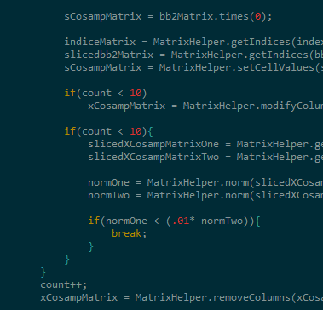
Sketch of ‘several’ keyword
Another Generalization of ‘once’
job do_some_job(A, B, C) {
several (10) {
do something only for 10 times.
}
}
job do_another_job(A, B, C) {
status (Named_state) [state2] {
do job for state2.
if (cond_for_state3)
Named_state <= [state3].
}
[state3] {
do job for state3.
}
}
excerpted from a Compressive Sampling Algorithm

Slide 24
Which Programming Language Inspires the Most Swearing?
From Andrew Vos’s blog

Slide 25
Proactive Debugging Support
Suggest Fixes for Runtime Errors
Interactive
Fixing the bytecode on the fly
Applicable Runtime errors:
Non-compatible Matrix size Error
A(m*n) * B(m*n) ➔ recommend + or -
Non-matched number of return variables Error
Operation Type Mismatches (no broadcasting)
e.g.) String + matrix

Slide 26
Conclusion
Applying Dynamic Code to programming languages with JVM-based backends
Can improve performance
Can reduce code size (not initially)
Can enhance Debuggability

