Slide 1
Android runtime environment the dalkvik vm and jit optimizatiOns
Neeraja Ramanan
COMS 6998: Advanced topics in Prog. Lang and Compilers

Slide 2
Overview
A brief (yet, hopefully comprehensive) overview of Android Runtime system
  Nice to know
  Keeping in mind the audience, keeping it brief
The Dalvik VM
  A little more detail
  Contrast with JVMs
JIT compiler in Dalvik
  The focus of this lecture
  The JIT flow
Demo – Runtime execution
Questions and Discussion

Slide 3
What is Android?
Android is a Linux-based operating system designed primarily for touchscreen mobile devices such as smartphones and tablets, developed by Google in conjunction with the Open Handset Alliance

Slide 4
Some history…
Open Handset Alliance (OHA)
  84 firms
  Open standards for mobile devices
  Google, HTC, Sony, Dell, Qualcomm, Intel, T-Mobile, etc
Beta version of SDK - 2007
Commercial product – HTC Dream – 2008 – Cupcake Android!

Slide 5
Growth
Everyday more than 1 million Android devices are activated worldwide – source http://developer.android.com
App store downloads:
  1.5 billion per month
Open-source code base:
  3.6M to 17.1M lines of code in 3.5 years
Iterative development
  New versions – biannual
  Annual flagship device

Slide 6
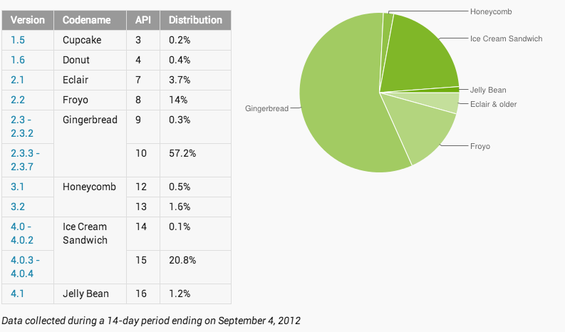
Version History
Image Source: http://developer.android.com

Slide 7
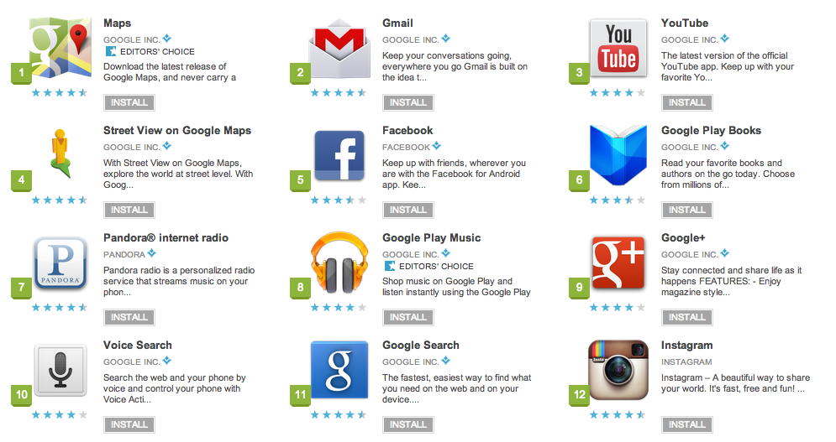
About a few apps
Google Nexus
  Flagship -> pure Android experience
  Mix-up the OEMs now and then
Open-source
As seen on Android Market – 10/01/2012

Slide 8
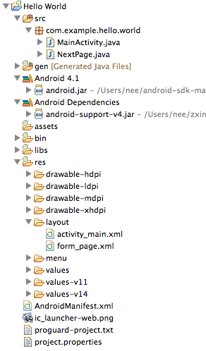
Structure of an App

Slide 9
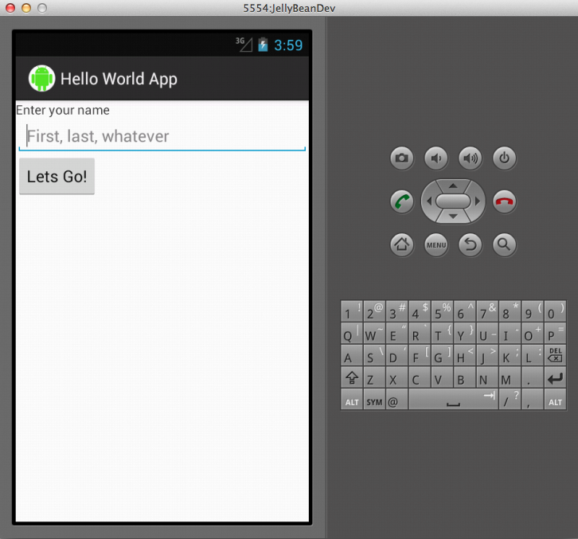
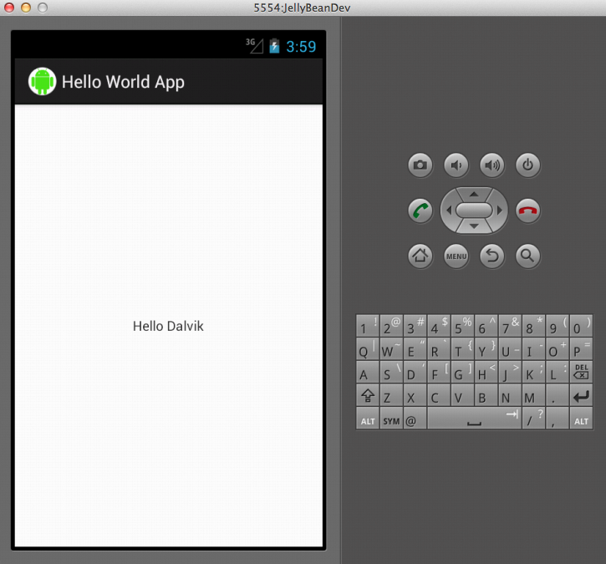
Hello Dalvik

Slide 10
Temple Run
Top 25 Downloaded Free App
Good benchmark
  Rendering of landscape
  Calculation of nodes
Stresses everything on the phone
Also, fun to test!

Slide 11


Screenshots
Image Source: Android Market

Slide 12
Introduction to logcat
Built-in logging tool
View the system logs as and when they occur
Best way to diagnose a problem
  Sometimes, only way!

Slide 13
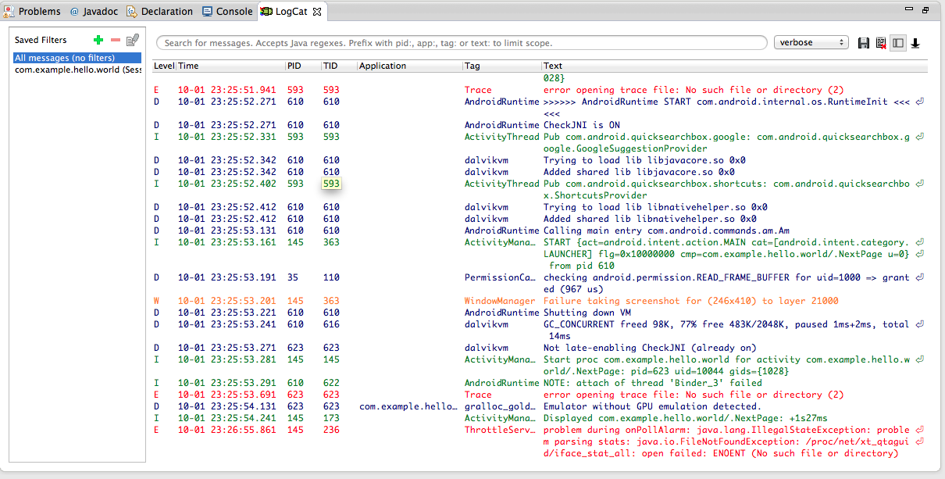
Screenshot

Slide 14
And now to business…

Slide 15
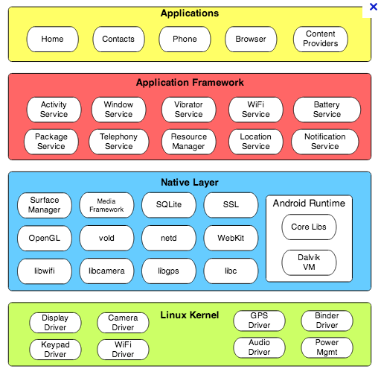
Anatomy of the Android
Image Source: http://marakana.com/static/slides/android_for_enterprise/index.html

Slide 16
Why the Linux kernel?
Memory and process management
Permission space and security model
Open source!
But its not Linux
  Not a windowing system
  Does not have glib c support
  Lots of Linux functionality not present

Slide 17
On Start-up
init – similar to Linux
  Starts the daemons which run the basic device drivers
  Also starts zygote
Zygote – nascent process at system boot time
  Initializes system libraries and loads it on to one dalvik
  This then starts the different modules on the framework
Then wait for socket requests from runtime processes
  Forks new VM instances for each request

Slide 18
Let’s take a small break before we talk about Dalvik

Slide 19
What is Dalvik?
It’s a process virtual machine
  To run on a slow CPU
  With a smaller RAM
  And an OS with no swap space
  While powered by a battery
Source: Dan Bornstein’s 2008 Google IO Talk; Dalvik VM Internals
Register-based
Relies on the Linux kernel for threading and low-level memory management

Slide 20
Why Dalvik?
Limited Memory
Limited RAM
Typical stats:
  Uncompressed .class – 100%
  Jar file - ~50%
  Dex files- ~40%
Significant for this size of memory

Slide 21
Why Dalvik?
Register-based VMs
  No intra-frame stack
  All registers are used – dense if interpreter is right
  This case: 30% fewer instructions; 35% code units
  However 35% more bytes - of the overheads of the dex file format
  BUT: Memory savings in the .dex file format
But wait, how do we really save memory because of .dex files?

Slide 22
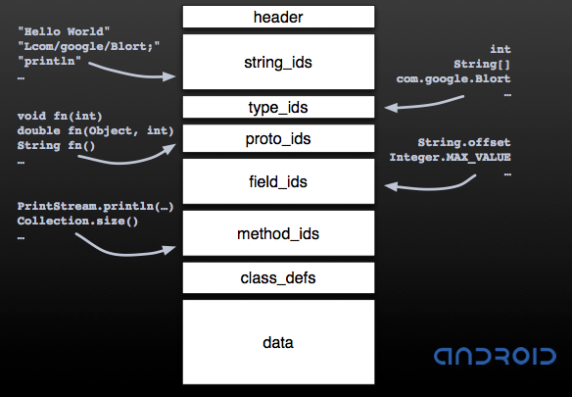
The Dex file format
Source: Dan Bornstein’s 2008 Google IO Talk; Dalvik VM internals

Slide 23
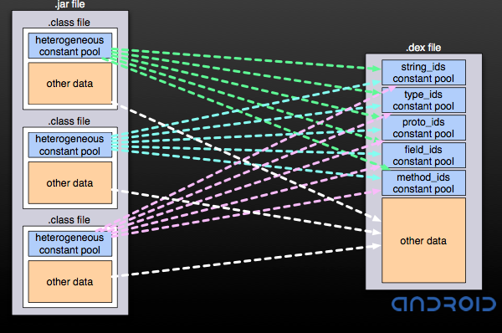
At build time
Source: Dan Bornstein’s 2008 Google IO Talk; Dalvik VM internals

Slide 24
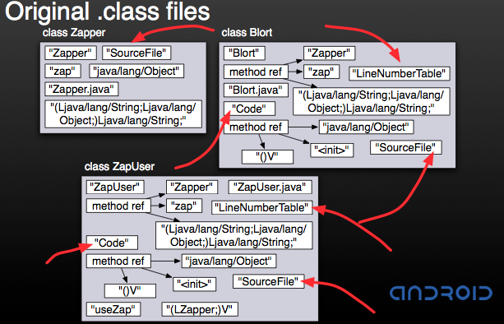
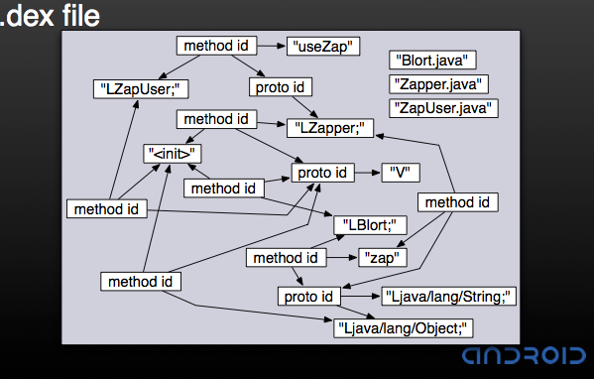
Contrasting…
Source: Dan Bornstein’s 2008 Google IO Talk; Dalvik VM internals

Slide 25
Garbage Collection in Dalvik
Mark-and-sweep strategy
Two types:
  Embedded marked bits – quicker
  Separate marked bits – more dense cache
Dalvik shares data across different processes
  Has to be individual marked bits

Slide 26
And moving on to… the Interpreter
Roughly twice as fast as the Java interpreter
Less than one-third of the time is spent here
Native libraries, statically compiled
But what about compute intensive applications?
  Dalvik byte code is compressed
  ~ 5 to 10 times increase in the footprint

Slide 27
Two Part Solution
Android NDK
  Isolate compute intensive sections
  Natively compile
  Neat, but not so nice!
JIT compiler

Slide 28
A quick break before we talk about the JIT

Slide 29
What does the JIT need to have/be
Take up minimal memory
Dalvik’s container security model
Quick delivery of boost
  No point if the user has to play the game 50 times
Smooth transition between modes of the code

Slide 30
But, quickly – What is a JIT
JIT compilers translate byte codes during run time to the native hardware instruction set of the target machine – Source: the dragon book; Compilers: Principles, Techniques and Tools – Aho, Lam, Sethi, Ullman
What it actually means
  Check for the compute intensive sections and natively compile them
  Beyond this, statically compiled

Slide 31
Flavors of JIT
Classified on how they identify the sections
Two Types:
  Method-based – each method is tracked
  Trace-based – different sections of the code

Slide 32
Method-based JIT
Most common – server style
Check for hot methods
Advantages:
  Good optimization window
  Transition boundaries – clearly demarcated
Disadvantages:
  Hot methods may contain cold sections
  More memory
  Longer to see benefit

Slide 33
Trace-based JIT
Chunks of straightened out instructions
Compiled in a trace
Chained in transition cache
Advantages:
  More tightly integrated with interpreter
  Detects exceptions and rolls back
  Quicker performance improvement

Slide 34
Trace-based JIT (cont’d)
Disadvantages:
  Window of optimizations
  Extra cost of transitions
  Can’t share across processes
Selected for Dalvik (for now):
  Minimize Memory use
  Example: System server 4.5 Mb, M-JIT – 8% ; T-JIT – only 2%
  Quicker performance
Future: Use Method-based JIT for interpretation when plugged in

Slide 35
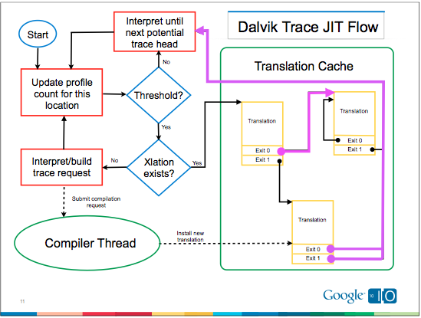
JIT Flow
Source: Ben Chung, Bill Buzzbee’s 2010 Google IO Talk; The JIT Compiler for Dalvik VM

Slide 36
Dalvik JIT
Each process has own translation cache - Threads share
Simple traces - One or two basic blocks
  String of instructions followed by branch-out
Optimizations
  Local
    Register promotion
    Load/store elimination
    redundant null-check elimination
    Heuristic scheduling
  Loop
    Simple
    Invariant code motion
    Induction variable optimization

Slide 37
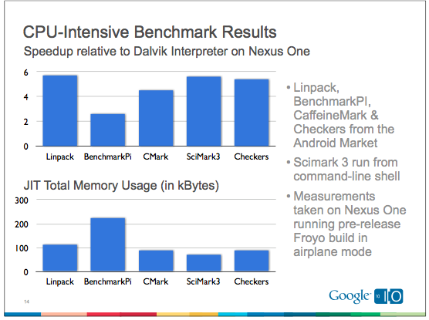
Benchmark Testing
Source: Ben Chung, Bill Buzzbee’s 2010 Google IO Talk; The JIT Compiler for Dalvik VM

Slide 38
How does it optimize
Resource consumed by the JIT
  Large code-cache
  No garbage collection
Large code bloat for native
  System server process
  Native is 7.7 times larger
Significantly smaller compilation time
  Reduces milliseconds to micro-seconds

Slide 39
Other features of the JIT
Has internal profiling version
  Oprofile will not work due to dynamic nature
  Just set a single command to enable profiling
Debugging tools
  Self-verification against the interpreter
  First disable JIT and check
  Then interleave with interpreter sequence
  Verify machine states

Slide 40
All fine, but where’s the benefit?

Slide 41
Consider Checkers
2010 bench mark
  Node traversed in a fixed amount of time
  Compared Froyo with JIT and Éclair version – 5.5x Speedup
For a game like temple run?
  RoboDefense – only 4.3%
  Conservatively: around ~2 to 5 times the speed up

Slide 42
Future Directions
Method inlining
Trace extension - to identify loops
Offline Translations
  Persistent profile
  Off-line trace and method translation

Slide 43
Demo

Slide 44
Summary
Android programming environment
  Uses Java and Eclipse
  Ease of developer use
To achieve that, the runtime environment has a lot of optimized feature
  Redesign the VM for hand-held computing systems- Dalvik
  Optimize the Dalvik for high performance
    Android NDK
    JIT Compiler in Dalvik

Slide 45
Questions and Discussion

Slide 46
Thank you for listening!

