Slide 1
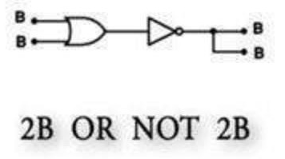
Bo01Zebra

Slide 2
Team Members
Digvijay Singh(ds3161) – Project Manager
Snigdha Reddy Challa(sc3545) – Language Guru
Rashmi Prithyani(rp2614) – System Integrator
Tanmay Mehrotra(tm2635) – System Architect
Nandita Rao(nr2445) – Test and Validation

Slide 3
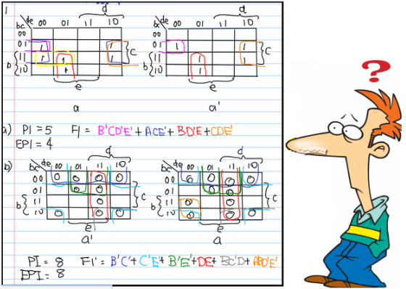
What is Bo01Zebra ??
Bo01Zebra is a programming language that allows you to understand Boolean Circuits in an intuitive visual manner. Enables you to write programs for creating Truth Tables. You can also use Bo01Zebra’s operators to calculate the SOP and POS.

Slide 4
Motivation
Have you just started at the board with its 1’s and 0’s when the professor explained the concepts of a truth table ?
Have you gazed trying to figure out how the truth table is reduced using a Kmap?
Or unable to decide how to design a real world problem using Boolean Logic ?

Slide 5
Hence the solution
Would you like your base truth table to be made for you, and you are just asked to fill in the result ?
Or maybe if you could validate your truth table
And even better – Flip the Kmap for groupings.

Slide 6
Feature Highlights
Easy to write intuitive language
Small compact power packed language
Several ways to define a truth table
Ways to view the truth table and Kmap
Reduced Boolean Expression
Compare user and auto generated Boolean constructs

Slide 7
BuzzWords
Robust Secure
Portable Domain –
Specific
Simple Easy to Use Visual

Slide 8
So how does the Bo01Zebra Language Code look like

Slide 9
Let’s say you want to
Reduce a Boolean Expression using Kmaps as taught in class.
With Bo01Zebra you can:
Create a Kmap
Fill in its values
Visually see the Kmaps to do the groupings
Flip Kmap Horizontally and Vertically.

Slide 10
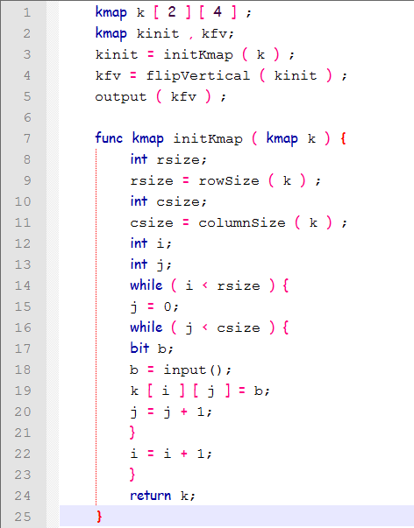
Just Write 25 Lines of Code in Bo01Zebra and your done !!

Slide 11
Just Write 25 Lines of Code in Bo01Zebra and your done !!

Slide 12
Just Write 25 Lines of Code in Bo01Zebra and your done !!

Slide 13
Just Write 25 Lines of Code in Bo01Zebra and your done !!

Slide 14
Just Write 25 Lines of Code in Bo01Zebra and your done !!

Slide 15
Just Write 25 Lines of Code in Bo01Zebra and your done !!

Slide 16
Just Write 25 Lines of Code in Bo01Zebra and your done !!

Slide 17
Just Write 25 Lines of Code in Bo01Zebra and your done !!

Slide 18
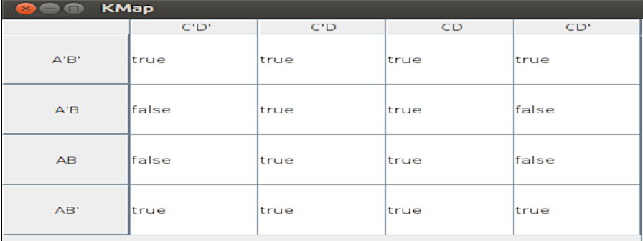
Output
Output of Original Kmap

Slide 19
Output
Output of Flipped Kmap

Slide 20
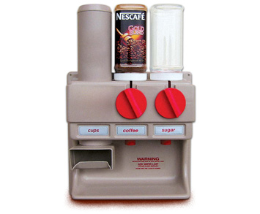
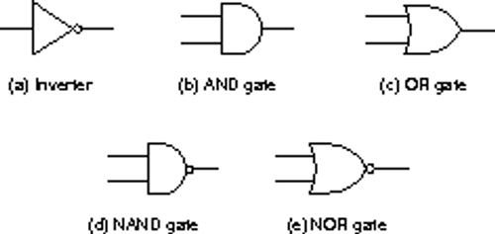
Another situation where
You are asked to design a real world problem that requires the knowledge of Boolean Circuits.
Ex: Designing a coffee machine to dispense at most one of tea, coffee and milk.
Which one to use ??

Slide 21
This is so Cool !!
Just write the following code in Bo01Zebra to help you come up with the expression for the coffee machine

Slide 22
This is so Cool !!
Just write the following code in Bo01Zebra to help you come up with the expression for the coffee machine

Slide 23
This is so Cool !!
Just write the following code in Bo01Zebra to help you come up with the expression for the coffee machine

Slide 24
This is so Cool !!
Just write the following code in Bo01Zebra to help you come up with the expression for the coffee machine

Slide 25
This is so Cool !!
Just write the following code in Bo01Zebra to help you come up with the expression for the coffee machine

Slide 26
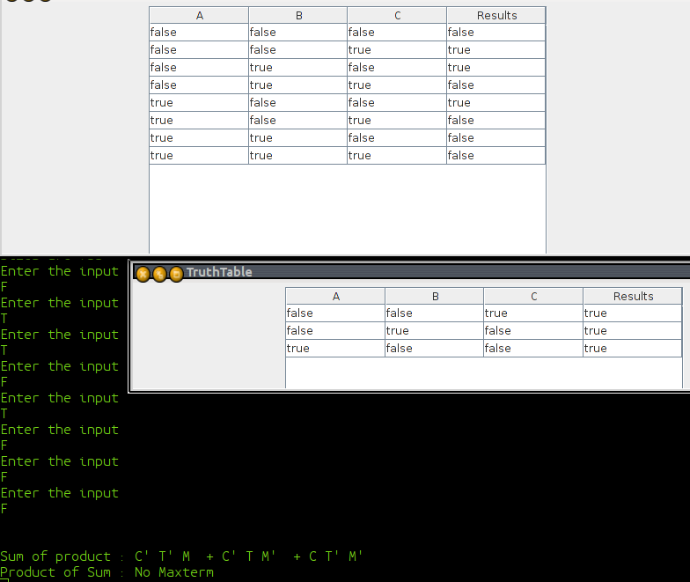
Output

Slide 27
DEMO!!!!!!!!

Slide 28
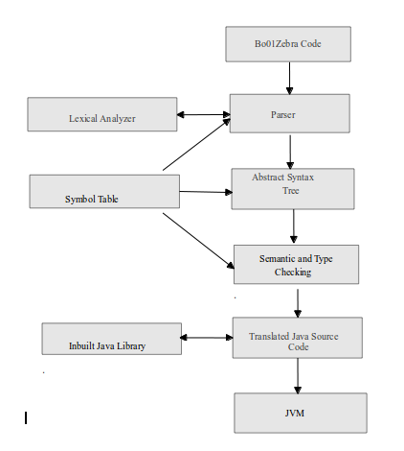
Compiler Architecture

Slide 29
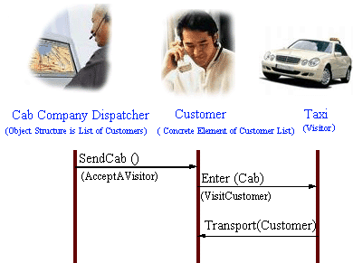
Visitor Design Pattern

Slide 30
What it is and how does it help ?
According to GoF, visitor design pattern helps in decoupling the operations from the object structure
helps in the centralization of operation code at one place, creating in a short span of time a more clearner and robust design
Lets go ahead and look at the following code this would make things clear!

Slide 31
public interface Visitor{
public void visit(Book book);
public void visit(Table Table);
}
public class RoadVisitor implements Visitor{
........
public void visit (Book book){
//computation of road fair for a book
}
public void visit (Table table){
//computation for road fair for a table
}
}
public class AirVisitor implements Visitor{
........
public void visit (Book book){
//computation for air for book
}
public void visit (Table table){
//computation for air for table
}
}

Slide 32
public interface Visitable{
public void accept(Visitor visitor);
}
public class Book implements Visitable{
public void accept(Visitor vistor){
visitor.visit(this);
}
}
public class Table implements Visitable{
public void accept(Visitor vistor){
visitor.visit(this);
}
}
public class DrivingVisitor{
private ArrayList<Visitable> items;
public double calculateFair(){
new Book().accept(new RoadVisitor());
new Table().accept(new airVisitor());
}
}

Slide 33
How does this relate to a compiler?
we do multiple traversal of AST to do operations like symbol table entry, type checking and translation.
These operations are performed by assigning each one of the operation to a particular visitor which then takes care of the whole operation.
One big advanatge - you don’t have to query the type of each node and cast the pointer to the correct type before performing the desired operation

Slide 34
Visitor Pattern In Bo01Zebra
goal : compilation_unit {
Nodelist nd=new Nodelist(n,lexer.getLine()+1);
ArrayList<ErrorMsg> errors=new ArrayList<ErrorMsg>();
SymbolTable symboltable=new SymbolTable();
nd.accept(new SymbolTableVisitor(symboltable,errors));
nd.accept(new TypeCheckerVisitor(symboltable,fdecl,errors));
….....................
nd.accept(new PrettyPrintVisitor(symboltable,errors));
}

Slide 35
Java Library
graphical output of truthtables and Kmaps
functionality to evalutes a boolean expression
compare functionality which assists user to confirm his understanding of kmaps and truthtable
functionality to make truthtable and kmap lookalike readymade data structures

Slide 36
Inbuilt Functionality
String Input( )
int CountVariables( )
String[ ] nameOfVariables(String bexp)
boolean compare(Kmap k_user, String bexp)
boolean compare(TruthTable tt, String bexp)
boolean comparebexp(String bexp1, String bexp2)
Kmap flipVertical()
Kmap flipHorizontal()
…..........few others

Slide 37
Walk Through Sample Code
bexp be;
bit A , B , C ;
int num;
be = A and B or C;
num = countVariables ( be ) ;
truthtable t1 [ be ] ;
truthtable t2 [ num ] ;
t2 = t1 @ T;
output ( t1 ) ;
output ( t2 ) ;

Slide 38
Lexer
bexp be;
bit A , B , C ;
int num;
be = A and B or C;
num = countVariables ( be ) ;
truthtable t1 [ be ] ;
truthtable t2 [ num ] ;
t2 = t1 @ T;
output ( t1 ) ;
output ( t2 ) ;

Slide 39
Lexer
bexp be;
bit A , B , C ;
int num;
be = A and B or C;
num = countVariables ( be ) ;
truthtable t1 [ be ] ;
truthtable t2 [ num ] ;
t2 = t1 @ T;
output ( t1 ) ;
output ( t2 ) ;

Slide 40
Lexer
bexp be;
bit A , B , C ;
int num;
be = A and B or C;
num = countVariables ( be ) ;
truthtable t1 [ be ] ;
truthtable t2 [ num ] ;
t2 = t1 @ T;
output ( t1 ) ;
output ( t2 ) ;

Slide 41
Lexer
bexp be;
bit A , B , C ;
int num;
be = A and B or C;
num = countVariables ( be ) ;
truthtable t1 [ be ] ;
truthtable t2 [ num ] ;
t2 = t1 @ T;
output ( t1 ) ;
output ( t2 ) ;

Slide 42
Lexer
bexp be;
bit A , B , C ;
int num;
be = A and B or C;
num = countVariables ( be ) ;
truthtable t1 [ be ] ;
truthtable t2 [ num ] ;
t2 = t1 @ T;
output ( t1 ) ;
output ( t2 ) ;

Slide 43
Lexer
bexp be;
bit A , B , C ;
int num;
be = A and B or C;
num = countVariables ( be ) ;
truthtable t1 [ be ] ;
truthtable t2 [ num ] ;
t2 = t1 @ T;
output ( t1 ) ;
output ( t2 ) ;

Slide 44
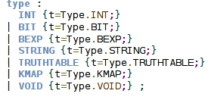
Parser
bexp be;
bit A , B , C ;
int num;
be = A and B or C;
num = countVariables ( be ) ;
truthtable t1 [ be ] ;
truthtable t2 [ num ] ;
t2 = t1 @ T;
output ( t1 ) ;
output ( t2 ) ;

Slide 45
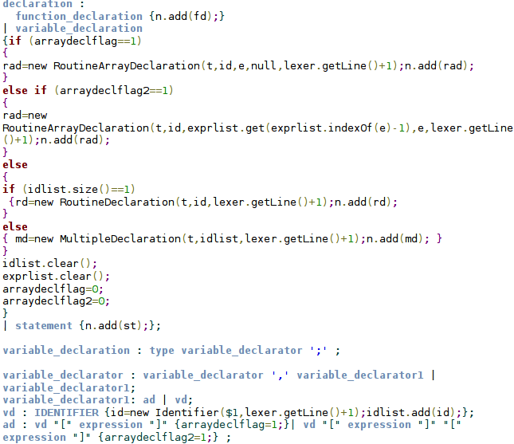
Parser
bexp be;
bit A , B , C ;
int num;
be = A and B or C;
num = countVariables ( be ) ;
truthtable t1 [ be ] ;
truthtable t2 [ num ] ;
t2 = t1 @ T;
output ( t1 ) ;
output ( t2 ) ;

Slide 46
Parser
bexp be;
bit A , B , C ;
int num;
be = A and B or C;
num = countVariables ( be ) ;
truthtable t1 [ be ] ;
truthtable t2 [ num ] ;
t2 = t1 @ T;
output ( t1 ) ;
output ( t2 ) ;

Slide 47
Parser
bexp be;
bit A , B , C ;
int num;
be = A and B or C;
num = countVariables ( be ) ;
truthtable t1 [ be ] ;
truthtable t2 [ num ] ;
t2 = t1 @ T;
output ( t1 ) ;
output ( t2 ) ;

Slide 48
Parser
bexp be;
bit A , B , C ;
int num;
be = A and B or C;
num = countVariables ( be ) ;
truthtable t1 [ be ] ;
truthtable t2 [ num ] ;
t2 = t1 @ T;
output ( t1 ) ;
output ( t2 ) ;

Slide 49
Parser
bexp be;
bit A , B , C ;
int num;
be = A and B or C;
num = countVariables ( be ) ;
truthtable t1 [ be ] ;
truthtable t2 [ num ] ;
t2 = t1 @ T;
output ( t1 ) ;
output ( t2 ) ;

Slide 50
AST nodes

Slide 51
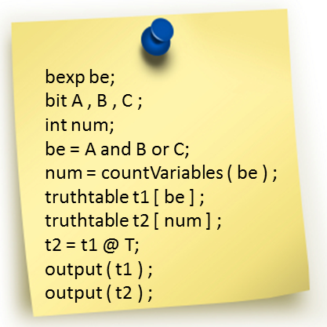

Slide 52
Symbol Table and Type Checking
Type Checking:
Check the types of operands in expressions.
Check return types of functions.
Check sizes of truthtables, arrays.

Slide 53
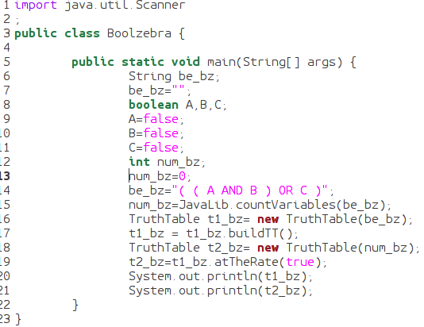
Translated Java Code

Slide 54
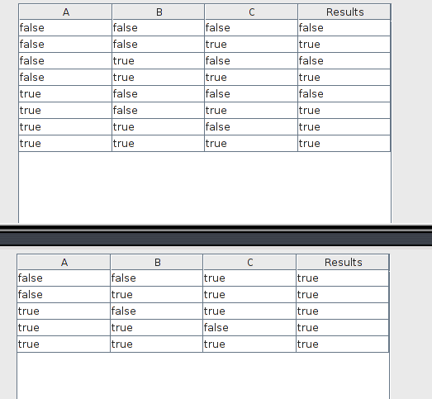
Output

Slide 55
Execution Environment

Slide 56
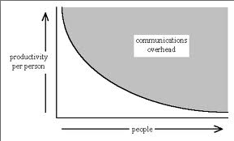
Process used to manage Project
Team meetings suiting everyone's schedule
Regular email exchange with TA mentor, and meeting when required.
Very important that each team member is on the same page.
Communicate among each other

Slide 57
Process used to manage Project
Deadlines rock! (Good to be a little strict, than doing everything last moment)
Take up somebody else's work in case of unavailability
Respect the time and effort each member has put in.

Slide 58
Testing
Phase 1 – Construct verification
157 test cases

Slide 59
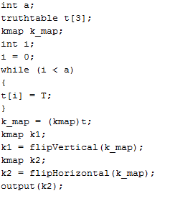
Testing
Phase 2 – Writing programs in Bo01Zebra
Wrote programs like anybody new to Bo01Zebra would, by referring the LRM.

Slide 60
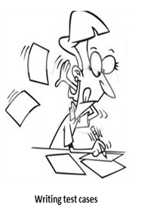
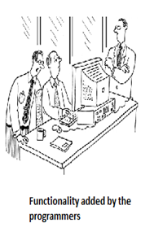
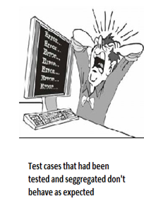
Problems in testing

Slide 61
Lessons Learned
Version control is a MUST!
Strict deadlines from the beginning are necessary.
More time should be spent on Design before starting programming.

Slide 62
Thank you!

