Slide 1

The Email Sending and Editing Language
Members:
Yuting Chen (Program Manager)
Serge Yegiazarov (Language Guru)
Curtis Cooper (System Architect)
Jiazhen Zhou (System Integrator)
I-Hung Wang (System Tester)
Karan Bathla (Mentor)

Slide 2
What is EliteMail?
EliteMail is a language designed to make the sending of mass customized emails incredibly simple and intuitive.
It operates using Oracle’s JavaMail API, but abstracts away all the messy details.
Should be incredibly useful to anyone who has to routinely send out lists of emails, including HR representatives, professors, managers, etc.
Uses a familiar and clean C-like syntax.

Slide 3
Why Do You Care?
Suppose you want to send a “Happy New Years!” message to an entire mailing list, but want to personalize each one with a name.
Suppose you want to send a congratulatory message to an entire mailing list, but don’t want to send the exact same one everywhere.
Suppose you want to send to an entire mailing list, but want to send one type of email to one type of colleague, and another to another type.

Slide 4
Can You Tell Me More Then?
EliteMail builds on top of Java’s incredibly powerful virtual machine, leveraging only the code segments needed for an email language.
An EliteMail source file is translated to a Java file, which is then run on the JVM to produce results.
Error checking occurs on front and back end.
Imperative, strongly and statically typed, statically scoped, pass by value, NE evaluation.

Slide 5
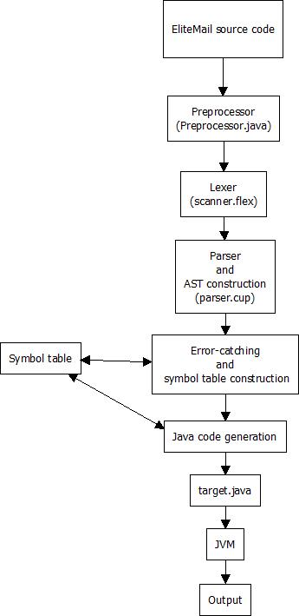
The Translator:

Slide 6
Translation In Action: Example
#account{
host = smtp.gmail.com;
username = rrichardson@gmail.com;
password = password1234;
}
main{
message happyNewYears = “Happy New Years!”;
list<string> contactList;
contactList.add(“yuting@gmail.com”, “curtis@gmail.com”);
foreach string s in contactList{
send(“Hello!”, happyNewYears, s);
}
}

Slide 7
Lexer
“ main ” -->
“ { ” -->
“ message ” -->
“ happyNewYears ” -->
“ = ” -->
“ “ ” -->
“ Happy ” -->
“ New ” -->
“ Years! ” -->
“ ” ” -->
“ ; ” --> …etc

Slide 8
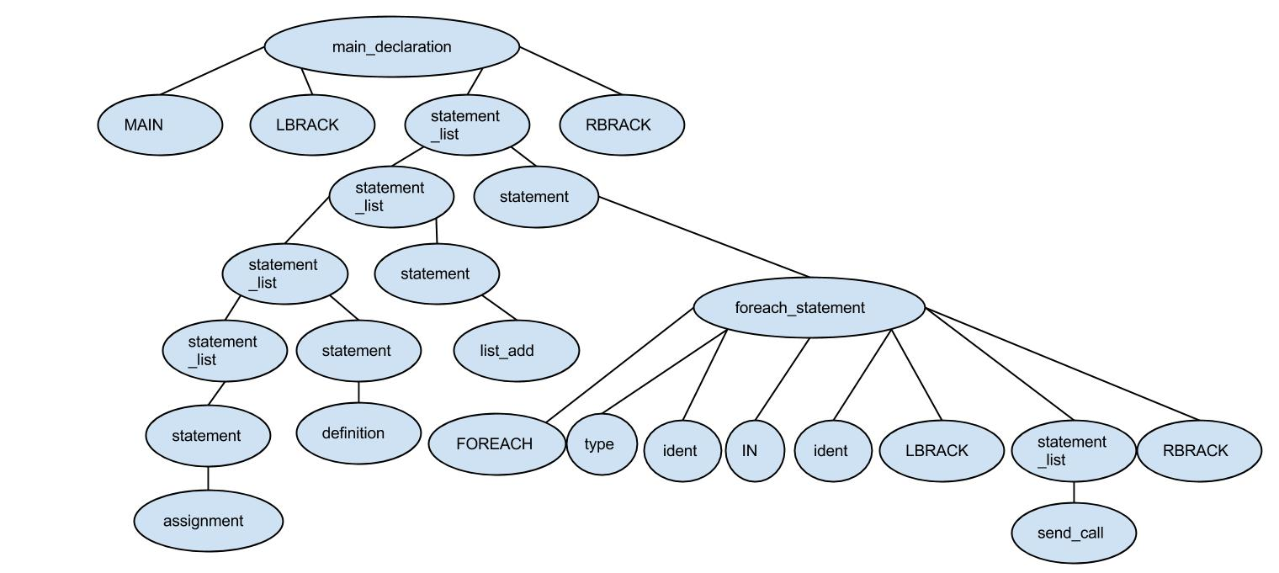
Parse Tree

Slide 9
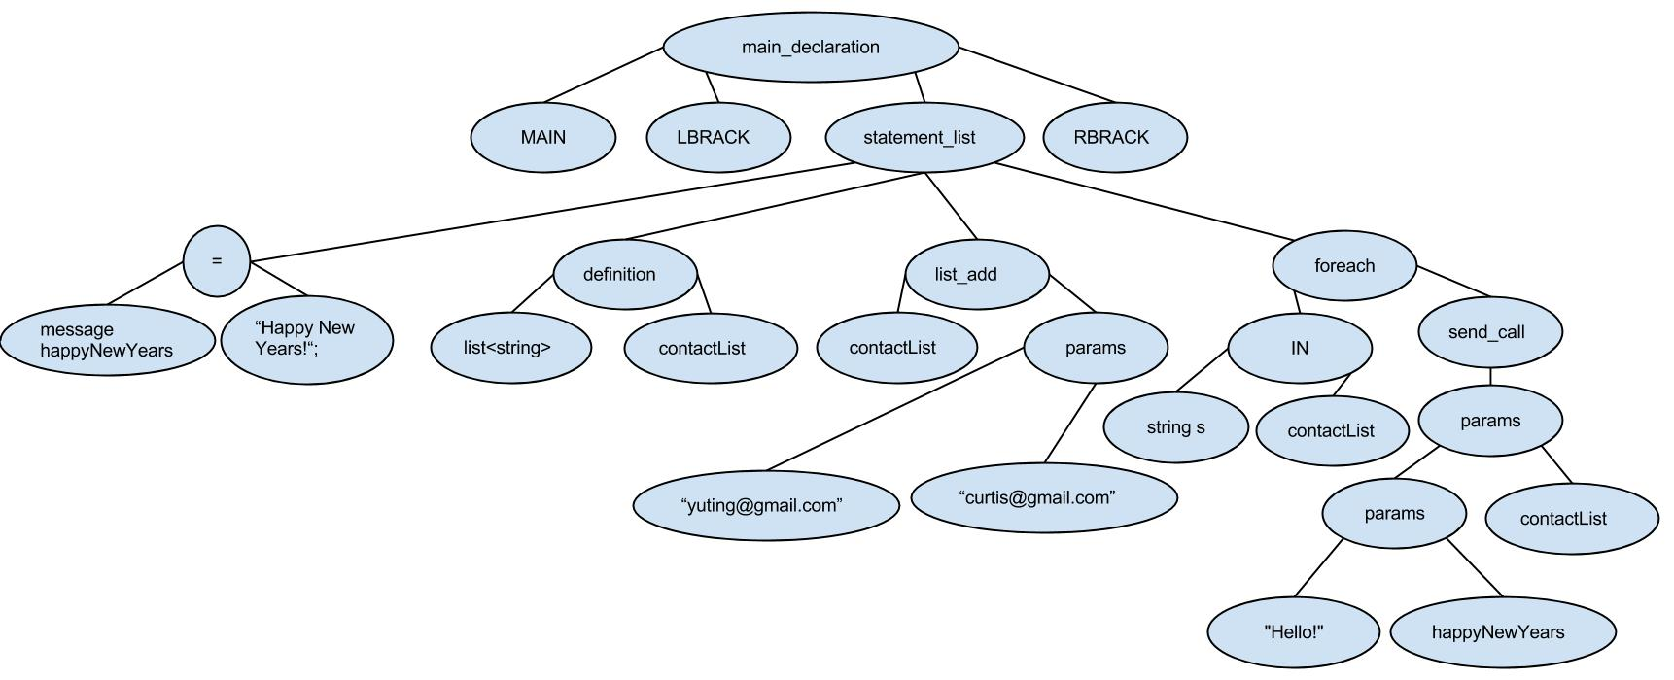
AST

Slide 10
Symbol Table
Address | Type | Name
00000020 | message | happyNewYears
00000040 | list<string> | contactList
00000080 | string | s

Slide 11
Final Java Code
public class Target {
public static void main(String[] args) throws Exception {
String happyNewYears = "Happy New Years!";
ArrayList<String> contactList = new ArrayList<String>();
contactList.add("yuting@gmail.com");
contactList.add("curtis@gmail.com");
for (String s : contactList) {
Properties props = new Properties();
props.put("mail.smtp.auth", "true");
props.put("mail.smtp.starttls.enable", "true");
props.put("mail.smtp.host", "smtp.gmail.com");
final String username = "rrichardson@gmail.com”;
final String password = “password1234";
Session session = Session.getInstance(props, new javax.mail.Authenticator() {
protected PasswordAuthentication getPasswordAuthentication() {
return new PasswordAuthentication(username , password);
}
});
try {
Message message = new MimeMessage(session);
message.setRecipients(Message.RecipientType.TO, InternetAddress.parse(s));
message.setSubject("Hello!");
message.setText(happyNewYears);
Transport.send(message);
} catch (MessagingException e) {
throw new RuntimeException(e);
}
}
}
}

Slide 12
Program 1
Showcases structs and wildcards.

Slide 13
Program 2
By Karan Bathla
Showcases user-defined functions, control flow, and wildcards.

Slide 14
Program 3
Showcases #insert, import(), export(), and wildcards.

Slide 15
How Do We Execute All This?
EliteMail is largely a translator, so it does not have its own runtime environment per se. Our environment works by translating EliteMail source code into a Java file.
The Java file is then executed through the usual Java virtual machine. Thus, the runtime environment of EliteMail is essentially the runtime environment of Java.
The execution environment consists of three main portions: the Main driving file, all the AST node classes, and the symbol table.
We are able to run this setup via both Eclipse and command line + .jar file.

Slide 16
What Tools Were Used?
JFlex and CUP were used to develop the lexer and parser.
Windows batch scripts were used as early “makefiles”, but later moved to Eclipse.
Notepad++ first used to edit Java files, but later Eclipse.
GitHub for version control.
Google Drive for early lexer + grammar development, papers, and idea exchange.

Slide 17
Early “Makefile”
del Yylex.java
call jflex scanner.flex
del parser.java
java -jar java-cup-11a.jar -interface parser.cup
javac -cp java-cup-11a-runtime.jar javax.mail.jar AST.java parser.java sym.java Symtab.java SymtabEntry.java Tstring_literal.java Tmessage_literal.java Tdefinition.java Texp.java Tident.java Tlist.java Tmain_declaration.java Tmessage.java Tnumber.java Tobject_function_call.java Tpar.java Tparlist.java Tprogram.java Tsend_call.java Tstatement_list.java Tstatement.java Tstring.java Tstruct_declaration_list.java Tstruct_declaration.java Tstruct_field_declaration_list.java Tstruct_field_declaration.java Ttype.java Yylex.java Main.java
java -cp java-cup-11a-runtime.jar;javax.mail.jar;. Main<example.as
PAUSE

Slide 18
How’d We Manage This?
Roles were assigned, but were kept intentionally loose.
Weekly (but necessary) meetings were had.
Constant communication via Google Docs.
One person would initiate section, and others would build on top of it.
“Agile” methodology – test while you code.
Project success ultimately dependent on desire and discipline of the group.

Slide 19
How Can You Even Test This?
A Windows batch file was used to pump multiple EliteMail source files into the compiler, while keeping track of errors.
boolean bool = 999;
Result: Failure
type mismatch (999 does not match boolean)
int score = abc;
Result: Failure
type mismatch (abc does not match int)
list<contact> plt;
add(plt);
Result: Failure
add() takes two arguments

Slide 20
So, What Have We Learned?
It is important to begin early and work consistently (consistently meaning a little bit each week, instead of putting in a lot of work one week and taking the next week off).
It is good to keep in touch with your advisor, as he/she has lots of helpful advice.
There is no shame in reaching out to anybody for help - sometimes even the smallest bit of support can give your project weeks worth of progress.
Google Docs is a very useful tool for team communications, but is not ideal for sharing code. Used together with GitHub however, just about all coordination efforts are covered.
Having things planned out early was important and defined reasonable milestones at each development stage.
Make compromises when necessary.

