Slide 1
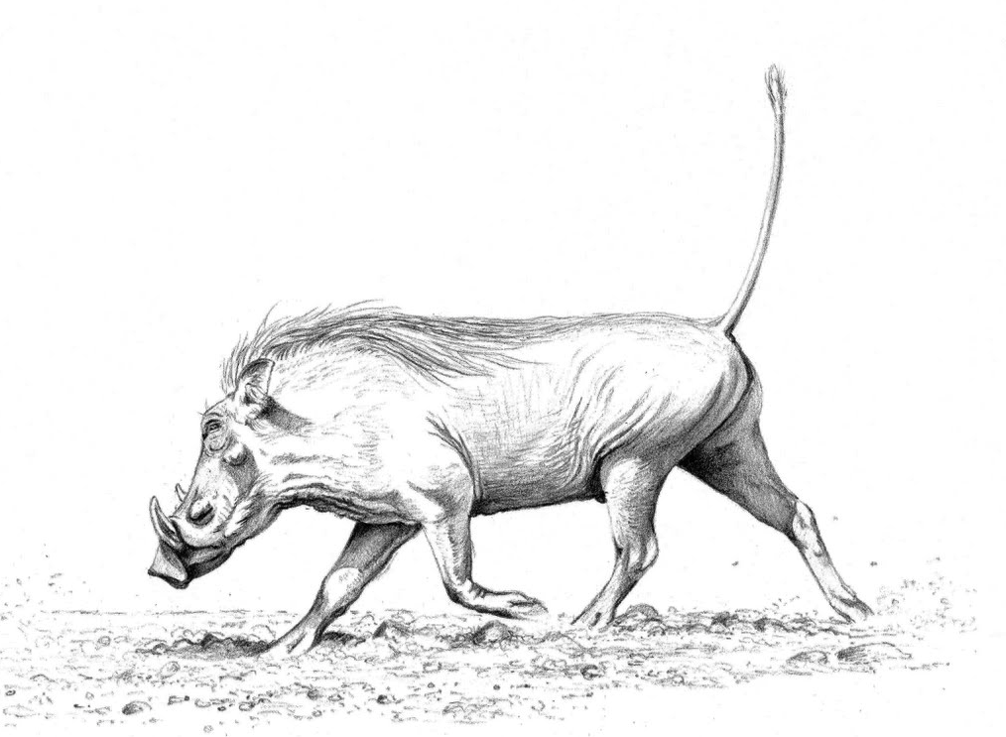
The Hog Language
Jason Halpern
Testing/Validation
Samuel Messing
Project Manager
Benjamin Rapaport
System Architect
Kurry Tran
System Integrator
Paul Tylkin
Language Guru
A scripting MapReduce language.

Slide 2
outline
Introduction (Sam)
Syntax and Semantics (Paul)
Compiler Architecture (Ben)
Runtime Environment (Kurry)
Testing (Jason)
Demo
Conclusions

Slide 3
Introduction
Samuel Messing (Project Manager)

Slide 4
Motivation
Say you’re…
Say you’re…
a corporation,
with data from your mail server,
and you want to find out the average amount of time a client waits for a response…
a statistician,
with millions upon millions of data points,
and you need descriptive statistics about your sample…
Samuel Messing (Project Manager)

Slide 5

It’s time to think distributedly.
More and more, we’re looking to distributed-computation frameworks such as Apache’s Hadoop MapReduce™ for ways to process massive amounts of data as quickly as possible…
Out
R
M
R
M
R
M
M
M
In
M
Samuel Messing (Project Manager)

Slide 6
Say you want to…
Sort 400K numbers stored in a text file, e.g.,
user@home ~ > head -12 numbers.txt
1954626 53347517 849648024 9657788
2347498 33984398 463743309 6134796
7105100 3091405 521851259 5918563
2131501 85799847 721508718 1247805
397861 30679201 223117730 1790475
1488469 98776106 584707188 4480355
4913326 71618420 718037263 9947687
5655971 50369050 760931522 3130455
8724084 18220824 487366423 2279977
3499188 82965874 954984276 1356189
160876 11574903 295671087 2205428
4850150 58224366 109125742 3271166
Samuel Messing (Project Manager)

Slide 7
Just write eleven lines of code
Eleven lines of Hog code are enough to,
Read in gigabytes of data formatted as,
      1293581234 821958 73872 87265982 4272 112371 5455423...
Distribute the data over a highly scalable network of computers,
Synchronize computation across multiple machines to sort and remove duplicate numbers,
Store the sorted set of numbers on a fault-tolerant distributed file-system.
Running your sort program is as easy as typing,
user@home ~ > Hog Sort.hog input/numbers.txt
Samuel Messing (Project Manager)

Slide 8







Project development
Samuel Messing (Project Manager)

Slide 9
The language
Paul Tylkin (Language Guru)

Slide 10
Program Structure
@Functions:
User-defined functions
@Map
Define map stage of MapReduce
@Reduce
Define reduce stage of MapReduce
@Main
Call MapReduce(), other tasks
Paul Tylkin (Language Guru)

Slide 11
Word count (@Map)
0 @Map (int lineNum, text line) -> (text, int) {
1 # for every word on this line,
2 # emit that word and the number ‘1’
3 foreach text word in line.tokenize(" ") {
4 emit(word, 1);
5 }
6 }
Paul Tylkin (Language Guru)

Slide 12
Word count (@Reduce)
7 @Reduce (text word, iter<int> values) -> (text, int) {
8 # initialize count to zero
9 int count = 0;
10 While (values.hasNext()) {
11 # for every instance of '1' for this word, add to count.
12 count = count + values.next();
13 }
14 # emit the count for this particular word
15 emit(word, count);
16 }
Paul Tylkin (Language Guru)

Slide 13
Word count (@Main)
17 @Main {
18 # call map reduce
19 mapReduce();
20 }
Paul Tylkin (Language Guru)

Slide 14
User-defined functions (@Functions)
0 @Functions {
1 int fib(int n) {
2 if (n == 0) {
3 return 1;
4 } elseif (n == 1) {
5 return 1;
6 } else {
7 return fib(n-1) + fib(n-2);
8 }
9 }
Paul Tylkin (Language Guru)

Slide 15
User-defined functions (@Functions)
10 list<int> reverseList(list<int> oldList) {
11 list<int> newList;
12 for (int i = oldList.size() - 1; i >= 0; i--;) {
13 newList.add(oldList.get(i));
14 }
15 return newList;
16 } # end of functions
Paul Tylkin (Language Guru)

Slide 16
A simple distributed sort
0 @Map (int lineNum, text line) -> (text, text) {
1 foreach text number in line.tokenize(" ") {
2 emit(number, number);
3 }
4 }
5 @Reduce (text number, iter<text> garbage) -> (text, text) {
6 emit(number, "");
}
8 @Main {
9 mapReduce();
10 }
Paul Tylkin (Language Guru)

Slide 17
architecture
Benjamin rapaport (system Architect)

Slide 18
Hog Platform Architecture
Hog Source
Hog Compiler
Output
Hog.java
Java Compiler
Reduce
Hog.jar
Input
Hadoop Framework
Map
Benjamin Rapaport (System Architect)

Slide 19


Hog Compiler Architecture
Hog Source
Java MapReduce Program
Lexer
Java Generating Visitor
Token Stream
Fully Decorated AST
Parser
Symbol Table
Semantic Analyzer
AST
Fully Decorated AST
Symbol Table Visitor
Type Checking Visitor
Partially
Decorated AST
Benjamin Rapaport (System Architect)

Slide 20
runtime
Kurry tran (System integrator)

Slide 21
Makefile and Shellscript
Hog Compiler – Compiles Hog Source to Java Source
Java Compiler – Compiles Java Source with Hadoop Jars
Copies Input Data into HDFS
Executes Job on Hadoop Cluster
Reports Results to User
Kurry Tran (System Integrator)

Slide 22
Runtime Environment
JVM | Default Memory Used (MB) | Memory Used for 8 Processors
Datanode | 1,000 | 1,000
Tasktracker | 1,000 | 1,000
Tasktracker Child Map Task | 2x200 | 7x400
Tasktracker Child Reduce Task | 2x200 | 7x400
Total | 2,800 | 7,600
Kurry Tran (System Integrator)

Slide 23
Testing
Jason halpern (testing/validation)

Slide 24
Iterative Testing Cycle
White Box Tests
  Test Internal Structure: token streams, nodes, ASTs
Black Box Tests
  Test Functionality
Six Phases of Unit Testing
JUnit
Lexer Testing
Parser Testing
AST Testing
Code Generation
Testing
Type Checker Testing
Symbol Table Testing
Jason Halpern (Testing/Validation)

Slide 25
INTEGRATION TESTING
Sample Programs
  Word Count
  Sort
  Log Processing
Exception Handling and Errors
  Undeclared Variables
  Invalid Arguments
  Type Mismatch
Testing on Amazon Elastic MapReduce
  Upload Compiled Jar from Hog Program
  Create Job Flow and Launch EC2 Instances
  Analyze Output Files
Jason Halpern (Testing/Validation)

Slide 26
demo

Slide 27
conclusions
The hog team

Slide 28
conclusions
Modularity is key.
Expend the effort to reduce development time.
Pare down your goals as much as possible in the beginning, allow yourself to not know at every stage how your language will develop.
Work in the same room as your teammates.

Slide 29
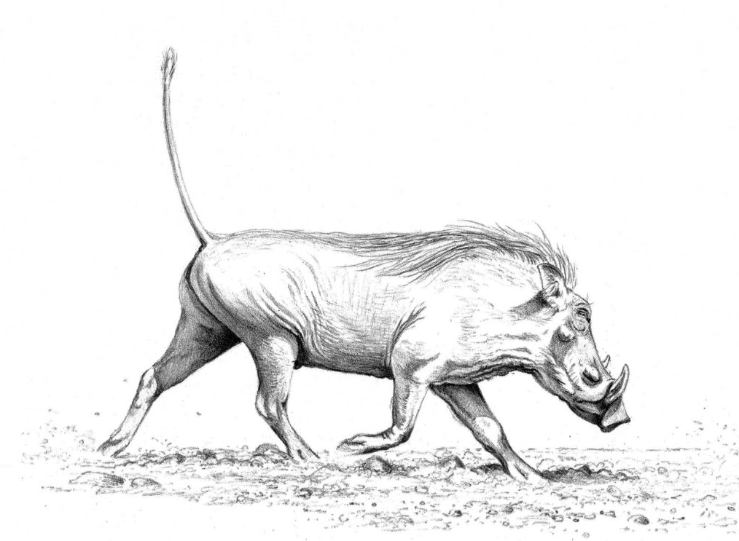
Thank you!

Slide 30
Hadoop Architecture
A small Hadoop cluster will include a single master and multiple worker nodes.
Master Node – JobTracker, TaskTracker, NameNode, and DataNode
DataNode – Sends blocks of data over the network using TCP/IP layer for communication; clients use RPC to communicate between each other.
JobTracker – Sends MapReduce tasks to nodes

Slide 31
Hadoop Architecture (Continued)
NameNode – Keeps the directory tree of all files in the file system, and trackers where file data is kept.
TaskTracker– A node in the cluster that accepts tasks.
    The TaskTracker spawns separate JVM processes to do work to ensure process failure does not take down the task tracker.
    When the process finishes, successfully or not, the tracker notifies the JobTracker.

Slide 32
Performance Benefits
Improves CPU Utilization
Node Failure Recovery
Data Awareness
Portability
Six Scheduling Priorities

