Slide 1
Graphite
Grigory Arashkovich, Anuj Khanna, Anirban Gangopadhyay, Michael D’Egidio, Laura Willson

Slide 2
Outline
Introduction
Why Use Graphite
Example
Challenges
Lessons Learned

Slide 3
Introduction
Graphite is a high level programming language
Graphite is designed for users who want to minimize tedious syntax whilst being able to perform effective data visualization
Designed for people who don’t want to learn the semantics of web programming but want to be able to execute proper data visualization
Inputs in a source file that follows the syntax as specified in the language reference manual
Outputs an html page that contains the desired charts

Slide 4
Why Use Graphite
Domain Specific- Designed to help new programmers and people inexperienced with web programming be able to output html charts and graphs using high level Java-like syntax
Easy to Use- The syntax created is very similar to that of Java’s. Built in chart types and the Series data structure are supplied with the language
Portable- Source code can be run on any machine and compiled due to portable Java backend
Web Friendly- Nice html charts are outputted by the program

Slide 5
Source Program
class MichaelPLT {
void main {
Barchart grades;
grades.name = “Michael’s Grades for PLTs”;
grades.subtitle = “Spring 2012”;
Series<String> assignments = {“HW1”, “HW2”, “HW3”, “HW4”, “Final”};

Slide 6
Source Program Continued
grades.xCoordinate = assignments;
grades.yCoordinate = assignmentGrades;
grades.xAxis = “Assignments”;
grades.yAxis = “Grade out of 100”;
Page p;
p.add(grades);
p.save(“MichaelPLT.html”);

Slide 7
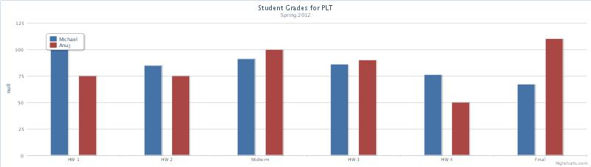
Program Output

Slide 8
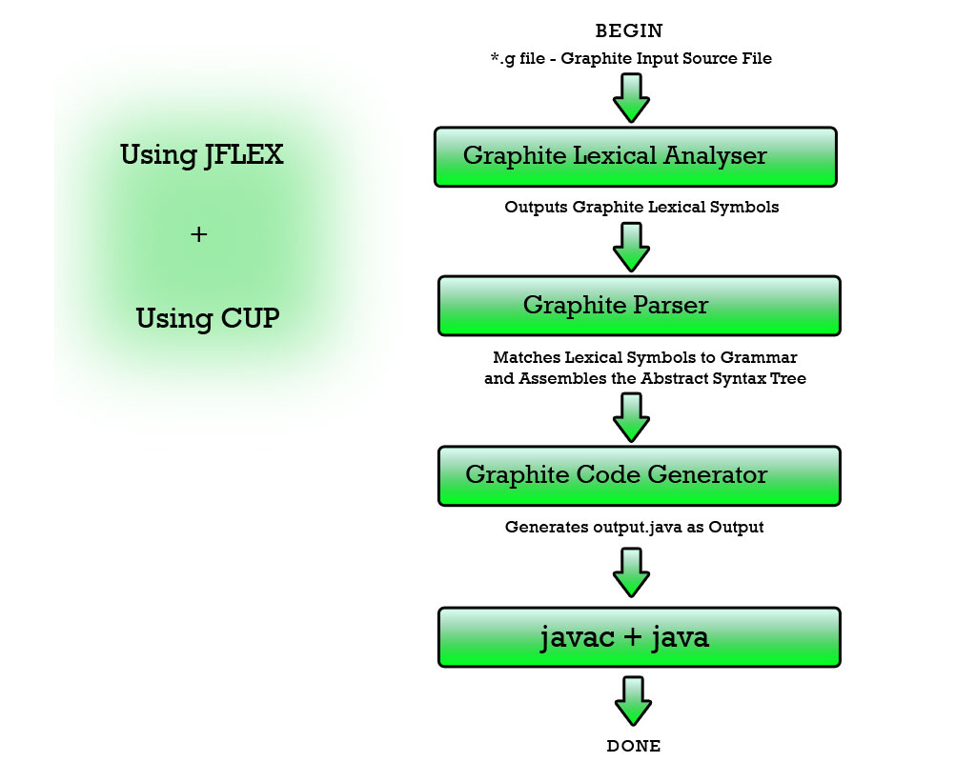

Slide 9
Grammar
Implemented using a .CUP file with SDTS in Java
Implements control flow, variable declarations, field instantiations, Graph type declarations
Utilizes synthesized and inherited attributes
Main problem that the team faced was cutting the grammar down to a reasonable length

Slide 10
Abstract Syntax Tree
Implemented using the Java programming language.
Using the syntax directed translations and the decompile() method, we implemented code generation and successfully compiled down to the Java Programming language.
The syntax tree is comprised of both a traditional tree structure and linked lists

Slide 11
Scope/Type Checking
Scoping algorithm would instantiate and set required table entries into the symbol table during the first traversal of the Abstract Syntax Tree
We attempted to work on scoping and type checking algorithms by doing a second traversal of the AST and comparing identifiers with declared class names, function names and variables

Slide 12
Code Generation
Implemented directly in the ASTNode class
Each tree node implements the decompile() method which recursively generates Java source code given Graphite code by calling the decompile() method on the children and returning a string that contains the compiled Java code

Slide 13
JavaScript Creation
JavaScript packages written in Java are designed to input Java source code and output charts created in JavaScript
The JavaScript code is run using the HighCharts API
The front end wraps the Chart classes, GraphiteNumber, GraphiteString and the Series classes

Slide 14
Challenges
Balancing the complexities of the grammar and the abstract syntax tree
Debugging the grammar for the language
Making design decisions on the robustness of the grammar

Slide 15
Hand created sample ASTs to test the Intermediate Representation
Tested system integration
Black box testing on front end and back end separately
JavaScript code generation throws multiple errors if handled incorrectly
Testing

Slide 16
Lessons Learned
Test code while writing it!
Plan out design decisions before starting implementation!
Set strict deadlines and adhere to them throughout the allotted time!

