Slide 1

David LOU – Project Manager
Markus SCHANTA – Language Guru
Long CHEN – System Architect
Xiaolong JIANG – System Integrator
Jingbo YANG – Tester & Validator

Slide 2
SIMPL - Motivation
General purpose languages require quite a bit of overhead to read and write images using builtin libraries.
Pixel-by-pixel manipulation is quite tedious. To do the same manipulation to the same pixel, you must use nested for loops in Java.
Image manipulation software (e.g. Photoshop) are very limited in the types of automated manipulation that one might perform.

Slide 3
SIMPL – Feature Highlights
Arrays in SIMPL are fixed in dimension, but dynamic in size.
Operators are overloaded to perform element-wise manipulations on arrays.
Mathematical builtin functions (e.g. log, pow) are also overloaded for element-wise manipulation on arrays.

Slide 4


Example 1 – Correcting Brightness

Slide 5
Example 2 – Image Difference

Slide 6
Example 3 – Noise Reduction

Slide 7
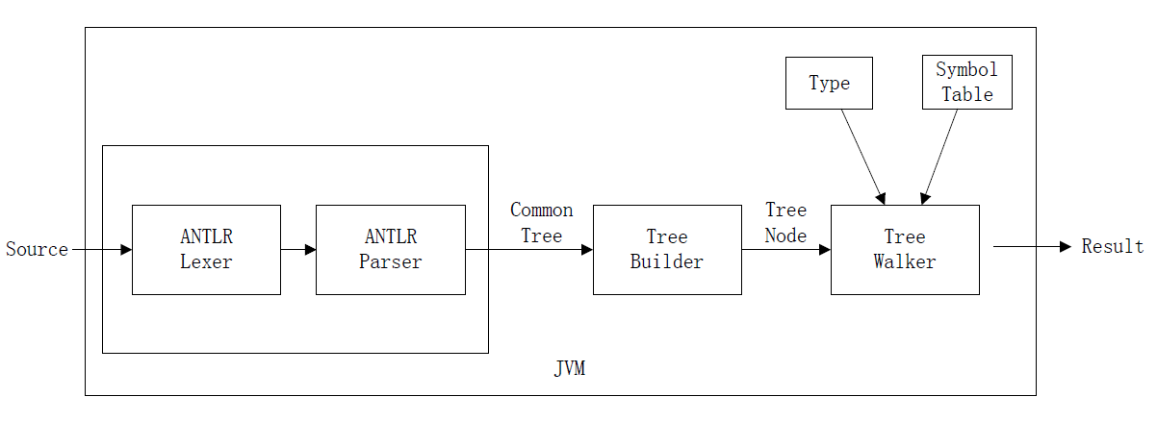
SIMPL – Translator Architecture

Slide 8
SIMPL – Implementation Highlights (Symbol Table)
Symbol Table: A Stack of HashTable <String, SymbolUnit>
Interface for tree walker
enterBlock
enterFunction
exit
declareSymbol
getSymbol
setSymbol

Slide 9
SIMPL – Implementation Highlights (cont.)
Type coercions follow a type hiearchy: ints are automatically cast to floats, but floats must be manually cast to ints.
Dynamic arrays automatically double in size when an element is assigned to an index out of bounds with respect to the current size of the array.
Efficient iterator implemented for computing element-wise operations.

Slide 10
Project Management
Project was divided into two major phases:
Language Design
Implementation
Kernel implementation (basic types + control flow)
User-defined functions including recursion
Dynamic array implementation + builtin functions
Weekly meetings for progress updates.
Aggressive deadlines and milestones kept us consistently ahead of schedule so we would have plenty of time for testing.

Slide 11
Technologies Used
Language Implementation
Lyx for generating documents (LRM, Tutorial, etc).
ANTLR – Lexer & Parser
Java & Eclipse for development environment
Java: SIMPL programs live in the Java Virtual Machine

Slide 12
Test Plan
Early on, regression test-suite was built for anticipated SIMPL programs.
Three types of tests:
I/O Tests – Majority of our tests
Tree-Walk tests
Component-specific tests
I/O tests take as input file a SIMPL program and the expected output.
Tree-walk tests verify correct behavior for small ASTs.
Built for testing dynamic arrays and image I/O.

Slide 13
Conclusions
Lessons learned:
Start early!
Have mechanisms for resolving or mitigating conflicts.
Be rigorous about testing.
What worked well:
Generating grammar in ANTLR.
Communication.
What would we have done differently:
Would be interesting to design this as a dynamically typed language.
Why use SIMPL?

Slide 14
Demo

Slide 15
Q & A

Slide 16


