Slide 1
MIPL
Mining-Integrated Programming Language
Team 25
Project Manager: Younghoon Jeon
System Architect: YoungHoon Jung
Language Guru: Jinhyung Park
System Integrator: Wonjoon Song
Validation and Testing: Akshai Sarma

Slide 2
Data Mining
HOT Trend
+ Big Data
Mostly Implemented in Matrix Operations
C4.5
PageRank
The k-Means Algorithm
Support Vector Machines
Expectation-Maximization
AdaBoost
K-Nearest Neighbor Classification
Naïve Bayes
CART
How to Parallelize?
How to Port?

Slide 3
What Does MIPL Provide?
Easy Data Mining Implementation
  Matrix Operations
Easiest Data Mining Usage
  Fact, Rule, and Query
Automatic Parallelization / Acceleration
Convenient Interfaces in 3 modes

Slide 4
Project STATISTICS
14K LOC over 96 files
Total 356 commits

Slide 5
Project LOG
PROTOTYPE [3/28]
basic FRQ, matrix op on local machines
1st RELEASE [4/4]
matrix op over Hadoop, built-in matrix support
2nd RELEASE [4/11]
job support
3rd RELEASE [4/18]
command line options, configuration
FINAL RELEASE [4/25]
interpreter support

Slide 6
PROJECT TIMELINE

Slide 7
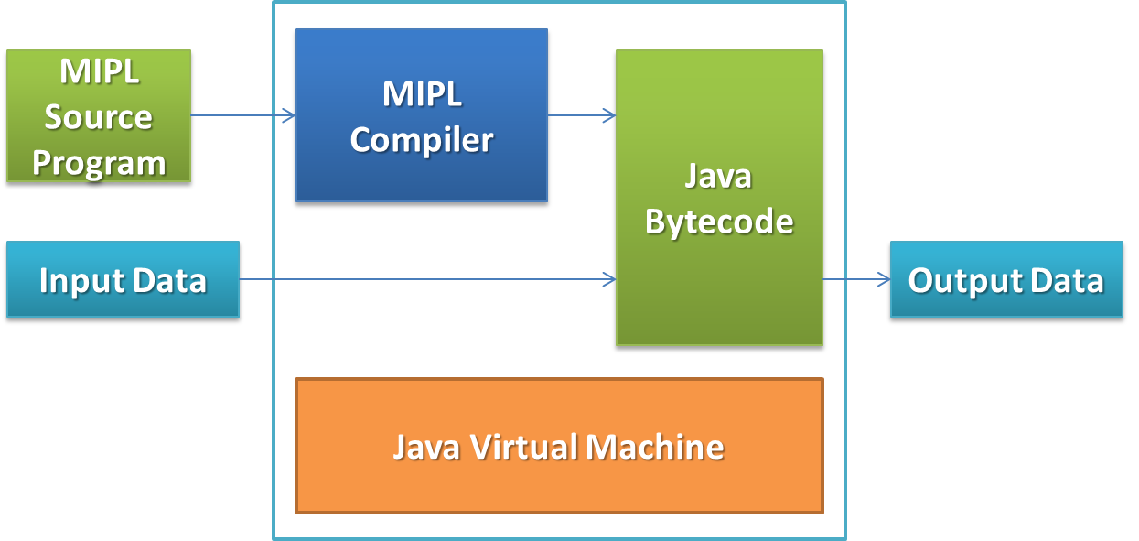
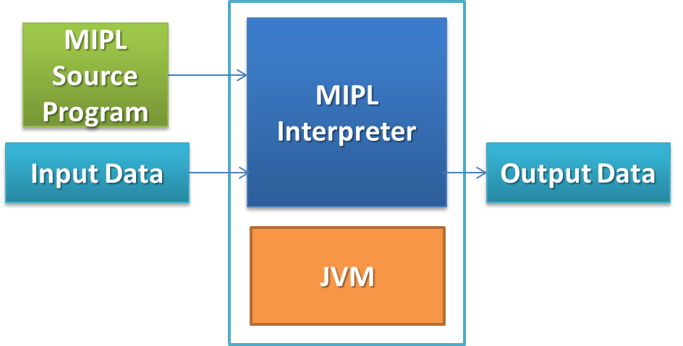
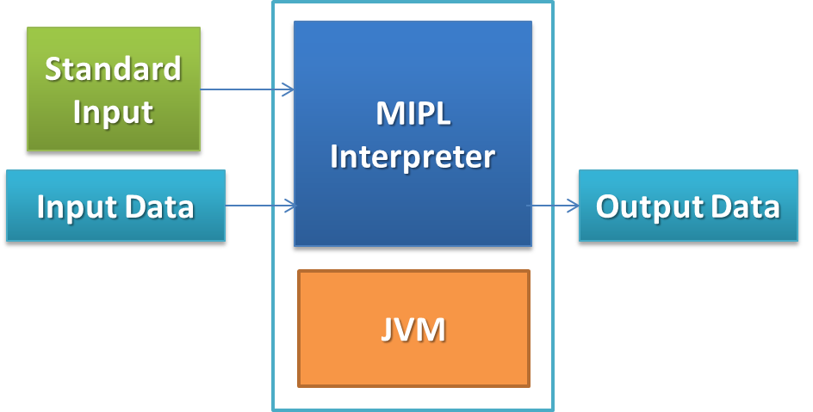
Mipl compiler’s Three modes
Compiler
Mode
Interpreter
Mode
Interactive
Mode

Slide 8
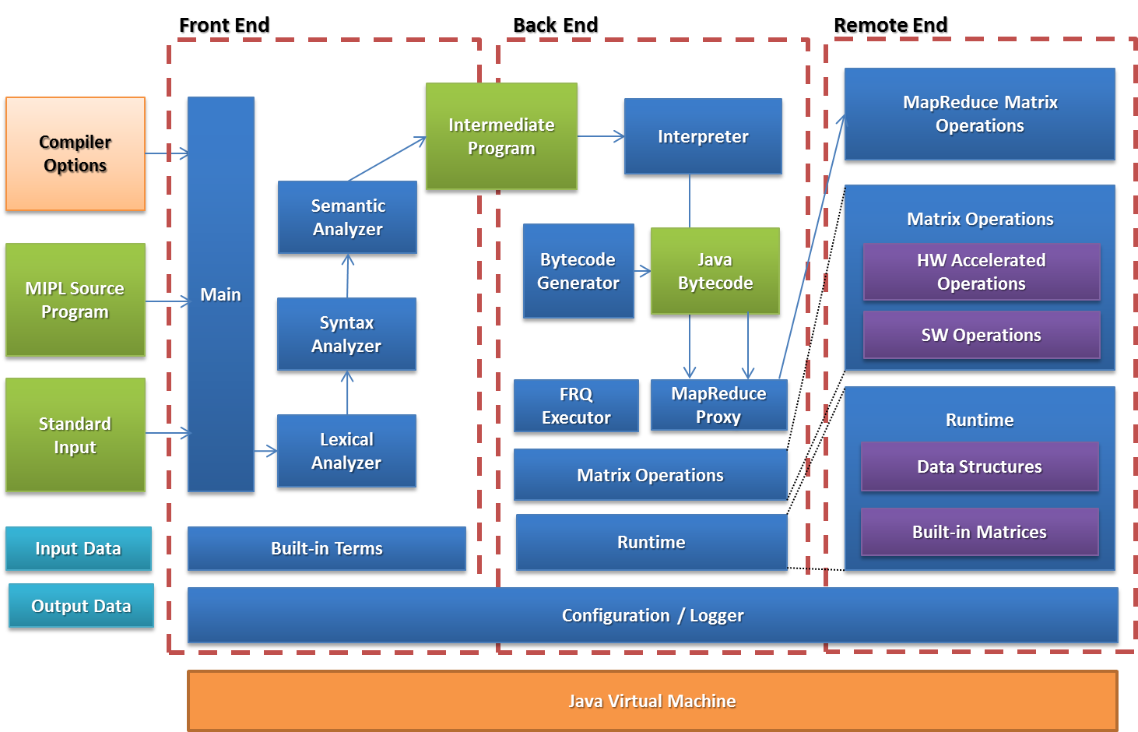
MIPL Compiler Architecture

Slide 9
Linguistic characteristics
Logical Programming Language
Imperative Programming Language
Automatic Conversion b/w Facts and a Matrix
Multiple Returns
Weak-typed
Inclusion, Recursive Calls, Matrix Operations Support

Slide 10
Used technologies
Java
  Our compiler is written in Java
Byacc/J
  Parser Generator
BCEL
  To generate Java Byte Code
Ant
  Build Automation
Junit
  Unit Testing

Slide 11
Language Grammar
Fact, Rule, and Query (FRQ)
  Compatible to Prolog Basic Syntax
Fact
  A fact is a predicate expression that makes a declarative statement about the problem domain.
Rule
  A rule is a predicate expression that uses logical implication to describe a relationship among facts.
Query
  A query is terminated with a ”?”. The MIPL language responds to queries about the facts and rules.
Notes:
MIPL's FRQ is simple to use. A user with only a little programming experience can quickly
learn the syntax of the FRQ and create a complete Data Mining program very quickly. However, the simplicity does not sacrifice the capabilities of MIPL as JOB can be used to develop by experienced users to generate powerful new algorithms by using and defining in-built operations.

Slide 12
Language Grammar
Fact, Rule, and Query Example
cat(tom). # fact
cat(foo). # fact
cat(tom)? # query -> true
cat(X) ? # query -> tom, foo
animal(X) <- cat(X). # rule
animal(tom) ? # true
animal(jane) ? # false

Slide 13
Language Grammar
Job
  Like Function in C
  Supports parallel running
  Supports Multi-return
  Can be accelerated with the GPU

Slide 14
Classification Example
job classify(A, M, Ca, Cb, Cc) {
B = A - urow(M). # Built-in Function urow
B = B./abs(B). # Built-in Function abs
Ba = B * Ca. # Getting each column
Bb = B * Cb.
Bc = B * Cc.
R = (Ba - 1)/2 + (Ba + 1)/2 .* Bb. # Classification Formular
R = R/2 + Bc.
@R. # Return the result
}

Slide 15
Classification Example
# To create the identity matrix
ca(1). cb(0). cc(0).
ca(0). cb(1). cc(0).
ca(0). cb(0). cc(1).
# Temperature, Rain(1 = No Rain, 0 = Rain),
# Girl Friend(1 = is coming, 0 = is not coming)
a(60, 1, 0). # Temperature 60, No Rain, No Girl
a(60, 1, 1). # Temperature 60, No Rain, Girl! Yay!
a(-40, 0, 0). # Temperature -40, Rain, No Girl
a(40, 1, 1). # Temperature 40, No Rain, Girl
# Coefficients for the classification formula
m(50, 0.5, 0.5).

Slide 16
MapReducePlan

Slide 17
Matrix Operation in MapReduce

Slide 18
Matrix Operation in MapReduce

Slide 19
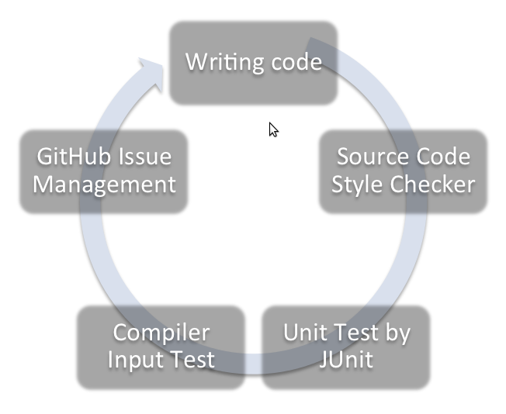
Test Plan
The MIPL test plan : conceived at design
Sample input programs already written : test driven development. Tests as important as source
Iterative development with
integrations
Build process : automated
testing

Slide 20
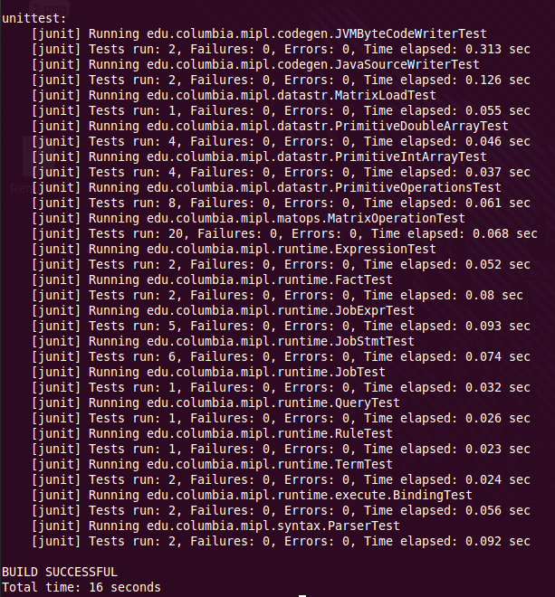
Test Plan : Unit Tests
Core functionality of
modules
60+ Unit Tests for modules
Written in JUnit (1-1 source).
Ant used to run on build
Test failure = build failure
=> Repository clean

Slide 21
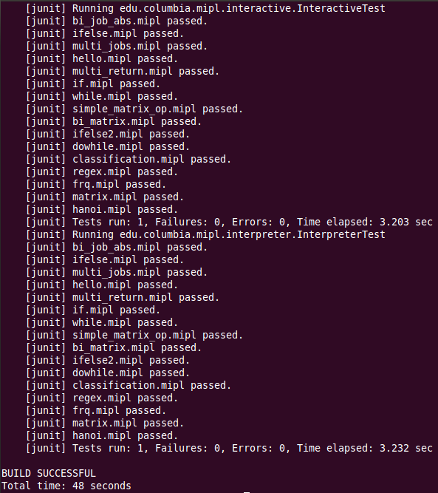
Test Plan : Regression Tests
Interplay between modules
& Test Driven Development
Sample programs : 17
Full top-down testing of compiler from source to execution
Critical during integrations
Used in build when code-base was young

Slide 22
Test Plan : Validation
Weekly top-down complete integrations of work
Partners in Code : Code Inspections. Design time decision
Coding Style : Long way toward writing less error prone code and extremely helpful in debugging

Slide 23
Conclusions
What we learned:
- Team work, Communication, Technical Skills, …
What worked well:
- Modularization, Test Driven Development, ..
What we could have done differently
- Bison
Why use MIPL?
- Why not?

