Slide 1
Team 11: Tandem
Varun Ravishankar: Project Manager
Patrick de la Garza: Language Guru
Jeneé Benjamin: System Architect
Donald Pomeroy: System Integrator

Slide 2
What is Tandem?
Node-based scripting language
Node is a blackbox: input -> output
Useful for simulations
Compiled, but has dynamic features
Notes:
When talking about blackbox, mention immutability, object-orientation

Slide 3
Why Tandem?
Writings simulations is hard!
Task distribution
Blackbox representation

Slide 4
Desired Features
Assemble nodes into supernodes
Everything should be a node
Architecture Independent
Parallel

Slide 5
Hello World!
Println "Hello, World!”
Notes:
Boring to look at, so look at next one instead

Slide 6
Hello World2!
node Hello()
node MyWords(text)
return text
end
MyWords "Hello, World!" | Println
end
Hello

Slide 7
hello.td
Print "Please enter your first name. "
a = Kernel.gets
c = a.chomp
a = c.upcase
Print "Please enter your last name. "
b = Kernel.gets
b = b.chomp.upcase
Print "Hello " c "!\n"
Print "This is your name in upper case: " a " " b

Slide 8
Fibonacci.td
    node Fibonacci(input)
    node Iterative(number)
    prev1 = 0
    prev2 = 1
    for x in 0..number
    savePrev1 = prev1
    prev1 = prev2
    prev2 = savePrev1 + prev2
    end
    return prev1
    end
    node Recursive(number)
    if number <=2
    return number
    else
    (Recursive (number-1)) + (Recursive (number-2))
    end
    end
    Iterative input | Println
    Recursive input | Println
    end
    Print "This is the Fibonacci program. Please enter a number."
    a = Kernel.gets
    a = a.to_i
    Fibonacci a

Slide 9
Compiling Tandem Code
$ ./tandem -h
Usage: tandem [options] [filename]
options:
-b --ruby Attempt to use system Ruby. If not valid, use JRuby.
-c --compile Only compile Tandem file.
-h --help List Tandem usage and options.
-j --jruby Use downloaded JRuby.
-r --run Assume compiled Ruby file exists and try running file.
-v --version Print Tandem version.
-w --whole Compile and run Tandem file.

Slide 10
Compiling hello.td
Print "Please enter your first name. "
a = Kernel.gets
c = a.chomp
a = c.upcase
Print "Please enter your last name. "
b = Kernel.gets
b = b.chomp.upcase
Print "Hello " c "!\n"
Print "This is your name in upper case: " a " " b

Slide 11
Compiling Tandem Code
$ ./tandem test/tutorial/hello.td
resolving dependencies…
compiling...
Please enter your first name. Varun
Please enter your last name. Ravishankar
Hello Varun!
This is your name in upper case: VARUN RAVISHANKAR

Slide 12
Syntactic Constructs in Hello World2
node Hello()
node MyWords(text)
return text
end
MyWords "Hello, World!" | Println
end
Hello

Slide 13
Nodes
node Hello()
node MyWords(text)
return text
end
MyWords "Hello, World!" | Println
end
Hello
Notes:
Main construct is the node

Slide 14
Nodes within Nodes
node Hello()
node MyWords(text)
return text
end
MyWords "Hello, World!" | Println
end
Hello
Notes:
Can have subnodes too

Slide 15
The Pipeline
node Hello()
node MyWords(text)
return text
end
MyWords "Hello, World!" | Println
end
Hello
Notes:
Pipeline

Slide 16
Syntactic Constructs in Fibonacci.td
    node Fibonacci(input)
    node Iterative(number)
    prev1 = 0
    prev2 = 1
    for x in 0..number
    savePrev1 = prev1
    prev1 = prev2
    prev2 = savePrev1 + prev2
    end
    return prev1
    end
    node Recursive(number)
    if number <=2
    return number
    else
    (Recursive (number-1)) + (Recursive (number-2))
    end
    end
    Iterative input | Println
    Recursive input | Println
    end
    Print "This is the Fibonacci program. Please enter a number."
    a = Kernel.gets
    a = a.to_i
    Fibonacci a

Slide 17
Dynamic Typing
    node Fibonacci(input)
    node Iterative(number)
    prev1 = 0
    prev2 = 1
    for x in 0..number
    savePrev1 = prev1
    prev1 = prev2
    prev2 = savePrev1 + prev2
    end
    return prev1
    end
    node Recursive(number)
    if number <=2
    return number
    else
    (Recursive (number-1)) + (Recursive (number-2))
    end
    end
    Iterative input | Println
    Recursive input | Println
    end
    Print "This is the Fibonacci program. Please enter a number."
    a = Kernel.gets
    a = a.to_i
    Fibonacci a

Slide 18
Loops
    node Fibonacci(input)
    node Iterative(number)
    prev1 = 0
    prev2 = 1
    for x in 0..number
    savePrev1 = prev1
    prev1 = prev2
    prev2 = savePrev1 + prev2
    end
    return prev1
    end
    node Recursive(number)
    if number <=2
    return number
    else
    (Recursive (number-1)) + (Recursive (number-2))
    end
    end
    Iterative input | Println
    Recursive input | Println
    end
    Print "This is the Fibonacci program. Please enter a number."
    a = Kernel.gets
    a = a.to_i
    Fibonacci a
Notes:
Loops

Slide 19
Conditionals
    node Fibonacci(input)
    node Iterative(number)
    prev1 = 0
    prev2 = 1
    for x in 0..number
    savePrev1 = prev1
    prev1 = prev2
    prev2 = savePrev1 + prev2
    end
    return prev1
    end
    node Recursive(number)
    if number <=2
    return number
    else
    (Recursive (number-1)) + (Recursive (number-2))
    end
    end
    Iterative input | Println
    Recursive input | Println
    end
    Print "This is the Fibonacci program. Please enter a number."
    a = Kernel.gets
    a = a.to_i
    Fibonacci a
Notes:
Conditionals

Slide 20
Syntactic Constructs in hello.td
Print "Please enter your first name. "
a = Kernel.gets
c = a.chomp
a = c.upcase
Print "Please enter your last name. "
b = Kernel.gets
b = b.chomp.upcase
Print "Hello " c "!\n"
Print "This is your name in upper case: " a " " b

Slide 21
Calling Ruby Code
Print "Please enter your first name. "
a = Kernel.gets
c = a.chomp
a = c.upcase
Print "Please enter your last name. "
b = Kernel.gets
b = b.chomp.upcase
Print "Hello " c "!\n"
Print "This is your name in upper case: " a " " b

Slide 22
Just use the Ruby APIs!
Print "Please enter your first name. "
a = Kernel.gets
c = a.chomp
a = c.upcase
Print "Please enter your last name. "
b = Kernel.gets
b = b.chomp.upcase
Print "Hello " c "!\n"
Print "This is your name in upper case: " a " " b
Notes:
Use import, require, or require_relative

Slide 23
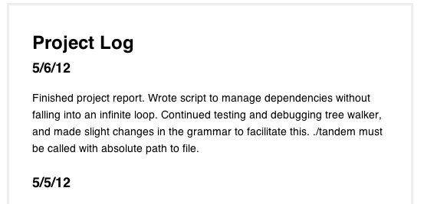
Project Management
Notes:
Weekly meetings

Slide 24
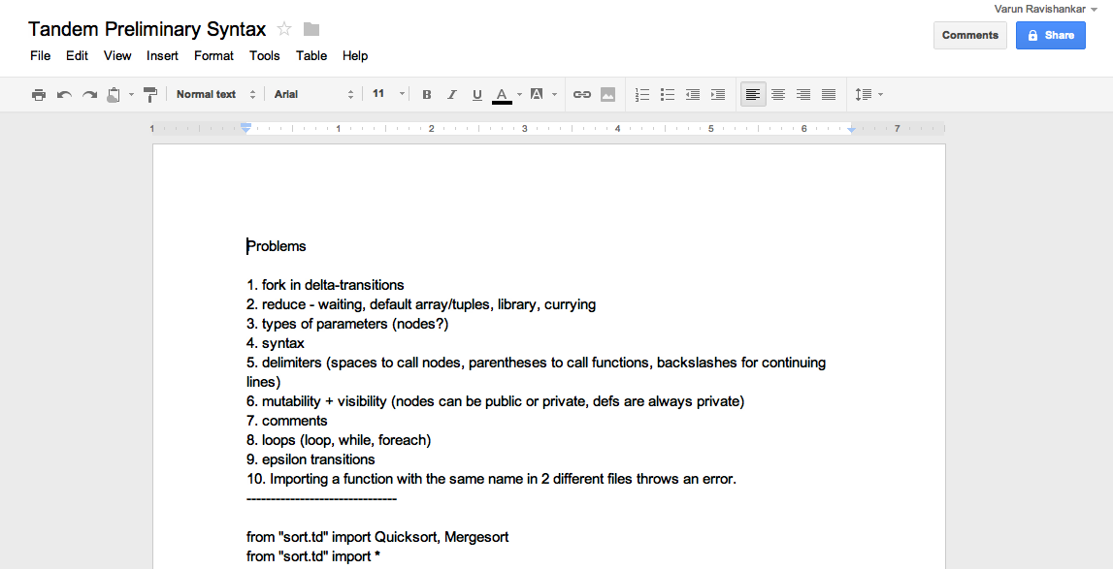
Google Docs

Slide 25
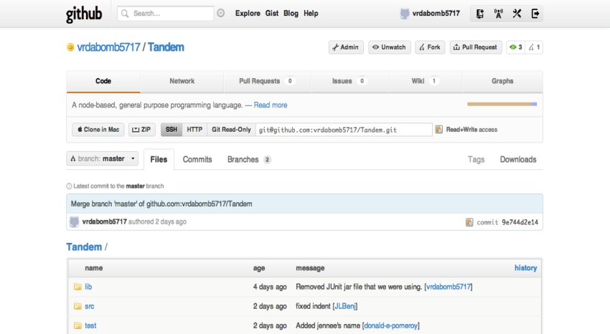
Github

Slide 26
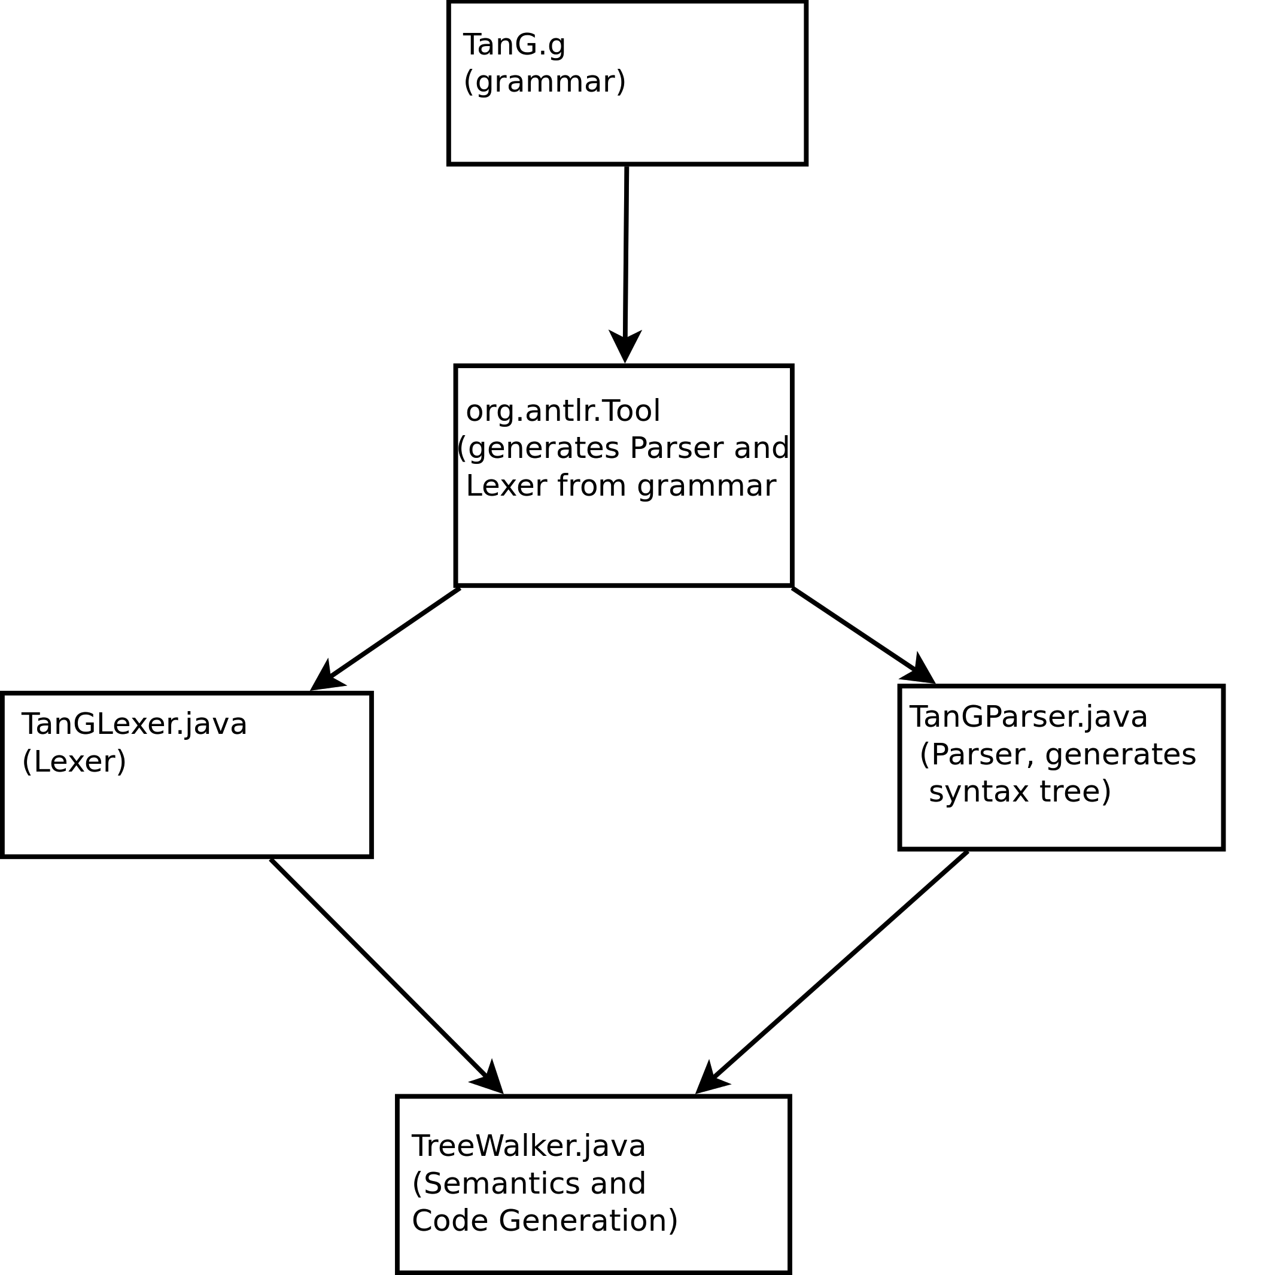
Translator Architecture

Slide 27
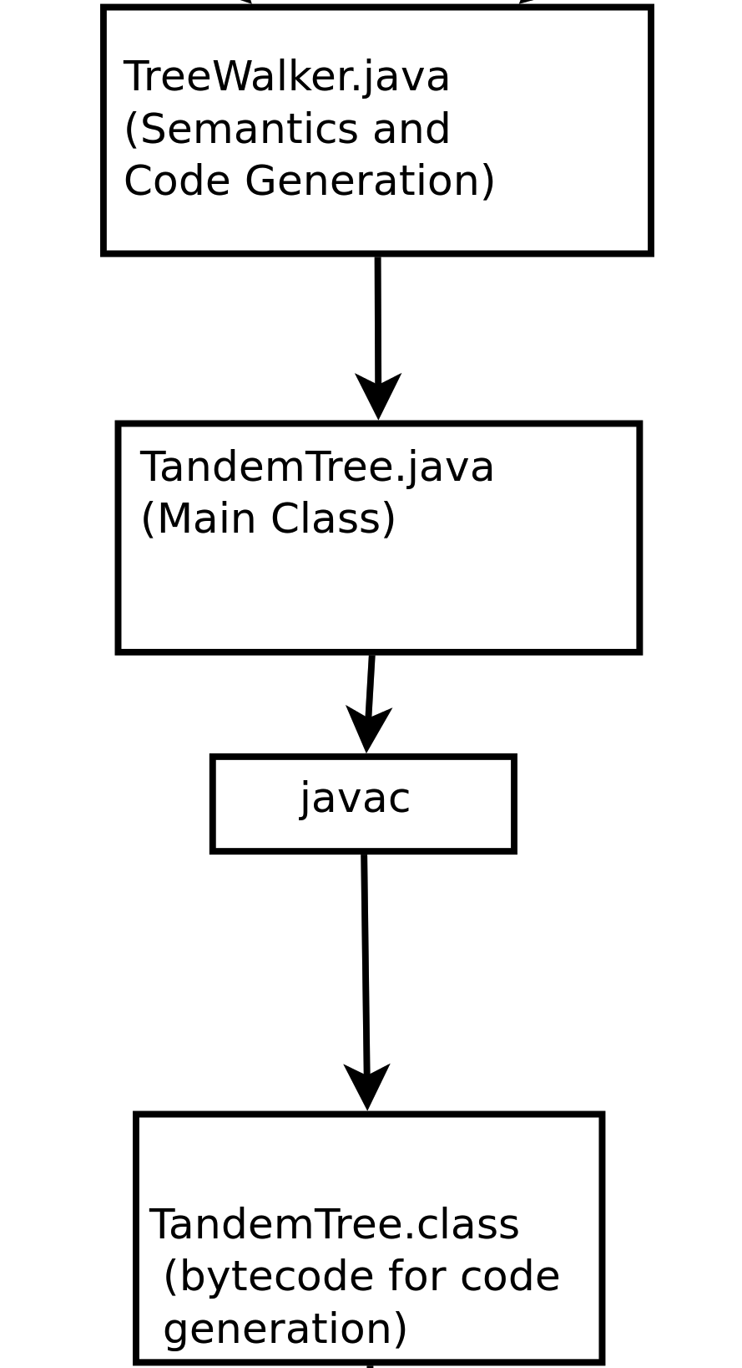
Translator Architecture

Slide 28
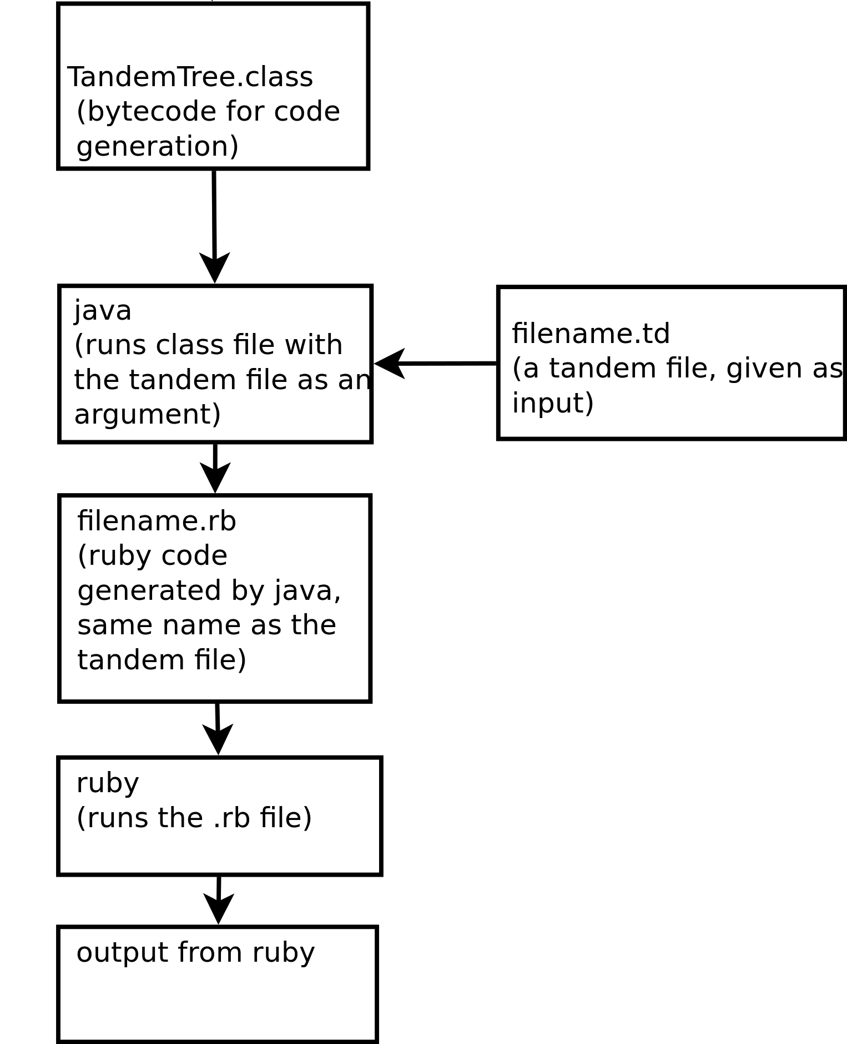
Translator Architecture

Slide 29
Inside the Java Code…
TanGLexer lex = new TanGLexer(new ANTLRInputStream(new FileInputStream(args[0])));
TokenStream ts = new CommonTokenStream(lex);
lex.reset();
TanGParser parse = new TanGParser(ts);
TanGParser.tanG_return result = parse.tanG();
CommonTree t = (CommonTree)result.getTree();
TreeWalker walk = new TreeWalker();
walk.walkTree(t, args[0].substring(0, args[0].length()-3));
TandemTree Tr = new TandemTree();

Slide 30
Hello World2!
node Hello()
node MyWords(text)
return text
end
MyWords "Hello, World!" | Println
end
Hello

Slide 31
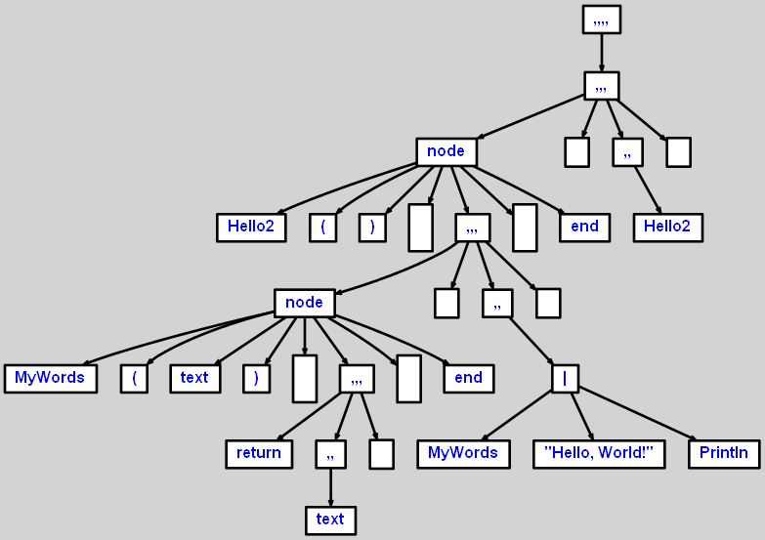
Hello World2 AST

Slide 32
Hello World2 Ruby Code
class Hello2
def main()
Kernel.puts(MyWords.new().main("Hello, World!" ))
end
class MyWords
def main(td_text )
return td_text
end
end
end
Hello2.new().main()

Slide 33







Run-time Environment

Slide 34
Run-time Environment
Bash script checks for arguments and calls Ant file
Ant file downloads dependencies
Ant file automates compiling Tandem files to Ruby code
Bash script calls compiled Ruby code

Slide 35






Software Development Environment

Slide 36
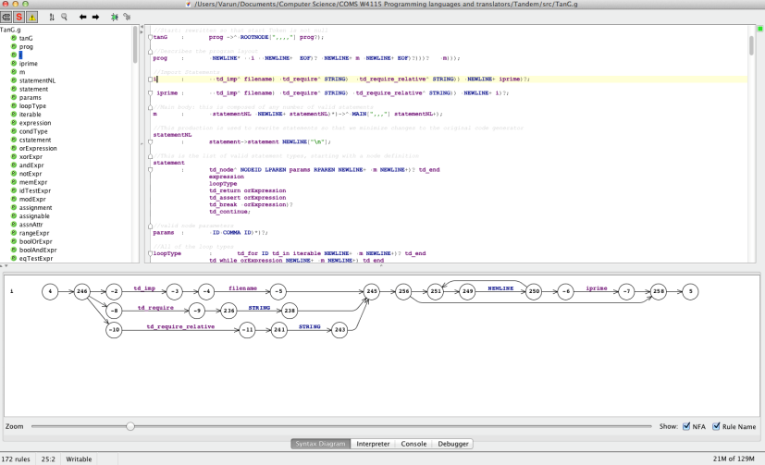
Software Development Environment

Slide 37
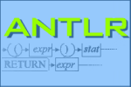
Compiler Tools

Slide 38
Testing
Grammar testing with gUnit
Parser testing with JUnit
Functional testing with Test/unit

Slide 39
Grammar Testing with gUnit
//Expression Unit Tests
Expression:
//Should fail, no NodeCode in the PIPELINE!!
<<A|B|(C+2)>>FAIL
//Should fail, no NodeCode again!
<<A|2>>FAIL
//should succeed: note that it is actually two pipelines (pipe has higher precedence than +)
<<A|B+C|D>>OK

Slide 40
Grammar Testing with gUnit
$ ant gunit_test
gunit_test :
[copy] Copying 1 file to /Users/Varun/Documents/ Computer Science/COMS W4115 Programming languages and translators/Tandem/bin
[ java ] executing testsuite for grammar:TanG with 69 tests
[java] 0 failures found:
[java] Tests run: 69, Failures: 0
BUILD SUCCESSFUL

Slide 41
Parser Testing with JUnit
$ ant parse_test
parse_test:
[junit] Testsuite: TandemTest
[junit] Tests run: 9, Failures: 0, Errors: 0, Time elapsed: 0.611 sec
[junit] ------------- Standard Error -----------------
[junit] Tandem/test/failure/crazycharacter.td line 1:0 no viable alternative at input '@'
[junit] Number of syntax errors in Tandem/test/failure/crazycharacter.td: 1
[junit] Testcase: test_expression took 0.142 sec
[junit] Testcase: test_statement took 0.073 sec
[junit] Testcase: test_failures took 0.035 sec
[junit] Testcase: test_tutorial took 0.104 sec
BUILD SUCCESSFUL

Slide 42
Functional Testing
Tested for valid Ruby code generated by tree walker
Some done by eyeballing for similar output (like looking for files being written to)
Were able to use Ruby’s Test/unit to automate checking for valid code

Slide 43
Conclusions
Hard to settle on a language spec!
Learn to split work up so people can work concurrently
Tests are amazing for finding bugs!
Use Tandem!

Slide 44
Thank you!
Abdullah Al-Syed
Shuai Sun
Professor Aho

Slide 45
DEMO

