Slide 1
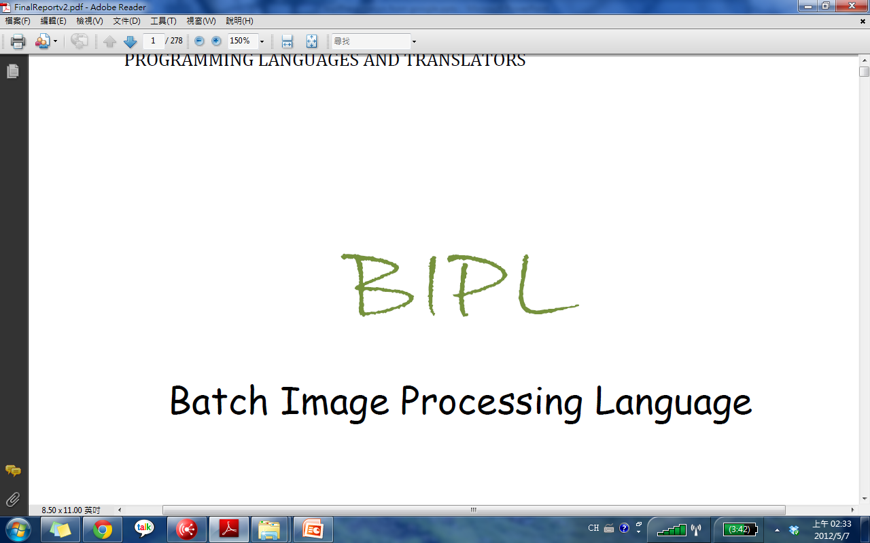

Batch Image Processing Language
Programming Language and Translator Final Project
(Team 15)
Notes:
Good afternoon everyone,
We are team 15
BIPL
Batch image processing language

Slide 2
What is BIPL
Batch Image Processing Language
Procedural scripting language
Notes:
BIPL
Stand for batch image processing language
It’s a sequential 3 blocked style programming language
As the name, we designed it to treat batch of images at a time
We will show the details later
an AWK-inspired, procedural scripting language designed for the high-level
processing of images in large batches. It is simple, intuitive, powerful and flexible.

Slide 3
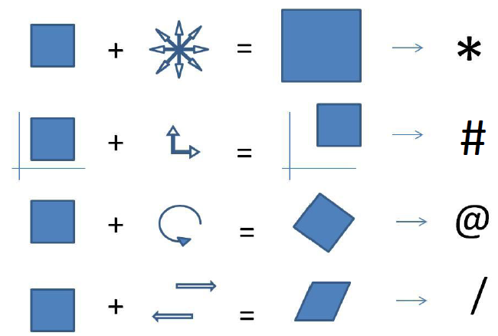
Why is BIPL
Simple & Intuitive
Powerful
Flexible
Notes:
BIPL is designed to be Simple & intuitive---Inspite of all the built-in function, for the basic image operation, we chose the symbols in an intuitive way like the star means scale, the @ means rotation
BIPL is designed to be strong ---BIPL can treats almost all kinds of image type, with lots of built-in function,
BIPL is designed to be flexible --- Besides the built-in function, the user can also design and create his own filter to apply to the images. In addition, we apply a concept in BIPL. Which is canvas. The user could design his own program by modifying the different canvas .
We are going to show the details now.
Simple : For those more complicated tasks, users can compose the basic operations with the rich variety of built-in image processing filters via the built-in filter data type. Filtersare essentially functions that take source images and effect parameters to produce modified images, but use left composition instead of the more common right
composition we use with functions. That is why BIPL supports a vast number of formats and
attempts to abstract the details away, allowing the user to focus on the actual manipulation of the images rather than how to actually read them
Strong: Most batch image processors are designed to only perform disjoint jobs such as applying
the same effect to a collection of photos or converting all images to the same format.
With the AWK-styled 3 block programs (begin, body, end), BIPL can do much more
beyond simple disjoint jobs. With a bit of creativity using only the built-in filters, it is
possible to create collages and mosaics or even generate complex fractal images.
Flexible: The BIPL has a broad flexibility in many ways. At the beginning of the input section, the
wild acceptable of input image formats; during the processing part, the flexibility to
create the programmer's own specific filters; through to the result, there's a variety of
methods for achieving the target images.
The BIPL implements the concepts of layers to do the image processing. The layer, a.k.a.
canvas, provides lots of possibilities to the programmer. The programmer can not only
compose different image layers to a target image, but also can insert, hide, extract layers
from images.

Slide 4
Project Manage
  Shih-Hao Tsai (Project Manager)
Structure
  Terry Tsai (Language Guru)
Compiler Architecture
  Fan Wei (System Architect)
Environment
  Yi-Hong Lin (System Integrator)
Testing
  Chun-Chao Wang (Testing & validate)
Notes:
Before we are going to the detail of BIPL
Let me introduce our team member
I am Shih-Hao, the PM
Terry language guru
Fan System architect
Yi-Hong system integrator
Chun-Chao tester

Slide 5
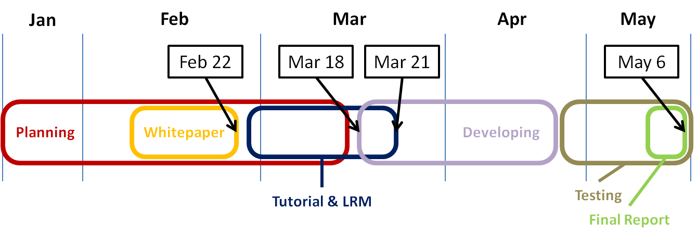
How Project Managed
Weekly meeting
Version Control
Notes:
During the project, we almost meet every Wednesday after class.
This is the timeline, combine with our develop steps and the deadline of each documentation.
For the up-to-date documentation, we use google doc. And for coding part, we use git to do the version control
Our team met weekly to help ensure that we were headed in the right direction and
making progress. We spent the weekly meetings planning our strategy for long and short
term developments and working on the documentations as well. Besides the main body
of the project, which is the source code, we not only have the language tutorial to guide
the user but also have the language reference manual to help the user.
Development was done individually or in pairs, and weekly meetings were used to catch
the team up on what progress was made over the week. Any small testing was done as
features were implemented. And we start with the language final report right after the
completely final testing is done.

Slide 6
Project Manage
  Shih-Hao Tsai (Project Manager)
Structure
  Terry Tsai (Language Guru)
Compiler Architecture
  Fan Wei (System Architect)
Environment
  Yi-Hong Lin (System Integrator)
Testing
  Chun-Chao Wang (Testing & validate)
Notes:
And now, let’s talk about the structure.

Slide 7
Program Structure
Function Declarations
Begin Block
Body Block
End Block

Slide 8
Function Declarations
image apply_watermark(string str, image i)
{
image lbl = label(str, "Tahoma",72, 0, 200, 40);
return lbl
# [(i.width-lbl.width)/2, (i.height-lbl.height)/2]
: compose(i, .);
}

Slide 9
Begin Block
BEGIN {
string path = "";
int x = 0, y = 0;
int xRes = 1366, yRes = 768;
int scale = yRes / 10;
image canv = canvas(xRes, yRes);
}

Slide 10
Body Block
{
if (path == "")
canv.pathname = $.pathname;
$ = $ * [$.width, scale];
if (x + $.width <= canv.width) {
canv = compose(canv, $ # [x,y]);
x += $.width;
} else {
int lsize = canv.width-x;
int rsize = $.width - lsize;
canv = $
: crop(., [0,0], [lsize,$.height])
# [x,y]
: compose(canv, .);
(x = 0, y += scale);
if (y >= canv.width) break;
canv = $
: crop(., [lsize,0], [rsize,$.height])
# [x,y]
: compose(canv, .);
x += rsize;
}
}
canv = $
: crop(., [0,0], [lsize,$.height])
# [x,y]
: compose(canv, .);
(x = 0, y += scale);
if (y >= canv.width) break;
canv = $
: crop(., [lsize,0], [rsize,$.height])
# [x,y]
: compose(canv, .);
canv = $
: crop(., [0,0], [lsize,$.height])
# [x,y]
: compose(canv, .);
(x = 0, y += scale);
if (y >= canv.width) break;
canv = $
: crop(., [lsize,0], [rsize,$.height])
# [x,y]
: compose(canv, .);

Slide 11
End Block
END {
canv = apply_watermark("generated using BIPL", canv);
canv.filename = "CANVAS";
save(canv, "JPG");
}

Slide 12
Project Manage
  Shih-Hao Tsai (Project Manager)
Structure
  Terry Tsai (Language Guru)
Compiler Architecture
  Fan Wei (System Architect)
Environment
  Yi-Hong Lin (System Integrator)
Testing
  Chun-Chao Wang (Testing & validate)

Slide 13
Translator Architecture
FRONTEND
Function Declarations
BACKEND
module.dll
test.exe
test.bipl
Begin Block
bipl_frontend.exe
skeleton
Body Block
Image modules
End Block
Tokenizer
Parser
Symbol
Table
7 types
operator overloading
flex++
bison
C
Built-in functions
prebuilt libraries
bipl.l
bipl.y
symboltable.h

Slide 14
Sample Program
int x () return 1;
BEGIN {
  image c = canvas( 1000.0, 1000.0);
  int i = 0, j = 0;
}
{
  c = compose(c, $ * [100,100] # [i*100,j*100]);
  i = i + 1;
  if (i == 10) {
    i = 0;
    j = j + 1;
  }
}
END {
  c.filename = "test";
  save(c, "JPG");
}

Slide 15
Translator Architecture
FRONTEND
Function Declarations
BACKEND
module.dll
test.exe
test.bipl
Begin Block
bipl_frontend.exe
skeleton
Body Block
Image modules
End Block
Tokenizer
Parser
Symbol
Table
7 types
operator overloading
flex++
bison
C
Built-in functions
prebuilt libraries
bipl.l
bipl.y
symboltable.h

Slide 16
Tokenizer
int x () return 1;
BEGIN {
  image c = canvas( 1000.0, 1000.0);
  <T_INT> <id, 1> <(> <)> <RETURN> <INT_CONST> <;>
  <BEGIN> <{>
<T_IMAGE> <id, 2> <=> <id, 3> <(> <FLT_CONST> <,> <FLT_CONST> <)> <;>

Slide 17
Translator Architecture
FRONTEND
Function Declarations
BACKEND
module.dll
test.exe
test.bipl
Begin Block
bipl_frontend.exe
skeleton
Body Block
End Block
Image modules
End Block
Tokenizer
Parser
Symbol
Table
7 types
operator overloading
flex++
bison
C
Built-in functions
prebuilt libraries
bipl.l
bipl.y
symboltable.h

Slide 18
Parser
int x () return 1;
BEGIN {
  image c = canvas( 1000.0, 1000.0);
=
expr1
expr2
T_IMAGE
(
)
;
id1
id2
FLT_CONST
FLT_CONST
,
imageTypes
c
canvas
1000.0
1000.0
... | … | …
c | imageTypes | -1
x | intTypes | 0
canvas | imageTypes | 2
compose | imageTypes | 2
… | … | …

Slide 19
Translator Architecture
FRONTEND
Function Declarations
BACKEND
module.dll
test.exe
test.bipl
Begin Block
bipl_frontend.exe
skeleton
Body Block
Image modules
End Block
Tokenizer
Parser
Symbol
Table
7 types
operator overloading
flex++
bison
C
Built-in functions
prebuilt libraries
bipl.l
bipl.y
symboltable.h

Slide 20
Frontend Output
Function Declarations
intTypes x() return intTypes(1);
Begin Block
imageTypes c = canvas(floatTypes(1000.0),floatTypes(1000.0));
intTypes i = intTypes(0), j = intTypes(0);
Body Block
c = compose(c,_dollar_sign*pairTypes(100,100)|pairTypes (i*intTypes(100),j*intTypes(100)));
i = i+intTypes(1);
if (i==intTypes(10)) {
  i = intTypes(0);
  j = j+intTypes(1);
}
End Block
c.filename = stringTypes("test");
save(c,stringTypes("JPG"));
int x () return 1;
BEGIN {
  image c = canvas( 1000.0, 1000.0);
  int i = 0, j = 0;
}
{
  c = compose(c, $ * [100,100] # [i*100,j*100]);
  i = i + 1;
  if (i == 10) {
    I = 0;
    j = j + 1;
  }
}
END {
  c.filename = "test";
  save(c, "JPG");
}

Slide 21
Translator Architecture
FRONTEND
Function Declarations
BACKEND
module.dll
test.exe
test.bipl
Begin Block
bipl_frontend.exe
skeleton
Body Block
Image modules
End Block
Tokenizer
Parser
Symbol
Table
7 types
operator overloading
flex++
bison
C
Built-in functions
prebuilt libraries
bipl.l
bipl.y
symboltable.h

Slide 22
Project Manage
  Shih-Hao Tsai (Project Manager)
Structure
  Terry Tsai (Language Guru)
Compiler Architecture
  Fan Wei (System Architect)
Environment
  Yi-Hong Lin (System Integrator)
Testing
  Chun-Chao Wang (Testing & validate)

Slide 23
Runtime Environment
Use parameters to indicate files or directory
Supported image file type will be selected
(runtime) Dynamic-linked library may load
> build_bipl.bat test.bipl
> test.exe -f path/to/somefolder
> test.exe
> test.exe lena.jpg lena.bmp
directory
list of image files
test.exe
Outputs
Dynamic-linked libraries

Slide 24




Development Environment
Bison(yacc), flex(lex), Visual Studio 2010(cl.exe)
msbuild to build libraries and BIPL files.
c-generic-libraries
argtable

Slide 25
Project Manage
  Shih-Hao Tsai (Project Manager)
Structure
  Terry Tsai (Language Guru)
Compiler Architecture
  Fan Wei (System Architect)
Environment
  Yi-Hong Lin (System Integrator)
Testing
  Chun-Chao Wang (Testing & validate)

Slide 26
Test Plan
System Test
Frontend
Backend
Non-Technical
Performance
Space

Slide 27
System Test
Frontend
Redefinition
Undeclared identifier
Scope of identifier
# of Function parameter
Built-in functions
Dollar sign
Backend
Primitive types
  Operator
  Type conversion
Image type
  Operators
  Built-in functions
Notes:
In frontend, we have to make sure our grammar and symbol table work correctly as expected. Therefore, the items listed are being tested. Including….
In backend, since we overloaded the basic operators for primitive types, we have to test on each operator to ensure they output the expected results, and to test on type conversions between different types while performing arithmetic and logical operations.
Image type is tested, too. The four special operators and the built-in functions for image are tested to see if they have the expected behavior as specified in LRM.

Slide 28
Non-Technical Part
Performance
Space
Dynamic-link library
Batch image processing test
Notes:
Since bipl is for batch image processing. The speed issue is of great concern. < 70ms/image
To save the space of our program. Image modules are constructed as dlls, which are placed in one space and can be shared and reused by each code in the program.
An important feature of dlls is that the library can simply be linked rather than imported in each code, which can save the total space occupied in our program.

Slide 29
Demonstration
  Terry Tsai / Yi-Hong Lin
Conclusion
  Shih-Hao Tsai

Slide 30
DEMO
demo sample code 1

Slide 31
DEMO
demo sample code 2

Slide 32
Demonstration
  Terry Tsai / Yi-Hong Lin
Conclusion
  Shih-Hao Tsai

Slide 33
Conclusion
What we learned?
What worked well?
What’s done differently?
Why people need to use BIPL?
Notes:
make everything on schedule and plan early,
You would never know what will happen, reserve the time slots for debugging and for any unexpected events.
We believe that There’s always a person who kindly know almost every stuff for each team, and for our team, the system integrator was at this spot.
And over all the project, The beginning is confusing, the process of coding and brainstorming is tough,
But finally when we are playing with our language , it is interesting and full of the sense of fulfillment.
Above these all stuff, we know that BIPL is Easy to learn, plenty of built-in functions and image operations give you multiple ways to create and design
as each member, we all have our individual experiences. For being is BIPL team,
1.)the first one is to make everything on schedule up front, reserve the time slots for debugging and for any unexpected events.
2.)each team always needs one person who knows every stuff and details in the project, and put the everyone's progress in mind. This person does not need to be the project manager, but has to let each teammate can well communicate and discuss to each other.
At the end of this semester, we are grateful for this opportunity to makegood friends and for those painful time which let us grow.
generally separated by role, and also during the development period, some works done individually, some was done by pair. No matter what, the most important is the cooperation. as we learn, no one is the person who know all the stuff. we need to help each other, teach each other to approach the final goal

Slide 34
~THANKS~

