Slide 1


Project Manager: Kathy Sun
Language Guru: Toni Ma
System Architect: Mark Florian
System Integrator: Kim Ly
System Tester: Madhavan Somanathan
COMS W4115 Spring 2012
Professor Alfred Aho
TA: Melanie Kambadur
Notes:
Kathy introduces all of the team members

Slide 2
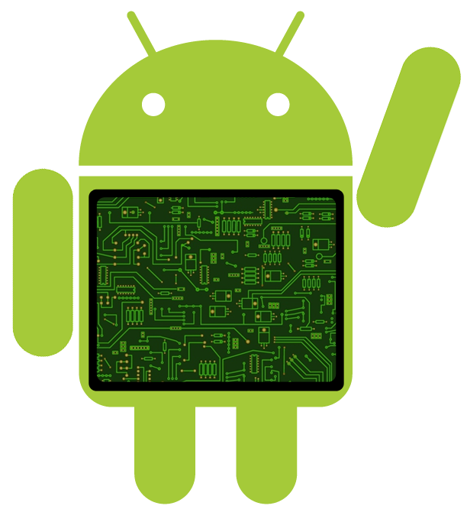
Introduction
Notes:
this is the slide that we insert a recording of mark saying “cyborg”

Slide 3
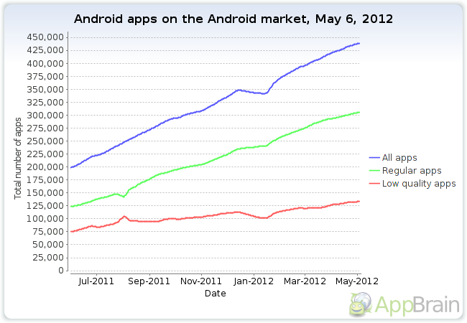
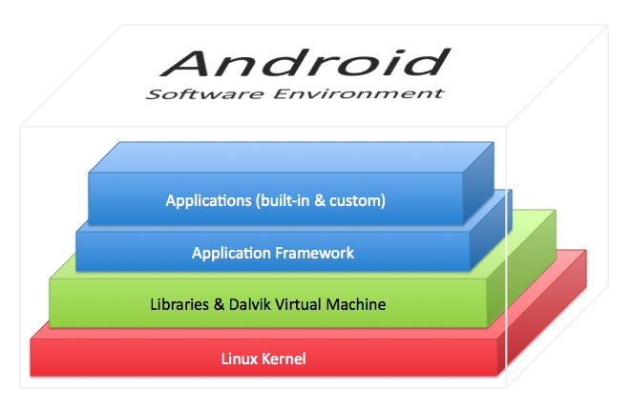
What is Android?
Android is a software stack for mobile devices
  includes an OS, middleware and key applications
This software stack includes a Dalvik VM on top of which an Android application can be run.
Why do people develop Android apps?
Graph Source: http://blog.appbrain.com/2011/03/new-android-market-statistics-overload.html
Notes:
Mark
explain what is android
what is an android app? why do ppl develop android app?
statistics about growth of android development- get image/graphs

Slide 4
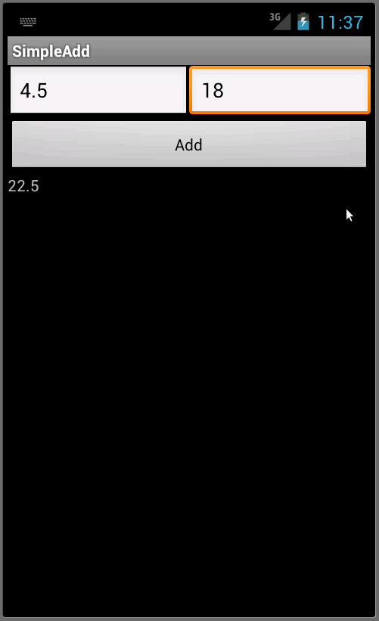
Android Development
SimpleAdd Program:
4 files to keep track of:
SimpleAddActivity.java
main.xml
strings.xml
AndroidManifest.xml
108 lines of code
Notes:
Mark
how people currently develop for android
how cyborg develops for android
show an image of an android app: simple add. requires __ lines, ___ files

Slide 5

Cyborg Development
<head
name="SimpleAdd"
api="10“
/>
<LinearLayout id="defaultLayout">
<LinearLayout id="row1“
height="wrap_content">
<EditText id="box 1“
width="wrap_content“
height="1" />
</LinearLayout>
<LinearLayout id="row2“
height="wrap_content">
<Button id="add"
height="wrap_content"
text="add">
<event type="onClick">
result.setText(Double.parseDouble(box1.getText()) + Double.parseDouble(box2.getText()));
</event>
</Button>
</LinearLayout>
<LinearLayout id="row3“
height="wrap_content">
<TextView id="result"
width="wrap_content"/>
</LinearLayout>
</LinearLayout>
1 file to keep track of:
SimpleAdd.cy
28 lines of code
Yay!!
Notes:
Mark
show the same image of simple add. cyborg uses ___ lines, __ files

Slide 6

What is Cyborg?
hybrid between an imperative language and a mark-up language
has two contexts:
  XML context: used for GUI elements
  Java: used for defining functions
<Button id=“myButton”>
<event type=“onClick”>
t.setText(“Hello, Cyborg!”);
</event>
</Button>
Notes:
Toni
explain what kind of language it is and what kind of model of computation you had in mind when you designed the language

Slide 7
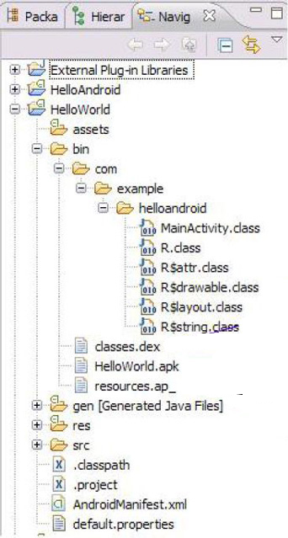
Why use Cyborg?
Cyborg aims to simplify Android programming
  allows GUI elements & event handlers to be written in the same place
complicated & unintuitive Android file structure
XML files for GUI elements are located in res (resources)
No natural connection between these two
Java files for functional computations are located in src (source)
Notes:
Toni
Motivations for creating our language

Slide 8
Translator Architecture
Lexical Analysis
Syntax Analysis
Semantic Analysis
Intermediate Code Gen.
Cyborg Source Program
Android Abstract Syntax Tree
Parser.cup
Preprocessor
Semantic Analyzer
JFLEX
JAVACUP
*.java
Token Stream
Syntax Tree
Target Source Code
Lexer.java
Parser.java
Android File Structure
Front End
Symbol Table
*.java
*.xml
Sym.java
*.apk
Back End
Notes:
[Madhavan]
show a block diagram of your translator
[Toni] shows demo
show how a sample program is processed by your translator

Slide 9
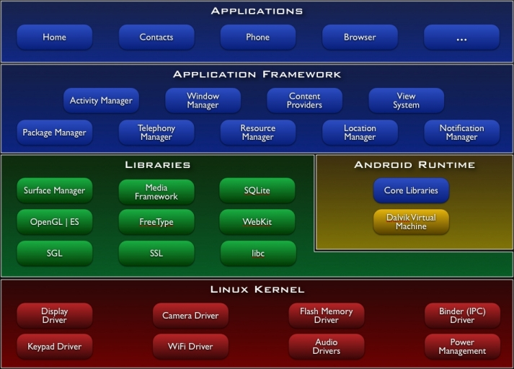
Run-Time Framework
Cyborg target program
Cyborg run-time environment
Dalvik Virtual Machine: The process virtual machine in the Android OS
Cyborg target code
compile to bytecode
JVM-compatible .class files
convert to .dex files
.dex files along with resources, assets, certificates, and manifest file
.apk
Android device
Notes:
[kim]
dvm is similar to jvm. any machine with a jvm can compile java programs. similarly any machine with a dvm can compile cyborg programs. platform independent
Explain the run-time environment and how the target program is executed in that environment.

Slide 10


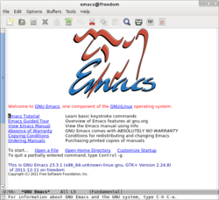
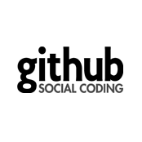




Software Development Environment & Tools
Notes:
[kim]
Code development environment:
Eclipse: an integrated development environment, mainly for Java
VIM & Emacs: text editors
Github: repository for version control
JFlex is a lexical analyzer generator (also known as scanner generator) for Java, written in Java.
CUP- LALR Parser generator for Java. Works in conjunction with Jflex. Recognizes the tokens specified using Jflex and parses them according to the grammar specified in the CUP program
Apache Ant is a software tool for automating software build processes. It is similar to Make but is implemented using the Java language, requires the Java platform, and is best suited to building Java projects. The most immediately noticeable difference between Ant and Make is that Ant uses XML to describe the build process and its dependencies, whereas Make uses Makefile format. By default the XML file is named build.xml.
Describe the software development environment used.
Describe what compiler-generator tools were used.

Slide 11
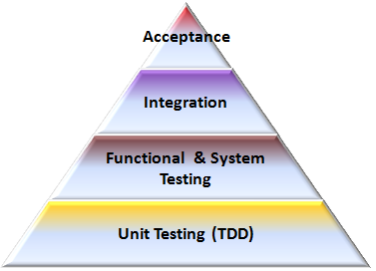
Test Plan
Developed test cases for integrated systems
Test the five components individually:
preprocessor
lexical analyzer
syntax analyzer
semantic analyzer
code generator
Bottom-up Testing Methodology
Notes:
Madhavan
Test plan: show how you tested your translator.
refer to the report on testing 3-4 bullet points
Toni compiles next

Slide 12
Project Management
Met weekly to discuss compiler ideas
Kept meeting logs
Sent weekly emails discussing progress and schedule
Software:
Used Github.com for version control and easier code management
Notes:
[kathy]
NOT FINISHED
Briefly describe how the project was managed.

Slide 13
Our Takeaways
Glad to build a language that solves a problem we care about.
Difficult to integrate two separately working modules of code!
Every group member should be able contribute to any other part of the development (regardless of their own task).
Do research about what development tools to use. Unfamiliar tools and software are very hard to use without good documentation.
Bond and learn to love your team, it makes the even the hardest tasks enjoyable!
Notes:
kathy
explain
what you learned,
what worked well,
what you would have done differently, and
why everyone should use your language!

