Slide 1
turnt.
A turn based game creation language.

Slide 2
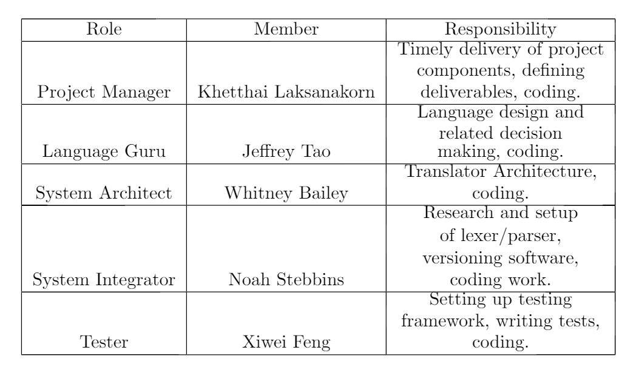

Slide 3
turnt Language
Jeffrey Tao

Slide 4
Buzzwords
Event-driven model
  Declare events that can be manually or automatically emitted
  Register callbacks (directives) that run on event emission
An action/response way of thinking about implementation (“when … do …”)
Globally-accessible, mutable game state

Slide 5
Motivation
Create a generalized system for writing the game logic of turn-based games with well-defined rules
Ease of implementation translating as directly as possible from rules to source code

Slide 6
Usage
Build the translator from grammar using ANTLR
cat source.tt | java Translate
javac Main.java
java Main

Slide 7
Let’s get turnt
http://youtu.be/W6VhVGbdClM
http://pastebin.com/8Ndf3cEp

Slide 8
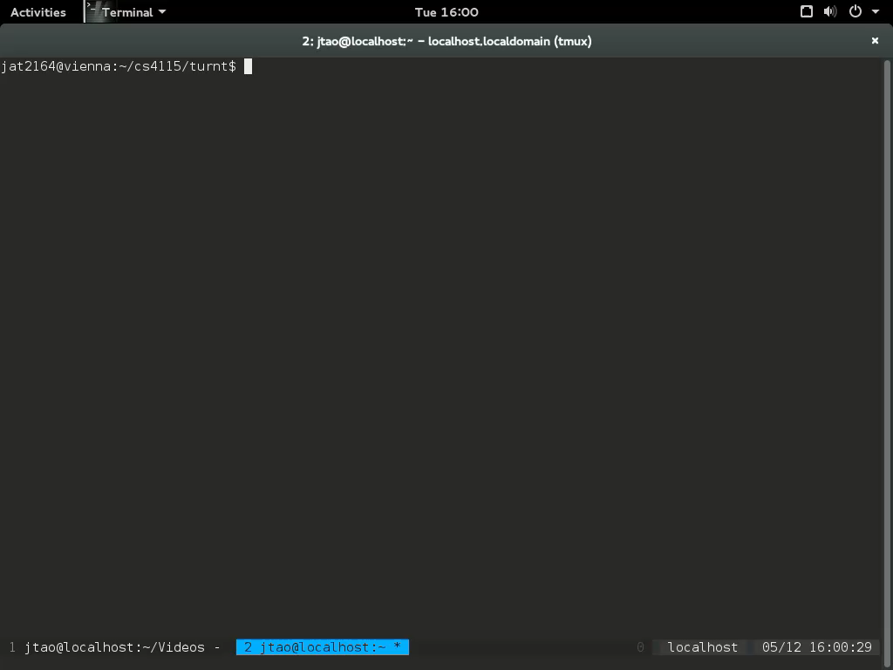

Slide 9
turnt. Driver
Maintains:
  List of Events
  List of Directives
  Priority Queue of Queued Directives
Events:
  Maintain a list of directives registered to it.
  Can have an auto emit condition.
Directives:
  Contain a procedure that is called when popped from the priority queue.
  Many to many relationship with events.

Slide 10
turnt. Driver
When executed, the turnt driver emits the “main” event, queueing all directives registered to “main” as of running.
Directives are popped. During the execution of a directive if an event is emitted, all directives registered to that event are pushed onto the directive priority queue.
After each directive finishes execution, all events are checked to see if their auto-emit conditions are met. Events whose auto-emit conditions are met are emitted, and their registered directives are queued.
Directive Popped
Directive Executed
Emitted Events Have Their Registered Directives Queued
Event List Checked for Auto-Emit
Auto-Emitted Events’ Directives Queued

Slide 11
turnt. Driver (Actions)
Actions serve as procedures which are executed immediately upon being called with their identifier name, followed by a semi colon.
Actions can be called from directives.
Nothing is passed or returned, relying on state.

Slide 12
turnt. Driver (State)
State is a set of global variables that can be accessed from any directive or action.
A variable in state is initialized with a value using the command “state <type> <identifier> <literal>”, which brings the value into local scope.
A variable in state is retrieved using the command “state <identifier>”, which brings the value into local scope.
A variable in state is modified using the command “state <identifier> <literal>”. The variable must be brought into local scope by a state initialization or get first.

Slide 13
Project Management
Khetthai Laksanakorn

Slide 14
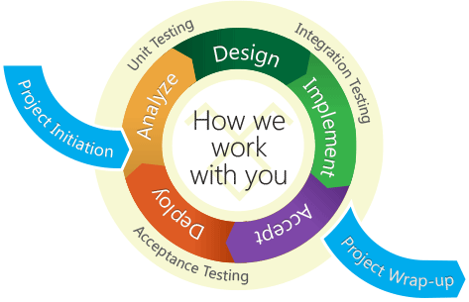
Project Management (Agile)
The following principles of Agile Software Development were followed in implementing the language/translator.
  Welcoming changing requirements.
  Working software delivered frequently.
  Face to face conversation
  Measuring progress via working software.
  Sustainable development at a constant pace.
  Attention to technical excellence and good design.
  Simplicity.
Credit: pixshark.com
Notes:
I decided to use a software development model inspired by Agile in managing turnt. Motives behind using Agile: allows us to make iterations of working software. Our first iteration will be relatively fast and simple to implement, which let everyone see the concept in practice. Because rapid iterations allows fast development, we can submit a language that works. Also, since we were all learning as we went along, Agile principles such as adapting to changing requirements were well suited to developing turnt. We ended up cutting some features that we intended to include and adding features that we designated as optional.

Slide 15
Project Management (Meetings)
Group meetings: weekly during planning, biweekly during development.
Planning: Deciding on language’s programming constructs and features.
Development: meetings had two aspects.
  Goals – identifying deliverables for the next iteration and how they will be implemented.
  Coding – realizing those deliverables.
Coding was also done on an individual basis.

Slide 16
Project Management (Iterative Process)
Iteration 1: Driver code, grammar, translator prototype. Capable of running “Hello World” (events, directives, register)
Iteration 2: Event emission, runtime register, testing framework.
Iteration 3: Type declarations, assignment, control blocks. Priorities for directives. Included overhaul of grammar for ambiguity.
Iteration 4: State, user input, auto emission of events.

Slide 17
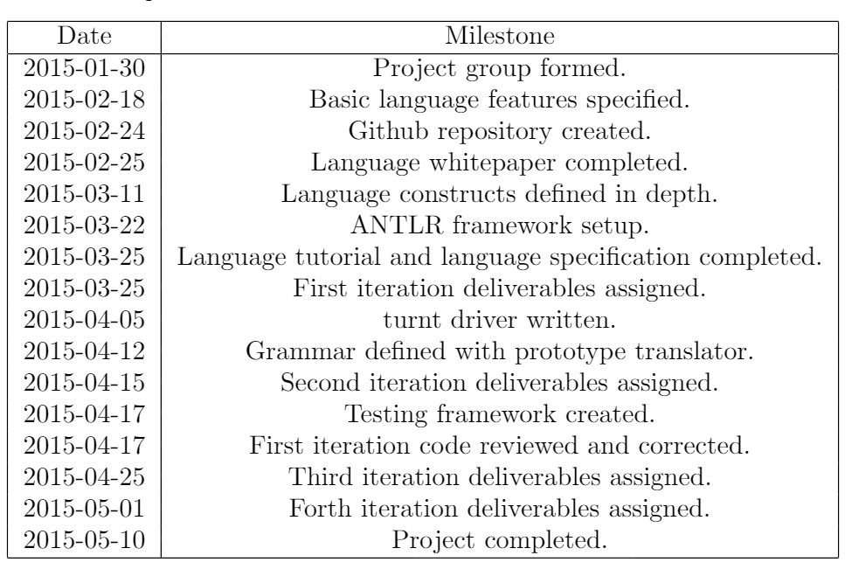
Project Management (Timeline)

Slide 18
Translator Architecture
Whitney Bailey

Slide 19
Block Diagram
Turnt Program
(example: program.tt)
turntLexer.java
Turnt Program Token Stream
turntParser.java
Parse Tree
TurntTranslator.java
turntToJava.java
Main.java

Slide 20
Example Program: Hello World.tt
register start main 0;
dir start {
print “Hello World”;
}

Slide 21
Lexical Analysis
register start main 0;
dir start {
print “Hello World”;
}
‘register’
ID: start
‘main’
INT: 0
‘;’
‘dir’
ID: start
‘{‘
‘print’
String: “Hello World”
‘;’
‘}’
turntLexer.java

Slide 22
Syntactical Analysis
prgm
‘register’
ID: start
‘main’
INT: 0
‘;’
‘dir’
ID: start
‘{‘
‘print’
String: “Hello World”
‘;’
‘}’
method
method
registerMain
dir
turntParser.java
‘dir’
blocks
‘register’
ID
‘main’
INT
;
ID
{
}
‘start’
0
‘start’
block
line
print
‘print’
String
“Hello World”

Slide 23
Translation
prgm
method
method
Main.java
startDirective.java
State.java
MainEvent.java
Event.java
Engine.java
Actions.java
Directive.java
registerMain
dir
‘dir’
blocks
TurntTranslator.java
turntToJava.java
‘register’
ID
‘main’
INT
;
ID
{
}
‘start’
0
‘start’
block
line
print
‘print’
String
“Hello World”

Slide 24
“turnt” environment
Noah Stebbins

Slide 25

Dev Environment
UNIX: CLIC & Mac OS X
Editors rather than IDEs (Sublime & Vim)
Github & Git
README
  file structure
  CLASSPATH variables

Slide 26
Run-time Environment
Scripts
  test_trans.sh → test translator with grammar for input
    generates Java files, then “java Main”
  test_parse.sh → test parse tree with grammar for input
  test_compile.sh → early stages grammar changes
  clean.sh

Slide 27

Tools
ANTLR: “Another Tool for Language Recognition”
  everything in Java = convenient
  LL parsing
  tree parser, walked for a given input (.tt)
    turntToJava() contains translations

Slide 28
Testing
Xiwei Feng

Slide 29
Test Plan
Framework: JUnit version 4.12
A simple Java-based test framework for repeatable tests.
One-click for all tests.

Slide 30
Tested Feature
Loop: for, while
IO: print, prompt
Flow control: If-else
Data Type and Operation: Bool, Array
Others: Action, State, Priority Queue, Emit

Slide 31
Test Sample
Turnt file
register whileTest main 1;
dir whileTest {
int i = 0 ;
while (i < 10) {
print "0";
if (i == 5) {
print "5";
}
i = i + 1;
}
}

Slide 32
Test Sample
Java file
import org.junit.*;
import java.io.*;
public class WhileTest {
@Test
public void testWhile() {
final ByteArrayOutputStream out = new ByteArrayOutputStream();
System.setOut(new PrintStream(out));
Main.main(null);
Assert.assertEquals("0\n0\n0\n0\n0\n0\n5\n0\n0\n0\n0\n", out.toString());
}
}

Slide 33
Test Screenshot
kl2679@brussels:~/plt/turnt/test$ cd ../src/
kl2679@brussels:~/plt/turnt/src$ ls
Translate.java install.sh test_parse.sh translateToJava.java
clean.sh test_compile.sh test_trans.sh turnt.g4
kl2679@brussels:~/plt/turnt/src$ antlr4 turnt.g4
kl2679@brussels:~/plt/turnt/src$ javac turnt*.java
kl2679@brussels:~/plt/turnt/src$ javac Translate.java
kl2679@brussels:~/plt/turnt/src$ cd ../test/
kl2679@brussels:~/plt/turnt/test$ ./run_test.sh WhileTest/
Running Test WhileTest
JUnit version 4.12
.
Time: 0.033
OK (1 test)
kl2679@brussels:~/plt/turnt/test$

Slide 34
Lessons Learned
Project management is challenging in large groups.
Communication of concepts is more difficult than anticipated.
Difficult to come to a consensus when team members have different opinions.
Difficult to keep track of all the moving parts in the translator.

Slide 35
What Went Well
Weekly meetings were effective means of facilitating iterative development.
Starting the project early allowed up to finish most of the functionality upfront.

Slide 36
What Should Have Been Done Differently
A lot of time was wasted trying to explain concepts.
Less time should have been spent debating details (50/50 decisions that don’t matter)
More tests needed to be written.

Slide 37
Why Everyone Should Get turnt.
Interesting coding paradigm.
Provides easy translation of game rules into code.
Utilizes a robust driver in the target program.
Experience in an event-oriented language.
Turn down for what?

