Slide 1
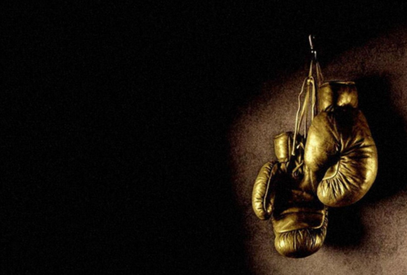
Real Boxing by Jiaqi Guo

Slide 2
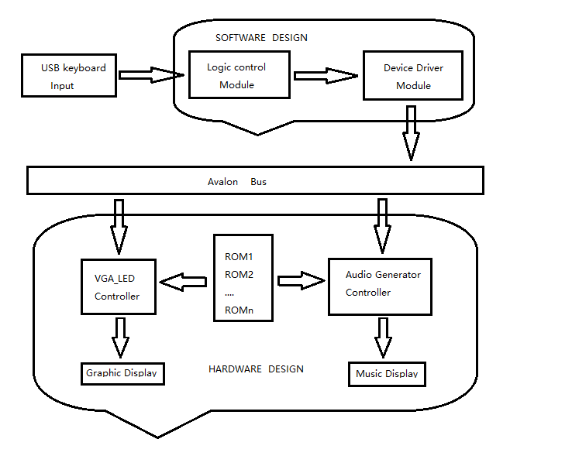
System Flowchart

Slide 3



VGA Image Display Module
Sprite Graphics

Slide 4
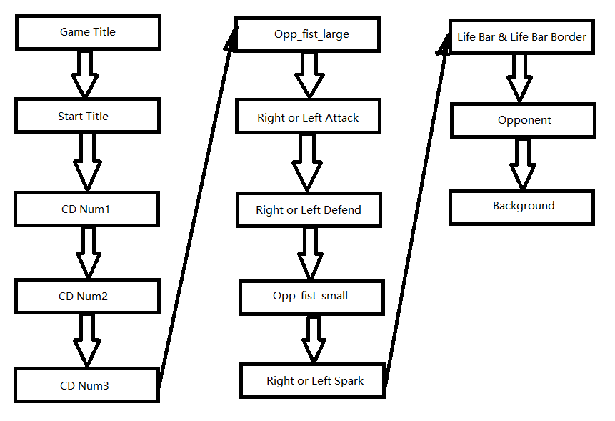
VGA Image Display Module
Priority

Slide 5



Memory Saving Tricks
Symmetricity, Dilation and Color Information Redundancy

Slide 6
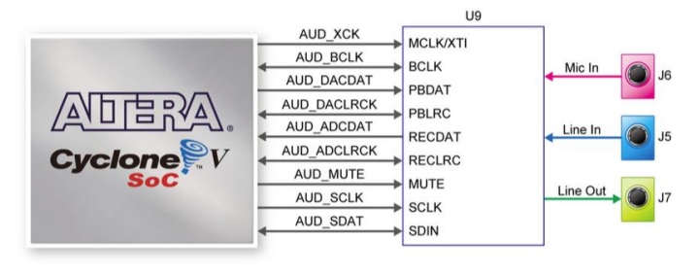
SSM2603 Audio Codec

Slide 7
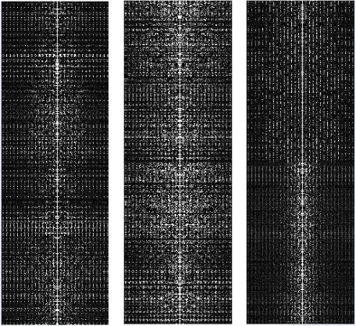
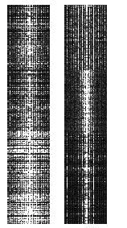
Sampling Theory
Fourier Transform
Frequency Domain

Slide 8
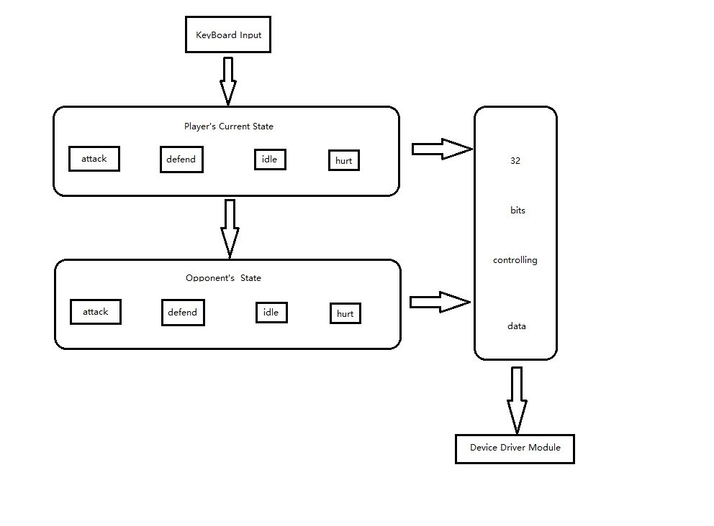
Game Logic Design

Slide 9
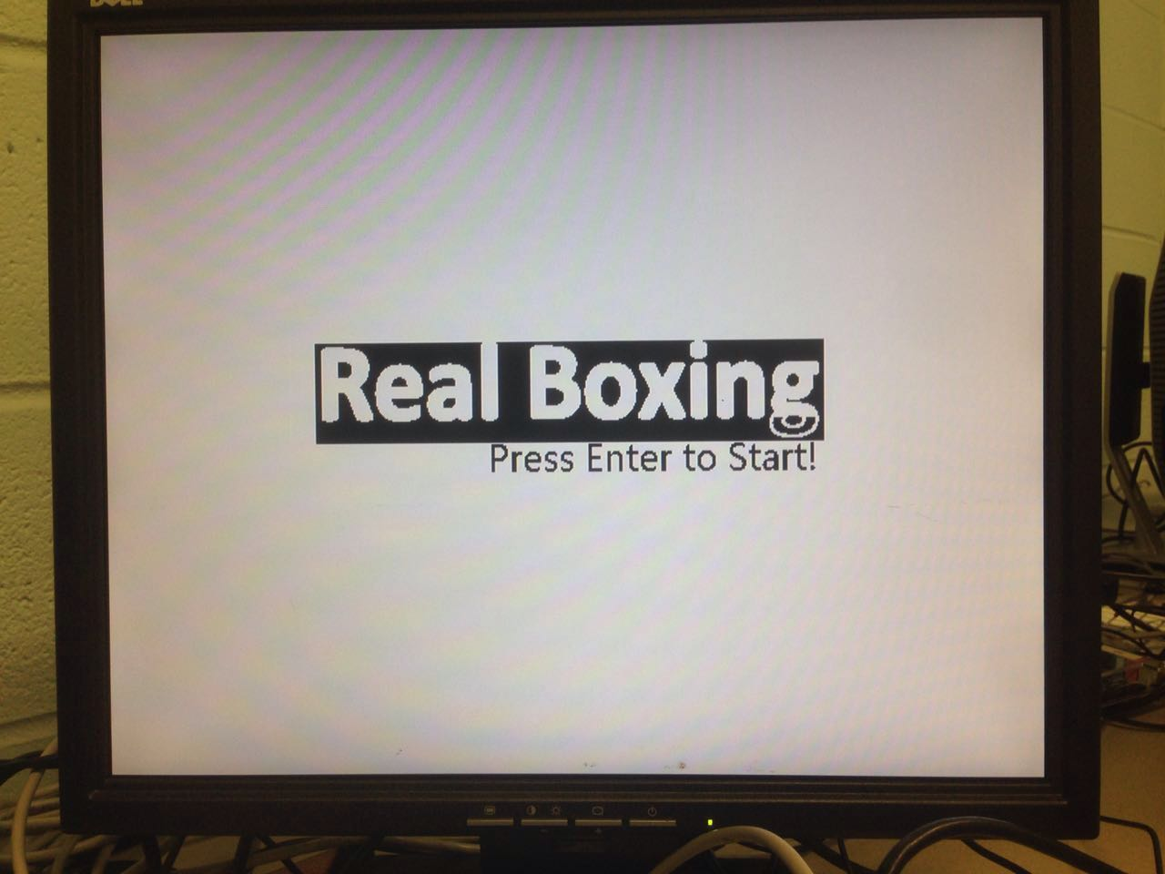
Demo

Slide 10
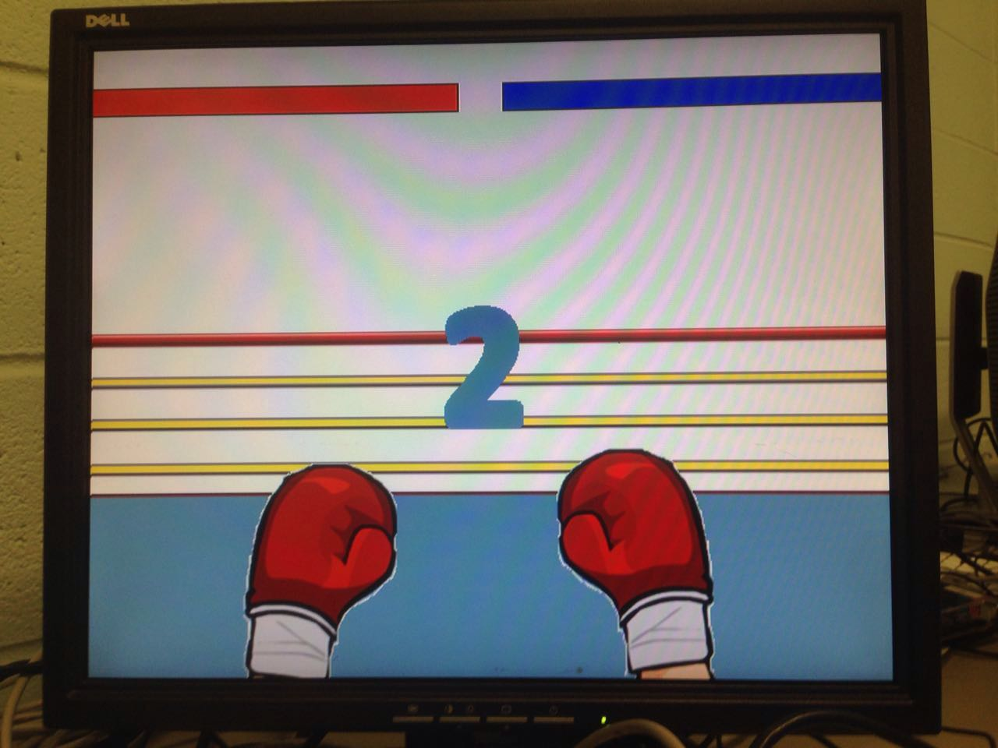
Demo

Slide 11
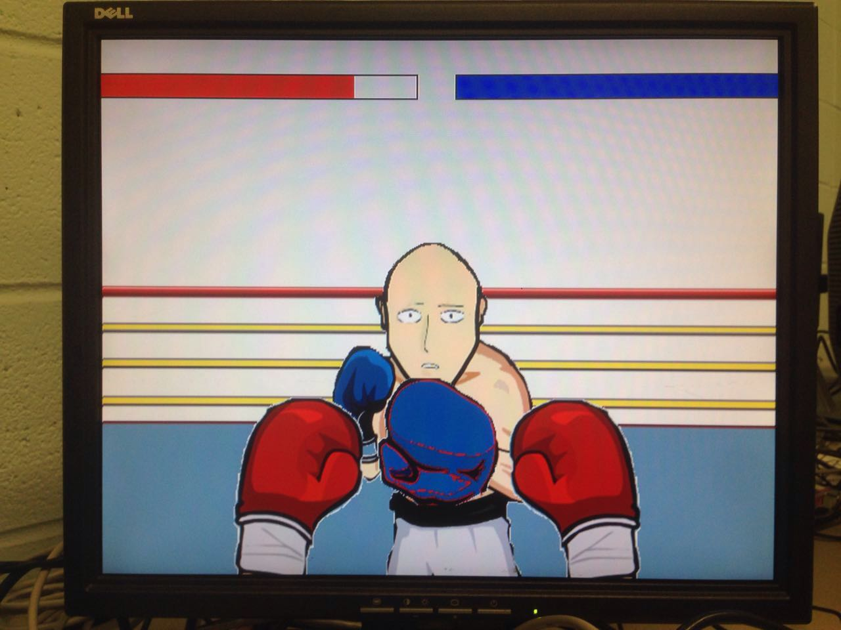
Demo

Slide 12
Future Direction
One thing I really want to implement in this project is using an acceleration sensor as controller. We could attach such sensors on our fist. When we punch or defend, the sensor captures the speed and direction of our fist and uses these data to determine attacking damage.
Another intriguing direction of this project is to design a more intelligent computer opponent. Currently the state machine contains only three states for the AI boxer. We could design more complicated model and give it more reflection than just dodge and attack.

Slide 13
Thank you for listening !
Q&A

