Slide 1
The Extend Language
Jared Samet Nigel Schuster Ishaan Kolluri Kevin Ye

Slide 2
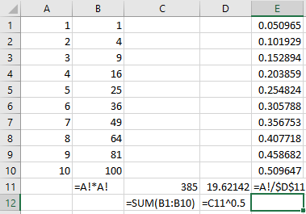
Introduction & Motivation
Inspired by limitations of spreadsheets as a language
Reusability vs. copy-pasting a block of cells
Declarative programming language
Cells can contain composite as well as primitive data types
Reusable Extend Code
normalize([m,n] arg) {
[m,n] squared_lengths := #arg * #arg, normalized := #arg / vector_norm;
vector_norm := sqrt(sum(squared_lengths));
return normalized;
}
main(args) {
v1 := {3,3,3,3}, v2 := {4,4}, v3 := append(v1, v2);
return print_endline(normalize(v1)) -> print_endline(normalize(v3)) -> 0;
}
{0.500000, 0.500000, 0.500000, 0.500000}
{0.363803, 0.363803, 0.363803, 0.363803, 0.485071, 0.485071}

Slide 3
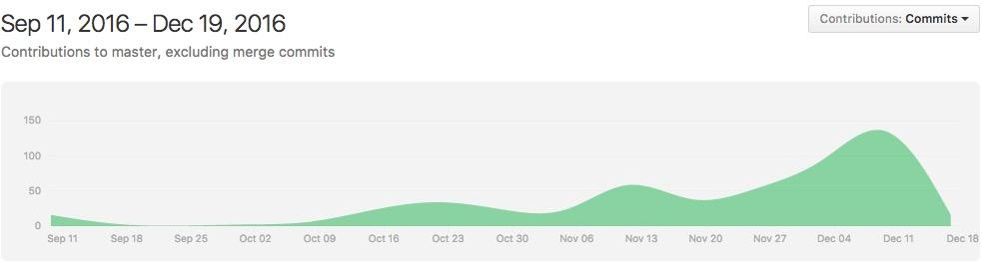
Extend’s Current Project Status
~2500 lines of OCaml Code
~1400 lines of C Code
~800 commits on GitHub
125 regression test cases

Slide 4
The Basic Architecture
Scanner
Parser
AST
Transformer
Semantic Analysis
Code Generation
Linking
Success!
Extend contains code in C to define and instantiate variables at runtime, along with their contents and respective scopes.

Slide 5
Variables in Extend
Contains cells, which contain a formula that evaluates to a number, string, “empty”, or a range type.
Value of a cell is calculated only once according to the assigned formula, and never if it is never referred to. You cannot apply multiple formulae to a single cell!
NOT a data type, but a collection of cells with assigned formulae
A Range is a value, implemented as a pointer to a subset of a variable’s cells.
Always composed of more than one value, unlike a variable, which can be one.
There is a variable “backing” a range; can be explicitly defined or anonymous(range literals)

Slide 6
Lazy Evaluation of Values
maybeCircular(truth_value) {
x := x;
return truth_value ? x : 0;
}
main(args) {
foo :=
print_endline("To be or not to be?") ->
print_endline("Enter \"Not to be\" to attempt to evaluate a circular reference.") ->
readline(STDIN);
return
maybeCircular(foo == "Not to be" || foo == "\"Not to be\"") ->
print_endline("Good thing I didn't look at the value of x.");
}

Slide 7
Syntax makes “list comprehensions” easy
splitChars([1,n] stringchars, splitchar) {
loc := matchRow(stringchars, splitchar);
firstword := fromASCII(stringchars[:loc]);
lastwords := splitChars(stringchars[loc+1:],splitchar);
combined := stack(firstword, lastwords);
return
loc == empty ? fromASCII(stringchars) : combined;
}
split(string, splitter) {
return splitChars(toASCII(string), toASCII(splitter));
}
splitToRange(string, row_splitter, col_splitter) {
split_rows := split(string, row_splitter);
[numRows(split_rows),1] split_cols := split(#split_rows,col_splitter);
[numRows(split_rows),1] col_lengths := numRows(#split_cols);
[numRows(split_rows), max(col_lengths)] result := #split_cols[column()];
return result;
}
main(args) {
tokenize_me := "1,2,3\n12,15,18,20,42\nishaan,jared,kevin,nigel";
return print_endline(splitToRange(tokenize_me, "\n", ","));
}

Slide 8
Syntax makes “list comprehensions” easy
splitChars([1,n] stringchars, splitchar) {
loc := matchRow(stringchars, splitchar);
firstword := fromASCII(stringchars[:loc]);
lastwords := splitChars(stringchars[loc+1:],splitchar);
combined := stack(firstword, lastwords);
return
loc == empty ? fromASCII(stringchars) : combined;
}
Recursively tokenizes the range of chars
fromASCII, toASCII are the only functions not implemented in-language; needed to “split the atom” since String is an atomic type in Extend.
split(string, splitter) {
return splitChars(toASCII(string), toASCII(splitter));
}
splitToRange(string, row_splitter, col_splitter) {
split_rows := split(string, row_splitter);
[numRows(split_rows),1] split_cols := split(#split_rows,col_splitter);
[numRows(split_rows),1] col_lengths := numRows(#split_cols);
[numRows(split_rows), max(col_lengths)] result := #split_cols[column()];
return result;
}
split_rows: {tok_a;tok_b} // Strings
split_cols: {{tok_a1;tok_a2};{tok_b1;tok_b2,tok_b3}} // Ranges
col_lengths: {2,3} // Numbers
result: {tok_a1, tok_a2; tok_b1, tok_b2} // Strings

Slide 9
Transformations Part 1 - Simplifying the LHS
Extend allows you to write:
[3+4, f(x,y)] foo;
By turning it into:
_tmp_foo_rows := 3+4;
_tmp_foo_cols := f(x,y);
Similar transformation for:
foo[q+r, g(w):h(z)] = 42;
That becomes:
_tmp_startrow := q+r;
_tmp_startcol := g(w);
_tmp_endcol := h(z);
foo[_tmp_startrow, _tmp_startcol:_tmp_endcol] = 42;

Slide 10
Transformations Part 2 - Conditionals
Consistent short-circuiting everywhere
foo && bar ===> truthy(foo) ? truthy(bar) : 0;
foo || bar ===> truthy(foo) ? 1 : truthy(bar);
switch (x) {case a: ex1; case b, c: ex2; default: ex3} ===>
(x == a ? ex1 : (x == b || x == c ? ex2 : ex3))
switch {case d: ex4; case f, g: ex5; default: ex6} ===>
d ? ex4 : (b || c ? ex5 : ex6)
Much smaller set of cases for code gen, but lots of internal variables

Slide 11
Transformations Part 3 - Return val, size asserts
foo([m,n] arg1, [m,1] args) {
return m+n;
}
_tmp_size_1 := size(arg1);
_tmp_size_2 := size(arg2);
m := _tmp_size_1[0];
n := _tmp_size_2[1];
_assert := 1 && (m == _tmp_size_2[0]) && (1 == _tmp_size_2[1]); // the initial 1 is base case for List.fold_left
_ret_val := m+n;

Slide 12
Extend Runtime
Some values must be determined at runtime:
[x, f(y)] foo;
Achieved by keeping a “blueprint” around, but only instantiating if necessary
[x, f(y)] foo;
return 2<3 ? 0 : foo;
Does not do computation until necessary:
[2,1] foo := column() == 0 ? easy() : expensive();
Return foo[0,0];

Slide 13
Function Pointers All The Way Down
Each variable (both user defined and transformation-generated) gets one of these; one instance of this struct per program, not per function
struct var_defn {
int rows_varnum, cols_varnum;
int numFormulas;
struct ExtendFormula *formulas;
char isOneByOne; // true for the transformation-generated LHS vars
char *name; // used to make user-friendly runtime errors
};

Slide 14
Function Pointers All The Way Down
One per program - essentially a class definition
struct var_defn {
int rows_varnum, cols_varnum;
int numFormulas;
struct ExtendFormula *formulas;
char isOneByOne;
char *name;
};
One per function call - essentially an object
struct var_instance {
int rows, cols;
int numFormulas;
struct ResolvedFormula *formulas;
struct ExtendScope *closure;
value_p *values;
char *status;
char *name;
};
Closure = the other local variables and the function parameters

Slide 15
Function Pointers All The Way Down
Each formula gets one of these; one instance per program
typedef value_p (*FormulaFP) (struct ExtendScope *scope, int row, int col);
struct ExtendFormula {
char fromFirstRow; int rowStart_varnum;
char toLastRow; int rowEnd_varnum; char isSingleRow;
char fromFirstCol; int colStart_varnum;
char toLastCol; int colEnd_varnum; char isSingleCol;
FormulaFP formula;
};

Slide 16
Function Pointers All The Way Down
One per program
struct ExtendFormula {
char fromFirstRow;
int rowStart_varnum;
char toLastRow;
int rowEnd_varnum;
char isSingleRow;
char fromFirstCol;
int colStart_varnum;
char toLastCol;
int colEnd_varnum;
char isSingleCol;
FormulaFP formula;
};
One per var instance
struct ResolvedFormula {
int rowStart, rowEnd;
int colStart, colEnd;
FormulaFP formula;
};
typedef value_p (*FormulaFP)(struct ExtendScope *scope, int r, int c);
struct ExtendScope {
struct var_defn *defns; // “Class”
struct var_instance **vars; “Object”
int numVars;
int refcount;
value_p *functionParams;
};

Slide 17
Demo & Elaborations
The “True Shooting %” program as an application of Extend to a spreadsheet use case.
Analytic used to measure shooting efficiency of NBA players
Reads data from input file into variable
Using that data, it calculates the tsp for every player
This is an example of an industry use case of Extend

Slide 18
Team Responsibilities
Jared Samet: Language design, code generation, semantic analysis, transformations
Nigel Schuster: software architecture, building, code generation, runtime
Ishaan Kolluri: documentation, standard library, regression tests
Kevin Ye: scanner, standard library, regression tests

Slide 19
Reflections
Testing is paramount
  Testing exposes what features you have yet to do, and provides you with direction
  A comprehensive regression test suite increases the probability that a new feature will integrate properly
Use version control to its utmost potential
  Continuous Integration and Pull Requests keep us accountable
Open communication is key
  Never be afraid to ask for help
  Use online mediums to ask questions (Github, Group Chat)

