Slide 1
FPGA Based Smoke Simulator
Jonathan Chang
Yun Fei
Tianming Miao
Guanduo Li

Slide 2
Objective
Building animations for fluid like motion is important and challenging in computer graphic
Smoke Effect can be used in many applications including games, animations, etc

Slide 3
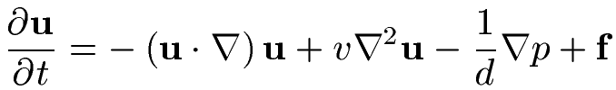
Algorithm and Model
Derived from momentum conservation condition
4 Components:
  Advection/Convection
  Diffusion (damping)
  Pressure
  External force (gravity, etc)
Navier-Stokes Equation

Slide 4
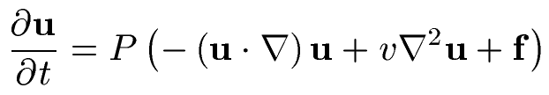



Solving the System
Need to calculate:
Start with initial state
Calculate new velocity fields
New state:

Slide 5
Step 1 – Add Force
Assume change in force is small during timestep
Just do a basic forward-Euler step
Note: f is actually an acceleration

Slide 6
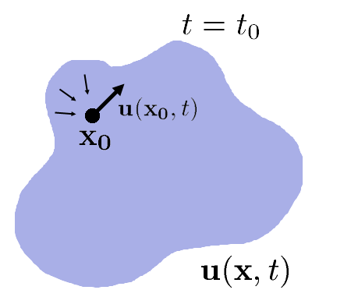
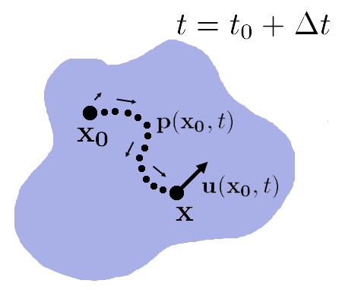
Step 2 - Advection

Slide 7



Step 3 – Diffusion
Standard diffusion equation
Use implicit method:
Sparse linear system

Slide 8



Step 4 - Projection
Enforces mass-conservation condition
Poisson Problem:
Discretize q using central differences
  Sparse linear system
  Maybe banded diagonal…
Relaxation methods too inaccurate
  Method of characteristics more precise for divergence-free field

Slide 9
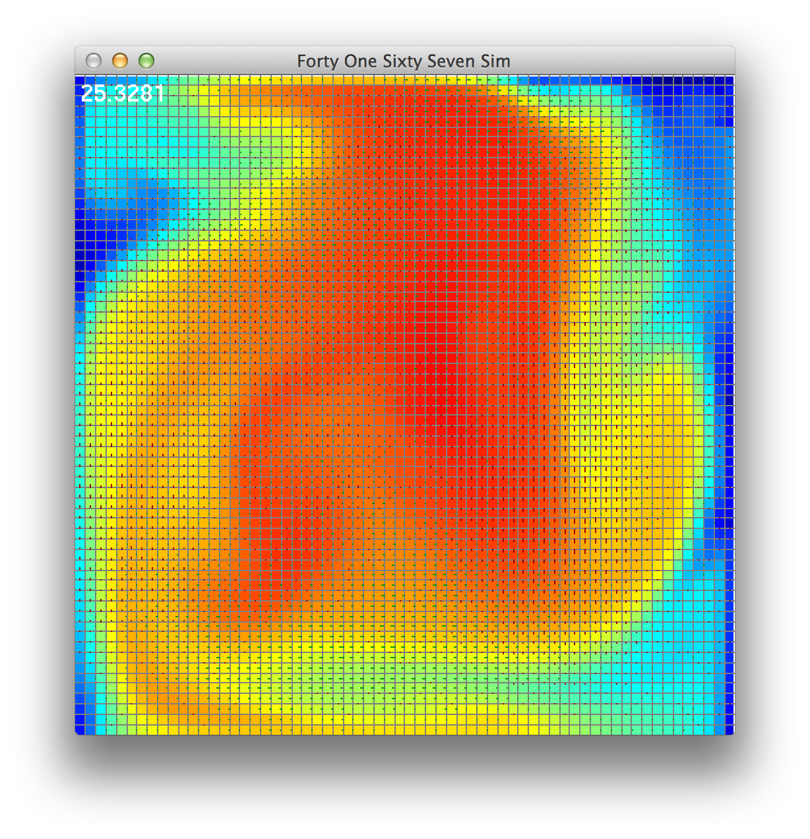
Software Simulation

Slide 10
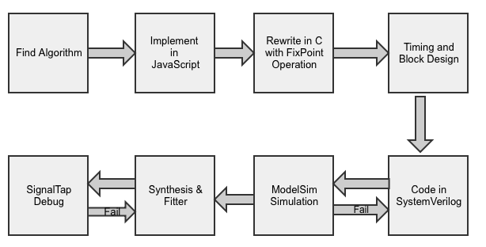
Design Flow

Slide 11
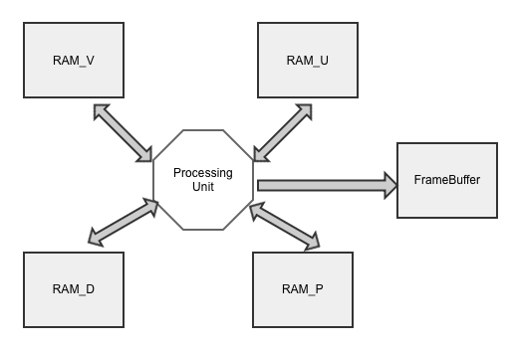
System Architecture
Each RAM has 8192 Words

Slide 12
Timing Design
640 x 480 Screen Resolution
50MHZ FrameBuffer Clock
6.144ms/frame
64 x 64 smoke can have 5.3248ms to compute
Each Pixel must be calculated in 65 clock cycles (conservative)

Slide 13
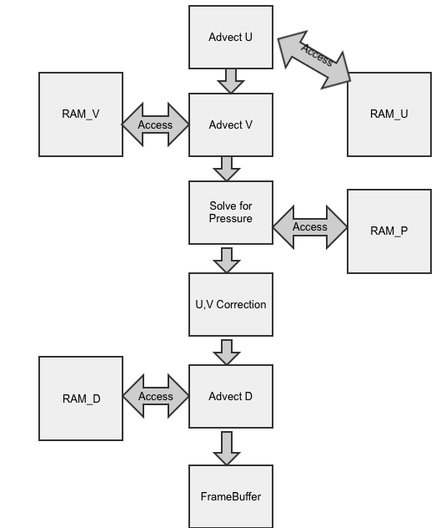
Hardware Implementation Order

Slide 14
Conclusion
Numerous work on converting the c code to SV code. And there are lots of timing issue, read and write technics from the data store in the RAM array

